Slide 1
Wastewater Analysis Using R

Slide 2
Introduction
In this module, we will analyze a wastewater dataset from the CDC to investigate how COVID-19 viral levels change through time.
We will learn ways to manipulate dates in R using the library lubridate (part of the Tidyverse package).

Slide 3
Recap: Dates and Times in R
There are two most popular R classes used when working with dates and times:
Date class representing a calendar date
POSIXct class representing a calendar date with hours, minutes, seconds
A date-time object in R is a point on the timeline stored as the number of seconds since January 1st, 1970, 00:00 UTC. This date is also called the Unix epoch and serves as a reference by computer systems to track and operate with time.

Slide 4
The lubridate Package
The lubridate package allows us to work with dates and times in a simple and efficient way.
In this module, we will learn to:
Input dates in different formats
Perform basic operations with dates
Extract components of dates

Slide 5
lubridate First Needs to Understand the Date Format
You tell lubridate how to “read” your character object.
# YYYY-M-DD a <- ymd("2024-9-20") # DD/MM/YYYY a <- dmy("20/09/2024") # MM-DD-YY a <- mdy("09-20-24")

Slide 6
Extract the Components of a Date with lubridate
Year, month, and day of the month (mday):
a <- ymd_hms("2024-09-20 3:59:01") year(a)
[1] 2024
month(a)
[1] 9
mday(a)
[1] 20

Slide 7
Extract the Components of a Date (Continued)
Day of the year (yday), day of the week (wday), hour, minute, and seconds:
yday(a)
[1] 264
wday(a)
[1] 6
hour(a)
[1] 3
minute(a)
[1] 59
second(a)
[1] 1

Slide 8
Perform Operations with Dates
a <- ymd("2024-09-20") b <- ymd("2025-07-15") b - a
Time difference of 298 days
a - ymd("2024-08-20")
Time difference of 31 days
year(a) - 1989
[1] 35

Slide 9
Gut Check
What does the package lubridate allow us to do?
Work with dates in R
Produce time series data
Plot time series data

Slide 10
Data Used
We will use data reporting the level of SARS-CoV-2 (the virus responsible for COVID-19) viral particles in wastewater.
This data reports the level of SARS-CoV-2 at the state, regional, and national level through time. According to this website, national, regional, and state/territory data represent the median values across all wastewater treatment plants in the respective area.
You can read about the data and how it was collected here: https://www.cdc.gov/nwss/rv/COVID19-statetrend.html

Slide 11
Download the Data
We will use the data located here:
dat <- read_csv("http://daseh.org/data/wastewater_COVID-19_State_and_Territory_Trends.csv")

Slide 12
Clean Up the Data a Little Bit
Some column names contain / and spaces, which are not standard form. We will change them so it is easier to work with them.
To do so, we use the function clean_names in the janitor package.
library(janitor) dat1 <- dat |> clean_names()

Slide 13
Clean Up the Data a Little Bit
Look at the column names of the old dataset (called dat) and the column names of the new dataset (called dat1). The new names are all in lower case with underscores between words.
colnames(dat)
[1] "State/Territory" "Week_Ending_Date" "Data_Collection_Period" [4] "State/Territory_WVAL" "National_WVAL" "Regional_WVAL" [7] "WVAL_Category" "Coverage" "date_updated"
colnames(dat1)
[1] "state_territory" "week_ending_date" "data_collection_period" [4] "state_territory_wval" "national_wval" "regional_wval" [7] "wval_category" "coverage" "date_updated"

Slide 14
Mission: Understand the Trends of COVID-19 Disease Through Time in Different Parts of the United States
Let’s imagine we want to understand how SARS-CoV-2 infections (and hence COVID-19 disease) change through time in three different parts of the US: the East coast, the West coast, and the Midwest. We want to obtain plots that should look like this:

Slide 15
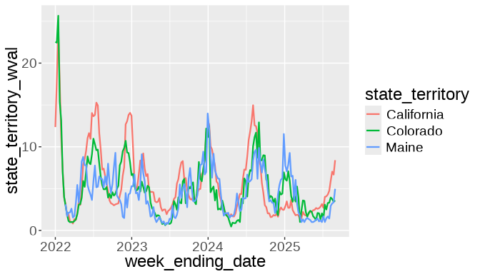

Slide 16
Clean Up the Data (Continued)
We will not be using the columns Coverage and date_updated, so we will remove them from our data frame. We will conduct our analysis using all the results available, so we will remove the rows with results at 1 year or every 6 months.
dat2 <- dat1 |> select(!c(coverage, date_updated)) |> filter(data_collection_period == "All Results") head(dat2)
# A tibble: 6 × 7 state_territory week_ending_date data_collection_period state_territory_wval <chr> <date> <chr> <dbl> 1 Tennessee 2022-04-02 All Results 0.987 2 Tennessee 2022-02-12 All Results 2.45 3 Tennessee 2022-01-01 All Results 3.37 4 Tennessee 2022-01-08 All Results 1.31 5 Wyoming 2023-09-23 All Results 3.94 6 Vermont 2022-05-07 All Results 13.9 # ℹ 3 more variables: national_wval <dbl>, regional_wval <dbl>, # wval_category <chr>

Slide 17
Select 3 States to Look At
We will select three states in the US in three different parts (East, Center, West) to look at their wastewater data: South Carolina, Nebraska, and Washington.
df <- dat2 |> filter(state_territory %in% c('South Carolina', 'Nebraska', 'Washington')) head(df)
# A tibble: 6 × 7 state_territory week_ending_date data_collection_period state_territory_wval <chr> <date> <chr> <dbl> 1 South Carolina 2024-02-24 All Results 8.89 2 South Carolina 2024-03-16 All Results 1.67 3 South Carolina 2025-01-25 All Results 10.9 4 South Carolina 2023-12-30 All Results 5.99 5 South Carolina 2024-04-06 All Results 1.53 6 South Carolina 2024-06-01 All Results 1.91 # ℹ 3 more variables: national_wval <dbl>, regional_wval <dbl>, # wval_category <chr>

Slide 18
Look at the Data
We will plot the data using ggplot:
ggplot(data = df, aes(x = week_ending_date, y = state_territory_wval, color = state_territory)) + geom_line(linewidth = 0.8) + theme(text = element_text(size = 18))

Slide 19
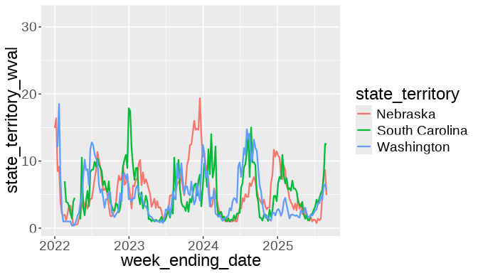

Slide 20
Split the Plots to See the Patterns More Clearly
ggplot(data = df, aes(x = week_ending_date, y = state_territory_wval, color = state_territory)) + geom_line(linewidth = 0.8) + theme(text = element_text(size = 18)) + facet_grid(state_territory ~ .)

Slide 21
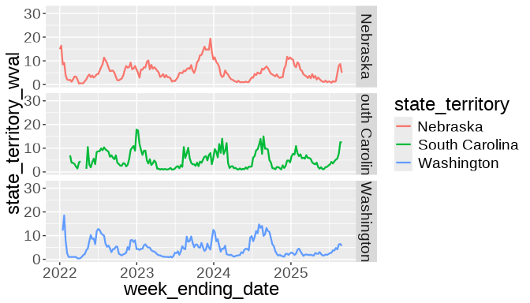

Slide 22
What Can We Say About This Data?
There is a seasonality pattern for each state
The peaks of the 2023-2024 winter season occurred at slightly different times in each state
Most of the big waves happen in winter time, but all three states had a summer outbreak in 2024

Slide 23
Zoom In With the Data
Now, we want to investigate the size of the summer outbreak in each state in 2024.
We use lubridate to select only the data from year 2024:

Slide 24
Quick Quiz
Do you remember how to extract the year from a date called mydate?
year(mydate)
extract(year, mydate)
mydate.year()

Slide 25
Extract the Data for Year 2024
df2024 <- df |> filter(year(week_ending_date) == 2024) head(df2024)
# A tibble: 6 × 7 state_territory week_ending_date data_collection_period state_territory_wval <chr> <date> <chr> <dbl> 1 South Carolina 2024-02-24 All Results 8.89 2 South Carolina 2024-03-16 All Results 1.67 3 South Carolina 2024-04-06 All Results 1.53 4 South Carolina 2024-06-01 All Results 1.91 5 South Carolina 2024-12-28 All Results 4.01 6 South Carolina 2024-04-27 All Results 1 # ℹ 3 more variables: national_wval <dbl>, regional_wval <dbl>, # wval_category <chr>

Slide 26
Obtain the Peak Viral Level in Each State
First, we need to group the data by state. We use the function group_by from dplyr to do it:
maxRows <- df2024 |> group_by(state_territory) |>
Then retrieve the rows with the peak level:
maxRows <- df2024 |> group_by(state_territory) |> ???
How do we do this?

Slide 27
Quick Quiz
Do you remember what function to use to obtain the peak level?
max(dat)
min(dat)
unique(dat)

Slide 28
Obtain the Peak Viral Level in Each State
To do this, we need to group the data by state and retrieve the rows with the maximum level:
maxRows <- df2024 |> group_by(state_territory) |> filter(state_territory_wval == max(state_territory_wval, na.rm=TRUE)) maxRows
# A tibble: 3 × 7 # Groups: state_territory [3] state_territory week_ending_date data_collection_period state_territory_wval <chr> <date> <chr> <dbl> 1 Washington 2024-08-03 All Results 14.7 2 South Carolina 2024-08-24 All Results 15.0 3 Nebraska 2024-12-14 All Results 11.7 # ℹ 3 more variables: national_wval <dbl>, regional_wval <dbl>, # wval_category <chr>

Slide 29
Extract the Peak Wastewater Levels for Each State
We will compute the date of the summer peak in each state:
Nebraska_peak <- maxRows %>% filter(state_territory=="Nebraska") %>% pull(week_ending_date) South_Carolina_peak <- maxRows %>% filter(state_territory=="South Carolina") %>% pull(week_ending_date) Washington_peak <- maxRows %>% filter(state_territory=="Washington") %>% pull(week_ending_date) Nebraska_peak
[1] "2024-12-14"
South_Carolina_peak
[1] "2024-08-24"
Washington_peak
[1] "2024-08-03"

Slide 30
Days Between Peaks
Compute the Number of Days Between the Peak Wastewater Levels for Each State During the Summer Wave:
Difference between South Carolina and Nebraska:
Nebraska_peak - South_Carolina_peak
Time difference of 112 days
Difference between South Carolina and Washington:
South_Carolina_peak - Washington_peak
Time difference of 21 days
Difference between Nebraska and Washington:
Nebraska_peak - Washington_peak
Time difference of 133 days

Slide 31
Summer Wave
From this data, we can see that South Carolina and Washington had a summer wave that peaked 21 days apart.
However, the maximum calculated for Nebraska corresponds to the winter wave, not to the summer wave.

Slide 32


Slide 33
Let’s Look Again at the Plot, but This Time Restricted to the Year 2024
ggplot(data = df2024, aes(x = week_ending_date, y = state_territory_wval, color = state_territory)) + geom_line(linewidth = 0.8) + theme(text = element_text(size = 18)) + facet_grid(state_territory ~ .)

Slide 34
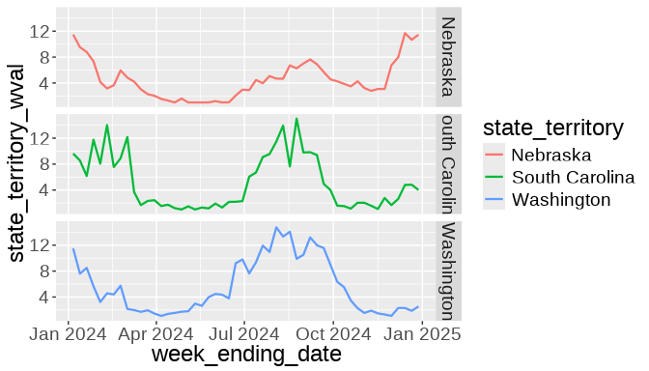

Slide 35
Summer Wave (Continued)
How can we obtain the day that the wastewater measurement reached the maximum level for Nebraska in the summer?

Slide 36
Summer Wave (Continued)
We will further zoom our attention to the summer months and modify the code to look at the data for the months of June, July, and August 2024:
maxRows <- df2024 |> filter(month(week_ending_date) %in% c(06, 07, 08)) |> group_by(state_territory) |> filter(state_territory_wval == max(state_territory_wval, na.rm=TRUE)) maxRows
# A tibble: 3 × 7 # Groups: state_territory [3] state_territory week_ending_date data_collection_period state_territory_wval <chr> <date> <chr> <dbl> 1 Washington 2024-08-03 All Results 14.7 2 South Carolina 2024-08-24 All Results 15.0 3 Nebraska 2024-08-31 All Results 7.01 # ℹ 3 more variables: national_wval <dbl>, regional_wval <dbl>, # wval_category <chr>

Slide 37
Re-compute the Peaks in the Summer
Now we can re-compute the number of days between the peak wastewater levels for each state during the summer wave:
Nebraska_peak <- maxRows %>% filter(state_territory=="Nebraska") %>% pull(week_ending_date) South_Carolina_peak <- maxRows %>% filter(state_territory=="South Carolina") %>% pull(week_ending_date) Washington_peak <- maxRows %>% filter(state_territory=="Washington") %>% pull(week_ending_date) Nebraska_peak
[1] "2024-08-31"
South_Carolina_peak
[1] "2024-08-24"
Washington_peak
[1] "2024-08-03"

Slide 38
Number of Days Between Summer Peaks
Difference between South Carolina and Nebraska:
Nebraska_peak - South_Carolina_peak
Time difference of 7 days
Difference between South Carolina and Washington:
South_Carolina_peak - Washington_peak
Time difference of 21 days
Difference between Nebraska and Washington:
Nebraska_peak - Washington_peak
Time difference of 28 days

Slide 39
Conclusion
South Carolina and Washington had a summer wave that peaked 21 days apart
Nebraska and Washington had a summer wave that peaked 28 days apart
Nebraska and South Carolina had a summer wave that peaked one week apart

