Slide 1
Functions

Slide 2
Writing your own functions
So far we’ve seen many functions, like c(), class(), filter(), dim() …
Why create your own functions?
Cut down on repetitive code (easier to fix things!)
Organize code into manageable chunks
Avoid running code unintentionally
Use names that make sense to you

Slide 3
Writing your own functions
The general syntax for a function is:
my_function <- function(argument) { <function body> }
OR
my_function <- \(argument) { <function body> }

Slide 4
Writing your own functions
Here we will write a function that divides some number x by 100:
div_100 <- function(x) x / 100
When you run the line of code above, you make it ready to use (no output yet!).
Let’s test it:
div_100(x = 600)
[1] 6

Slide 5
Writing your own functions
We can take all kinds of arguments. Here is one with text:
greeting <- function(name) paste("Hello my name is", name)
Let’s test it:
greeting(name = "Ava") # Named argument
[1] "Hello my name is Ava"
greeting("Ava") # R guesses argument based on position
[1] "Hello my name is Ava"

Slide 6
Writing your own functions: { }
Adding the curly braces - {} - allows you to use functions spanning multiple lines:
div_100 <- function(x) { x / 100 } div_100(x = 10)
[1] 0.1

Slide 7
Writing your own functions: return
If we want something specific for the function’s output, we use return():
div_100_plus_4 <- function(x) { output_int <- x / 100 output <- output_int + 4 return(output) } div_100_plus_4(x = 10)
[1] 4.1

Slide 8
Writing your own functions: multiple inputs
Functions can take multiple inputs:
div_100_plus_y <- function(x, y) x / 100 + y div_100_plus_y(x = 10, y = 3)
[1] 3.1

Slide 9
Writing your own functions: multiple outputs
Functions can return a vector (or other object) with multiple outputs.
x_and_y_plus_2 <- function(x, y) { output1 <- x + 2 output2 <- y + 2 return(c(output1, output2)) } result <- x_and_y_plus_2(x = 10, y = 3) result
[1] 12 5

Slide 10
Writing your own functions: defaults
Functions can have “default” arguments. This lets us use the function without using an argument later:
div_100_plus_y <- function(x = 10, y = 3) x / 100 + y div_100_plus_y()
[1] 3.1
div_100_plus_y(x = 11, y = 4)
[1] 4.11

Slide 11
Writing another simple function
Let’s write a function, sqdif, that:
takes two numbers x and y with default values of 2 and 3.
takes the difference
squares this difference
then returns the final value

Slide 12
Writing another simple function
sqdif <- function(x = 2, y = 3) (x - y)^2 sqdif()
[1] 1
sqdif(x = 10, y = 5)
[1] 25
sqdif(10, 5)
[1] 25
sqdif(11, 4)
[1] 49

Slide 13
Writing your own functions: characters
Again, functions can have any kind of input.
loud <- function(word = "hooray!") { output <- rep(toupper(word), 5) return(output) }
loud()
[1] "HOORAY!" "HOORAY!" "HOORAY!" "HOORAY!" "HOORAY!"
loud("wow!")
[1] "WOW!" "WOW!" "WOW!" "WOW!" "WOW!"

Slide 14
Functions for tibbles - Example with ggplot
er <- read_csv(file = "https://daseh.org/data/CO_ER_heat_visits.csv") visits_plot <- function(the_county){ er_sub <- er |> filter(county == the_county) ggplot(data = er_sub, aes(x = year, y = visits)) + geom_point() }
visits_plot("Larimer")

Slide 15
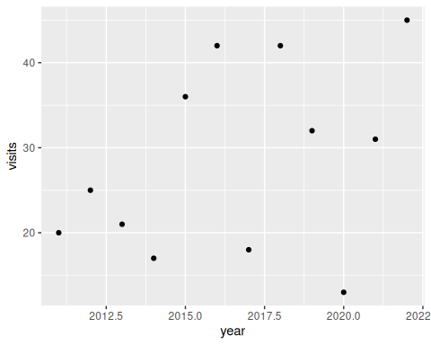

Slide 16
visits_plot("Weld")

Slide 17
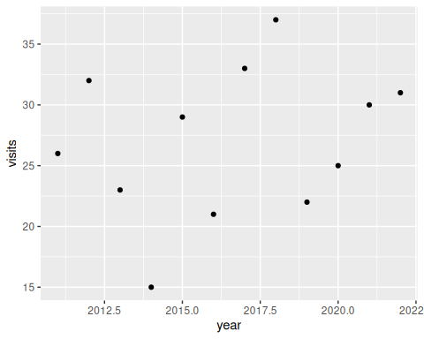

Slide 18
Functions for tibbles - curly braces
Tell tidyverse functions that you mean the column not an object with curly braces ({}):
visits_plot2 <- function(the_column){ ggplot(data = er, aes(x = year, y = visits, color = {{the_column}})) + geom_point() }

Slide 19
Functions for tibbles - example
visits_plot2(year)

Slide 20
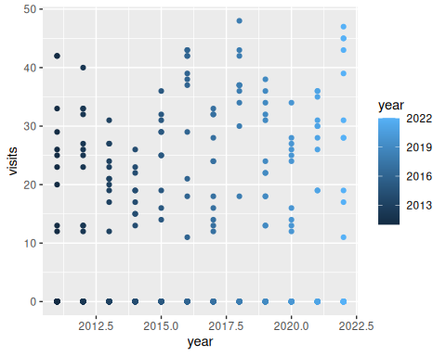

Slide 21
visits_plot2(rate)

Slide 22
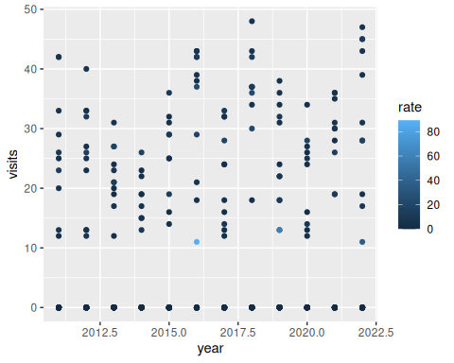

Slide 23
Summary
Simple functions take the form:
NEW_FUNCTION <- function(x, y){x + y}
Can specify defaults like function(x = 1, y = 2){x + y}
return will provide a value as output
Specify a column (from a tibble) inside a function using {{double curly braces}}

Slide 24
Lab Part 1
🏠 Class Website
💻 Lab

Slide 25
Functions on multiple columns

Slide 26
Using your custom functions: sapply()- a base R function
Now that you’ve made a function… You can “apply” functions easily with sapply()!
These functions take the form:
sapply(<a vector, list, data frame>, some_function)

Slide 27
Using your custom functions: sapply()
Let’s apply a function to look at the CO heat-related ER visits dataset.
🚨There are no parentheses on the functions!🚨
You can also pipe into your function.
sapply(er, class)
county rate lower95cl upper95cl visits year "character" "numeric" "numeric" "numeric" "numeric" "numeric"
# also: er |> sapply(class)

Slide 28
Using your custom functions: sapply()
Use the div_100 function we created earlier to convert 0-100 percentiles to proportions.
er |> select(ends_with("cl")) |> sapply(div_100) |> head()
lower95cl upper95cl [1,] NA 0.09236776 [2,] 0.02848937 NA [3,] 0.04359735 0.09313561 [4,] 0.01711087 0.04846996 [5,] 0.01892912 0.05232461 [6,] 0.06124961 0.11572046

Slide 29
Using your custom functions “on the fly” to iterate
Also called “anonymous function”.
er |> select(ends_with("cl")) |> sapply(function(x) x / 100) |> head()
lower95cl upper95cl [1,] NA 0.09236776 [2,] 0.02848937 NA [3,] 0.04359735 0.09313561 [4,] 0.01711087 0.04846996 [5,] 0.01892912 0.05232461 [6,] 0.06124961 0.11572046

Slide 30
Anonymous functions: alternative syntax
er |> select(ends_with("cl")) |> sapply(\(x) x / 100) |> head()
lower95cl upper95cl [1,] NA 0.09236776 [2,] 0.02848937 NA [3,] 0.04359735 0.09313561 [4,] 0.01711087 0.04846996 [5,] 0.01892912 0.05232461 [6,] 0.06124961 0.11572046

Slide 31
across

Slide 32
Using functions in mutate() and summarize()
Already know how to use functions to modify columns using mutate() or calculate summary statistics using summarize().
er |> summarize(max_visits = max(visits, na.rm = T), max_rate = max(rate, na.rm = T))
# A tibble: 1 × 2 max_visits max_rate <dbl> <dbl> 1 48 89.3

Slide 33
Applying functions with across from dplyr
across() makes it easy to apply the same transformation to multiple columns. Usually used with summarize() or mutate().
summarize(across(<columns>,function))
or
mutate(across(<columns>,function))
List columns first : .cols =
List function next: .fns =
If there are arguments to a function (e.g., na.rm = TRUE), use an anonymous function.

Slide 34
Applying functions with across from dplyr
Combining with summarize()
er |> summarize(across( c(visits, rate), mean # no parentheses ))
# A tibble: 1 × 2 visits rate <dbl> <dbl> 1 NA NA

Slide 35
Applying functions with across from dplyr
Add anonymous function to include additional arguments (e.g., na.rm = T).
er |> summarize(across( c(visits, rate), function(x) mean(x, na.rm = T) ))
# A tibble: 1 × 2 visits rate <dbl> <dbl> 1 7.19 2.43

Slide 36
Applying functions with across from dplyr
Can use with other tidyverse functions like group_by!
er |> group_by(year) |> summarize(across( c(visits, rate), function(x) mean(x, na.rm = T) ))
# A tibble: 12 × 3 year visits rate <dbl> <dbl> <dbl> 1 2011 5.20 1.49 2 2012 5.89 1.75 3 2013 5.63 1.83 4 2014 4.12 1.41 5 2015 6.4 1.96 6 2016 10.1 5.28 7 2017 7.24 2.13 8 2018 11.7 3.28 9 2019 9.12 4.09 10 2020 6.26 1.73 11 2021 8.06 2.08 12 2022 9.29 3.21

Slide 37
Applying functions with across from dplyr
Using different tidyselect() options (e.g., starts_with(), ends_with(), contains())
er |> group_by(year) |> summarize(across( contains("cl"), function(x) mean(x, na.rm = TRUE) ))
# A tibble: 12 × 3 year lower95cl upper95cl <dbl> <dbl> <dbl> 1 2011 0.836 2.12 2 2012 1.06 2.41 3 2013 1.07 2.62 4 2014 0.810 2.11 5 2015 1.21 2.77 6 2016 3.05 7.99 7 2017 1.28 3.08 8 2018 2.17 4.41 9 2019 2.32 6.21 10 2020 1.02 2.52 11 2021 1.30 2.92 12 2022 1.93 4.71

Slide 38
Applying functions with across from dplyr
Combining with mutate() - the replace_na function
Let’s look at the yearly CO2 emissions dataset.
yearly_co2 <- read_csv(file = "https://daseh.org/data/Yearly_CO2_Emissions_1000_tonnes.csv") yearly_co2 |> select(country, starts_with("194")) |> mutate(across( c(`1943`, `1944`, `1945`), function(x) replace_na(x, replace = 0) ))
# A tibble: 192 × 11 country `1940` `1941` `1942` `1943` `1944` `1945` `1946` `1947` `1948` <chr> <dbl> <dbl> <dbl> <dbl> <dbl> <dbl> <dbl> <dbl> <dbl> 1 Afghanistan NA NA NA 0 0 0 NA NA NA 2 Albania 693 627 744 462 154 121 484 928 704 3 Algeria 238 312 499 469 499 616 763 744 803 4 Andorra NA NA NA 0 0 0 NA NA NA 5 Angola NA NA NA 0 0 0 NA NA NA 6 Antigua and B… NA NA NA 0 0 0 NA NA NA 7 Argentina 15900 14000 13500 14100 14000 13700 13700 14500 17400 8 Armenia 848 745 513 655 613 649 730 878 935 9 Australia 29100 34600 36500 35000 34200 32700 35500 38000 38500 10 Austria 7350 7980 8560 9620 9400 4570 12800 17600 24500 # ℹ 182 more rows # ℹ 1 more variable: `1949` <dbl>

Slide 39
GUT CHECK!
Why use across()?
A. Efficiency - faster and less repetitive
B. Calculate the cross product
C. Connect across datasets

Slide 40
purrr package
Similar to across, purrr is a package that allows you to apply a function to multiple columns in a data frame or multiple data objects in a list.
While we won’t get into purrr too much in this class, it’s part of the tidyverse and is great if you’re doing lots of iterative work!

Slide 41
One cool function: modify_if()
Columns must meet a certain criteria to be modified.
er |> modify_if(is.numeric, \(x) round(x)) |> glimpse()
Rows: 768 Columns: 6 $ county <chr> "Adams", "Adams", "Adams", "Adams", "Adams", "Adams", "Adams… $ rate <dbl> 7, 5, 7, 3, 3, 9, 7, 7, 7, 5, 7, 8, 0, 0, NA, 0, NA, NA, NA,… $ lower95cl <dbl> NA, 3, 4, 2, 2, 6, 4, 5, 5, 3, 5, 6, 0, 0, NA, 0, NA, NA, NA… $ upper95cl <dbl> 9, NA, 9, 5, 5, 12, 9, 9, 9, 7, 9, 11, 0, 0, NA, 0, NA, NA, … $ visits <dbl> 29, 23, 31, 15, 16, 42, 32, 37, 36, 24, 35, 45, 0, 0, NA, 0,… $ year <dbl> 2011, 2012, 2013, 2014, 2015, 2016, 2017, 2018, 2019, 2020, …

Slide 42
Summary
Apply your functions with sapply(<a vector or list>, some_function)
Use across() to apply functions across multiple columns of data
Need to use across within summarize() or mutate()
Check out purrr if you want to get into the weeds!

Slide 43
Lab Part 2
🏠 Class Website
💻 Lab
📃 Day 9 Cheatsheet
📃 Posit’s purrr Cheatsheet

Slide 44
Research Survey
https://forms.gle/5ac2WPiR9kJu5D3c6

Slide 45


Slide 46
Image by Gerd Altmann from Pixabay

