Slide 1
Statistics

Slide 2
Summary
ggplot() specifies what data to use and what variables will be mapped to where
inside ggplot(), aes(x = , y = , color = ) specify what variables correspond to what aspects of the plot in general
layers of plots can be combined using the + at the end of lines
use geom_line() and geom_point() to add lines and points
sometimes you need to add a group element to aes() if your plot looks strange
make sure you are plotting what you think you are by checking the numbers!
facet_grid(~variable) and facet_wrap(~variable) can be helpful to quickly split up your plot

Slide 3
Summary
the factor class allows us to have a different order from alphanumeric for categorical data
we can change data to be a factor variable using mutate(), as_factor() (in the forcats package), or factor() functions and specifying the levels with the levels argument
fct_reorder({variable_to_reorder}, {variable_to_order_by}) helps us reorder a variable by the values of another variable
arranging, tabulating, and plotting the data will reflect the new order

Slide 4
Overview
We will cover how to use R to compute some of basic statistics and fit some basic statistical models.
Correlation
T-test
Linear Regression / Logistic Regression

Slide 6
Overview
We will focus on how to use R software to do these. We will be glossing over the statistical theory and “formulas” for these tests. Moreover, we do not claim the data we use for demonstration meet assumptions of the methods.
There are plenty of resources online for learning more about these methods.
Check out www.opencasestudies.org for deeper dives on some of the concepts covered here and the resource page for more resources.

Slide 7
Correlation

Slide 8
Correlation
The correlation coefficient is a summary statistic that measures the strength of a linear relationship between two numeric variables.
The strength of the relationship - based on how well the points form a line
The direction of the relationship - based on if the points progress upward or downward

Slide 10
source
See this case study for more information.

Slide 11
Correlation
Function cor() computes correlation in R.
cor(x, y = NULL, use = c("everything", "complete.obs"), method = c("pearson", "kendall", "spearman"))
provide two numeric vectors of the same length (arguments x, y), or
provide a data.frame / tibble with numeric columns only
by default, Pearson correlation coefficient is computed

Slide 12
Correlation test
Function cor.test() also computes correlation and tests for association.
cor.test(x, y = NULL, alternative(c("two.sided", "less", "greater")), method = c("pearson", "kendall", "spearman"))
provide two numeric vectors of the same length (arguments x, y), or
provide a data.frame / tibble with numeric columns only
by default, Pearson correlation coefficient is computed
alternative values:
two.sided means true correlation coefficient is not equal to zero (default)
greater means true correlation coefficient is > 0 (positive relationship)
less means true correlation coefficient is < 0 (negative relationship)

Slide 13
GUT CHECK!
What class of data do you need to calculate a correlation?
A. Character data
B. Factor data
C. Numeric data

Slide 14
Correlation
Let’s look at the dataset of yearly CO2 emissions by country.
yearly_co2 <- read_csv(file = "https://daseh.org/data/Yearly_CO2_Emissions_1000_tonnes.csv")

Slide 15
Correlation for two vectors
First, we create two vectors.
# x and y must be numeric vectors y1980 <- yearly_co2 |> pull(`1980`) y1985 <- yearly_co2 |> pull(`1985`)
Like other functions, if there are NAs, you get NA as the result. But if you specify use = "complete.obs", then it will give you correlation using the non-missing data.
cor(y1980, y1985, use = "complete.obs")
[1] 0.9936257

Slide 16
Correlation coefficient calculation and test
cor.test(y1980, y1985)
Pearson's product-moment correlation data: y1980 and y1985 t = 114.59, df = 169, p-value < 0.00000000000000022 alternative hypothesis: true correlation is not equal to 0 95 percent confidence interval: 0.9913844 0.9952853 sample estimates: cor 0.9936257

Slide 17
Broom package
The broom package helps make stats results look tidy
library(broom) cor_result <- tidy(cor.test(y1980, y1985)) glimpse(cor_result)
Rows: 1 Columns: 8 $ estimate <dbl> 0.9936257 $ statistic <dbl> 114.5851 $ p.value <dbl> 0.00000000000000000000000000000000000000000000000000000000… $ parameter <int> 169 $ conf.low <dbl> 0.9913844 $ conf.high <dbl> 0.9952853 $ method <chr> "Pearson's product-moment correlation" $ alternative <chr> "two.sided"

Slide 18
Correlation for two vectors with plot
In plot form… geom_smooth() and annotate() can look very nice!
corr_value <- pull(cor_result, estimate) |> round(digits = 4) cor_label <- paste0("R = ", corr_value) yearly_co2 |> ggplot(aes(x = `1980`, y = `1985`)) + geom_point(size = 1) + geom_smooth() + annotate("text", x = 2000000, y = 4000000, label = cor_label)

Slide 19
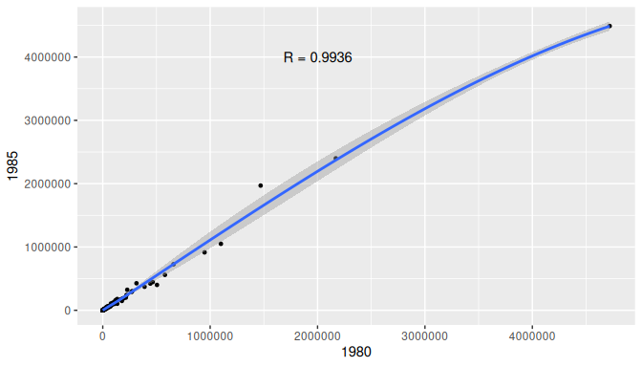

Slide 20
Correlation for data frame columns
We can compute correlation for all pairs of columns of a data frame / matrix. This is often called, “computing a correlation matrix”.
Columns must be all numeric!
co2_subset <- yearly_co2 |> select(c(`1950`, `1980`, `1985`, `2010`)) head(co2_subset)
# A tibble: 6 × 4 `1950` `1980` `1985` `2010` <dbl> <dbl> <dbl> <dbl> 1 84.3 1760 3510 8460 2 297 5170 7880 4600 3 3790 66500 72800 119000 4 NA NA NA 517 5 187 5350 4700 29100 6 NA 143 249 524

Slide 21
Correlation for data frame columns
We can compute correlation for all pairs of columns of a data frame / matrix. This is often called, “computing a correlation matrix”.
cor_mat <- cor(co2_subset, use = "complete.obs") cor_mat
1950 1980 1985 2010 1950 1.0000000 0.9228253 0.8818288 0.5415047 1980 0.9228253 1.0000000 0.9935477 0.7270839 1985 0.8818288 0.9935477 1.0000000 0.7827256 2010 0.5415047 0.7270839 0.7827256 1.0000000

Slide 22
Correlation for data frame columns with plot
corrplot package can make correlation matrix plots
library(corrplot) corrplot(cor_mat)

Slide 23
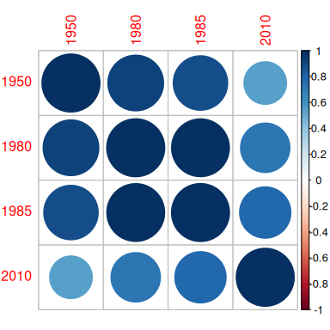

Slide 24
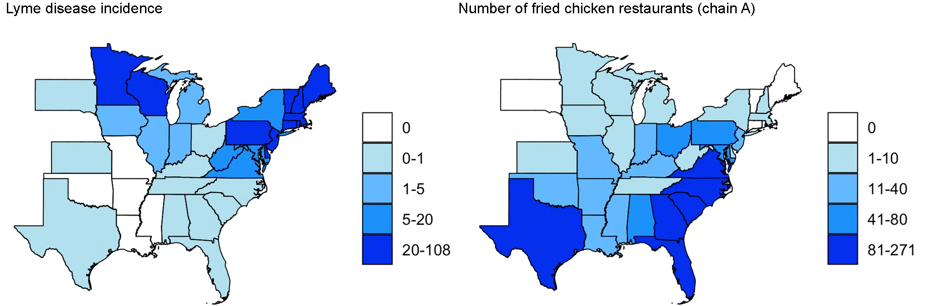
Correlation does not imply causation

Slide 25
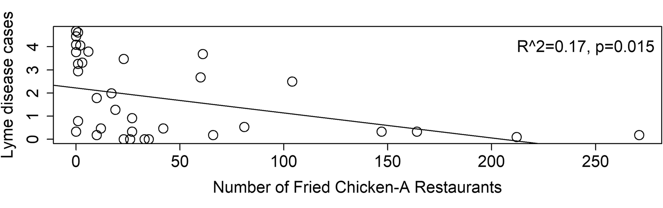

Slide 26
source

Slide 27
T-test

Slide 28
T-test
The commonly used t-tests are:
one-sample t-test – used to test mean of a variable in one group
two-sample t-test – used to test difference in means of a variable between two groups
if the “two groups” are data of the same individuals collected at 2 time points, we say it is two-sample paired t-test)
The t.test() function does both.
t.test(x, y = NULL, alternative = c("two.sided", "less", "greater"), mu = 0, paired = FALSE, var.equal = FALSE, conf.level = 0.95, ...)

Slide 29
Running one-sample t-test
It tests the mean of a variable in one group. By default (i.e., without us explicitly specifying values of other arguments):
tests whether a mean of a variable is equal to 0 (mu = 0)
uses “two sided” alternative (alternative = "two.sided")
returns result assuming confidence level 0.95 (conf.level = 0.95)
omits NA values in data
Let’s look at the CO2 emissions data again.
t.test(y1980)
One Sample t-test data: y1980 t = 3.3324, df = 170, p-value = 0.001056 alternative hypothesis: true mean is not equal to 0 95 percent confidence interval: 44745.81 174792.25 sample estimates: mean of x 109769

Slide 30
Running two-sample t-test
It tests the difference in means of a variable between two groups. By default:
tests whether difference in means of a variable is equal to 0 (mu = 0)
uses “two sided” alternative (alternative = "two.sided")
returns result assuming confidence level 0.95 (conf.level = 0.95)
assumes data are not paired (paired = FALSE)
assumes true variance in the two groups is not equal (var.equal = FALSE)
omits NA values in data
Check out this this case study and this case study for more information.

Slide 31
Running two-sample t-test in R
t.test(y1980, y1985)
Welch Two Sample t-test data: y1980 and y1985 t = -0.090533, df = 341, p-value = 0.9279 alternative hypothesis: true difference in means is not equal to 0 95 percent confidence interval: -95902.79 87462.97 sample estimates: mean of x mean of y 109769.0 113988.9

Slide 32
T-test: retrieving information from the result with broom package
The broom package has a tidy() function that can organize results into a data frame so that they are easily manipulated (or nicely printed)
result <- t.test(y1980, y1985) result_tidy <- tidy(result) glimpse(result_tidy)
Rows: 1 Columns: 10 $ estimate <dbl> -4219.909 $ estimate1 <dbl> 109769 $ estimate2 <dbl> 113988.9 $ statistic <dbl> -0.09053303 $ p.value <dbl> 0.9279168 $ parameter <dbl> 340.999 $ conf.low <dbl> -95902.79 $ conf.high <dbl> 87462.97 $ method <chr> "Welch Two Sample t-test" $ alternative <chr> "two.sided"

Slide 33
P-value adjustment
You run an increased risk of Type I errors (a “false positive”) when multiple hypotheses are tested simultaneously.
Use the p.adjust() function on a vector of p values. Use method = to specify the adjustment method:
my_pvalues <- c(0.049, 0.001, 0.31, 0.00001) p.adjust(my_pvalues, method = "BH") # Benjamini Hochberg
[1] 0.06533333 0.00200000 0.31000000 0.00004000
p.adjust(my_pvalues, method = "bonferroni") # multiply by number of tests
[1] 0.19600 0.00400 1.00000 0.00004
my_pvalues * 4
[1] 0.19600 0.00400 1.24000 0.00004
See here for more about multiple testing correction. Bonferroni also often done as p value threshold divided by number of tests (0.05/test number).

Slide 34
Some other statistical tests
wilcox.test() – Wilcoxon signed rank test, Wilcoxon rank sum test
shapiro.test() – Test normality assumptions
ks.test() – Kolmogorov-Smirnov test
var.test()– Fisher’s F-Test
chisq.test() – Chi-squared test
aov() – Analysis of Variance (ANOVA)

Slide 35
Summary
Use cor() to calculate correlation between two vectors, cor.test() can give more information.
corrplot() is nice for a quick visualization!
t.test() one sample test to test the difference in mean of a single vector from zero (one input)
t.test() two sample test to test the difference in means between two vectors (two inputs)
tidy() in the broom package is useful for organizing and saving statistical test output
Remember to adjust p-values with p.adjust() when doing multiple tests on data

Slide 36
Lab Part 1
🏠 Class Website
💻 Lab

Slide 37
Regression

Slide 38
Linear regression
Linear regression is a method to model the relationship between a response and one or more explanatory variables.
Most commonly used statistical tests are actually specialized regressions, including the two sample t-test, see here for more.

Slide 39
Linear regression notation
Here is some of the notation, so it is easier to understand the commands/results.
$$y_{i}=α+βx_{i}+ε_{i}$$
where:
$y_{i}$ is the outcome for person i
$α$ is the intercept
$β$ is the slope (also called a coefficient) - the mean change in y that we would expect for one unit change in x (“rise over run”)
$x_{i}$ is the predictor for person i
$ε_{i}$ is the residual variation for person i

Slide 40
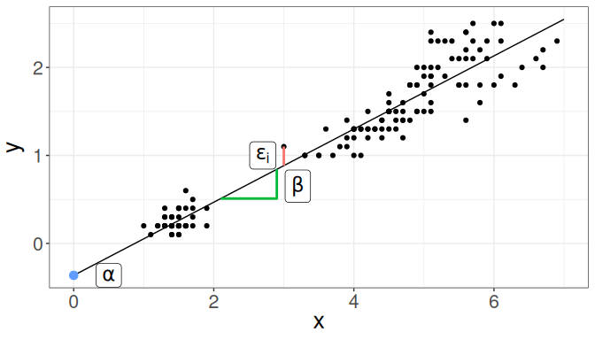
Linear regression

Slide 41
Linear regression
Linear regression is a method to model the relationship between a response and one or more explanatory variables.
We provide a little notation here so some of the commands are easier to put in the proper context.
$$y_{i}=α+β_{1}x_{i1}+β_{2}x_{i2}+β_{3}x_{i3}+ε_{i}$$
where:
$y_{i}$ is the outcome for person i
$α$ is the intercept
$β_{1}$, $β_{2}$, $β_{3}$ are the slopes/coefficients for variables $x_{i1}$, $x_{i2}$, $x_{i3}$ - average difference in y for a unit change (or each value) in x while accounting for other variables
$x_{i1}$, $x_{i2}$, $x_{i3}$ are the predictors for person i
$ε_{i}$ is the residual variation for person i
See this case study for more details.

Slide 42
Linear regression fit in R
To fit regression models in R, we use the function glm() (Generalized Linear Model).
You may also see lm() which is a more limited function that only allows for normally/Gaussian distributed error terms (aka typical linear regressions).
We typically provide two arguments:
formula – model formula written using names of columns in our data
data – our data frame

Slide 43
Linear regression fit in R: model formula
Model formula
$$y_{i}=α+βx_{i}+ε_{i}$$
In R translates to
y ~ x

Slide 44
Linear regression fit in R: model formula
Model formula
$$y_{i}=α+βx_{i}+ε_{i}$$
In R translates to
y ~ x
In practice, y and x are replaced with the names of columns from our data set.
For example, if we want to fit a regression model where outcome is income and predictor is years_of_education, our formula would be:
income ~ years_of_education

Slide 45
Linear regression fit in R: model formula
Model formula
$$y_{i}=α+β_{1}x_{i1}+β_{2}x_{i2}+β_{3}x_{i3}+ε_{i}$$
In R translates to
y ~ x1 + x2 + x3
In practice, y and x1, x2, x3 are replaced with the names of columns from our data set.
For example, if we want to fit a regression model where outcome is income and predictors are years_of_education, age, and location then our formula would be:
income ~ years_of_education + age + location

Slide 46
Linear regression example
Let’s look variables that might be able to predict the number of “crowded” households.
We’ll use a dataset that has socioeconomic measures from CDC. Find out more on https://daseh.org/data.
It has already been filtered to include a few counties from Washington State.
Each row represents a census tract/area.

Slide 47
Linear regression example
sp_dat <- read_csv(file = "https://daseh.org/data/socioeco_cdc.csv") sp_dat
# A tibble: 927 × 12 county fips description pci hu munit sngpnt crowd noveh f_sngpnt <chr> <dbl> <chr> <dbl> <dbl> <dbl> <dbl> <dbl> <dbl> <dbl> 1 Clark 53011040101 Census Trac… 27021 1767 6 52 114 110 0 2 Clark 53011040102 Census Trac… 28694 1182 0 28 117 13 0 3 Clark 53011040201 Census Trac… 38606 2430 0 103 25 58 0 4 Clark 53011040202 Census Trac… 32070 1431 0 69 51 7 0 5 Clark 53011040203 Census Trac… 33441 1990 0 52 64 59 0 6 Clark 53011040301 Census Trac… 40783 737 0 37 21 41 0 7 Clark 53011040302 Census Trac… 42532 3041 0 261 19 60 0 8 Clark 53011040403 Census Trac… 43666 1639 0 21 10 19 0 9 Clark 53011040407 Census Trac… 26155 2235 231 138 76 122 0 10 Clark 53011040408 Census Trac… 42397 1269 8 14 28 32 0 # ℹ 917 more rows # ℹ 2 more variables: f_crowd <dbl>, f_noveh <dbl>

Slide 48
Linear regression: model fitting
For this model, we will use two variables:
crowd - At household level (occupied housing units), more people than rooms
hu - Number of housing units
fit <- glm(crowd ~ hu, data = sp_dat) fit
Call: glm(formula = crowd ~ hu, data = sp_dat) Coefficients: (Intercept) hu -12.43948 0.03547 Degrees of Freedom: 926 Total (i.e. Null); 925 Residual Null Deviance: 4223000 Residual Deviance: 3428000 AIC: 10250

Slide 49
Linear regression: model summary
The summary() function returns a list that shows us some more detail
summary(fit)
Call: glm(formula = crowd ~ hu, data = sp_dat) Coefficients: Estimate Std. Error t value Pr(>|t|) (Intercept) -12.439483 5.499063 -2.262 0.0239 * hu 0.035468 0.002422 14.644 <0.0000000000000002 *** --- Signif. codes: 0 '***' 0.001 '**' 0.01 '*' 0.05 '.' 0.1 ' ' 1 (Dispersion parameter for gaussian family taken to be 3706.214) Null deviance: 4222997 on 926 degrees of freedom Residual deviance: 3428248 on 925 degrees of freedom AIC: 10253 Number of Fisher Scoring iterations: 2

Slide 50
tidy results
The broom package can help us here too!
The estimate is the coefficient or slope.
for every 1 additional housing unit, we see 0.035 more crowded households (~29 housing units to one more crowded household might make more sense!). This relationship appears to be quite strong, with a p value 7.96e-44!
tidy(fit) |> glimpse()
Rows: 2 Columns: 5 $ term <chr> "(Intercept)", "hu" $ estimate <dbl> -12.43948257, 0.03546794 $ std.error <dbl> 5.499062635, 0.002422068 $ statistic <dbl> -2.26211, 14.64366 $ p.value <dbl> 0.02392196115632636357895002277018647873774170875549, 0.0000…

Slide 51
Linear regression: multiple predictors
Let’s try adding another other explanatory variable to our model, average per capita income for each census area (pci).
fit2 <- glm(crowd ~ hu + pci, data = sp_dat) summary(fit2)
Call: glm(formula = crowd ~ hu + pci, data = sp_dat) Coefficients: Estimate Std. Error t value Pr(>|t|) (Intercept) 21.8387846 6.3550308 3.436 0.000616 *** hu 0.0411363 0.0023864 17.238 < 0.0000000000000002 *** pci -0.0011459 0.0001198 -9.566 < 0.0000000000000002 *** --- Signif. codes: 0 '***' 0.001 '**' 0.01 '*' 0.05 '.' 0.1 ' ' 1 (Dispersion parameter for gaussian family taken to be 3375.923) Null deviance: 4222997 on 926 degrees of freedom Residual deviance: 3119353 on 924 degrees of freedom AIC: 10167 Number of Fisher Scoring iterations: 2

Slide 52
Linear regression: multiple predictors
Can also use tidy and glimpse to see the output nicely.
fit2 |> tidy() |> glimpse()
Rows: 3 Columns: 5 $ term <chr> "(Intercept)", "hu", "pci" $ estimate <dbl> 21.838784553, 0.041136308, -0.001145853 $ std.error <dbl> 6.3550308287, 0.0023863704, 0.0001197898 $ statistic <dbl> 3.436456, 17.238023, -9.565525 $ p.value <dbl> 0.0006156467274999594379431000490399128466378897428512573242…

Slide 53
Linear regression: factors
Factors get special treatment in regression models - lowest level of the factor is the comparison group, and all other factors are relative to its values.
Let’s add the county (county) as a factor into our model. We’ll need to convert it to a factor first.
sp_dat <- sp_dat |> mutate(county = factor(county))

Slide 54
Linear regression: factors
The comparison group that is not listed is treated as intercept. All other estimates are relative to the intercept.
fit3 <- glm(crowd ~ hu + pci + county, data = sp_dat) summary(fit3)
Call: glm(formula = crowd ~ hu + pci + county, data = sp_dat) Coefficients: Estimate Std. Error t value Pr(>|t|) (Intercept) 42.4231040 7.4265782 5.712 0.0000000150 *** hu 0.0393317 0.0022483 17.494 < 0.0000000000000002 *** pci -0.0018146 0.0001248 -14.542 < 0.0000000000000002 *** countyKing 35.4770337 6.3140724 5.619 0.0000000255 *** countyPierce -9.9662254 6.7432134 -1.478 0.140 countySnohomish 5.4030130 6.9562416 0.777 0.438 countySpokane -35.1309611 7.5396924 -4.659 0.0000036378 *** --- Signif. codes: 0 '***' 0.001 '**' 0.01 '*' 0.05 '.' 0.1 ' ' 1 (Dispersion parameter for gaussian family taken to be 2921.148) Null deviance: 4222997 on 926 degrees of freedom Residual deviance: 2687457 on 920 degrees of freedom AIC: 10037 Number of Fisher Scoring iterations: 2

Slide 55
Linear regression: factors
Maybe we want to use King County as our reference. We can relevel the factor.
The counties are relative to the level that is not listed.
sp_dat <- sp_dat |> mutate(county = factor(county, levels = c("King", "Clark", "Pierce", "Snohomish", "Spokane") )) fit4 <- glm(crowd ~ hu + pci + county, data = sp_dat) summary(fit4)
Call: glm(formula = crowd ~ hu + pci + county, data = sp_dat) Coefficients: Estimate Std. Error t value Pr(>|t|) (Intercept) 77.9001378 7.7746490 10.020 < 0.0000000000000002 *** hu 0.0393317 0.0022483 17.494 < 0.0000000000000002 *** pci -0.0018146 0.0001248 -14.542 < 0.0000000000000002 *** countyClark -35.4770337 6.3140724 -5.619 0.0000000255 *** countyPierce -45.4432591 5.3237881 -8.536 < 0.0000000000000002 *** countySnohomish -30.0740208 5.3714389 -5.599 0.0000000285 *** countySpokane -70.6079948 6.4062707 -11.022 < 0.0000000000000002 *** --- Signif. codes: 0 '***' 0.001 '**' 0.01 '*' 0.05 '.' 0.1 ' ' 1 (Dispersion parameter for gaussian family taken to be 2921.148) Null deviance: 4222997 on 926 degrees of freedom Residual deviance: 2687457 on 920 degrees of freedom AIC: 10037 Number of Fisher Scoring iterations: 2

Slide 56
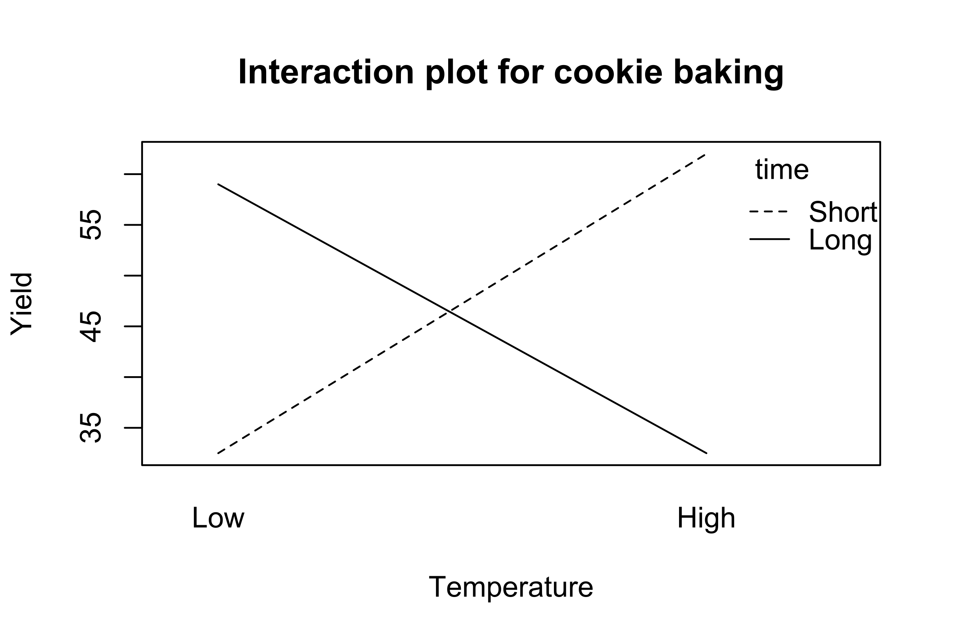
Linear regression: interactions

Slide 57
source

Slide 58
Linear regression: interactions
You can also specify interactions between variables in a formula with *. This allows for not only the intercepts between factors to differ, but also the slopes with regard to the interacting variable.
fit5 <- glm(crowd ~ hu + pci * county, data = sp_dat) summary(fit5)
Call: glm(formula = crowd ~ hu + pci * county, data = sp_dat) Coefficients: Estimate Std. Error t value Pr(>|t|) (Intercept) 73.4590707 8.3703790 8.776 < 0.0000000000000002 *** hu 0.0389502 0.0022620 17.220 < 0.0000000000000002 *** pci -0.0017060 0.0001442 -11.827 < 0.0000000000000002 *** countyClark -1.9469215 23.2496384 -0.084 0.9333 countyPierce -16.1835554 16.0960723 -1.005 0.3150 countySnohomish -17.5168167 18.8785553 -0.928 0.3537 countySpokane -86.9928211 19.3206605 -4.503 0.00000758 *** pci:countyClark -0.0009480 0.0006469 -1.465 0.1431 pci:countyPierce -0.0008377 0.0004379 -1.913 0.0561 . pci:countySnohomish -0.0003007 0.0004626 -0.650 0.5158 pci:countySpokane 0.0006271 0.0005971 1.050 0.2939 --- Signif. codes: 0 '***' 0.001 '**' 0.01 '*' 0.05 '.' 0.1 ' ' 1 (Dispersion parameter for gaussian family taken to be 2910.925) Null deviance: 4222997 on 926 degrees of freedom Residual deviance: 2666408 on 916 degrees of freedom AIC: 10038 Number of Fisher Scoring iterations: 2

Slide 59
Linear regression: interactions
By default, ggplot with a factor added as a color will look include the interaction term. Notice the different intercept and slope of the lines.
ggplot(sp_dat, aes(x = pci, y = hu, color = county)) + geom_point(size = 1, alpha = 0.2) + geom_smooth(method = "glm", se = FALSE) + theme_classic()

Slide 60
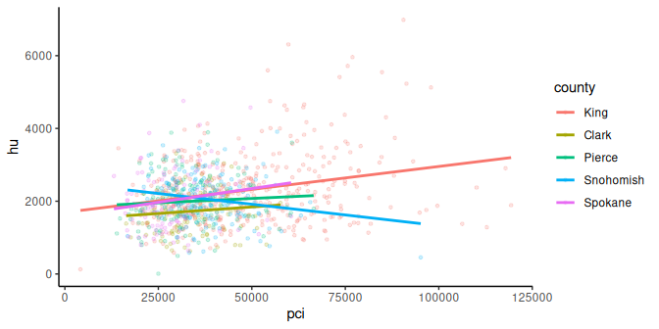

Slide 61
Generalized linear models (GLMs)
Generalized linear models (GLMs) allow for fitting regressions for non-continuous/normal outcomes. Examples include: logistic regression, Poisson regression.
Add the family argument – a description of the error distribution and link function to be used in the model. These include:
binomial(link = "logit") - outcome is binary
poisson(link = "log") - outcome is count or rate
others
Very important to use the right test!
See this case study for more information.
See ?family documentation for details of family functions.

Slide 62
Logistic regression
Let’s look at a logistic regression example. We’ll use the sp_dat dataset again with a different variable.
f_crowd - Flag for the percentage of crowded households is in the 90th percentile (1 = yes, 0 = no)
There are 36 census tracks in the 90th percentile for crowded households.
sp_dat |> count(f_crowd)
# A tibble: 2 × 2 f_crowd n <dbl> <int> 1 0 891 2 1 36

Slide 63
Logistic regression
Let’s explore how hu, pci, and county might predict f_crowd.
# General format glm(y ~ x, data = DATASET_NAME, family = binomial(link = "logit"))
binom_fit <- glm(f_crowd ~ hu + pci + county, data = sp_dat, family = binomial(link = "logit")) summary(binom_fit)
Call: glm(formula = f_crowd ~ hu + pci + county, family = binomial(link = "logit"), data = sp_dat) Coefficients: Estimate Std. Error z value Pr(>|z|) (Intercept) 3.46642282 0.97204634 3.566 0.000362 *** hu 0.00025822 0.00029372 0.879 0.379314 pci -0.00019389 0.00003096 -6.263 0.000000000378 *** countyClark -2.22310417 0.77710614 -2.861 0.004226 ** countyPierce -2.49172286 0.59240684 -4.206 0.000025981444 *** countySnohomish -2.13812813 0.76448803 -2.797 0.005161 ** countySpokane -3.91697302 1.06411805 -3.681 0.000232 *** --- Signif. codes: 0 '***' 0.001 '**' 0.01 '*' 0.05 '.' 0.1 ' ' 1 (Dispersion parameter for binomial family taken to be 1) Null deviance: 304.47 on 926 degrees of freedom Residual deviance: 199.62 on 920 degrees of freedom AIC: 213.62 Number of Fisher Scoring iterations: 8

Slide 64
Logistic Regression
See this case study for more information.

Slide 65
Odds ratios
An odds ratio (OR) is a measure of association between an exposure and an outcome. The OR represents the odds that an outcome will occur given a particular exposure, compared to the odds of the outcome occurring in the absence of that exposure.
Check out this paper.
Use oddsratio(x, y) from the epitools() package to calculate odds ratios.

Slide 66
Odds ratios
Let’s see if a high prevalence of no vehicle homes can predict a high prevalence of crowded homes.
f_noveh - Flag for the percentage of households with no vehicles is in the 90th percentile (1 = yes, 0 = no)
f_crowd - Flag for the percentage of crowded households is in the 90th percentile (1 = yes, 0 = no)

Slide 67
Odds ratios
In this case, we’re calculating the odds ratio for census areas, indicating whether a prevalence of no vehicle households is associated with more crowded households.
library(epitools) response <- sp_dat %>% pull(f_crowd) predictor <- sp_dat %>% pull(f_noveh)

Slide 68
Odds ratios
The Odds Ratio is 3.33.
When the predictor is 1 (aka the census area has a lot of no vehicle households), the odds of the response (prevalence of crowded homes) are 3.33 times greater than when it is 0 (not a lot of no vehicle households).
oddsratio(predictor, response)
$data Outcome Predictor 0 1 Total 0 849 31 880 1 42 5 47 Total 891 36 927 $measure odds ratio with 95% C.I. Predictor estimate lower upper 0 1.000000 NA NA 1 3.331243 1.074548 8.385917 $p.value two-sided Predictor midp.exact fisher.exact chi.square 0 NA NA NA 1 0.03856847 0.03106555 0.01389049 $correction [1] FALSE attr(,"method") [1] "median-unbiased estimate & mid-p exact CI"

Slide 69
Final note
Some final notes:
Researcher’s responsibility to understand the statistical method they use – underlying assumptions, correct interpretation of method results
Researcher’s responsibility to understand the R software they use – meaning of function’s arguments and meaning of function’s output elements

Slide 70
Summary
glm() fits regression models:
Use the formula = argument to specify the model (e.g., y ~ x or y ~ x1 + x2 using column names)
Use data = to indicate the dataset
Use family = to do a other regressions like logistic, Poisson and more
summary() gives useful statistics
oddsratio() from the epitools package can calculate odds ratios (outside of logistic regression - which allows more than one explanatory variable)
this is just the tip of the iceberg!

Slide 71
Resources (also on the website!)
For more check out:
this chapter on modeling in this tidyverse book
this chart on when to do what test
opencasestudies.org
Content for similar topics as this course can also be found on Leanpub.

Slide 72
Lab Part 2
🏠 Class Website
💻 Lab
📃 Day 8 Cheatsheet

Slide 73


Slide 74
Image by Gerd Altmann from Pixabay

Slide 75
Extra Slides

Slide 76
Model Selection
Check out the leaps package and other code snippets here: https://r-statistics.co/Model-Selection-in-R.html

Slide 77
More about tests!

Slide 78
Wilcoxon Test
The Wilcoxon test is a good alternative to the t-test when the normal distribution of the differences between paired individuals cannot be assumed.
wilcox.test(x, y, ..)
Like t-test, provide one or two vectors (x, y)
Choose from alternative = c("two.sided", "less", "greater")
Use paired = TRUE for paired values (e.g., before and after)

Slide 79
Shapiro Test
Can tell you if a vector is normally distributed.
shapiro.test(x)
The smaller the p-value, the more likely the data violates normality assumptions.

Slide 80
Kolmogorov-Smirnov test
Can tell you if two groups come from different distributions.
ks.test()
The smaller the p-value, the more likely the data are from different distributions.

Slide 81
Fisher’s F-Test
Performs an F test to compare the variances of two samples from normal populations.
var.test()

Slide 82
Chi-squared test
For categorical data/ratios, can tell you if observations match expected values or if two categorical variables are independent.
chisq.test()

Slide 83
Analysis of Variance (ANOVA)
For balanced designs, determine if multiple variables influence a dependent variable. “Within versus among group variance”.
aov()

Slide 84
More on Linear regression: factors
You can view estimates for the comparison group by removing the intercept in the GLM formula
y ~ x - 1
Caveat is that the p-values change, and interpretation is often confusing.
fit_force_intercept <- glm(crowd ~ pci + sngpnt + county - 1, data = sp_dat) summary(fit_force_intercept)
Call: glm(formula = crowd ~ pci + sngpnt + county - 1, data = sp_dat) Coefficients: Estimate Std. Error t value Pr(>|t|) pci -0.0007588 0.0001463 -5.188 0.00000026132 *** sngpnt 0.2379315 0.0215775 11.027 < 0.0000000000000002 *** countyKing 84.8722295 9.2681555 9.157 < 0.0000000000000002 *** countyClark 44.0054938 8.7528775 5.028 0.00000059706 *** countyPierce 36.2601486 8.4082758 4.312 0.00001789033 *** countySnohomish 52.3318984 8.9457720 5.850 0.00000000683 *** countySpokane 15.4316228 8.8378663 1.746 0.0811 . --- Signif. codes: 0 '***' 0.001 '**' 0.01 '*' 0.05 '.' 0.1 ' ' 1 (Dispersion parameter for gaussian family taken to be 3438.458) Null deviance: 7852783 on 927 degrees of freedom Residual deviance: 3163382 on 920 degrees of freedom AIC: 10188 Number of Fisher Scoring iterations: 2

