Slide 1
NIH Data Management And Sharing Policy 2023

Slide 2

Terms of Use

Slide 3






For individuals who:
Are submitting a grant proposal to the NIH
Want to determine if a proposal requires compliance
Want support finding appropriate places to share data
Want support writing a data management and sharing plan
or
Icons from iconpacks, iconmonstr, and NIH
Notes:
For individuals who: are submitting a grant proposal to the NIH, want to determine if a proposal requires compliance with the new policy, want support finding appropriate places to share data, want support writing a data management and sharing plan

Slide 4


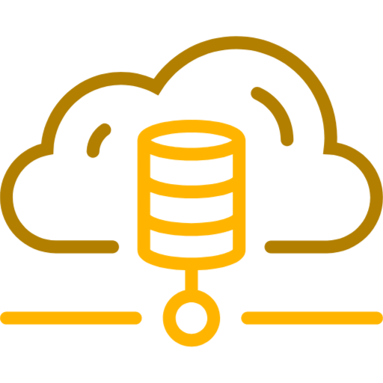



Major Takeaways for the NIH Data Management & Sharing Policy
Why this change? As of January 23, 2023, the NIH is requiring all grant proposals include a Data Management and Sharing Plan to aid in the transparency and reproducibility of NIH-funded research.
Does this apply to me? This will apply to most grants that create data, although some grant mechanisms and some data are exempt. It is not required to share all data, however a justification is required. Reasons not to share that are acceptable may be ethical, technical, or legal.
Where should I share my data? The NIH has lists of suggested repositories, and you will need to choose the most appropriate. If there is not an appropriate repository, you can share your data at an institutional (if available) or generalist repository.
How do I budget this? You may request funds for data management and sharing in direct costs. You may not infrastructure costs in direct costs as these should be included as indirect costs.
How do I write my plan? Your plan should be < 2 pages and include sections on data type; tools, software, and code; standards; data preservation, access, and timelines; access, distribution, and reuse considerations; and oversight. You can change your plan in the just-in-time process or during regular reporting intervals.
Will my plan influence my grant score? Although the Data Management and Sharing Plan is a mandatory part of most grant proposals, it will not be shared with reviewers and thus will not influence your score, however the budget will be visible to reviewers.

Slide 5
Major Takeaways for the NIH Data Management & Sharing Policy
Why this change? To aid in the transparency and reproducibility of research
Does this apply to me? It applies to most grants that create data. It is not required to share all data, however a justification is required
Where should I share my data? The NIH has lists of suggested repositories. If you can’t find one, you can use an institutional (if available) or generalist repository.
How do I budget this? You may request funds for data management and sharing in direct costs.
How do I write my plan? Your plan should be < 2 pages. You can change your plan in the just-in-time process or during regular reporting intervals.
Will plans be reviewed? Your plan will not be shared with reviewers, however the budget will be.

Slide 6
Major Takeaways for the NIH Data Management & Sharing Policy
The goal is to aid in the transparency and reproducibility of research.
The policy applies to most grants that create data. It is not required to share all data, however a justification is required.
The NIH has lists of suggested repositories. If you can’t find one, you can use an institutional (if available) or generalist repository.
You may request funds for data management and sharing in direct costs. Infrastructure costs should be budgeted as indirect costs.
Your plan should be < 2 pages. You can change your plan in the just-in-time process or during regular reporting intervals.
Your plan will not be shared with reviewers, however the budget will be.

Slide 7
Major Takeaways for the NIH Data Management & Sharing Policy
Why this change? As of January 23, 2023, the NIH is requiring all grant proposals include a Data Management and Sharing Plan to aid in the transparency and reproducibility of NIH-funded research.

Slide 8
Major Takeaways for the NIH Data Management & Sharing Policy
Does this apply to me? This will apply to most grants that create data, although some grant mechanisms and some data are exempt. It is not required to share all data, however a justification is required. Reasons not to share that are acceptable may be ethical, technical, or legal.

Slide 9

Major Takeaways for the NIH Data Management & Sharing Policy
Where should I share my data? The NIH has lists of suggested repositories, and you will need to choose the most appropriate. If there is not an appropriate repository, you can share your data at an institutional (if available) or generalist repository.

Slide 10

Major Takeaways for the NIH Data Management & Sharing Policy
How do I budget this? You may request funds for data management and sharing in direct costs. You may not infrastructure costs in direct costs as these should be included as indirect costs.

Slide 11

Major Takeaways for the NIH Data Management & Sharing Policy
How do I write my plan? Your plan should be < 2 pages and include sections on data type; tools, software, and code; standards; data preservation, access, and timelines; access, distribution, and reuse considerations; and oversight. You can change your plan in the just-in-time process or during regular reporting intervals.

Slide 12

Major Takeaways for the NIH Data Management & Sharing Policy
Will my plan influence my grant score? Although the Data Management and Sharing Plan is a mandatory part of most grant proposals, it will not be shared with reviewers and thus will not influence your score, however the budget will be visible to reviewers.

Slide 13
NIH Data Management & Sharing
Creating
a DMS Plan
Introducing the DMS Policy
DMS
Submission
Process
Notes:
Main topics covered in this course: Introducing the DMS policy, Creating a DMS plan, DMS submission process

Slide 14

NIH Data Management & Sharing
Motivations of the Policy
Data Storage
Options
Creating a DMS Plan
Post Submission Tips
Submission Tips
Personal Considerations
Budgeting
Notes:
Pathway of more specific topics covered in this course: motivations of the new policy, personal considerations, data storage options, budgeting, creating a DMS plan, submission tips, and post submission tips.

Slide 15






Motivations of the Policy
Data Storage
Options
Creating a DMS Plan
Post Submission Tips
Submission Tips
Personal Considerations
Budgeting
Notes:
We are on the first step of the pathway- understanding the motivations of the policy.

Slide 16

Motivations of the Policy
Data Storage
Options
Creating a DMS Plan
Post Submission Tips
Submission Tips
Personal Considerations
Budgeting
Notes:
We are on the second step of the pathway - personal considerations of the policy.

Slide 17
Motivations of the Policy
Data Storage
Options
Creating a DMS Plan
Post Submission Tips
Submission Tips
Personal Considerations
Budgeting
Notes:
We are on the third step of the pathway - Data Storage Options.

Slide 18
Motivations of the Policy
Data Storage
Options
Creating a DMS Plan
Post Submission Tips
Submission Tips
Personal Considerations
Budgeting
Notes:
We are on the fourth step of the pathway- Budgeting.

Slide 19
Motivations of the Policy
Data Storage
Options
Creating a DMS Plan
Post Submission Tips
Submission Tips
Personal Considerations
Budgeting
Notes:
We are on the fifth step of the pathway- Creating a DMS plan.

Slide 20
Motivations of the Policy
Data Storage
Options
Creating a DMS Plan
Post Submission Tips
Submission Tips
Personal Considerations
Budgeting
Notes:
We are on the sixth step of the pathway- Submission.

Slide 21
Motivations of the Policy
Data Storage
Options
Creating a DMS Plan
Post Submission Tips
Submission Tips
Personal Considerations
Budgeting
Notes:
We are on the final step of our pathway - Post Submission.

Slide 22







Scientific Data is …
results used to publish papers
unpublished results
null results
lab notebooks
preliminary analyses
case report forms
drafts of scientific papers
plans for future research
peer reviews
communications with colleagues
physical objects
Notes:
Scientific data should be shared under the new DMS policy, but there are many scientific products that are not considered scientific data.

Slide 23




Reasons Not to Share
Informed consent restrictions
Existing consent prohibits sharing
Privacy or safety of research participants would be compromised or place them at greater risk of re-identification
Explicit federal, state, local, or Tribal law, regulation, or policy prohibits disclosure
Restrictions are imposed by agreements with other parties
Datasets cannot practically be digitized
Data are considered too small
Data will not be widely used
Data are not thought to have a suitable repository
You don't have the right personnel to manage or share data
You don't want to pay for data storage
Notes:
Researchers with scientific data must justify why they will not share data with an appropriate exception.

Slide 24
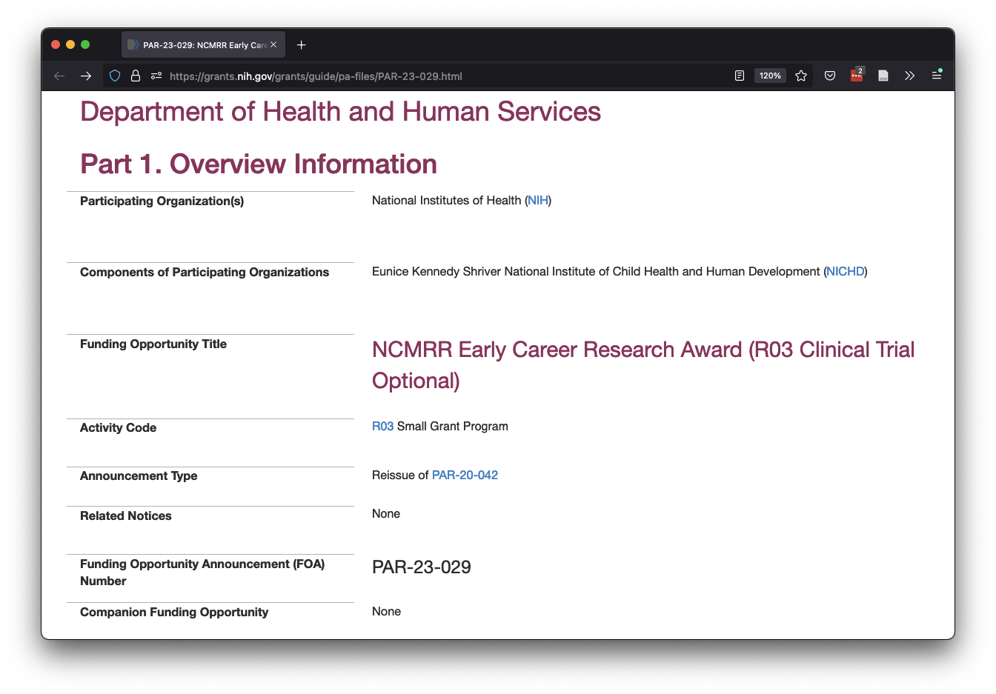
Activity Code
Notes:
I can find the R03 activity code in the request for applications.

Slide 25
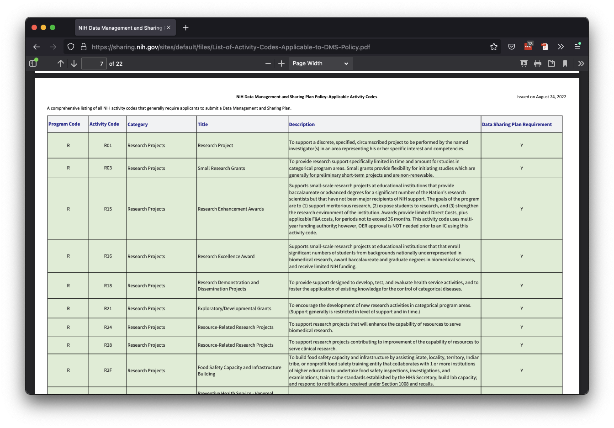
R03
DMS Plan required
NIH Data Management and Sharing Plan Policy: Applicable Activity Codes.
Notes:
I can determine if a DMS plan is required using the table here: https://sharing.nih.gov/sites/default/files/List-of-Activity-Codes-Applicable-to-DMS-Policy.pdf

Slide 26
What Can I Budget For?
Allowable
NOT Allowable
Local Management
Curation
Documentation
Standardization
Metadata
Formatting
De-identification
Local to Repository Transfer
Repository Storage
Facilities
Indirect Administration
Accessing other data
Collecting data
Notes:
Costs associated with FAIR principles are generally allowed, while infrastructure and data gathering costs are not.

Slide 27







A phone with 64GB of storage can hold…
1 genomics (WGS) file
1,280 flow cytometry files
2,560 clinical trial files
2 genomics (RNA-seq) files
8,000 imaging (microscopy) files
25 imaging (human medical) files
12,800 proteomics files
Notes:
A cell phone with 64GB of storage can fit 1 WGS file, 2 RNA-seq files, 25 imaging files, and thousands of flow cytometry, clinical trial, microscopy, and proteomics files.

Slide 28
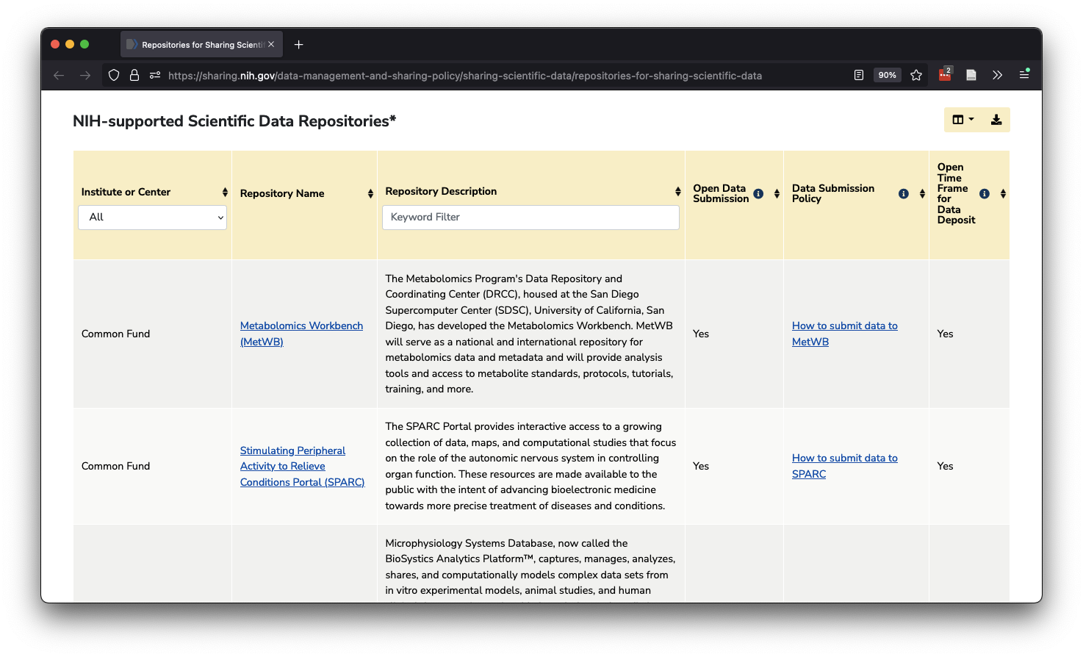
Interactive table of NIH-supported data repositories.
Notes:
The interactive table provided by NIH can help you find an appropriate repository.

Slide 29
Which Repository is Right?
yes
Use the repository listed in the FOA
yes
Use the repository established for your data type
Is a repository called out in the FOA?
Can you find a reasonable repository in NIH’s interactive table?
no
Use the repository established for your data type
yes
no
Can you find a reasonable repository in NIH’s additional links?
Use an institutional or generalist repository
no
Notes:
NIH prefers you to use the explicitly mentioned repository, followed by a known, FAIR repository, followed by a public generalist repository for data storage.

Slide 30



Make Sure Your Plan is…
Two Pages or Less
Free from Confidential Info / hyperlinks
Planned with Program Officer
Notes:
When writing the plan, ensure it is less than 2 pages long, contains no confidential information, and has been planned out carefully, contacting the program officer if necessary.

Slide 31

Worried your plan isn’t perfect?
Don’t Panic!
Update Your Plan during Just-In-Time
if not accepted
Update Your Plan during Regular Reporting if your resources or research change
Notes:
DMS plans can be edited during the Just In Time process or during regular reporting intervals, so it's okay if you need to make changes when you learn of better alternatives.

Slide 32
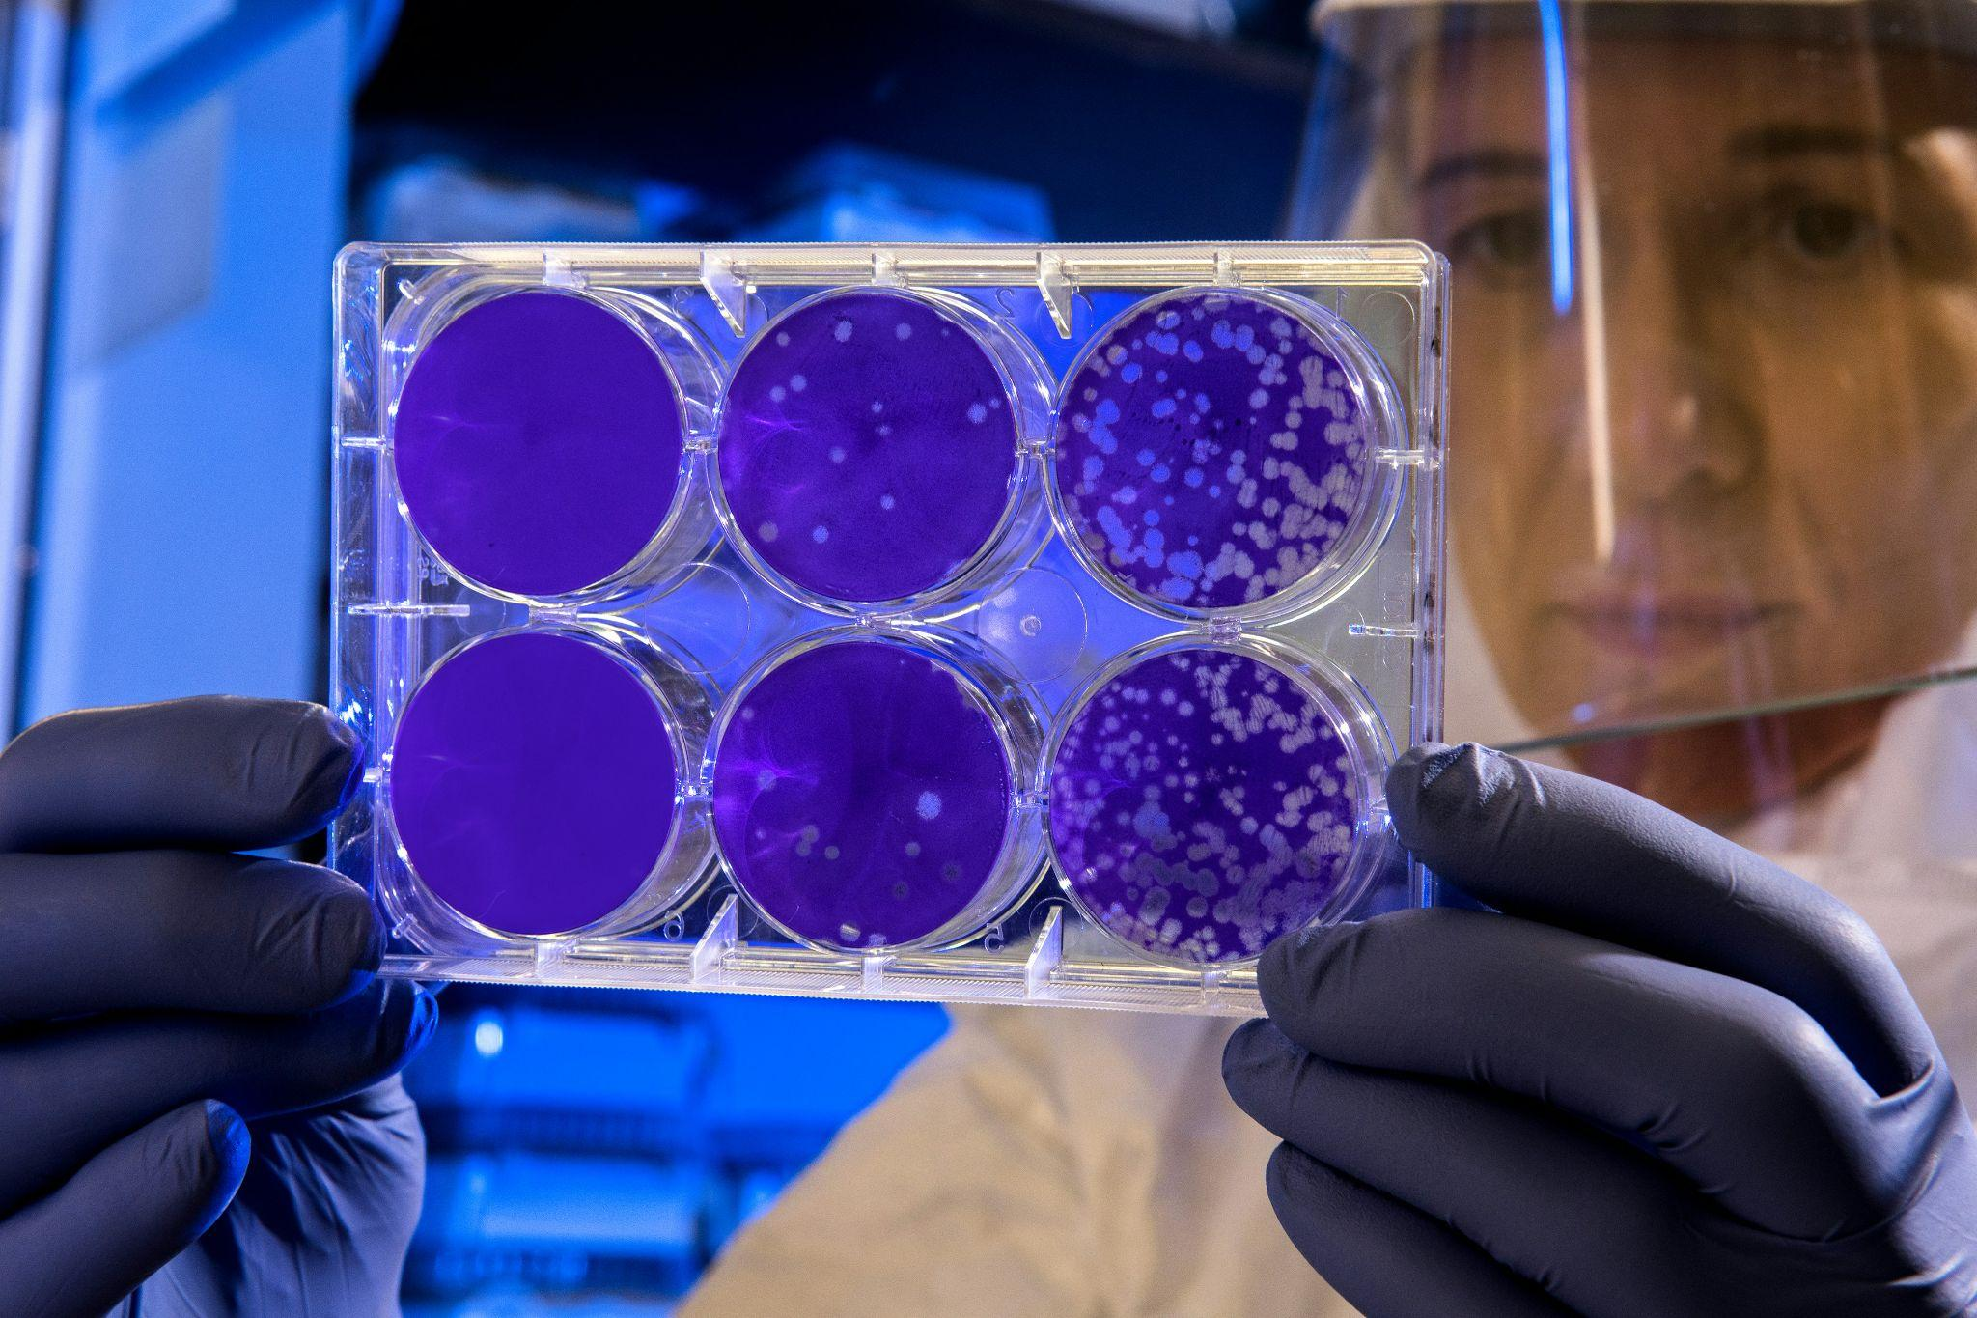
Data Sharing and good data management are part of good scientific practice. Image from CDC.

Slide 33


Slide 34

Inclusive
Open
Innovative
Accessible

Slide 35
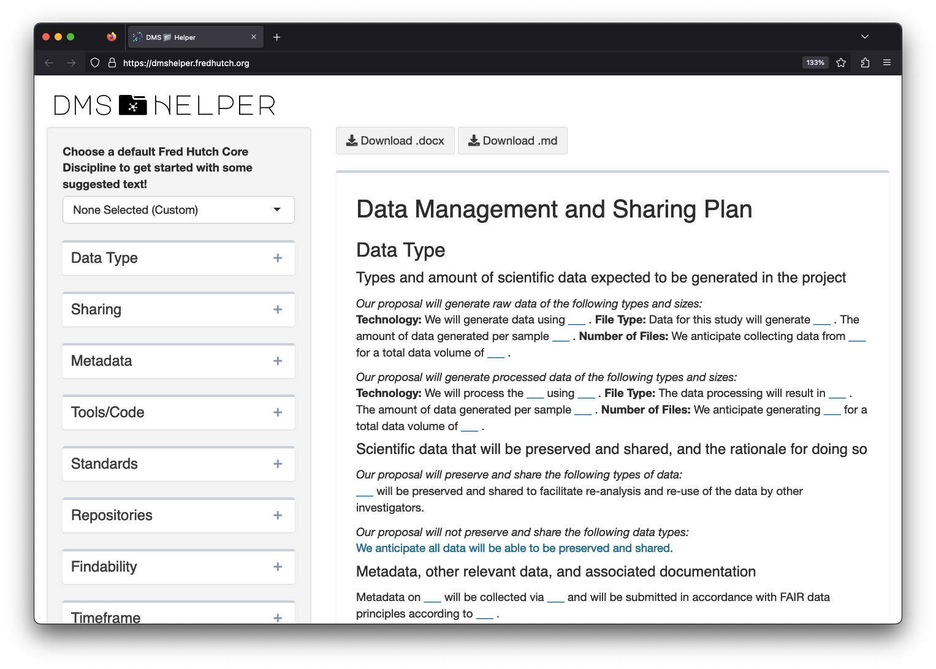
The Fred Hutch DaSL DMS Helper App.

