Slide 1
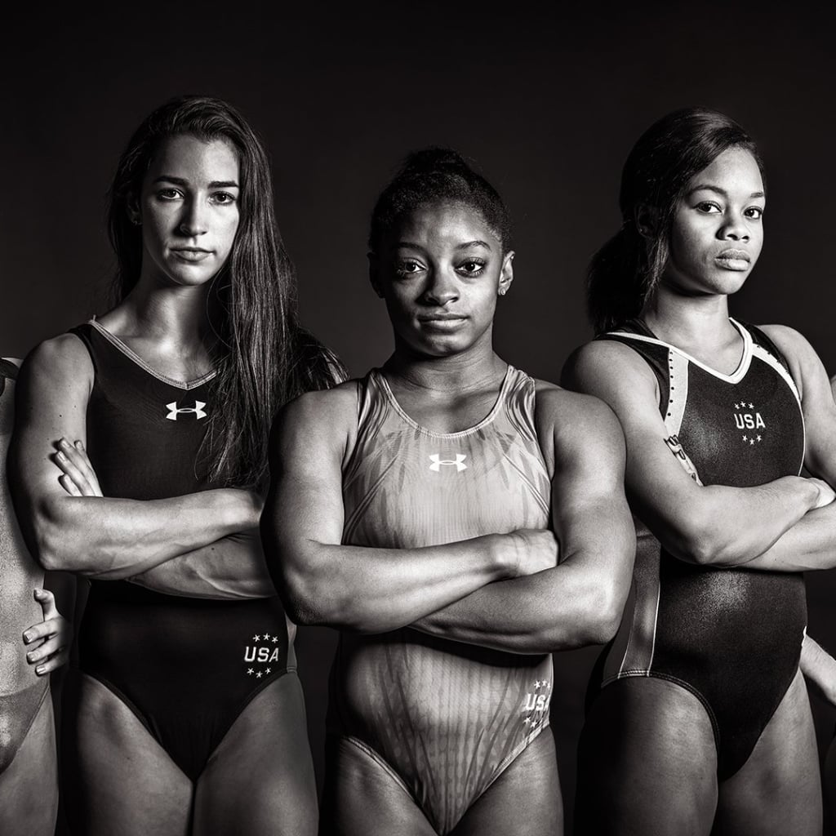
Women & the
Olympic Games
By Alexander Espinosa, Ashley Lutz, Celenia Chapa, Felecia Helms, and Tyler Cutrer

Slide 2
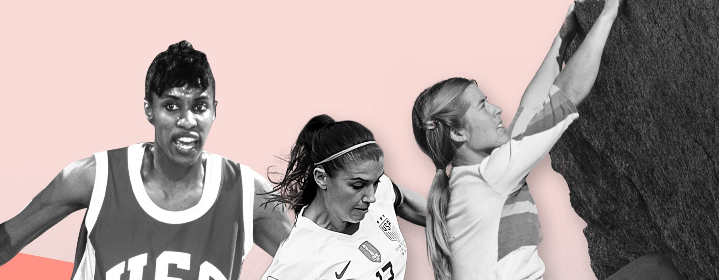
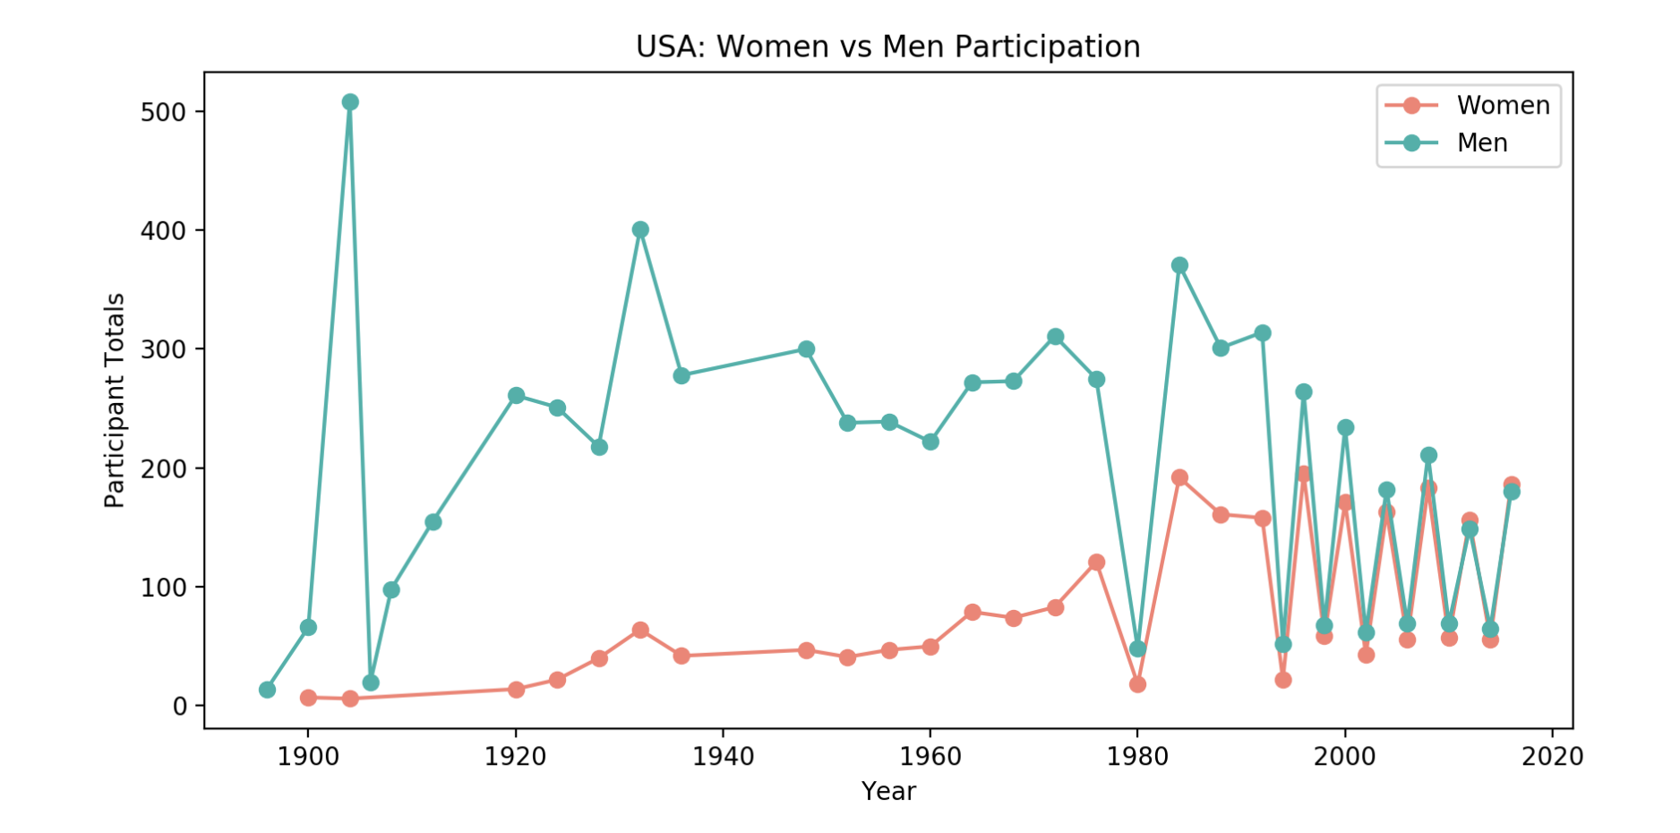
Women vs. Men

Slide 3
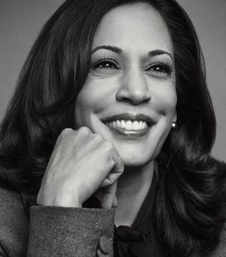
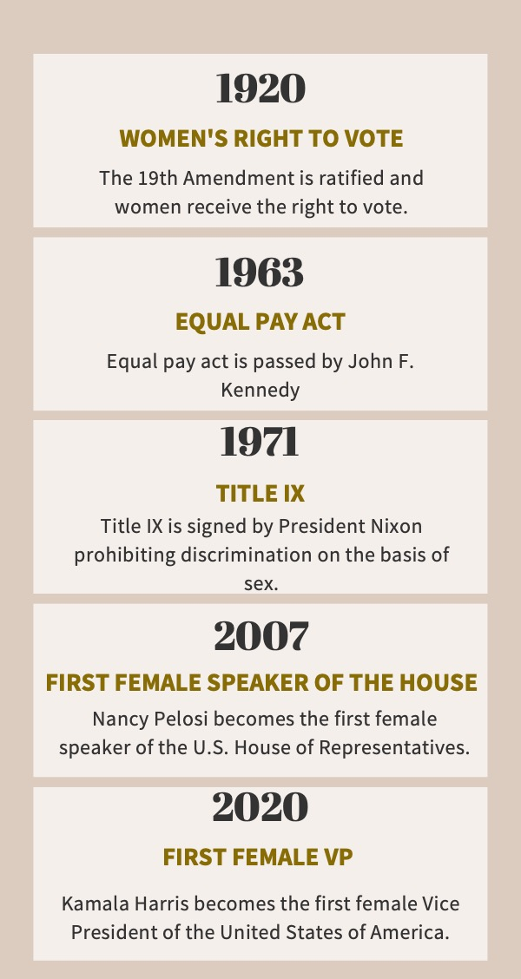
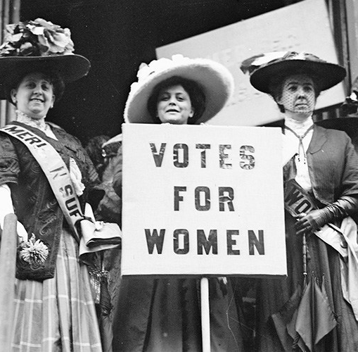
Women’s Suffrage

