Slide 1
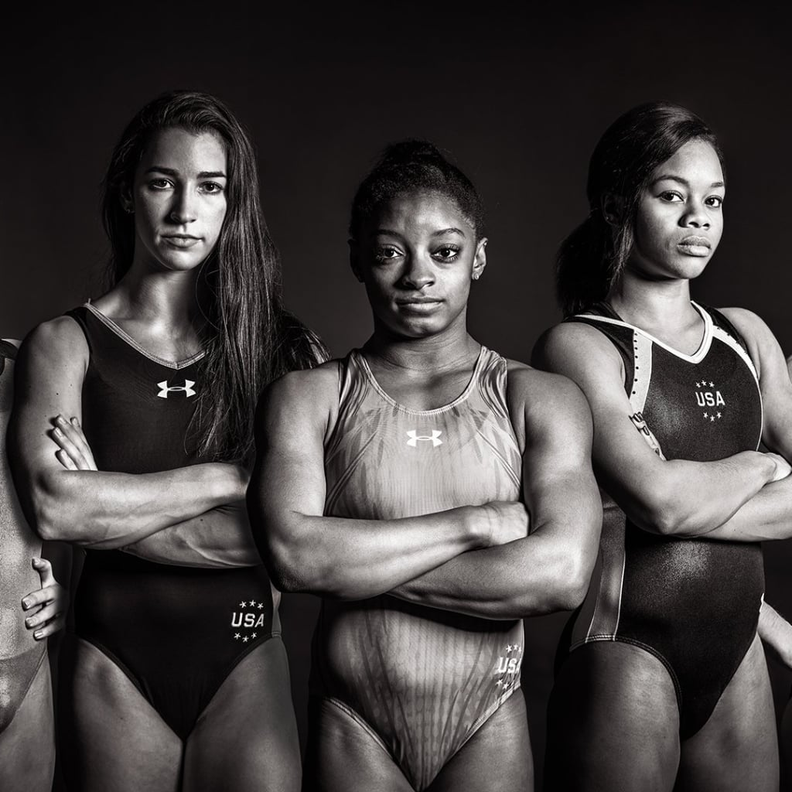
Women & the Olympic Games
By Alexander Espinosa, Ashley Lutz, Celenia Chapa, Felecia Helms, and Tyler Cutrer

Slide 2

Agenda
Presentation Outline:
Team
Overview
Data
Exploration
Analysis

Slide 3





Team
Alex Espinosa
Tyler Cutrer
Celenia Chapa
Ashley Lutz
Felecia Helms

Slide 4
Data Cleanup
Data Source: https://www.kaggle.com/heesoo37/120-years-of-olympic-history-athletes-and-results
The dataset that we sourced was HUGE.
We knew that we wanted to focus on women’s participation in the Olympics.

Slide 5

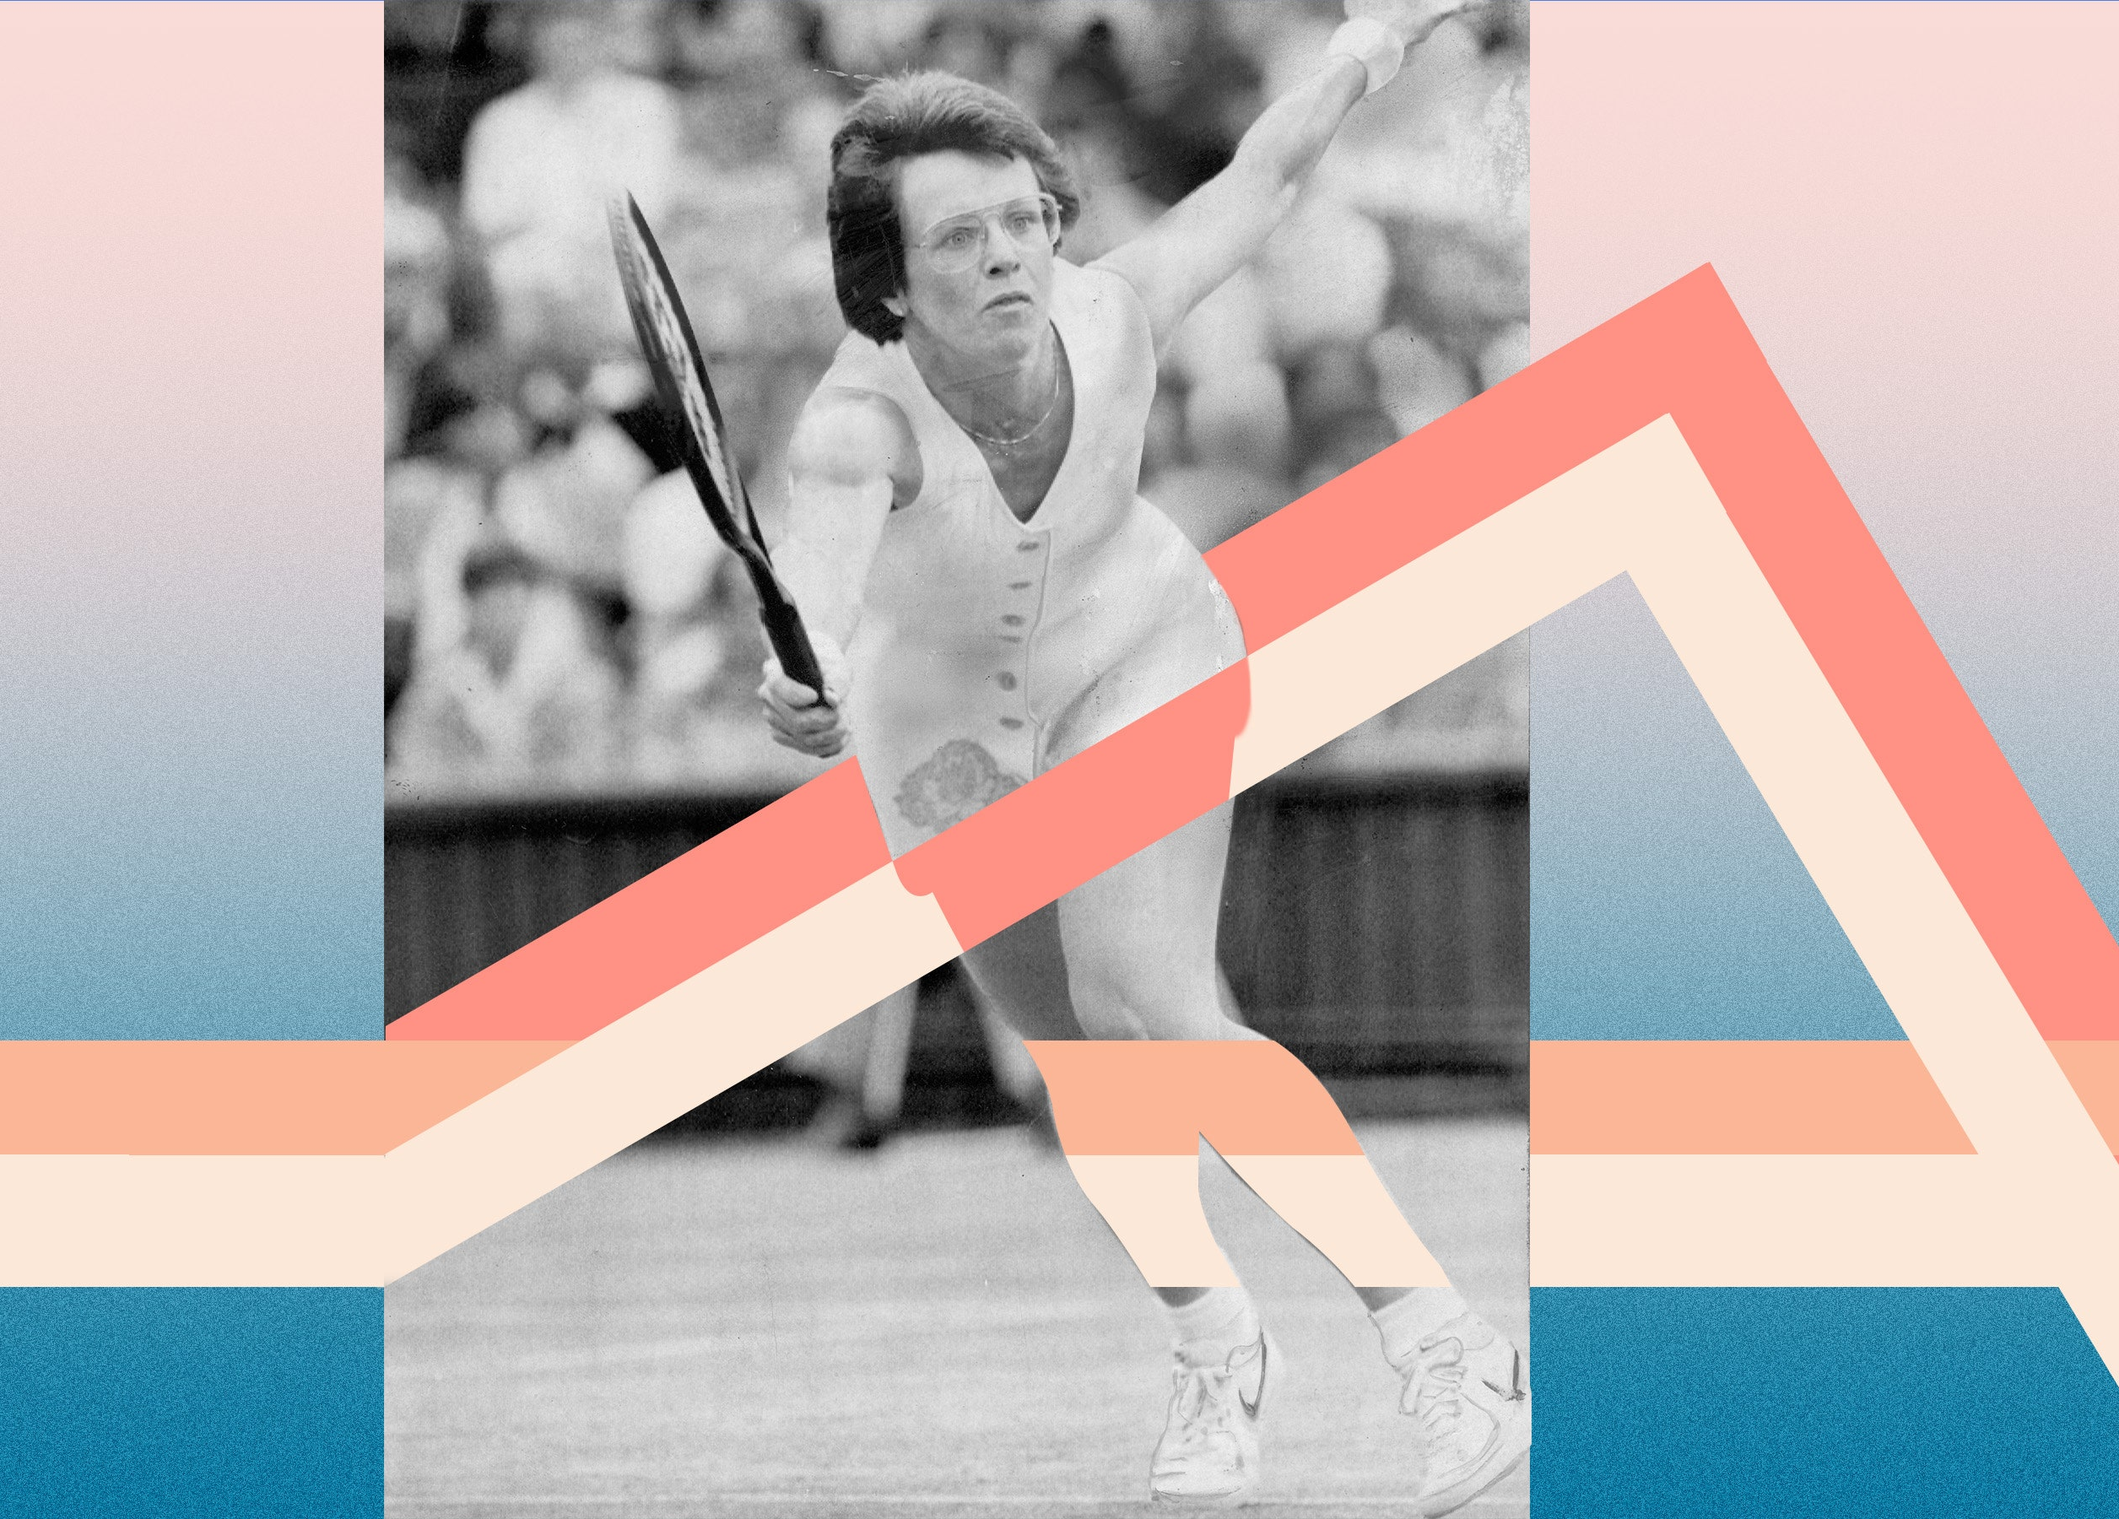
Women’s Suffrage
Historically, women are underpaid, undervalued, and overlooked at every turn. But they’re fighting back—and winning.

Slide 6
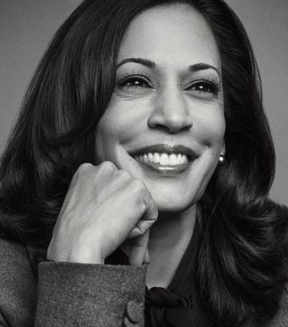
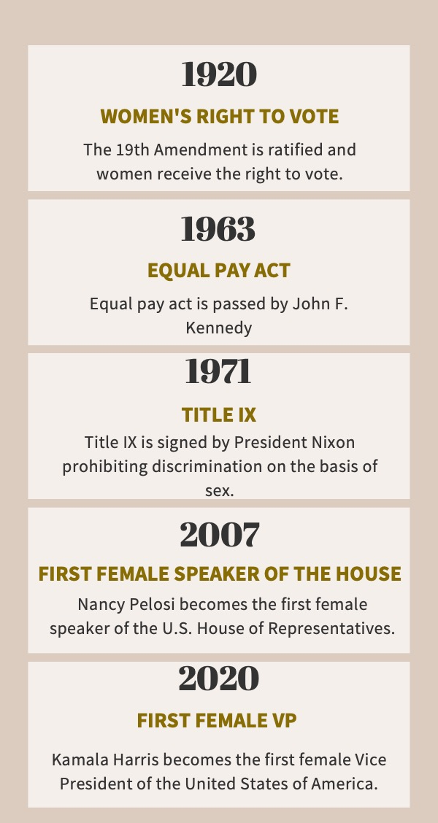
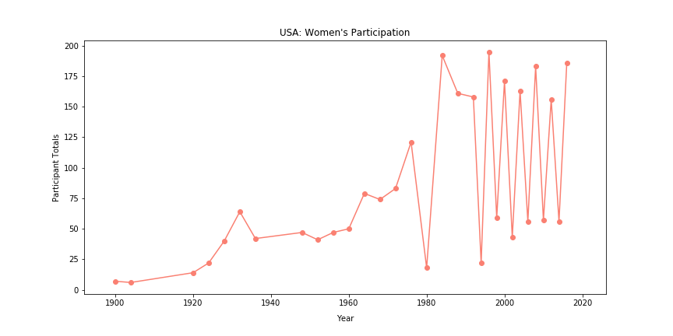
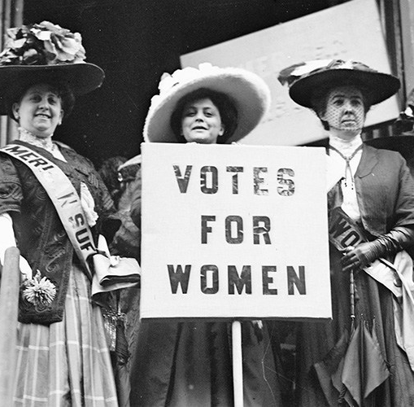
Women’s Suffrage

Slide 7
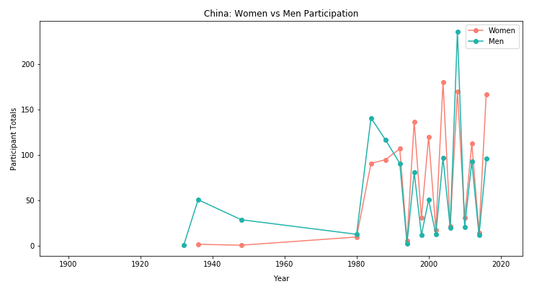
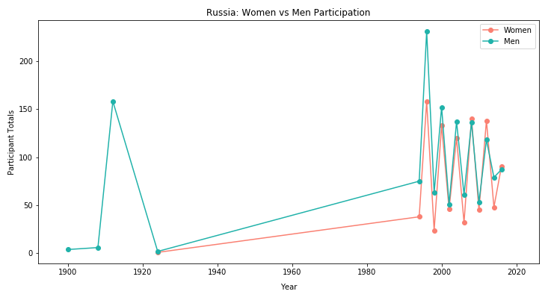
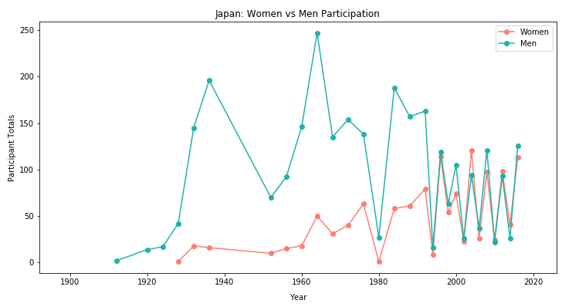
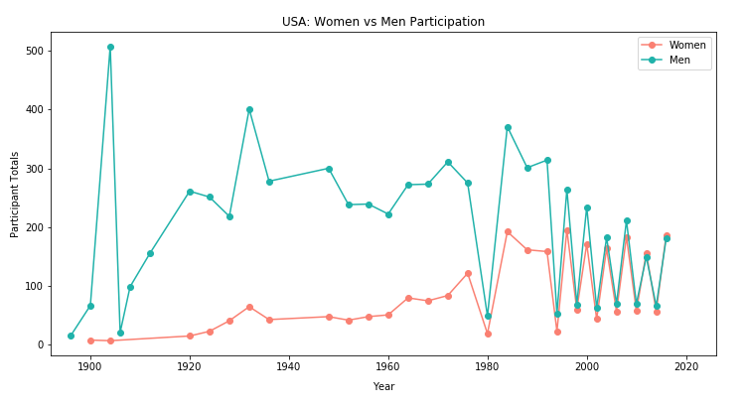
World Participation
China
Russia
Japan
USA

Slide 8
