Slide 1
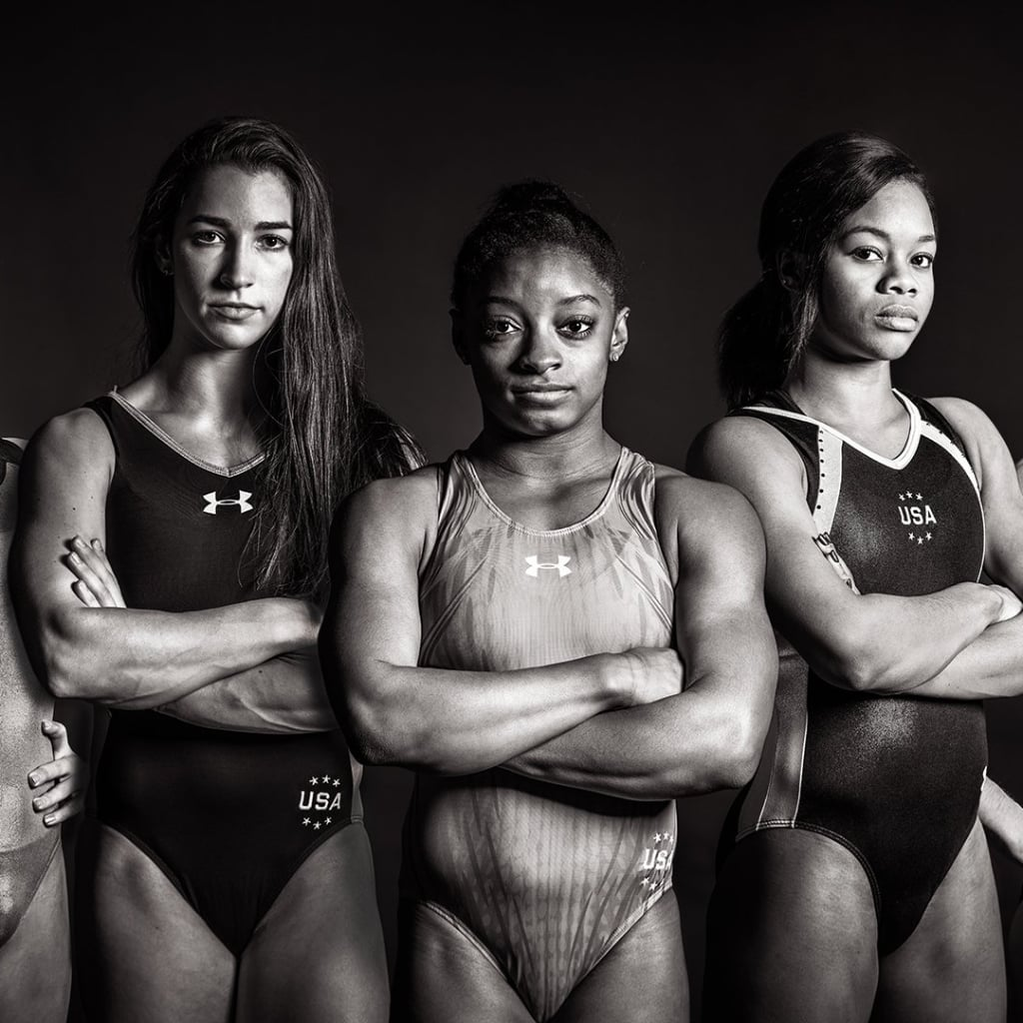
Women & the Olympic Games
By Alexander Espinosa, Ashley Lutz, Celenia Chapa, Felecia Helms, and Tyler Cutrer

Slide 2
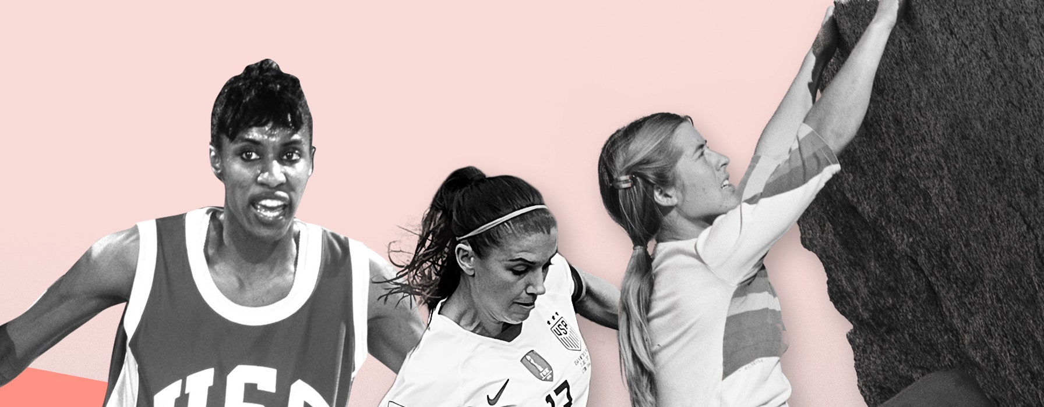
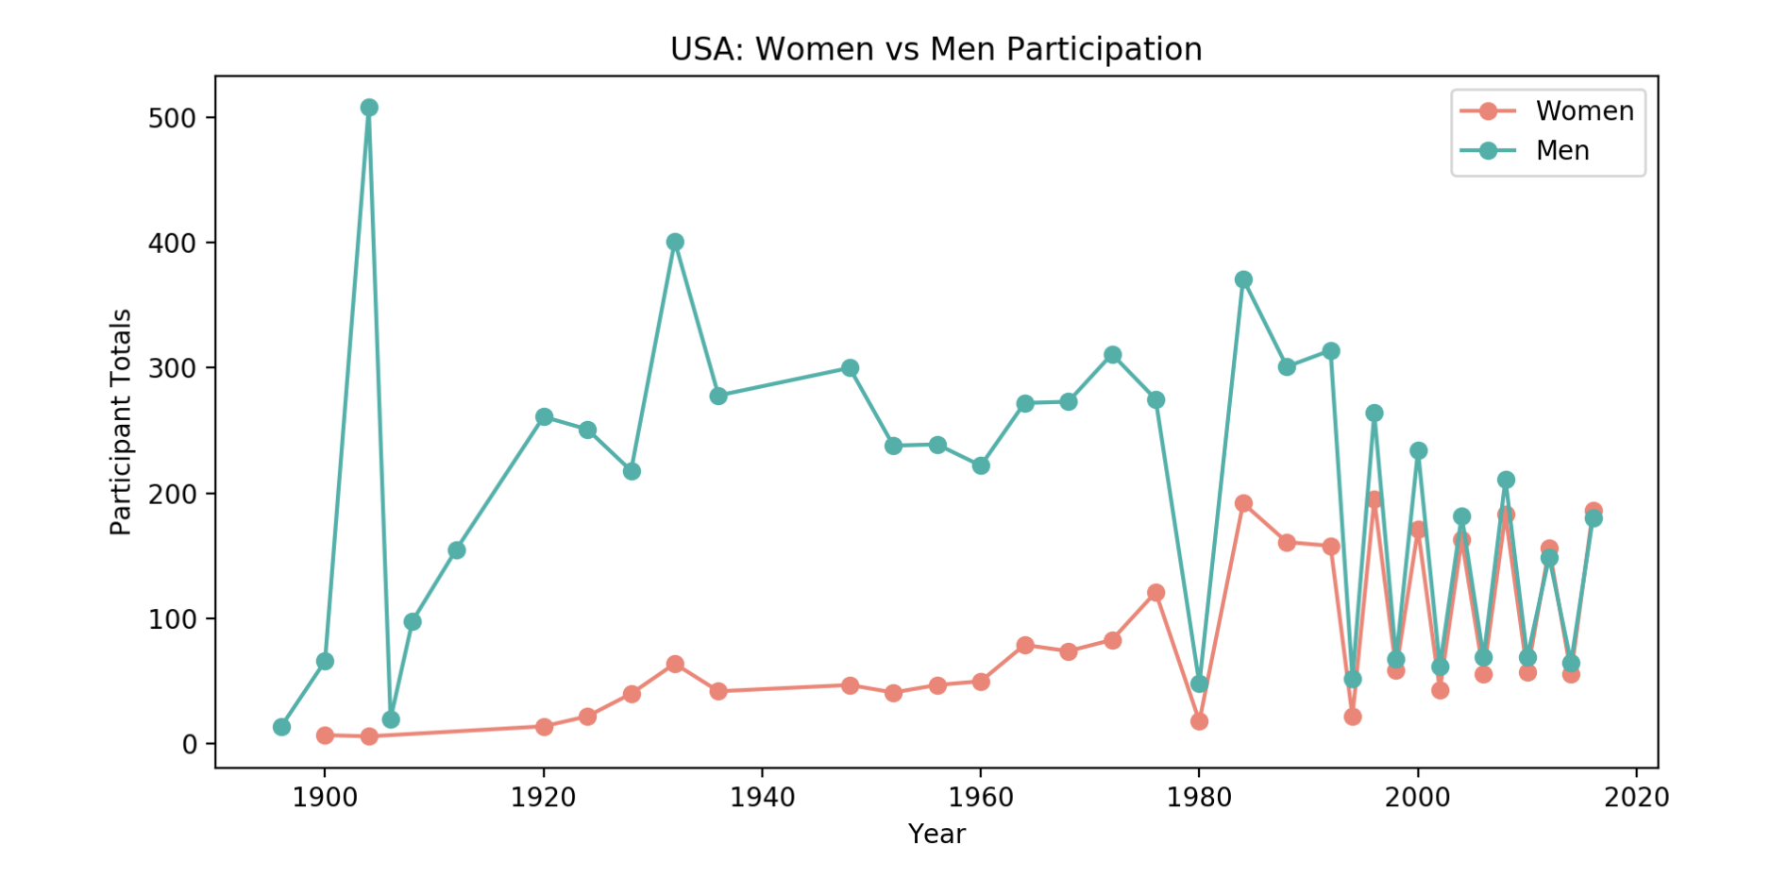
Women vs. Men
Women in sports are underpaid, undervalued, and underfunded at every turn. But they’re fighting back—and winning.

Slide 3
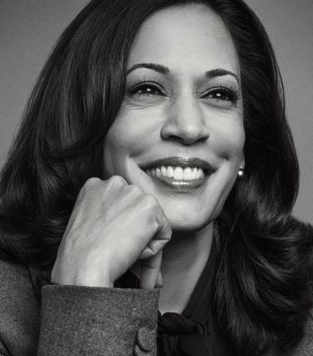
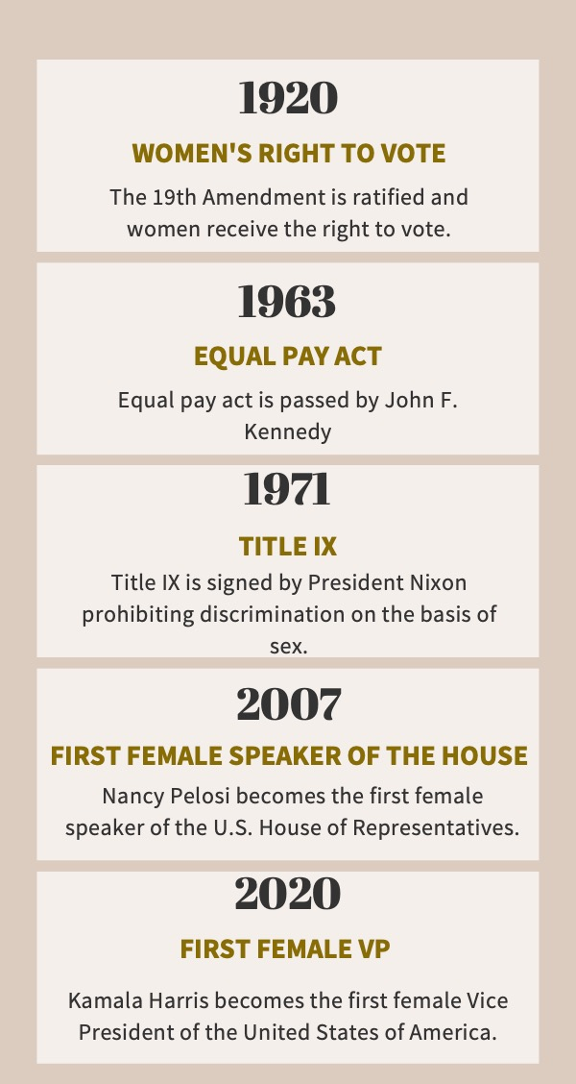
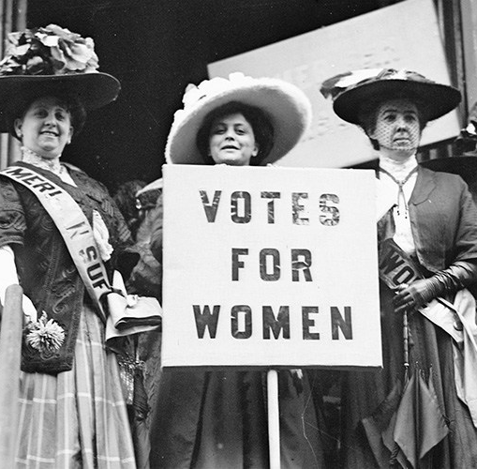
Women’s Suffrage

Slide 4
