Slide 1
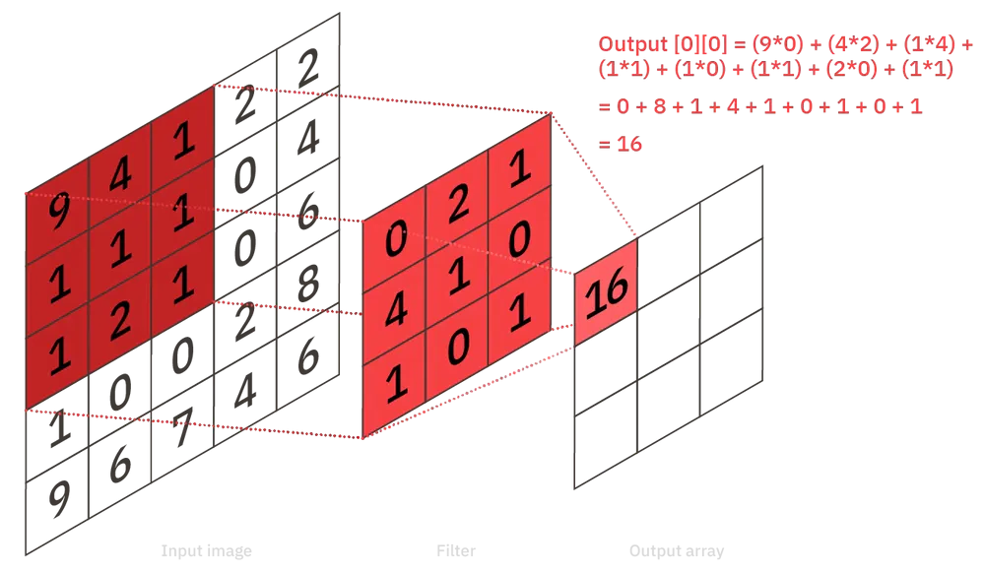

Slide 2
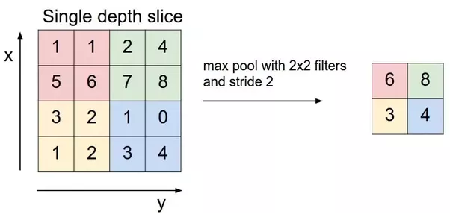
1
1
1
1
The input dimension is 4 x 4, while the max polling layer is a kernel of size 2 x 2 with a stride of 2, it results in a output of size
Ceil((4 – 2 + 1)/2) x ceil((4 – 2 + 1)/2)
= ceil( 3/ 2) x ceil(3/2) = ceil(1.5) x ceil(1.5) = 2 x 2

Slide 3
2*4 + 4*2 + 1*3 + 3*7
= 8 + 8 + 3 + 21
= 40
8
4
4
2
1
40
42
30
22
40
42
30
22
3
7
9
2
4
40
42
30
22
8
1
3
40
42
30
22
1
40
42
30
22
2
4
40
42
30
22
2*2 + 4*1 + 1*7 + 3*9
= 4 + 4 + 7 + 27
= 42

