Slide 1

A SOLID PROPERTY MANAGEMENT GROUP
PREPARED EXCLUSIVELY FOR
Your Community Association
A SOLID PROPERTY MANAGEMENT GROUP • MIAMI, FLORIDA

Slide 2
01
Who We Are
A full-service property management firm built on transparency, technology, and financial excellence for South Florida's condominium associations.

Slide 3
COMPANY OVERVIEW
ASPMG at a Glance
15+
30+
$50M+
100%
YEARS OF EXPERIENCE
ASSOCIATIONS MANAGED
ASSETS UNDER MANAGEMENT
BOARD TRANSPARENCY
"We don't just manage properties — we transform communities through proactive financial stewardship, cutting-edge technology, and relentless attention to detail."
85 Grand Canal Dr, Suite 201 • Miami, FL 33144

Slide 4
WHAT SETS US APART
The ASPMG Difference
Financial Stewardship
Technology-Driven
Radical Transparency
Growing reserves, eliminating debt, and saving over $200K on insurance — same coverage.
ApplyHOA delivers real-time reporting, owner portals, and digital management.
Photo inspection reports, itemized financials, and open-book project management.
Project Management
Proactive Inspections
Bilingual Team
Roof to pool — end-to-end capital projects with before/after documentation.
20+ page photo reports catch issues early and track every resolution.
Full English/Spanish staff for clear communication with every resident.
aspmg.com

Slide 5
02
Technology & Innovation
Powered by ApplyHOA — our proprietary platform that brings condominium management into the digital age.

Slide 6
POWERED BY APPLYHOA
Smart Management, Real-Time Control
Everything in One Platform
Our proprietary platform built for Florida condo associations — replacing outdated paper processes with a fully digital ecosystem.
Any device, anywhere, anytime.
Owner Portal — Payments, requests, and documents 24/7
PAYMENTS
REPORTS
VIOLATIONS
Board Dashboard — Real-time financials, violations, project status
REQUESTS
VOTING
DOCUMENTS
Digital Voting — Secure online elections and amendments
Maintenance Tracking — Every work order logged and resolved
applyhoa.com
Document Library — Bylaws, budgets, minutes — all searchable
applyhoa.com

Slide 7
03
Financial Excellence
Real numbers. Real results. See how ASPMG transforms the financial health of the associations we manage.

Slide 8
CASE STUDY
The Money Effect
Doral Grand Condominium
+107%
Under ASPMG management, Doral Grand's total assets more than doubled in just two years — with properly categorized reserves and dramatically reduced receivables.
TOTAL ASSET GROWTH
Metric | Mar 2024 | Mar 2026 | Change
Total Assets | $63,128 | $130,472 | +107%
Cash & Savings | $55,453 | $129,122 | +133%
Reserves | $47,010 | $101,325 | +116%
Receivables | $7,676 | $1,350 | -82%
In Just 24 Months
Reserves properly allocated across 5 categories: Painting, Seal Coat, General Reserve, Interest, and Roof Replacement.
Doral Grand Condominium Inc.

Slide 9
CASE STUDY
The Miracle Economy
The Seasons Villas & Townhomes
$318,728
The Seasons had a $318K credit line debt. Under ASPMG, we completely paid it off while growing total assets by 73% and restructuring reserves to meet Florida's new requirements.
CREDIT LINE DEBT → ELIMINATED
Metric | Aug 2023 | Feb 2026 | Change
Total Assets | $804,782 | $1,392,951 | +73%
Cash & Savings | $555,378 | $1,198,615 | +116%
Credit Line Debt | $318,728 | $0 | Paid Off
Total Reserves | $445,921 | $518,077 | +16%
RESERVE RESTRUCTURING (SB 4-D COMPLIANT)
Waterproofing $348,152
Roof $93,181
Electrical $28,615
Plumbing $24,909
Fire Protection $14,214
Structure $7,048
The Seasons Villas & Townhomes

Slide 10
CASE STUDY
$200K Insurance Savings
Laguna Club Condominium
ANNUAL SAVINGS
$200K+
Previous management was paying over $550K annually. We secured the exact same coverage for $350K — saving over $200,000 every year.
Saved per year — same coverage
$200,000 back in the association's pocket — every single year. Same coverage. Smarter management.
BEFORE ASPMG ~$550K
WITH ASPMG $350K
How We Did It
Multi-carrier competitive bidding — not just one quote
Leveraged portfolio relationships for better rates
COVERAGE Special Form + Wind/Hail
CARRIER Slide Insurance Co.
Optimized coverage without reducing protection
Eliminated unnecessary fees and redundant riders
ORD/LAW LIMIT $1,000,000
INCLUDES Equipment Breakdown
Ongoing annual review to prevent premium creep
Laguna Club Condominium Assoc.

Slide 11
04
Project Management
End-to-end oversight of capital improvement projects with full photo documentation and board transparency.

Slide 12
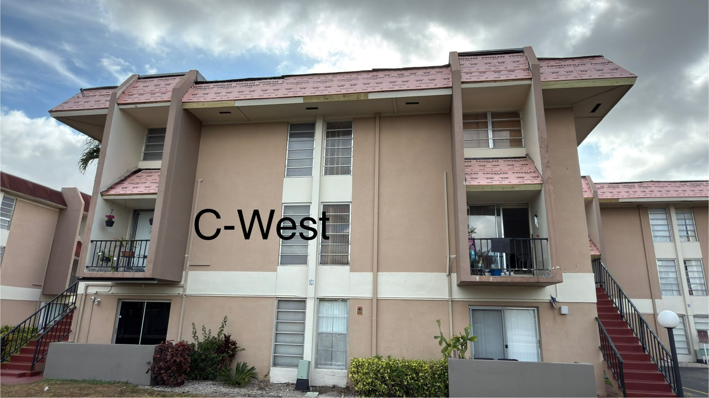
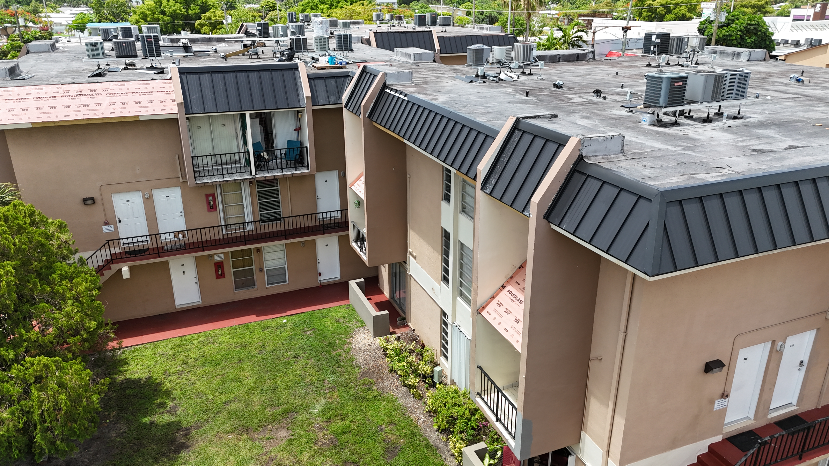
CAPITAL PROJECTS
Roof Replacement
BEFORE
AFTER
Complete roof replacement managed from bid solicitation through final inspection — on time and within budget. Modern standing-seam metal roofing for long-term durability.
100%
Drone
COMPLETED
DOCUMENTED
C-West Building

Slide 13
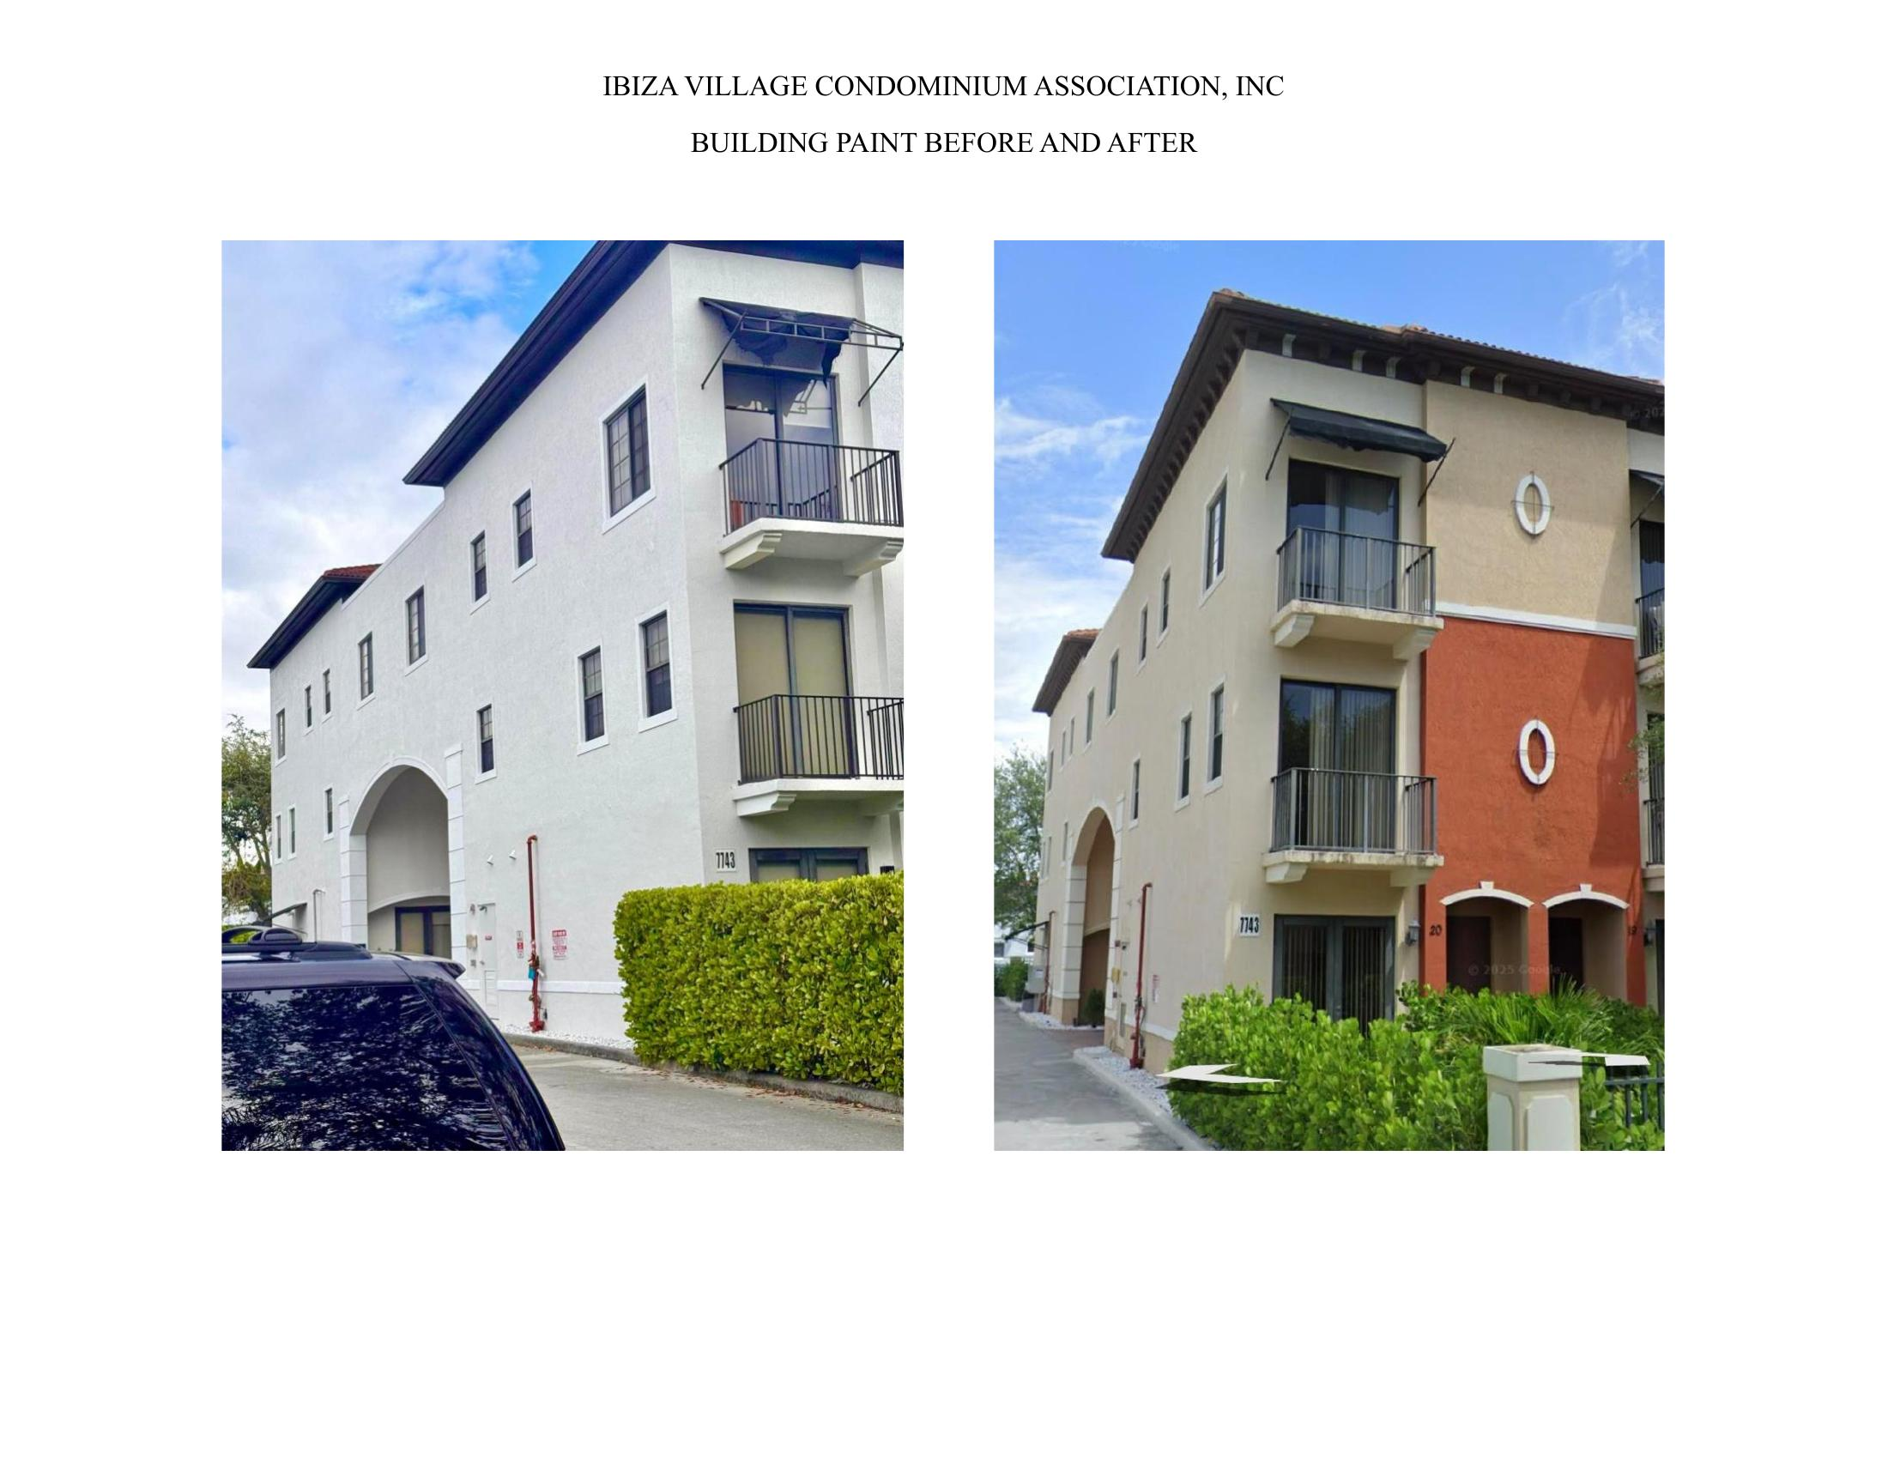
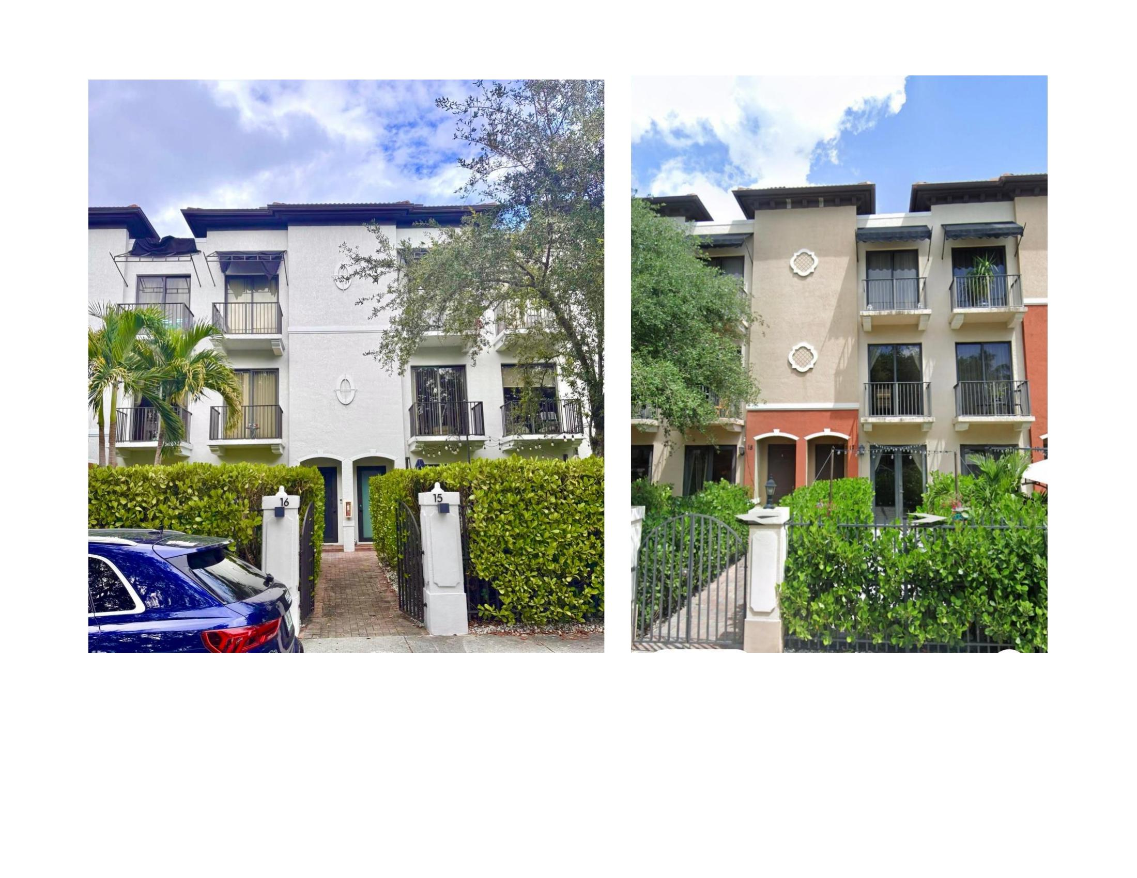
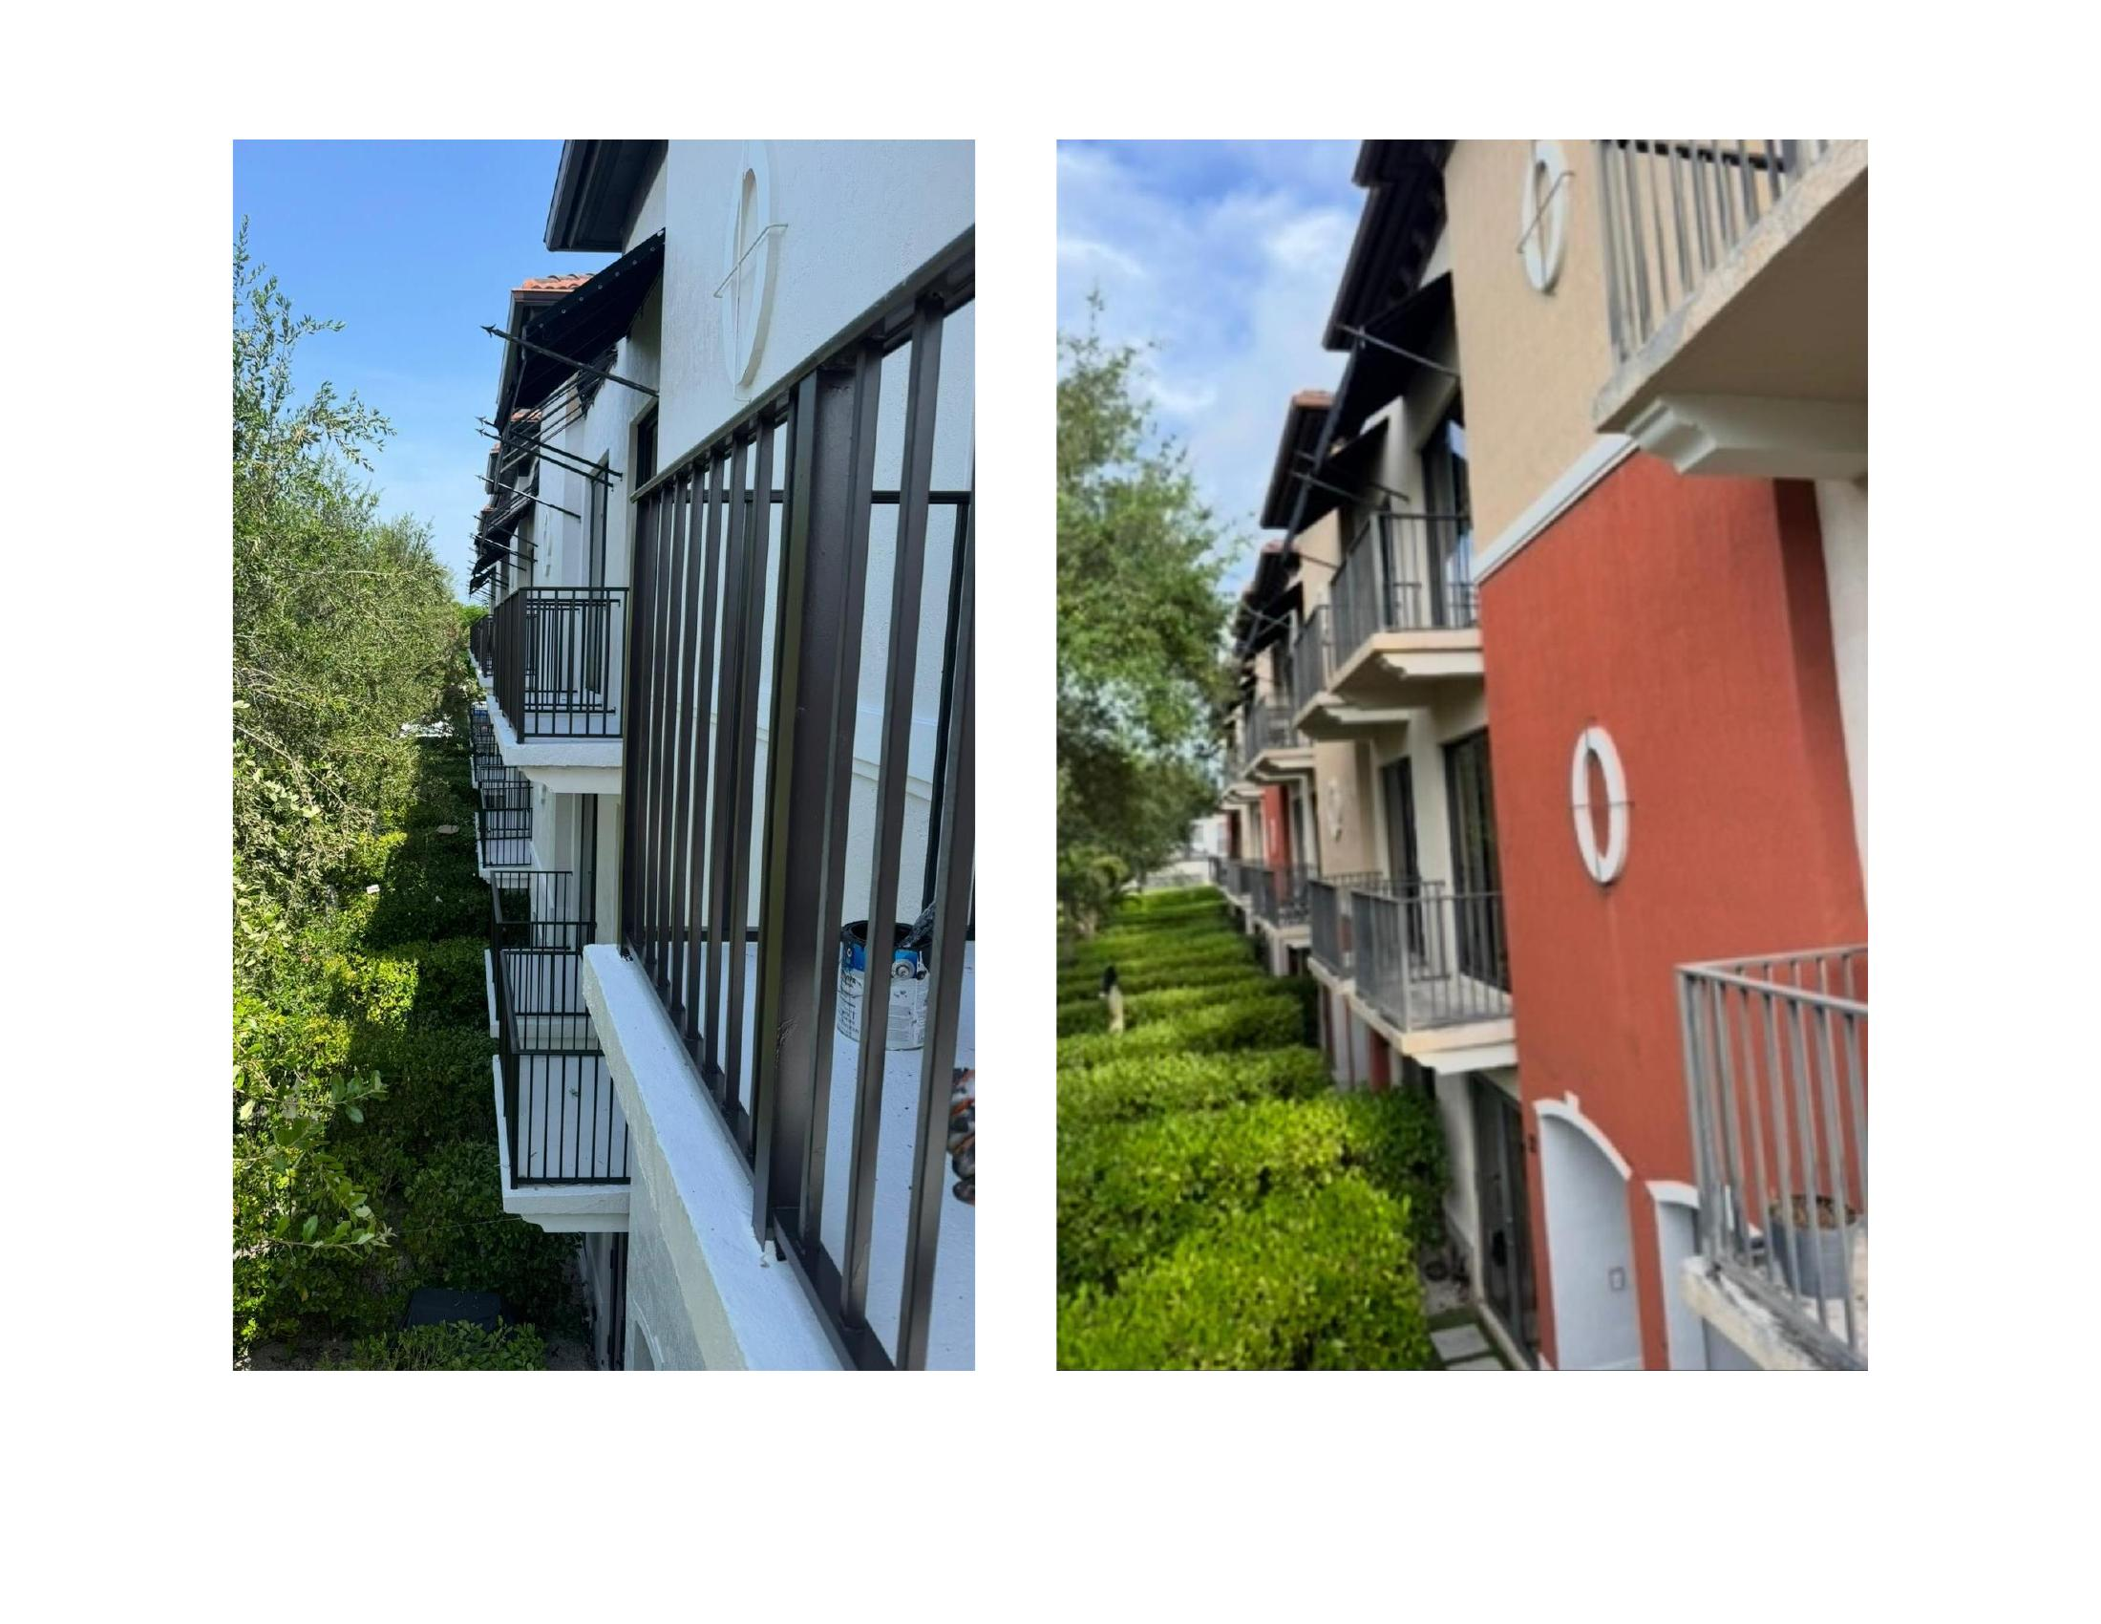
CAPITAL PROJECTS
Building Paint — Before & After
Ibiza Village Condominium Association
Complete exterior paint project transforming faded, weathered buildings into a vibrant, modern community aesthetic — managed from color selection through final walkthrough.
Ibiza Village Condominium Assoc.

Slide 14
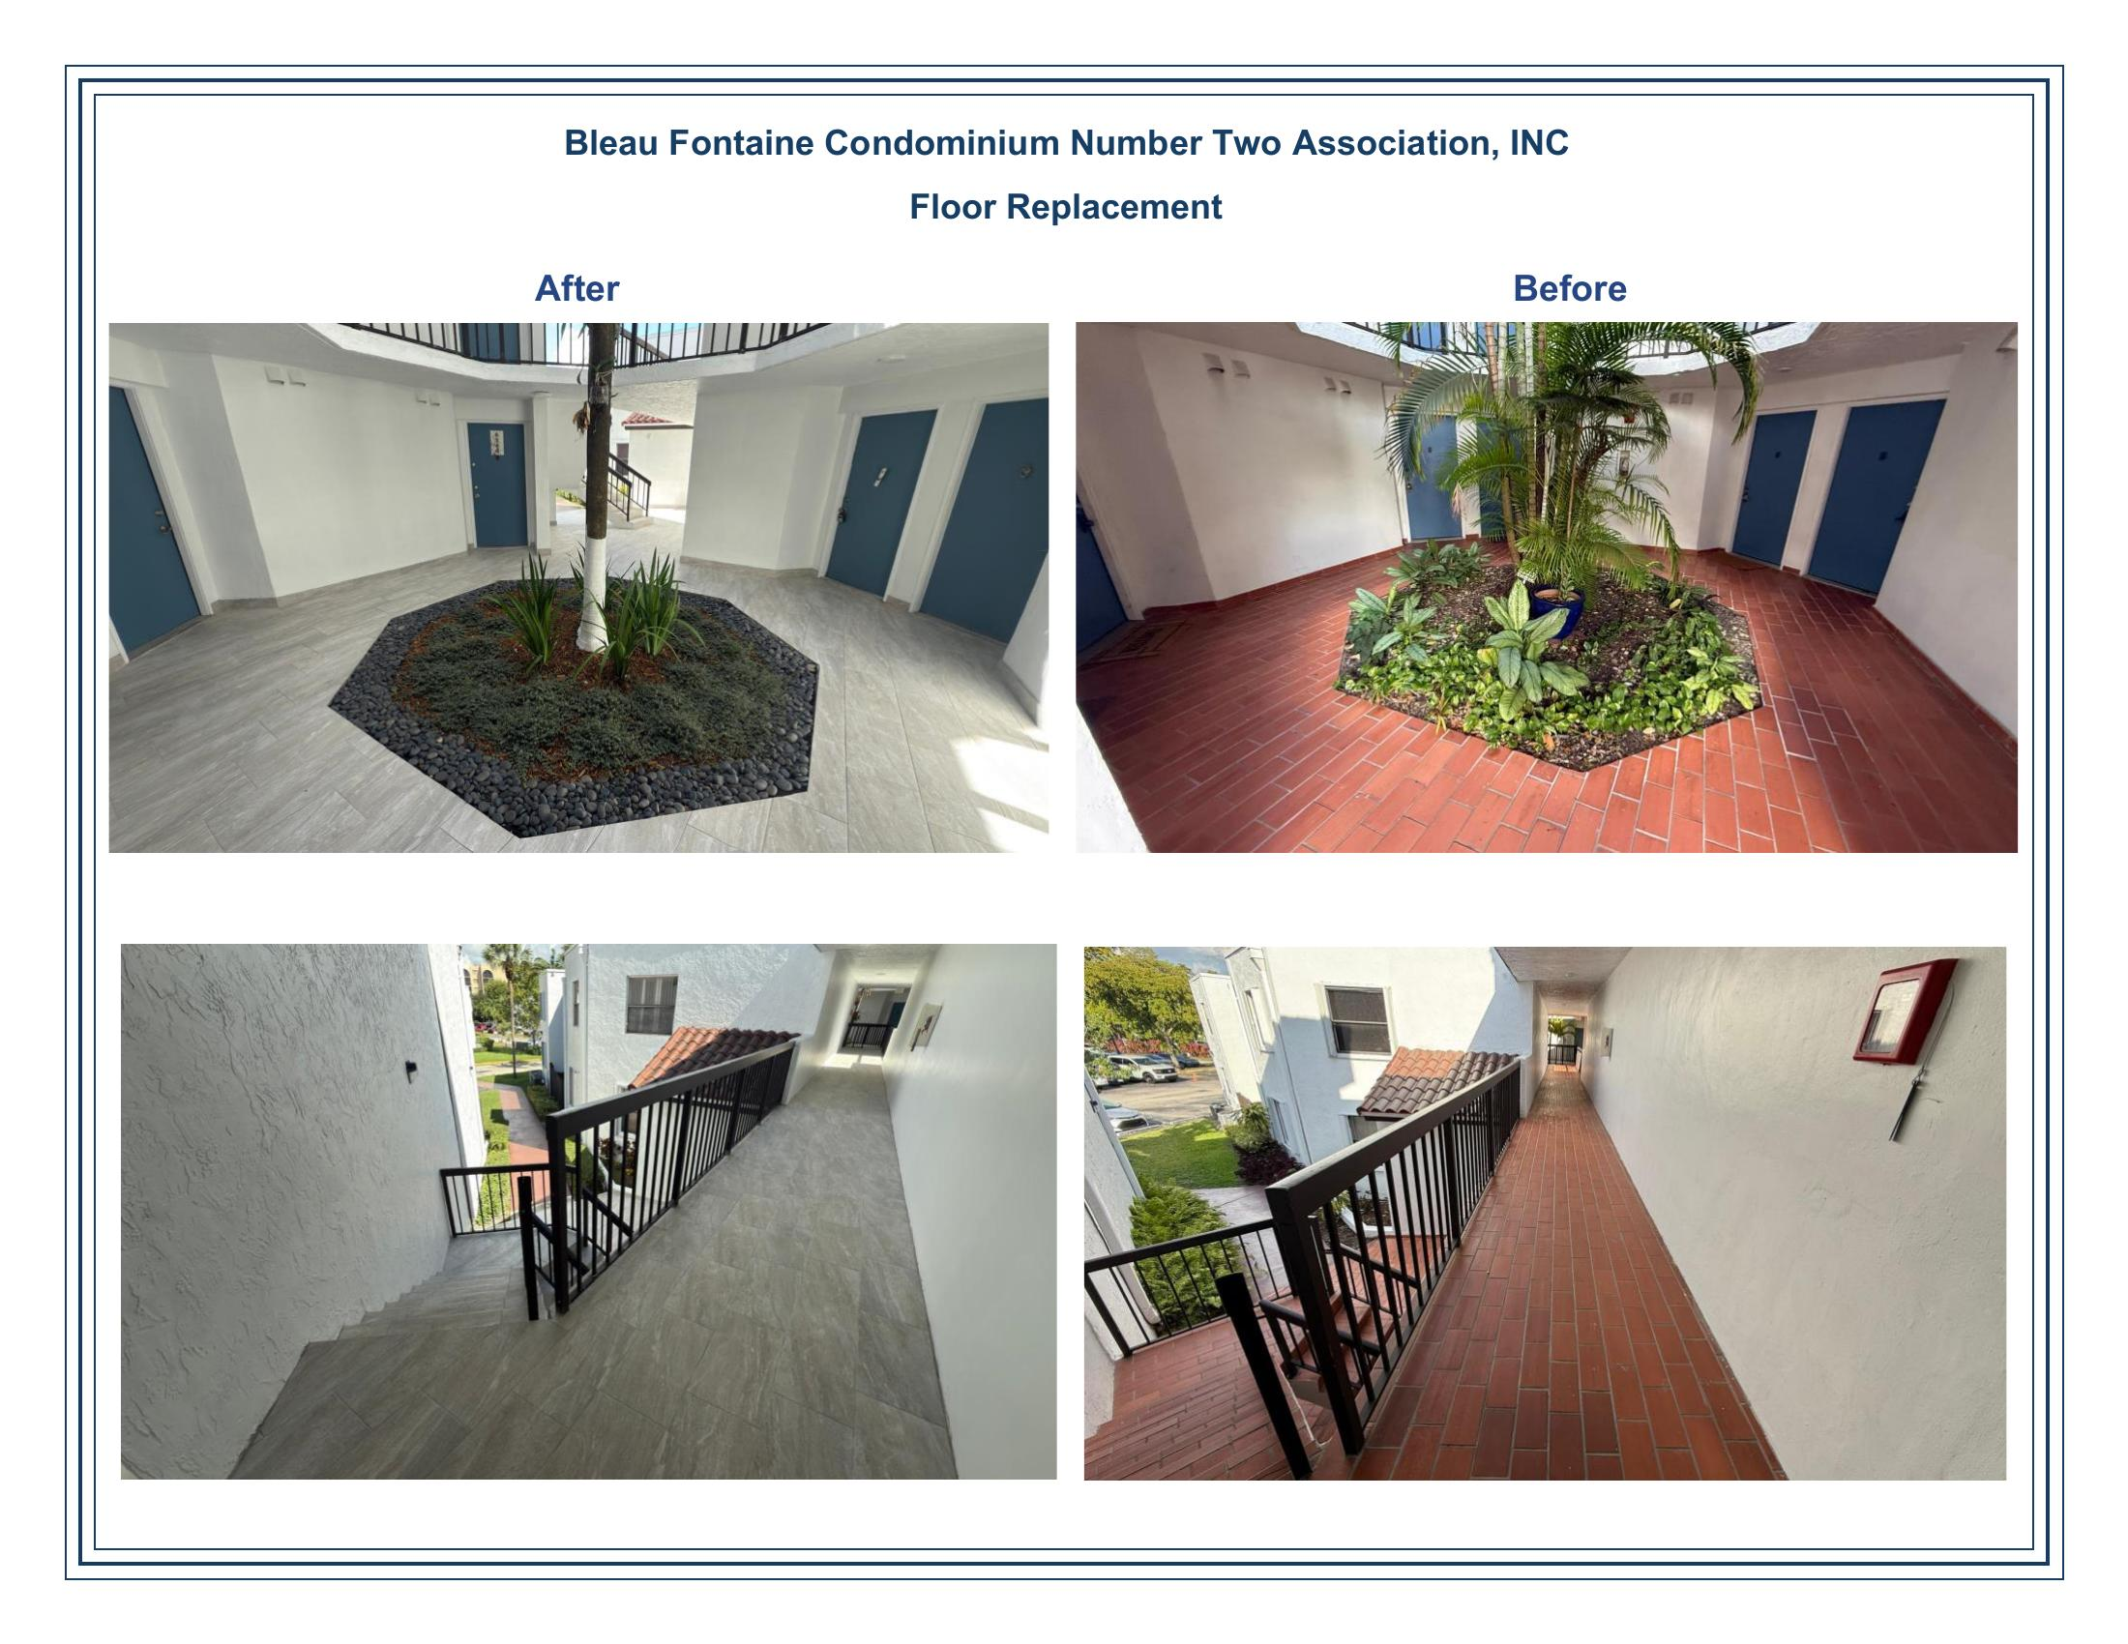
CAPITAL PROJECTS
Floor Replacement
Bleau Fontaine Condominium
Dated terracotta tile transformed into modern gray porcelain throughout lobbies, hallways, and stairwells.
Bid Solicitation
Competitive bids obtained and presented to the board
Material Selection
Board-approved porcelain with slip-resistant finish
Execution & Oversight
Daily monitoring with minimal disruption to residents
Final Inspection
Quality walkthrough and before/after documentation
Bleau Fontaine Condo No. 2

Slide 15
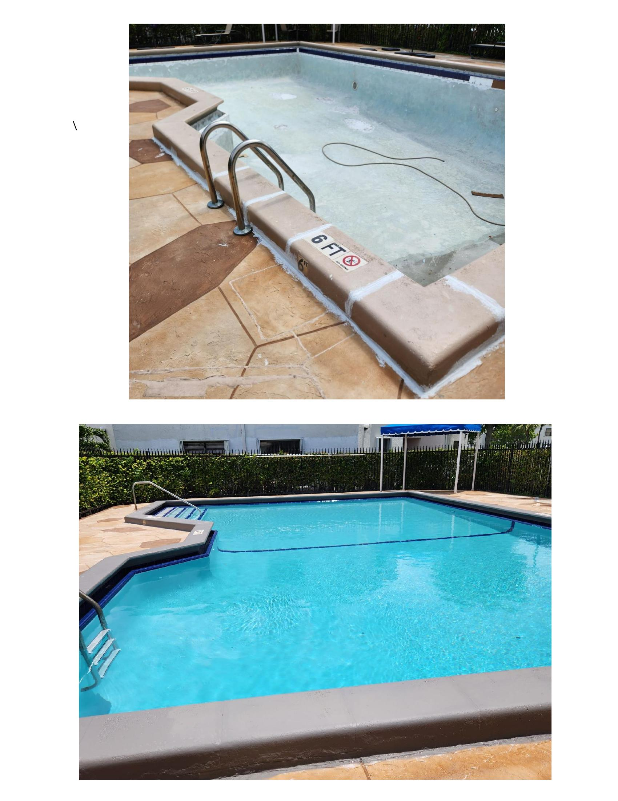
AMENITY MANAGEMENT
Pool Resurfacing & Maintenance
From draining to resurfacing to final fill — every step documented with photos and reported to the board. Our hands-on approach ensures quality control at every stage.
Emptied & Inspected
Resurfaced & Filled
Full drain, structural inspection, and surface assessment
New plaster application, chemical balance, and reopening
Photo Documented
Vendor Managed
Every phase captured and shared with the board
All contractors vetted, insured, and supervised on-site
Pool Management

Slide 16
05
Proactive Inspections
Detailed, photo-documented inspection reports that catch issues early and track resolution over time.

Slide 17
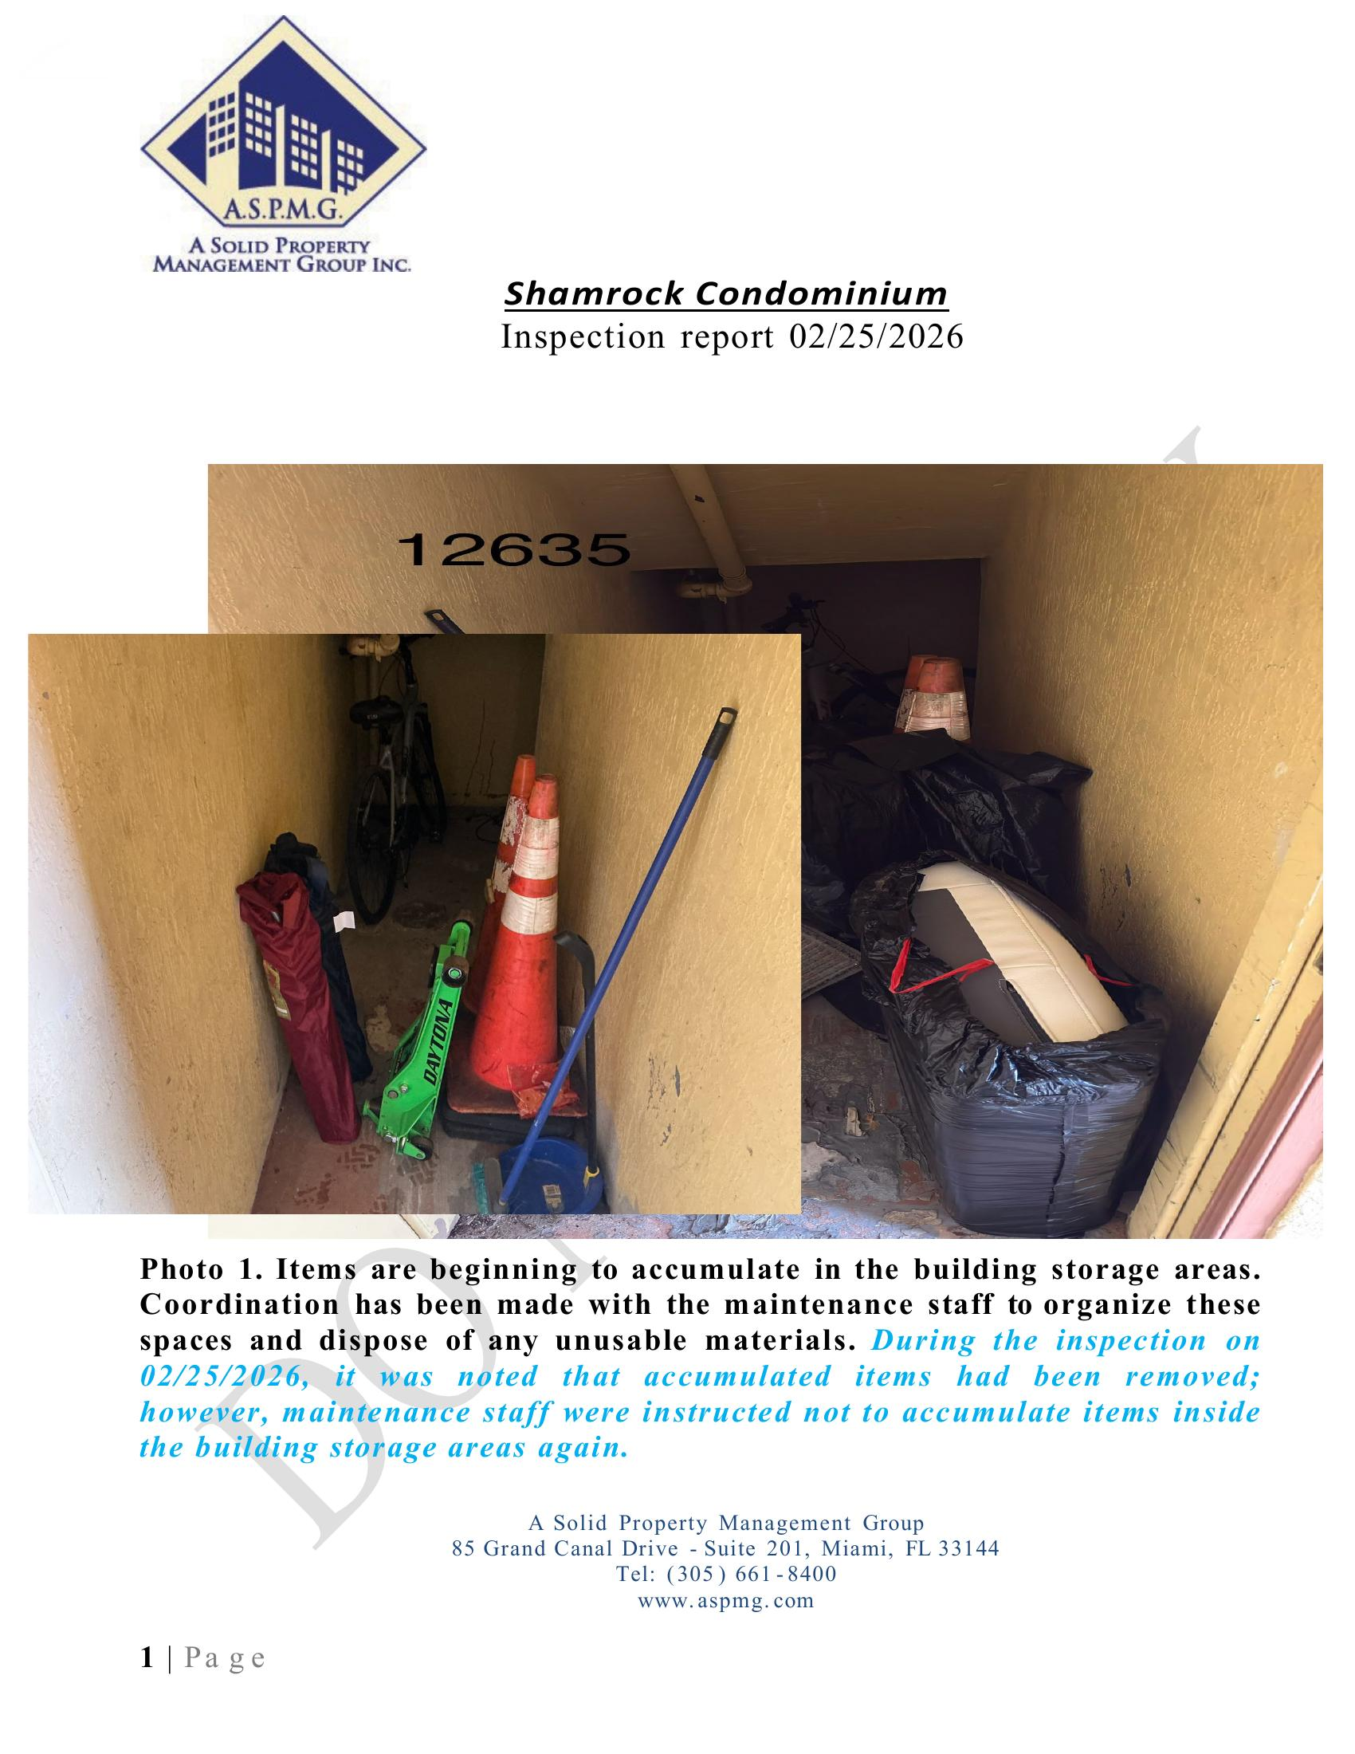
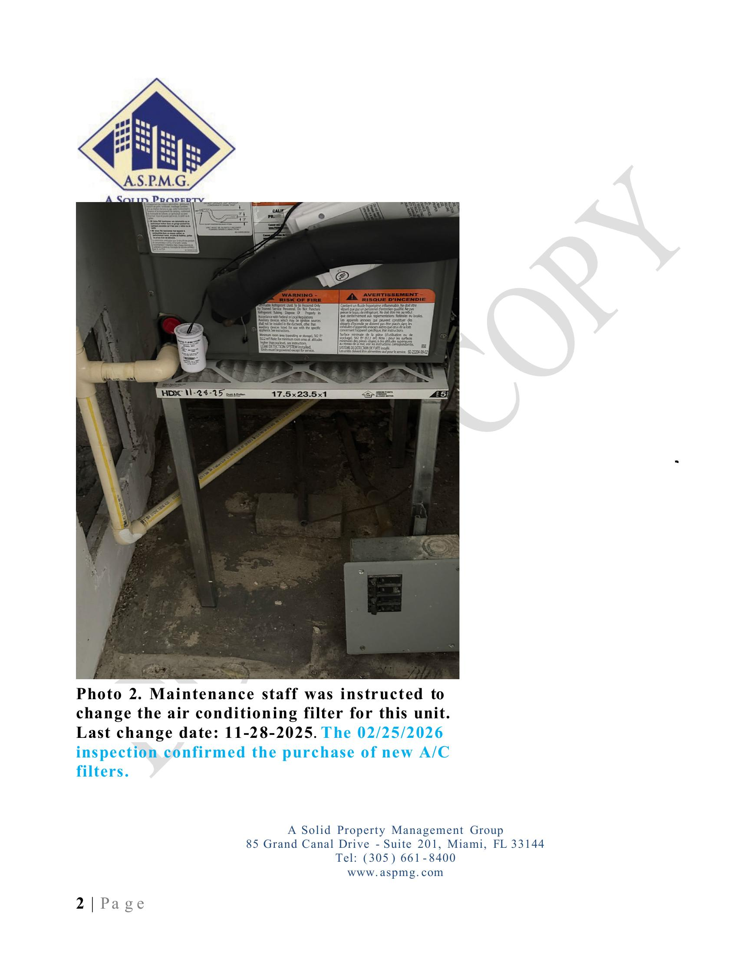
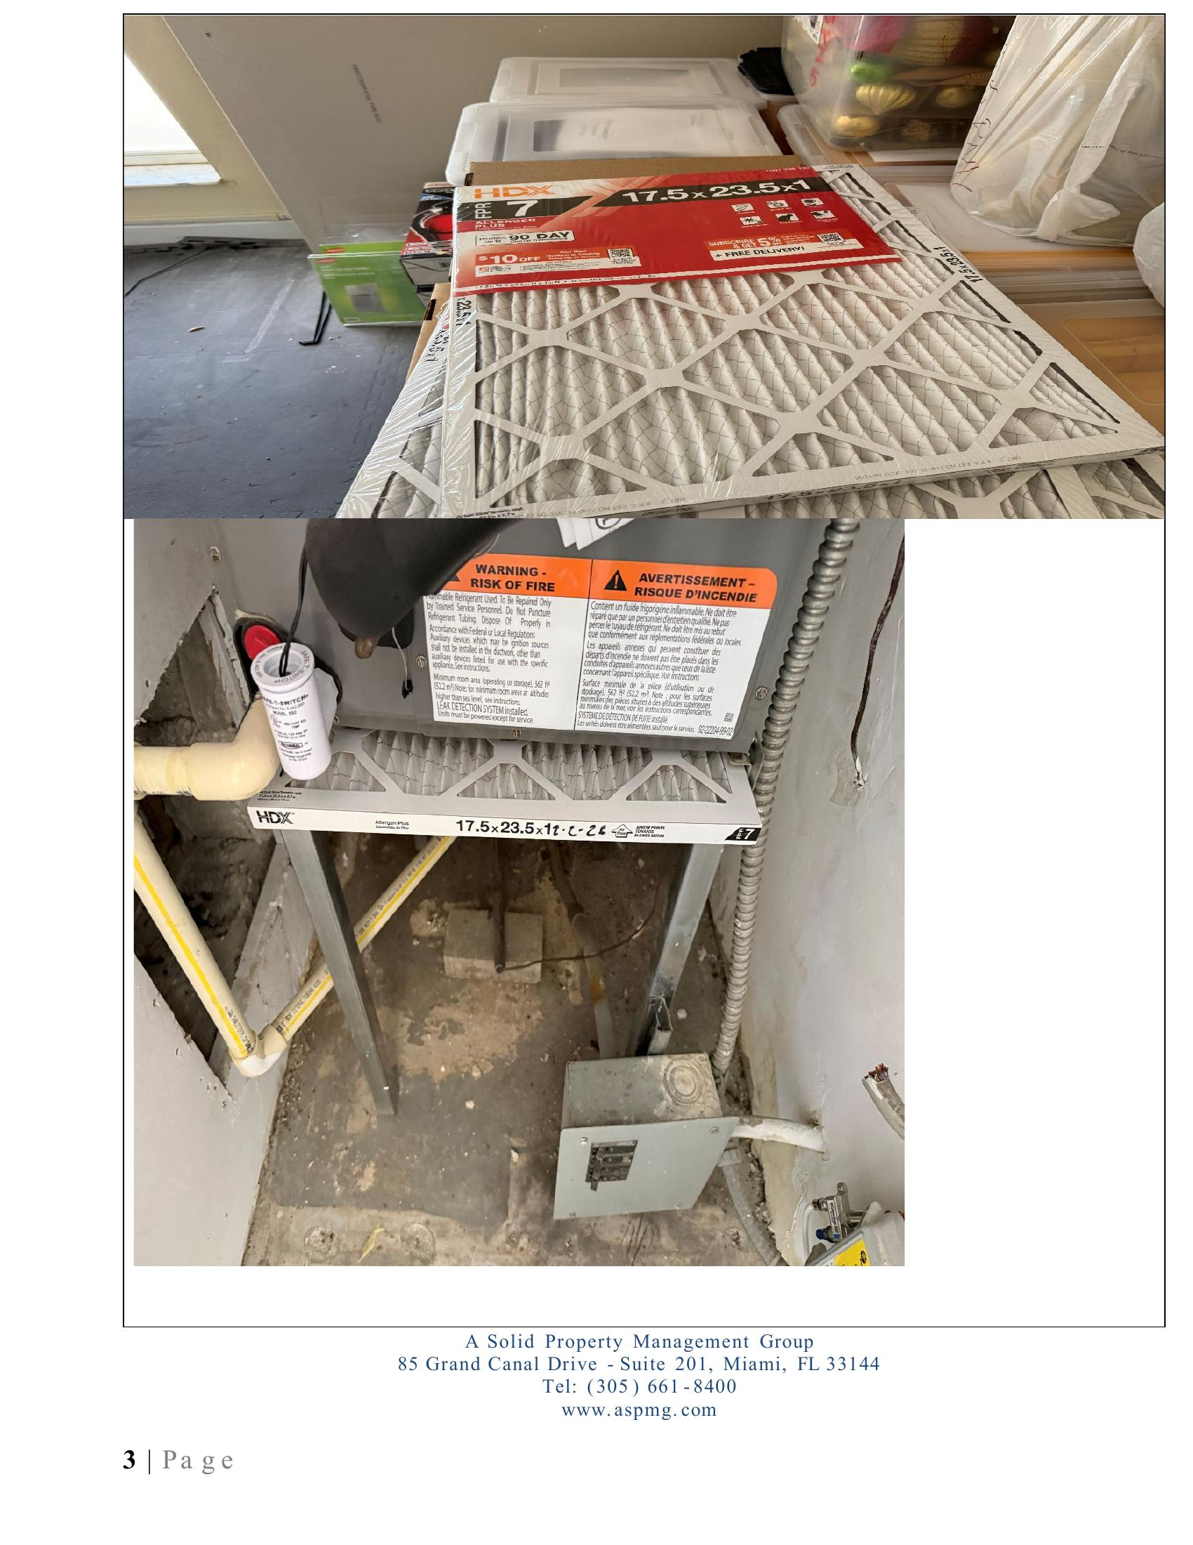
QUALITY ASSURANCE
Detailed Inspection Reports
Shamrock Condominium — Feb 2026
Regular on-site inspections with numbered photos, detailed descriptions, and follow-up tracking on every issue.
What We Document
• Storage compliance
• A/C filter tracking
• Fire alarm permits
• Lighting & electrical
• Common area violations
• Pool condition
• Landscaping
• Plumbing & structural
Full documentation Every observation numbered, photographed, and tracked with follow-up notes — issues identified, A/C filters logged with change dates, and resolutions confirmed on the next visit.
23
15+
Every
PAGES
PHOTOS
ISSUE TRACKED
Shamrock Condominium

Slide 18
OUR PROMISE
Total Transparency with Your Board
Every dollar accounted for. Every project documented. Every decision informed by data.
Monthly Financials
Photo Reports
Reserve Tracking
Open Communication
P&L, balance sheets, and bank reconciliations
Inspections and project updates with full imagery
Real-time funding status and projections
Direct line to your manager — always responsive
"An informed board makes better decisions. We provide more data, more often, and with more context than any other management company."
Board Transparency

Slide 19
THE RIGHT PARTNER
Why ASPMG for Your Community?
1.
Proven Financial Results
2.
Technology That Empowers
We grow reserves and eliminate debt. Our track record speaks through balance sheets, not promises.
ApplyHOA gives your board and residents 24/7 access to payments, documents, and real-time data.
3.
Hands-On Project Management
4.
Proactive, Not Reactive
Roofs, pools, paint — every detail overseen, every phase documented, delivered on time.
Detailed inspections catch problems before emergencies. We identify, document, and resolve.
5.
Insurance Expertise
6.
SB 4-D Compliance Ready
Saved Laguna Club $200K/year — same coverage. Portfolio leverage for rates no single association gets.
Reserves already restructured across our portfolio for Florida's structural integrity requirements.
Why ASPMG

Slide 20
Let's Build Something Great Together
We're ready to bring the same level of excellence, transparency, and innovation to your community.
PHONE (305) 661-8400
WEB www.aspmg.com
OFFICE 85 Grand Canal Dr, Suite 201
Miami, FL 33144
A SOLID PROPERTY MANAGEMENT GROUP INC. • CONFIDENTIAL • 2026

