Slide 1
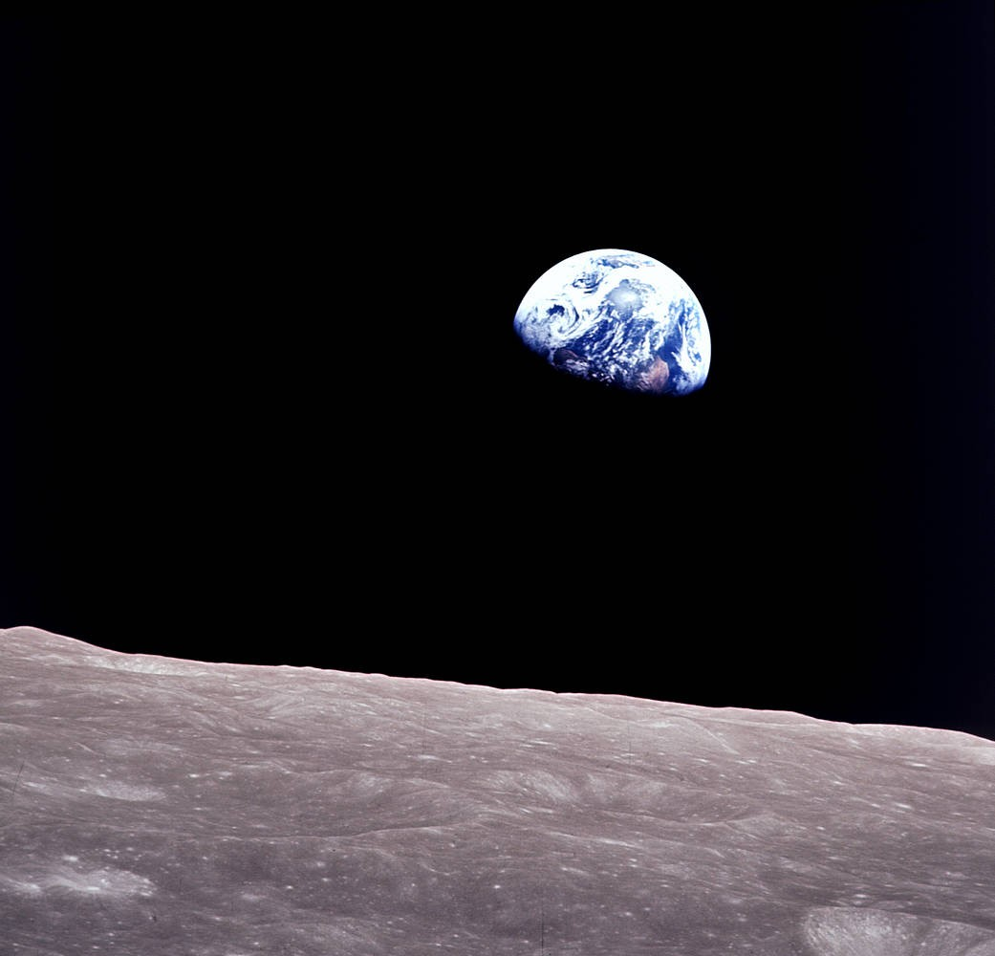
NASA SPACE APPS CHALLENGE
Where on
Earth?
Earth Event Lab
An iceberg investigation from space
Earthrise, 24 December 1968. NASA / Bill Anders.

Slide 2
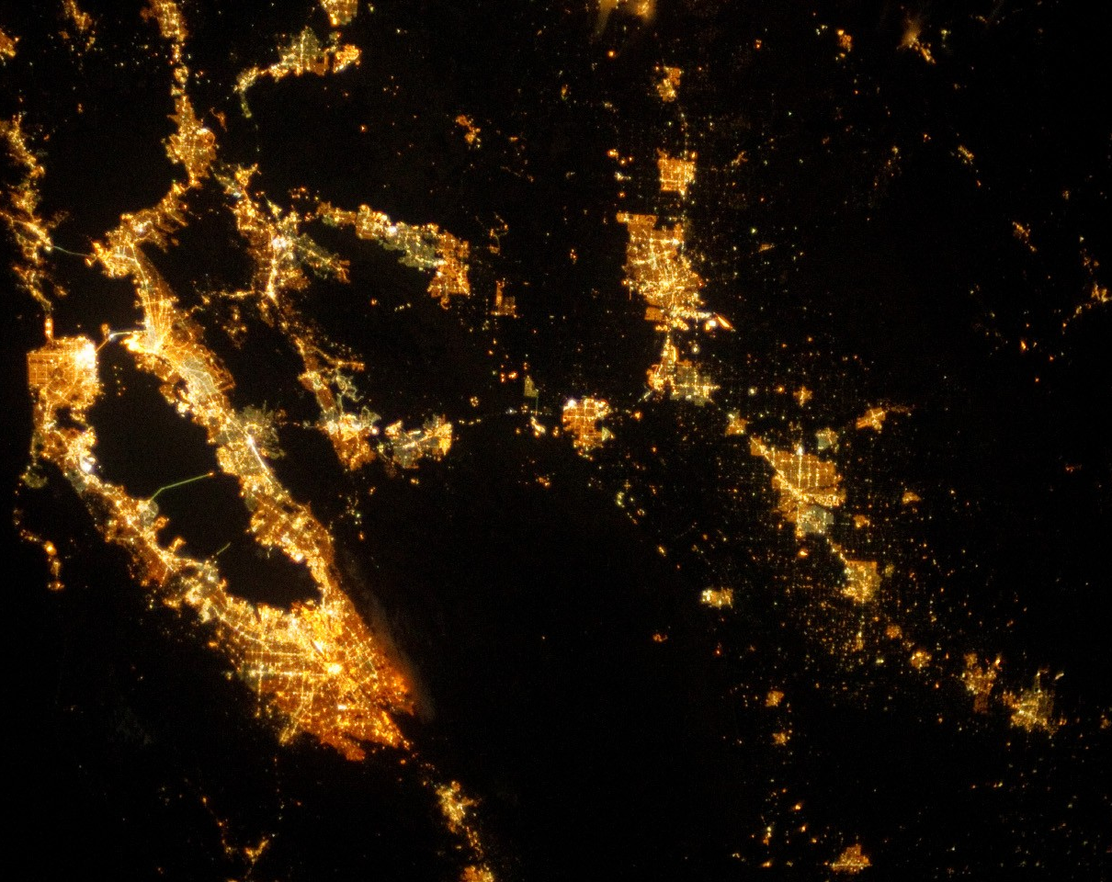
Where does the
city end?
Trace the dark edge with a finger. What would you add to the map to check your guess?
San Francisco Bay and the Central Valley, 25 September 2013. Astronaut photograph, NASA Johnson Space Center.

Slide 3
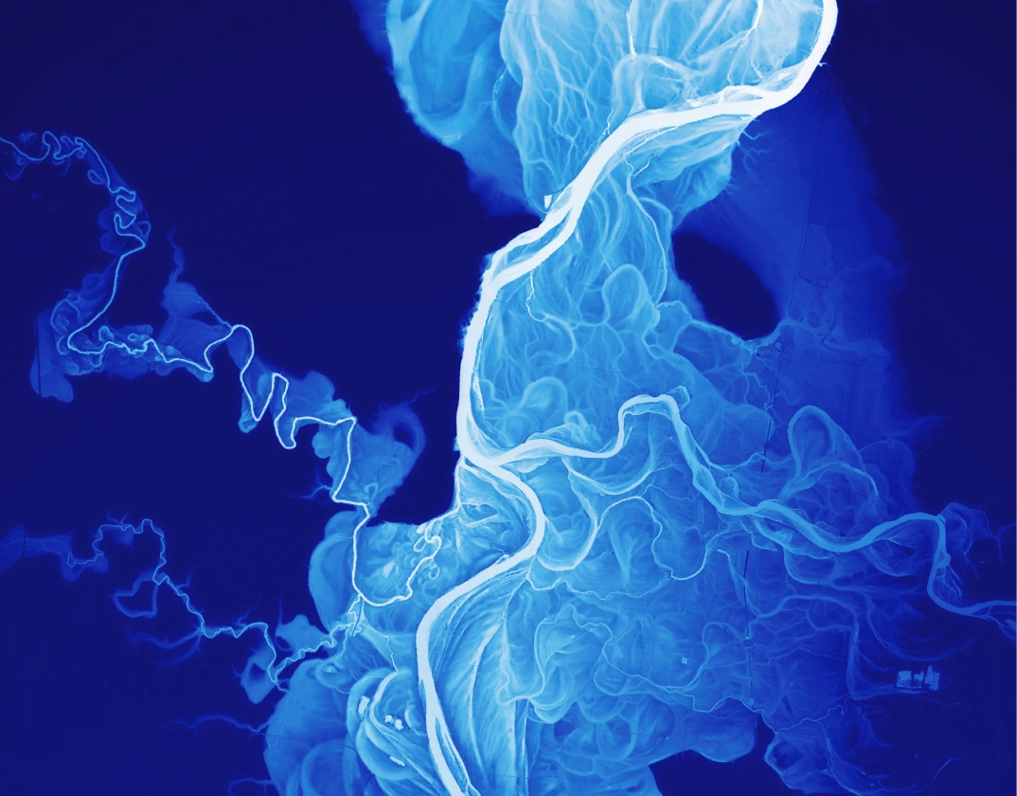
Can you trace
an old river?
Follow a pale loop away from the main channel.
White = lower ground
Dark blue = higher ground
Willamette River, Oregon • Detail of a lidar elevation map by Daniel E. Coe, Oregon Department of Geology and Mineral Industries.

Slide 4
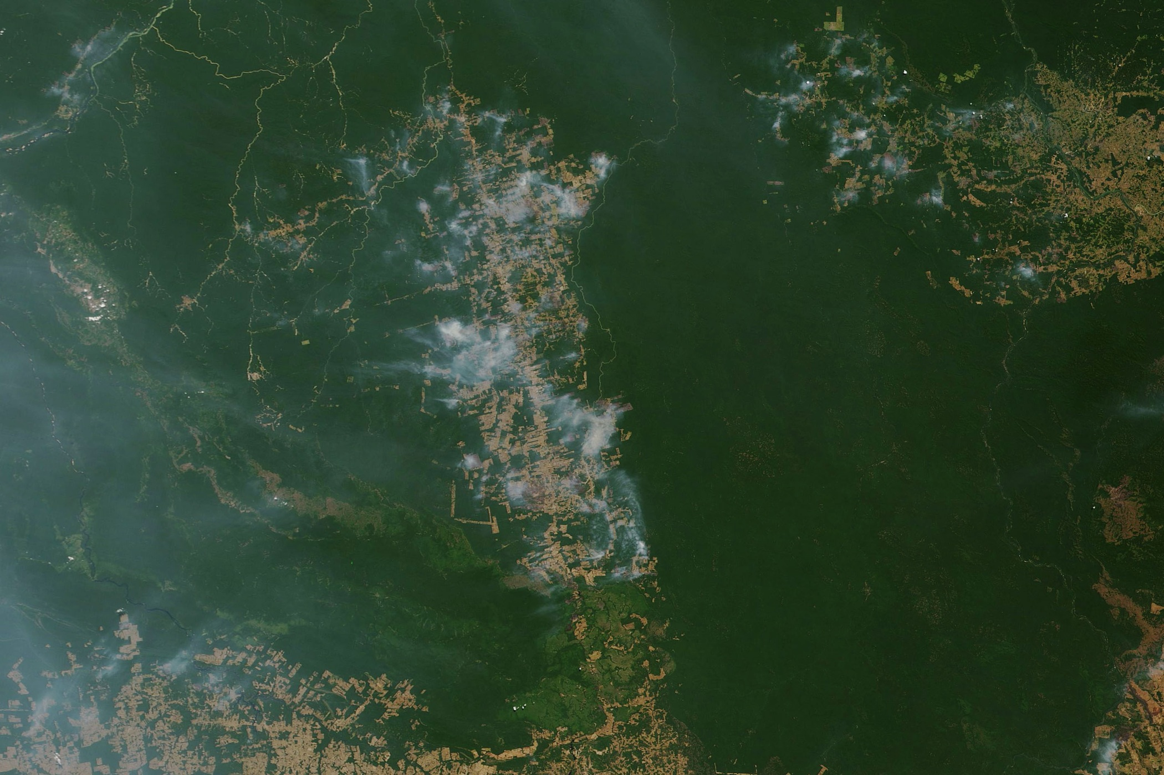
Where does the smoke begin?
Pick a plume. What would you map to find communities downwind?
Near Novo Progresso, Brazilian Amazon • 19 August 2019 • Terra/MODIS • NASA Earth Observatory, Joshua Stevens.

Slide 5
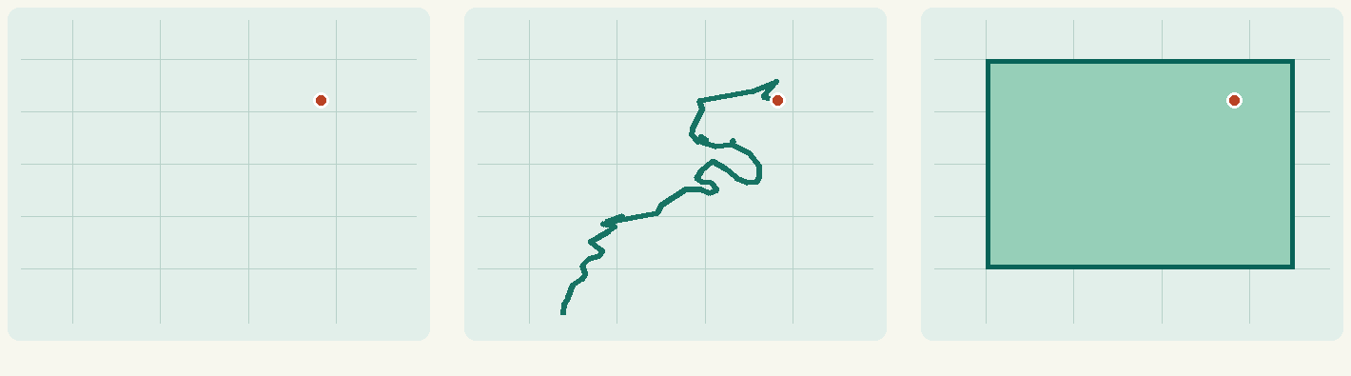
What shape would you map?
Point
Polyline
Polygon
One dated location
A sequence of positions
An area with a boundary
A-23A in the South Atlantic. The green polygon is our study box. Which shape would describe the ice edge?

Slide 6
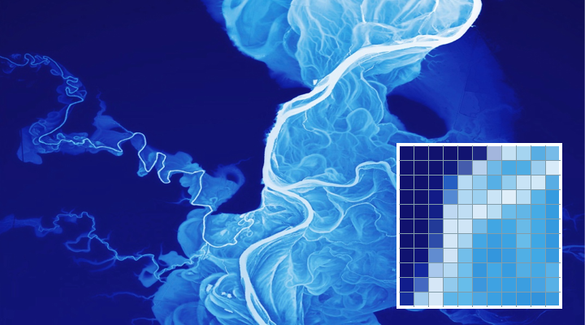
Pixels or features?
Raster
A grid of values. An elevation cell stores height. An image pixel can store brightness.
Vector
Features keep coordinates and attributes. One pin can carry a date and a source.
Which dataset would you use to read ground height? Which would you use to select one named iceberg?

Slide 7
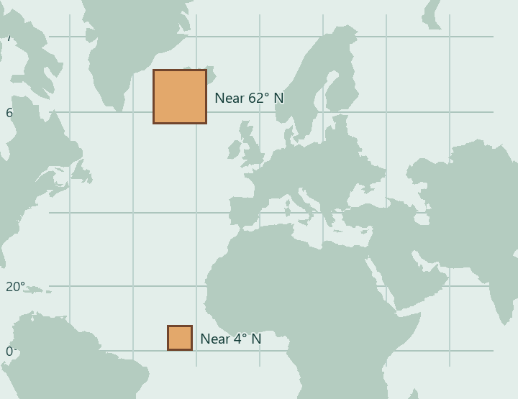
Why does the northern square grow?
Coordinates give a position
Our WGS 84 values use longitude and latitude in degrees.
A projection draws it flat
Web Mercator enlarges high latitudes. Use an equal-area projection to compare areas.
Both patches are roughly 900 km per side on Earth. Coastlines from Natural Earth.

Slide 8
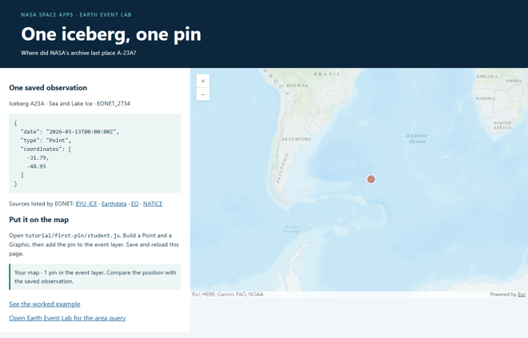
What loads when you zoom?
Basemap
Land, coastlines and labels give the event a geographic frame.
Tiles
The map requests small pieces at each zoom level. Raster tiles are images. Vector tiles carry features to style.
Pan across the ocean. The map requests other tiles. Predict whether the iceberg count changes.

Slide 9
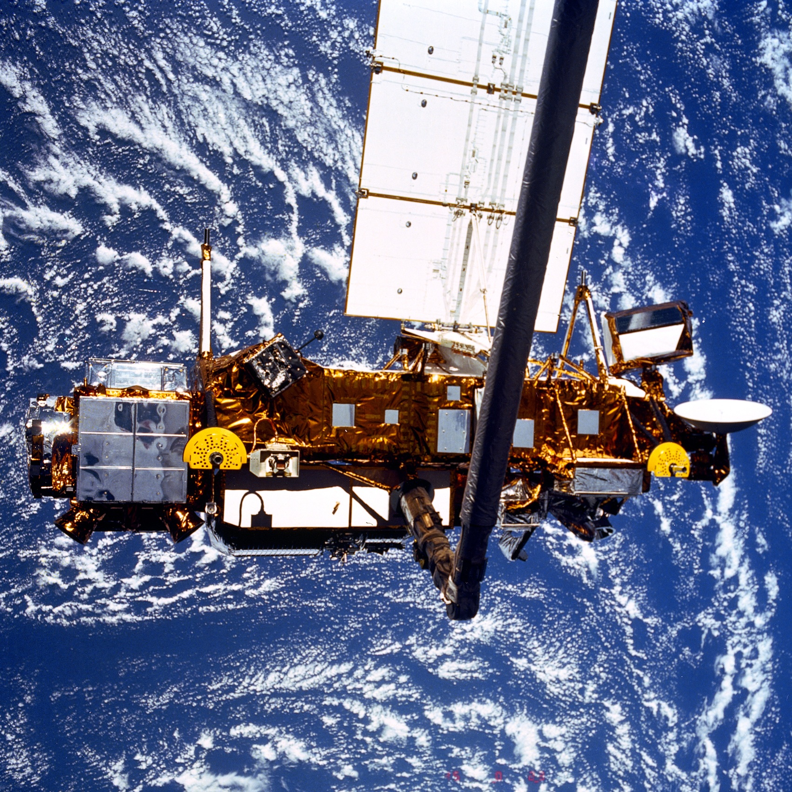
What can a satellite
measure from here?
This one studied Earth’s upper atmosphere. What could an instrument detect that our eyes miss?
Upper Atmosphere Research Satellite above Earth • Space Shuttle Discovery, 15 September 1991 • NASA, photo MSFC-9254338.

Slide 10
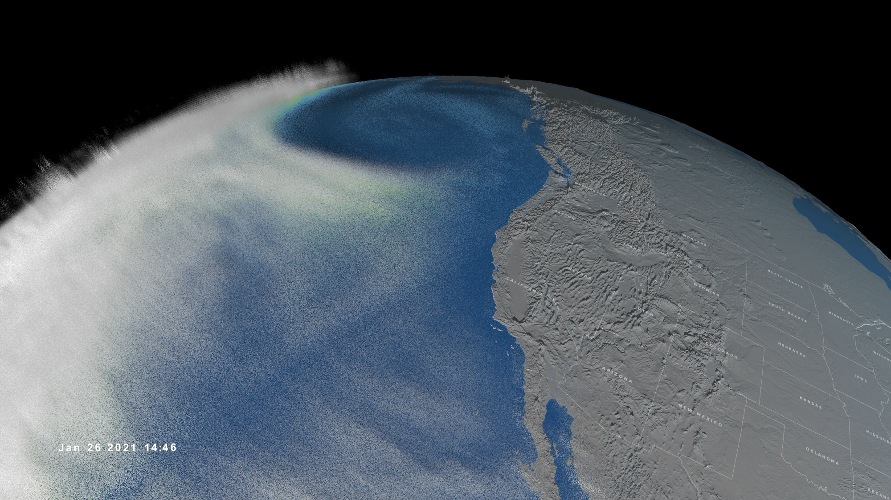
A river in the sky?
Trace the white band toward land. Which coast would you investigate first?
Pacific coast • 26 January 2021, 14:46 UTC • NOAA-20 atmospheric measurements • NASA’s Scientific Visualization Studio.

Slide 11
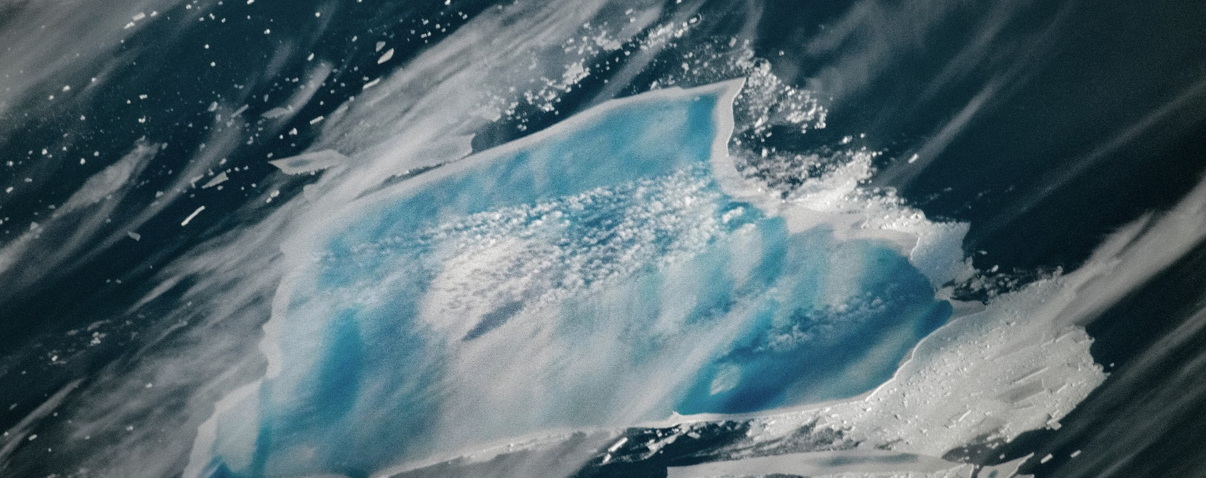
Why is the ice blue?
Look for a clue at the white rim. Compare guesses with a partner.
International Space Station, 27 December 2025. NASA Johnson Space Center.

Slide 12
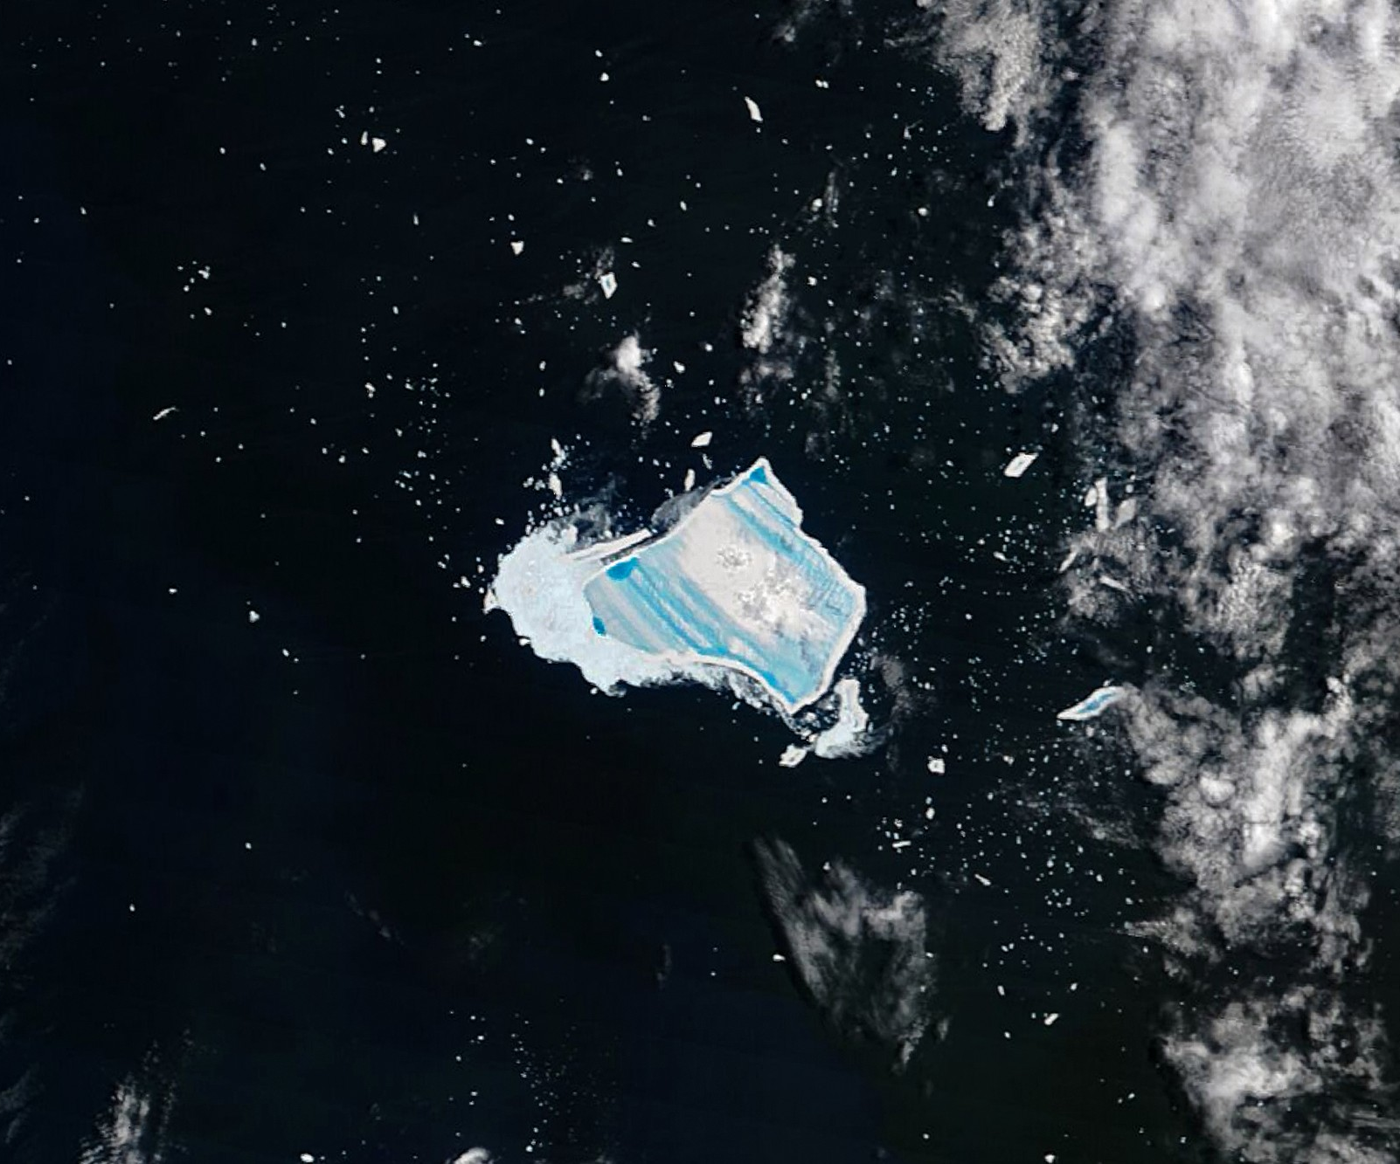
Pools on a
floating iceberg
A day earlier, NASA’s Terra satellite saw the same iceberg. Meltwater had collected across its surface.
How would you find this piece of ice again once it drifted?
A-23A in the South Atlantic, 26 December 2025. Terra MODIS satellite image, NASA Earth Observatory / Michala Garrison.

Slide 13
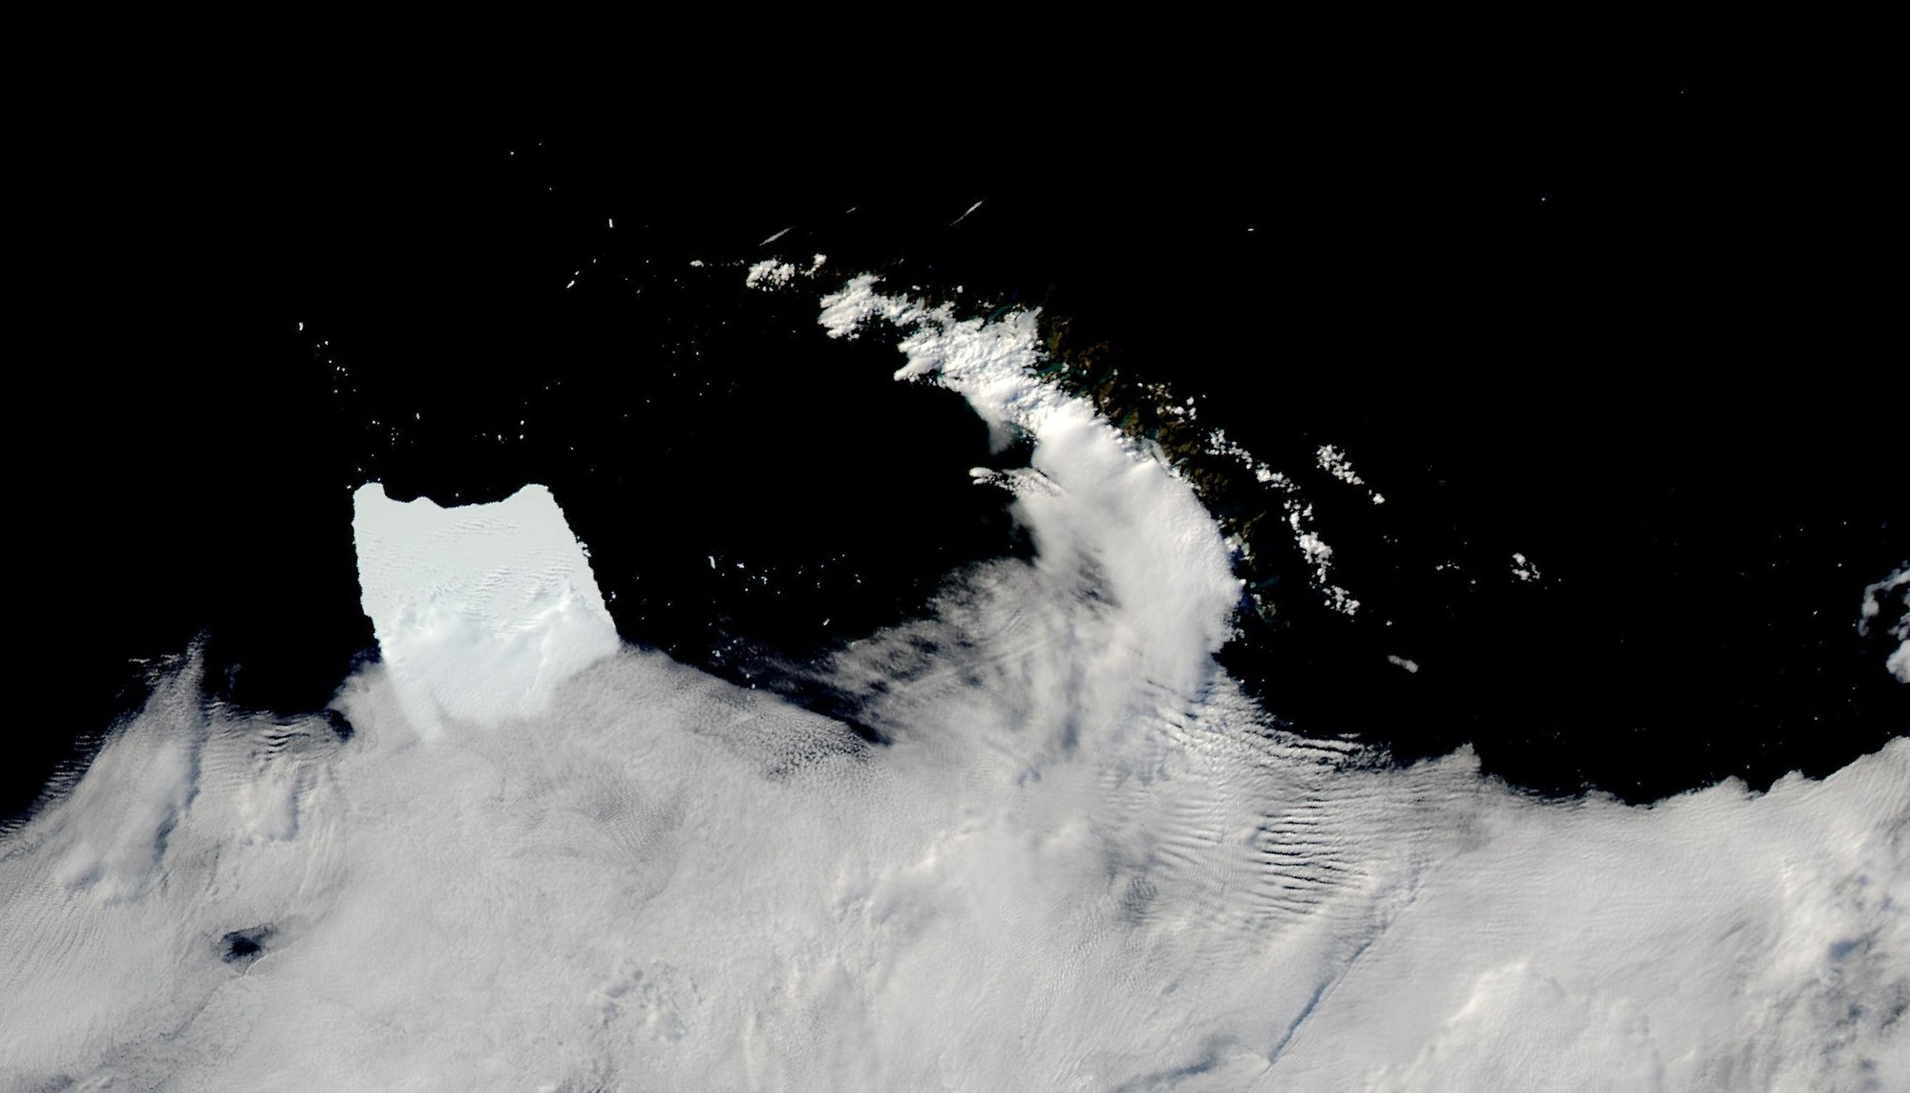
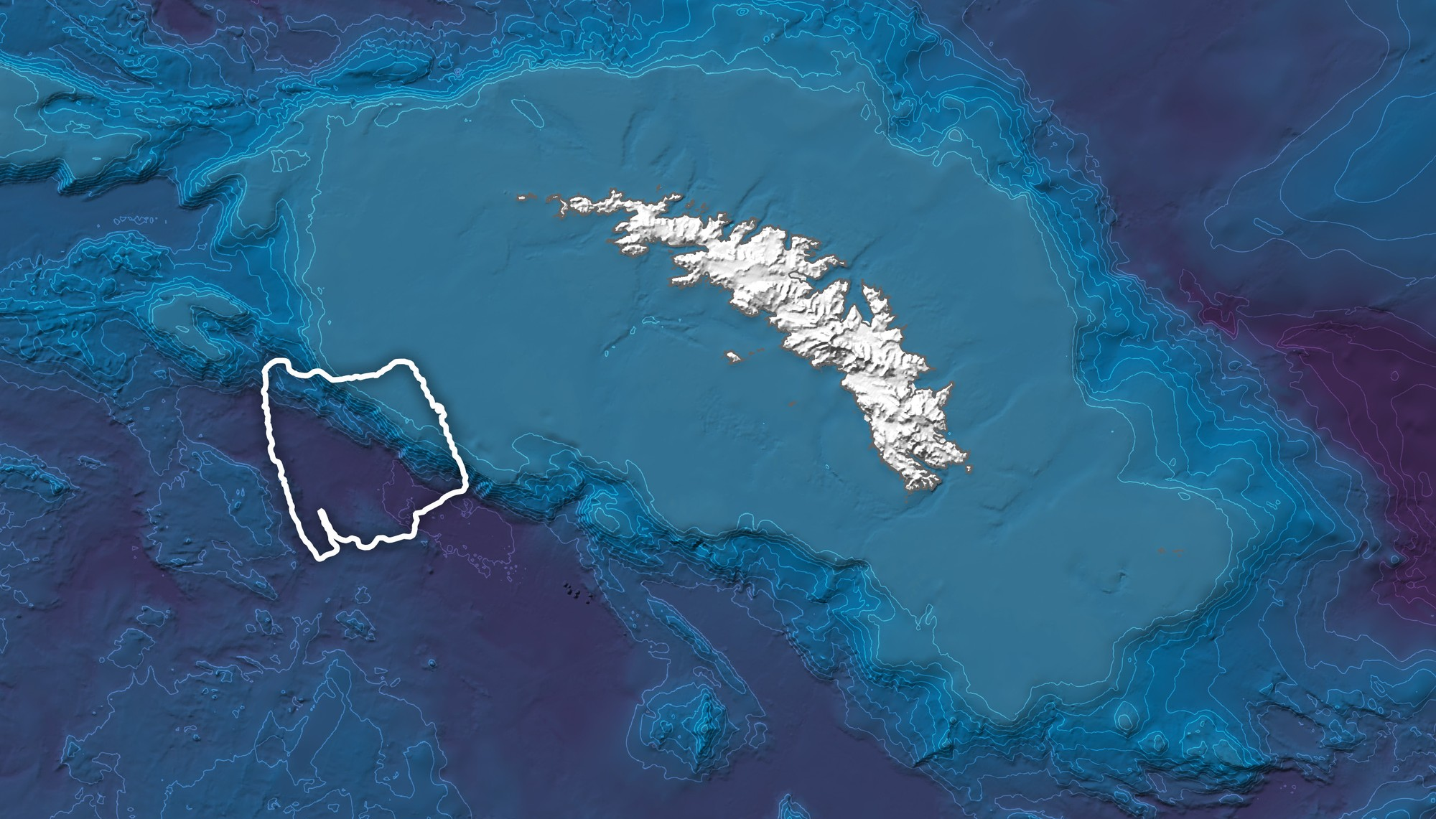
Why did the iceberg stop here?
What the satellite saw
What lies under the water
The outline of the ice meets the shallow shelf. A geographic information system (GIS) lets us compare these layers at the same place.
South Georgia, 4 March 2025. Satellite image and seafloor map, NASA Earth Observatory / Wanmei Liang. Aqua MODIS, GEBCO and British Antarctic Survey data.

Slide 14
Who does what on this map?
NASA EONET
Which events were reported, where and when?
ArcGIS Pro
Esri’s desktop GIS for preparing layers and analyzing terrain.
ArcGIS Maps SDK
Esri’s JavaScript tools draw our events in a browser.
Explore EONET reports for wildfires, severe storms, volcanoes or sea and lake ice.

Slide 15
Which mapping tool fits the job?
Esri ArcGIS
Prepare and analyze layers in Pro. Build a web or native GIS app.
Mapbox GL JS
Style an interactive vector map with Mapbox’s web renderer.
MapLibre GL JS
Use an open-source renderer with a compatible tile source.
Google Maps Platform
Show a Google map or look up nearby places.
The renderer, the data source and service credentials are separate choices.

Slide 16
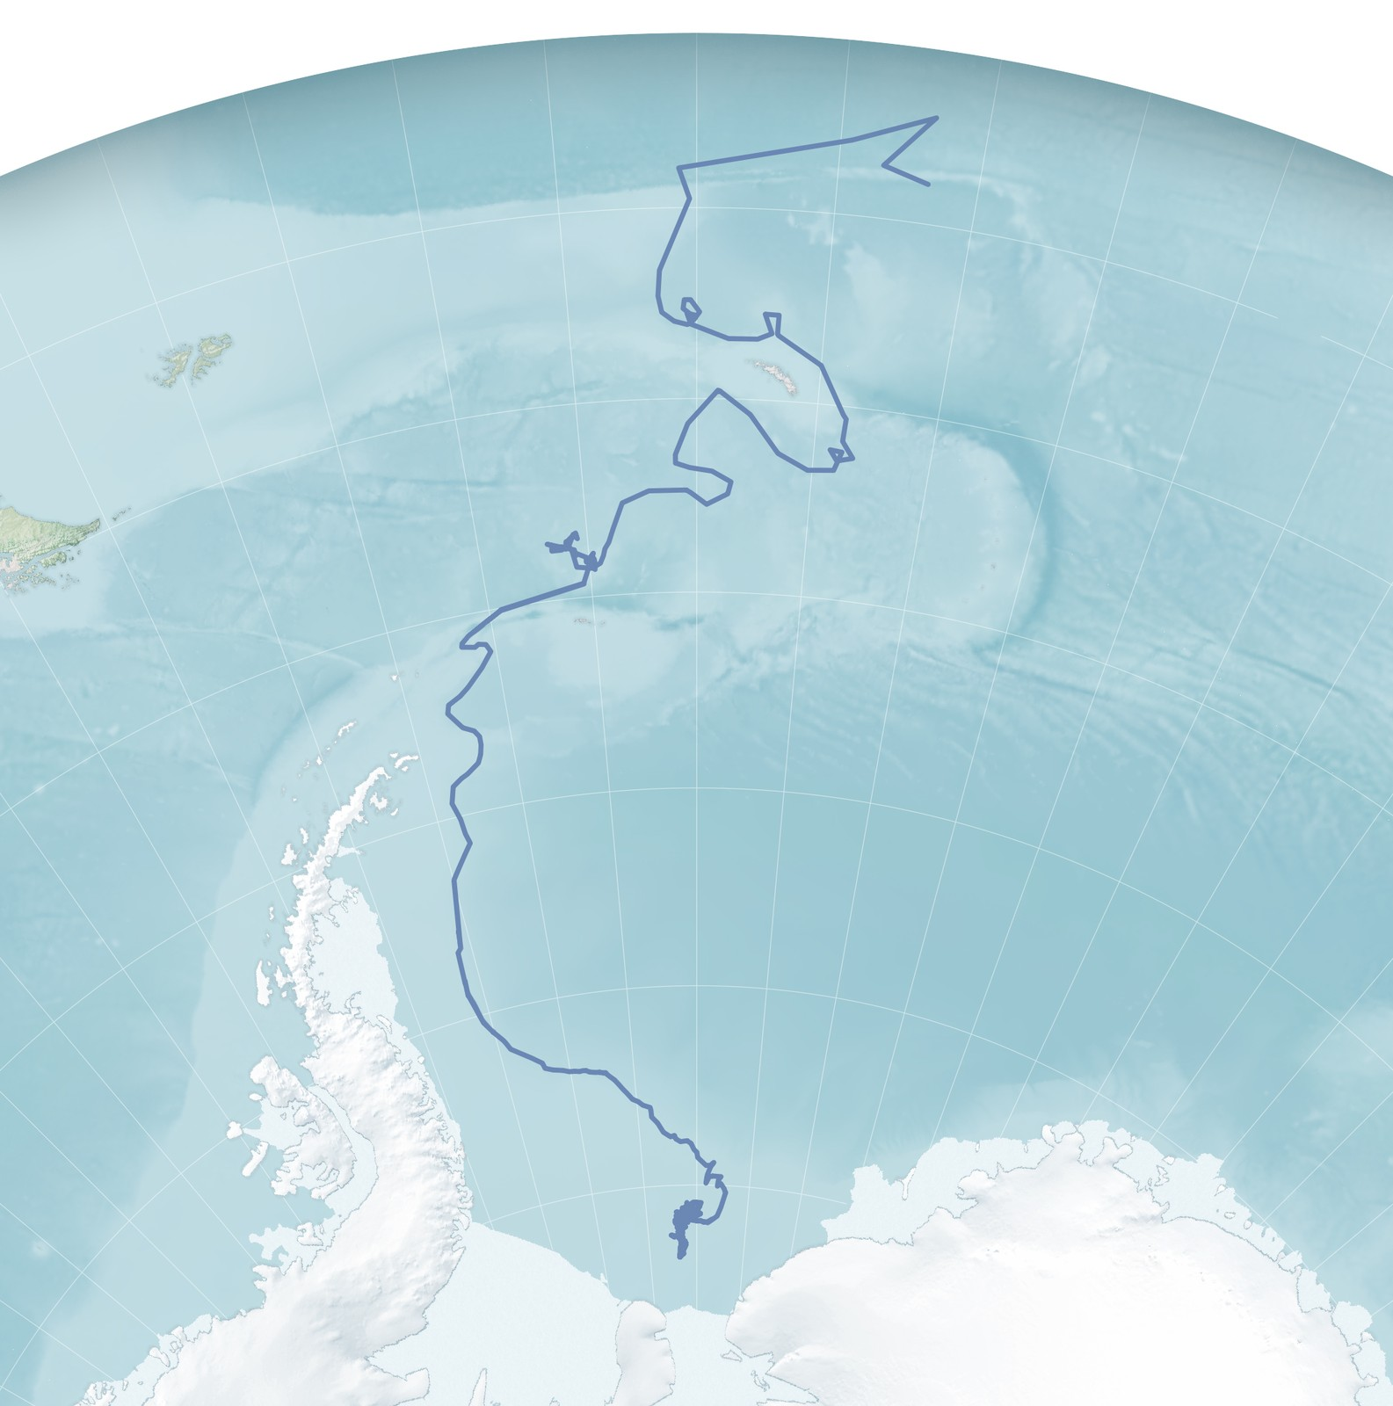
Which day does
a pin show?
NASA’s Earth Observatory Natural Event Tracker (EONET) lists 72 dated positions for A-23A in our sample.
Latest point in the app
13 March 2026
31.79° W, 48.95° S
Track map by Michala Garrison, NASA Earth Observatory, using USNIC and BYU data. The map and the workshop sample cover different observation dates.

Slide 17
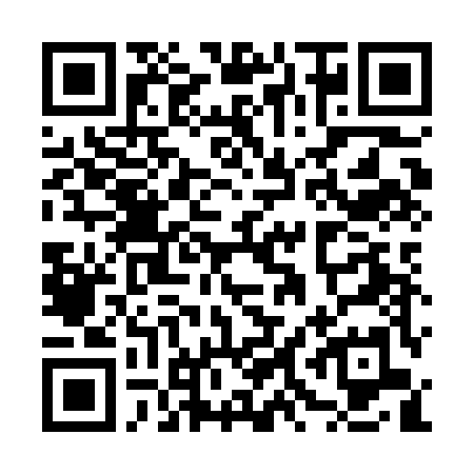

Open the workshop files
Workshop repository
NASA data you can try now
Placeholder for the class link
Scan for up to five sea and lake ice records.
Workshop GitHub
Open the NASA feed
Open the workshop folder that contains application, tutorial and sample-data.
The shared file sample-data/eonet-snapshot.json gives everyone the same 48 archived events.

Slide 18
Run the map on your laptop
Open a terminal in the workshop folder.
Windows
py -m http.server 8000
macOS / Linux
python3 -m http.server 8000
Open http://localhost:8000/tutorial/first-pin/
Keep the terminal open. You should see Iceberg A23A and a practice map with 0 pins.

Slide 19
Which two numbers place the pin?
Iceberg A23A / EONET_2734 / JSON excerpt
{
"date": "2026-03-13T00:00:00Z",
"type": "Point",
"coordinates": [-31.79, -48.95]
}
Longitude comes first.
Latitude comes second.
Which hemisphere does each minus sign indicate?
EONET v3 API eonet.gsfc.nasa.gov/api/v3/events
Open the practice map. Find the observation date and one reporting source.

Slide 20
What is GeoJSON?
It is a file format for geographic features. Geometry locates the feature. Properties describe it.
{
"type": "Feature",
"geometry": { "type": "Point", "coordinates": [-31.79, -48.95] },
"properties": { "title": "Iceberg A23A", "date": "2026-03-13" }
}
Open sample-data/a23a.geojson. Which field would you change to draw a different location?

Slide 21
Build one pin
Open tutorial/first-pin/student.js. The first line is already there.
const [longitude, latitude] = observation.coordinates;
const point = new Point({ longitude, latitude });
const pin = new Graphic({ geometry: point, symbol });
eventsLayer.add(pin);
Save and reload. Is your marker near 32° W, 49° S?

Slide 22
Which icebergs fall inside our box?
Open Earth Event Lab. Choose Use sample data, then Sea and Lake Ice.
West
East
South
North
−60°
−25°
−65°
−45°
Make a prediction. Enter the four bounds, choose Apply geographic box, and record the names you find.
In this archive, the category contains 12 ice records. Each contributes its latest valid point.

Slide 23
Which iceberg drops out?
Keep the other edges fixed. Move North from −45° to −50°.
Inside the first box | Latest latitude | Observation date
Iceberg A23A | 48.95° S | 13 Mar 2026
Iceberg A23J | 52.86° S | 16 Jan 2026
Iceberg D33D | 63.78° S | 23 Jul 2026
Predict with a partner, then apply the change. Point to the latitude that explains your result.
Latest valid point for each matching event in the 12 November 2026 workshop sample. All three longitudes are inside the original box.

Slide 24
Ask the same question in PostGIS
PostGIS adds geographic types and spatial queries to a PostgreSQL database.
SELECT title FROM events
WHERE ST_Intersects(geom,
ST_MakeEnvelope(-60, -65, -25, -50, 4326));
West, south, east, north. 4326 identifies WGS 84.
Our example table has the three ice points from the first box. Which two rows will the query return?

Slide 25
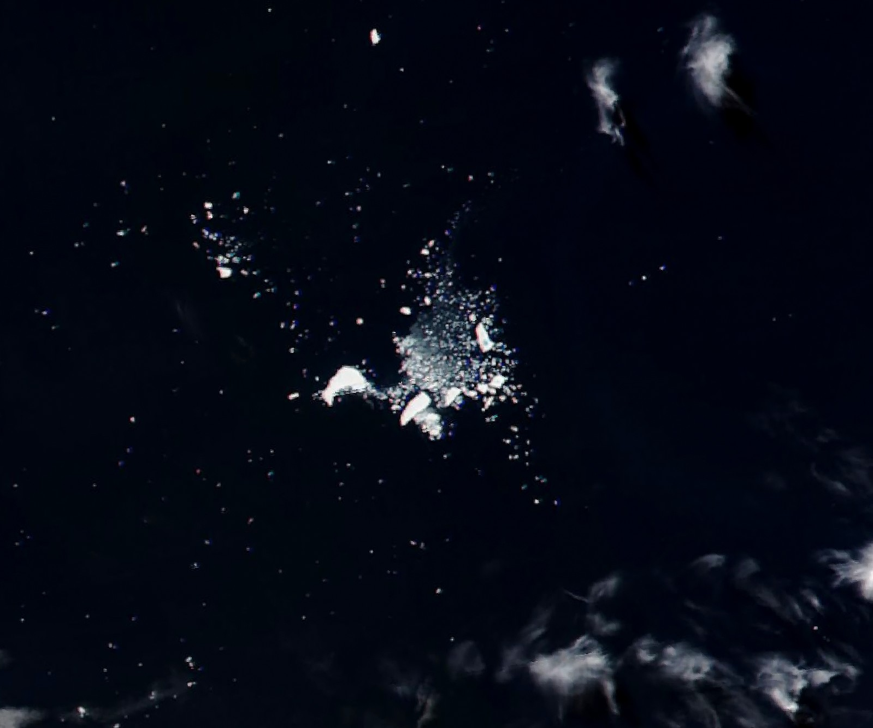
What became
of A-23A?
13 March 2026
The last position in our sample.
3 April 2026
A satellite saw scattered pieces.
South Atlantic, 3 April 2026. NOAA-21 VIIRS satellite image, NASA Earth Observatory / Michala Garrison.

Slide 26
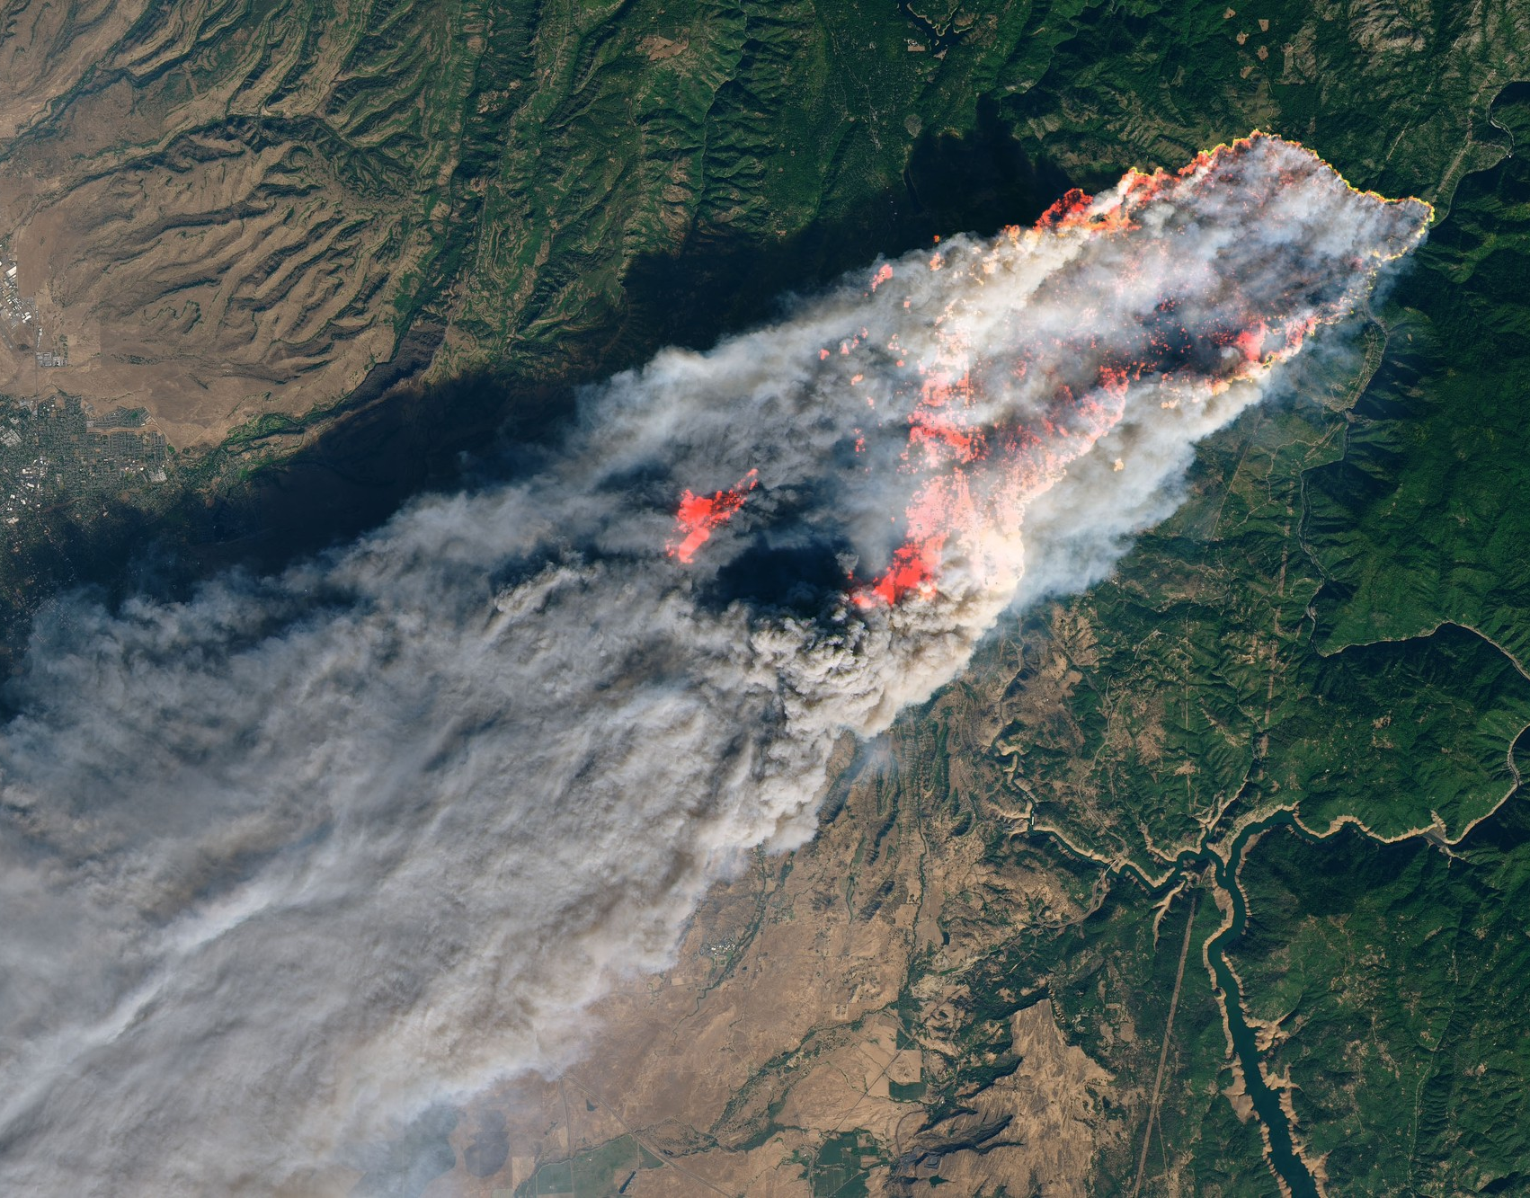
Which towns
were under
this smoke?
A fire report gives you a location. What would you layer over this image to investigate a town downwind?
Camp Fire, California, 8 November 2018. Landsat 8 satellite image using visible light and shortwave infrared to highlight fire. NASA Earth Observatory / Joshua Stevens, USGS data.

Slide 27
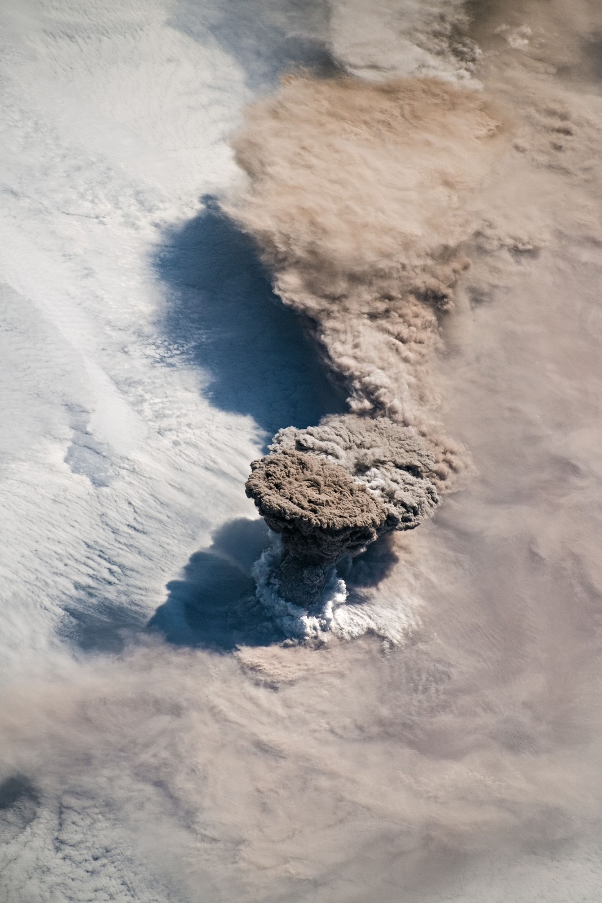
Where did the
ash go next?
An astronaut caught Raikoke erupting. Which observation would help you follow the plume an hour later?
Choose the time and the layer your map would need.
Raikoke, Kuril Islands, 22 June 2019. International Space Station photograph, NASA Johnson Space Center.

Slide 28
Could a model spot the smoke?
GeoAI uses models to recognize patterns in geographic data. Could one outline the smoke in this image?
How would you catch a cloud marked as smoke?
Amazon fires, 19 August 2019 • NASA Earth Observatory / Joshua Stevens, Terra MODIS.

Slide 29
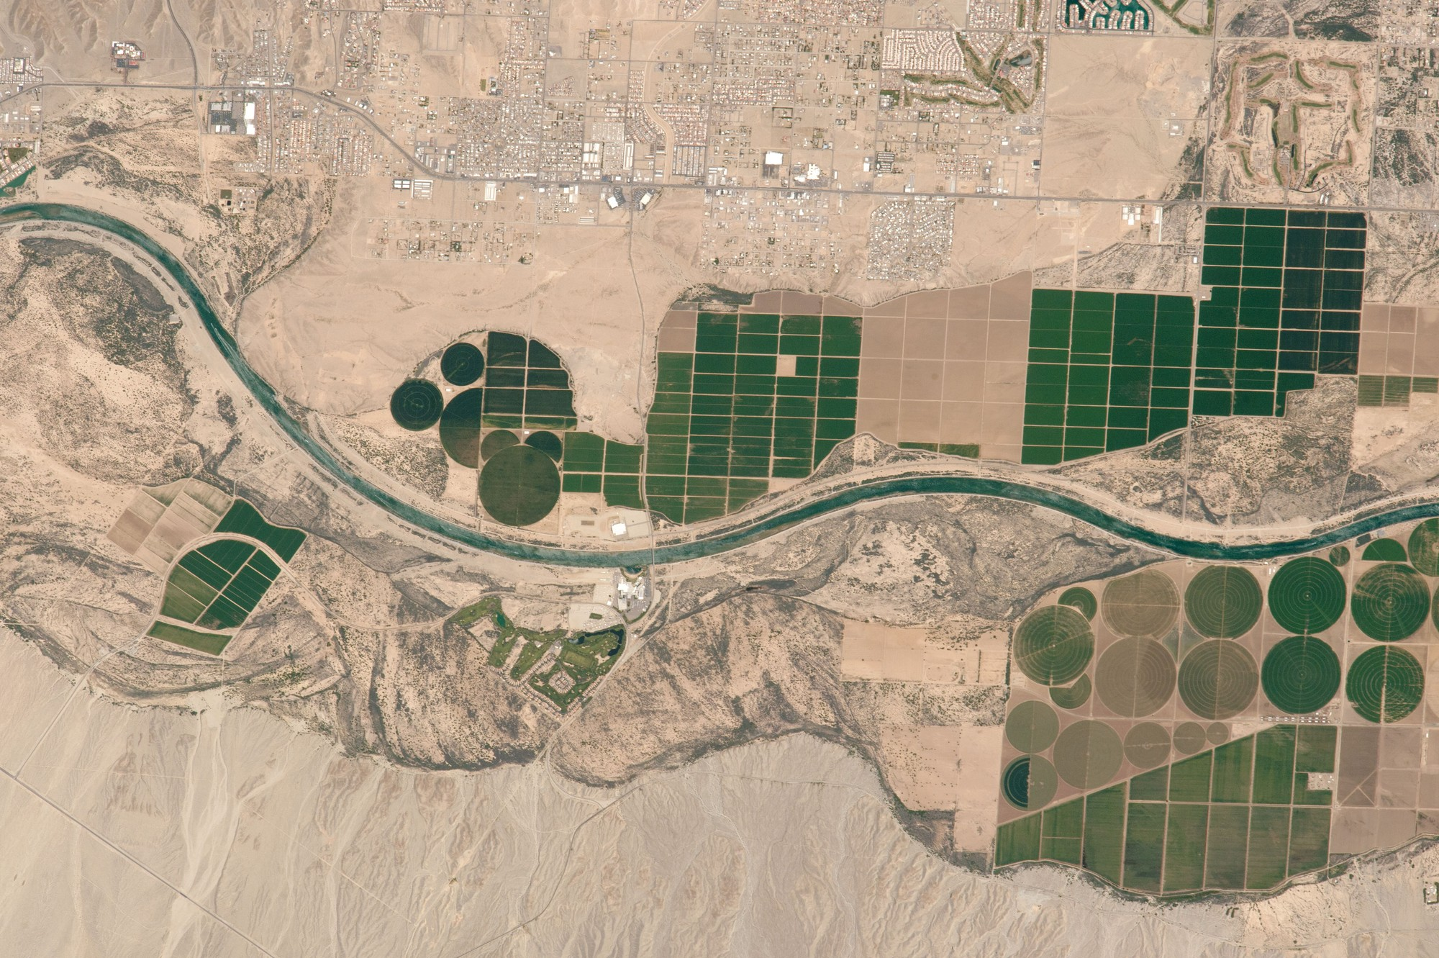
What would you map from home?
Choose a place someone at your table knows. Tell a partner who has a decision to make there.
“I’d compare ___ with ___ to find out ___.”
Name one observation that could change your answer.
Fields along the Colorado River, Fort Mojave Indian Reservation, 14 April 2017. International Space Station photograph, NASA Johnson Space Center.

Slide 30
Image and map sources
NASA’s original captions, credits and downloads
Earth and the iceberg
Other landscapes
Apollo 8 · Earthrise
Camp Fire, California
San Francisco region at night
Raikoke volcano, Kuril Islands
A-23A · blue meltwater from two views
Colorado River agriculture
A-23A · seafloor and satellite views
Workshop tools
A-23A · track map and final fragments
NASA EONET v3 data guide
Esri ArcGIS Maps SDK for JavaScript
Image dates on the slides refer to the observations. The hands-on exercise uses the saved EONET sample from 12 November 2026.

Slide 31
Sources for the new investigations
Earth from above
Build and extend the map
Willamette River elevation map · Oregon DOGAMI
A-23A event record · NASA EONET
What is a DEM? · USGS
ArcGIS Pro · Esri
Amazon fires near Novo Progresso · NASA
Map graphics in JavaScript · Esri
Space Shuttle photograph of UARS · NASA
iOS samples · Esri Swift
Pacific atmospheric river · NASA SVS
Android samples · Esri Kotlin
Nearby Search · Google Maps Platform
Find observation dates in the image captions. Open the source links for instrument details and credits.

Slide 32
GIS and mobile field notes
GIS concepts
Mobile projects
GeoJSON specification
My Esri · Get a native license
Coordinate systems and projections
ArcGIS Maps SDK for Swift · 200.x
PostGIS spatial queries
ArcGIS Maps SDK for Kotlin · 200.x
Natural Earth map data
Google Places · Nearby Search
GeoAI examples
Expo SDK documentation
In the workshop folder, application contains the web map and mobile contains the three phone projects.

Slide 33
How could this work on a phone?
A field map
A nearby-place search
Switch between two dates on an Esri map in the Swift or Kotlin starter.
Choose a place type and a search radius around a point.
Swift · iOS / Kotlin · Android
Google Places · Nearby Search
Choose a question to try on a phone. Which interaction would help a person in the field?

Slide 34
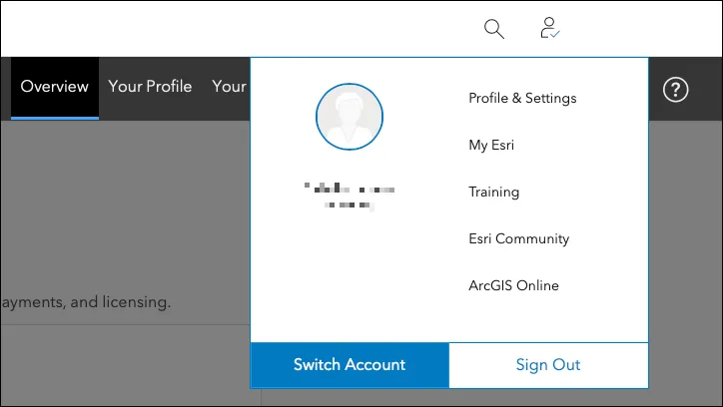
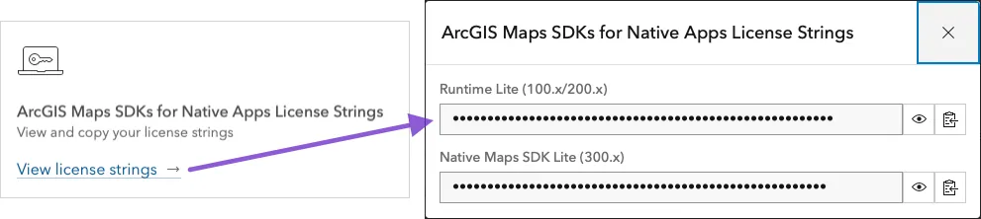
Find your Esri Lite license
Open the account menu
In Overview, open the license card
Choose Profile & Settings.
Choose View license strings, then copy the upper 100.x/200.x value for these projects.
Open My Esri
Screenshots from Esri’s native SDK licensing guide. The strings shown are masked.

Slide 35
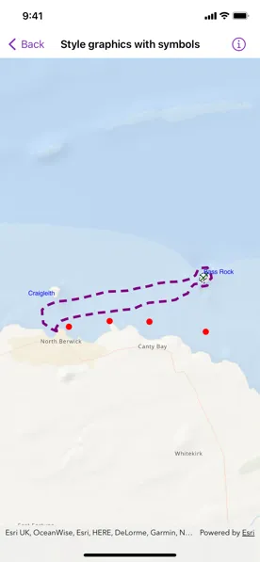
iOS / Move the iceberg one week
Open the Swift project
In Xcode, open IcebergMap.xcodeproj. Select the IcebergMap scheme and an iPhone simulator, then press Run.
Try both dates
Tap Show 6 March. The earlier position is farther west. Tap Show 13 March to return.
Starter and Mac test steps in mobile/ios-iceberg/README.md.
Esri Swift sample • reference

Slide 36
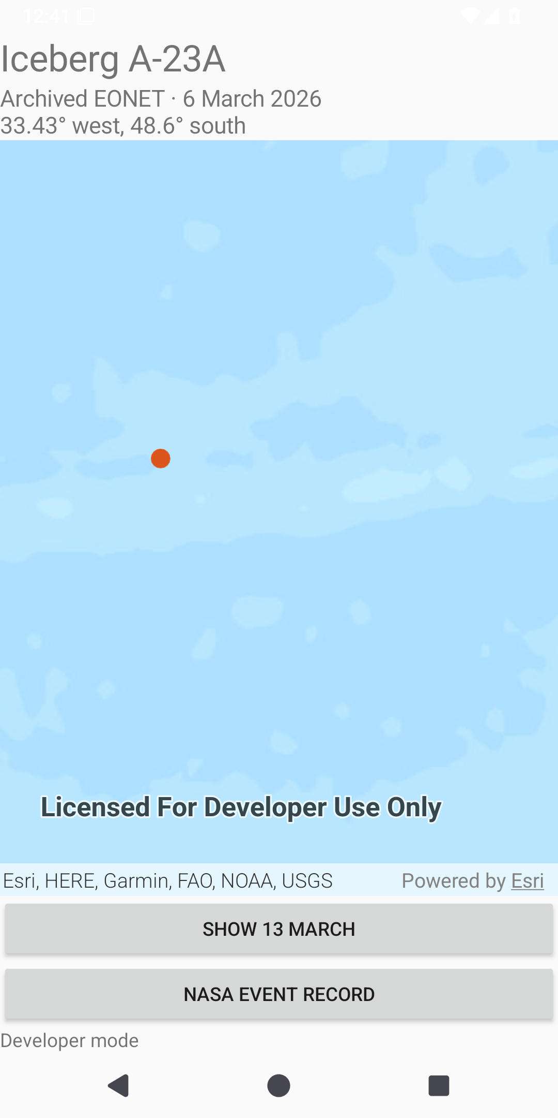
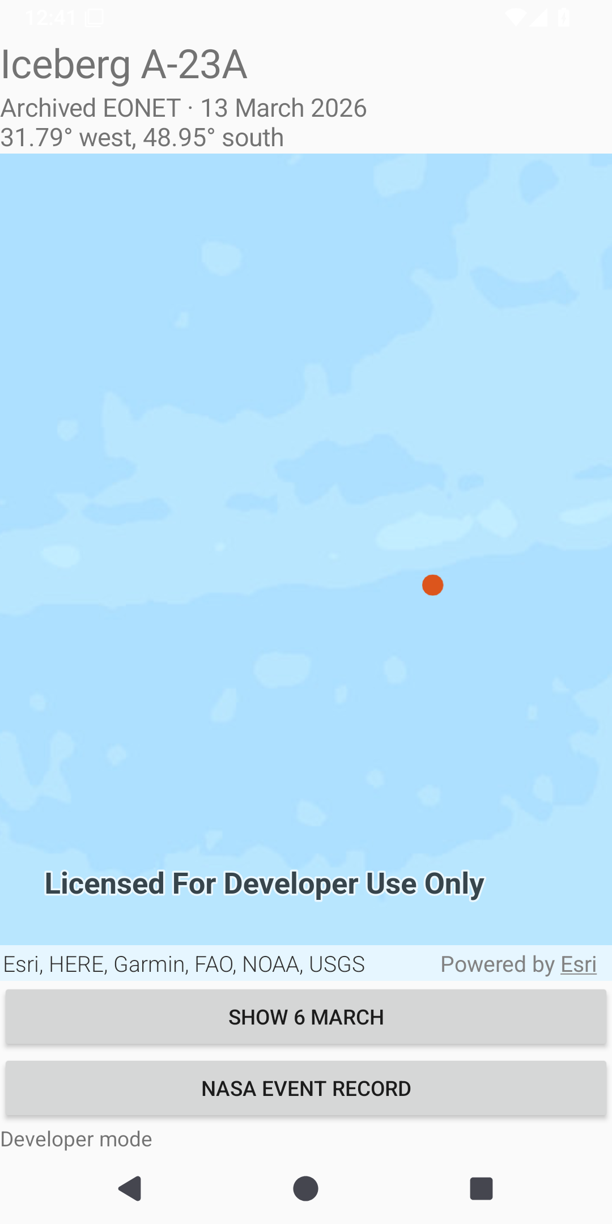
Android / Test the same prediction
Run Iceberg Map
Open mobile/android-iceberg in Android Studio. Sync Gradle and run the app on an emulator or device.
Which way did it move?
Switch dates, then compare the orange markers. Moving east makes a western longitude less negative.
Both captures are from the workshop app on Android 15.
6 March
13 March

Slide 37
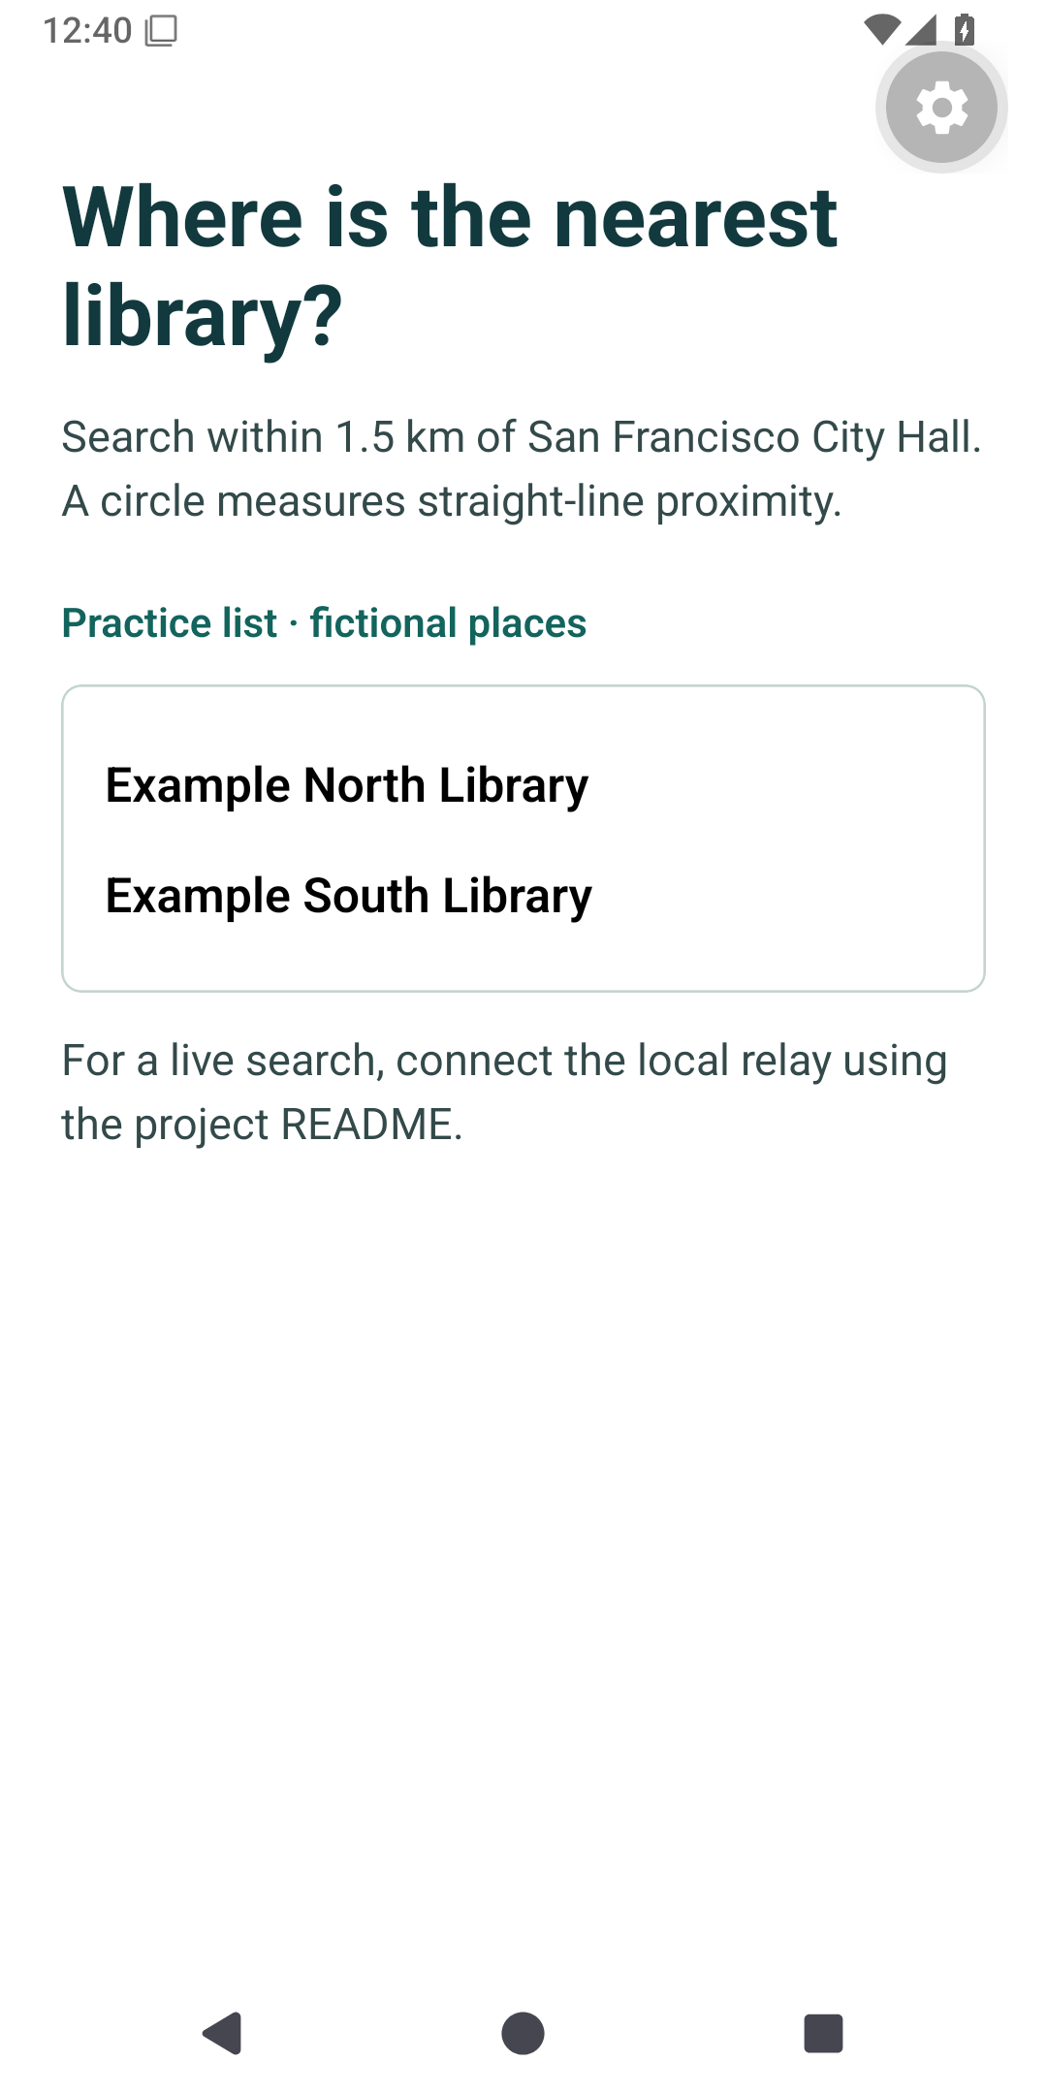
React Native / What is nearby?
Look for a library
The starter asks for libraries within 1.5 km of San Francisco City Hall. Run npm ci, then npm start in mobile/places-expo.
Read the result label
The two practice names are fictional. Connect the optional relay to run a live Google Places search.
Workshop app • Expo Go on Android
The practice screen runs without a Google key.

Slide 38
Thank you.
Questions?
What would you map first, and who would use the answer?

