Slide 1
Vergleich SimpleStorm, MyStorm, RapidStorm
Setting:
Trainingsdaten des Wettbewerbs wurden mit den drei Algorithmen bearbeitet und anschließend mit dem mitgelieferten Tool und dem Wissen um die Groundtruth ausgewertet.
MyStorm: keine Parameter
SimpleStorm: Threshold sinnvoll gesetzt
RapidStorm: nach bestem Wissen optimiert

Slide 2
BundledTubesHighDensity
Radius: 20nm
 | Inlier | Jaccard | f-Score | Precision | Recall | RSME
MyStorm | 2834 | 3.30 | 0.064 | 0.375 | 0.0350 | 13.28
SimpleStorm | 6065 | 6.50 | 0.122 | 0.332 | 0.0748 | 12.94
RapidStorm | 4452 | 4.29 | 0.0822 | 0.164 | 0.0549 | 13.35
Radius: 50nm
 | Inlier | Jaccard | f-Score | Precision | Recall | RSME
MyStorm | 6633 | 8.09 | 0.150 | 0.877 | 0.082 | 26.7
SimpleStorm | 14479 | 17.06 | 0.292 | 0.792 | 0.178 | 27.28
RapidStorm | 14133 | 15.02 | 0.2612 | 0.520 | 0.174 | 30.27
Radius:100nm
 | Inlier | Jaccard | f-Score | Precision | Recall | RSME
MyStorm | 7558 | 9.324 | 0.1705 | 0.999 | 0.0932 | 33.44
SimpleStorm | 18089 | 22.26 | 0.364 | 0.989 | 0.2231 | 38.7
RapidStorm | 22654 | 26.47 | 0.419 | 0.833 | 0.280 | 50.20

Slide 3
BundledTubesLowDensity
Radius: 20nm
 | Inlier | Jaccard | f-Score | Precision | Recall | RSME
MyStorm | 62277 | 71.44 | 0.833 | 0.911 | 0.768 | 9.90
SimpleStorm | 68227 | 76.98 | 0.870 | 0.900 | 0.842 | 9.85
RapidStorm | 67213 | 75.57 | 0.861 | 0.895 | 0.829 | 8.96
Radius: 50nm
 | Inlier | Jaccard | f-Score | Precision | Recall | RSME
MyStorm | 67148 | 81.59 | 0.899 | 0.982 | 0.828 | 12.47
SimpleStorm | 72790 | 86.59 | 0.928 | 0.960 | 0.898 | 12.14
RapidStorm | 71597 | 84.67 | 0.917 | 0.953 | 0.883 | 11.62
Radius:100nm
 | Inlier | Jaccard | f-Score | Precision | Recall | RSME
MyStorm | 68363 | 84.31 | 0.915 | 0.999 | 0.8434 | 15.27
SimpleStorm | 75213 | 92.12 | 0.959 | 0.992 | 0.928 | 17.75
RapidStorm | 74187 | 90.50 | 0.950 | 0.988 | 0.9153 | 17.81

Slide 4
Tubulin1
Radius: 30nm
 | Inlier | Jaccard | f-Score | Precision | Recall | RSME
MyStorm | 48783 | 45.23 | 0.623 | 0.861 | 0.488 | 15.57
SimpleStorm | 23275 | 21.65 | 0.356 | 0.75 | 0.233 | 14.27
RapidStorm | 60231 | 55.27 | 0.712 | 0.870 | 0.602 | 13.68
Radius: 75nm
 | Inlier | Jaccard | f-Score | Precision | Recall | RSME
MyStorm | 55649 | 55.10 | 0.711 | 0.983 | 0.556 | 21.47
SimpleStorm | 26503 | 25.41 | 0.405 | 0.860 | 0.265 | 22.02
RapidStorm | 66479 | 64.72 | 0.786 | 0.961 | 0.665 | 19.45
Radius:100nm
 | Inlier | Jaccard | f-Score | Precision | Recall | RSME
MyStorm | 56634 | 56.63 | 0.723 | 1 | 0.566 | 24.49
SimpleStorm | 28630 | 28.02 | 0.438 | 0.929 | 0.286 | 35.74
RapidStorm | 68762 | 68.46 | 0.813 | 0.994 | 0.688 | 26.72

Slide 5
Tubulin2
Radius: 30nm
 | Inlier | Jaccard | f-Score | Precision | Recall | RSME
MyStorm | 27523 | 25.57 | 0.407 | 0.783 | 0.275 | 17.18
SimpleStorm | 5711 | 4.97 | 0.095 | 0.277 | 0.057 | 16.52
RapidStorm | 13809 | 13.08 | 0.231 | 0.714 | 0.138 | 15.23
Radius: 75nm
 | Inlier | Jaccard | f-Score | Precision | Recall | RSME
MyStorm | 34273 | 33.97 | 0.507 | 0.975 | 0.343 | 24.93
SimpleStorm | 8173 | 7.269 | 0.136 | 0.396 | 0.082 | 30.30
RapidStorm | 17170 | 16.80 | 0.288 | 0.888 | 0.1717 | 26.07
Radius:100nm
 | Inlier | Jaccard | f-Score | Precision | Recall | RSME
MyStorm | 35156 | 35.15 | 0.520 | 1 | 0.352 | 28.56
SimpleStorm | 9552 | 8.60 | 0.158 | 0.46 | 0.096 | 48.47
RapidStorm | 18608 | 18.47 | 0.312 | 0.962 | 0.186 | 37.77

Slide 6
BundledTubesHighDensity
MyStorm (7500 detections)
SimpleStorm (18000 detections)

Slide 7
BundledTubesHighDensity
Grundtruth
RapidStorm (27000 detections)

Slide 8
BundledTubeLowDensity
MyStorm (68000 detections)
SimpleStorm (75000 detections)

Slide 9
Grundtruth
RapidStorm (75000 detections)

Slide 10
Tubulin1
MyStorm (56000 detections)
SimpleStorm (31000 detections)

Slide 11
Tubulin1
Grundtruth
RapidStorm (69000 detections)

Slide 12
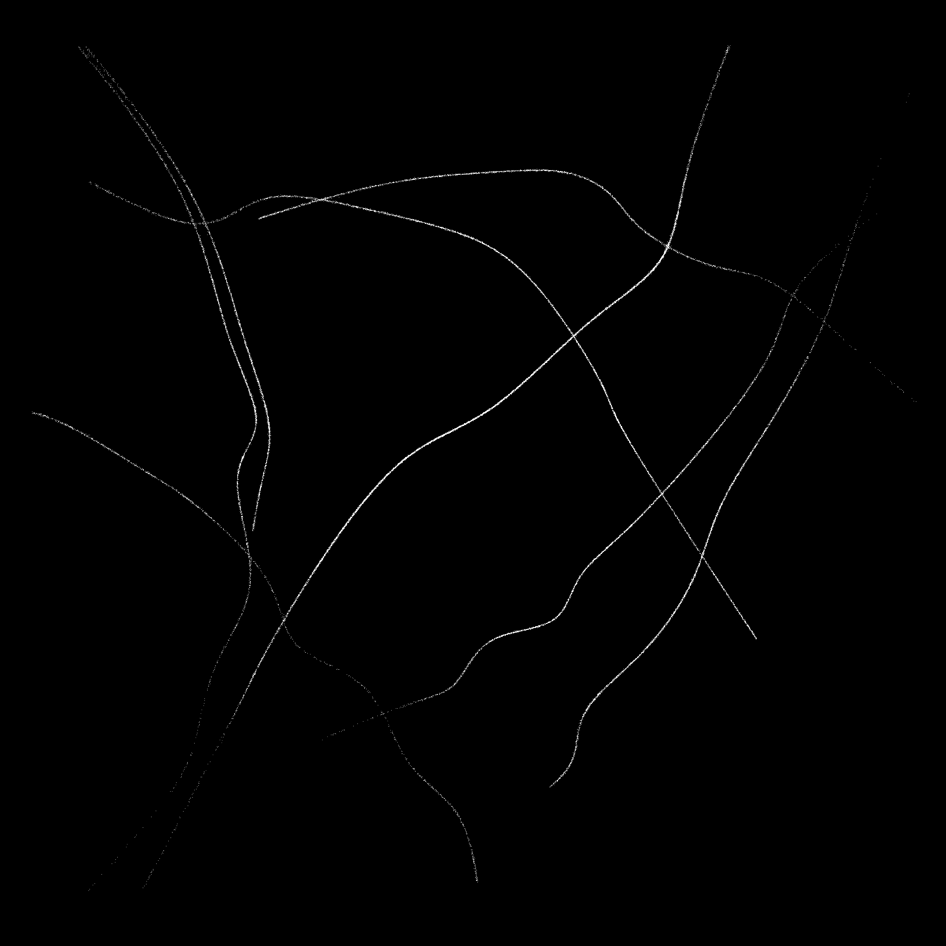
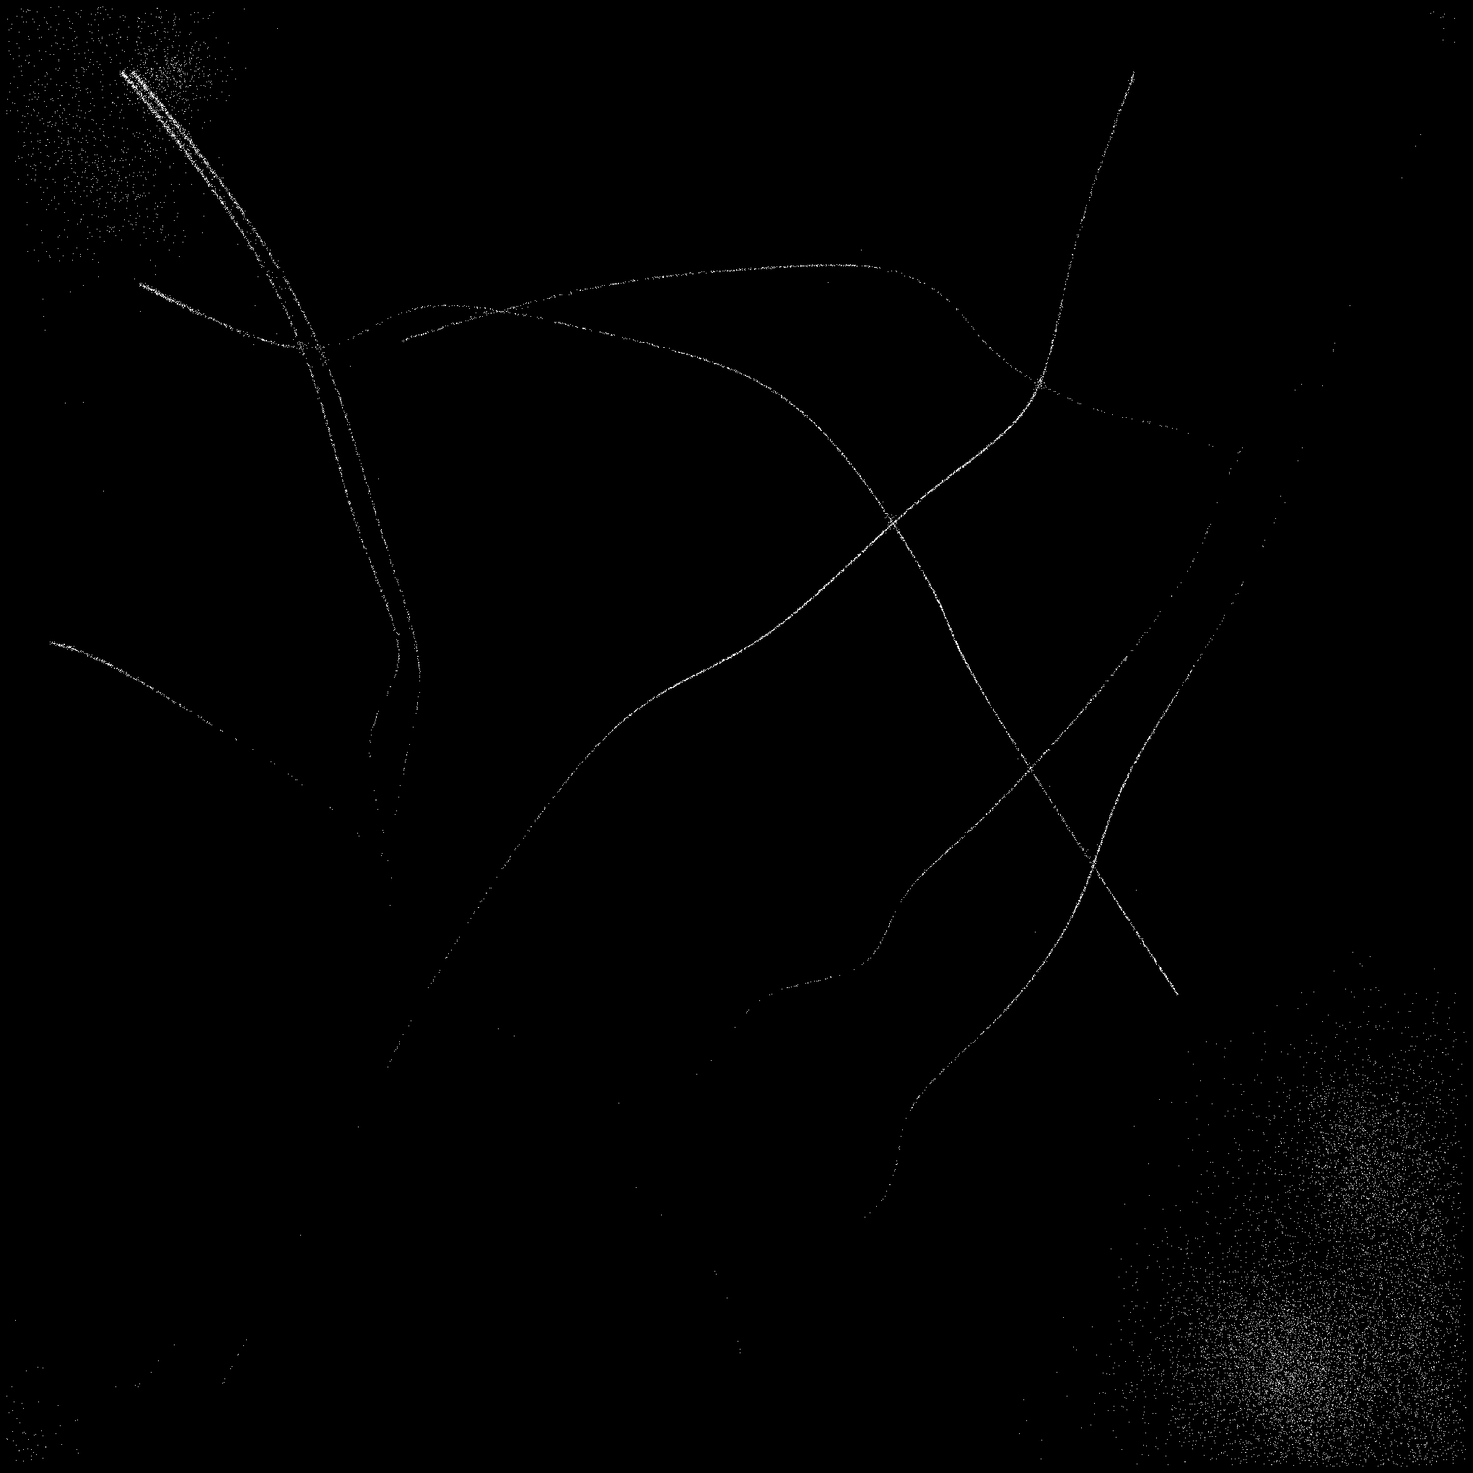
Tubulin2
MyStorm (56000 detections)
SimpleStorm (31000 detections)

Slide 13
Tubulin2
Grundtruth
RapidStorm (19000 detections)

