Slide 1
simpleSTORM:
a self-calibrating
Single molecule
localization
algorithm
Hamprecht Lab, HCI/IWR
Ilia Kats
April 22, 2013

Slide 2
Outline
Introduction: dSTORM
simpleSTORM: Overview
simpleSTORM in detail
ISBI Localization Microscopy Challenge

Slide 3
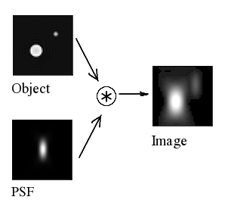
The optical resoltion limit
http://upload.wikimedia.org/wikipedia/commons/c/c2/Convolution_Illustrated_eng.png

Slide 4
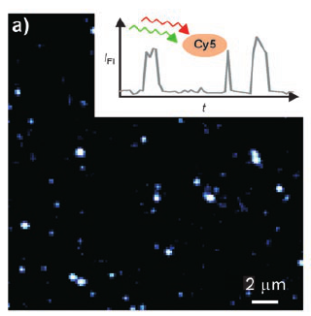
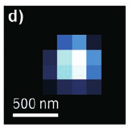
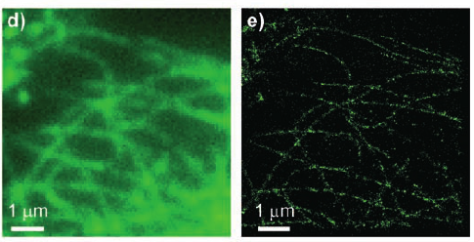
dSTORM
Heilemann, Mike, van de Linde, Sebastian, Schüttpelz, Mark, Kasper, Robert, Seefeldt, Britta, Mukherjee, Anindita, Tinnefeld, Philip, Sauer, Markus: Subdiffraction-resolution fluorescence imaging with conventional fluorescent probes., Angew. Chem. Int. Ed. Engl. 47(33), 6172–6, 2008
Notes:
Cy5: excitation at 633nm
500 ms cont. excitation: inactivation for 5 s
reactivation: irraditation at 488 nm
simultaneous irradiation with 488, 633 nm: blinking
adjust intensity such that only a subset of fluorophores is excited
image: microtubules in COS7

Slide 5
simpleSTORM:
Overview
Stage 1: estimate gain/offset
Stage 2: adjust gain
Stage 3: estimate PSF width
Stage 4: localize molecules

Slide 6
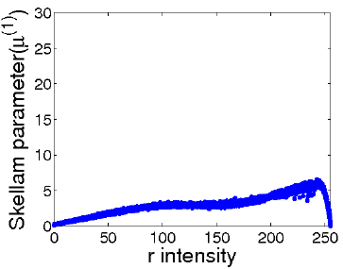
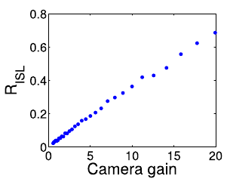
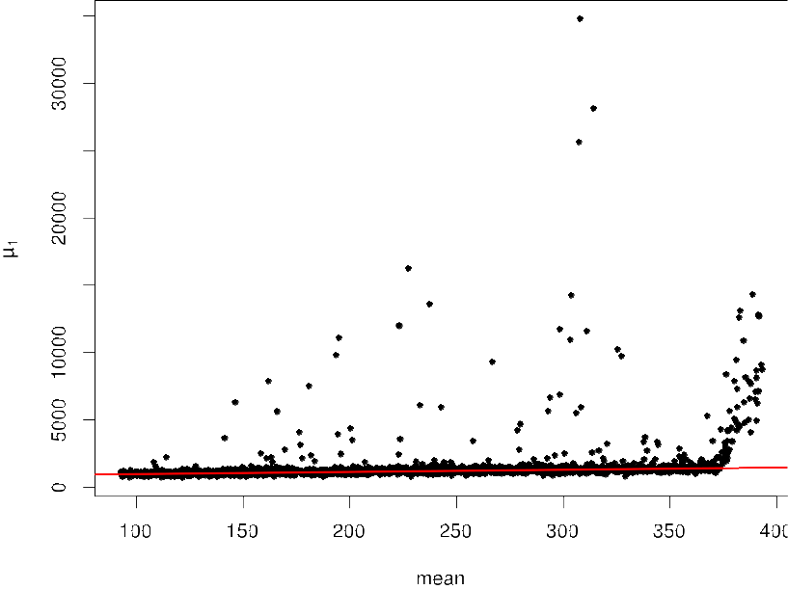
Stage 1:
Gain/offset estimation
Hwang, Youngbae, Kim, Jun-Sik, Kweon, In-So: Difference-Based Image Noise Modeling Using Skellam Distribution., IEEE Trans. Pattern Anal. Mach. Intell. 34(7), 1329–1341, 2012
Notes:
Skellam distribution: difference of Poisson
pixel has no true intensity, is result of random process
skellam parameter has much clearer linear dependence of intenstiy than variance
Risl: ration of ISL to to intensity, only depends on gain
ISL: intensity-skellam line
build average of all frames, sample points over complete value range
fitting: MCD, fit only over subset
gain: slope
offset: x0 > minVal ? minVal : x0
offset = 0 if minVal < 0

Slide 7
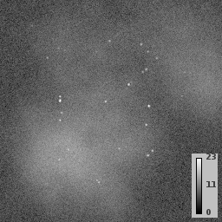
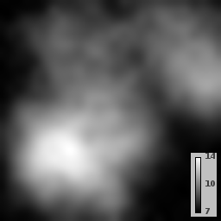
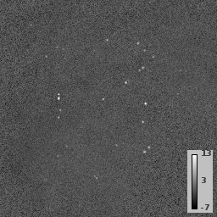
Stages 2-4:
Preprocessing
transform to Poisson distribution
Anscombe Transform: approx. Gaussian with unit variance
-
=

Slide 8
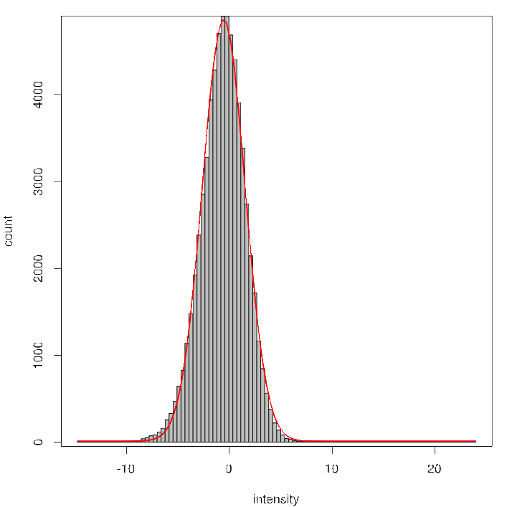
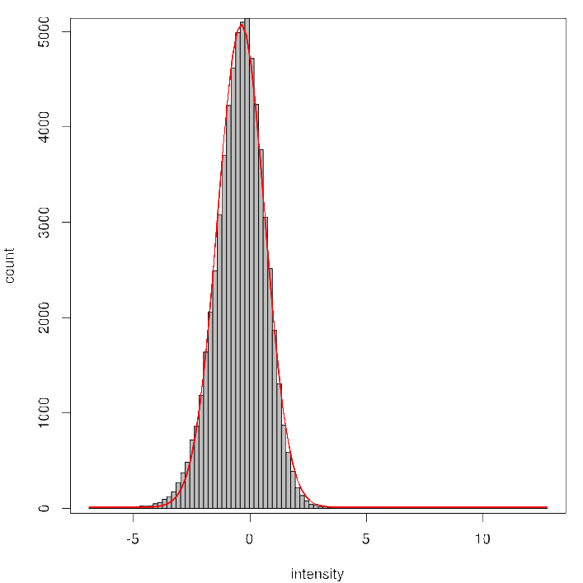
Stage 2:
Gain Adjustment
Notes:
iterative algorithm
use gain from stage 1 as starting value
goal: variance of 1 for the intensity distribution
histogram 1: variance = ca. 2
histogrm 2: variance = ca. 1

Slide 9
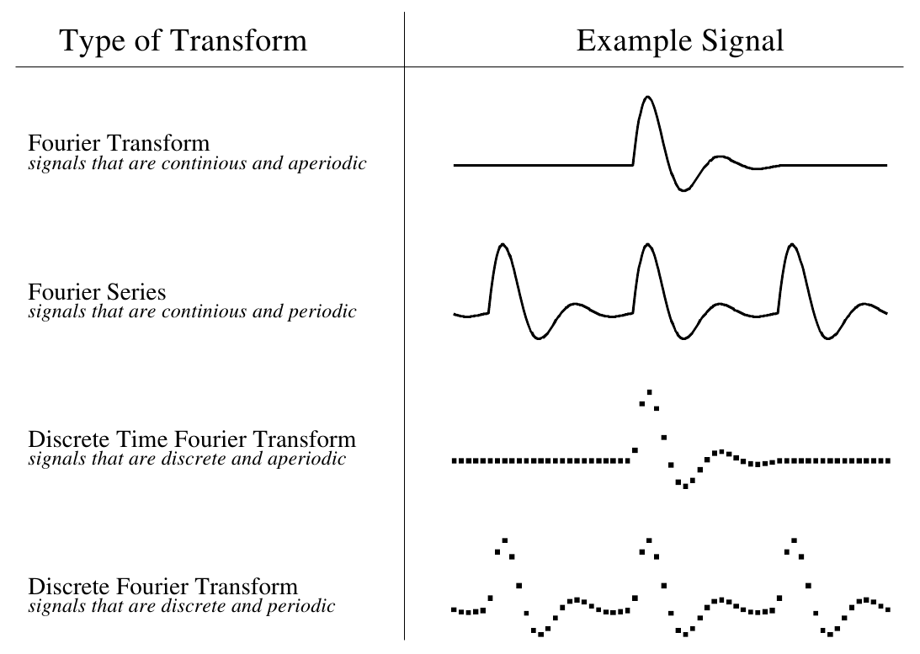
side-note:
Fourier Transform
Smith, Steven W.: The Scientist and Engineer's Guide to Digital Signal Processing, California Technical Publishing, 1997
Notes:
infinite number of sinusoids required to synthesize aperiodic signals
=> only DFT used in signal processing

Slide 10
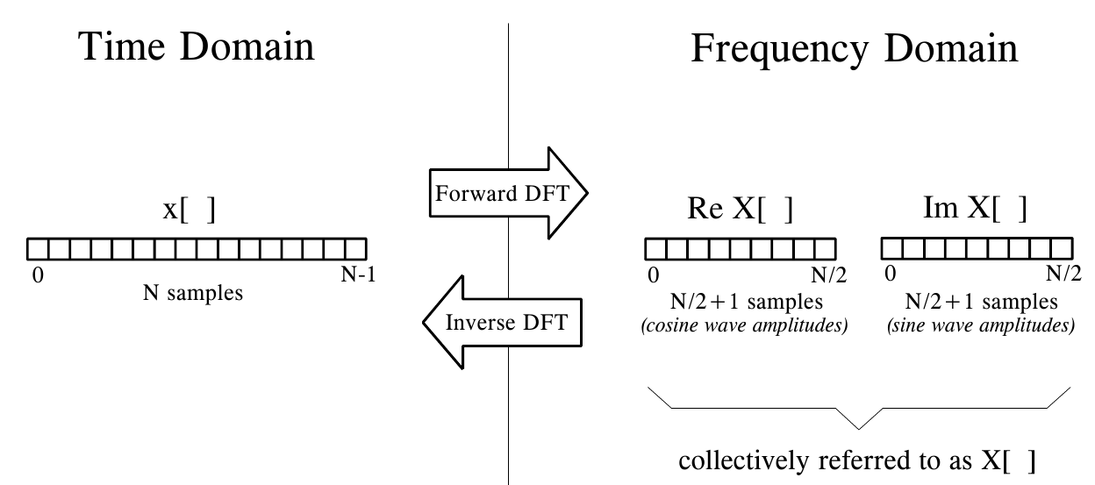
Side-Note:
Fourier Transform
Smith, Steven W.: The Scientist and Engineer's Guide to Digital Signal Processing, California Technical Publishing, 1997
Notes:
Nyquist frequency: ½ of samples
harmonics over Nyquist frequency yield the same time signal as those below => aliasing
real/imaginary: only meaningful for complex DFT

Slide 11
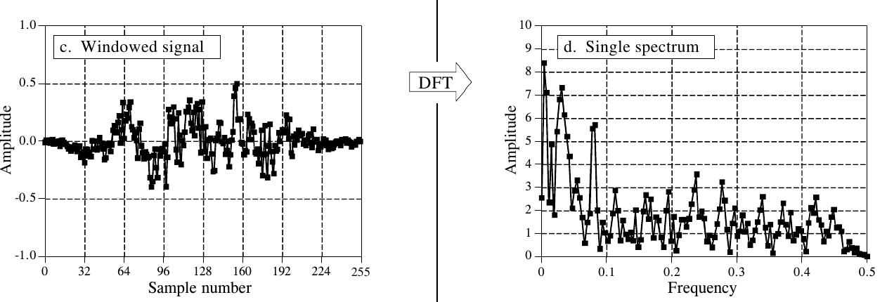
Side-Note:
Fourier Transform
Smith, Steven W.: The Scientist and Engineer's Guide to Digital Signal Processing, California Technical Publishing, 1997
magnitude of the complex number
Notes:
windowed signal: divide original (long) signal into short windows
multiply with smoothing filter, average DFTs of windows
=> smaller effect of noise

Slide 12
Stage 3:
PSF estimation
Notes:
FT of gaussian gives gaussian
std.dev. inversely proportional
select 5 random local maxima per frame, average Power Spectra
requirement for maximum: thresh = 0.7 * (max - min) + min
min, max: minimal and maximal intensity of image
repeat for 200 frames
fit Gaussian in frequency domain, compute std.dev. in spatial domain
center of FT: mean intensity of image (DC component)

Slide 13
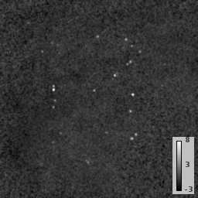
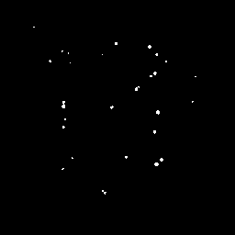
Stage 4:
Molecule localization
filter
threshold
Notes:
matched filter: improves SNR
threshold: based on p-value for normal distribution (0-mean, unit var.)
select local maxima above threshold
interpolate region around maximum
get local maximum, use as molecule localization

Slide 14
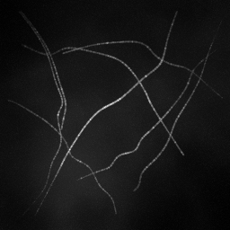
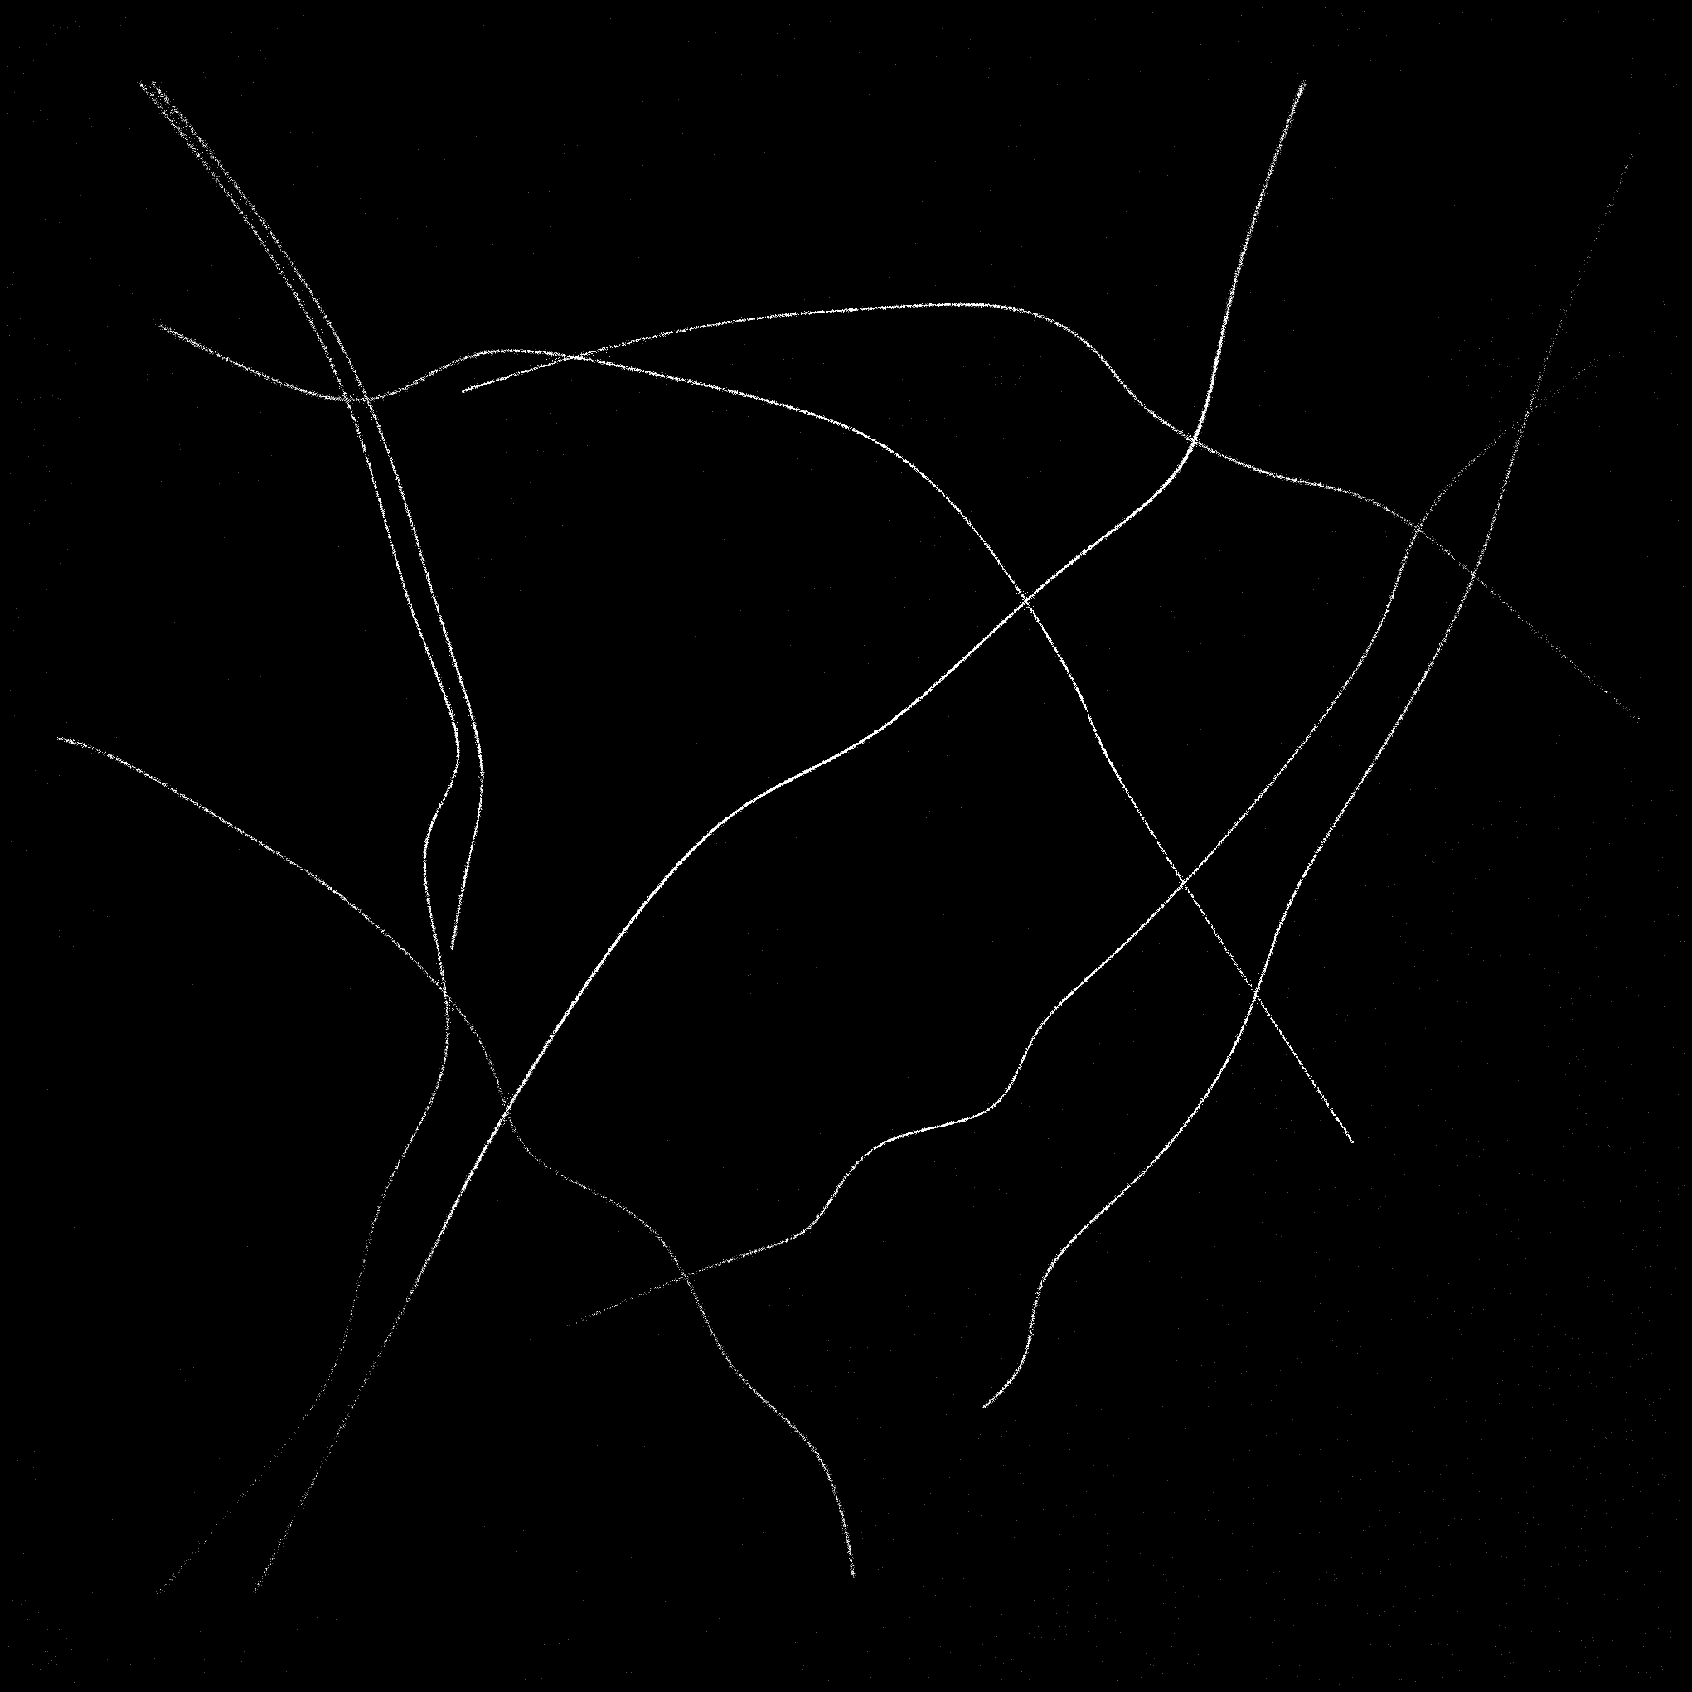
Result

Slide 15
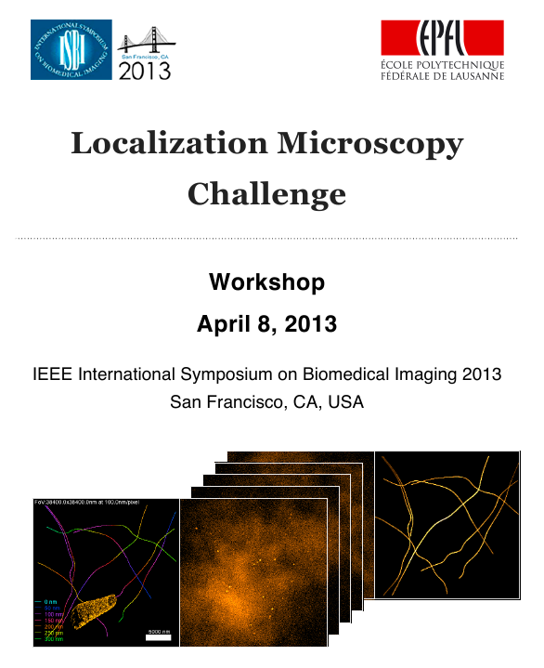
ISBI Localization microscopy Challenge

Slide 16
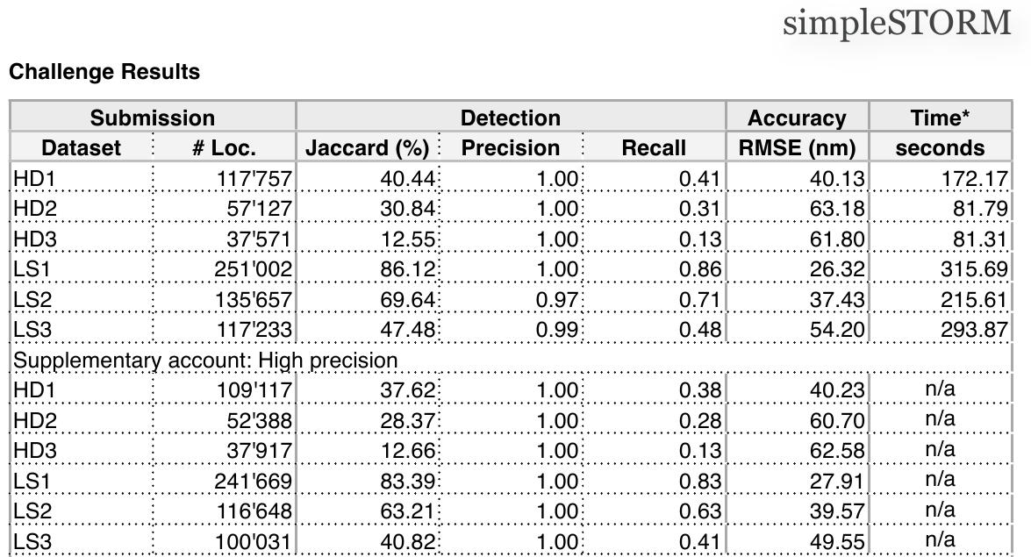
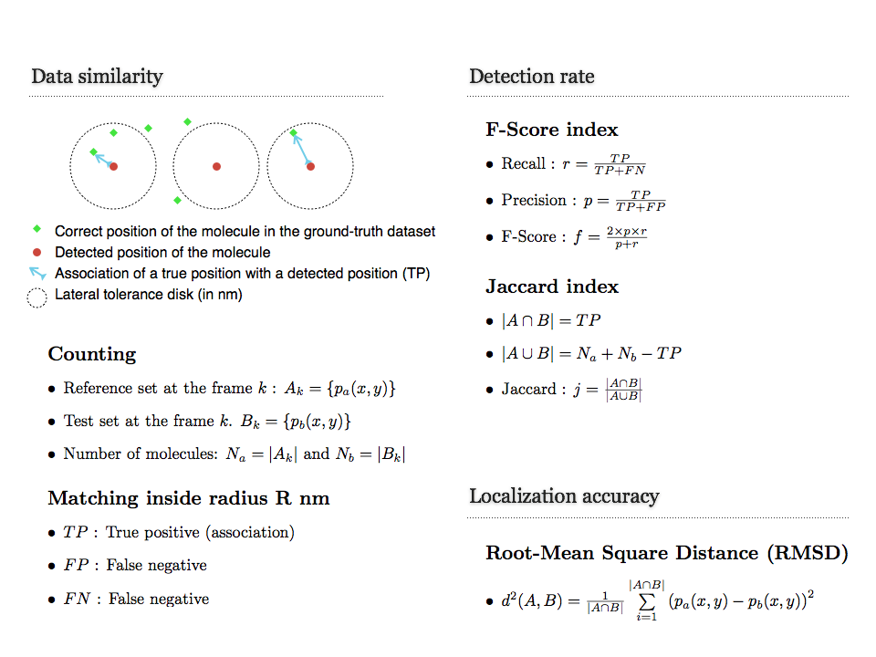
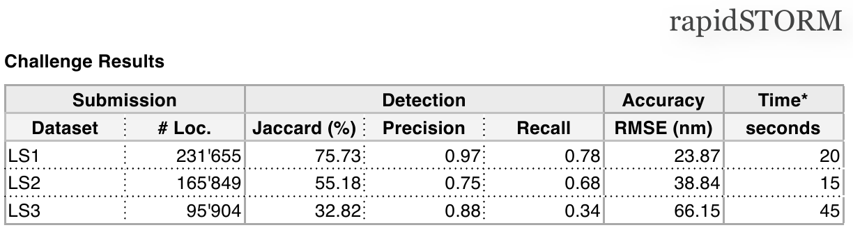
ISBI Localization Microscopy Challenge
http://bigwww.epfl.ch/smlm/challenge/images/lm.007.png

