Slide 1
Use of AI in preclinical development and target selection process
Journal Club
22 June 2026

Slide 2
Agenda
Part 1 — How we do it at SOTIO
The New Targets team and our problem
Kraken: our target discovery platform
Where AI enters the workflow
Results and outlook
Part 2 — How the field does it
Why AI now, and where it plays in the preclinical pipeline
From hype to clinic — and the limits

Slide 3
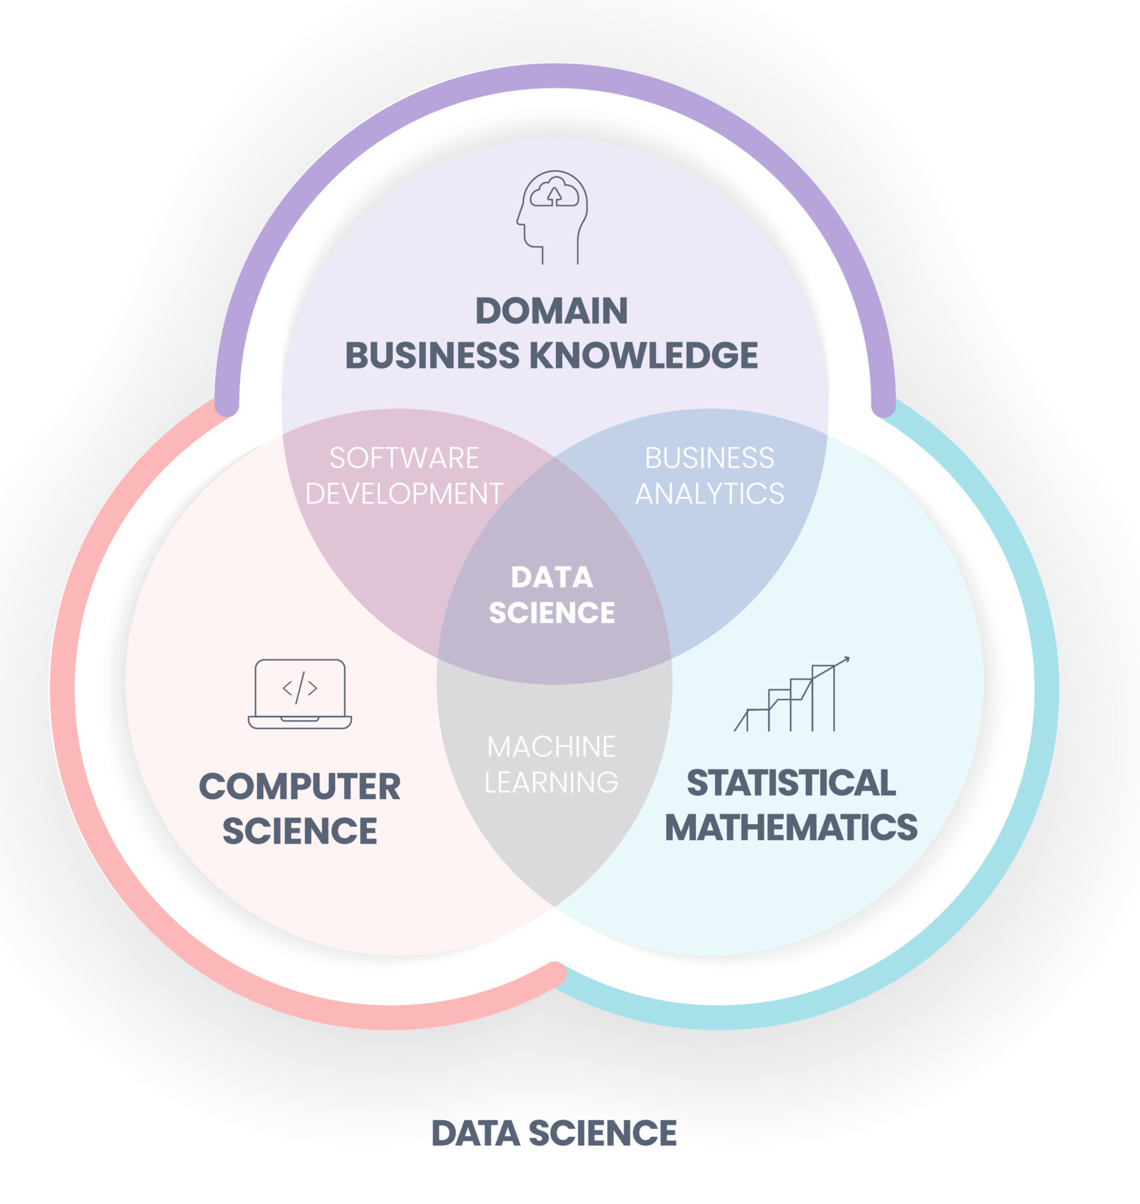

Slide 4
The New Targets / Data Science Team
[Team photos & roles — to be added by Flo]

Slide 5
Part 1: How we do it at SOTIO

Slide 6
Our task — and the requirements a good target must satisfy
Therapeutic window
Druggability
Highly expressed on tumor cells, NOT on healthy tissue. The single biggest determinant of ADC safety.
Surface-exposed, internalises into the cell, can carry an antibody-drug payload — not every protein fits.
Competitive landscape
Patient population
Targets crowded with 20+ programs are hard to differentiate. We want freedom-to-operate or a clearly novel angle.
Enough patients in our priority indications to make a clinical programme viable.

Slide 7
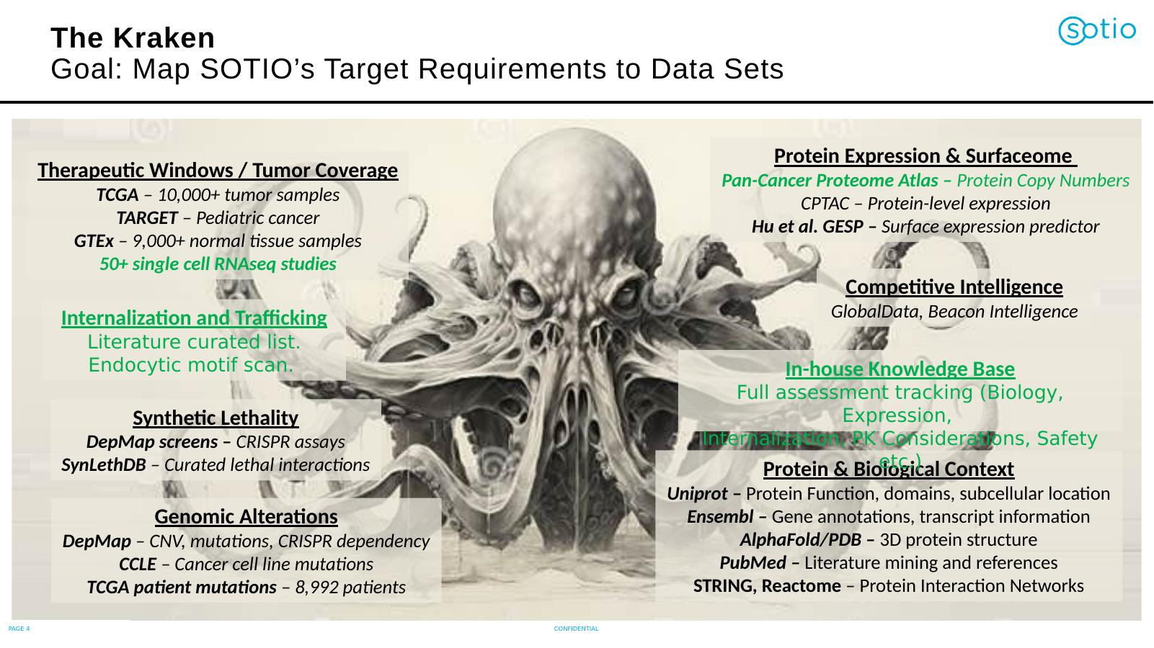

Slide 8
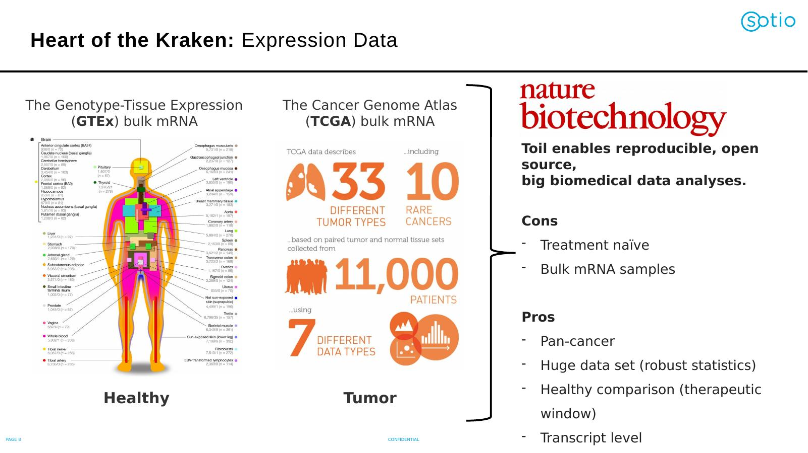

Slide 9
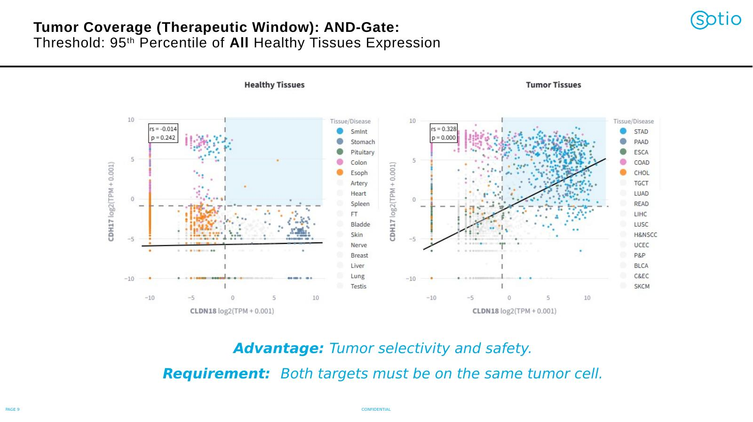

Slide 10
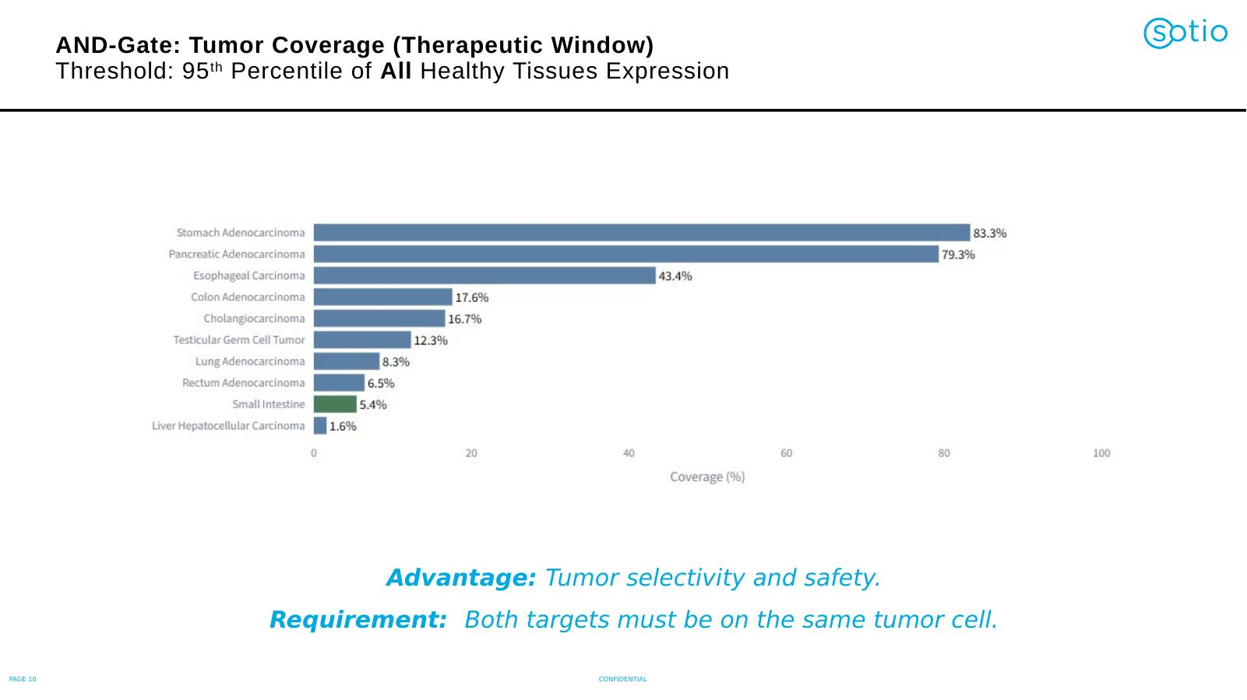

Slide 11
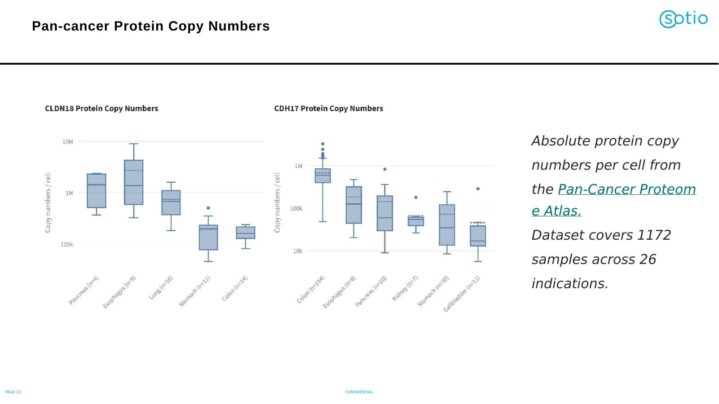

Slide 12
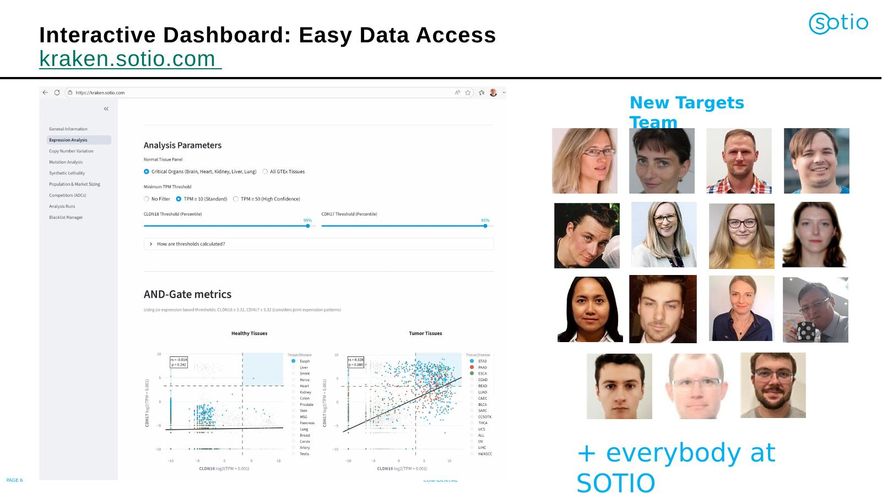

Slide 13
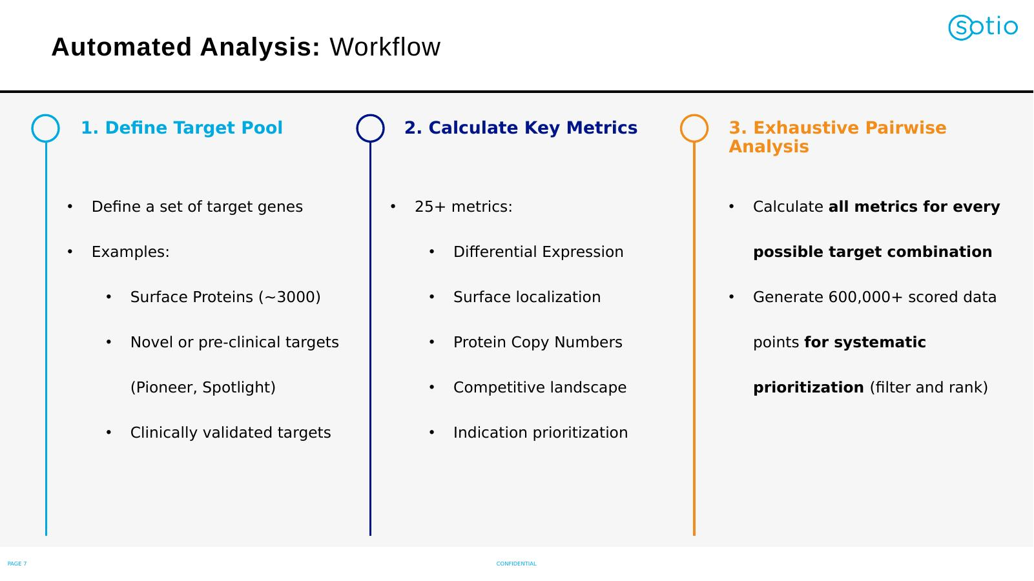

Slide 14
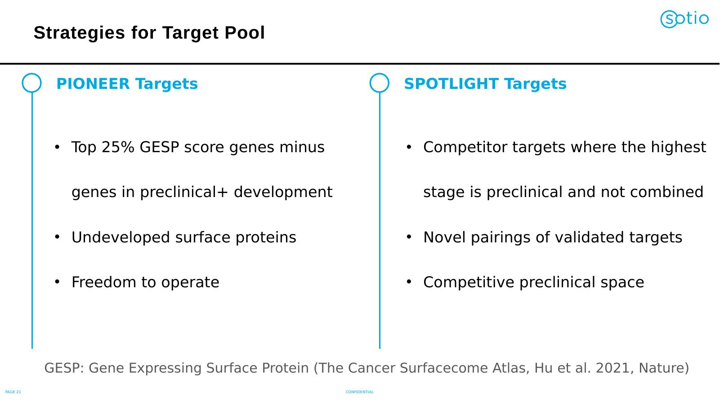

Slide 15
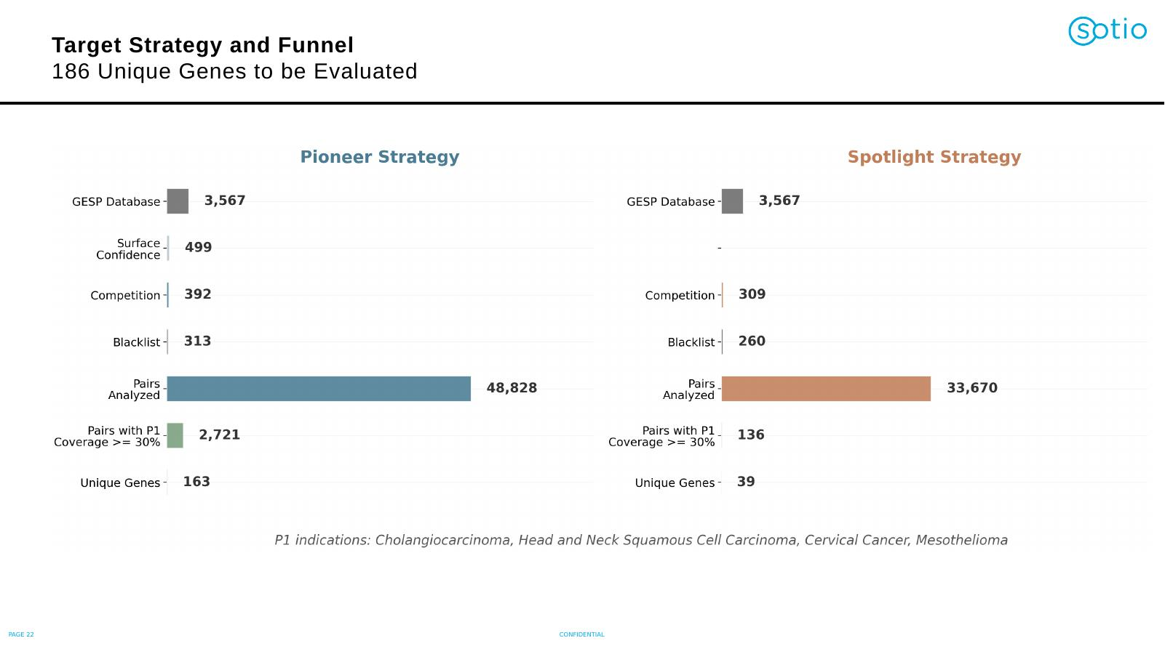

Slide 16
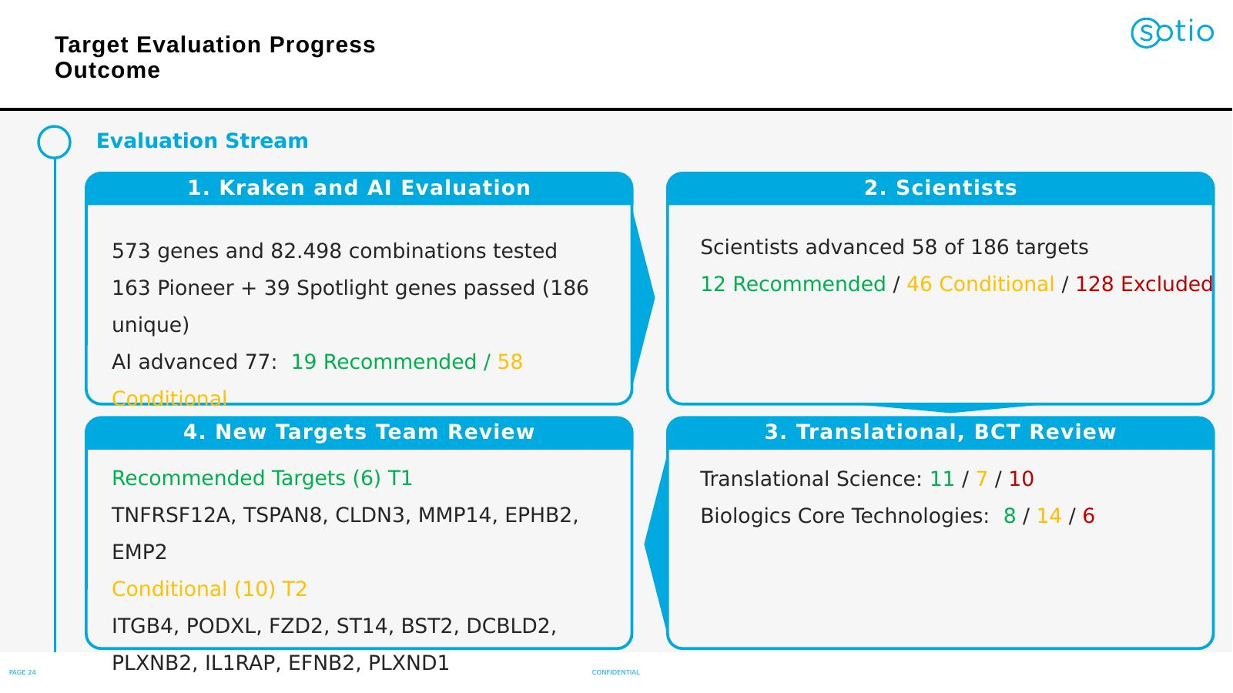

Slide 17
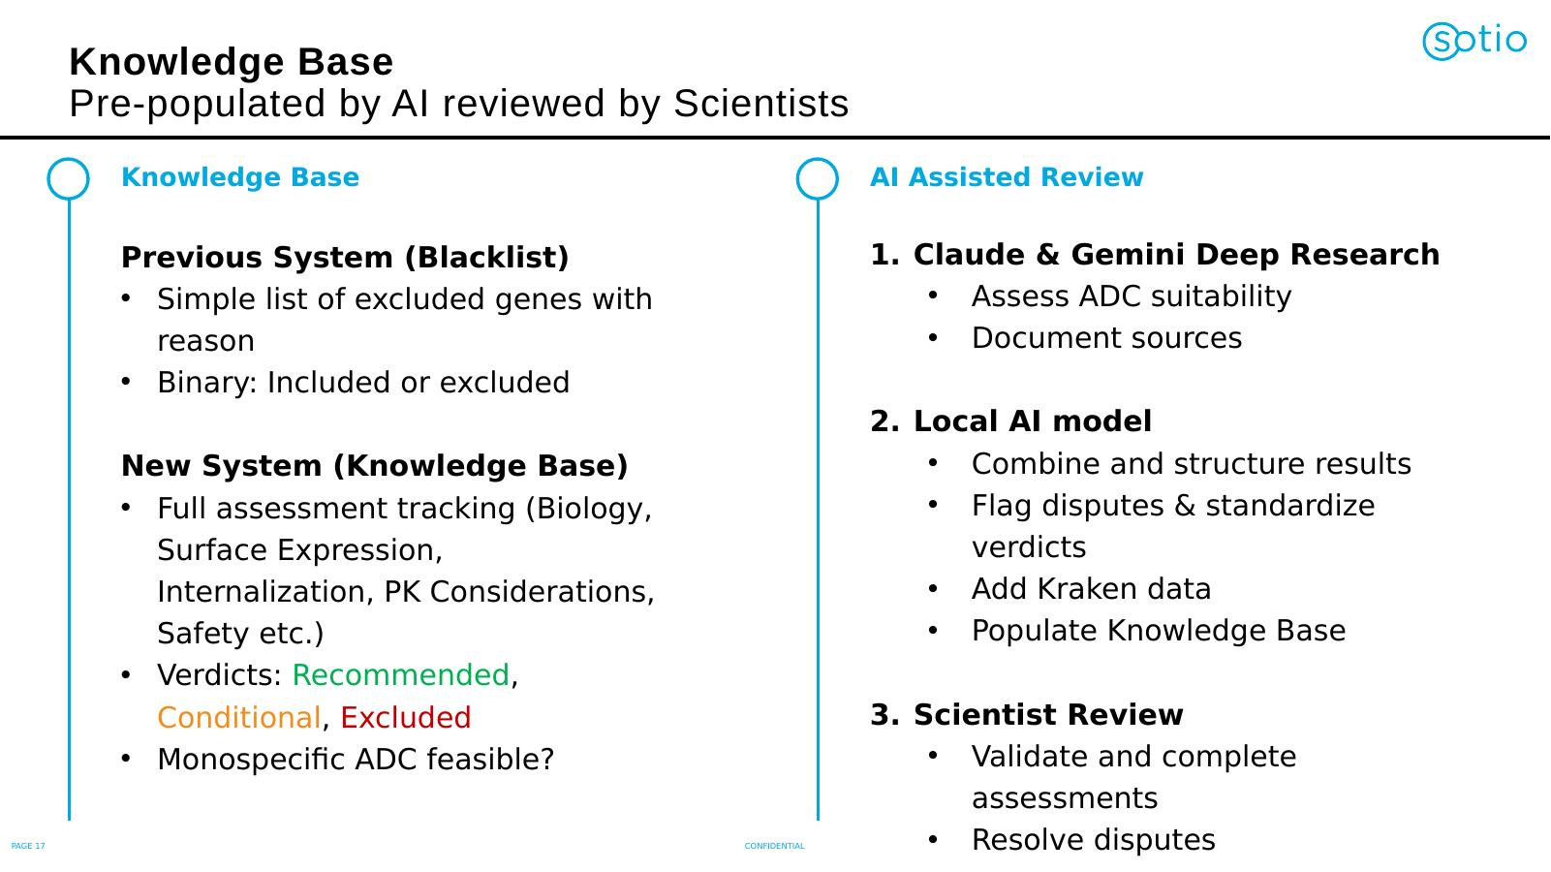

Slide 18
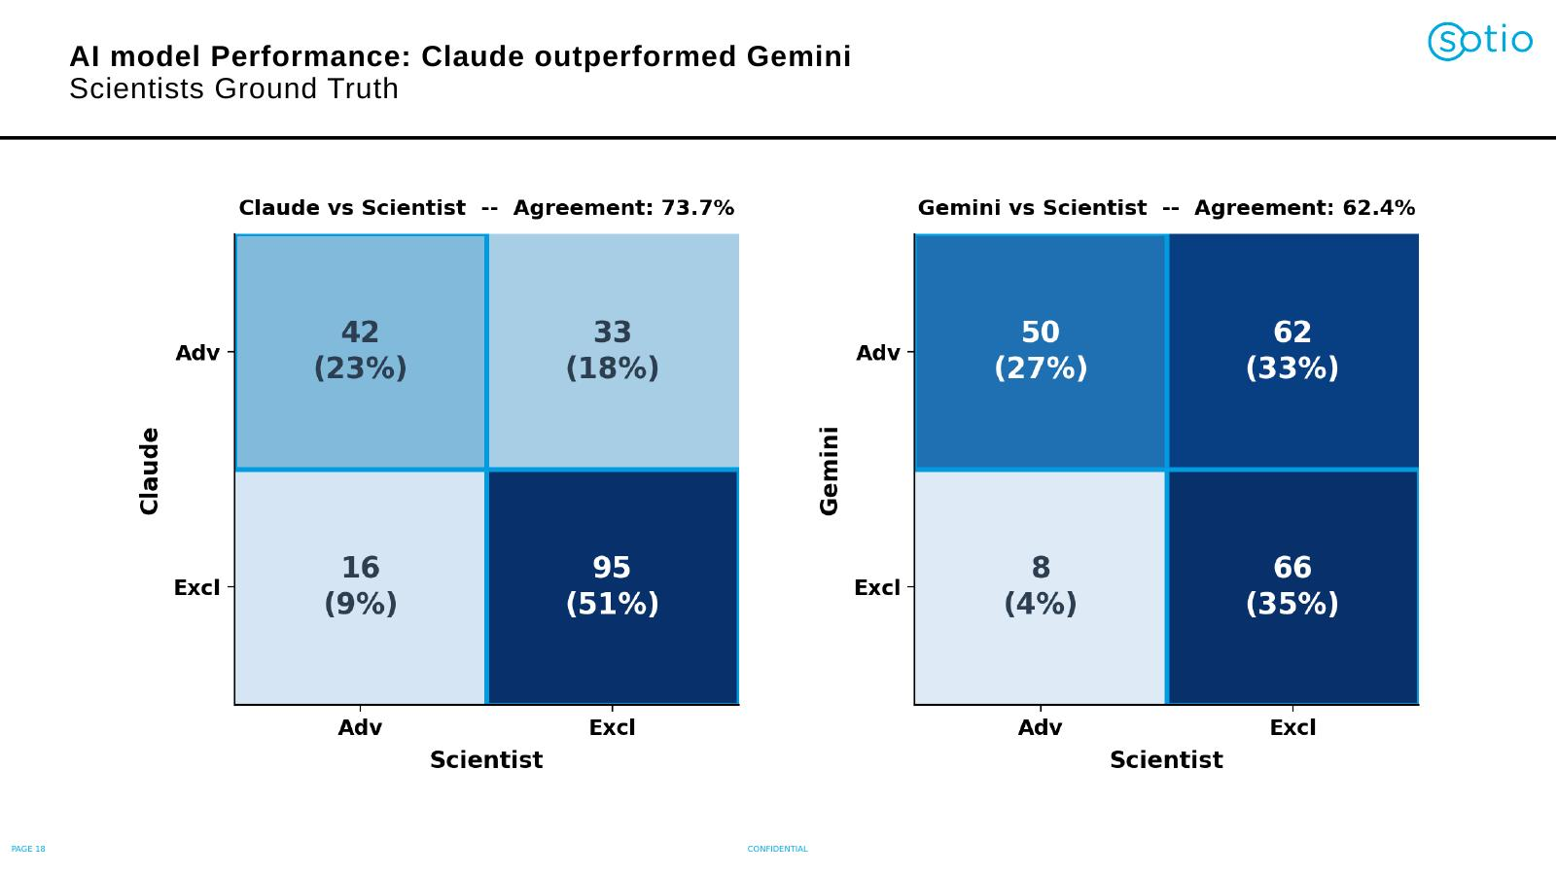

Slide 19
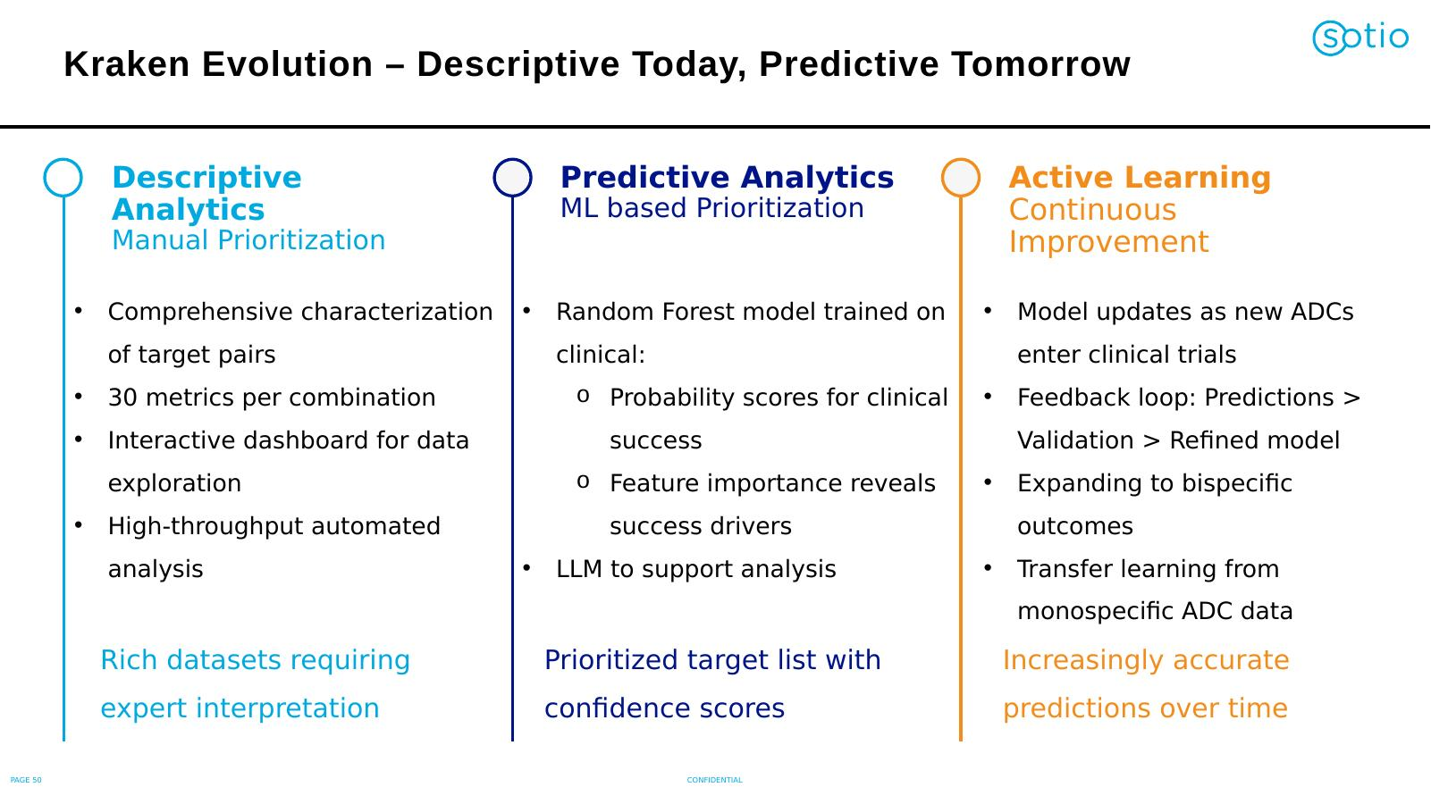

Slide 20
Part 1 — summary
What Kraken delivers today, and what AI added
Scale
AI today
AI tomorrow
~6 million possible target pairs · 25+ metrics each · automated, reproducible, run-centric DuckDB store. What used to take weeks per pair now runs overnight.
Claude + Gemini Deep Research triage literature for ADC suitability. Knowledge Base populated automatically, scientists validate. Claude reached 73.7% agreement with scientists.
Predictive ML on ~5,000 clinical ADC programs. Active-learning loop: predictions → wet-lab → refined model. Bispecific outcomes via transfer learning.
AI doesn't replace the scientists — it lets us ask 100x more questions in the same time.

Slide 21
Part 2: How the field does it

Slide 22
Why this matters — drug discovery is hard
~$2.6 billion
Average cost to bring a single new drug to market (DiMasi et al., 2016).
10 – 15 years
From the first biological idea to an approved medicine.
~90% failure rate
Of candidates that enter clinical trials, most fail in Phase II for efficacy or safety.
The promise of AI in preclinical work: better odds, earlier, cheaper.

Slide 23
The preclinical pipeline — and where AI plays
1
2
3
4
5
Target ID
Target Validation
Hit Discovery
Lead Optimisation
Candidate Selection
Find a biological
weak point in the disease
Prove modulating it
helps patients safely
Find molecules
that engage the target
Tune potency, selectivity,
drug-like properties
Pick the one molecule
to take into the clinic
AI example
Mining omics +
literature for new
disease drivers
AI example
Predicting safety
liabilities from
expression data
AI example
Virtual screening of
millions of
compounds
AI example
Generative design
of better drug-like
molecules
AI example
Predicting clinical
risk from preclinical
data
AI now contributes meaningfully at every stage of this pipeline.

Slide 24
Why AI in drug discovery — and why now
Biological data at scale
Genomes, transcriptomes, proteomes, single-cell, imaging, real-world clinical data — orders of magnitude more than ten years ago.
Compute and specialised hardware
GPUs and cloud infrastructure make training and running large models routine, not a special project.
Mature ML models
Transformer architectures and protein foundation models (AlphaFold, ESM, etc.) cracked problems that were considered unsolved.
Tasks that used to take a year of bench work can now be triaged in days.

Slide 25
AI for target identification
Out of ~20,000 human genes, which one should we drug?
Multi-omics integration
Knowledge graphs
Combine RNA, DNA, protein, single-cell data to find genes uniquely active in disease. This is essentially what Kraken does for surface proteins.
Reason over millions of papers, trials and databases to surface non-obvious links between genes, pathways and diseases.
Image-based phenotyping
Patient data mining
Deep learning on cell-microscopy images detects subtle, drug-relevant phenotypes humans miss.
Real-world clinical data — EHRs, biobanks — reveals which genes predict outcomes or treatment resistance.

Slide 26
AI for target validation and prioritisation
From a long list of hypotheses to a ranked short list worth wet-lab time
Disease relevance
Safety window
Is the target genetically or causally linked to the disease in patients — not just in cell lines?
Predict on-target toxicity: where else is the protein expressed? AI models flag risky tissues early.
Druggability
Competitive landscape
Can a small molecule, antibody or ADC actually engage this target? Structure-based AI scores this.
Is this target already being chased? AI mines patents, trials and pipelines automatically.

Slide 27
AI for designing the molecule itself
Predicting protein structure · AlphaFold, RoseTTAFold, ESMFold
Predict the 3D shape of any protein from its amino-acid sequence — in minutes.
Why it matters: structure is what drugs grab onto. Until 2021, getting a structure could take years and millions of euros.
Impact: 200M+ predicted structures freely available — essentially all known proteins.
Generating new molecules · RFdiffusion, generative chemistry models
Instead of screening millions of existing molecules, ask the model: design something that fits this pocket.
What it enables: custom-designed antibodies and small molecules; chemical space that nature never made.
Reality check: the designs still need to be made and tested — but a much smaller, smarter set than before.

Slide 28
From hype to clinic — it's already happening
A few illustrative public examples — not exhaustive
Insilico Medicine
Isomorphic Labs (DeepMind)
Fibrosis drug — target identified AND molecule designed by AI. Reached Phase II in record time.
Spin-off from AlphaFold. Multi-billion-euro partnerships with Novartis and Eli Lilly.
Recursion / Exscientia
BenevolentAI
Image- and ML-driven discovery platforms. Multiple AI-designed molecules in clinical trials.
Knowledge-graph-driven target discovery. Identified baricitinib as a COVID-19 treatment in days.

Slide 29
A realistic view — what AI can't do (yet)
Knowing the limits is what separates serious applications from hype
Data is the bottleneck
Correlation is not causation
Models are only as good as the biology they were trained on. Rare diseases and novel modalities have thin data.
AI finds patterns. Whether modulating a target actually helps patients still needs experiments and trials.
The validation gap
Bias toward known biology
An impressive prediction is not a drug. Most AI-suggested targets and molecules still fail in the wet lab.
Training data over-represents well-studied genes (kinases, GPCRs). True novelty is harder than it looks.

Slide 30
Where this is heading
Foundation models for biology
One model that understands DNA, proteins, cells and chemistry together — fine-tuned for each task.
Closed-loop labs
AI proposes → robotic labs test → results retrain the model. Discovery cycles in days, not years.
Patient-specific targets
Therapies designed against the biology of an individual tumour or patient — true precision oncology.

Slide 31
Take-aways
Three things to remember
Collaboration tool
Already working at SOTIO
What's next
AI in preclinical work is most powerful as a co-pilot. The best results come from combining domain experts with the right model on the right data.
Kraken operationalises this for bispecific ADC target discovery. The AI-assisted literature review delivered a validated shortlist faster than would have been possible otherwise.
Predictive ML on ADC outcomes, and tighter feedback loops between in-silico predictions and wet-lab validation.
Questions and discussion to follow.

Slide 32
