Slide 1

enable
We build
technology
solutions that
people
and verticals
www.confiz.com
1

Slide 2


Presented by Faiz Hassan | Sr.Software Architect
Software Design Patterns/Training

Slide 3
Agenda
Overview
Categorization
Singleton Design Pattern
Factory Design Pattern
Adapter Design Pattern
Facade Design Pattern
Observer Design Pattern
MVC Design Pattern

Slide 4
Agenda
Double Check Lazy Initialization Design Pattern
Read-Write (RW) Lock Design Pattern
Monitor Object Design Pattern
Thread Pool Design Pattern
Reactor Design Pattern
Proactor Design Pattern
Demo
Questions & Discussions

Slide 5
Overview
Software design pattern is a general reusable solution to a commonly recurring problem within a given context in software design.
Not a finished design that can be transformed directly into source or machine code.
Specific to design and not specific to technology.
Description or template for how to solve a problem.
Best practices/guidelines that the programmer should use to solve common problems when designing an application or system.

Slide 6
Categorization
Creational Patterns
In software engineering, creational design patterns are design patterns that deal with object creation mechanisms, trying to create objects in a manner suitable to the situation.
Structural Patterns
In software engineering, structural design patterns are design patterns that ease the design by identifying a simple way to realize relationships/interfacing between modules/entities. Addressing concerns related to global structures of applications being developed.
Behavioral Patterns
In software engineering, behavioral design patterns are design patterns that identify common communication patterns between objects and realize these patterns. By doing so, these patterns increase flexibility in carrying out this communication.
Concurrency Patterns
In software engineering, concurrency patterns are those types of design patterns that deal with the multi-threaded programming paradigm.

Slide 7
Singleton Design Pattern Creational Pattern
Singleton pattern ensures that a class has only one instance within an application/process scope/lifetime and provides a global point of access to that instance.
Define a private static attribute in the "single instance" class.
Define a public static accessor function in the class.
Do "lazy initialization" (creation on first use) in the accessor function.
Define all constructors to be protected or private.
Restricts Clients to only use the accessor function to manipulate the Singleton.
<<Implementation/Code>>
Real-World Example/Code Walk Through

Slide 8
Factory Design Pattern Creational Pattern
Factory Design Pattern is useful in a situation that requires the creation of many different types of objects , all derived from a common base type.
Different object types belong to the same family.
Define an interface for creating an object.
Decide at run time what object is to be created based on some configuration or application parameter.
<<Implementation/Code>>
Real-World Example/Code Walk Through

Slide 9
Adapter Design Pattern Structural Pattern
Adapter adds the required interface support to existing (service) class/software-component in order to make it client compatible.
Allows the interface of an existing class to be used as another interface.
Adapter lets classes/modules to work together that couldn't otherwise because of incompatible interfaces.
Often used to make existing classes work with others without modifying their source code.
Also acknowledged as wrapper or translator.

Slide 10


Real World Example Adapter Pattern
We’re living in digital age of smart devices like iPod media players.
Decade back we used Walkman for the same purpose.
Walkman devices works with DC power supply either in form of lithium-ion battery cells or DC input.
Home power supply is AC compatible.
DC Adapter is used to overcome the incompatibility.

Slide 11
Design Adapter Pattern
ITarget: Client Compatible Interface.
Adaptee: An implementation that needs adapting.
Adapter: The class that implements ITarget. interface in terms of the Adaptee.
Request: An operation that client wants.
SpecificRequest: The actual implementation of the Request functionality in the Adaptee.

Slide 12
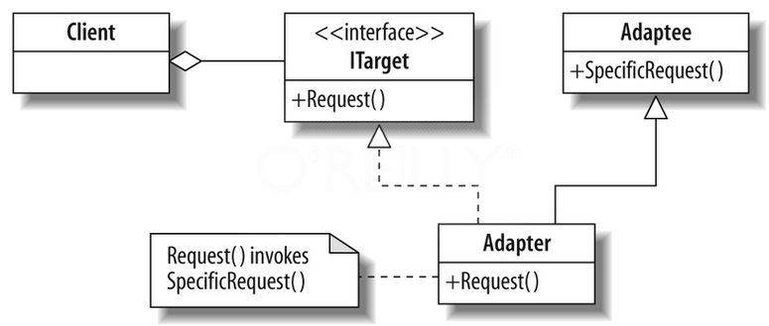
UML Diagram Adapter Pattern

Slide 13
Code/Implementation Adapter Pattern
IACPower Interface (Adaptee internal interface)
IDCPower Interface (iTarget/Client Compatible Interface)
CACPowerSupply Class (Adaptee implementation that remains intact)
CDCAdapter Class (IDCPower/iTarget implementation in terms of CACPowerSupply/Adaptee, Call Delegation)
Use of multiple inheritance and inheritance access specifier (Containment is an alternative approach)
CWalkmanDevice Class (Client/Service-Consumer)
<<Implementation/Code>>
Real-World Example/Code Walk Through

Slide 14
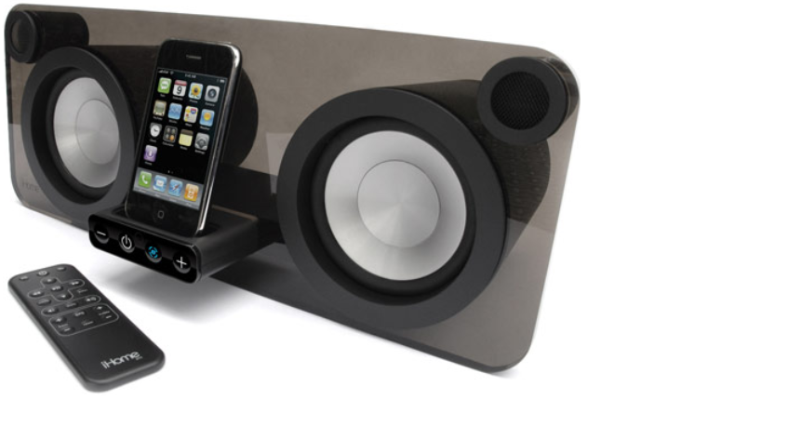
Demo Adapter Pattern
Lets run the Demo and Play music loud.

Slide 15
Facade Design Pattern Structural Pattern
Provide a unified interface to a set of interfaces in a complicated subsystems.
Facade defines a higher-level interface that makes the subsystem easier to use.
make a software library easier to use, understand and test, since the facade has convenient methods for common tasks.
make the library more readable, for the same reason.
reduce dependencies of outside code on the inner workings of a library, reduce coupling, since most code uses the facade, thus allowing more flexibility in developing the system.
wrap a poorly designed collection of APIs with a single well-designed API.
<<Implementation/Code>>
Walk Through/Real-World Example

Slide 16
Observer Design Pattern Behavioral Pattern
The observer pattern is a software design pattern in which an object, called the subject/notifier, maintains a list of its dependents, called observers/subscriber, and notifies/publishes them automatically of any state changes, usually by calling one of their methods.
Define a one-to-many dependency between objects where a state change in one object results in all its dependents being notified and updated automatically.
Mainly used to implement distributed event handling systems, in "event driven" software.
Most modern languages such as Java and C# have built in "event" constructs which implement the observer pattern components
Also acknowledged as pub/sub pattern.
<<Implementation/Code>>
Real-World Example/Code Walk Through

Slide 17
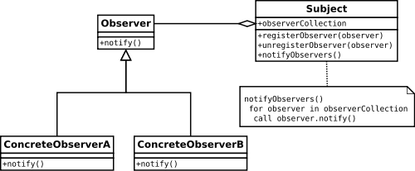
Observer Pattern

Slide 18
Model-View-Controller Design Pattern Behavioral Pattern
Model–view–controller (MVC) is a software architectural pattern for implementing user interfaces.
The Model-View-Controller (MVC) architectural pattern divides an application into three main components: the model, the view, and the controller.
Controller handles user interaction, works with the model, and ultimately selects a view to render that displays UI.
MVC pattern decouples main aspects of application into Input Logic(Controller), Business Logic(Model), and UI logic (View).
Pattern is not just specific to web application development.
Popular programming languages like Java, C#, Ruby, PHP and others have popular MVC frameworks that are currently being used in web application development straight out of the box.
Traditionally used for desktop graphical user interfaces (GUIs), this architecture has become popular for designing web applications and even mobile, desktop and other clients.

Slide 19

MVC Pattern

Slide 20
Double Check Lazy Initialization Design Pattern Concurrency Pattern
Lazy initialization avoids initializing a value until the first time it is accessed.
Reduce the overhead of acquiring a lock by first testing the locking criterion (the 'lock hint') in an unsafe manner; only if that succeeds does the actual locking logic proceed.
Only if the locking criterion check indicates that locking is required does the actual locking logic proceed
It is typically used to reduce locking overhead when implementing "lazy initialization" in a multi-threaded environment, especially as part of the Singleton pattern.
<<Implementation/Code>>
Real-World Example/Code Walk Through

Slide 21
Read-Write (RW) Lock Design Pattern Concurrency Pattern
Readers can only read the data set and they don’t perform any update.
Writers can both read and write
Allows concurrent read access to an object, but requires exclusive access for write operations.
Multiple Readers (Threads) are allowed concurrent access to CS/Protected-Resource.
Reader and Writer are mutually exclusive and only one is allowed at time.
Writer and Writer are mutually exclusive and only one is allowed at time.
Also acknowledged as a multiple readers/single-writer lock, multiple-reader or push lock.

Slide 22
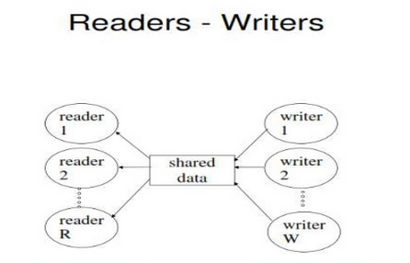
Read-Write (RW) Lock Pattern

Slide 23
Monitor Object Design Pattern Concurrency Pattern
In concurrent programming, a monitor is a synchronization construct that allows threads to have both mutual exclusion and the ability to wait (block) for a certain condition to become true.
Monitors also have a mechanism for signaling other threads that their condition has been met.
A monitor consists of a mutex (lock) object and condition variables.
A condition variable is basically a container of threads that are waiting for a certain condition.
Monitors provide a mechanism for threads to temporarily give up exclusive access in order to wait for some condition to be met, before regaining exclusive access and resuming their task.
Helps in avoiding busy waiting and hence optimized performance of multi-threaded application and overall system.
<<Implementation/Code>>
Real-World Example/Code Walk Through

Slide 24
Thread Pool Design Pattern Concurrency Pattern
Thread pool is a software design pattern for achieving concurrency of execution.
A number of threads are created to perform a number of parallel tasks, which are usually organized in a queue.
Typically, there are many more tasks than threads.
A thread pool maintains multiple threads waiting for tasks to be allocated for concurrent execution by the supervising program.
The model enhance performance and avoids latency in execution due to frequent creation and destruction of threads for short-lived tasks.
The number of available threads is tuned to the computing resources available to the program, such as parallel processors, cores, memory, and network sockets.

Slide 25
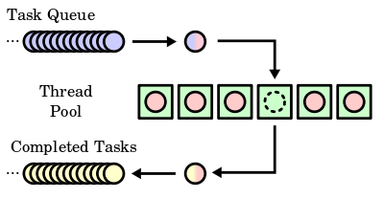
Thread Pool Pattern

Slide 26
Reactor Design Pattern Concurrency Pattern
A reactor object provides an asynchronous interface to resources that must be handled synchronously.
The reactor design pattern is an event handling pattern for handling service requests delivered concurrently to a service handler by one or more inputs.
The service handler then demultiplexes the incoming requests and dispatches them synchronously to the associated request handlers.
Reactor Pattern is a design pattern for synchronous de-multiplexing and dispatching of concurrently arriving events.
Provides synchronous demultiplexing of asynchronous events to their corresponding event-handlers
The purpose of the Reactor design pattern is to avoid the common problem of creating a thread for each incoming message/request/connection. It receives events from a set of handles and distributes them sequentially to the corresponding event handlers.

Slide 27
Reactor Pattern IO Multiplexing/Overlapped IO
I/O multiplexing means what it says - allowing the programmer to examine and block on multiple I/O streams/resources being notified whenever any one of the streams is active/ready so that it can process data on that stream.

Slide 28
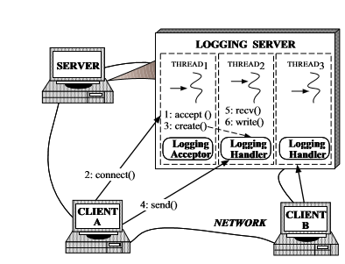
Reactor Pattern Real-World Example

Slide 29
Reactor Pattern Design/Structure
Resource: Any resource that can provide IO (IO Channel)
Synchronous Event De-multiplexer: Uses an event loop to block on all resources. When it is possible to start a synchronous operation on a resource without blocking, the de-multiplexer sends the resource to the dispatcher for service.
Dispatcher: Handles registering and unregistering of request handlers. Dispatches resources from the de-multiplexer to the associated request handler.
Request-Handler: An application defined request handler and to service the resource in ready state.

Slide 30
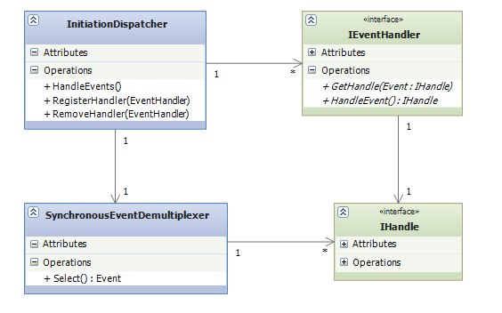
Reactor Pattern UML Diagram

Slide 31
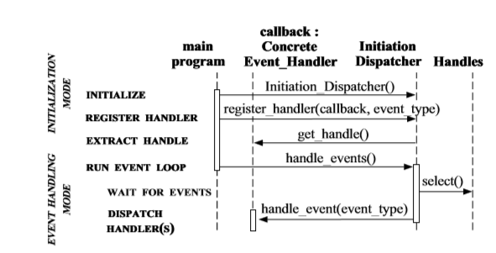
Reactor Pattern UML Sequence Diagram

Slide 32
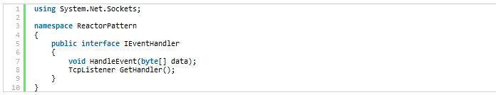
Reactor Pattern Code Snippet

Slide 33
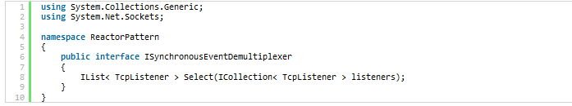
Reactor Pattern Code Snippet

Slide 34
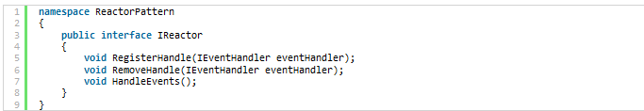
Reactor Pattern Code Snippet

Slide 35
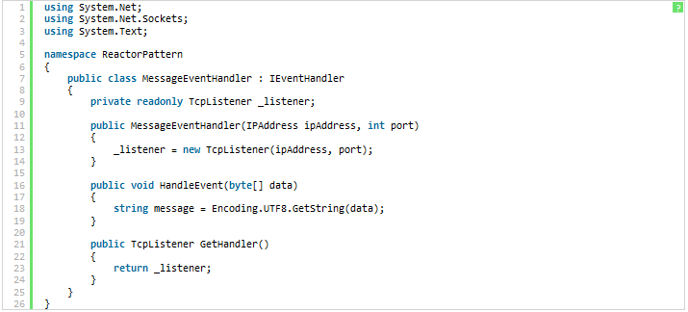
Reactor Pattern Code Snippet

Slide 36
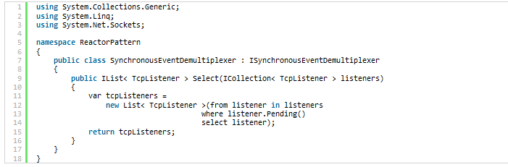
Reactor Pattern Code Snippet

Slide 37
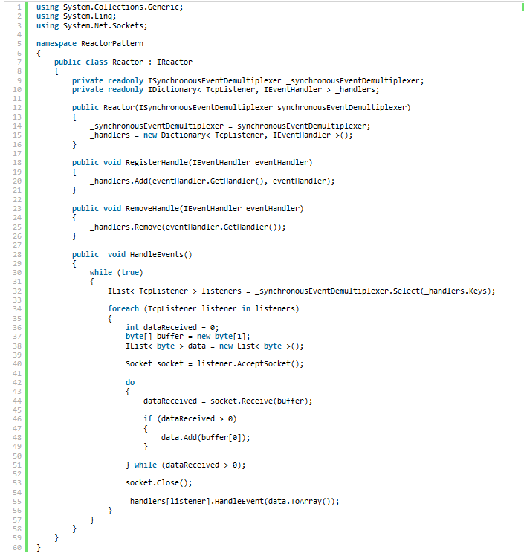

Slide 38
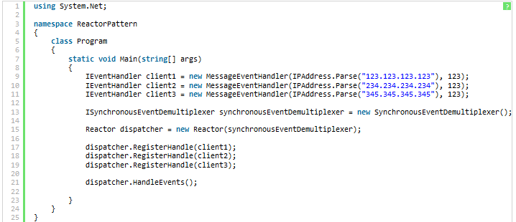
Reactor Pattern Code Snippet

Slide 39
Proactor Design Pattern Concurrency Pattern
The proactor pattern can be considered to be an asynchronous variant of the reactor pattern synchronous event dispatcher.
Proactor is a software design pattern for event handling in which long running activities are running in an asynchronous part.
A completion handler is called after the asynchronous part has terminated.

Slide 40
Proactor Pattern
The Proactive Initiator starts the asynchronous operation via the Asynchronous Operation Processor and defines the Completion Handler.
The Asynchronous Operation Processor controls the whole asynchronous operation.
Completion Handler is a called at the end of the operation from the Asynchronous Operation Processor.

Slide 41
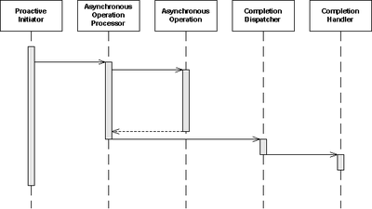
Proactor Pattern UML Sequence diagram of Proactor

Slide 42

Further Reading
https://en.wikipedia.org/wiki/Software_design_pattern
https://books.google.com.pk/books/about/Design_Patterns.html?id=6oHuKQe3TjQC&printsec=frontcover&source=kp_read_button&redir_esc=y
https://docs.google.com/document/d/1f8JBzVDlCqH168az39XtvwD-42K2_2OP8LCa2n4MFfs/edit

Slide 43

What’s on your Mind?

Slide 44


Thank You for participating!
www.confiz.com
44

