Slide 1

enable
We build
technology
solutions that
people
and verticals
www.confiz.com
1

Slide 2


Presented by Faiz Hassan | Sr.Software Architect
Git Training/Workshop

Slide 3
Agenda
Version/Revision/Source Control Manage System
Centralized VS Distributed Version Control
Git Revision Control Management System
GitHub
Git Repositories
Git Setup
Branch Initialization
Branch Creation
Branch Operations
Git Master Branch
Git Develop Branch
Git Feature Branches

Slide 4
Agenda
Git Release Branch
Git Repository Replication/Cloning
Confiz Git Branching Model
Branch Merging
Resolving Merging Conflicts
Git Ignore
Git Tagging
Further Reading

Slide 5
Version/Revision/Source Control Manage System
Revision control is any kind of practice that tracks and provides control over changes to source code.
Revision control software to maintain documentation and configuration files as well as source code.
Teams design, develop and deploy software.
Multiple versions of the same software to be deployed in different sites.
Software's developers to be working simultaneously on updates and bug fixing.
Process of retaining multiple copies of the different versions of the program, and label them appropriately.

Slide 6
Centralized VS Distributed Version Control
Centralized: Single “central” copy of the project.
Centralized: Programmers will “commit” their changes to this central copy.
Centralized: “Committing” a change simply means recording the change in the central system.
Centralized: Examples Subversion (SVN), Perforce
Distributed: Every developer “clones” a copy of a repository
Distributed: Clone has all of the metadata of the original.
Distributed: Performing actions other than pushing and pulling change-sets is extremely fast.
Distributed: No need of internet connection all the time.
Distributed: Examples Git, Mercurial

Slide 7
Git Version Control Management System
Git is a version control system (VCS) for tracking changes in computer files.
Primarily used for source code management in software development.
Distributed revision control system that is aimed at speed, data integrity, and support for distributed, non-linear workflows.
Git was created by Linus Torvalds in 2005 for development of the Linux kernel.

Slide 8

GitHub
GitHub is a web-based Git or version control repository hosted as a cloud service.
Offers all of the distributed version control and source code management functionality.
GitHub provides a Web-based graphical interface.
Git is a web-based platform for working on projects in a more collaborative way.

Slide 9
Git Repositories
In revision control systems, a repository is an on-disk data structure which stores metadata for a set of files and/or directory structure.
Main purpose of a repository is to store a set of files, as well as the history of changes made to those files
A historical record of changes in the repository.
A set of commit objects.
A set of references to commit objects, called heads.

Slide 10
Git Setup
Log into https://github.com
Create Project Repository @ GitHub
Download Git Client http://git-scm.com/downloads
Note: Git is primarily a command-line tool
Step by Step Git Client Installation

Slide 11
Branch Initialization
Open Git command shell and switch to Project Directory
Every command has git prefix
Git-Cmd > git init #created master branch by default
Add README.md file
Git-Cmd > git add README.md
Git-Cmd > git add . #Add all file in the current working directory.
Git-Cmd > git status
Git-Cmd> git commit -m "first commit“
Git-Cmd > git status
Git-Cmd > git remote add origin https://github.com/fhfarhan/mytestrepo
git push -u origin master #push the master branch to Git-Hub cloud

Slide 12
Branch Creation
Git-Cmd > git branch <branch-name>
Git-Cmd > git branch –a #Branch Listing
Git-Cmd > git checkout –b <branch-name> #single step branch creation and switching
Derived from the branch from where its created.
Git-Cmd > git pull origin <branch-name> #Derived from the branch
Adding Files/Make Changes
Add/Commit
Push to Remote
Git-Cmd > git push --set-upstream origin <branch-name>

Slide 13
Branch Operations
Local Operations (Staging, Snapshot)
Remote Operations (Clone, Pull, Push)
Git-Cmd > git branch –a #Branch Listing
Git-Cmd > git checkout <branch-name> #Branch Switching
Note: save local changes before branch switching
Git-Cmd > git branch –d <branch-name> # Delete Local Branch
Git-Cmd > git push origin – delete <branch_name> # Delete Remote Branch
e.g. Git-Cmd > git push git@github.com:Repository.git --delete release
Git-Cmd > git log # History of commits
Git-Cmd > git revert HEAD #one commit back
Git-Cmd > git reset –hard <commit hash> #Reset to commit and discard the commits history
Git-Cmd > git fetch –all #fetch branches and tags

Slide 14
Git Master Branch
Repository Origin
Master branch is a remote branch
Contains stable/tested Code
Code is labelled/Tagged
Never commit any change directly to master branch
develop is derived from master
hotfix is derived from master
release is merged back to develop and master

Slide 15
Git Develop Branch
Active development branch
Develop branch is a remote branch
Contains code under contentious transition
Contains unstable/untested code
Never commit any change directly to develop branch instead drive a separate branch
Feature branches are derived from develop
Feature branches are merged back to develop
release branch is derived from develop
release is merged back to develop and master

Slide 16
Git Feature Branches
Feature branch contains code for specific feature implementation
Feature branches are derived from develop
Generally feature branches are local branches
Peer review is differential of feature branch with develop
Complete Unit-Test, Static-Code Analysis and Peer-Review Changes before merging back to develop.
Feature branches are merged back to develop
Delete feature branch after its merged
Confiz Feature Branch Naming Convention is like fb-JIRA-Ticket-Id
Confiz Commit comment convention
Git-Cmd > git commit –m “fb-JIRA-Ticket-Id
Brief comment”

Slide 17
Git Release Branch
release is derived from develop branch
release branch is a remote branch
release is intended for QA
Git-Cmd > git push -u origin release
QA reported bug fixes is applied on release
release is merged back to develop and master
Delete release branch after its merged

Slide 18
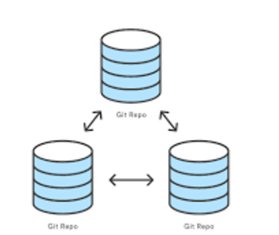
Git Repository Replication/Cloning
Following command replicate/clone already existing git repository
Git-Cmd> git clone <Repo-URL>

Slide 19

Confiz Git Branching Model

Slide 20
Branch Merging
git push origin --delete
Git-Cmd > git checkout <develop> #Target branch
Git-Cmd > git pull origin <develop>
Git-Cmd > git merge <release> #Source branch
git push -u origin <develop>
Git-Cmd > git push origin --delete <release>

Slide 21
Resolving Merging Conflicts
Resolving Merge Conflicts Manually
Use some visual diff-tool like WinMerge
Add WinMerge in .gitconfig for auto invocation
[diff] tool = winmerge
[difftool "winmerge"] cmd = "'C:/Program Files (x86)/WinMerge/WinMergeU.exe'" -e "$LOCAL" "$REMOTE“
git difftool <fb-branch> <develop>

Slide 22
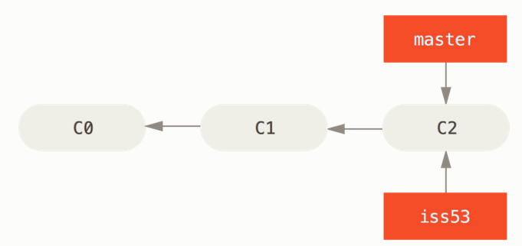
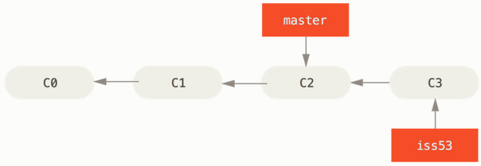
Resolving Merging Conflicts

Slide 23
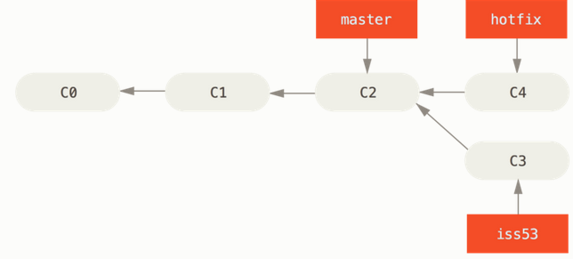
Resolving Merging Conflicts

Slide 24
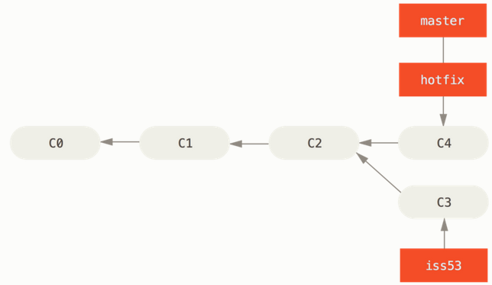
Resolving Merging Conflicts

Slide 25
Git Ignore
Git-Ignore file specifies rules to skip/ignore temporary files from staging
Object files generated during build process
IDE specific temporary files

Slide 26
Git Tagging
Tag is applied after release is merged back to master.
Possible versioning scheme vSprintNumber.Major.Minor
Git-Cmd> git tag -a vSN.m.n -m “Release Tag vSN.m.n"
Git-Cmd> git push origin vSN.m.n
Git-Cmd> git tag –l #list down active tags
Git-Cmd> git checkout <tag_name>
Git-Cmd> git checkout <tag_name> -b <branch_name>

Slide 27
Further Reading
https://git-scm.com/documentation
https://www.atlassian.com/git/tutorials
https://githowto.com/

Slide 28
Questions Answers
What’s on your Mind?

Slide 29


Thank You for participating!
www.confiz.com
29

