Slide 1

Analysis of Product Sales During the Month of January
Fernando Herrera Garza
Nov 2nd, 2023

Slide 2
Objective
The purpose of this analysis is to obtain the following insights regarding the company’s sales during the month of January:
Top five customers who placed the most orders in January.
Most popular productAgrupationID based on the total number of cases ordered.
Most ordered product ID of each productAgrupationID.
Sales volume variation across different territories.
Notable patterns or trends in the productAgrupationID with high sales volume.

Slide 3
Pre-Processing
The data was previously cleaned in order to avoid faulty entries from affecting the results. Discarded entries in this data set were due to:
Duplicated values.
Negative values in the Product Cases Ordered column.
Other transformations were performed regarding the Territory and Product Cases Ordered columns, involving the assignment of a region to each Territory and the adjustment of the Product Cases Ordered since the values consisted on mostly non-integers.

Slide 4
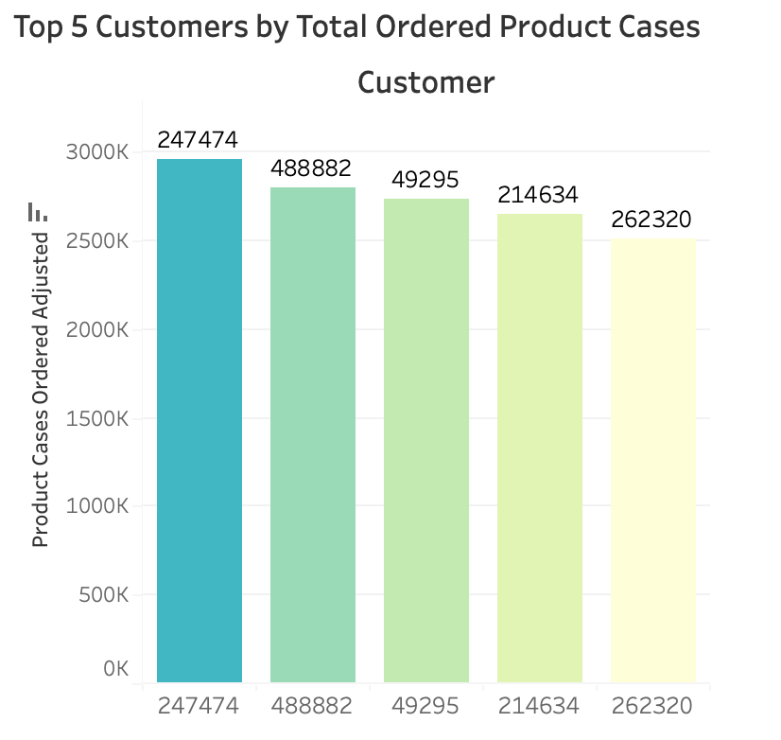
Insights
Top five customers who placed the most orders in January.
- - - - - - - - - - - - - - - -
Customers 247474, 488882, 49295, 214634, and 262320 where the five with the most orderes placed during January.

Slide 5
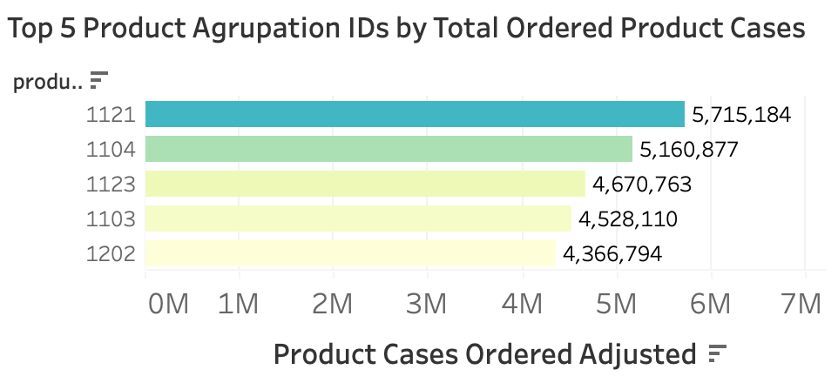
Insights
Most popular productAgrupationID based on the total
number of cases ordered.
- - - - - - - - - - - - - - - -
Product Agrupation ID 1121 was the most popular based on ordered cases, followed by 1104, 1123, 1103 and 1202.

Slide 6
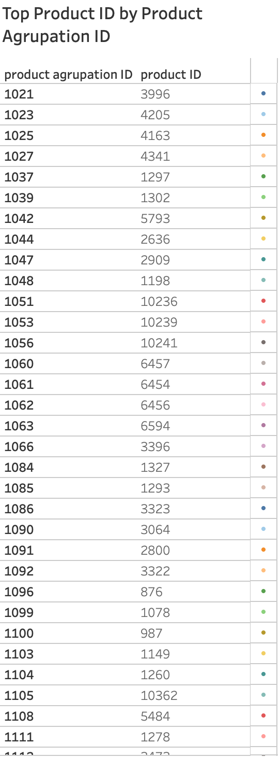
Insights
Most ordered product ID of each productAgrupationID.
- - - - - - - - - - - - - - - -
A total of 223 distinct product agrupation IDs where grouped, each with its corresponding most ordered product ID.

Slide 7
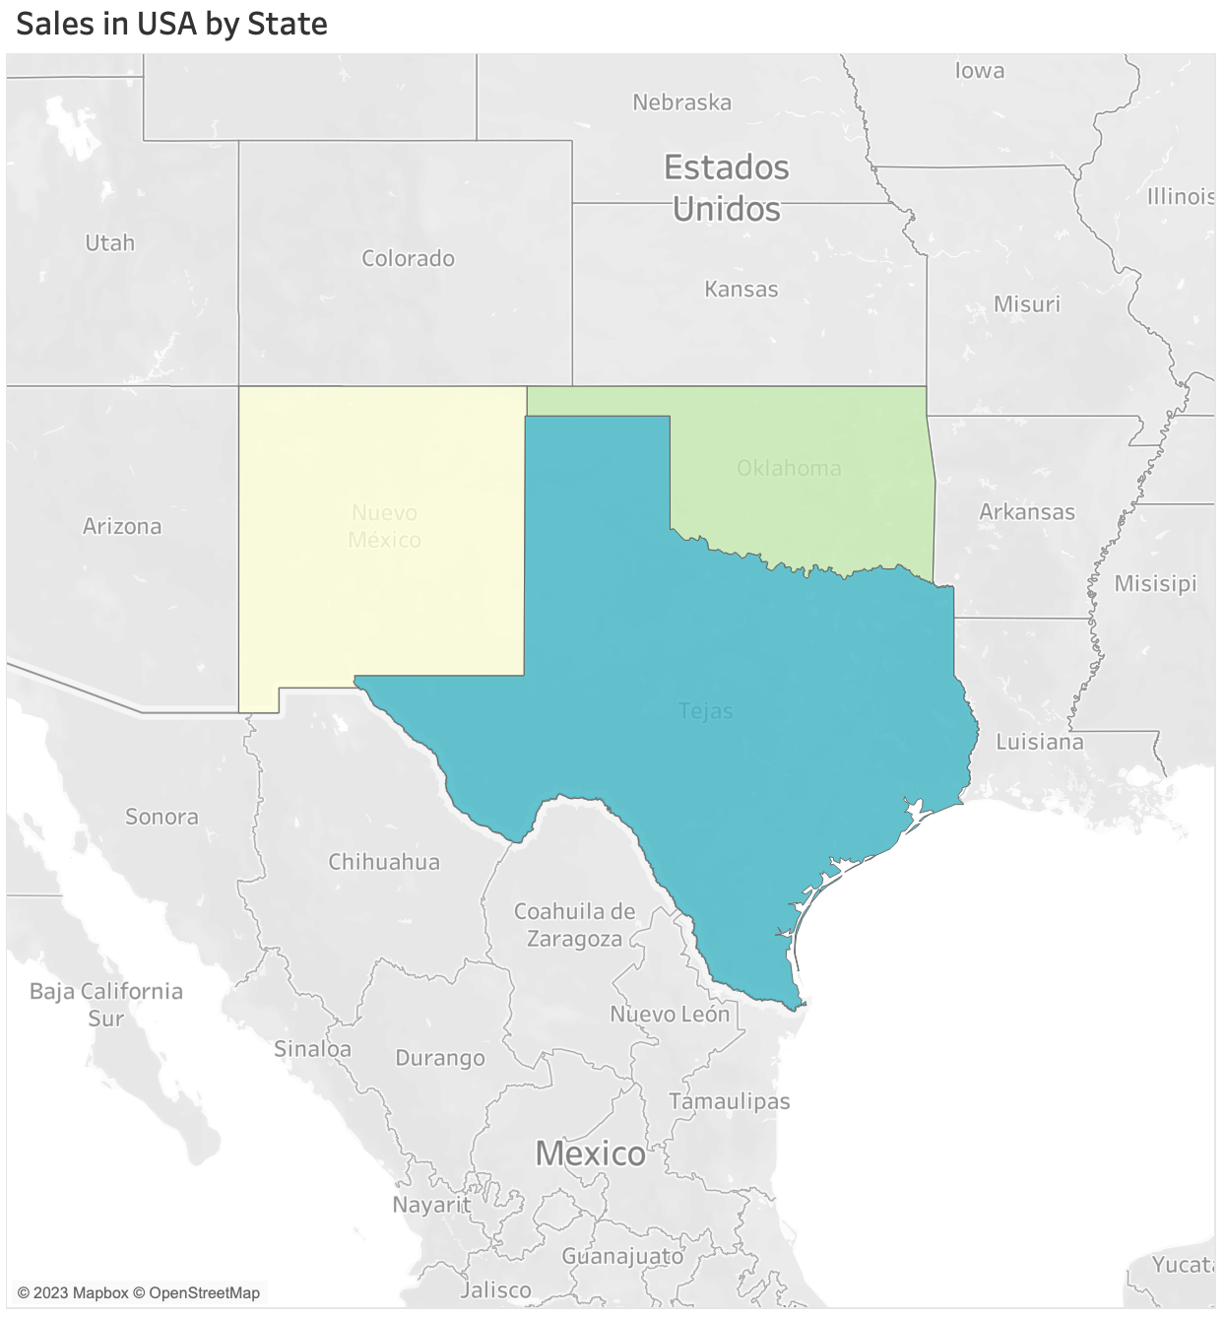
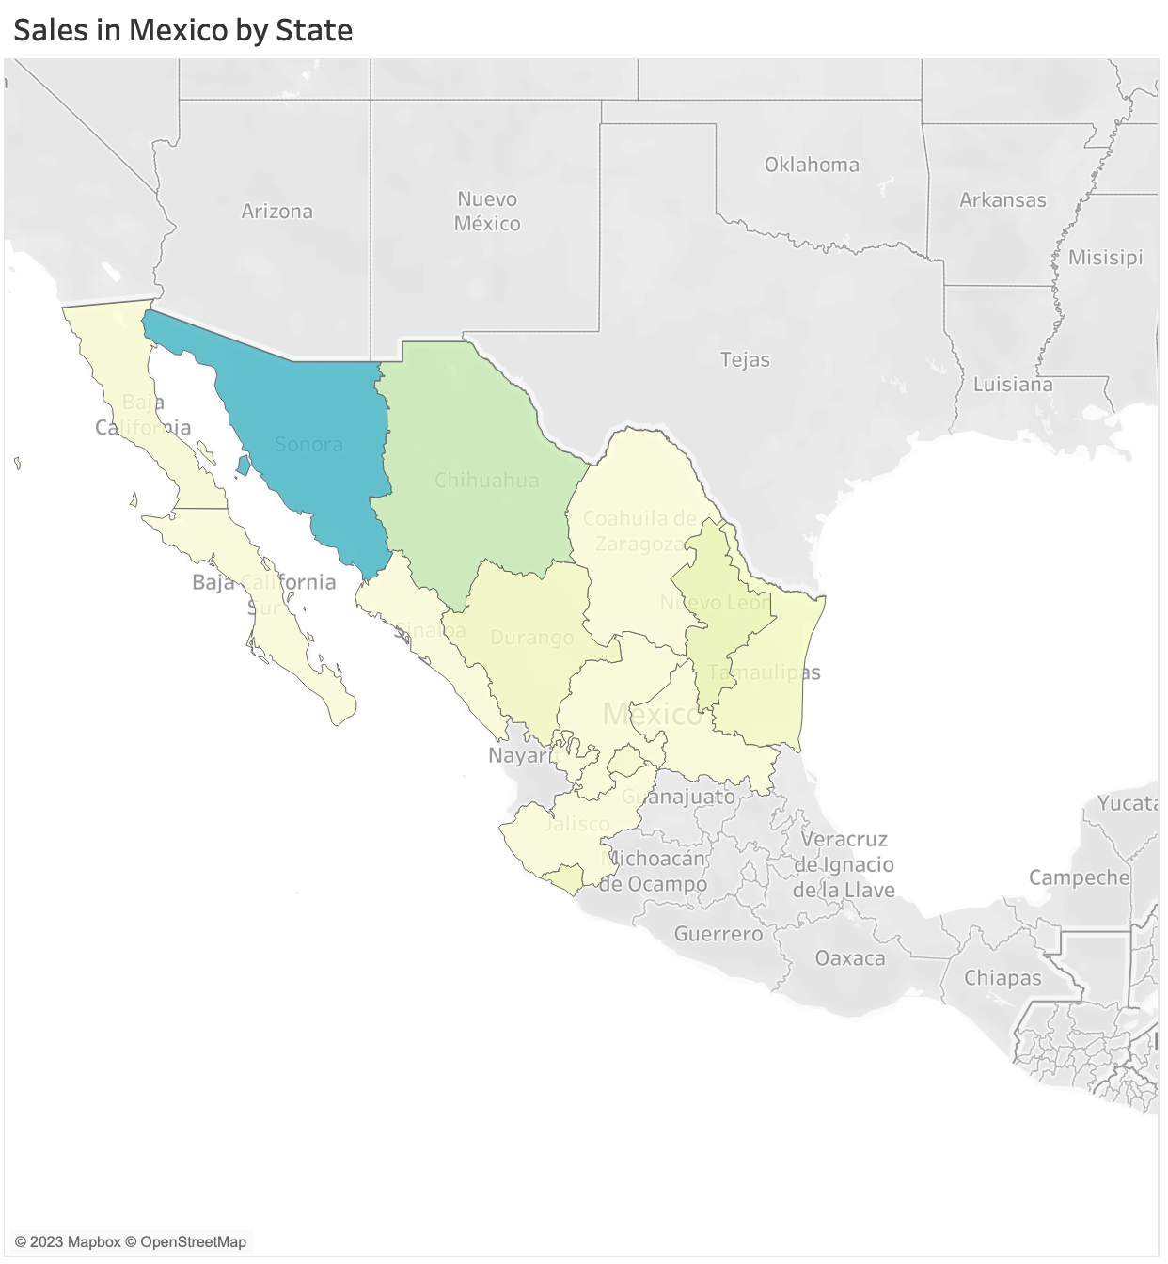
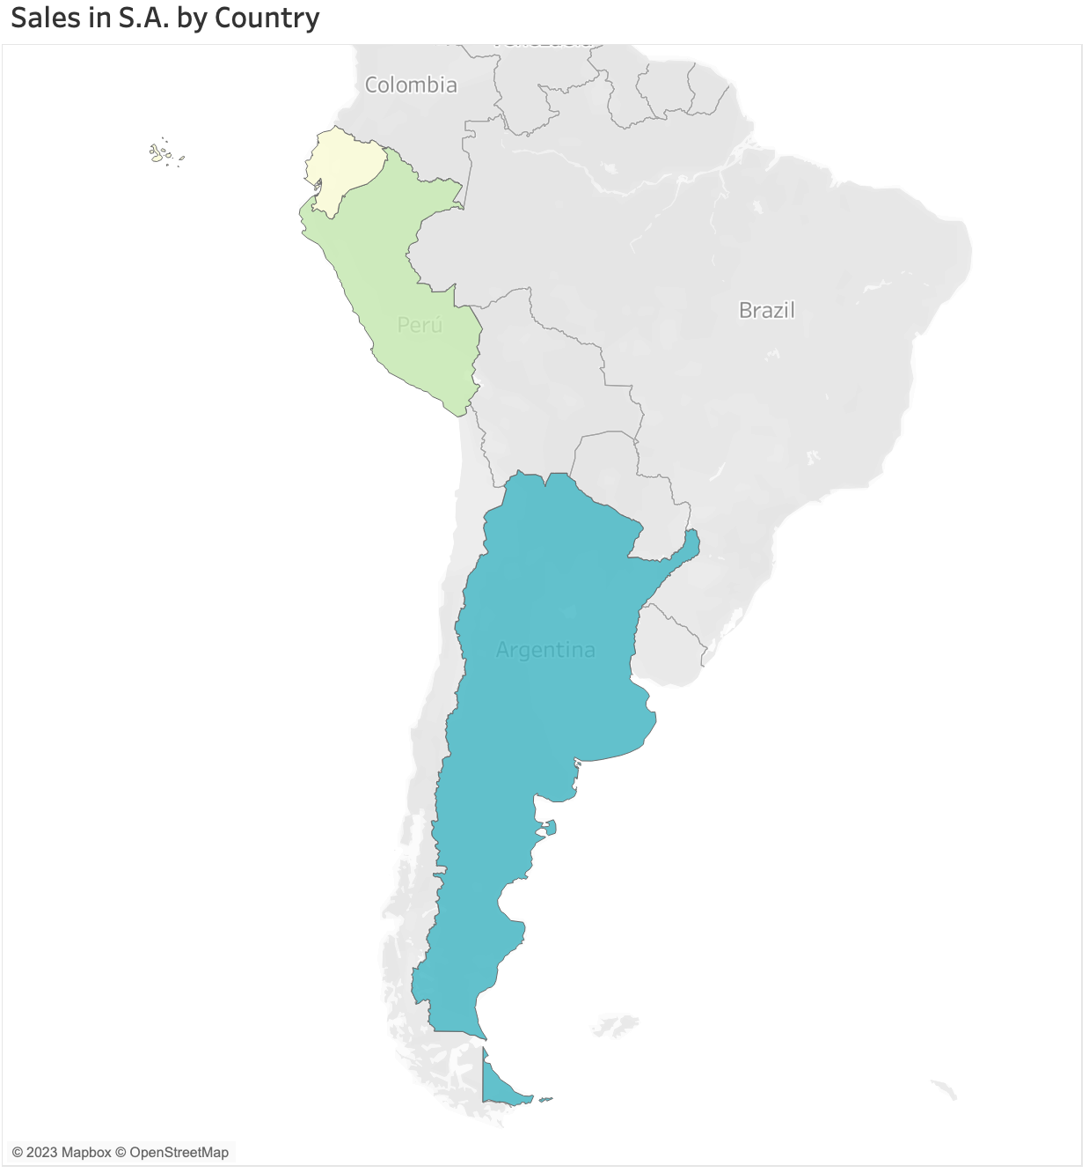
Insights
Sales volume variation across different territories.
- - - - - - - - - - - - - - - -
In Mexico, the state of Sonora showed the highest sales, while in USA Texas dominated. In South America, Argentina generated the most sales.

