Slide 1

Analysis of Product Sales During the Month of January
Data Analytics Team
Arca Continental
Nov 2nd, 2023
Collaborators:
Fernando Herrera Garza

Slide 2
Objective
The purpose of this analysis is to obtain the following insights regarding the company’s sales during the month of January:
Top five customers who placed the most orders in January.
Most popular product agrupation ID based on the total number of cases ordered.
Most ordered product ID of each product agrupation ID.
Sales volume variation across different territories.
Notable patterns or trends in the product agrupation ID with high sales volume.

Slide 3
Pre-Processing
The data was previously cleaned in order to avoid faulty entries from affecting the results. Discarded entries in this data set were due to:
Duplicated values.
Negative values in the product cases ordered column.
Other transformations were performed regarding the territory and product cases ordered fields, involving the assignment of a geographical region to each territory and the adjustment of the product cases ordered since the values consisted of mostly non-integers.

Slide 4
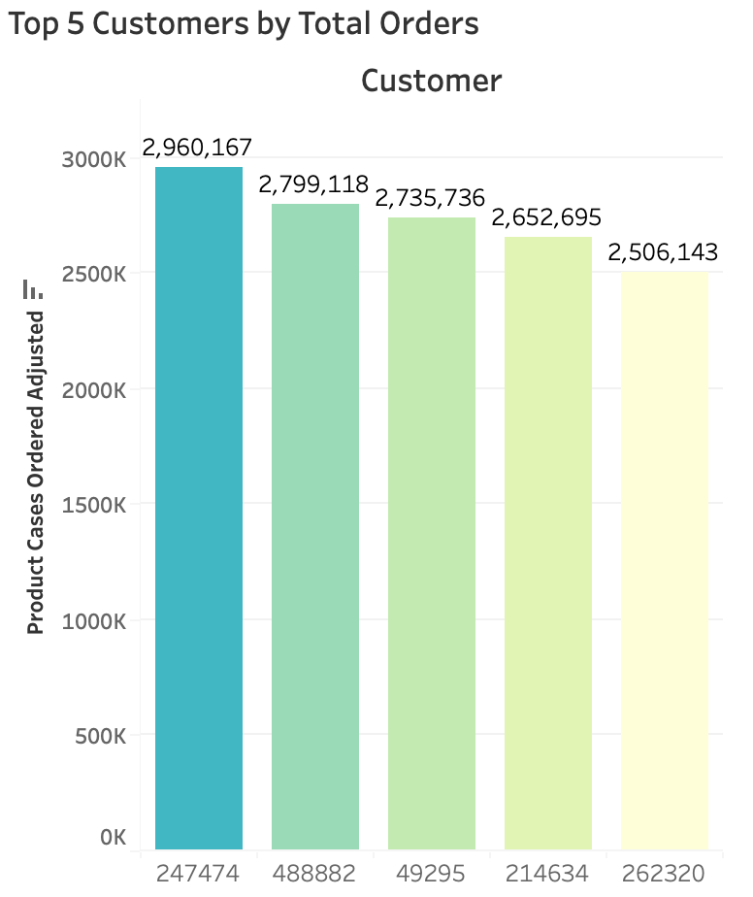
Insights
Top five customers who placed the most orders in January.
- - - - - - - - - - - - - - - -
Customers 247474, 488882, 49295, 214634, and 262320 were the five with the most orders placed during January.
4 of these customers are located in a border state of Mexico:
Durango, Chihuahua, Nuevo León, Sonora, and Baja California Norte.

Slide 5
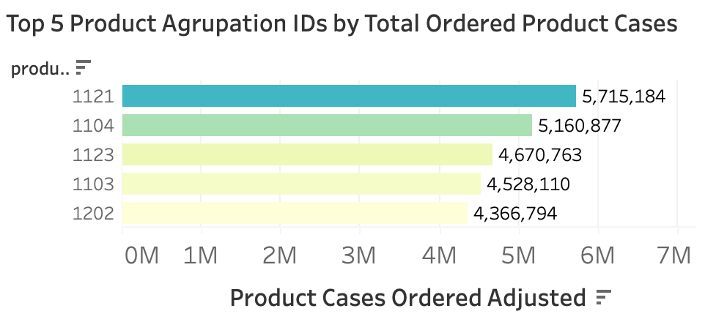
Insights
Most popular product agrupation ID based on the total number of cases ordered.
- - - - - - - - - - - - - - - -
Product agrupation ID 1121 was the most popular based on ordered cases, followed by 1104, 1123, 1103 and 1202.

Slide 6
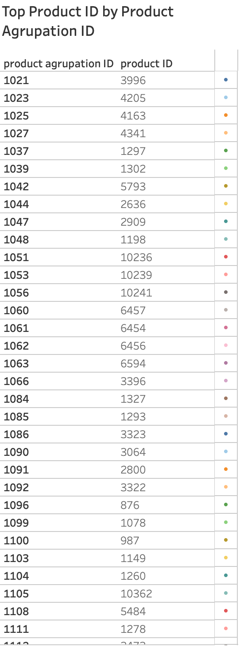
Insights
Most ordered product ID of each product
agrupation ID.
- - - - - - - - - - - - - - - -
A total of 223 distinct product agrupation IDs where grouped, each with its corresponding most ordered product ID.
*

Slide 7
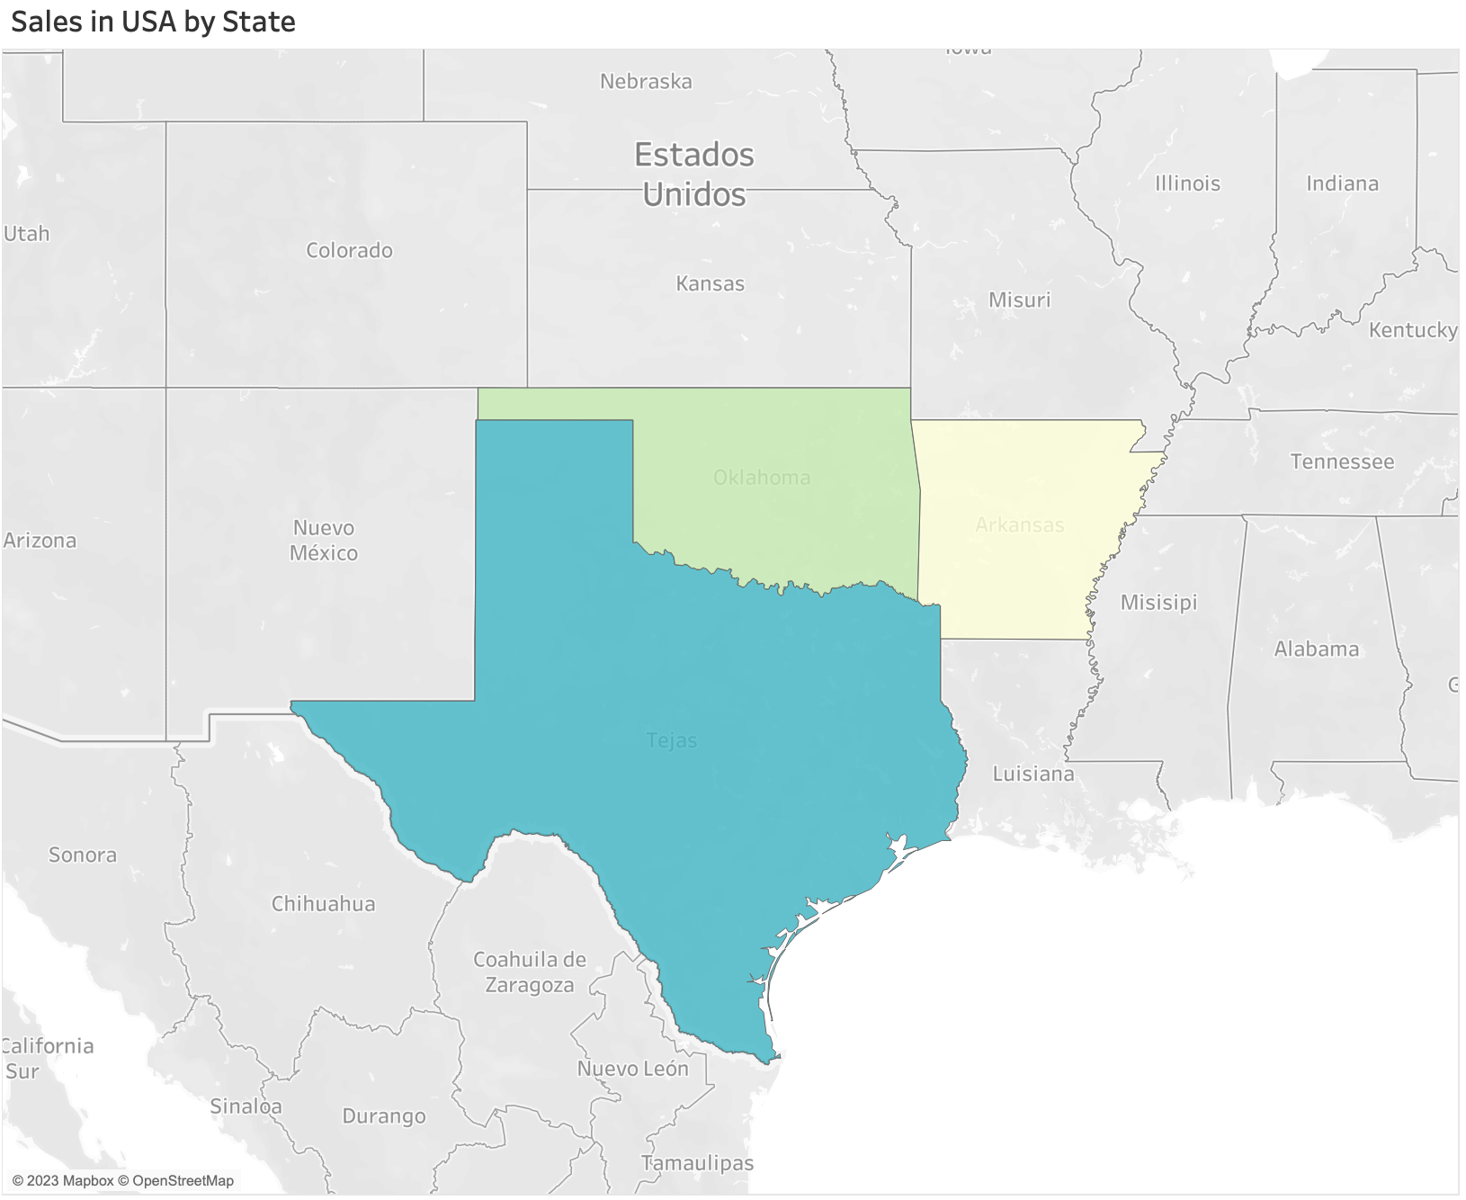
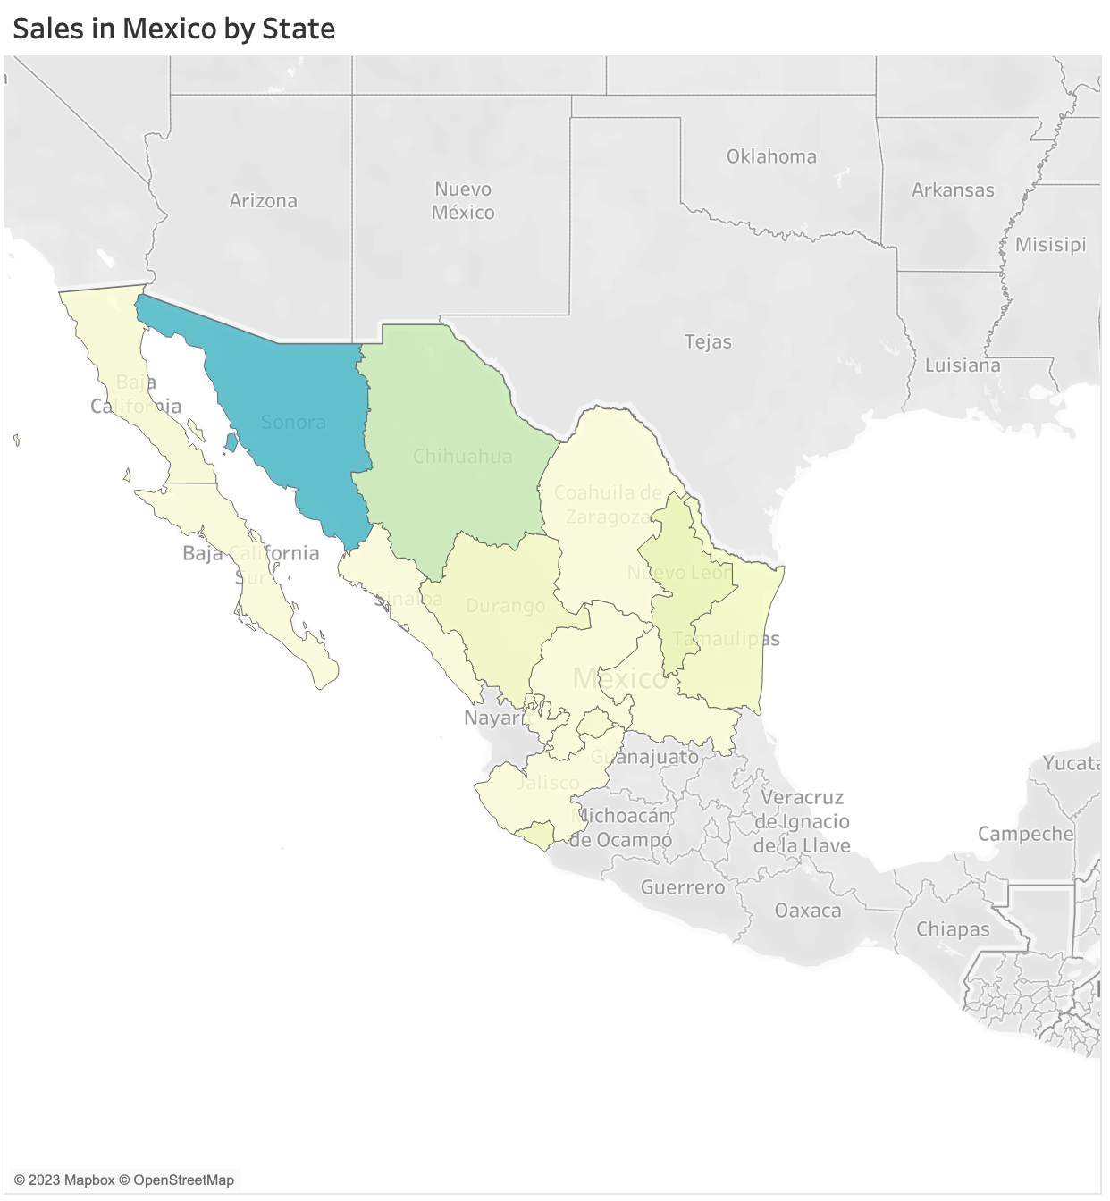
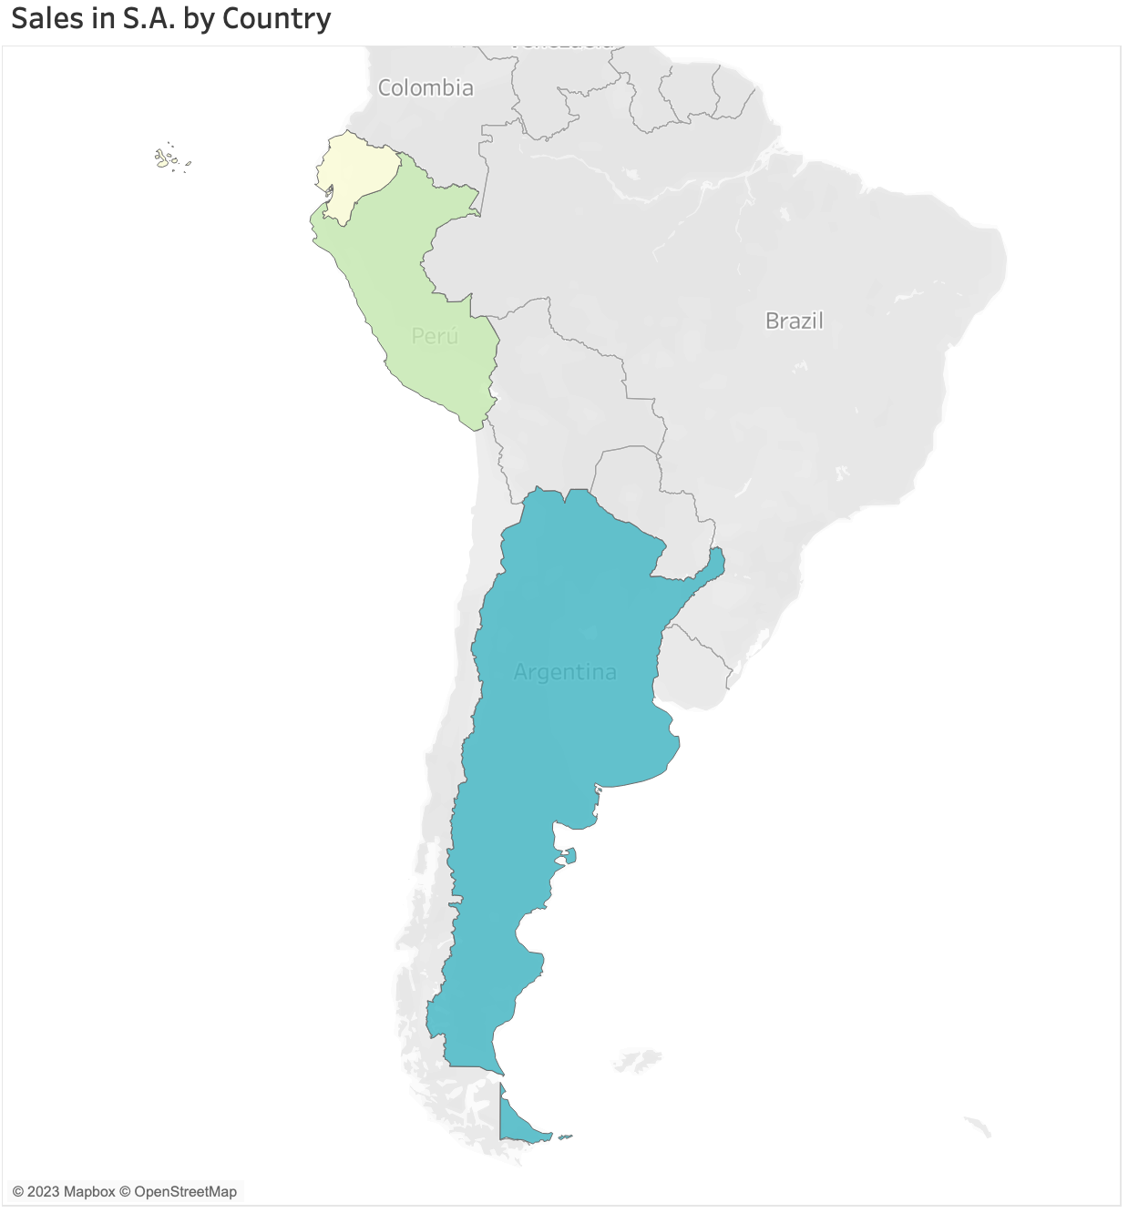
Insights
Sales volume variation across different territories.
- - - - - - - - - - - - - - - -
In Mexico, the state of Sonora showed the highest sales, while in USA Texas dominated. In South America, Argentina generated the most sales.
*

Slide 8
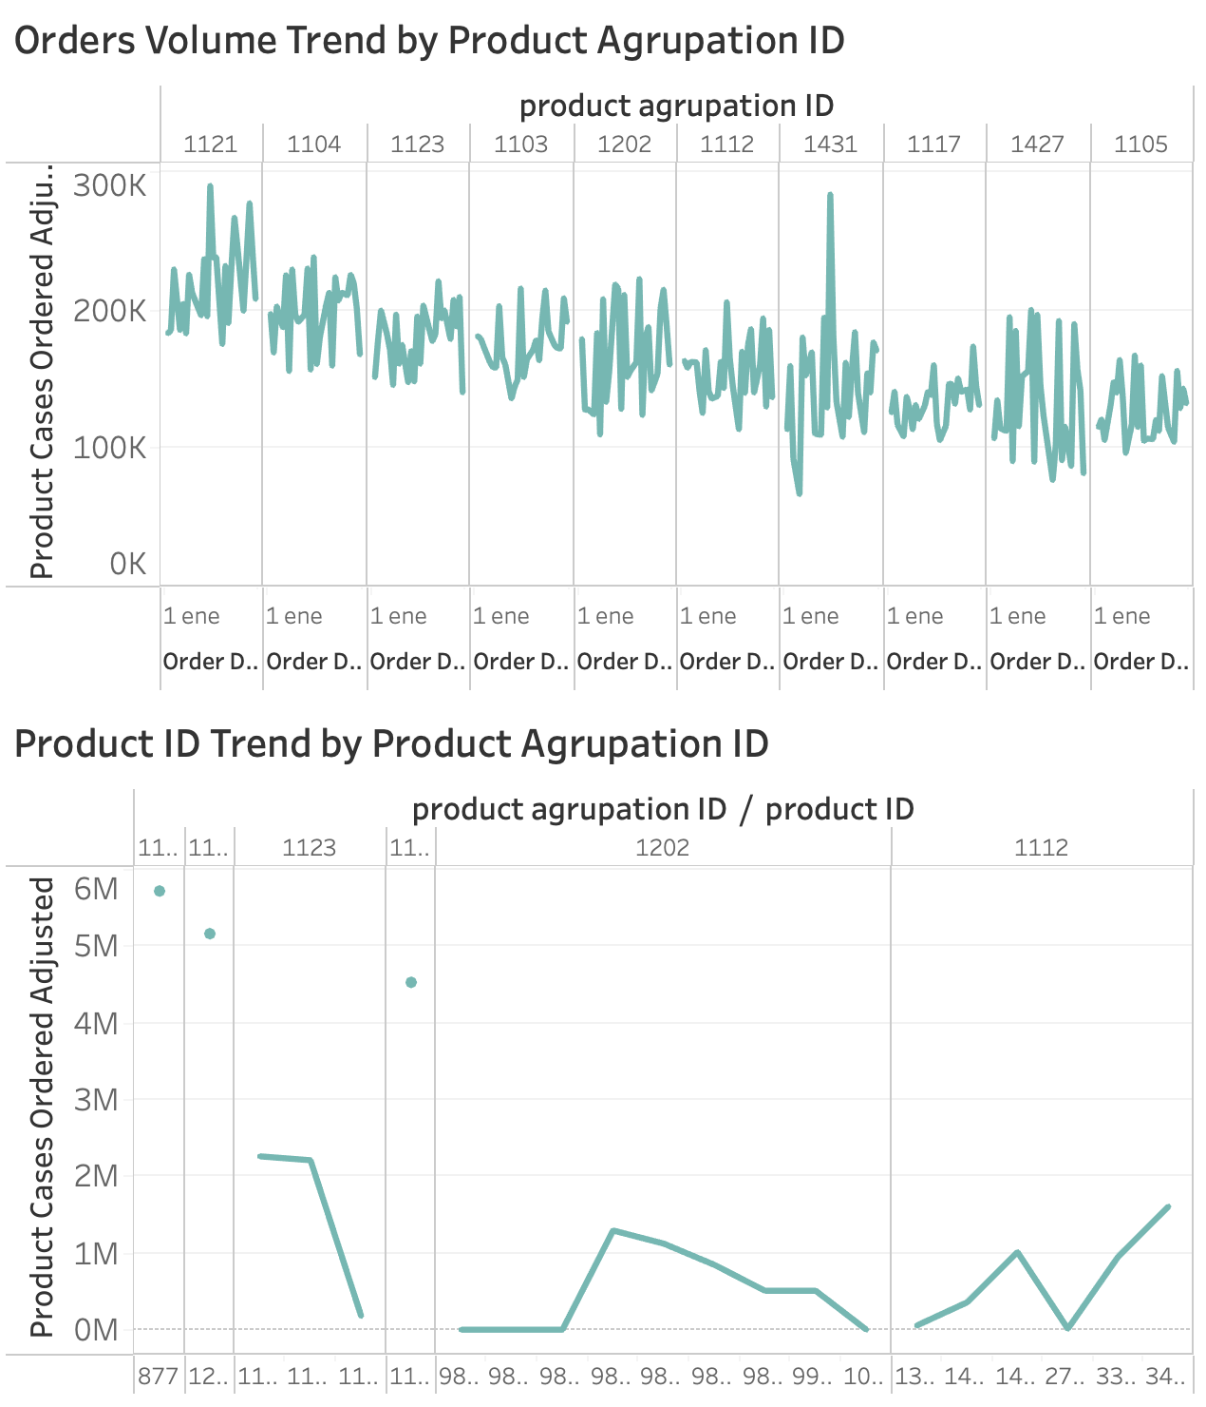
Insights
Notable patterns or trends in the product agrupation ID with high sales volume.
- - - - - - - - - - - - - - - -
For many of the most popular agrupation IDs, we can see sales spikes in the 16th of January (5 out of the top 7).
3 out of the top 5 agrupation IDs consist of a single product ID.

Slide 9
Appendix
Tableau Dashboard 1:
https://public.tableau.com/views/DataTranslationCaseDashboard1/Dashboard1?:language=es-ES&publish=yes&:display_count=n&:origin=viz_share_link
Tableau Dashboard 2:
https://public.tableau.com/views/DataTranslationCaseDashboard2/Dashboard2?:language=es-ES&publish=yes&:display_count=n&:origin=viz_share_link
Jupyter Notebook:
https://github.com/fhg99/ArcaApplication/blob/master/analysis.ipynb

