Slide 1
Elevator Control Center
Alexander Breitenberger, Michael Kargl, Philipp Holzer

Slide 2
Build Automation
Automated build
Automated tests
SonarCloud analysis (Coverage, Static code analysis)
Required coverage for old code at least 60%
Required coverage for new code at least 80%
Required mutation coverage of at least 80%
GitHub Actions
On pull request on master branch
Long CI runtime due to mutation tests

Slide 3
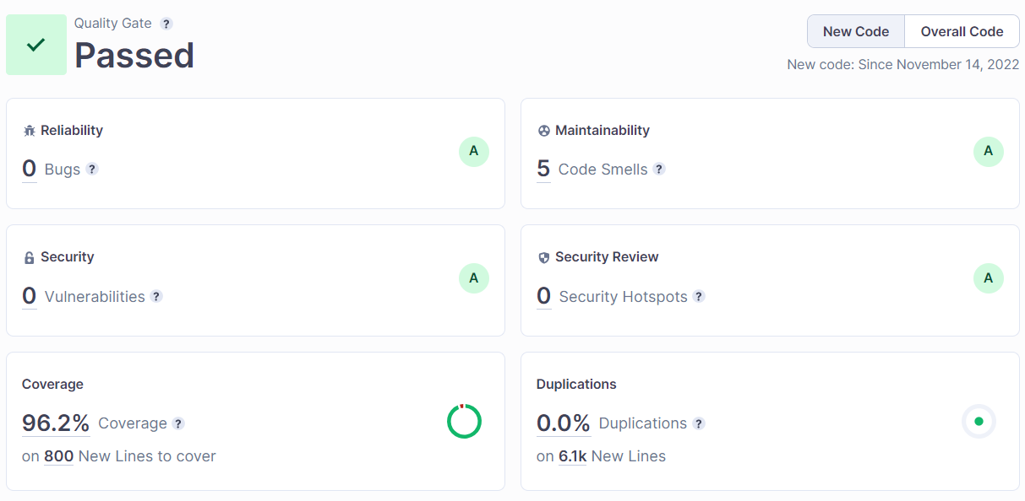
Static Code Analysis

Slide 4
Code Reviews
Master branch locked
Merging on master only via pull request
Review on pull request
Ad-hoc code review
Pair programming sessions (for debugging)

Slide 5
Issue Management
TODOs in code where issues were discovered
List of major issues and TODOs
Issue assignment to specific developers
Requesting support/further information for difficult issues

Slide 6
Testing Techniques
White box unit testing with JUnit
Mockito for mocking dependencies
Mutation tests to ensure high test quality
Testing sequences for automatic mode (automated with Junit)
Automated UI tests with TestFx
Special attention to error handling testing
Automated system tests with TestFx (e.g. update mechanism, reconnect)

Slide 7
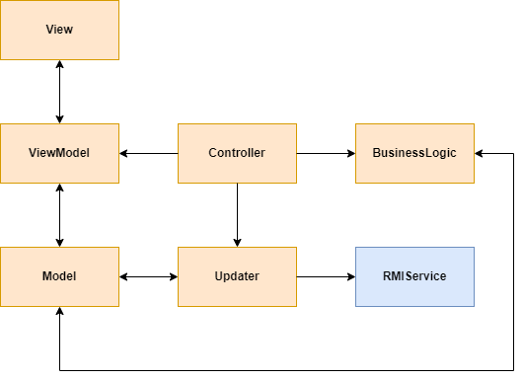
Software Architecture
MVVM
For each model:
Individual Updater
Individual ViewModel
Individual View
Trinity of the architecture:
Building
Floor
Elevator

Slide 8
What else to say…
Encountered problems
Lessons learned
Bug(s) in elevator simulator
Incomplete requirements (serviced floors)
Various timing issues in GUI tests
Logger causing security vulnerability in SonarCloud
Bad testability is an indicator for bad SW design
Too high quality metrics may hinder productivity
In-depth code reviews save time later

