Slide 1
ECC
Sebastian Fragner, Alexander Rupp & Julian Schwarzinger

Slide 2
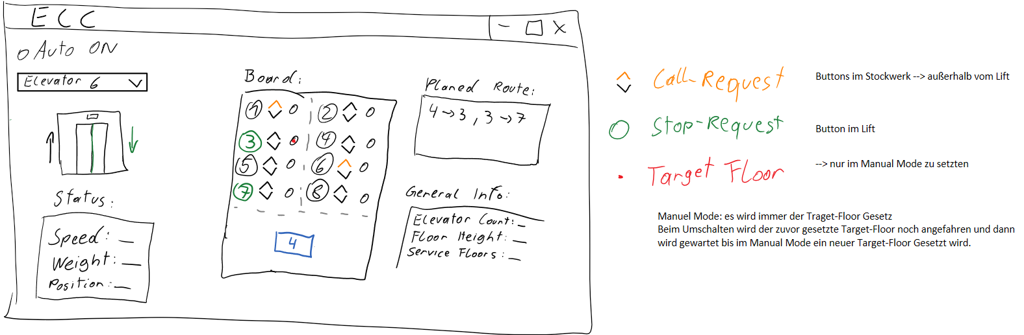
Design

Slide 3
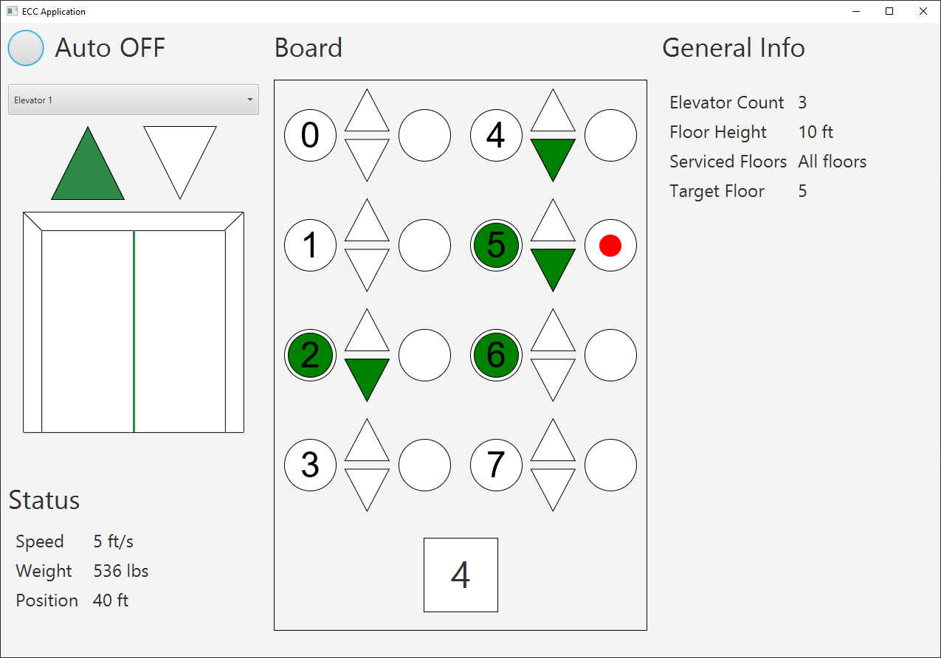
Main View

Slide 4
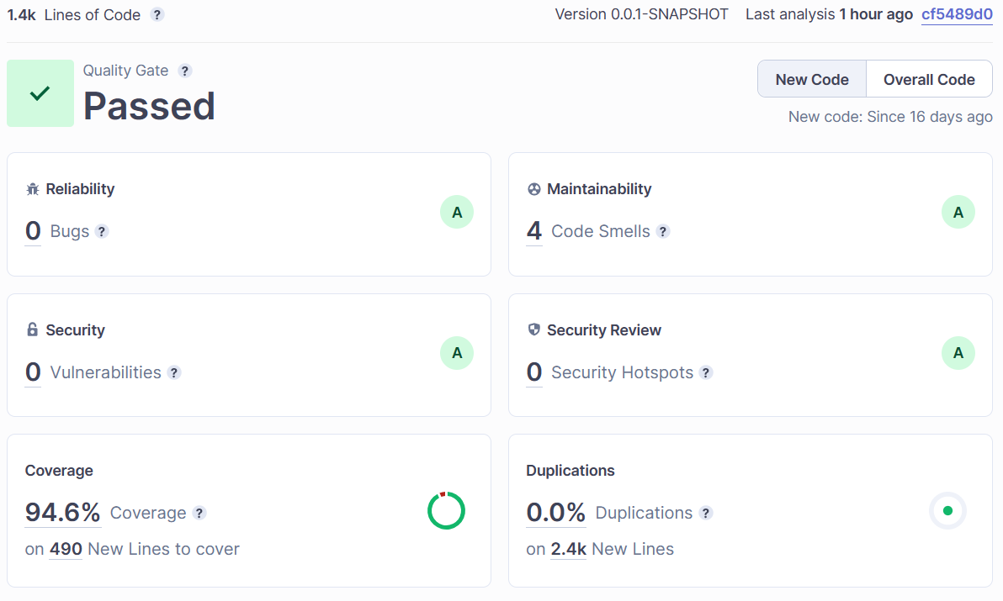
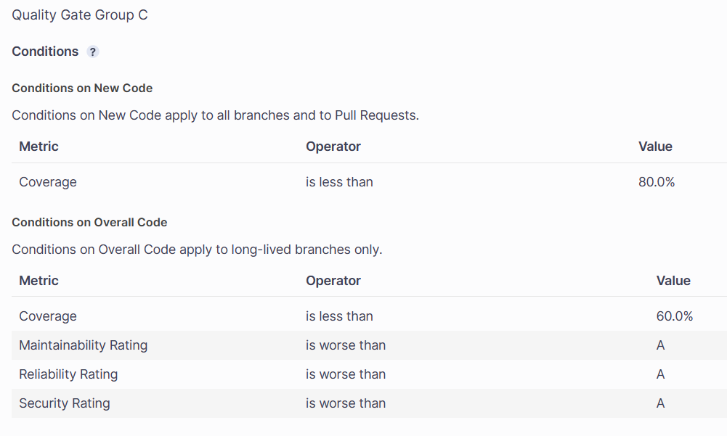
SonarCloud

Slide 5
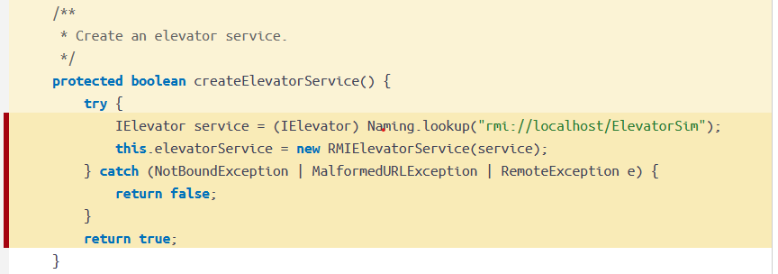
Code coverage

Slide 6
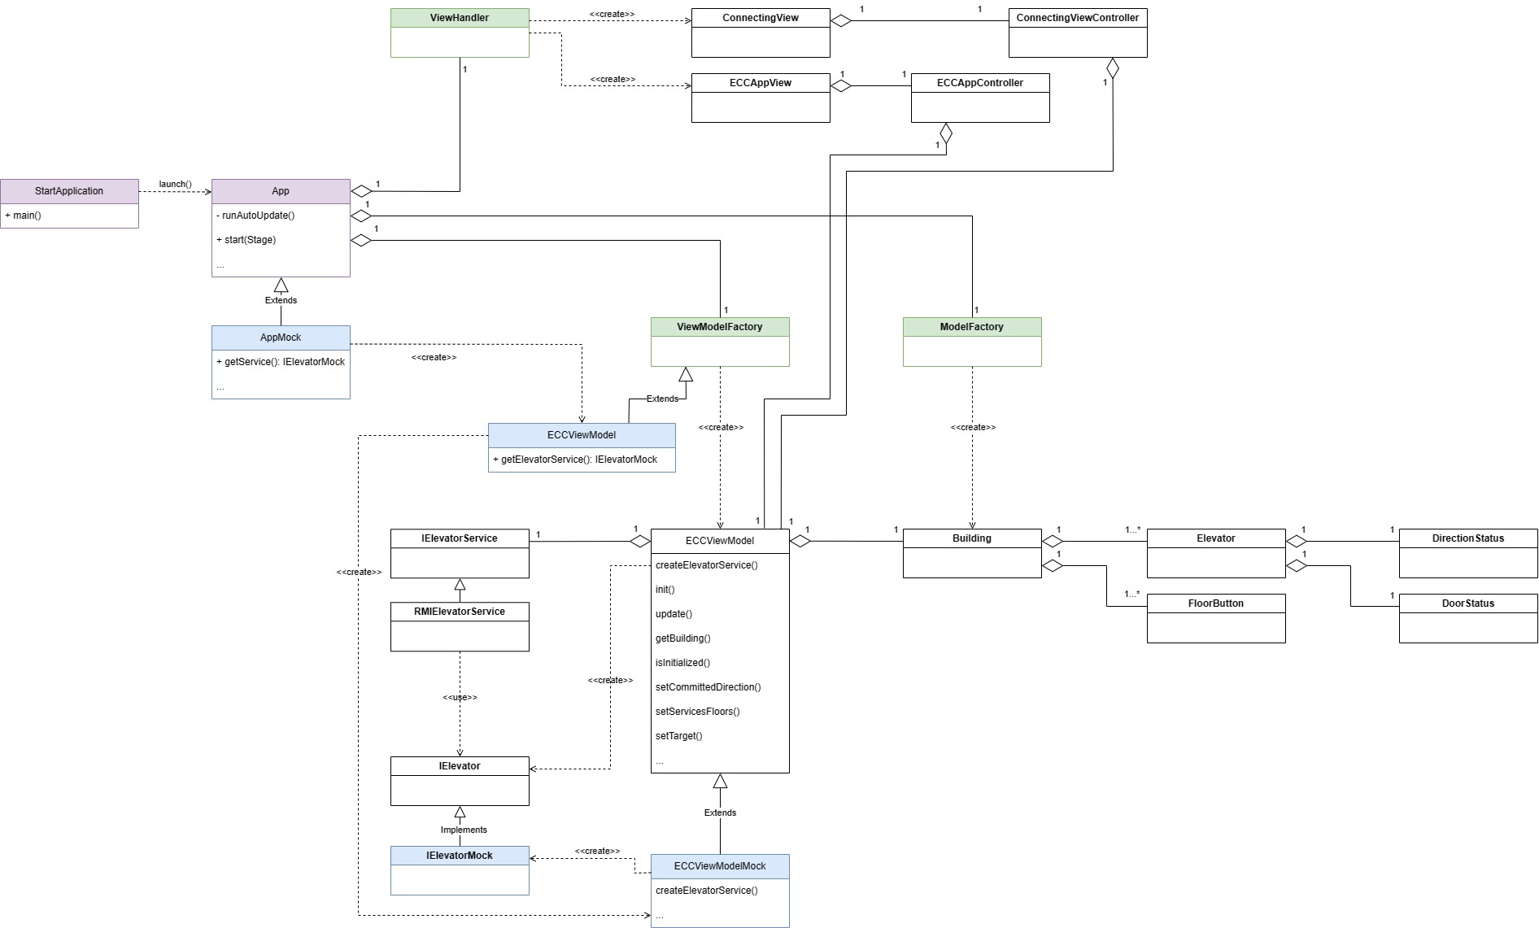
Architectural overview

Slide 7
Project & Product Quality
Build automation / Continous integration
Automated test execution
Issue management with Pair Programming
Testing techniques
White box
Unit Testing
Mock Objects
Black box
GUI test with FxRobot

Slide 8
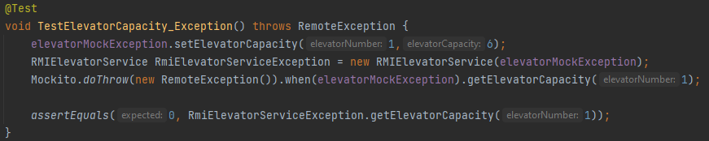
Trick code snippet

Slide 9
Lessons learned
Disable SonarCloud in the beginning of the project.
Create mock objects right from the beginning due to testing.
Think about a good structure first to make it easily testable.
Dynamic GUI implementation is not the easy stuff.

Slide 10
Live Demo

