Slide 1
Elevator Control System
Andreas Roither | Maike Rieger | Clemens Tögel

Slide 2
Architecture
01.
Lessons learned
04.
Project Quality
02.
Tricky problems
05.
Product Quality
03.
Demo
06.
System architecture
Lessons learned with testing
Techniques to ensure our project quality
Tricky problems we faced and solved
Techniques to ensure our product quality
Demo of automatic and manual mode

Slide 3
01
Architecture

Slide 4
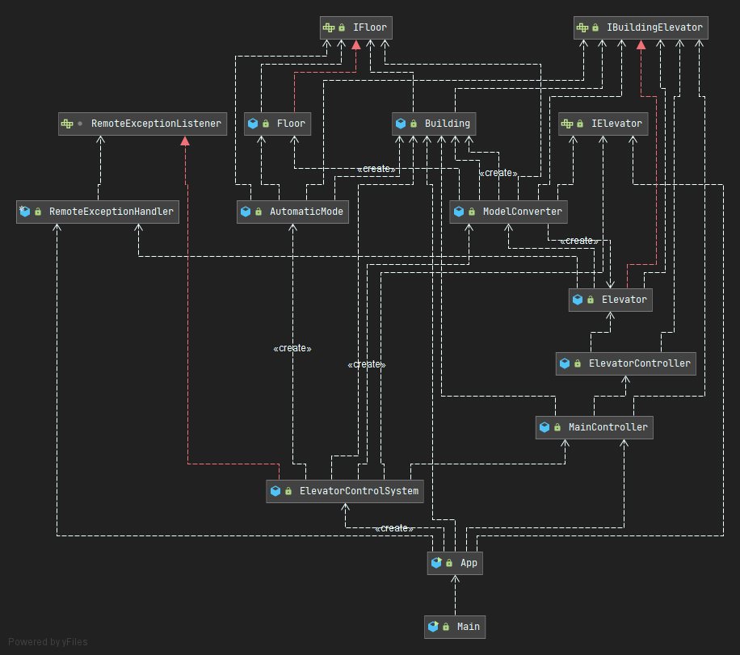
Class diagram
Main class: App - but started via Main class

Slide 5
02
Project Quality

Slide 6

Used techniques
Whatsapp
Submissions = Sprints
Tasks + Teamwork
coordination
used submission recommandations as sprint times
everyone got own tasks
hard things were done in team

Slide 7
03
Product
Quality

Slide 8

Used techniques
Github
Automated build + test execution
Quality Gates
coordination
quality gates have to be met
execute tests and build automatically
white-box, automatic and UI tests

Slide 9
Code quality
Code Reviews
Pull requests
Branches
remove code smells, hotspots, … (sonarcloud)
review branches before pushing into main
feature = branch

Slide 10
04
Lessons Learned

Slide 11
Lessons
Testing is hard
RMI
Time consuming
WhiteBox Tests
UI-Thread
Code Reviews
paths are often forgotten
does not always work as expected
good tests need time
code quality would increase with black box tests
“not on JavaFX application thread”
very helpful

Slide 12
05
Tricky Problems

Slide 13
Problems
Assert vs assert
jar file packaging
xvfb-run
application thread
hard with maven
application class not useable
gui - tests do not work without it

Slide 14
06
Demo

