Slide 1
A Hardware Performance Monitor Tool On The Data Path
Aleksandr Stankoski, Florian Hilprecht, David Brand, Jan Heidrich

Slide 2
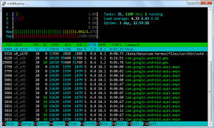
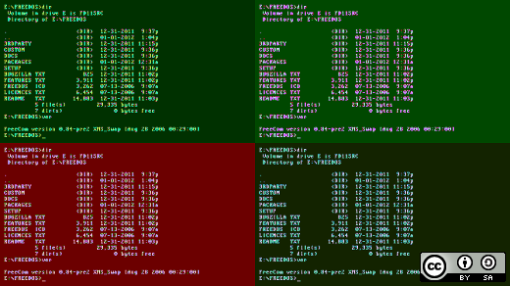

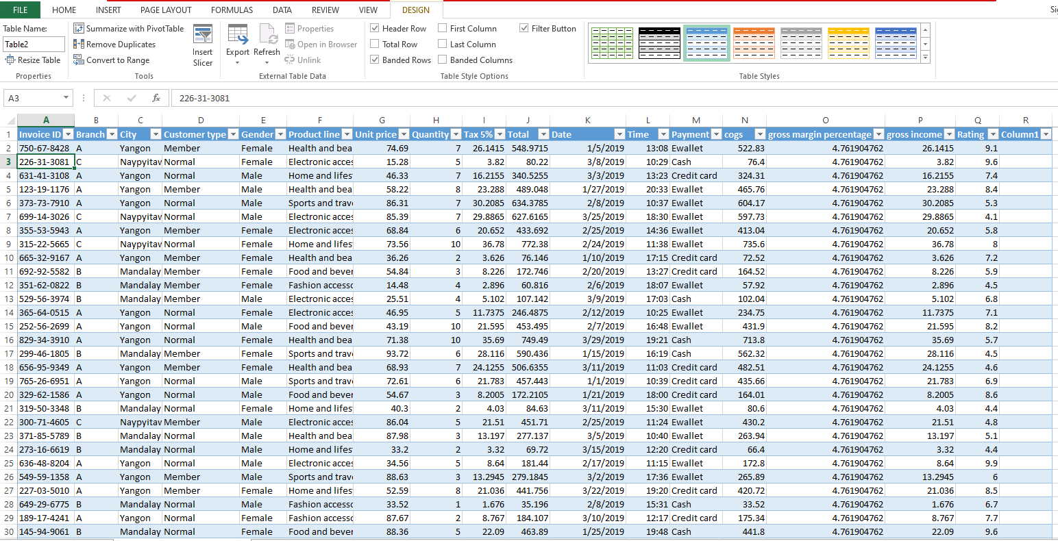
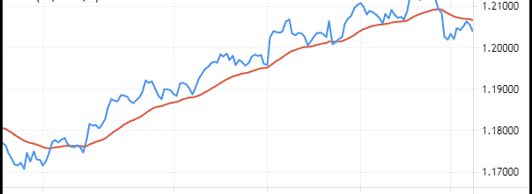
Motivation - Currently
Time consuming watching over measurement processes
No unified framework to use multiple tools at the same time
Tedious calculations on top of measurements
Repeatedly creating the same diagrams

Slide 3
Problem
We want to see all information that can measured on the data path
TODO show here animation of data path with olap

Slide 4
sleep
waitingKernel
CPU
GPU
CudaMemcpy
cuFileRead
host_write_bytes
SSD

Slide 5

Motivation - Goal
Extensible using good abstraction
Easy to use
GPU
Hardware
Monitoring
CSV - Output
CPU
MainProgram
SSD

Slide 6

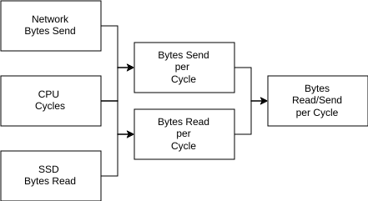

Architecture
Measuring Metrics
Aggregate Metrics
Create Metrics

Slide 7
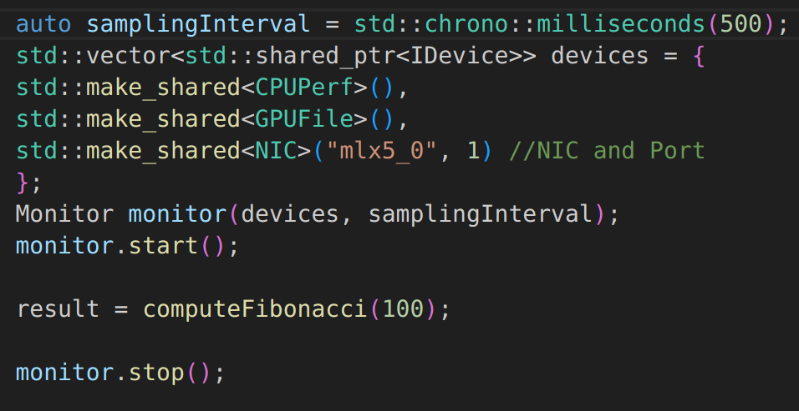
Usage
Start
Monitoring
Workload
End
Monitoring

Slide 8
Usage - Device

Slide 9
Experiments
Used to Verify Functionality
Test Impact on underlying Program
Show Example Usage

Slide 10
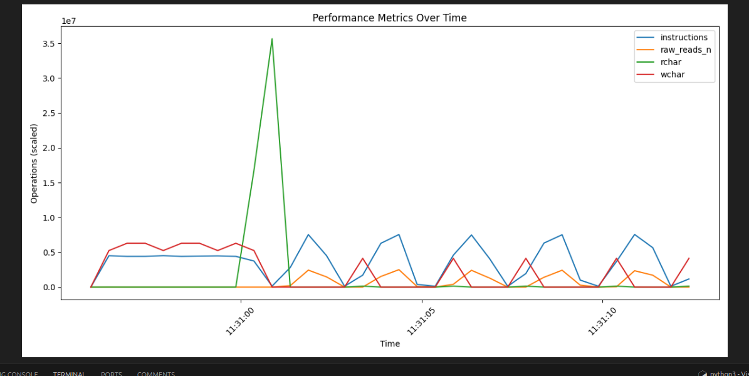
Experiment 0
Used to verify Tool Functionality
Run Tool with sample workload
Test prolonged usage (>1h) impact on program

Slide 11
Experiment 1 Validity Check
Devices run outside of monitoring are producing the same numbers
Maybe add a bar chart shoving that they are equal height

Slide 12
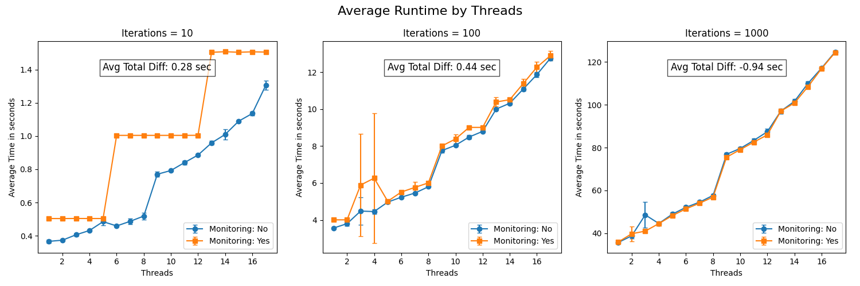
Experiment 2 Performance
Test Performance Impact on Program with high Thread Usage
Run High CPU Workload on multiple Threads many times

Slide 13
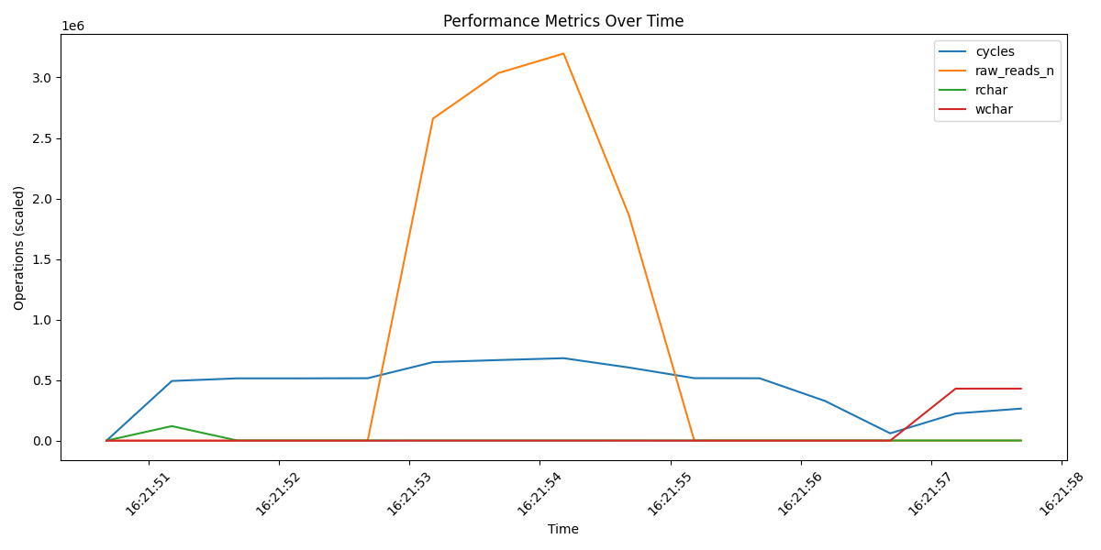
Experiments 3 Workloads
Blocking Optimize numbers a bit more

Slide 14
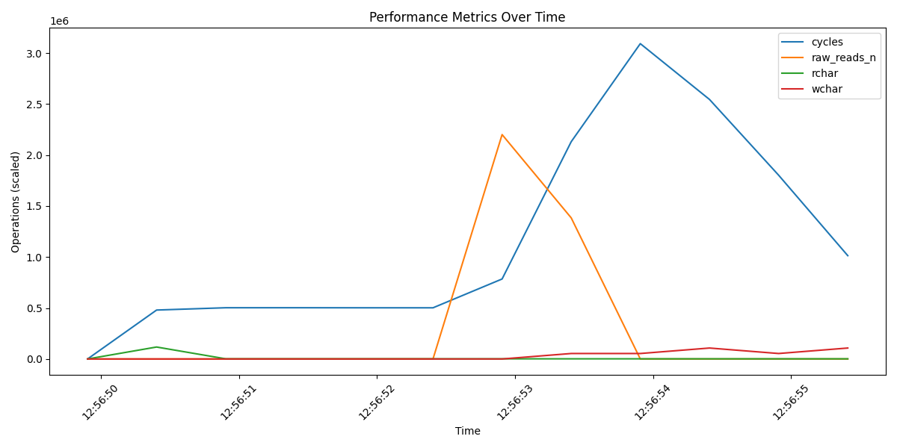
Experiments 3 Workloads
Pipelined same as before to see effect and improvement of algorithm

Slide 15
Summary
Unified and expandable monitoring framework along with foundational Devices (CPU/IO/GPU/NIC)
Allows to use other Metrics inside your Metric
Usable tool with the possibility to spot unexpected performance deficits in the data path
Small impact on program when setup properly

Slide 16
Future Work
Adding more devices
Group Devices of similar kind to ease implementing new Metrics
Usage in real world project

Slide 17
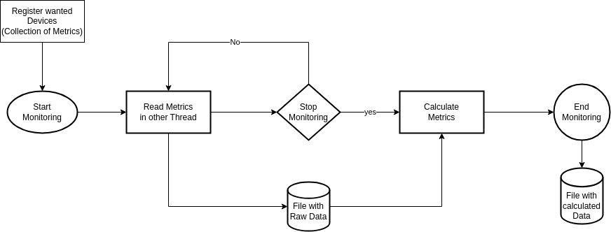
Architecture
Read Metrics: Only fetch (raw) Information in given Interval (Start, End, Periodically)
Calculate Metrics: Calculate new Metrics based on other Metrics/Data (AVG, Ratio, ...)

