Slide 1
A Hardware Performance Monitor Tool On The Data Path
Aleksandr Stankoski, Florian Hilprecht, David Brand, Jan Heidrich

Slide 2
Agenda
Motivation
Architecture
Usage
Experiments
Summary
Future Work

Slide 3
Motivation
Currently
  Wide range of performance tracking tools
  No unified framework to use multiple tools at the same time
  Can not easily correlate Metrics from multiple Tools
Our tool
  C++ Library to monitor program
  Unified and extensible framework
Goal: Monitoring whole data path

Slide 4
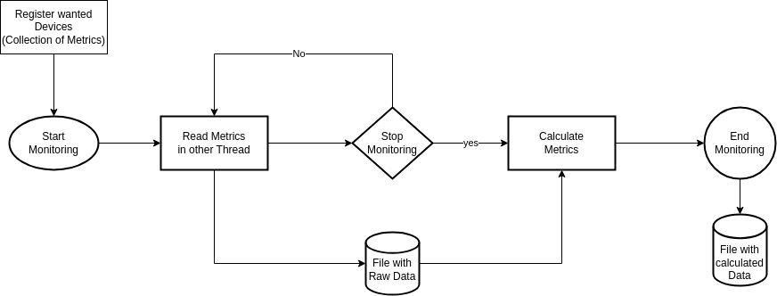
Architecture
Read Metrics: Only fetch (raw) Information in given Interval (Start, End, Periodically)
Calculate Metrics: Calculate new Metrics based on other Metrics/Data (AVG, Ratio, ...)

Slide 5
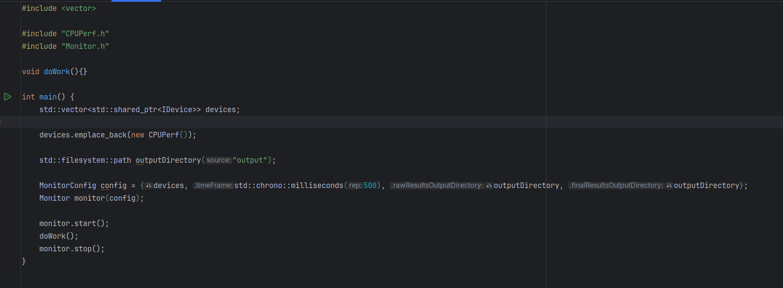
Usage

Slide 6
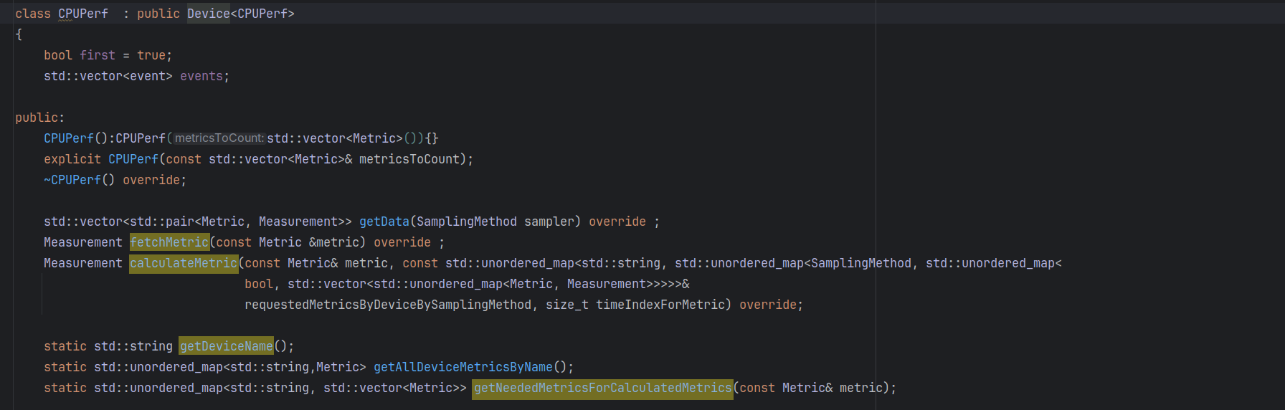
Usage - Device

Slide 7
Experiments
Used to Verify Functionality
Test Impact on underlying Program
Show Example Usage

Slide 8
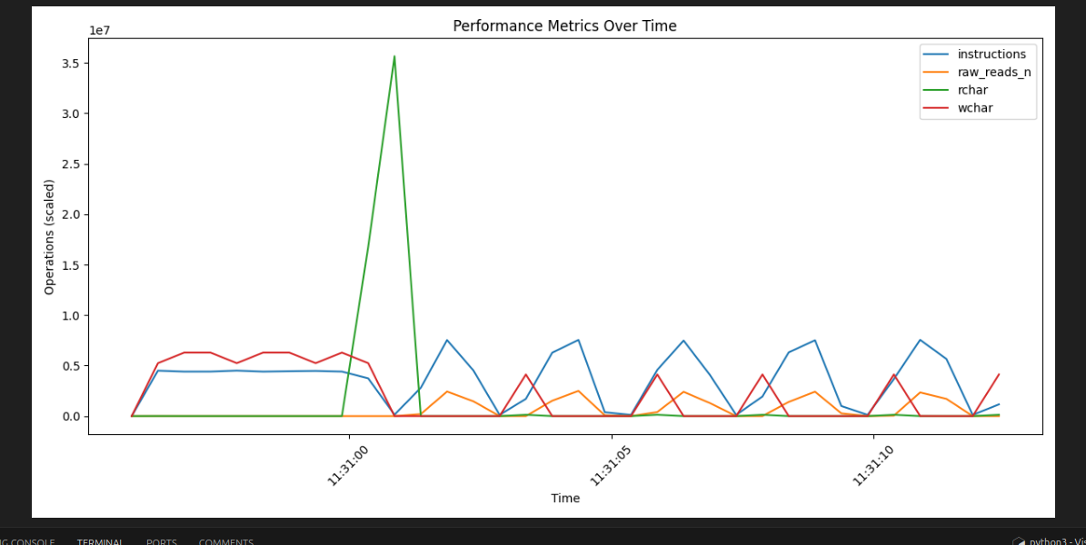
Experiment 0
Used to verify Tool Functionality
Run Tool with sample workload
Test prolonged usage (>1h) impact on program

Slide 9
Experiment 1 Validity Check
Devices run outside of monitoring are producing the same numbers
Maybe add a bar chart shoving that they are equal height

Slide 10
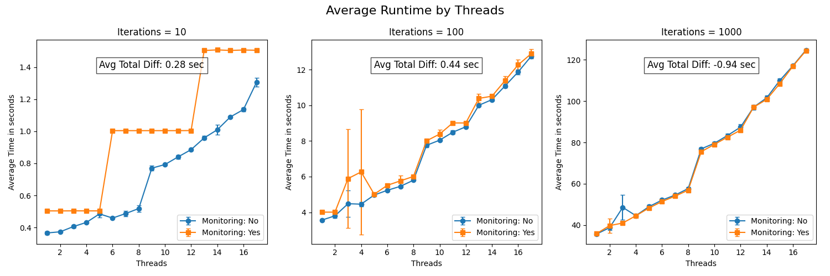
Experiment 2 Stability and Performance
Test Performance Impact on Program with high Thread Usage
Run High CPU Workload on multiple Threads many times

Slide 11
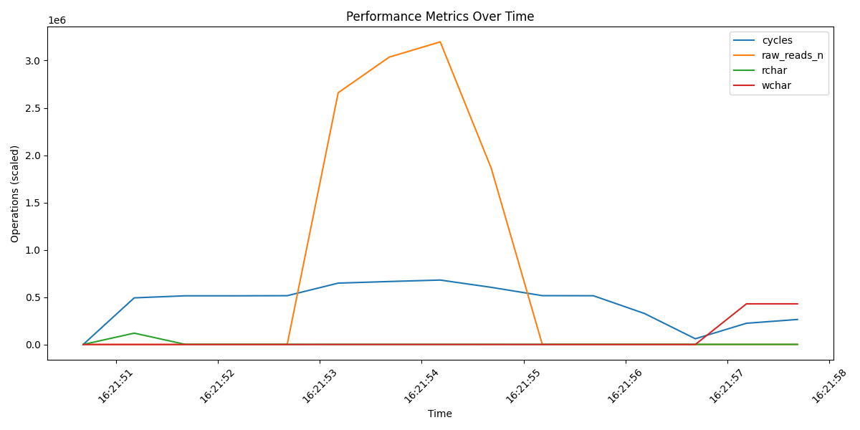
Experiments 3 Workloads
Blocking Optimize numbers a bit more

Slide 12
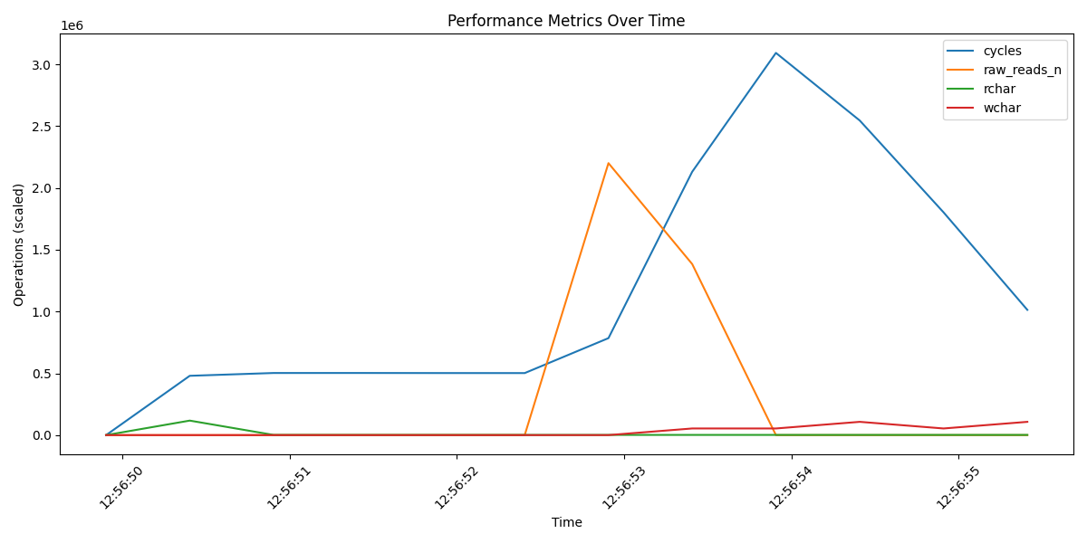
Experiments 3 Workloads
Pipelined same as before to see effect and improvement of algorithm

Slide 13
Summary
Unified and expandable monitoring framework along with foundational Devices (CPU/IO/GPU/NIC)
Allows to use other Metrics inside your Metric
Usable tool with the possibility to spot unexpected performance deficits in the data path
Small impact on program when setup properly

Slide 14
Future Work
Adding more devices
Group Devices of similar kind to ease implementing new Metrics
Usage in real world project

