Slide 1
A Hardware Performance Monitor Tool On The Data Path
Aleksandr Stankoski, Florian Hilprecht, David Brand, Jan Heidrich

Slide 2
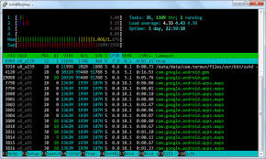
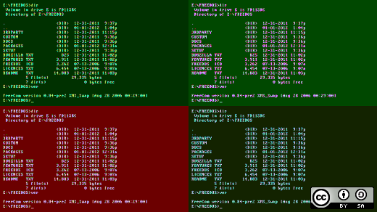

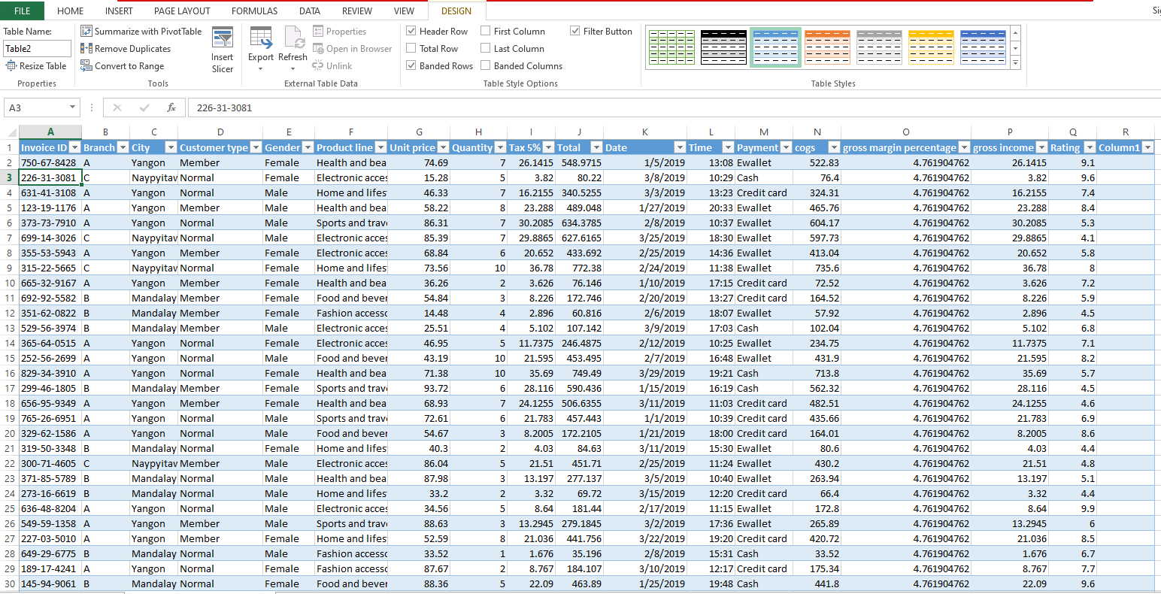
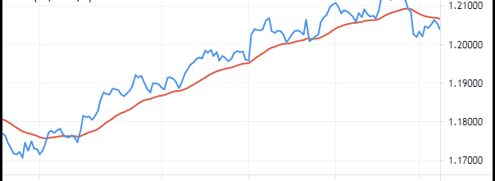
Motivation - Currently
Time consuming watching over measurement processes
No unified framework to use multiple tools at the same time
Tedious calculations on top of measurements
Repeatedly creating the same diagrams

Slide 3
CPU Work
Matrix Mults.
CPU
GPU
CudaMemcpy
cuFileRead
host_write_bytes
SSD

Slide 4
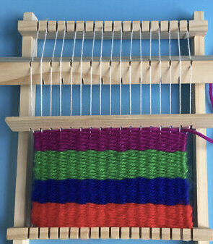
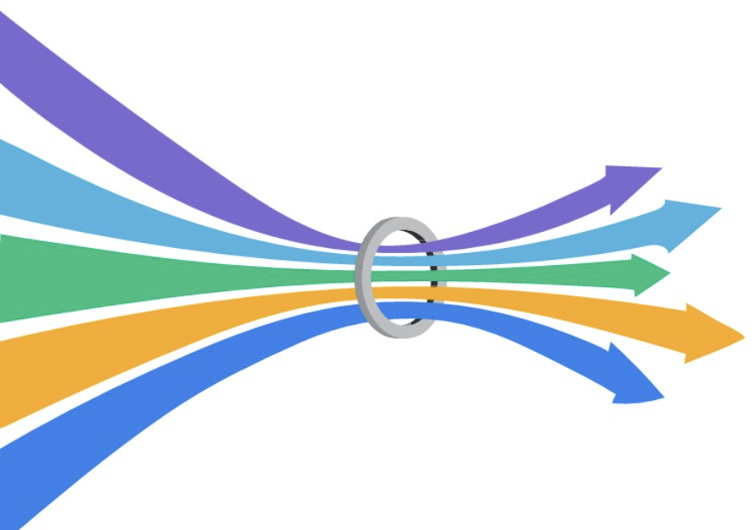

Other Use Cases and Problems
Finding Bottlenecks
Spot Potential for Parallelization
Finding Idling Devices
Distributing Workload

Slide 5

Schematic Overview
GPU
Hardware
Monitoring
CSV - Output
CPU
MainProgram
SSD

Slide 6
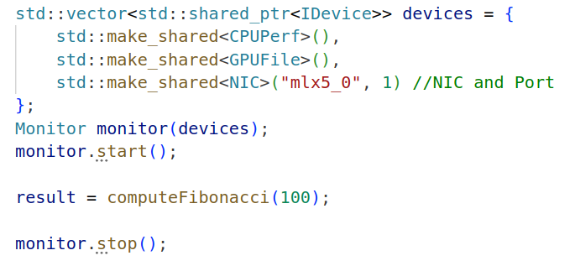
Usage in to be monitored Code
Define Devices and start Monitor
Workload while beeing monitored
End of Monitoring and potential rest of the program

Slide 7
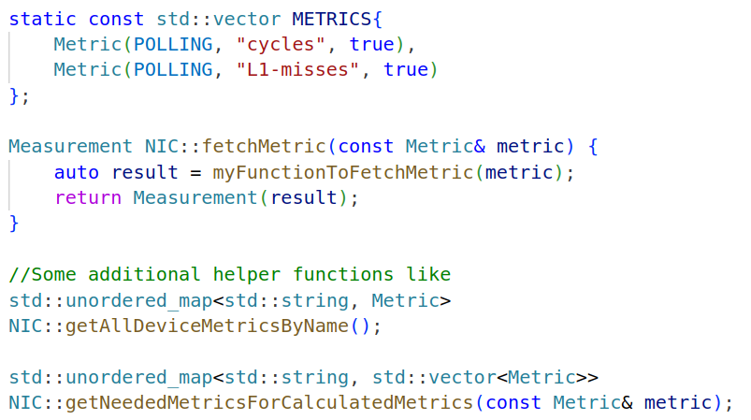
Usage – Adding new Devices
Defining Metrics
Implementing fetchMetric → The core thing that has to be done
Some additional helper functions

Slide 8
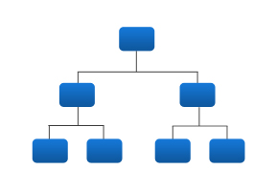




Challenges
Challenges
Finding good Abstractions to make it easy to use and extendable
Minimal Impact on Program performance
through calculation at the end
The recursive nature of calculations on top of calculations
Dealing with Cuda Integration

Slide 9

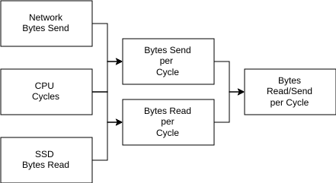

Architecture
Measuring Metrics
Aggregate Metrics
Create Metrics

Slide 10
Experiments
Some Applications on how you might use this tool
Experiments
1. Workload Optimizations
2 . Performance impact

Slide 11
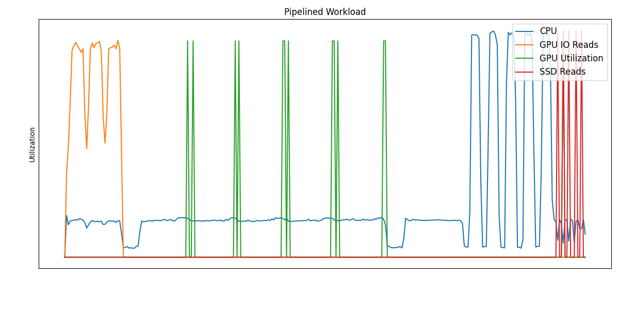
Experiments 1 Workloads – Blocking
Start
Monitoring
MatrixMult.
CPU Work
Write Back
to SSD
cuFileRead

Slide 12
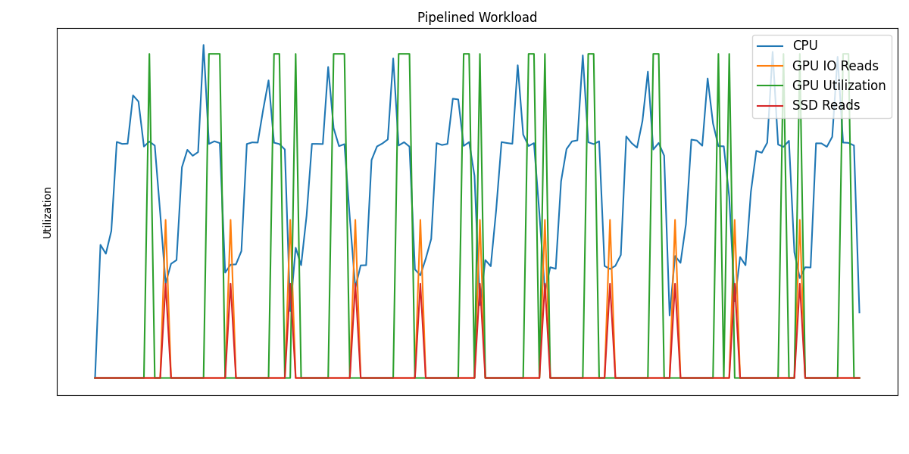
Experiments 1 Workloads - Pipelined
- Everything Intertwined, thus better performance
- Easily visible through HardwareMonitoring

Slide 13
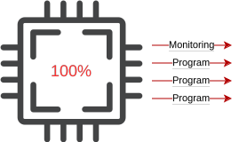
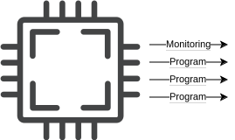
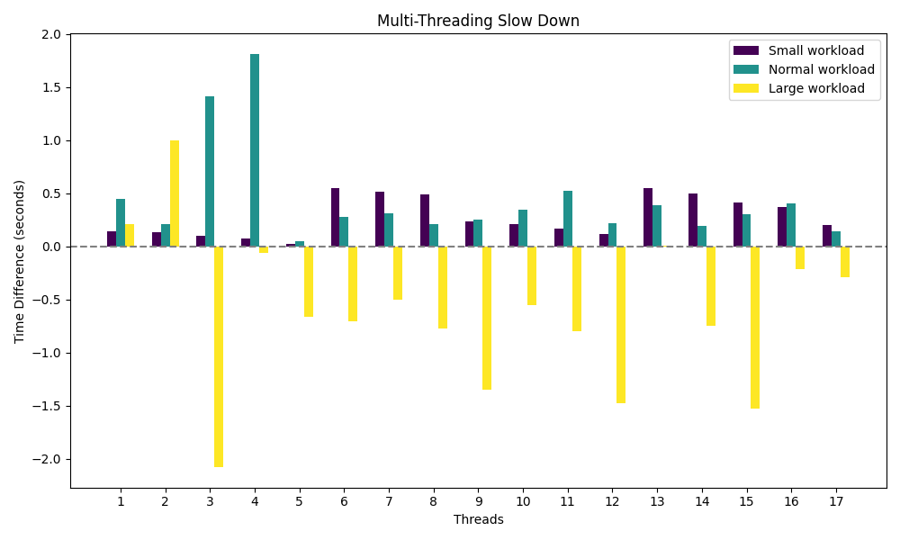
Experiment 2 Performance

Slide 14
Summary
Unified and expandable monitoring framework along with foundational Devices (CPU/IO/GPU/NIC)
Allows to use other Metrics inside your Metric
Usable tool with the possibility to spot unexpected performance deficits in the data path
Small impact on program when setup properly

Slide 15
Future Work
Adding more devices
Group Devices of similar kind to ease implementing new Metrics
Usage in real world project

Slide 16
Thank you for listening!
Questions….

Slide 17
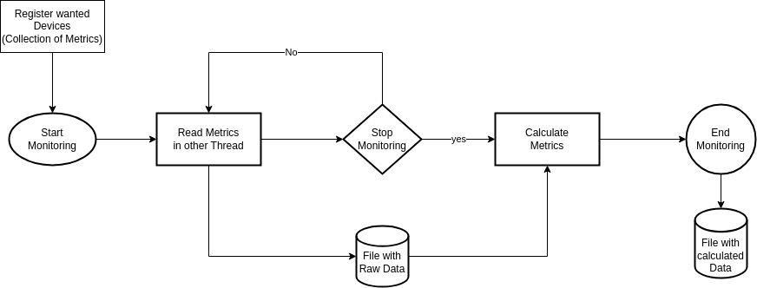
NOT PART OF PRESENTATION Architecture
Read Metrics: Only fetch (raw) Information in given Interval (Start, End, Periodically)
Calculate Metrics: Calculate new Metrics based on other Metrics/Data (AVG, Ratio, ...)

