Slide 1

Structured World Understanding: Integrating Object-Centric Learning with Model-Based RL
Author: Florian Hilprecht
1. Review: Prof. Dr. Kristian Kersting
2. Review: Jannis Blüml
3. Review: Raban Emunds

Slide 2
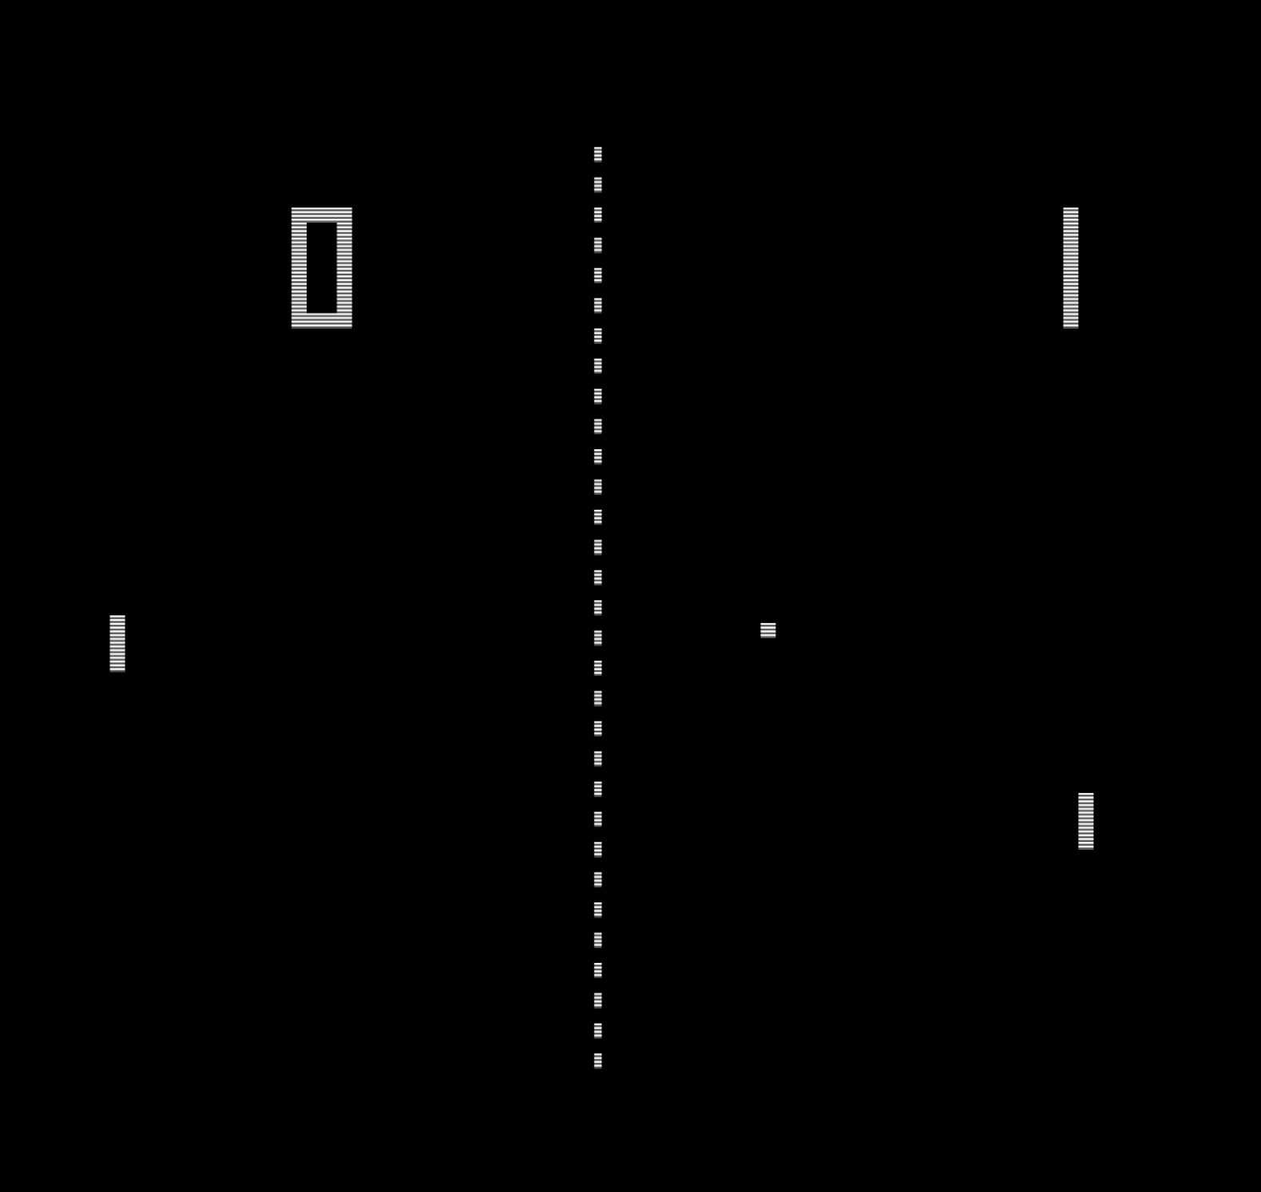
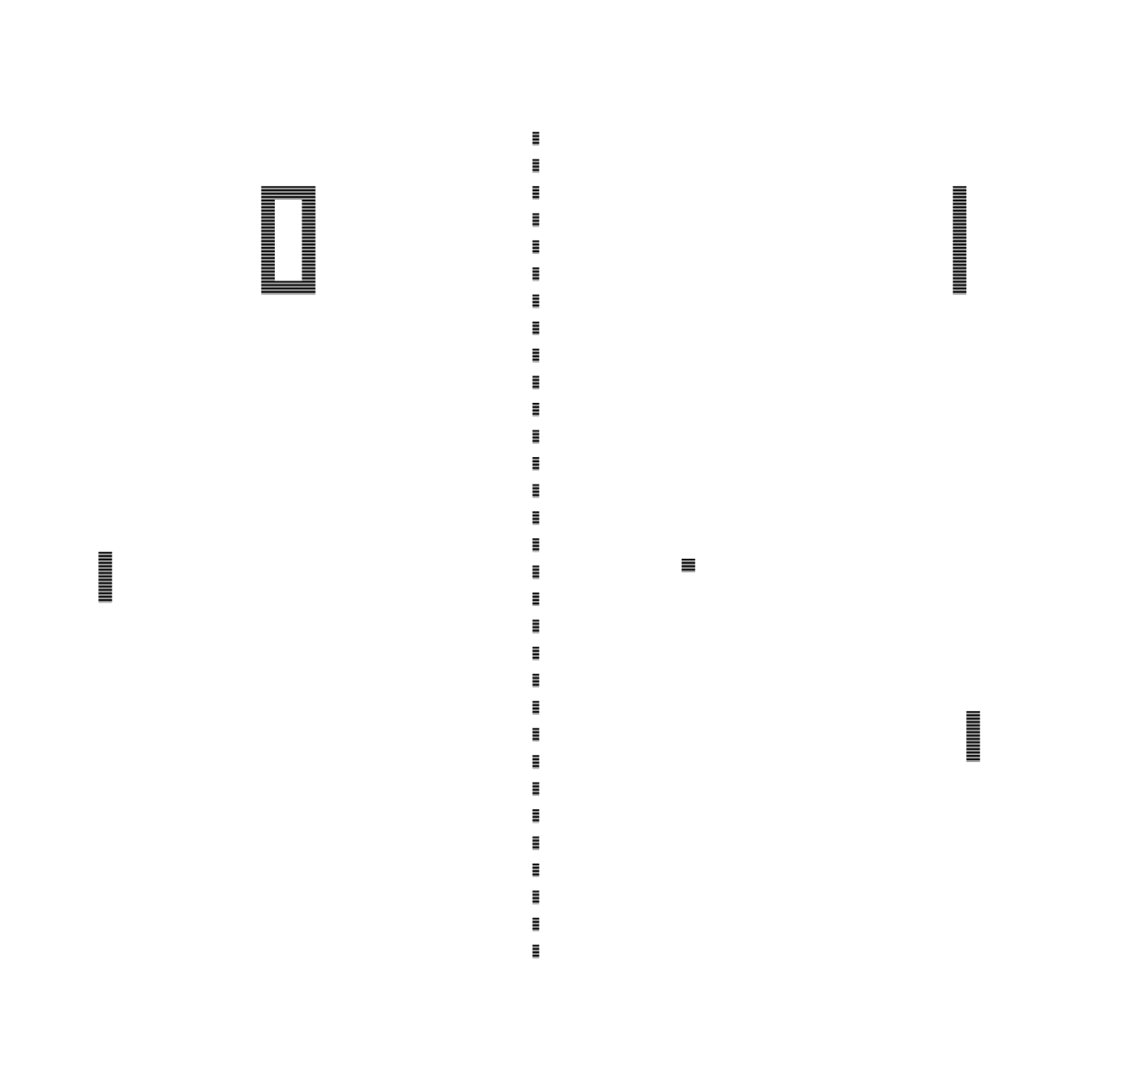
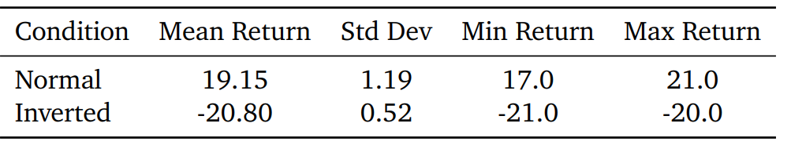
Why current RL Fails
Pixel-based RL Agents do not truly understand games
Agents exploit pixel patterns, not game logic
Sample ineffficient
Black-box decision making

Slide 3
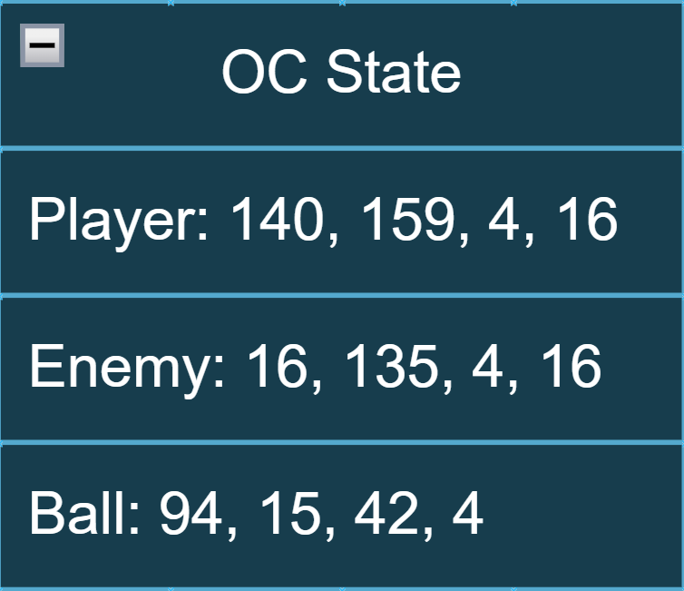

Object-Centric Representations
Represent game state as meaningful objects not pixels
Matches how humans understand games
Natural inductive Bias

Slide 4



World models
Predicting future game states using a separate model
Training the actor within predictions of that model instead of in the real environment

Slide 5
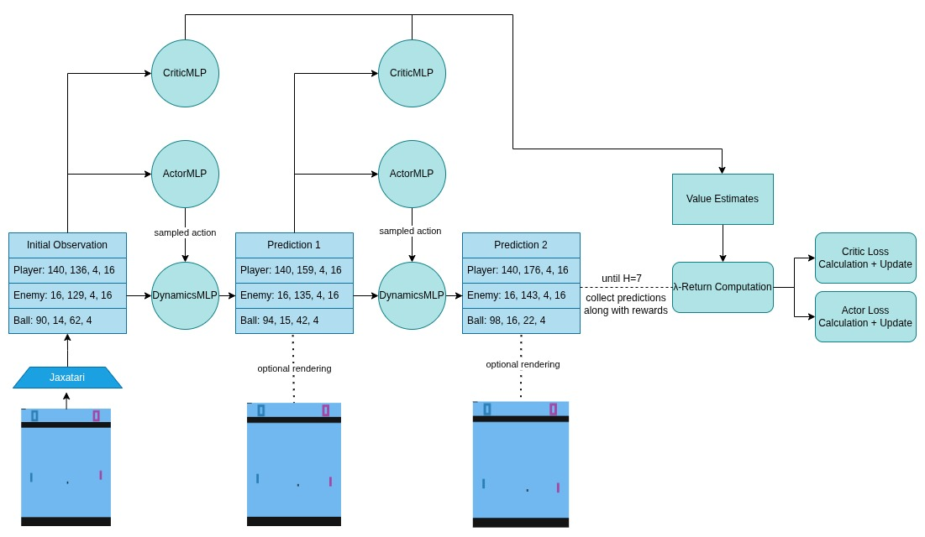
Our Approach
JAXAtari extracts object states
World Model predicts future object positions
Actor-Critic: learns policy from imagined rollouts
Key difference being that world model is predicting
OC-States instead of latent representation
Everything coded from scratch in JAX (ML Frame
work from Google)

Slide 6
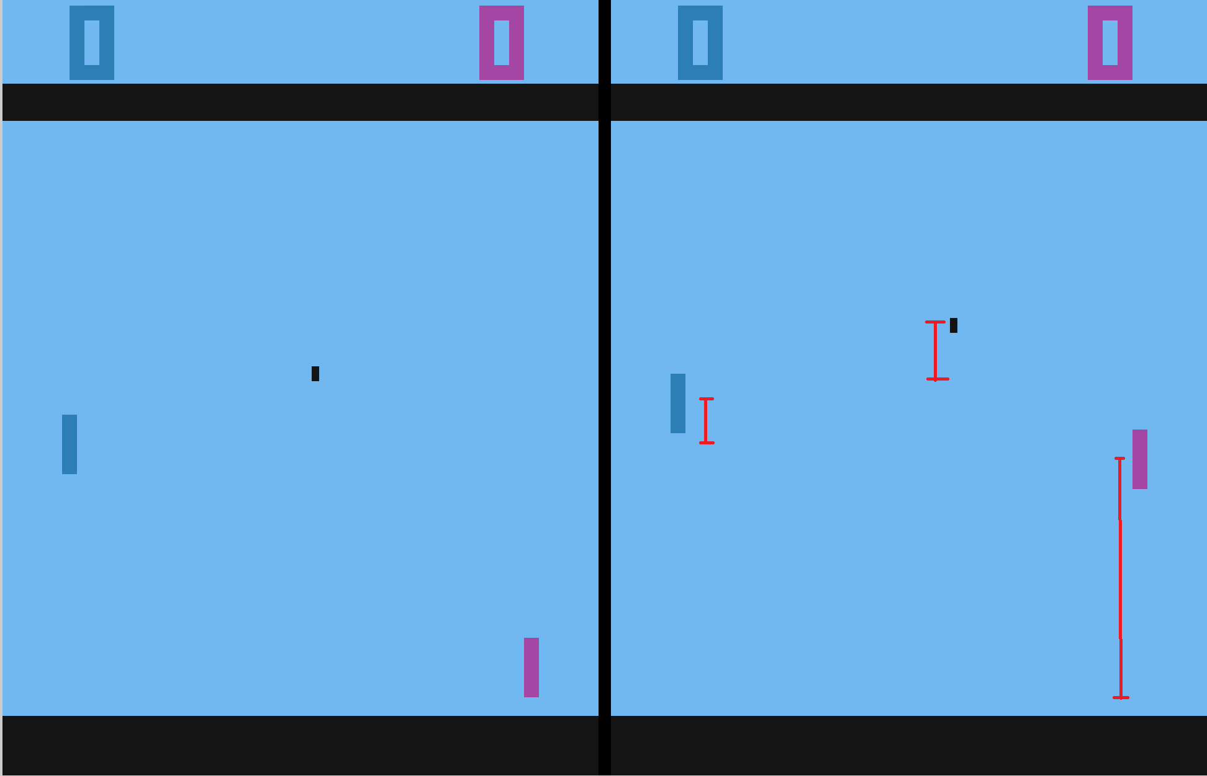
Research Questions
Can you train on OC States or do world models need a learned latent state representation
  Error accumulation too big?
Impacts on prediction accuracy and sample efficiency
Does it improve robustness
Real Prediction

Slide 7
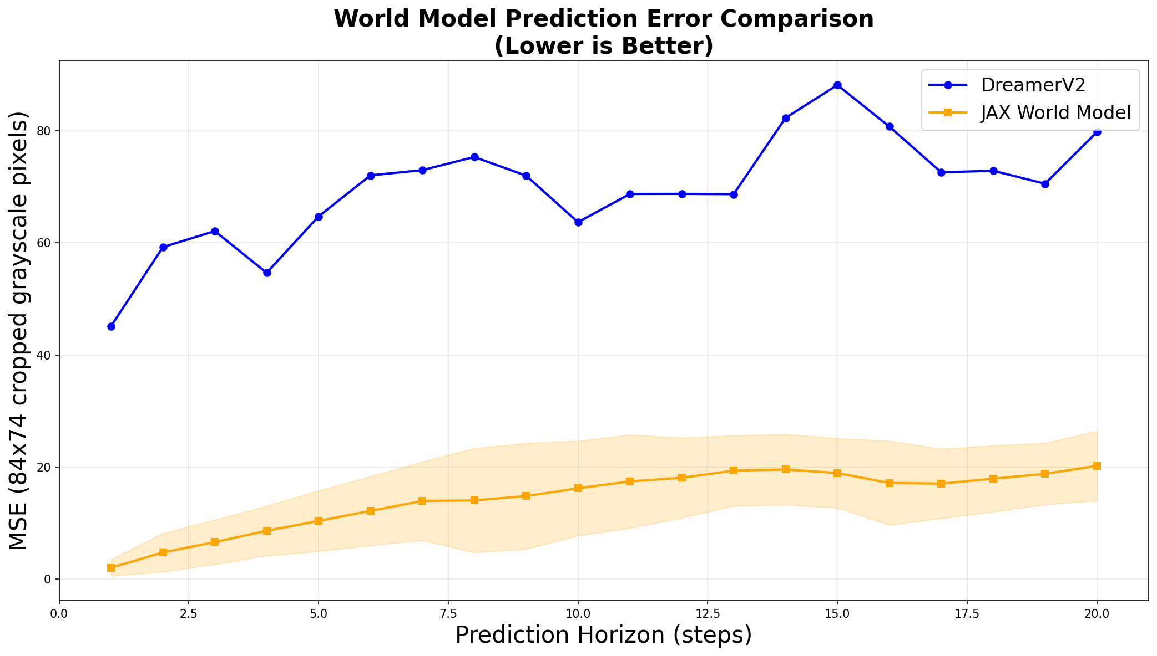
Prediction Accuracy
Object-centric: MSE ~10 vs DreamerV2 ~65
  Better planning possible

Slide 8
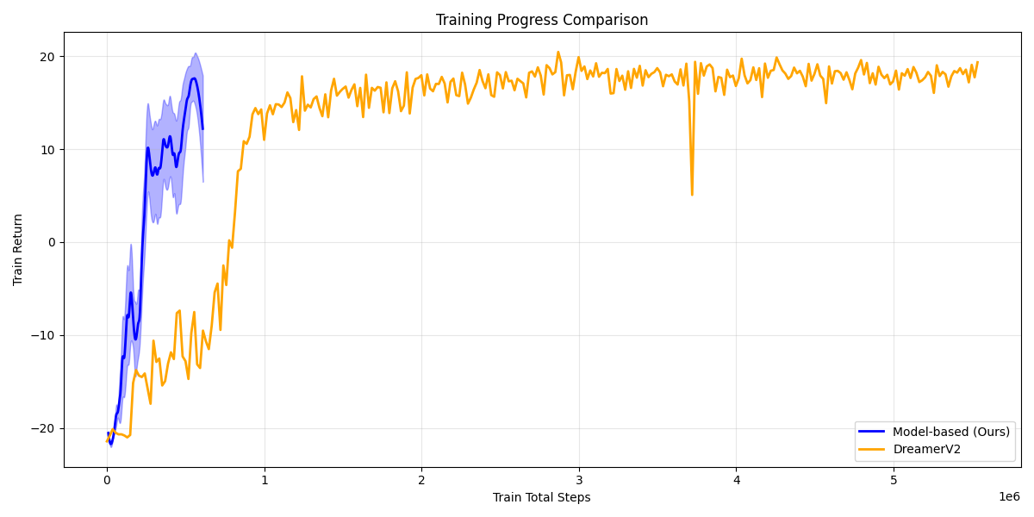
Sample Efficiency
100k-200k steps to converge
Dreamer 2mio steps
Much less compute necessary

Slide 9
Robustness
More robust by design, robust object extraction → robust actor learning

Slide 10
Limitations & open Questions
Only in Pong tested, needs adaptation for different games
Requires reliable object extraction
Scalability to more complex games?

Slide 11
Future Work and Broader Impact
Next steps:
Test on multi-object games (Breakout, Seaquest)
Integrate slot attention for learned object discovery
Longer planning horizons with uncertainty modeling
Broader implications:
Interpretable AI: Can explain decisions through object reasoning
Sample efficiency critical for robotics, real-world applications
Trade-off: Generality vs efficiency

Slide 12
Key Takeaways
Three bullet points:
Representation matters: 85% error reduction, 10× sample efficiency
Object-centric + model-based = powerful combination
Path toward interpretable, efficient RL
Final visual: Side-by-side comparison table from Table 4.2

Slide 13
Questions...

