Slide 1
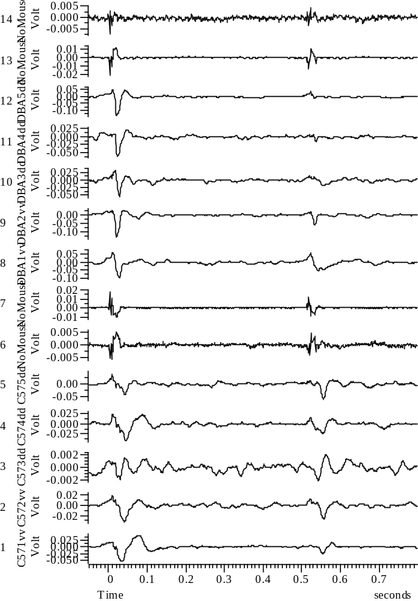
050208_Group8_01WYE103914@10_Baseline_A_all

Slide 2
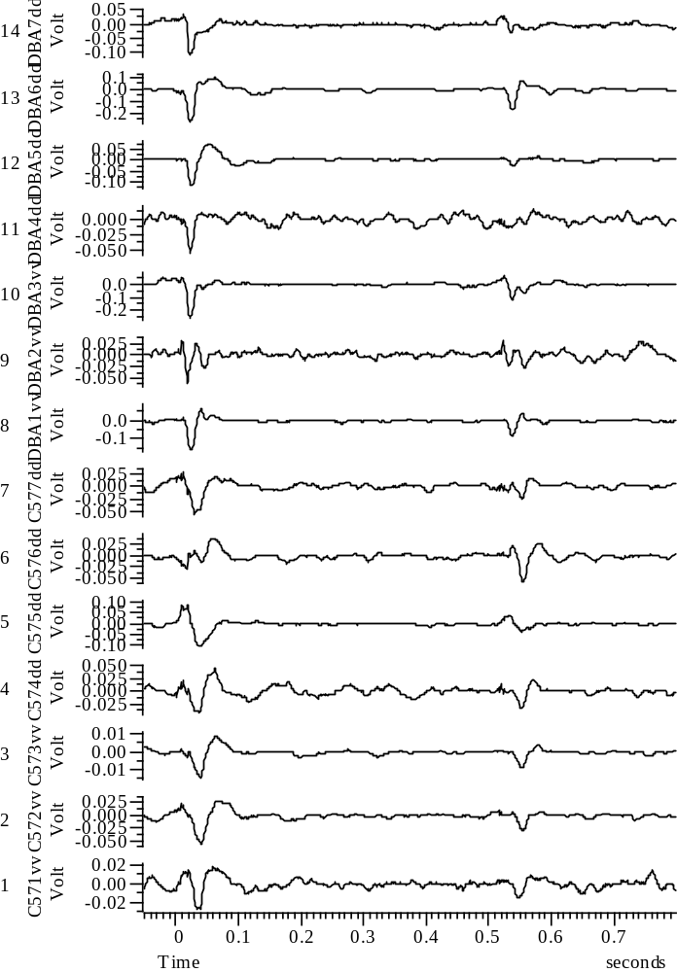
050808_Group8_01WYE103914@3_Baseline_A_all

Slide 3
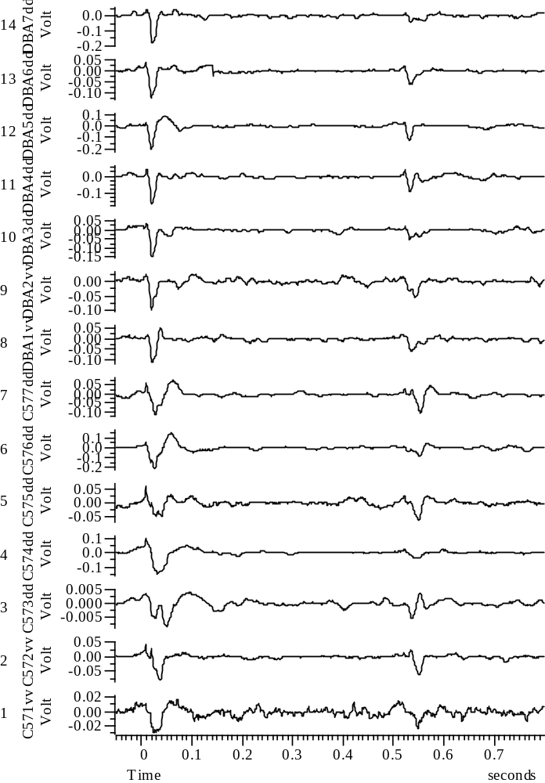
050908_Group8_01WYE103914@3_Baseline_A_all

Slide 4
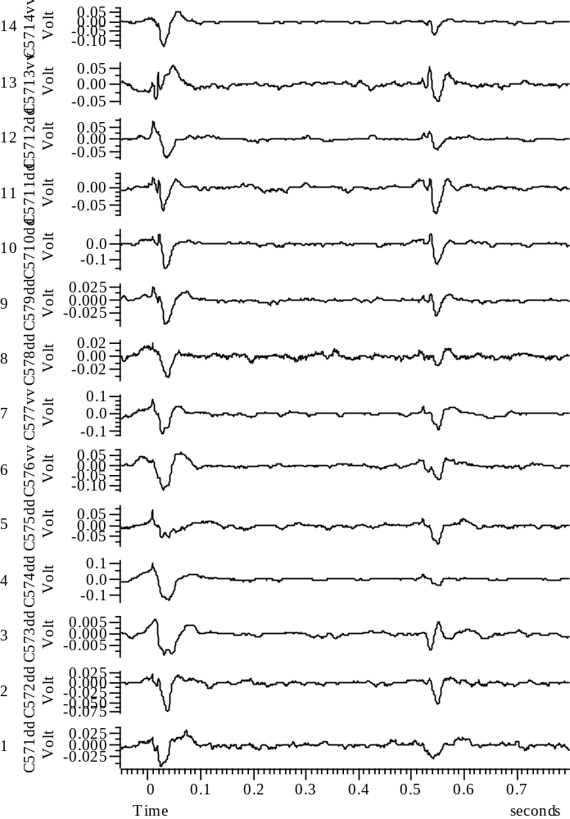
051108_Group8_01WYE103914@3_Baseline_A_all

Slide 5
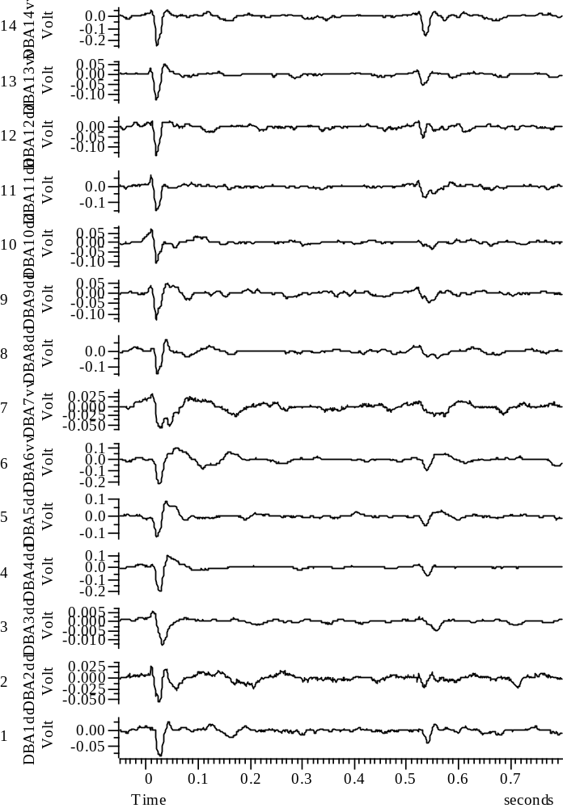
051208_Group8_01WYE103914@3_Baseline_A_all

