Slide 1
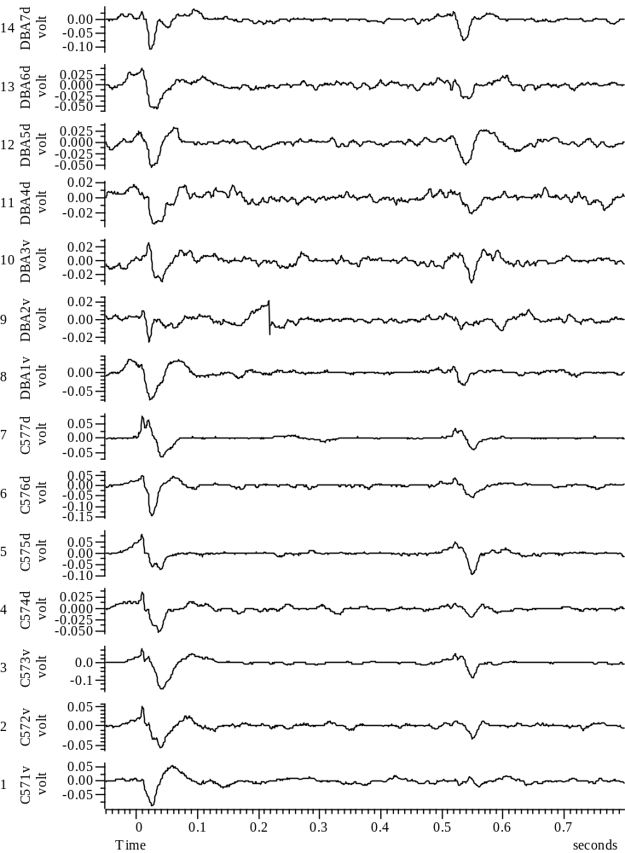
031708_Group67_01WYE103914@3_Baseline_A_all

Slide 2
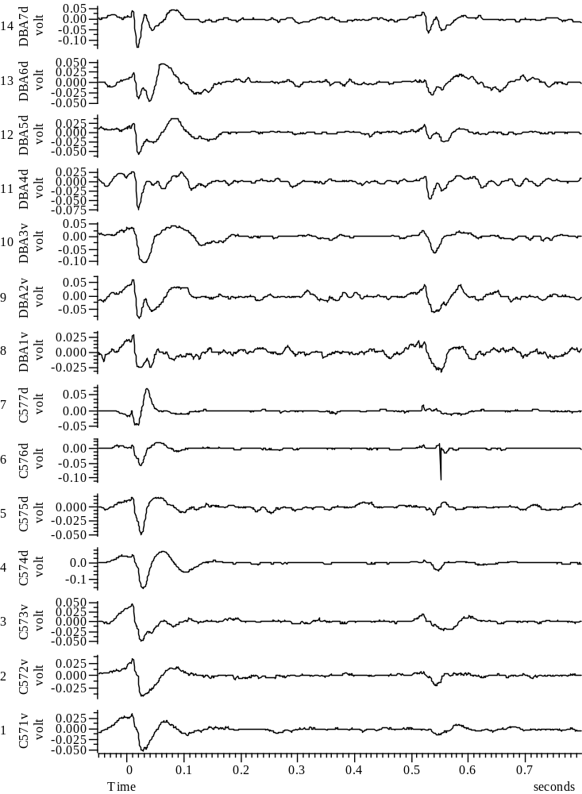
031808_Group45_01WYE103914@3_Baseline_A_all

Slide 3
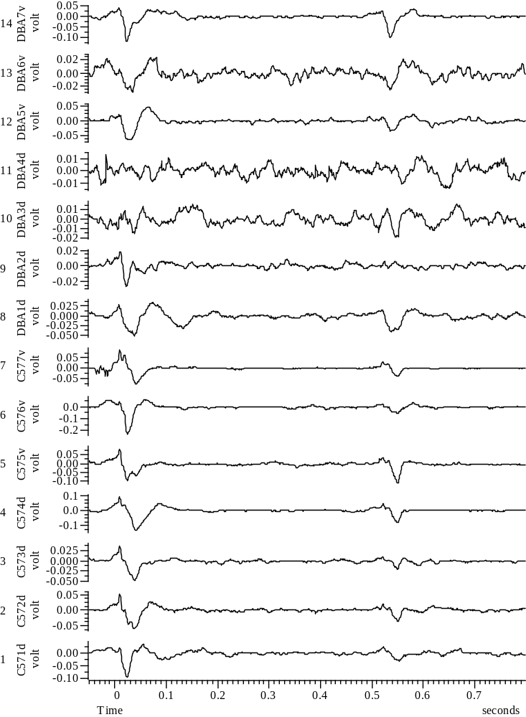
032108_Group67_01WYE103914@10_Baseline_A_all

Slide 4
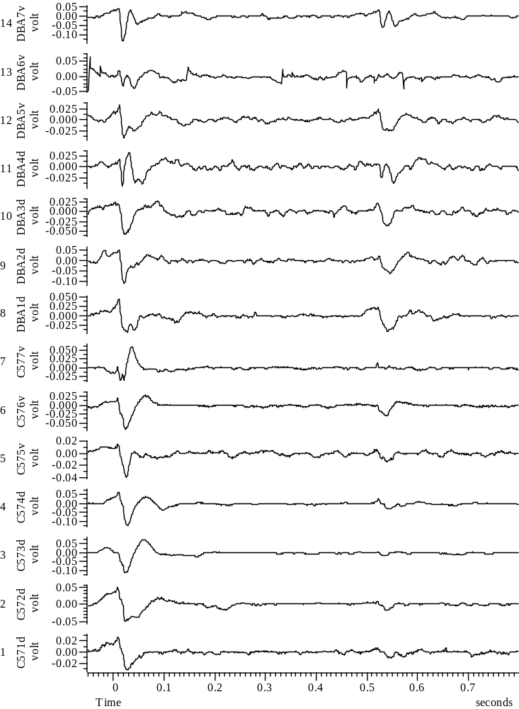
032408_Group45_01WYE103914@10_Baseline_A_all

Slide 5
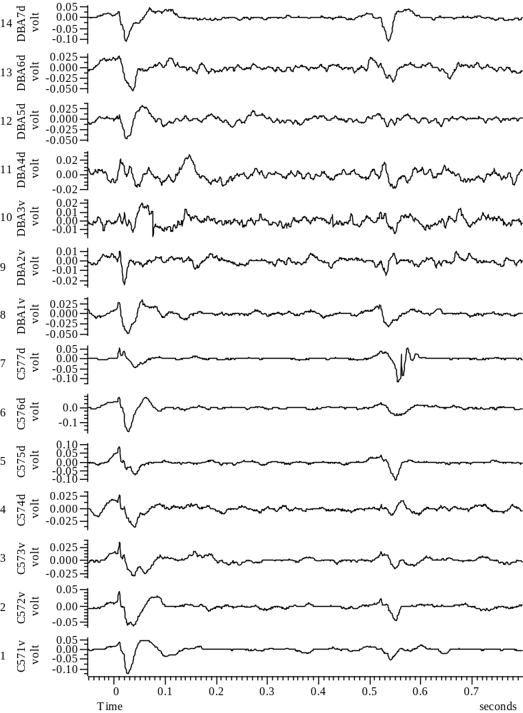
032508_Group67_01WYE103914@3_Baseline_A_all

Slide 6
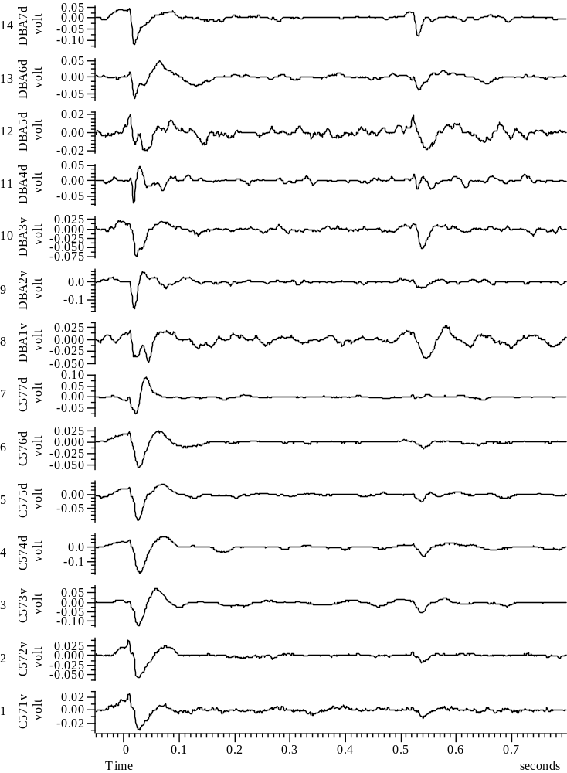
032708_Group45_01WYE103914@3_Baseline_A_all

Slide 7
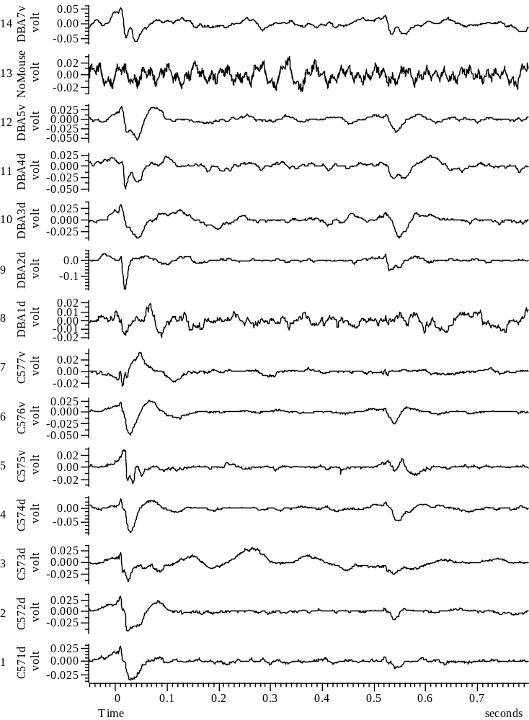
033008_Group45_01WYE103914@10_Baseline_A_all

