Slide 1
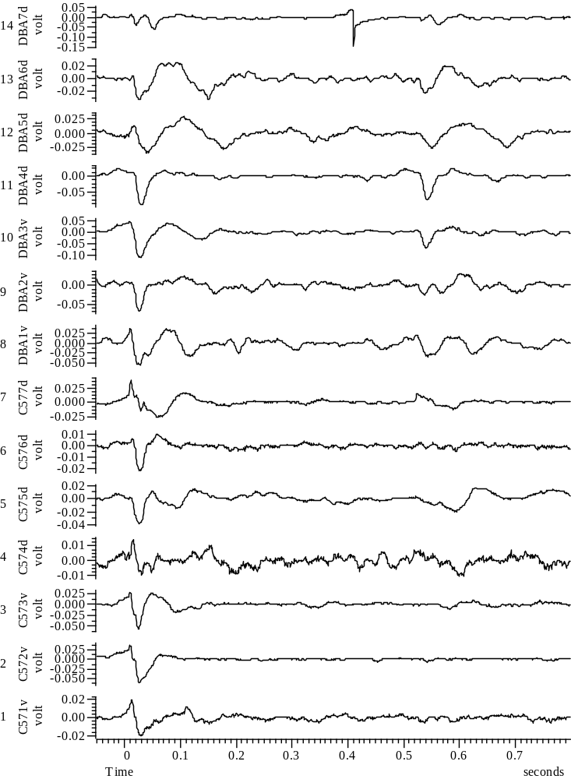
031808_Group45_3WYE103914@3_EXP2_A_all

Slide 2
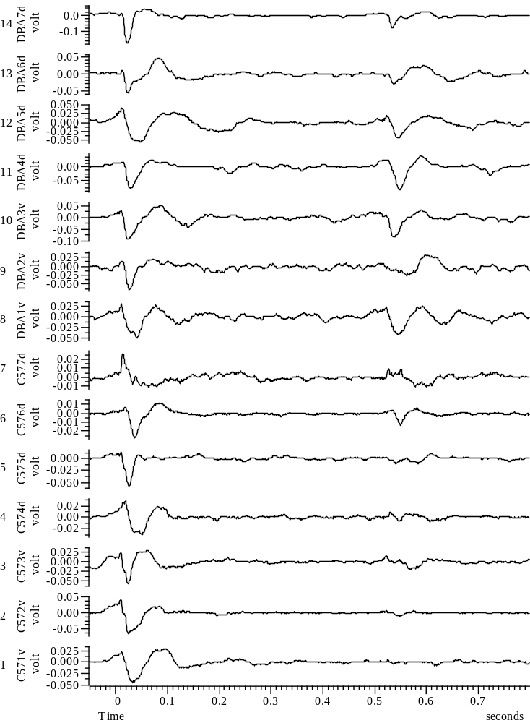
031808_Group45_5WYE103914@3_EXP4_A_all

Slide 3
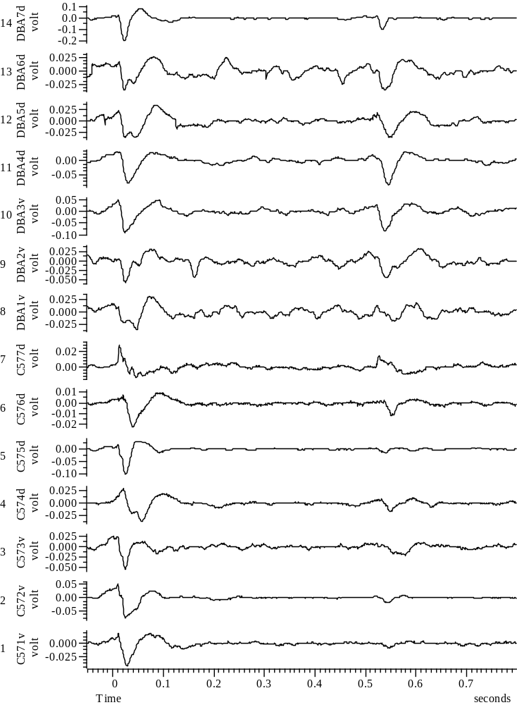
031808_Group45_6WYE103914@3_EXP5_A_all

Slide 4
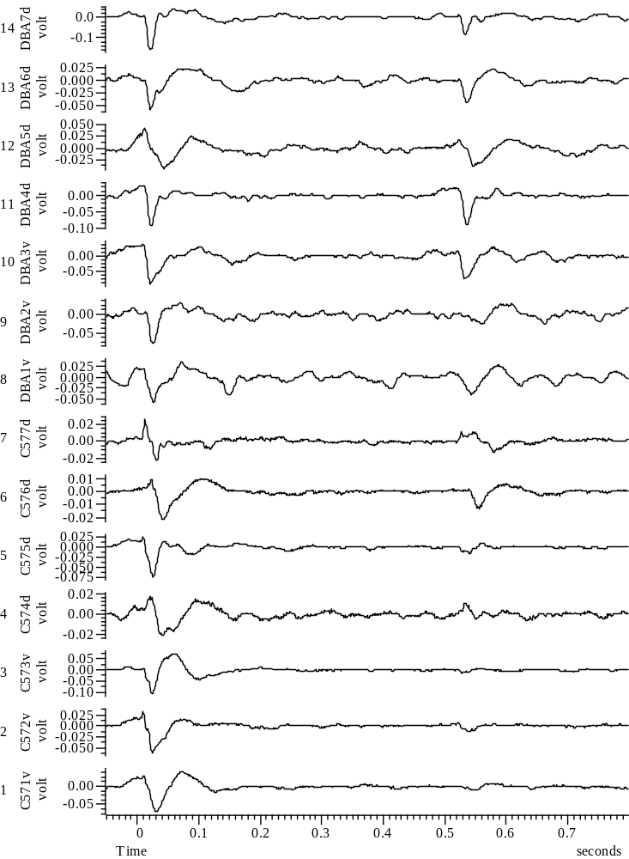
031808_Group45_7WYE103914@3_EXP6_A_all

Slide 5
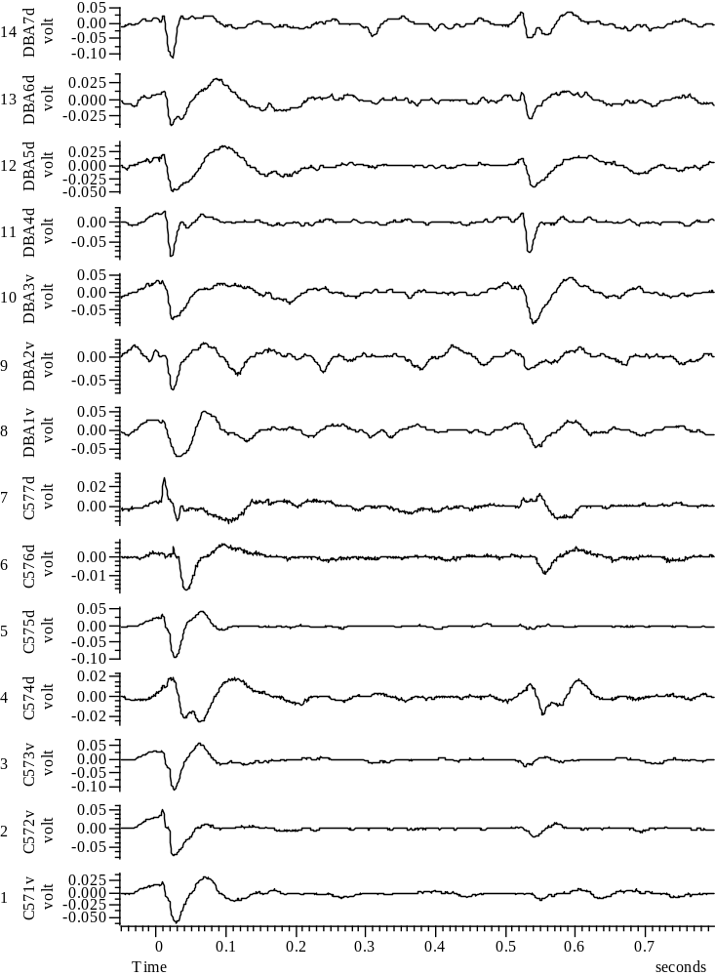
031808_Group45_8WYE103914@3_EXP7_A_all

Slide 6
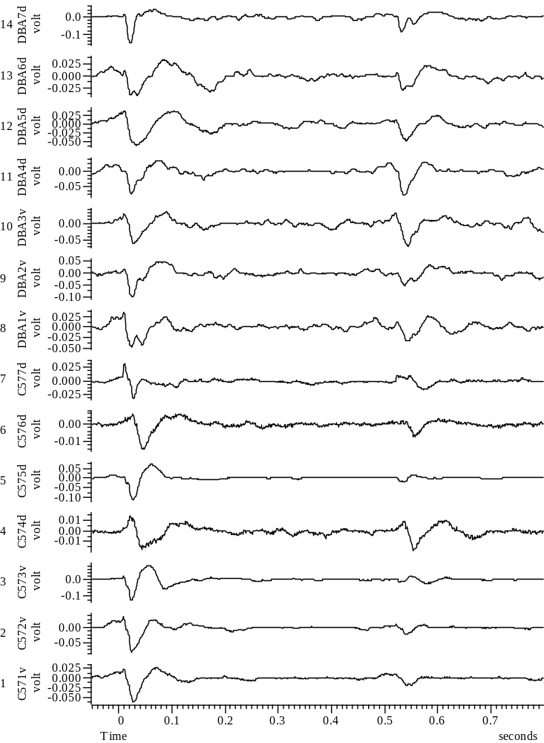
031808_Group45_9WYE103914@3_EXP8_A_all

Slide 7
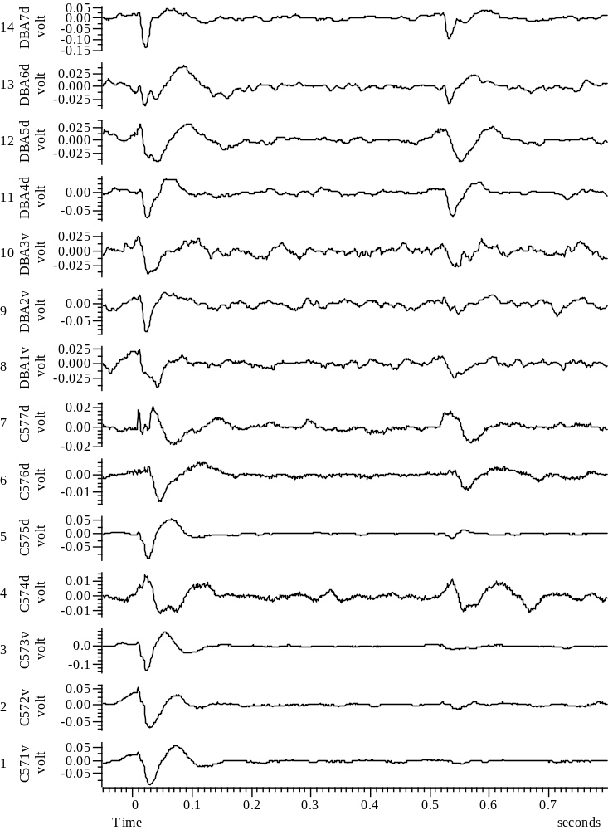
031808_Group45_10WYE103914@3_EXP9_A_all

Slide 8
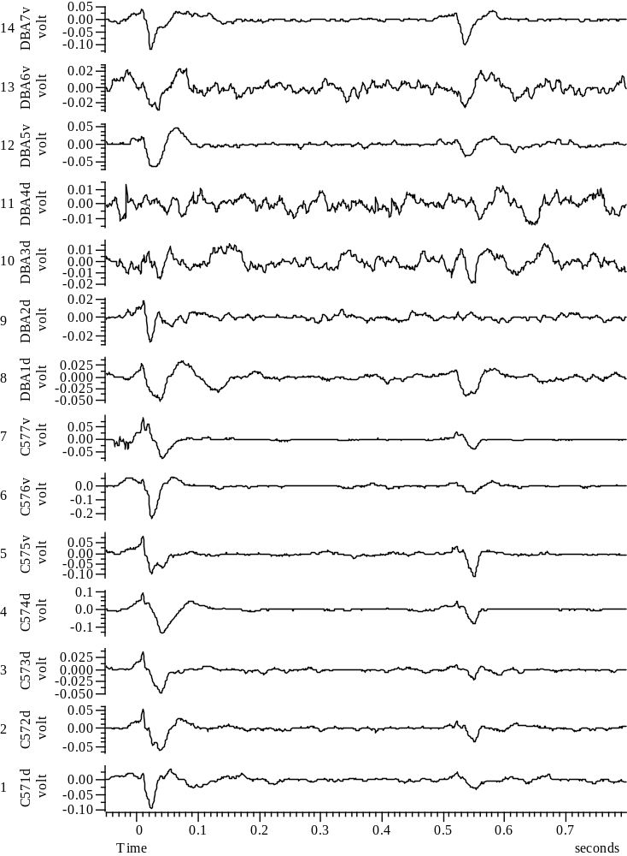
032108_Group67_01WYE103914@10_Baseline_A_all

Slide 9
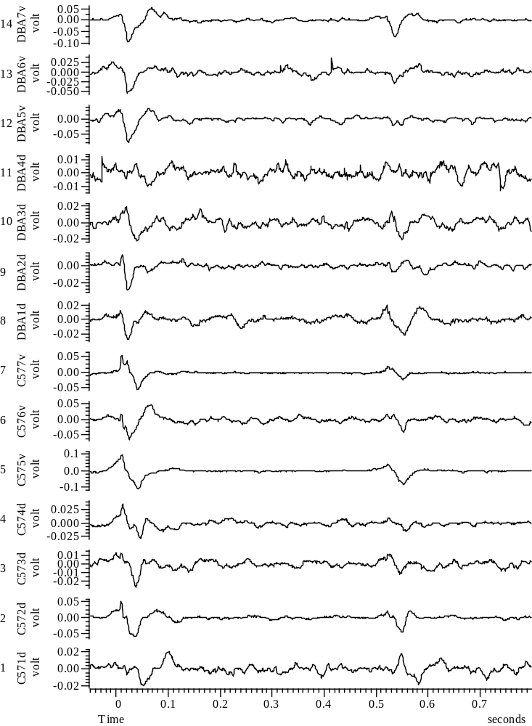
032108_Group67_2WYE103914@10_EXP1_A_all

Slide 10
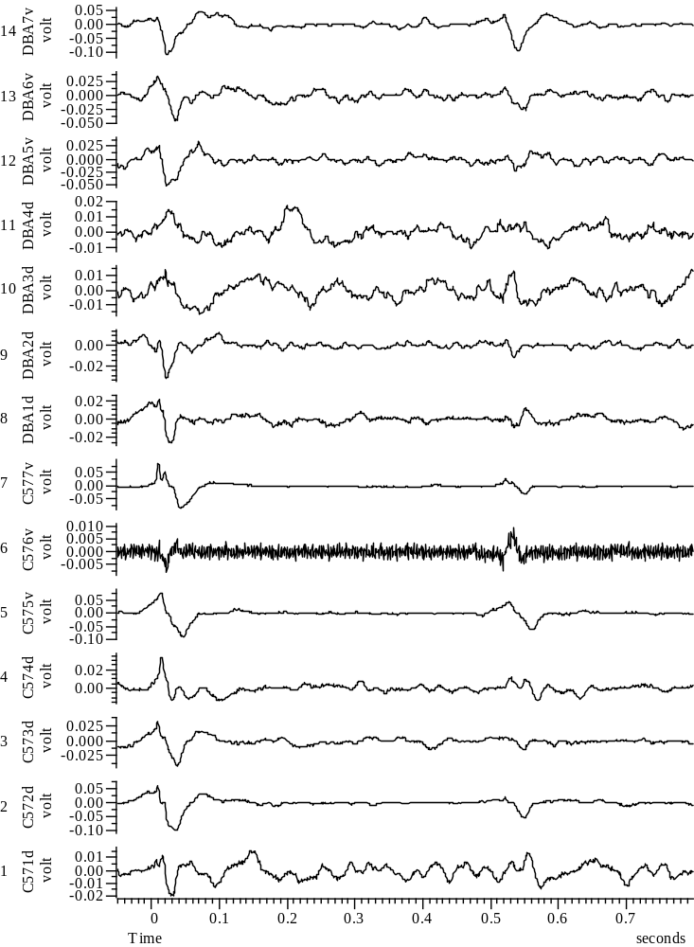
032108_Group67_3WYE103914@10_EXP2_A_all

Slide 11
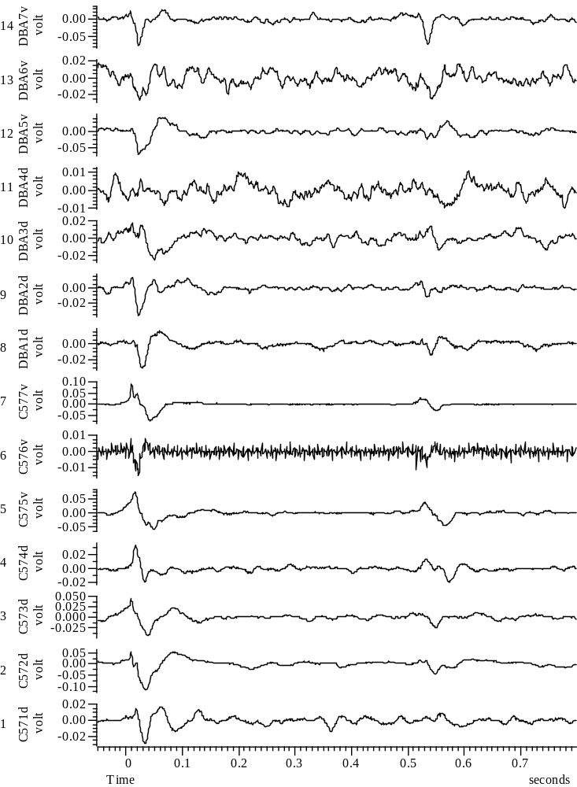
032108_Group67_4WYE103914@10_EXP3_A_all

Slide 12
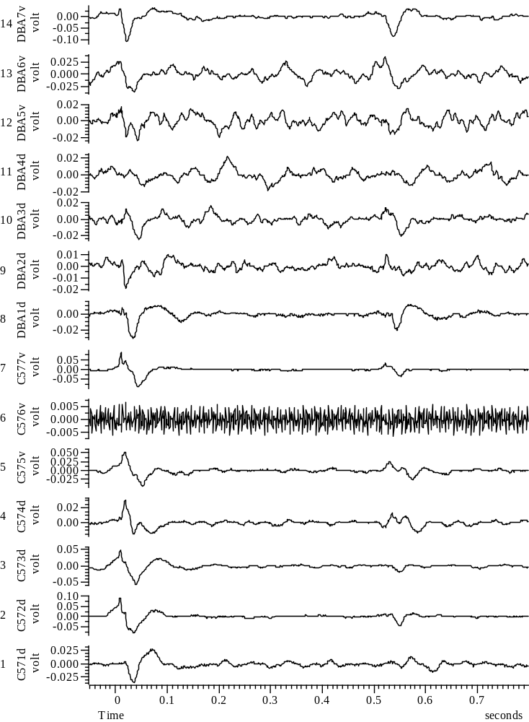
032108_Group67_5WYE103914@10_EXP4_A_all

Slide 13
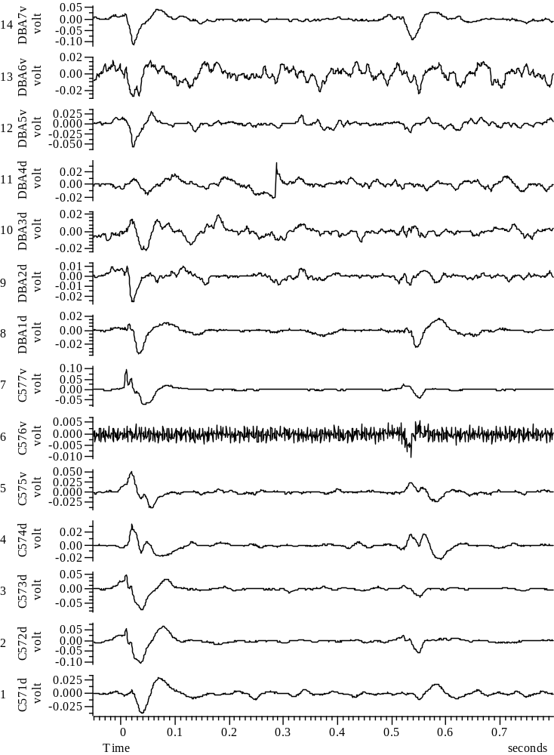
032108_Group67_6WYE103914@10_EXP5_A_all

Slide 14
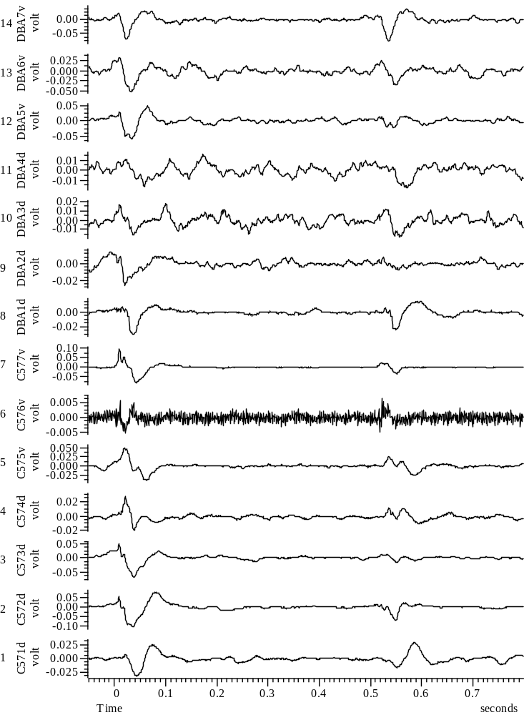
032108_Group67_7WYE103914@10_EXP6_A_all

Slide 15
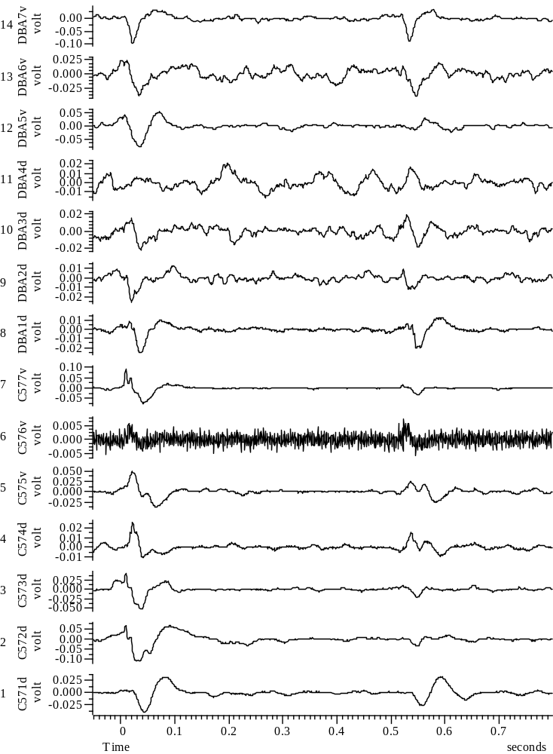
032108_Group67_8WYE103914@10_EXP7_A_all

Slide 16
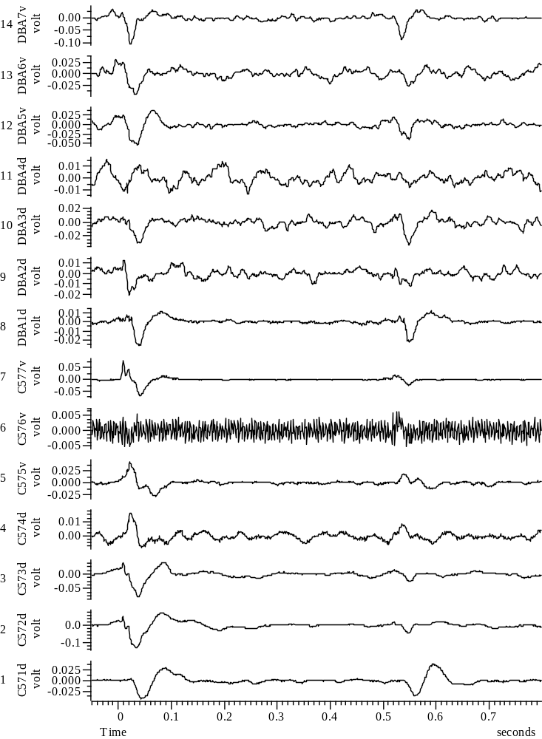
032108_Group67_9WYE103914@10_EXP8_A_all

Slide 17
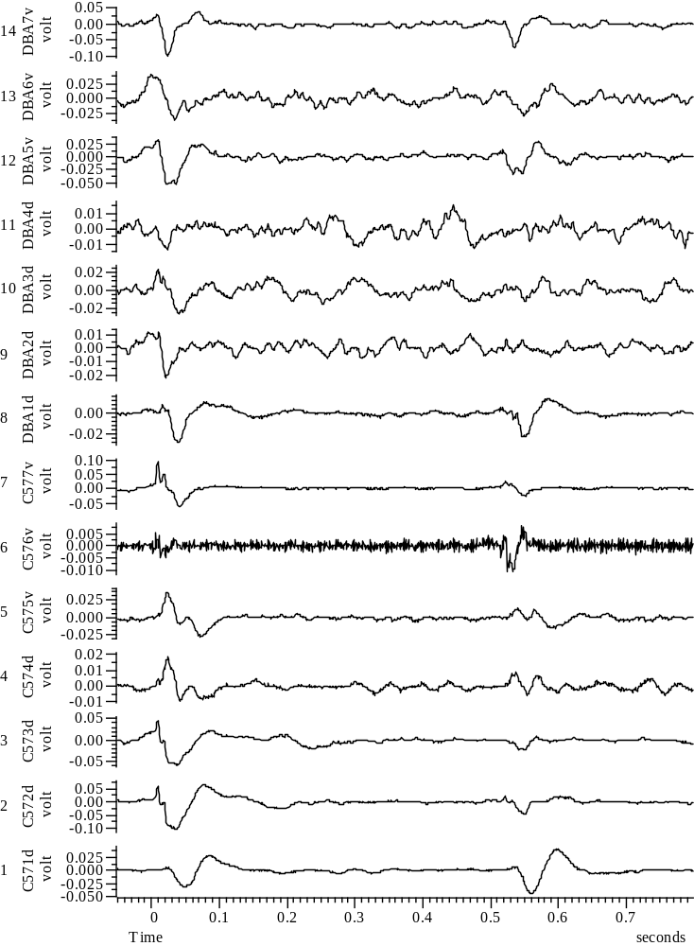
032108_Group67_10WYE103914@10_EXP9_A_all

Slide 18
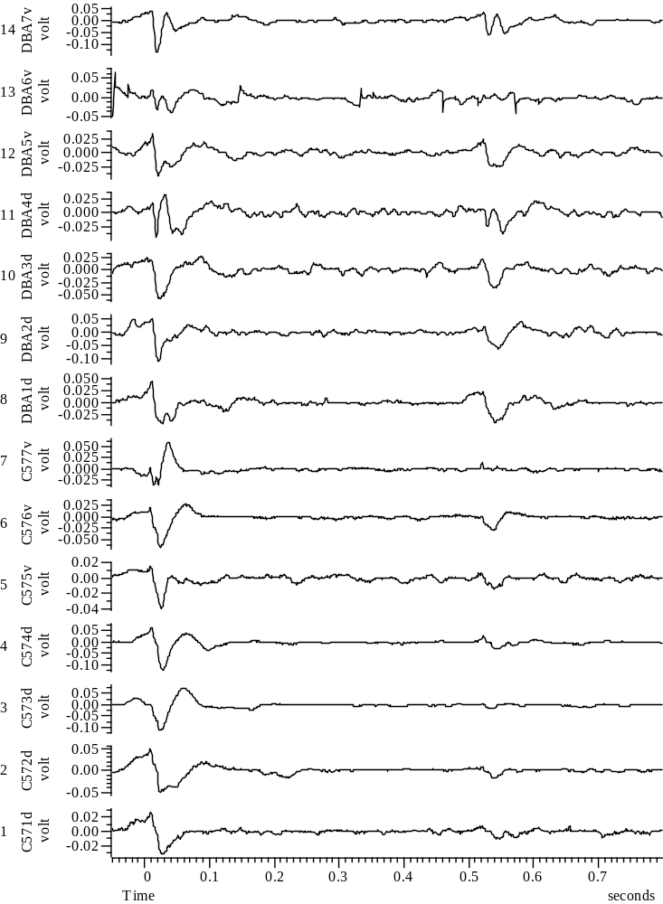
032408_Group45_01WYE103914@10_Baseline_A_all

Slide 19
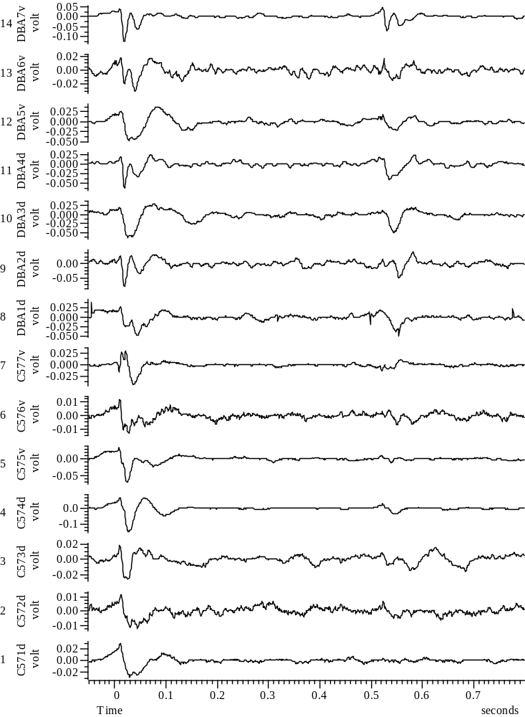
032408_Group45_2WYE103914@10_EXP1_A_all

Slide 20
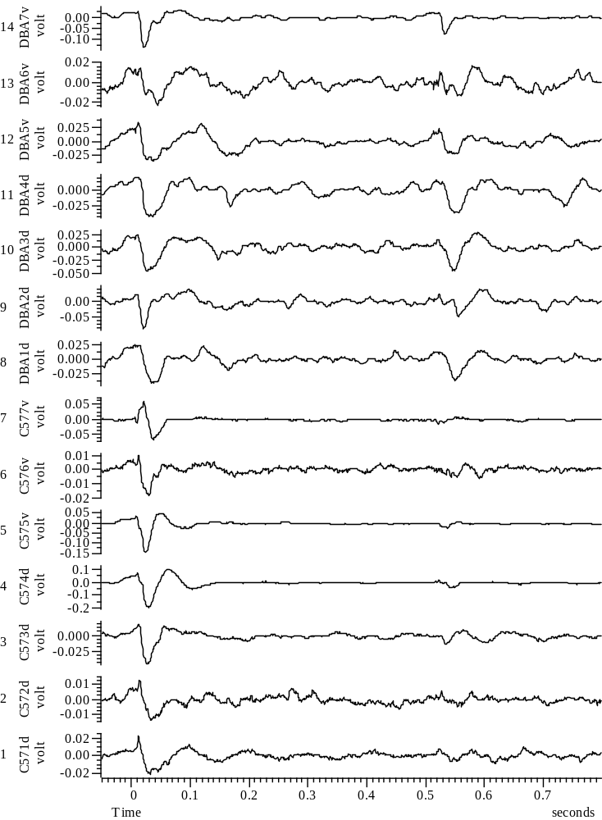
032408_Group45_3WYE103914@10_EXP2_A_all

Slide 21
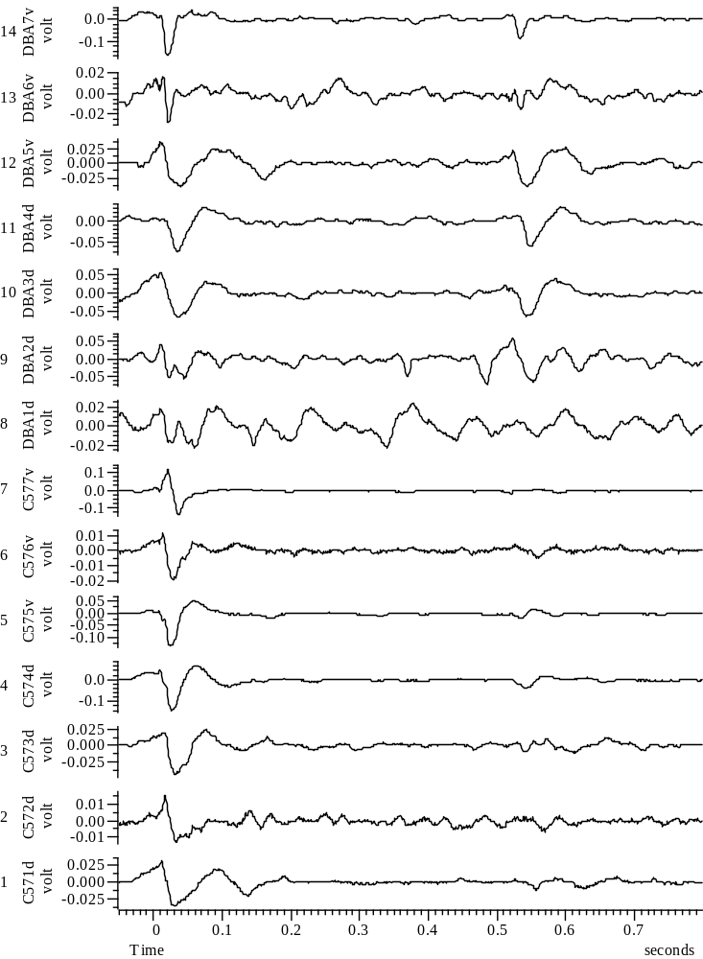
032408_Group45_4WYE103914@10_EXP3_A_all

Slide 22
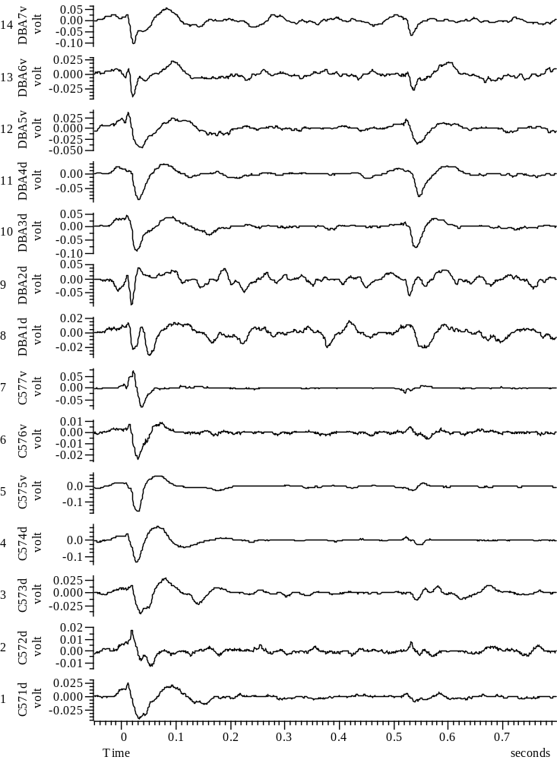
032408_Group45_5WYE103914@10_EXP4_A_all

Slide 23
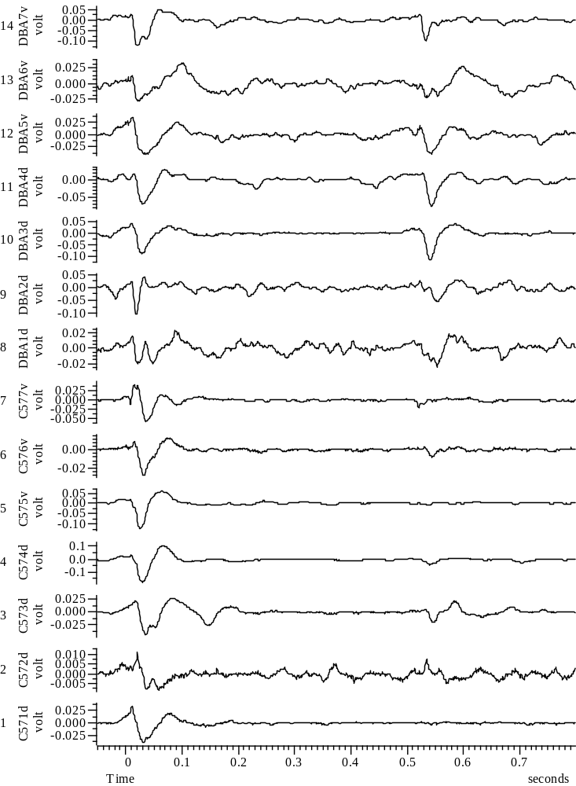
032408_Group45_6WYE103914@10_EXP5_A_all

Slide 24
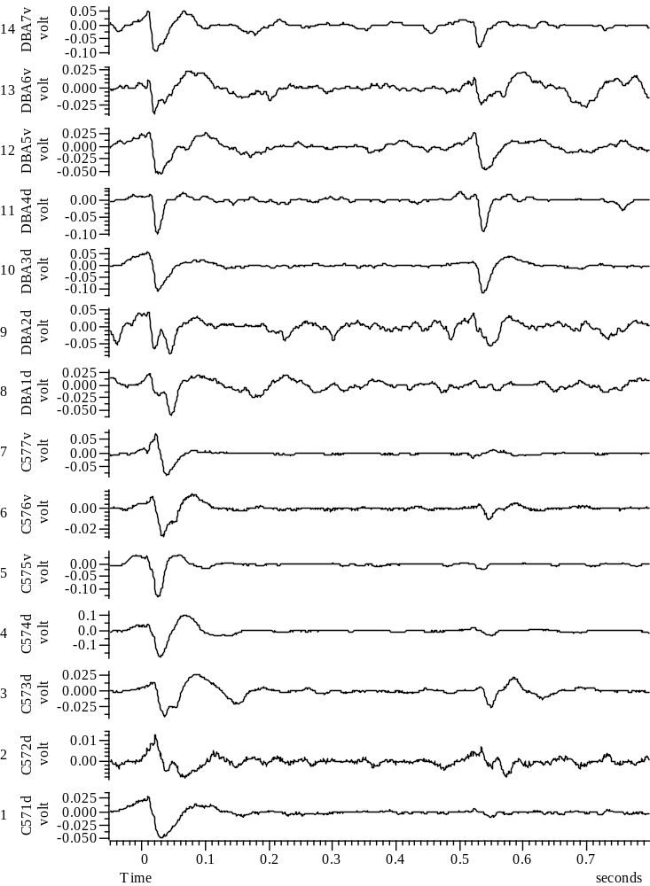
032408_Group45_7WYE103914@10_EXP6_A_all

Slide 25
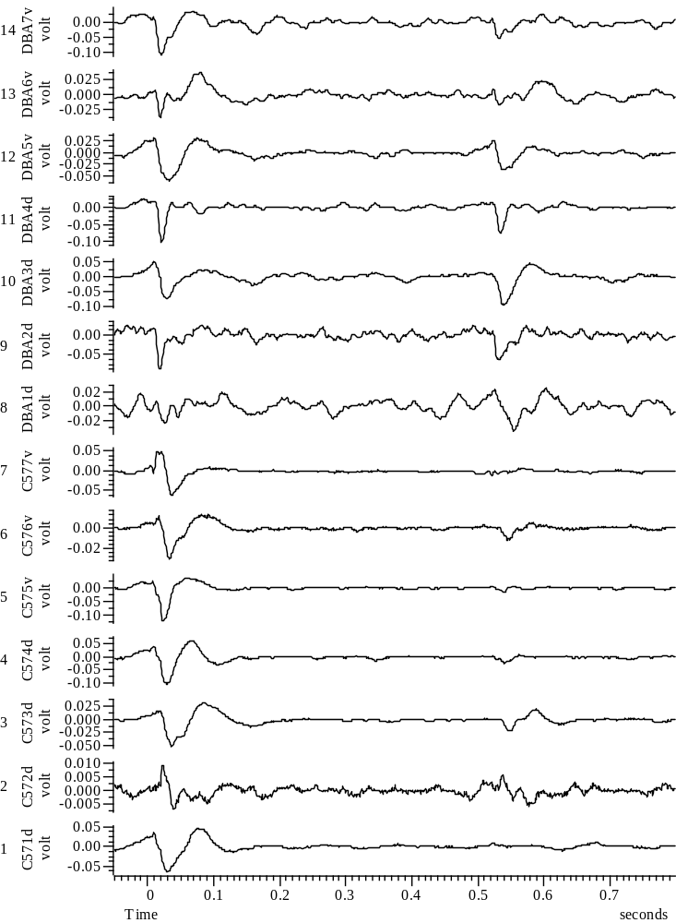
032408_Group45_8WYE103914@10_EXP7_A_all

Slide 26
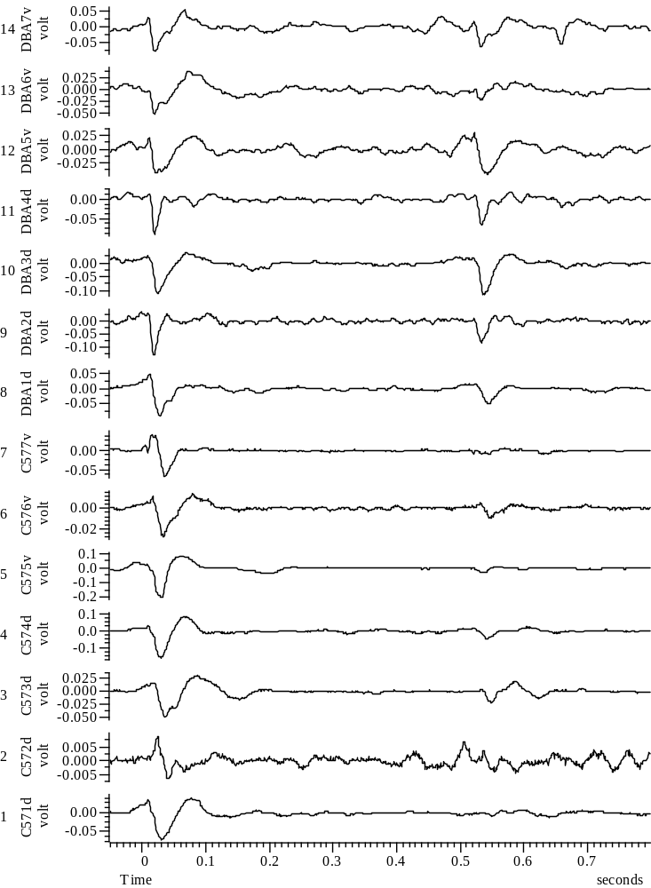
032408_Group45_9WYE103914@10_EXP8_A_all

Slide 27
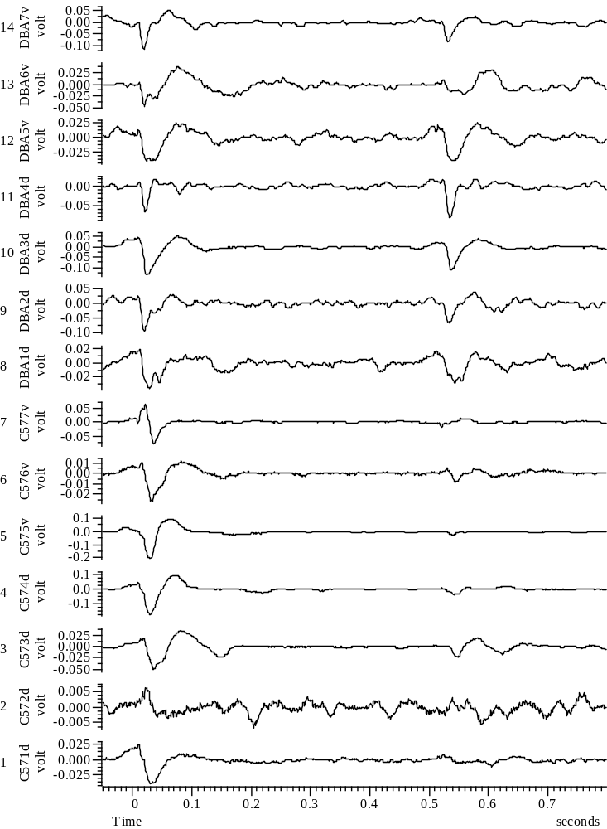
032408_Group45_10WYE103914@10_EXP9_A_all

Slide 28
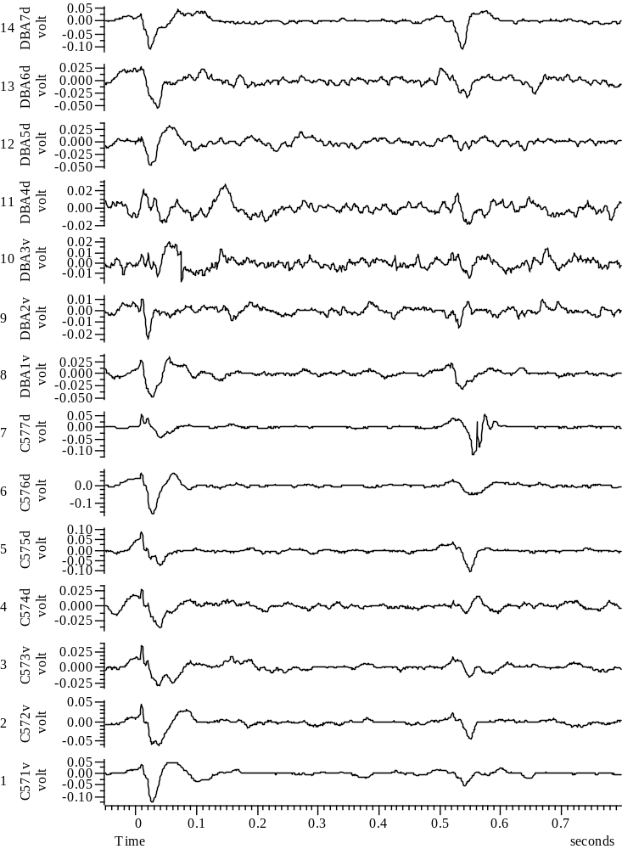
032508_Group67_01WYE103914@3_Baseline_A_all

Slide 29
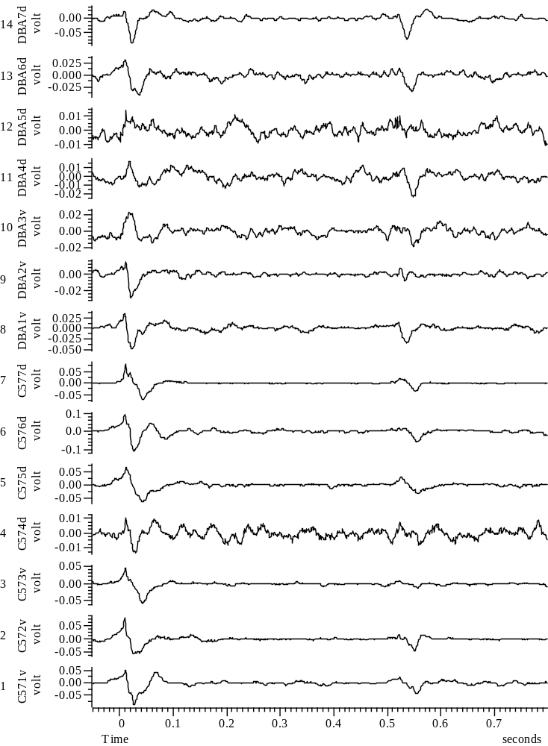
032508_Group67_2WYE103914@3_EXP1_A_all

Slide 30
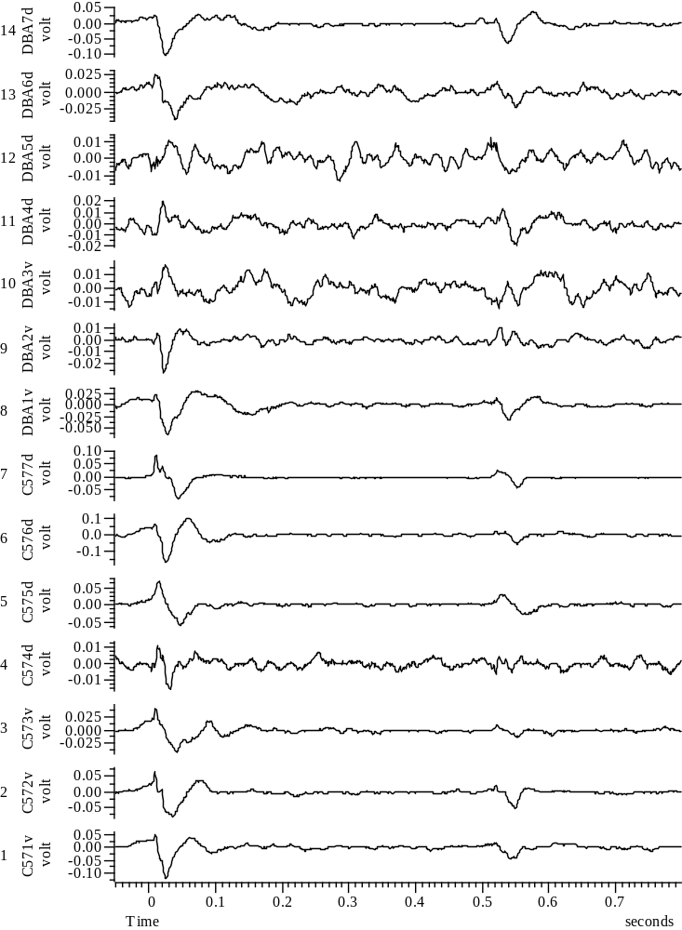
032508_Group67_3WYE103914@3_EXP2_A_all

Slide 31
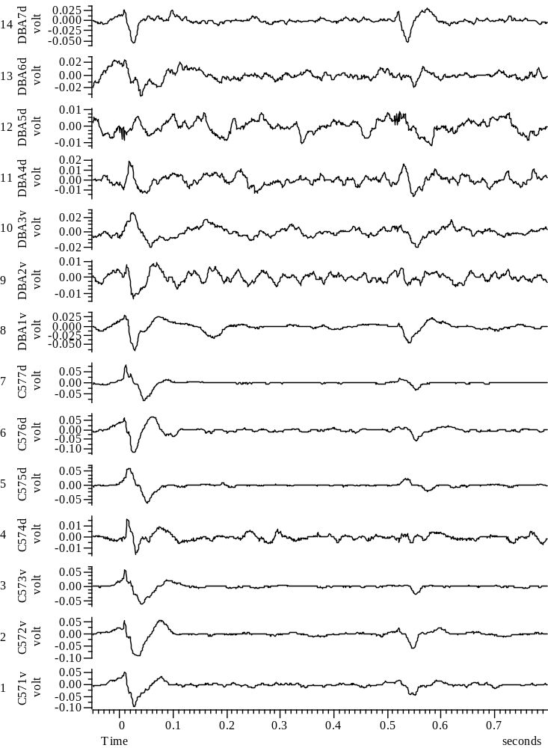
032508_Group67_4WYE103914@3_EXP3_A_all

Slide 32
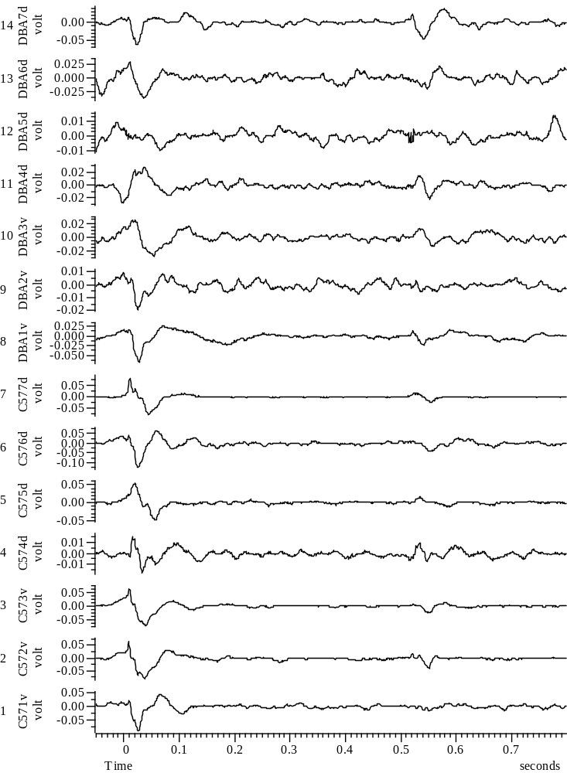
032508_Group67_5WYE103914@3_EXP4_A_all

Slide 33
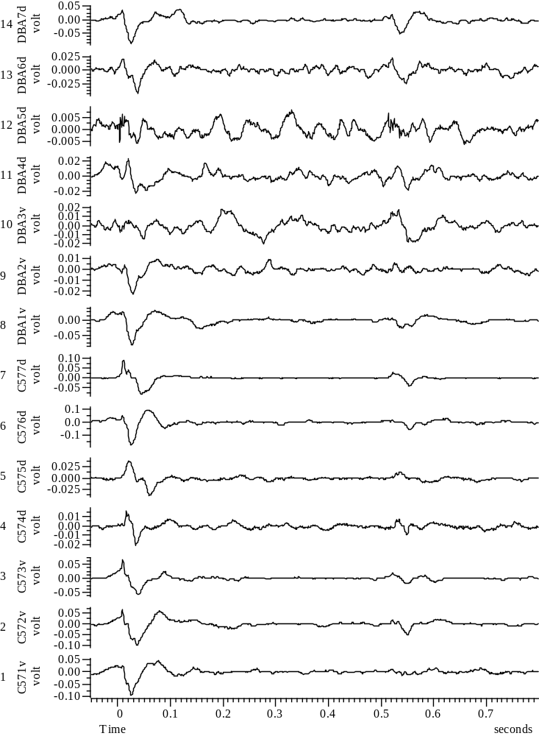
032508_Group67_6WYE103914@3_EXP5_A_all

Slide 34
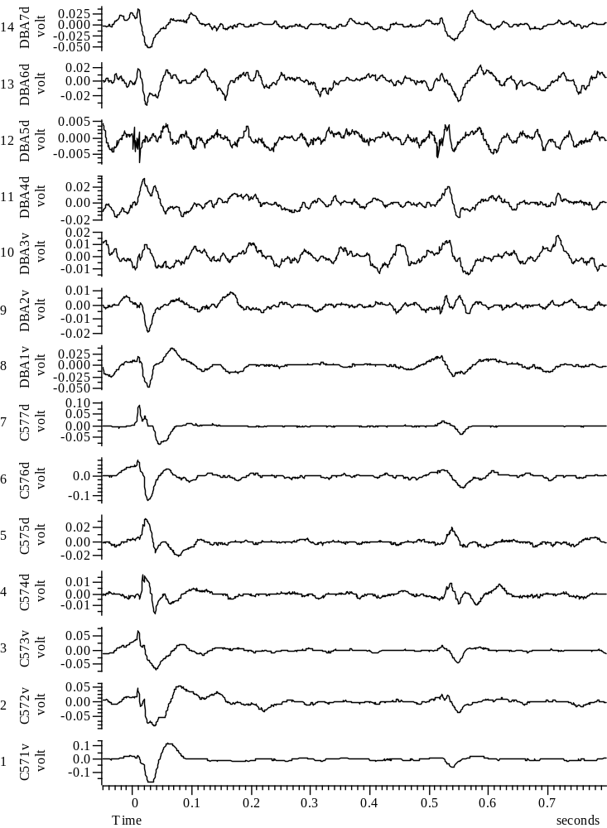
032508_Group67_7WYE103914@3_EXP6_A_all

Slide 35
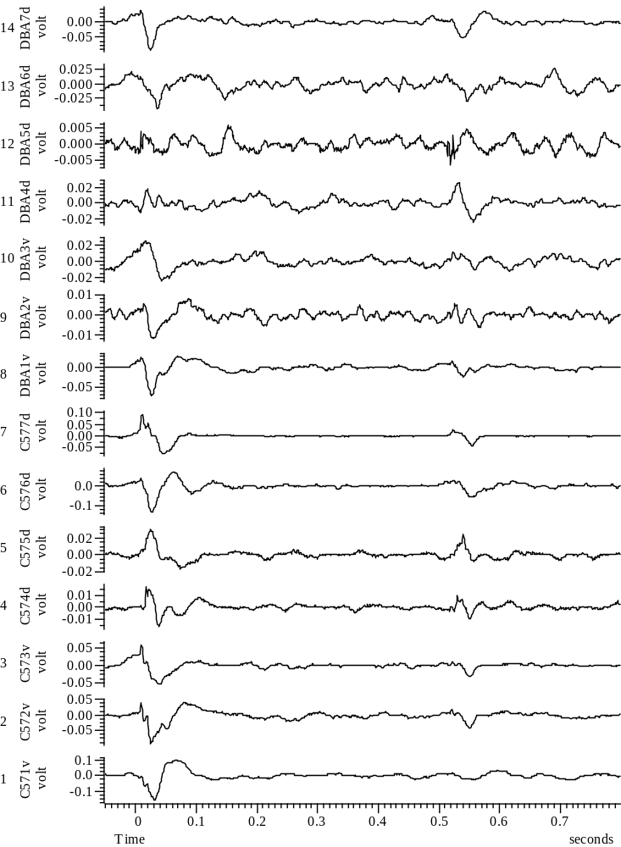
032508_Group67_8WYE103914@3_EXP7_A_all

Slide 36
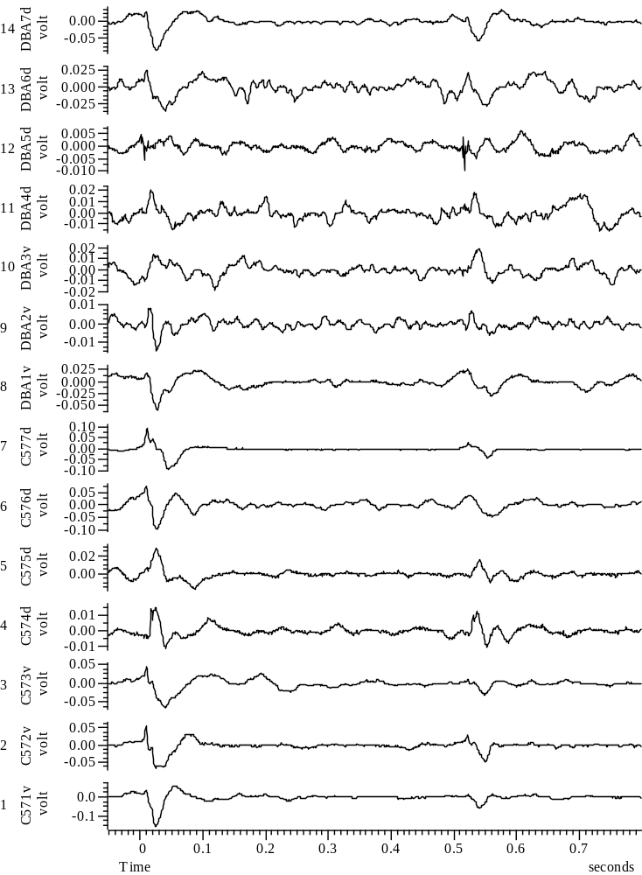
032508_Group67_9WYE103914@3_EXP8_A_all

Slide 37
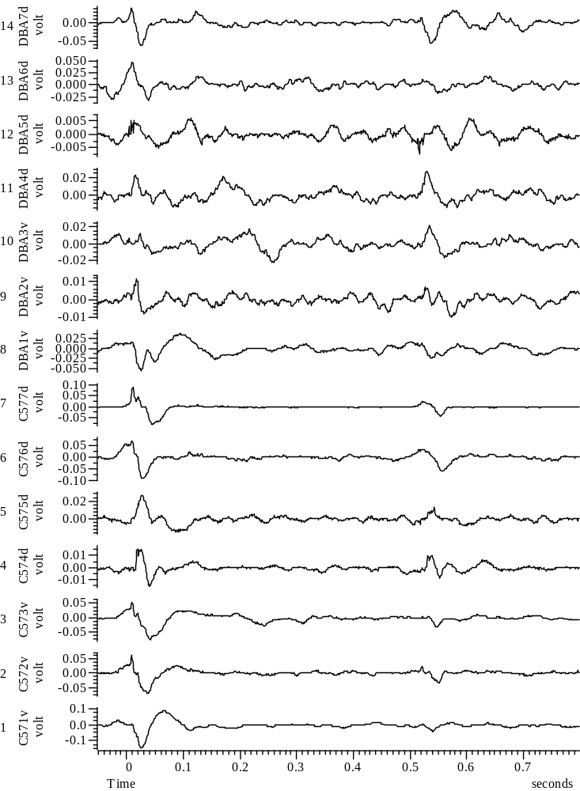
032508_Group67_10WYE103914@3_EXP9_A_all

Slide 38
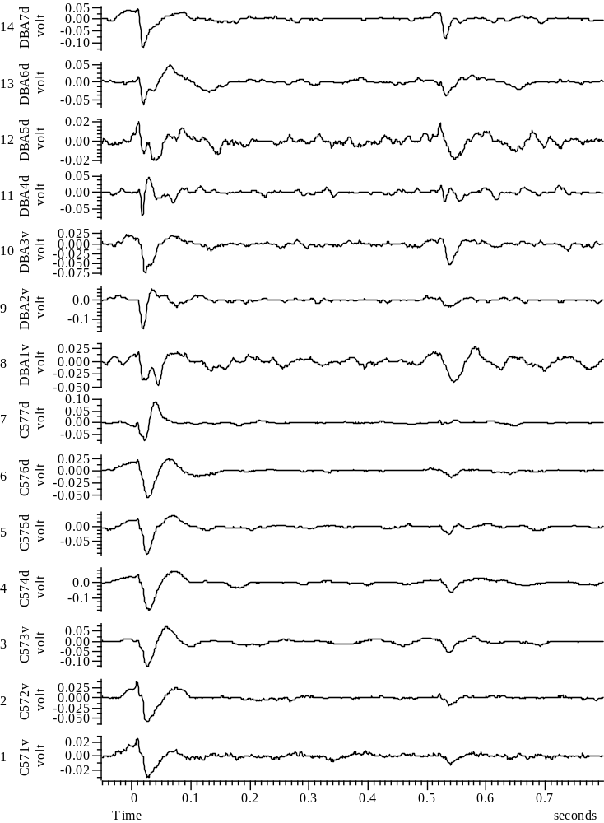
032708_Group45_01WYE103914@3_Baseline_A_all

Slide 39
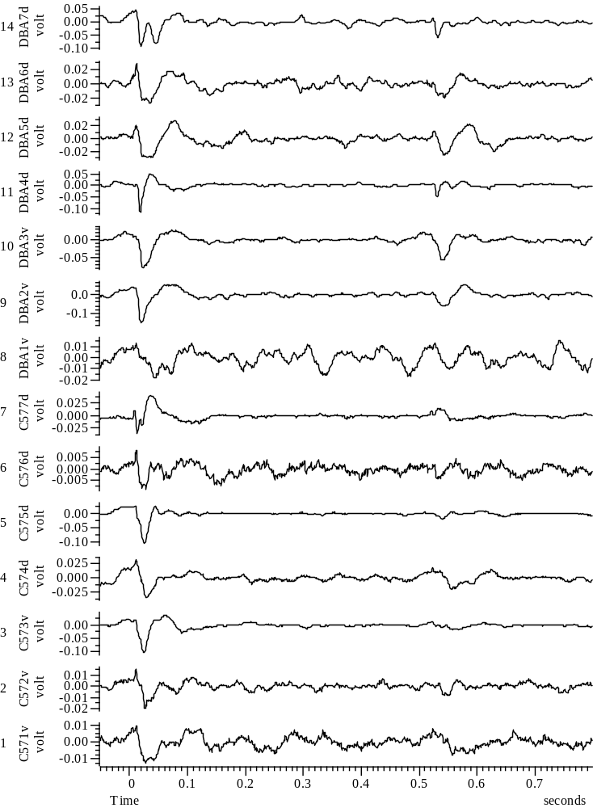

Slide 40
032708_Group45_2WYE103914@3_EXP1_A_all

Slide 41
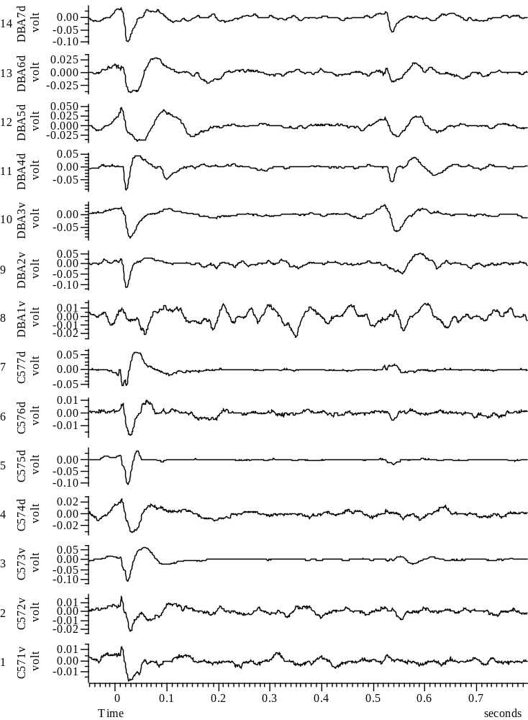
032708_Group45_3WYE103914@3_EXP2_A_all

Slide 42
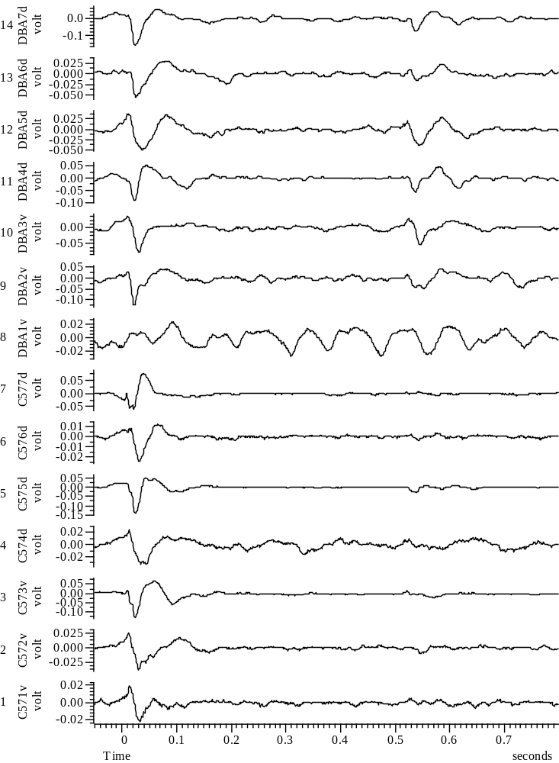
032708_Group45_4WYE103914@3_EXP3_A_all

Slide 44
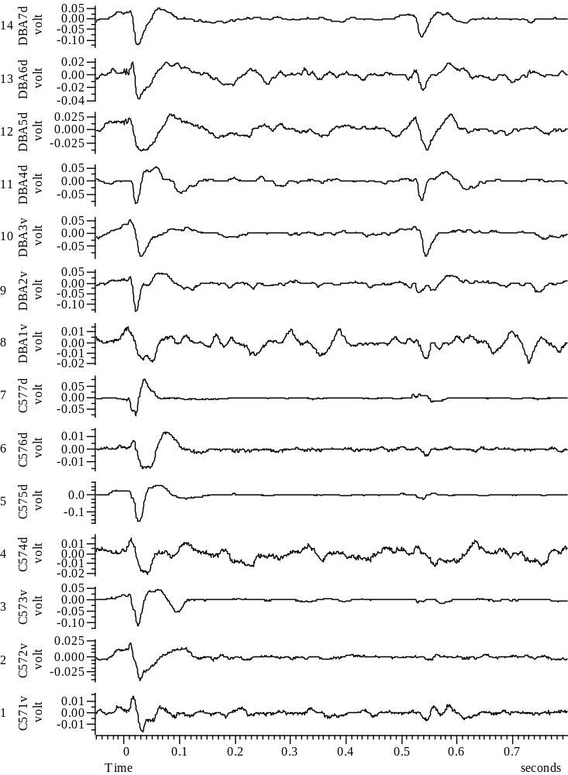
032708_Group45_5WYE103914@3_EXP4_A_all

Slide 45
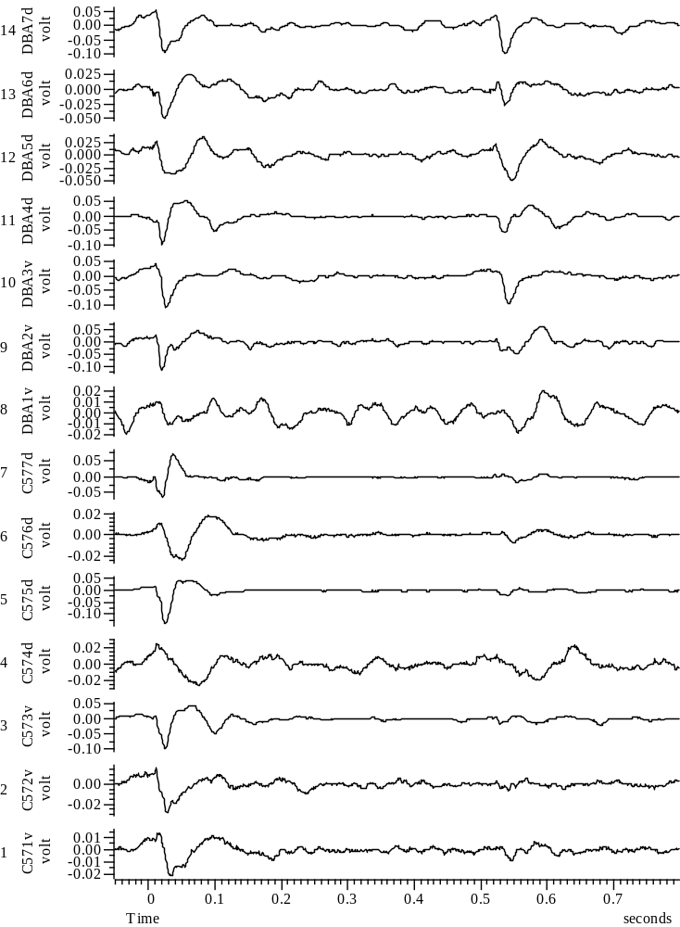
032708_Group45_6WYE103914@3_EXP5_A_all

Slide 46
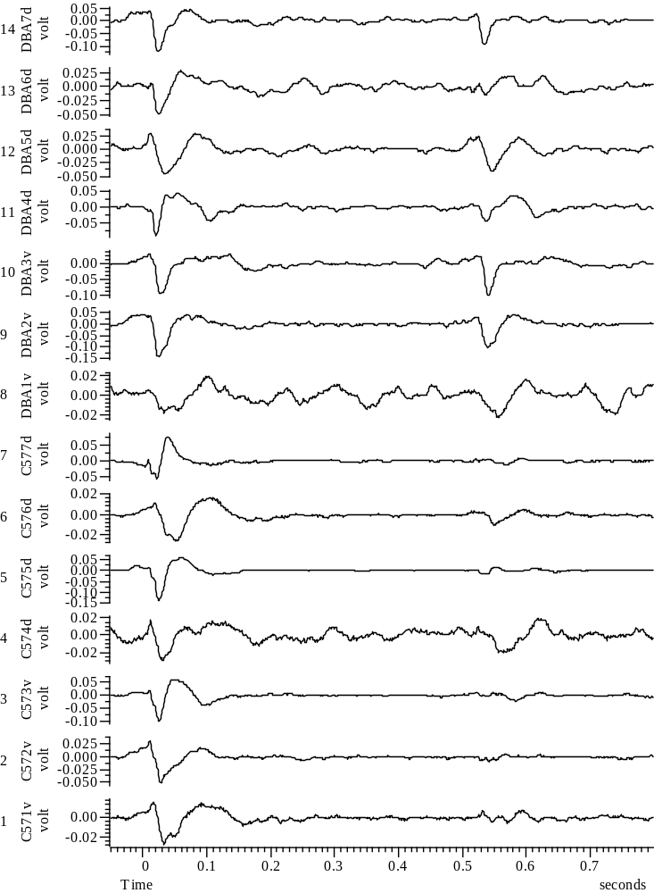
032708_Group45_7WYE103914@3_EXP6_A_all

Slide 47
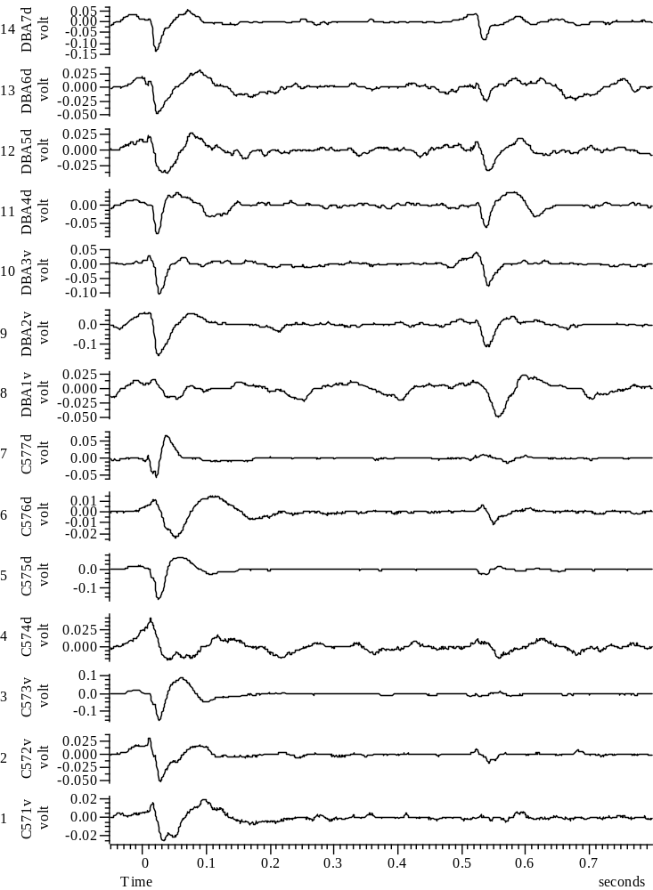
032708_Group45_8WYE103914@3_EXP7_A_all

Slide 48
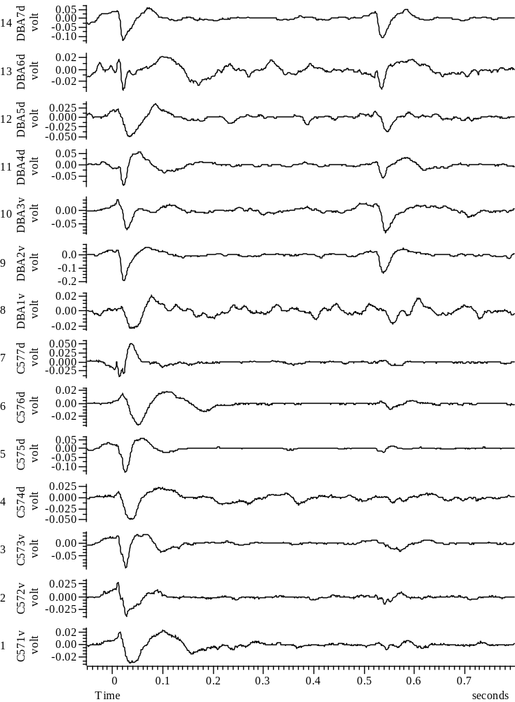
032708_Group45_9WYE103914@3_EXP8_A_all

Slide 49
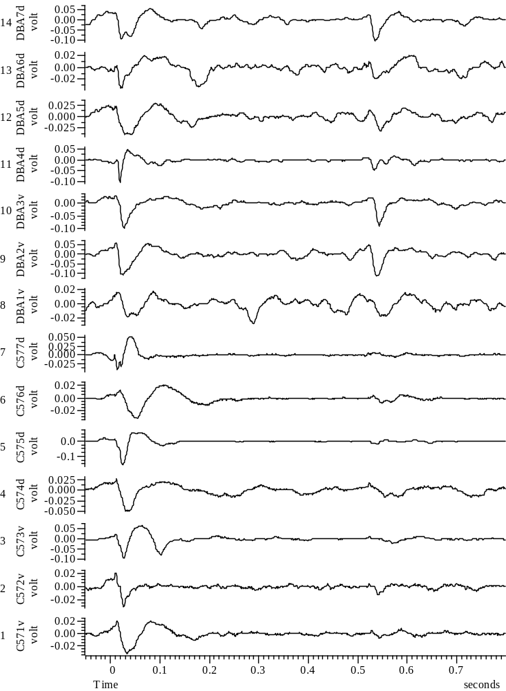
032708_Group45_10WYE103914@3_EXP9_A_all

Slide 50
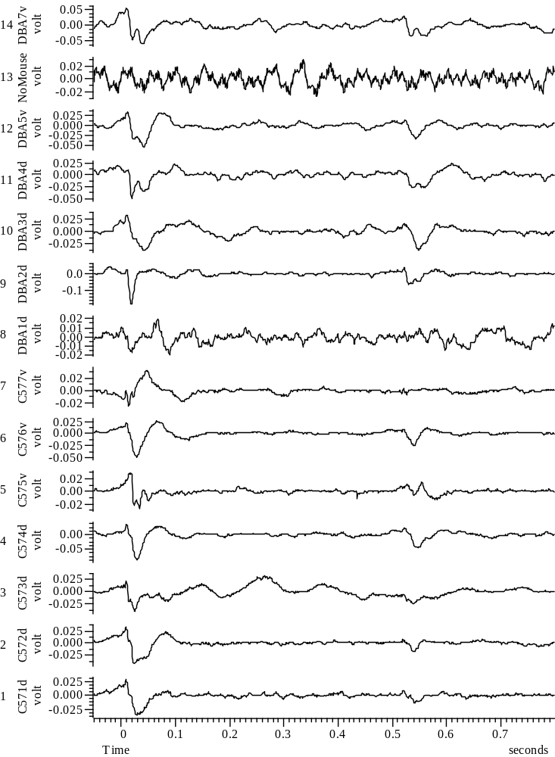
033008_Group45_01WYE103914@10_Baseline_A_all

Slide 51
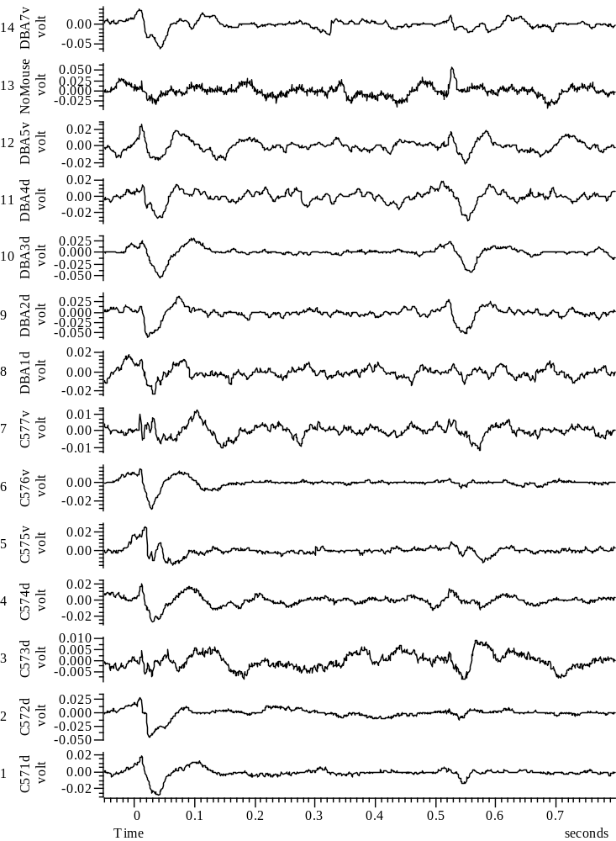
033008_Group45_2WYE103914@10_EXP1_A_all

Slide 52
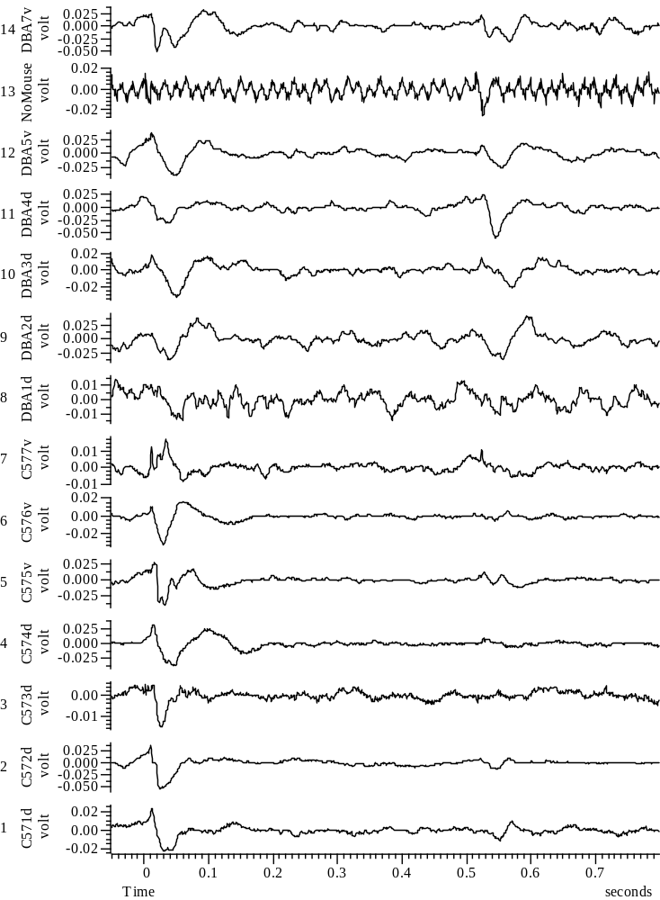
033008_Group45_3WYE103914@10_EXP2_A_all

Slide 53

033008_Group45_4WYE103914@10_EXP3_A_all

Slide 54

033008_Group45_5WYE103914@10_EXP4_A_all

Slide 55

033008_Group45_6WYE103914@10_EXP5_A_all

Slide 56

033008_Group45_7WYE103914@10_EXP6_A_all

Slide 57

033008_Group45_8WYE103914@10_EXP7_A_all

Slide 58

033008_Group45_9WYE103914@10_EXP8_A_all

Slide 59

033008_Group45_10WYE103914@10_EXP9_A_all

