Slide 1
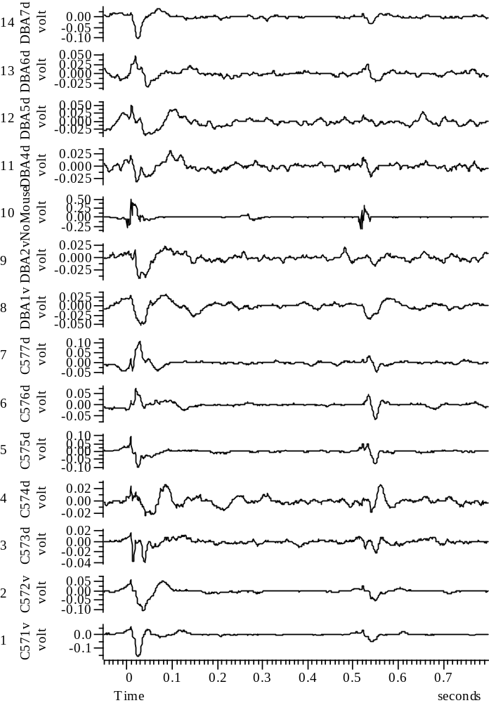
040708_Group67_01WYE103914@3_Baseline_A_all

Slide 2
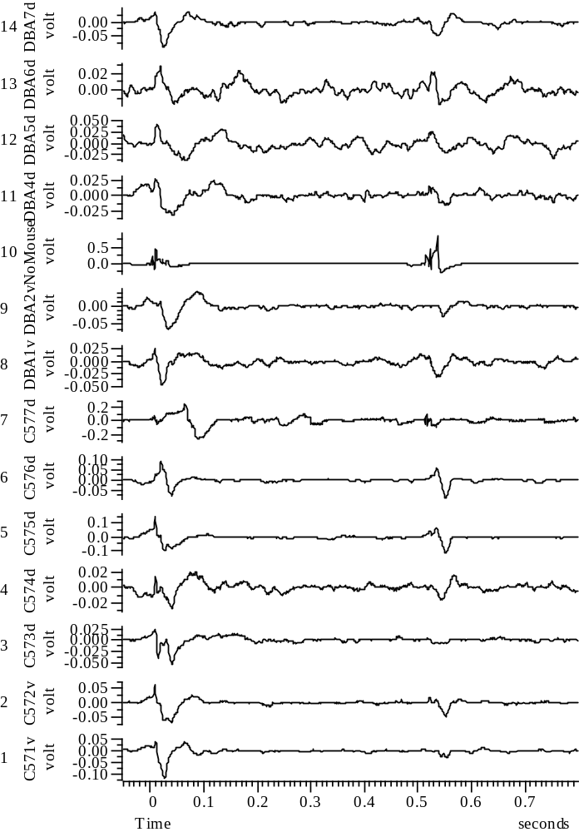
040708_Group67_2WYE103914@3_EXP1_A_all

Slide 3
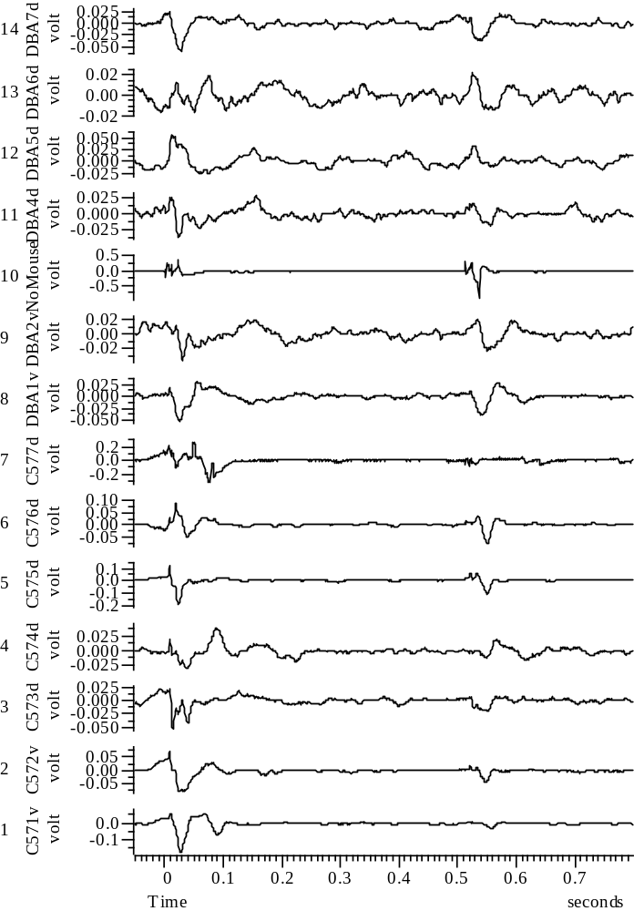
040708_Group67_3WYE103914@3_EXP2_A_all

Slide 4
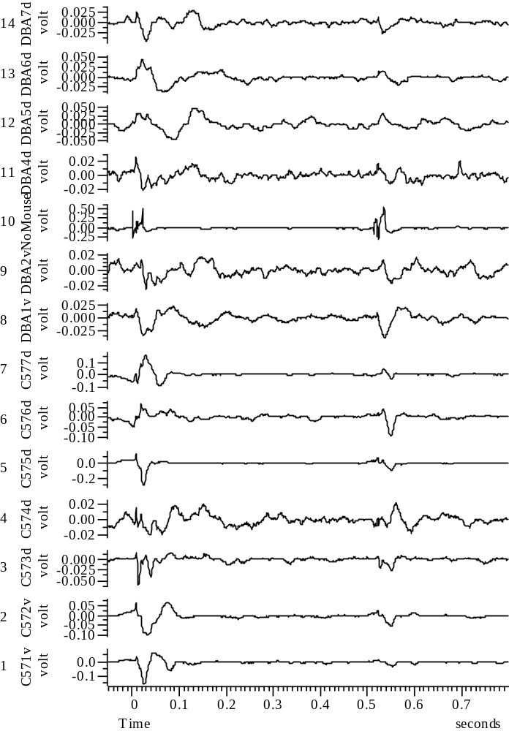
040708_Group67_4WYE103914@3_EXP3_A_all

Slide 5
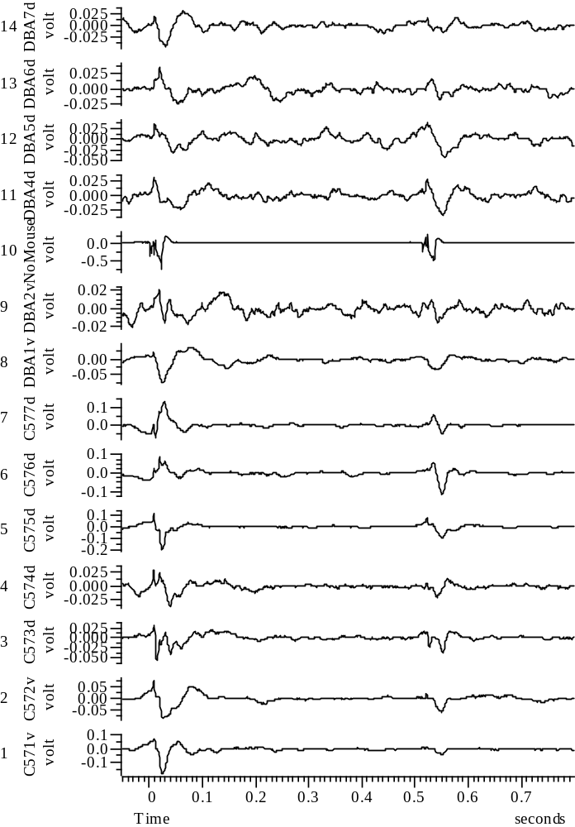
040708_Group67_5WYE103914@3_EXP4_A_all

Slide 6
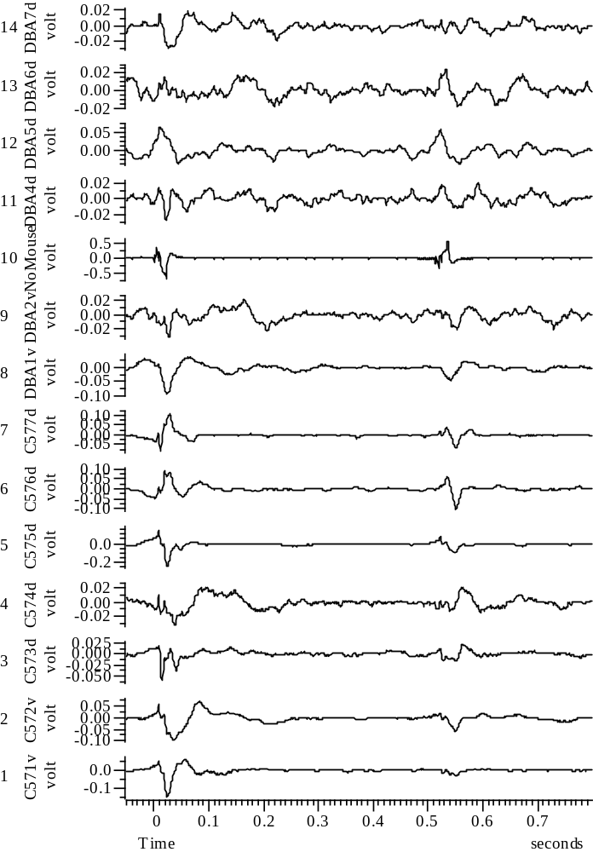
040708_Group67_6WYE103914@3_EXP5_A_all

Slide 7
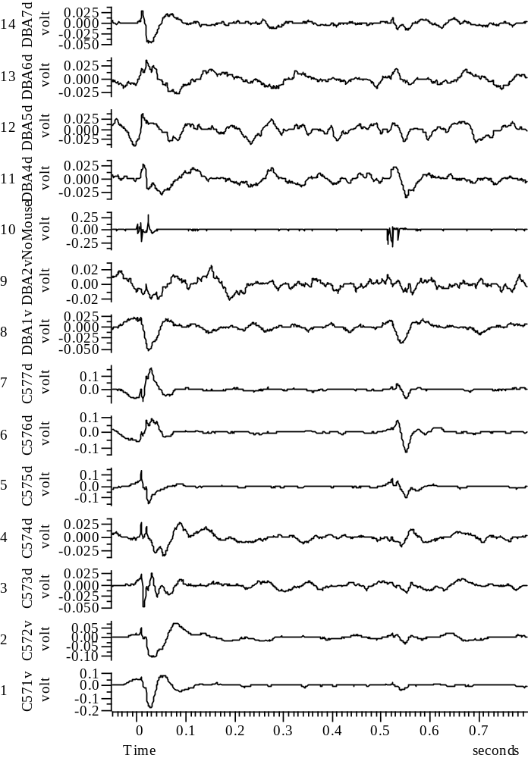
040708_Group67_7WYE103914@3_EXP6_A_all

Slide 8
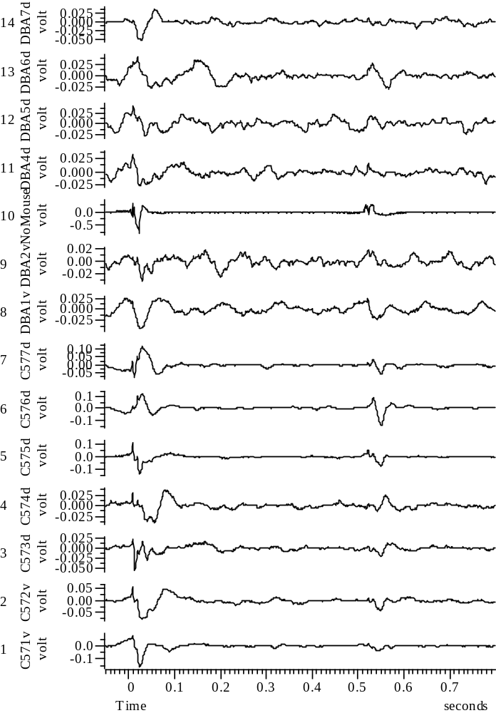
040708_Group67_8WYE103914@3_EXP7_A_all

Slide 9
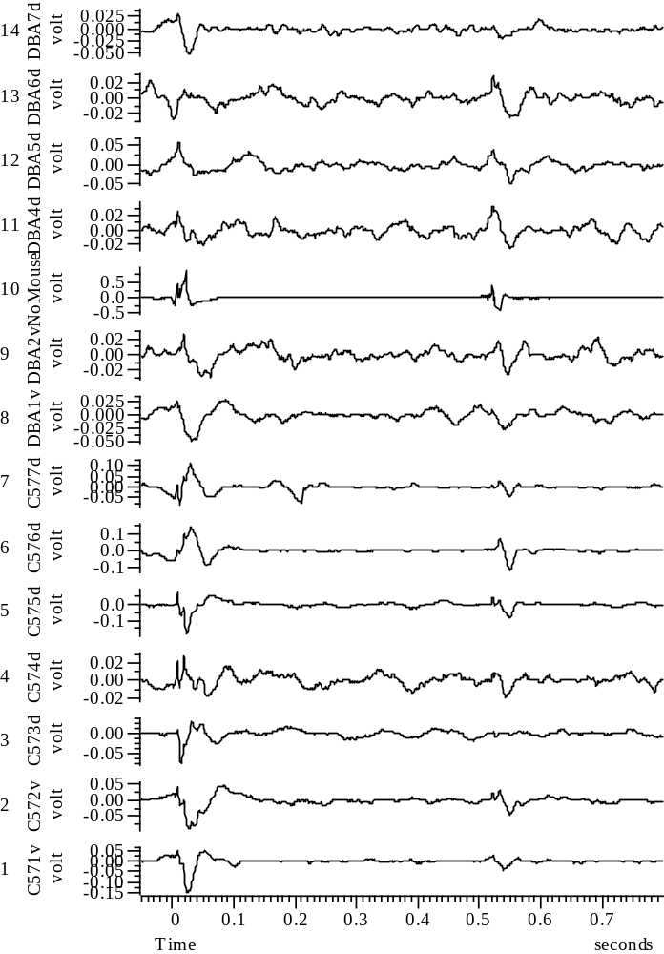
040708_Group67_9WYE103914@3_EXP8_A_all

Slide 10
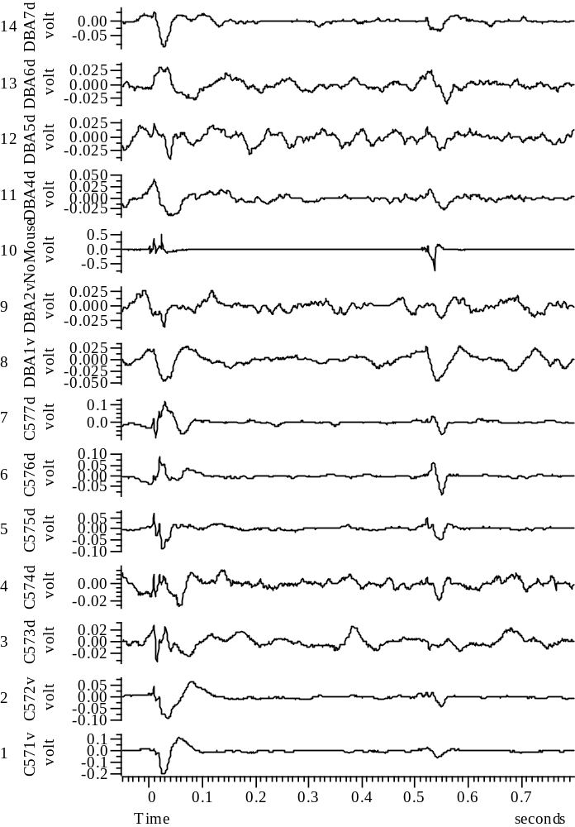
040708_Group67_10WYE103914@3_EXP9_A_all

Slide 11
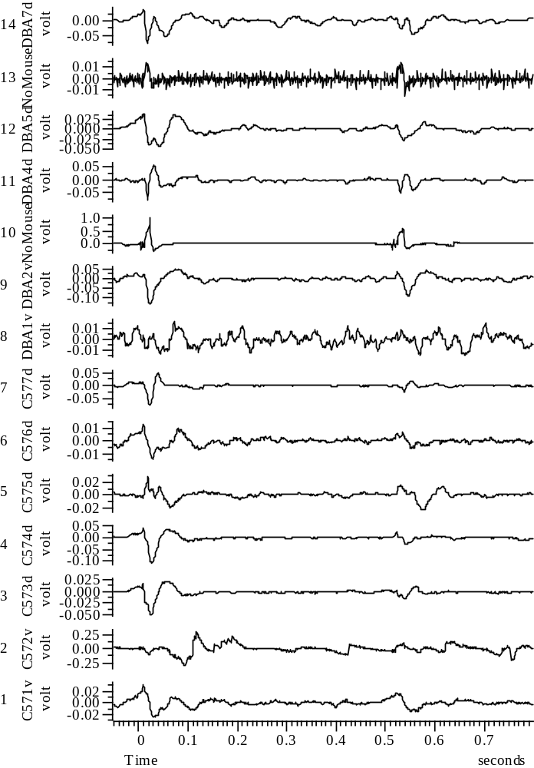
040808_Group45_01WYE103914@3_Baseline_A_all

Slide 12
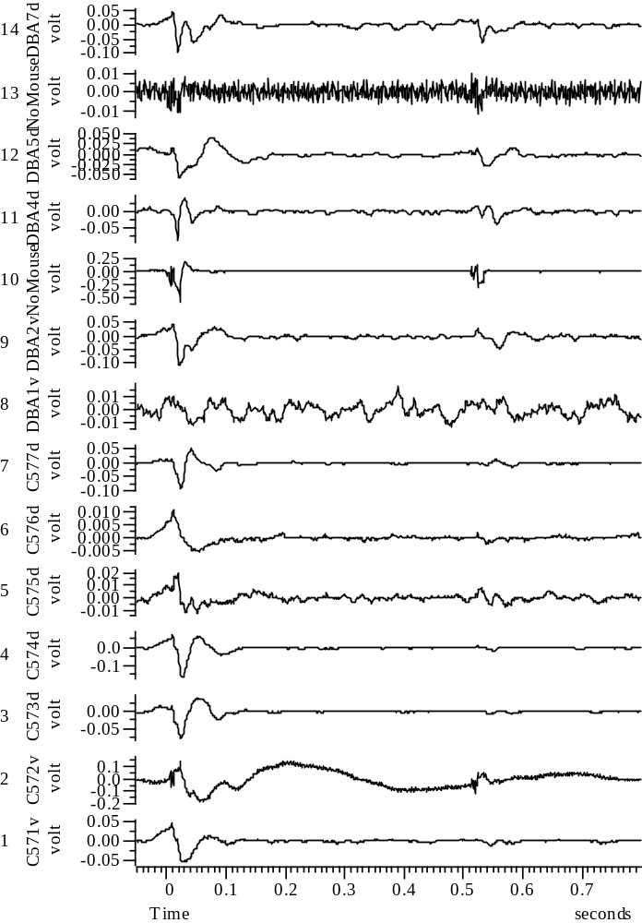
040808_Group45_2WYE103914@3_EXP1_A_all

Slide 13
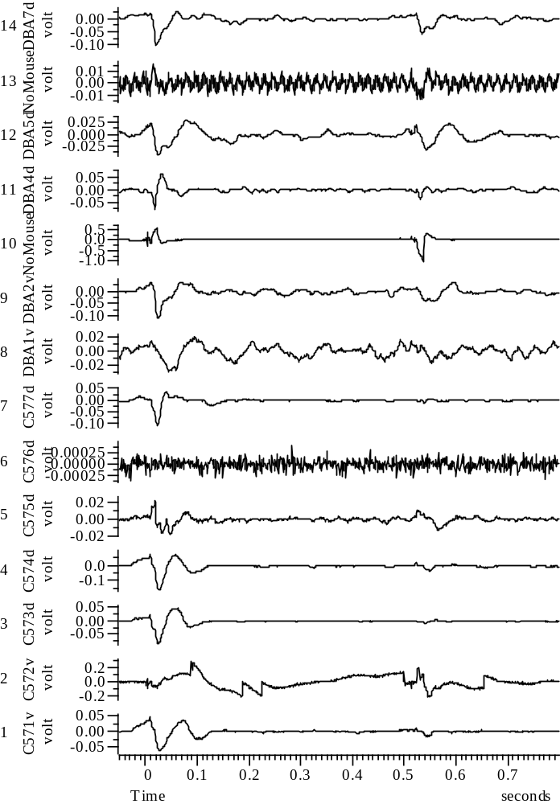
040808_Group45_3WYE103914@3_EXP2_A_all

Slide 14
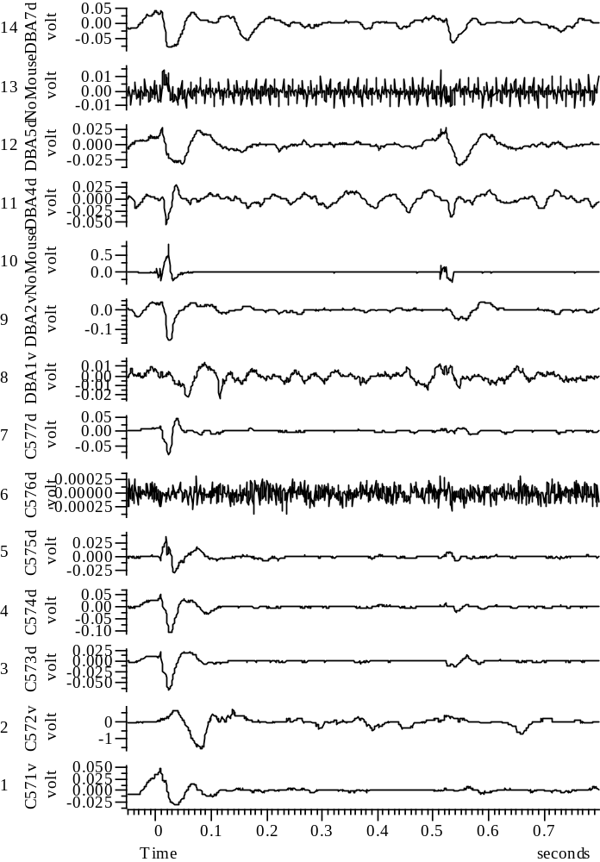
040808_Group45_5WYE103914@3_EXP4_A_all

Slide 15
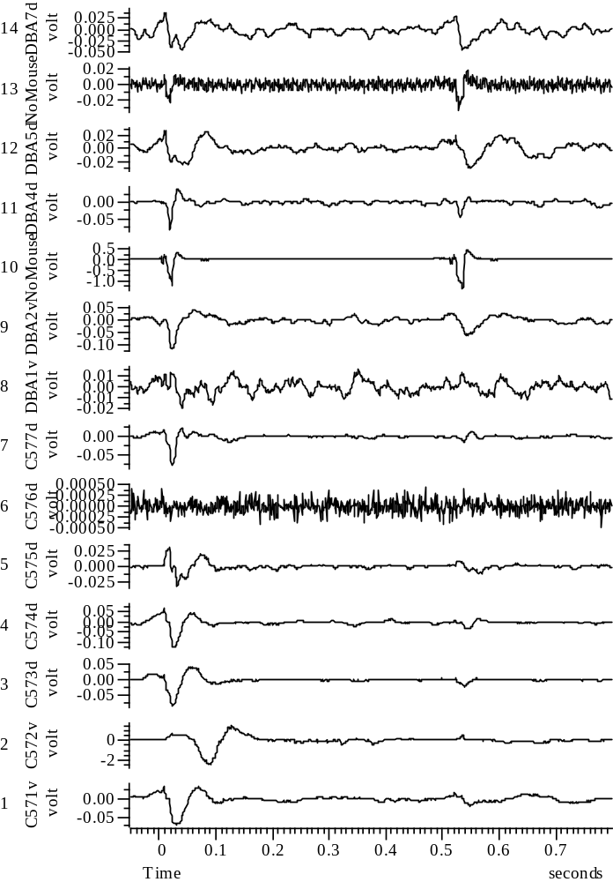
040808_Group45_6WYE103914@3_EXP5_A_all

Slide 16
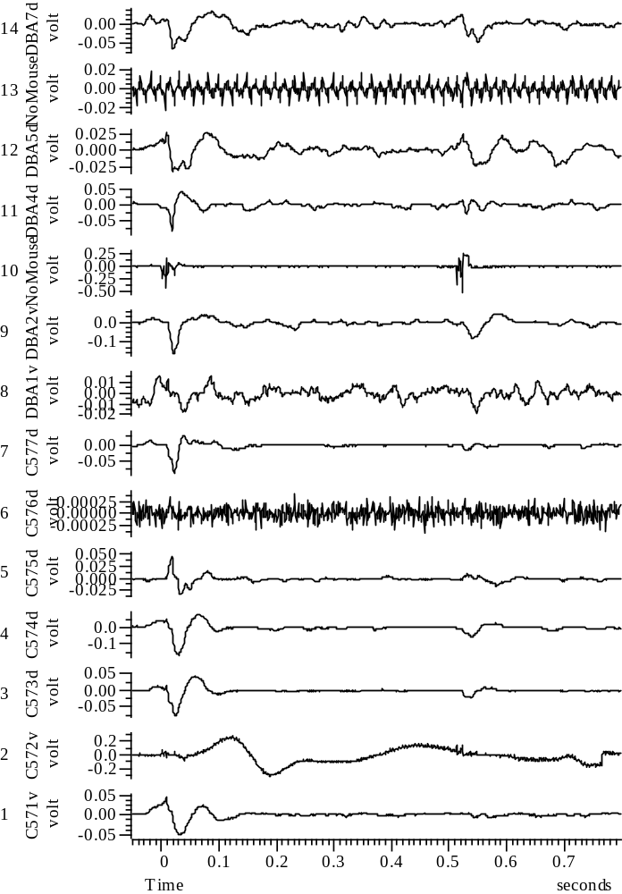
040808_Group45_7WYE103914@3_EXP6_A_all

Slide 17
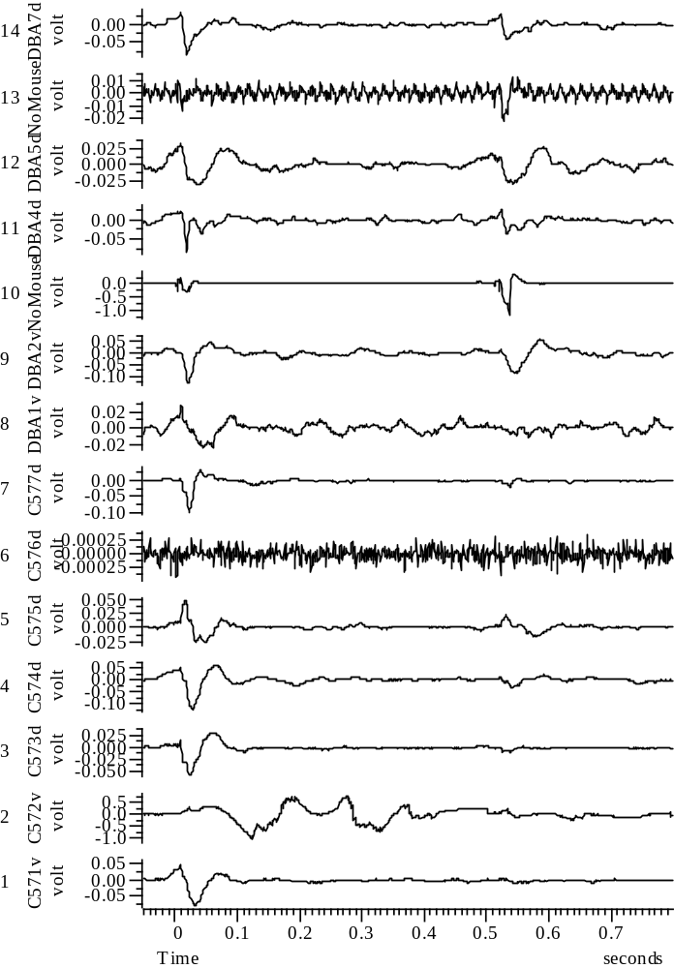
040808_Group45_8WYE103914@3_EXP7_A_all

Slide 18
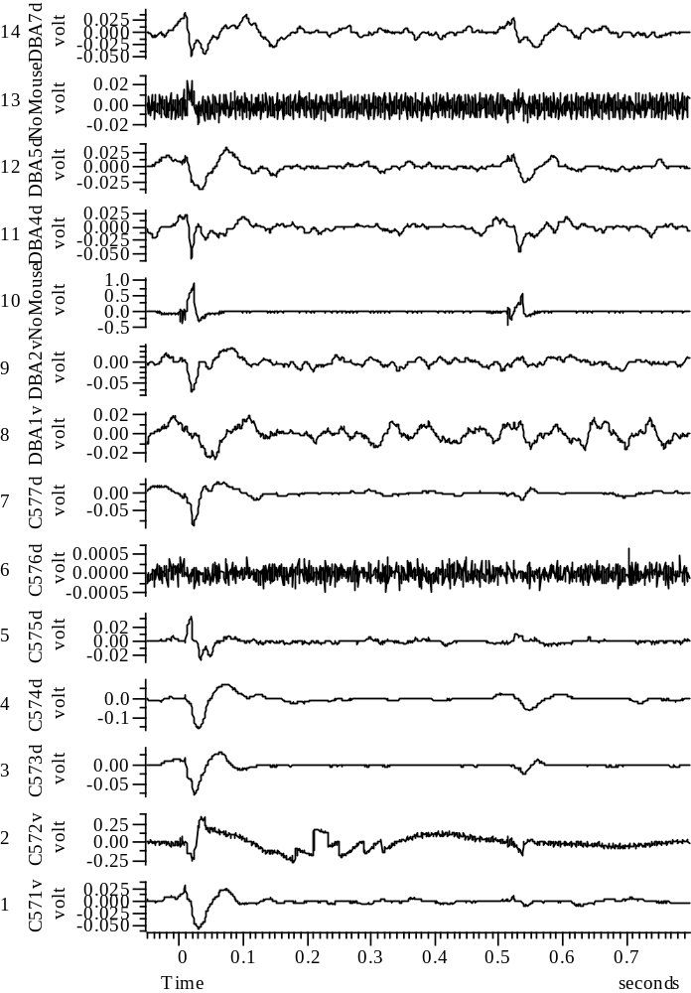
040808_Group45_9WYE103914@3_EXP8_A_all

Slide 19
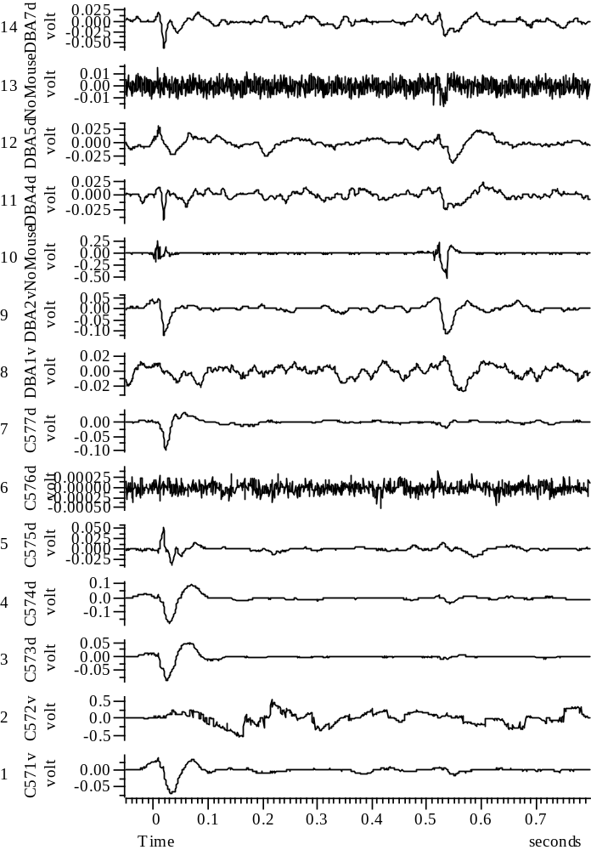
040808_Group45_10WYE103914@3_EXP9_A_all

Slide 20
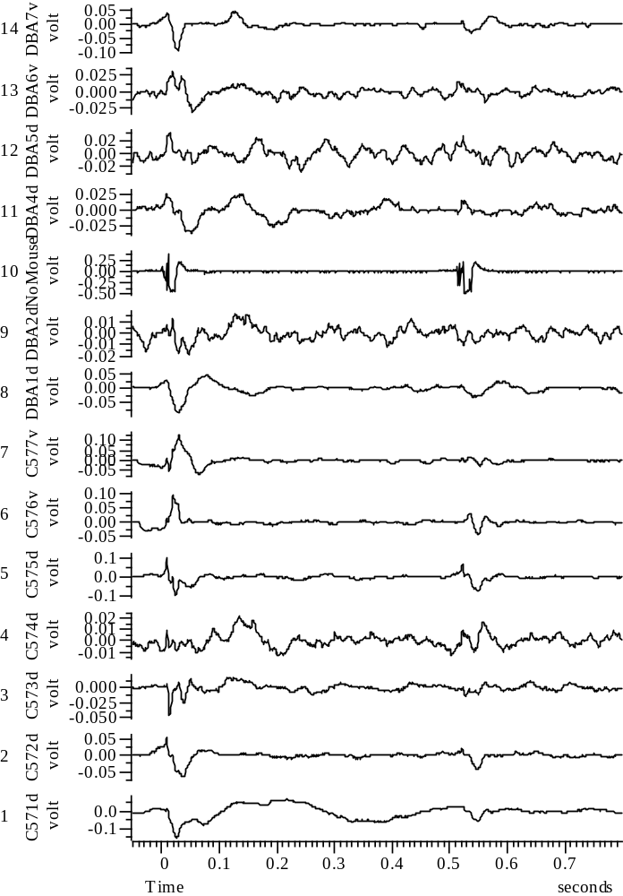
041008_Group67_01WYE103914@10_Baseline_A_all

Slide 21
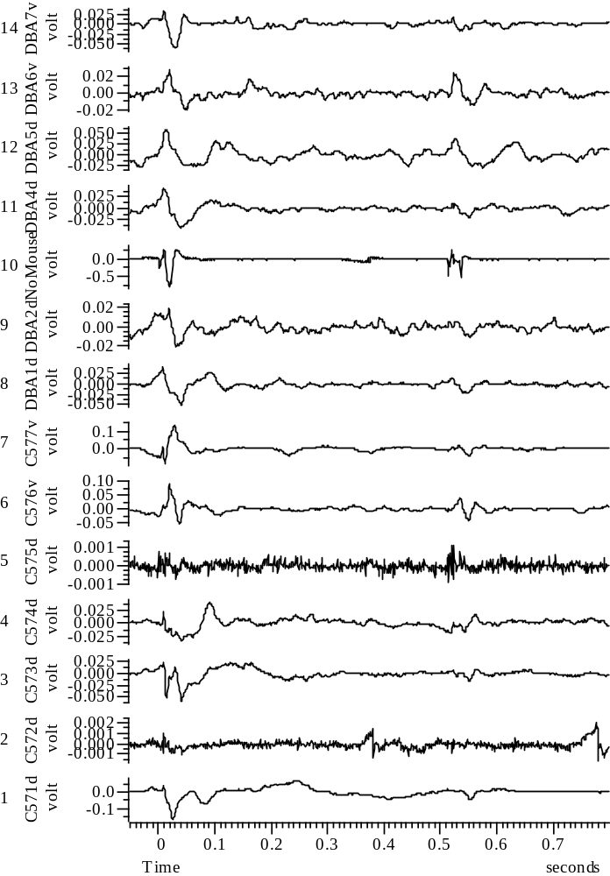
041008_Group67_2WYE103914@10_EXP1_A_all

Slide 22
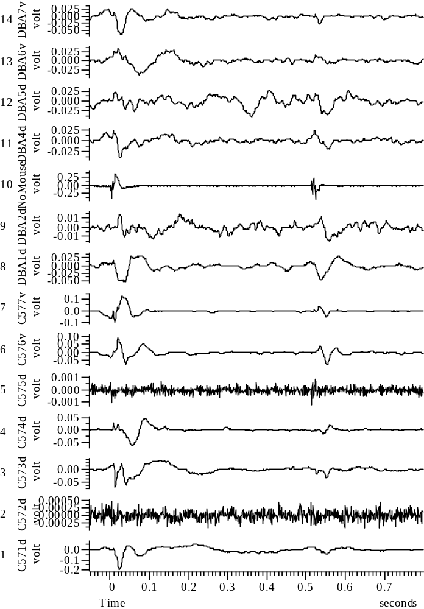
041008_Group67_3WYE103914@10_EXP2_A_all

Slide 23
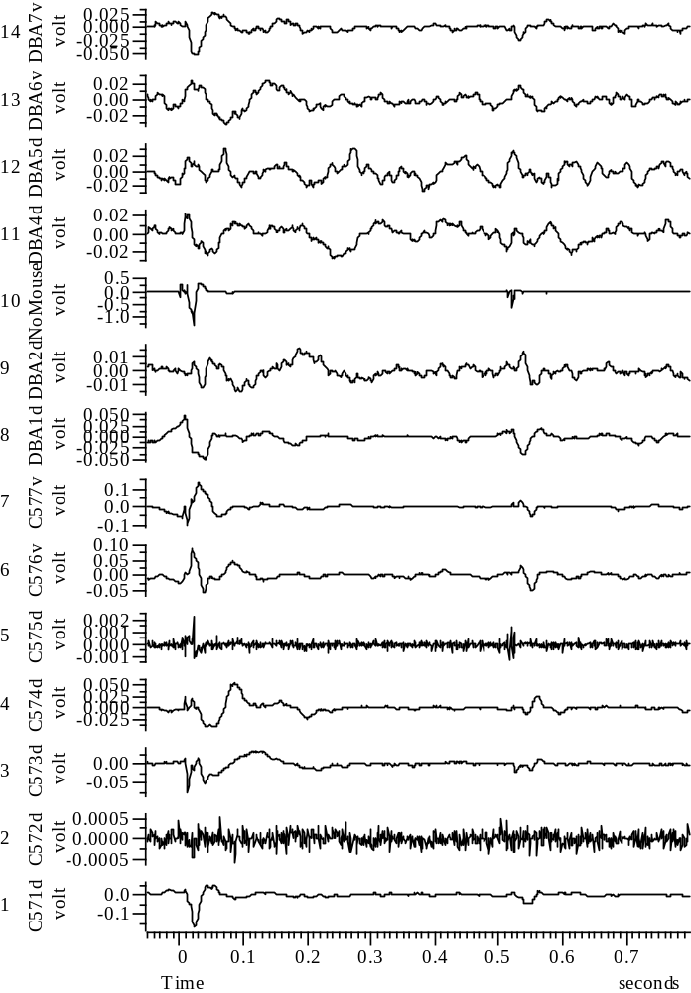
041008_Group67_4WYE103914@10_EXP3_A_all

Slide 24
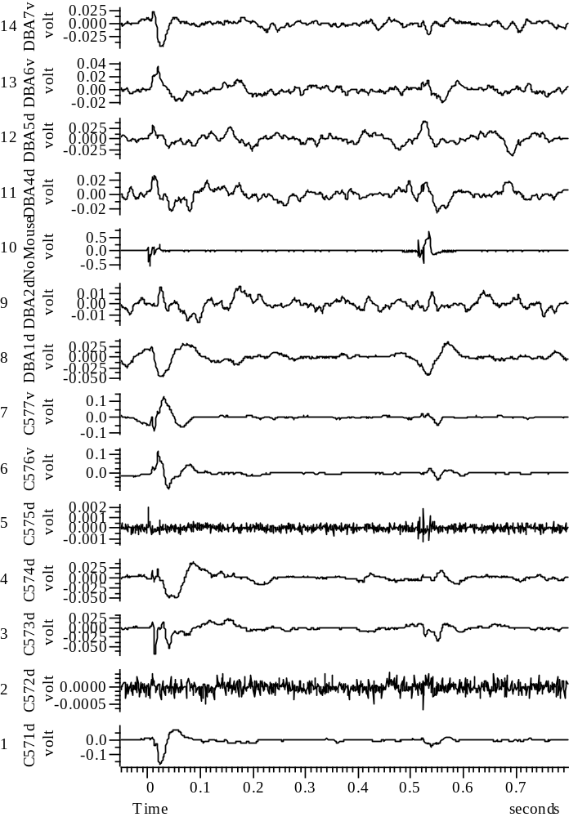
041008_Group67_5WYE103914@10_EXP4_A_all

Slide 25
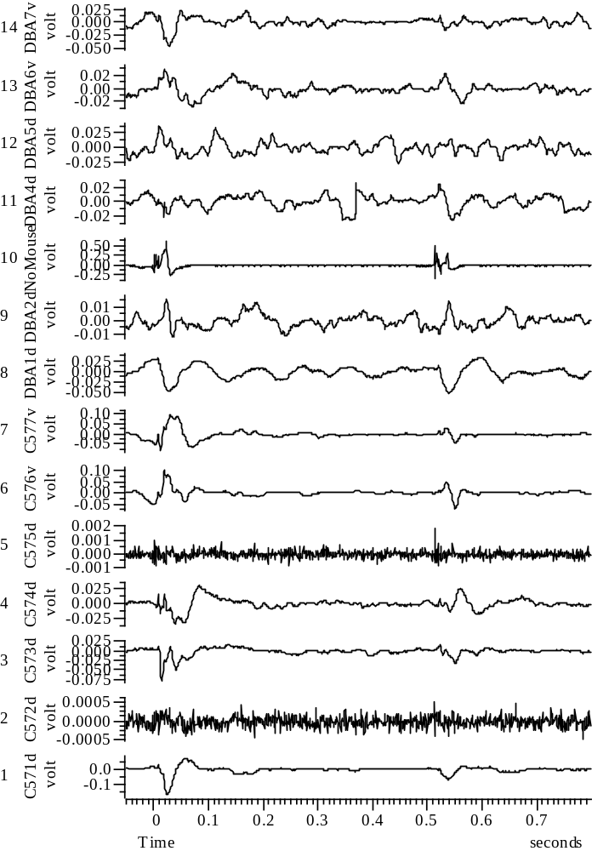
041008_Group67_6WYE103914@10_EXP5_A_all

Slide 26
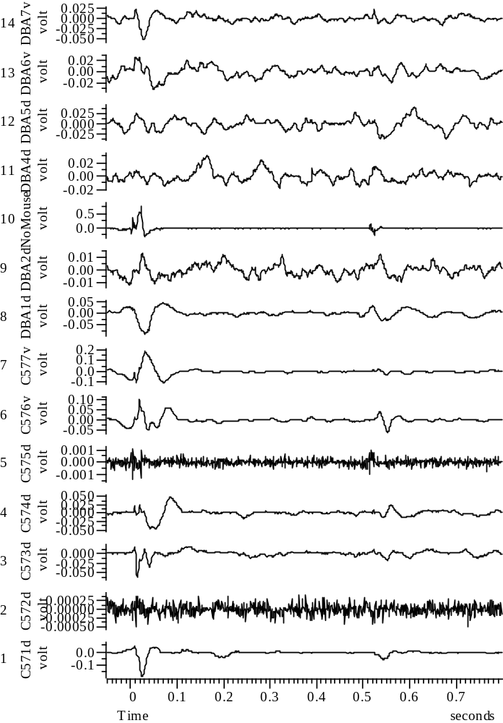
041008_Group67_7WYE103914@10_EXP6_A_all

Slide 27
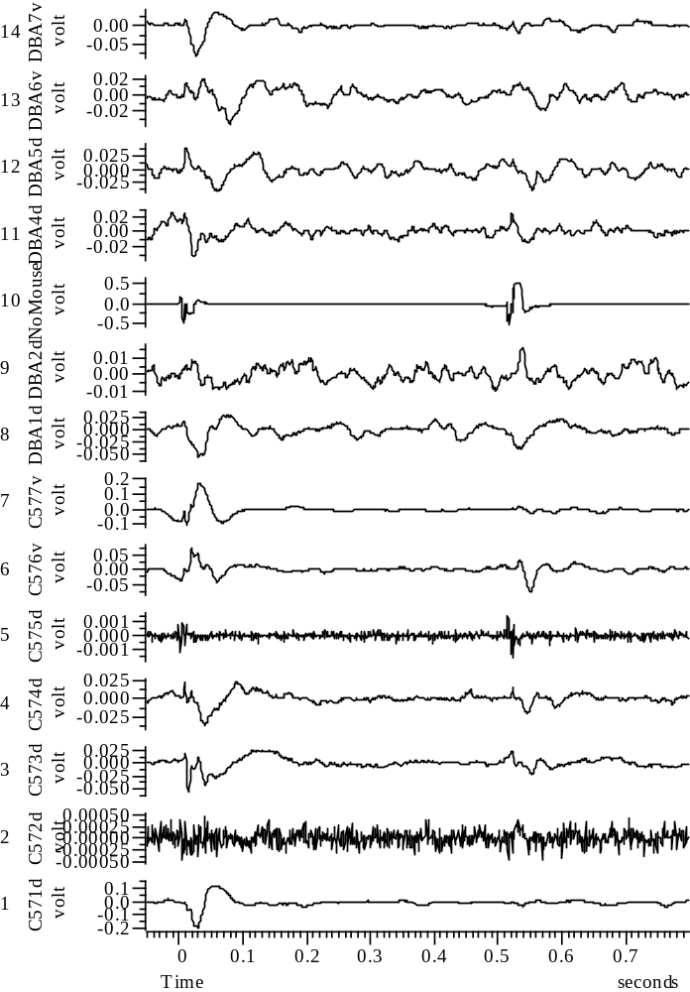
041008_Group67_8WYE103914@10_EXP7_A_all

Slide 28
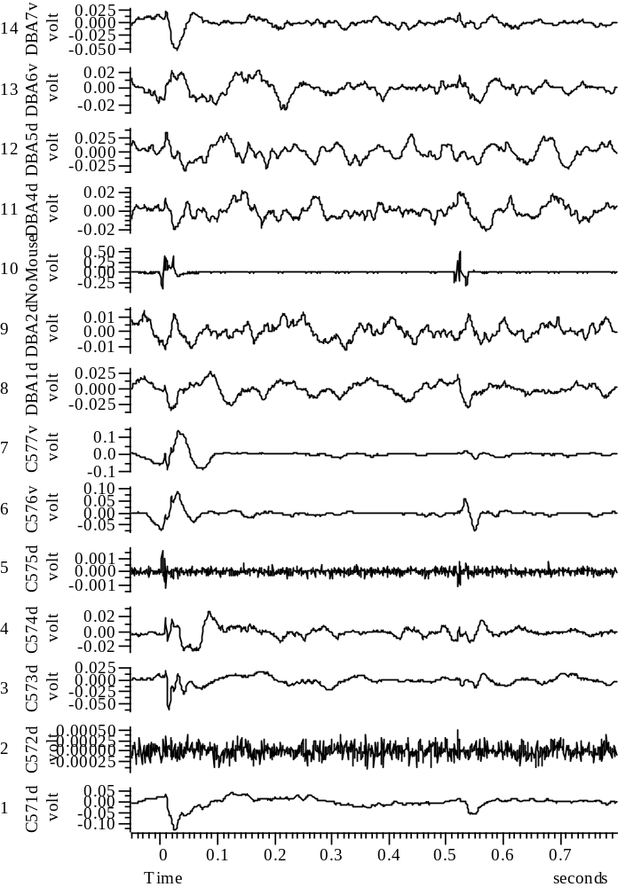
041008_Group67_9WYE103914@10_EXP8_A_all

Slide 29
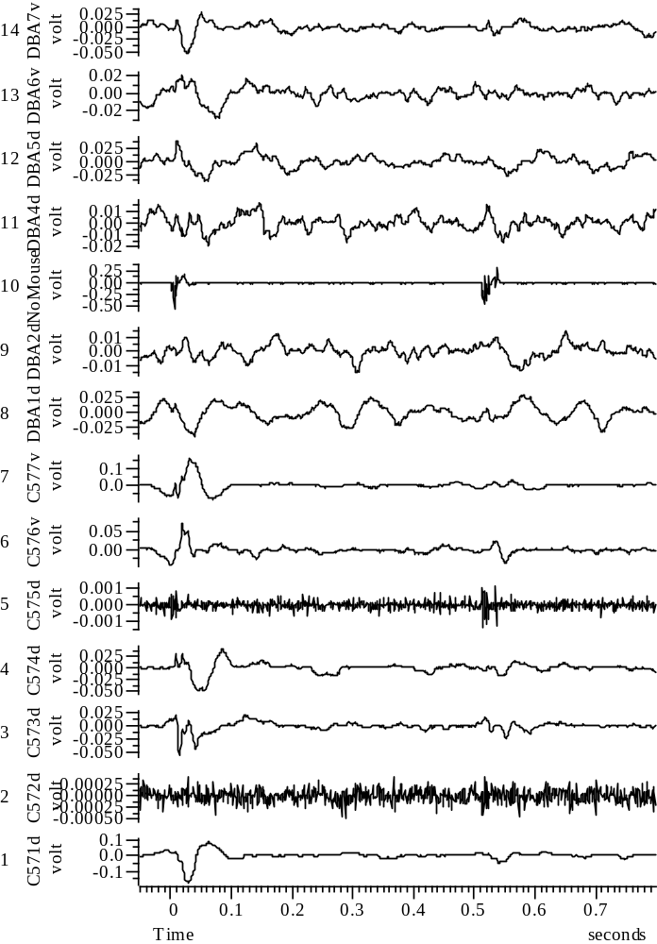
041008_Group67_10WYE103914@10_EXP9_A_all

Slide 30
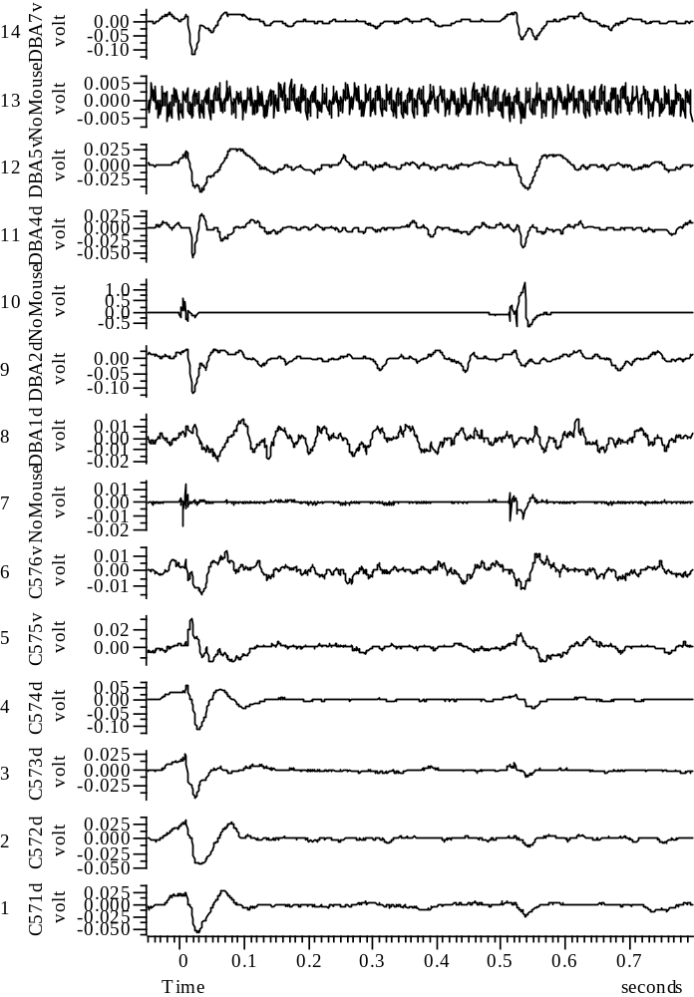
041108_Group45_01WYE103914@10_Baseline_A_all

Slide 31
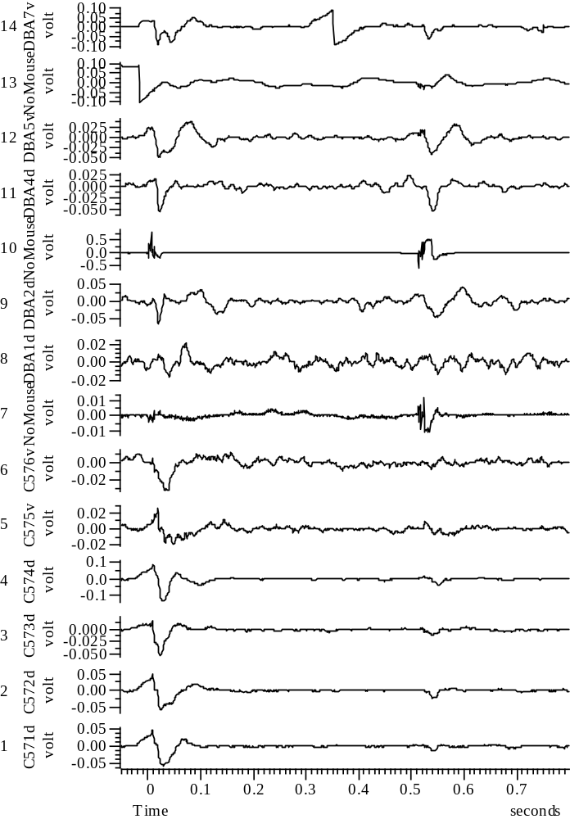
041108_Group45_2WYE103914@10_EXP1_A_all

Slide 32
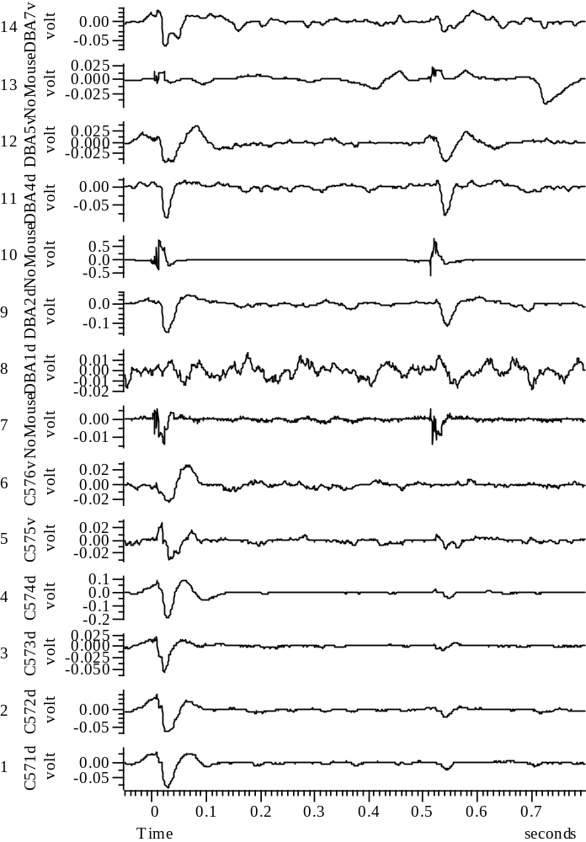
041108_Group45_3WYE103914@10_EXP2_A_all

Slide 33
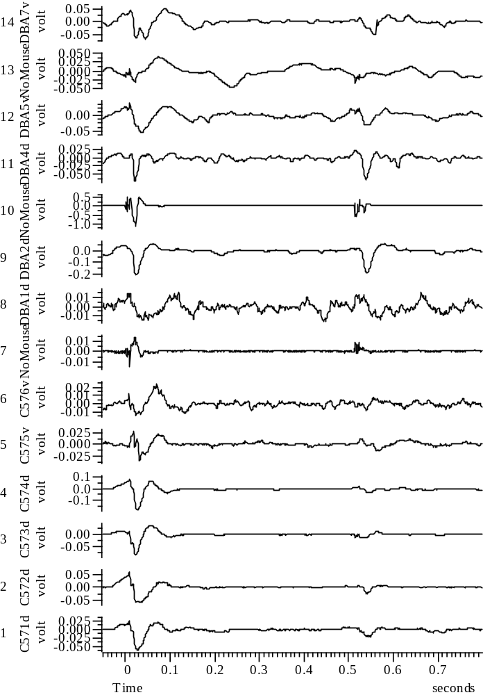
041108_Group45_4WYE103914@10_EXP3_A_all

Slide 34
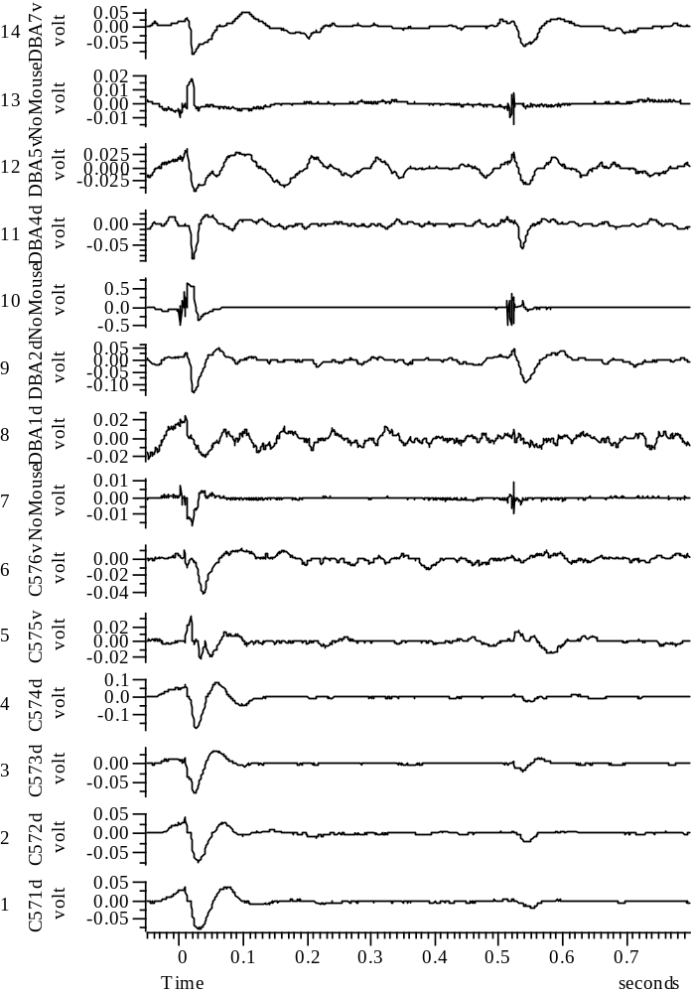
041108_Group45_5WYE103914@10_EXP4_A_all

Slide 35
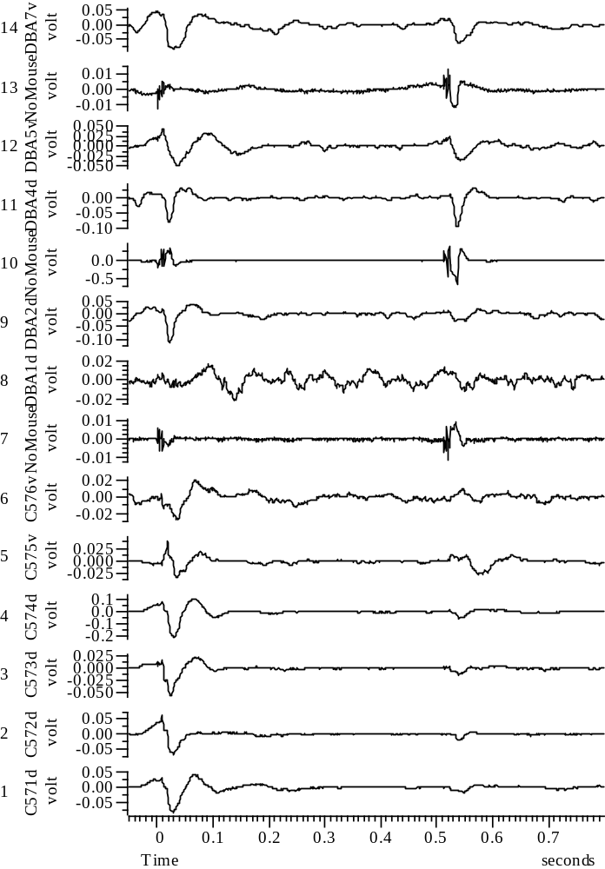
041108_Group45_6WYE103914@10_EXP5_A_all

Slide 36
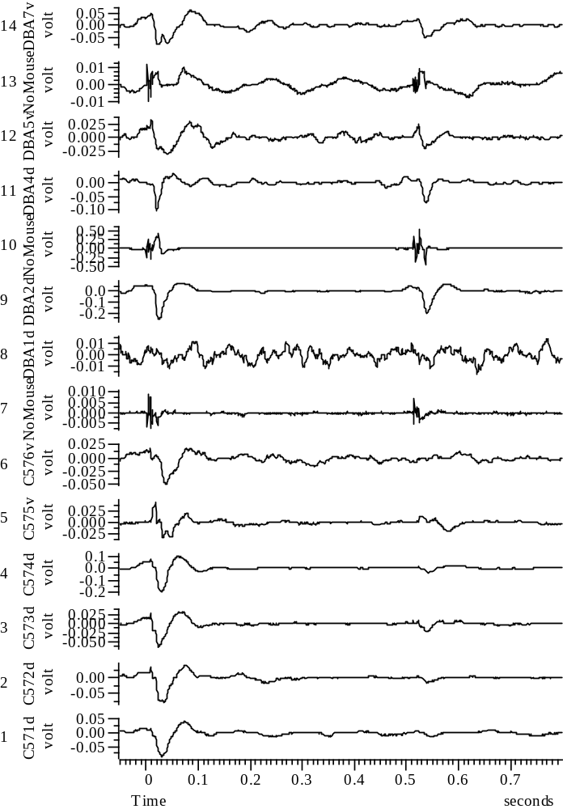
041108_Group45_7WYE103914@10_EXP6_A_all

Slide 37
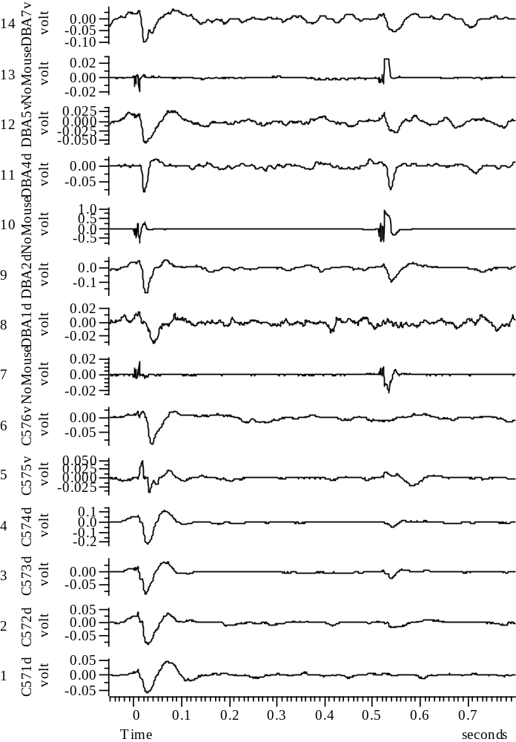
041108_Group45_8WYE103914@10_EXP7_A_all

Slide 38
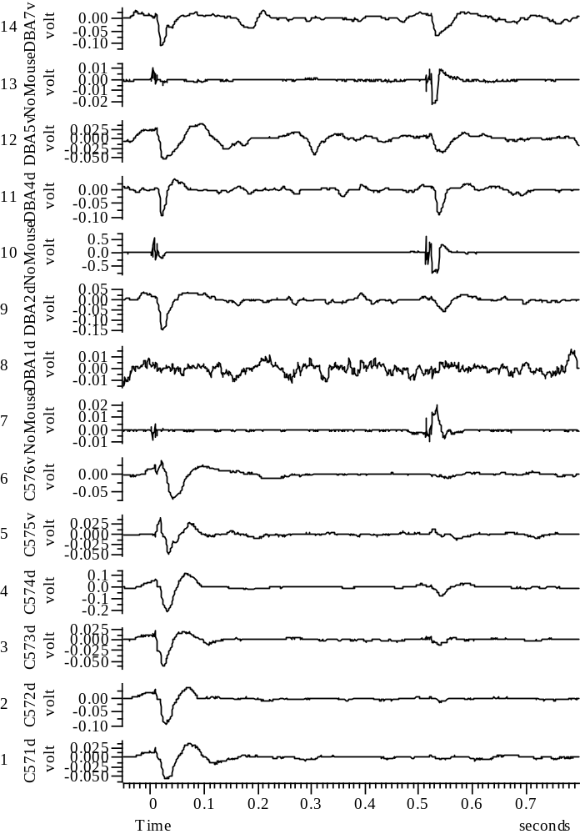
041108_Group45_9WYE103914@10_EXP8_A_all

Slide 39
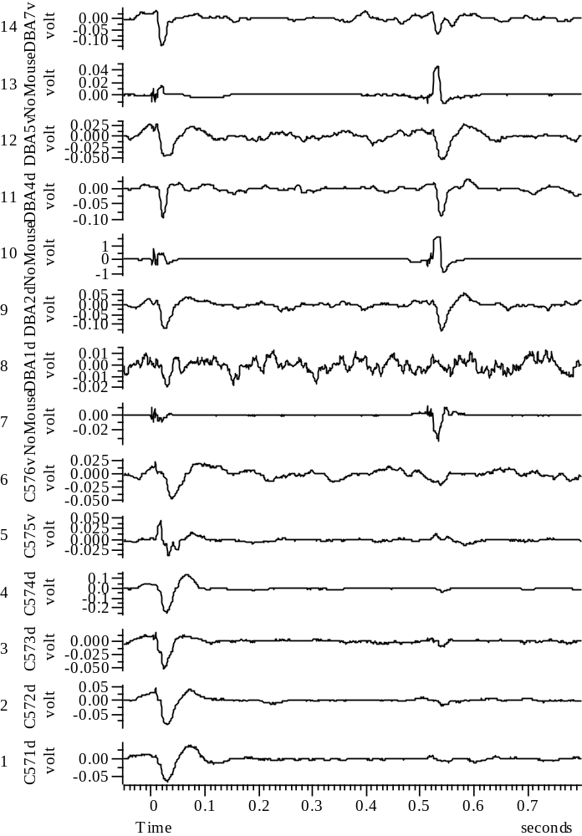
041108_Group45_10WYE103914@10_EXP9_A_all

