Slide 1
Proposal #2: Separate the SupplyRequest from the response
Supply
SupplyRequest
person|organization|practitioner
Reception?

Slide 2
Proposal #4: ALTERNATIVE to #2, reuse the Order Resource and have a resource for "material" or "product" or something existing.
Use Case 1: Supply for replenishing Stock
Order
OrderResponse
SupplyRequest
Device/Medication or “Product”?
PhysicalProduct ( see proposal #8)
Use Case 2: Supply for individual patient - does this go in patient record or is still work flow? If not then is this any different than above?

Slide 3
Proposal #5 Consider the creation of Shipment and Reception or a "ShipmentTracking" resource?.. To be discussed.
Order
OrderResponse
ShipmentTracking?
SupplyRequest
Device/Medication or “Product”?
PhysicalProduct ( see proposal #8)
Reception?

Slide 4
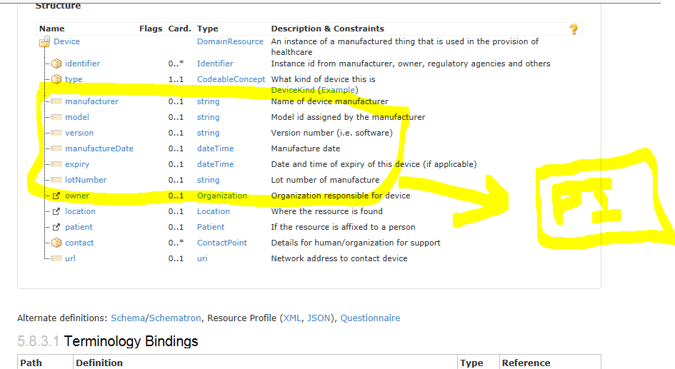
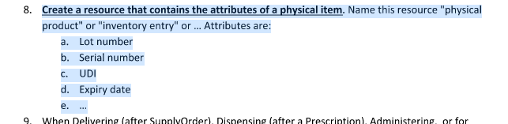
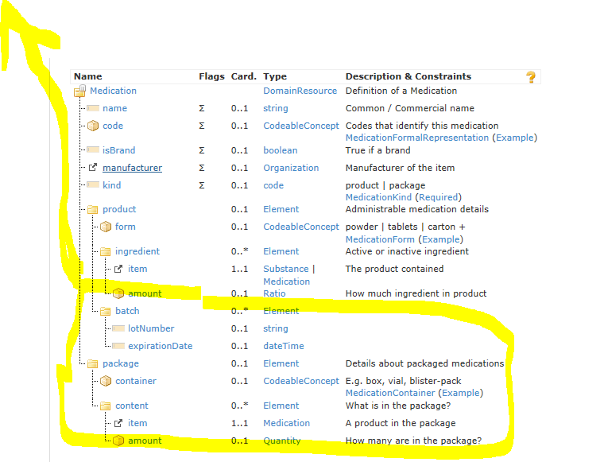
Proposal # 8: Remove the Physical Item information from Device and Medication and put in a shared ‘PhysicalProduct’ resource

