Slide 1
Construction of Mobile Robots 716.091
Richard Halatschek, Marco de Bortoli, Martin Kandlhofer, Gerald Steinbauer
Institute for Software Technology

Slide 2
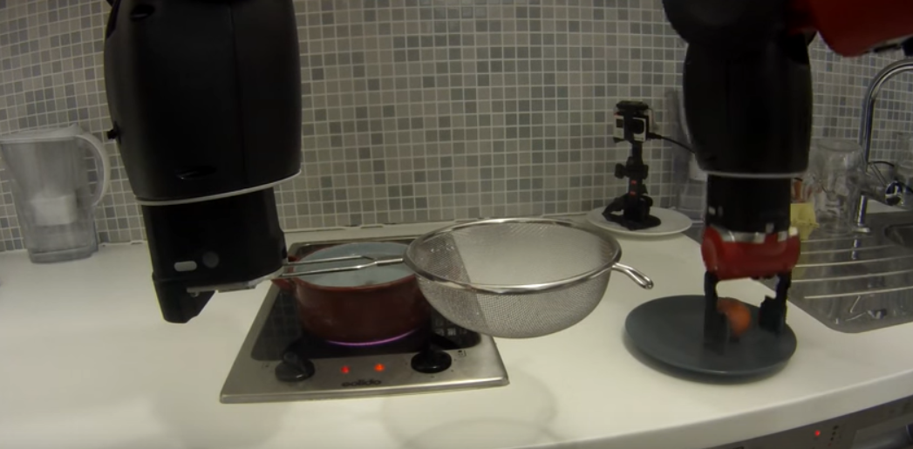
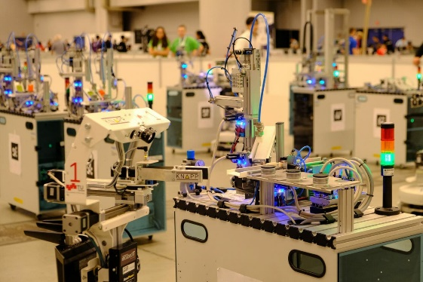
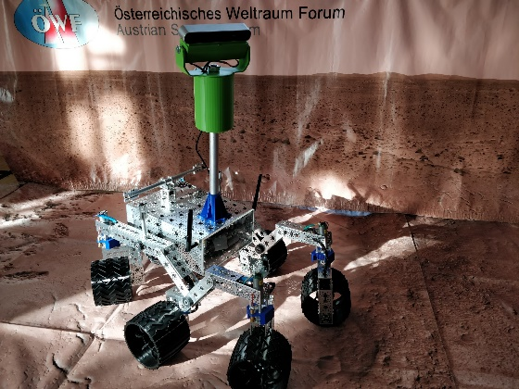
Previous Years
Breakfast Robot https://youtu.be/dtoQIKlQcug
RoboCup Logistics League https://youtu.be/jdQexkXq2Qs
Mini Mars Rover https://youtu.be/ew_Mrk4u0mA

Slide 3
This year …..

Slide 4
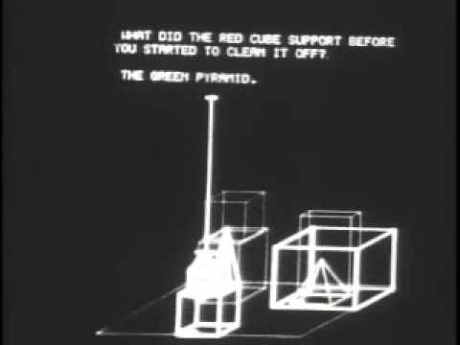
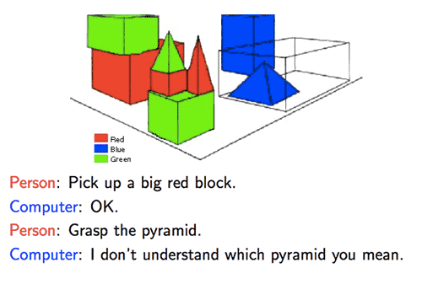
The Graz HRI Challenge (1)
inspired by Terry Winograd‘s SHRDLU
the robot is able to understand a scene
the robot is able to communicate with a user
the robot is able to answer queries and manipulate the scene based on user commands
https://www.youtube.com/watch?v=bo4RvYJYOzI
https://www.youtube.com/watch?v=TwWTtv3tb0Q

Slide 5
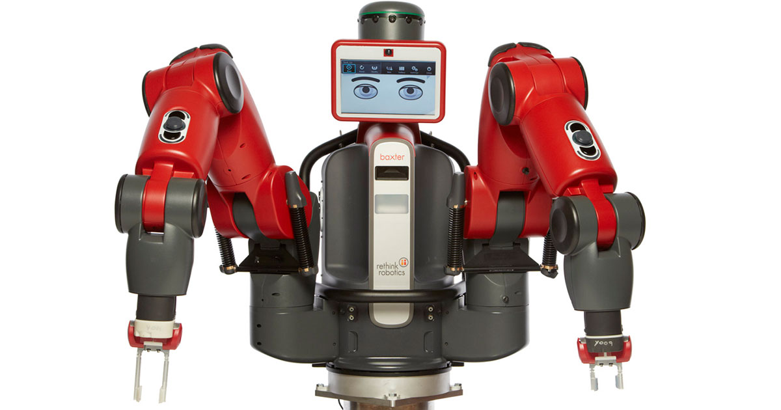
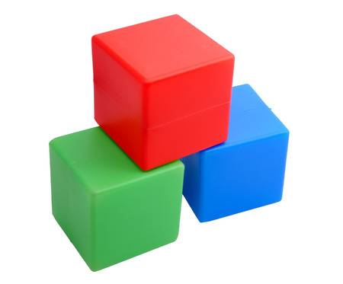
The Graz HRI Challenge (2)
we will do it in the real world!
we will use the Baxter robot
we communicate via speech
we simplify the setup to a table top with cubes of different size and color (to ease perception)

Slide 6
The Graz HRI Challenge (3)
the robots should be able
to understand the scene using sensors and to build up an internal representation of the world (e.g. small red cube 1 is on top of large blue cube 3, medium green cube 2 is free)
to understand spoken commands and queries from the user: “Baxter please stack all blue cubes!”
to resolve ambiguities and missing information in the commands and queries in a dialogue: “There are two green cubes. Which one do you mean?”
to be able to update the internal representation using spoken commands and to derive a plan to perform a command
to execute the commanded manipulation task in the real environment

Slide 7
Major Challenges
students form one team working on all major challenges
perception
detect the type and position of objects in the environment
update the internal representation of the environment
interaction by speech
understand and parse spoken natural sentences
generation of speech
reasoning and planning
answer queries based on the internal representation of the world
plan a sequence of basic skills for a given command
manipulation
grasping, moving, and releasing objects (basic skills)

Slide 8
Engineered Environment
the basic setup – robot + table + cubes – is fixed
but the actual configuration of the setup can be changed in favor of a simpler solution
the actual objects can be changed to make perception simpler – as long as enough different objects remain allowing for an interesting conversation and manipulation challenge
place any number of sensor in any position that is helpful

Slide 9
Audience/Prerequisites
Master Information and Computer Engineering/Computer Science/Software Development and Business Management
compulsory for major in mobile robots
interested students
specialization for mobile robots
expected skills
teamwork
independent work
experience with Linux
experience with ROS
programming skills (e.g. C++)
courses: mobile robots/advanced robotics

Slide 10
Resources
Baxter will be extended and adapted and remain the same for the rest of the course – so the entire setup
Baxter will be exclusively used for the course
access to the lab during late hours or holidays with the TUG Card

Slide 11
Available Software/Hardware
Robots
Baxter Research Robot
Software
ROS
Baxter SDK
MoveIt!
Point Cloud Library (PCL)
DexNet
Google Cloud Speech API
Stanford NLP Core
tmkit
object table detector
various 3rd Party Libraries
Additional Equipment & Small Parts
can be purchased or built during the course
Additional Sensors
2D Cameras
3D Cameras
2D Lidars
3D Lidars
Grippers
Parallel Gripper
Vacuum Gripper

Slide 12
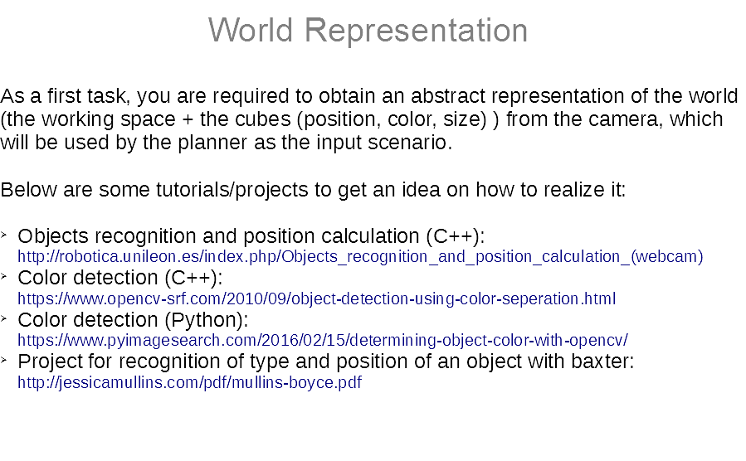

Slide 13
Goal/Procedure
students are able to select, build and apply a robot for a task
experience with robots, robotics software, actuators and sensors
solve a task with a robot
working as a team (sub-teams are ok)
as much as possible freedom und creativity, no usual static lab setup
independent working in the lab
FUN

Slide 14
Roadmap
02.10.2019, 10:00-12:00, robot lab: introduction
09.10.2019, 09:00-12:00, robot lab: practical introduction -robot, ROS, manipulation, speech recognition
21.10.2019, 23:59: submission design document - email
23.10.2019, 10:00-12:00, robot lab: discussion design document
20.11.2019, 10:00-12:00, robot lab: 1. progress meeting
11.12.2019, 10:00-12:00, robot lab: 2. progress meeting
08.01.2019, 10:00-12:00, robot lab: 3. progress meeting
29.01.2020, 10:00-12:00, robot lab: presentation and demo

Slide 15
Design Document
one comprehensive for the entire group
short description of the planned solution
content
solution idea
software modules including 3rd party libraries
robot adaptions including sensors and small parts
interfaces to other hardware/software modules
brief project plan (in keywords, milestones, risks)
organizational structure of the team (sub-teams, responsibilities)
document
PDF – 2-4 pages
via email to steinbauer@ist.tugraz.at, subject „KMR 2019 Design“

Slide 16
Developed Software
have to be based on ROS xy (tba)
all freely available ROS packages can be used
additional Packages of TUG will be available in the robot lab git repository
developed software has to be organized as independent ROS catkin packages including launch and parameter files
the software has to be stored in the robot lab git repository
access data to the git repository will be provided during the practical introduction

Slide 17
Grading
Task | Content | Available Points
Design Document | Solution Proposal | 20
Progress Meetings | Presentation of the Project Progress | 20
Final Demo | Presentation of the developed solution Live Demo | 40
Final Report | Documentation of the development and the realized system | 20
Sum |  | 100

Slide 18
Grading
Points Grade
-100 % 1
-87,5 % 2
-75 % 3
50-62,5 % 4
< 50 % 5

Slide 19
Information
Webpage of the Course: http://www.ist.tugraz.at/steinbauer/Kmr19
Literature: Papers, Documentation, recommended Books
Contact: email: steinbauer@ist.tugraz.at personal: Inst. for Software Technology, Inffeldgasse 16b/II

Slide 20
Questions ?

