Slide 1

Data Mining Cup 2014
TU_Darmstadt_2 Report
A team effort:
Patryk Hopner, Suiteng Lu, Mirko Köhler & Igor Achieser
Markus Brandt
Eneldo Loza Mencía, Fabian Hirschmann, Simon Holthausen, Michael Markert & Christoph Schatton
Jinseok Nam, Thomas Pignede, Svenja Stark, Elvir Sabic & Marc-André Bär

Slide 2
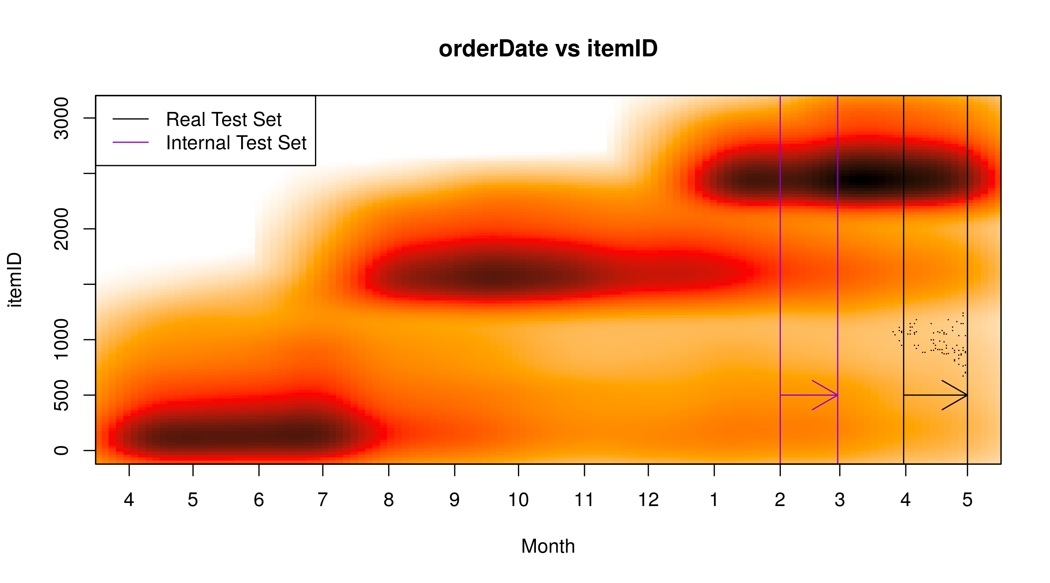

Approach
Binary Predictions:$Accuracy=1 − \frac{DMC Score}{Number of Instances}$
Internal Test Set:

Slide 3
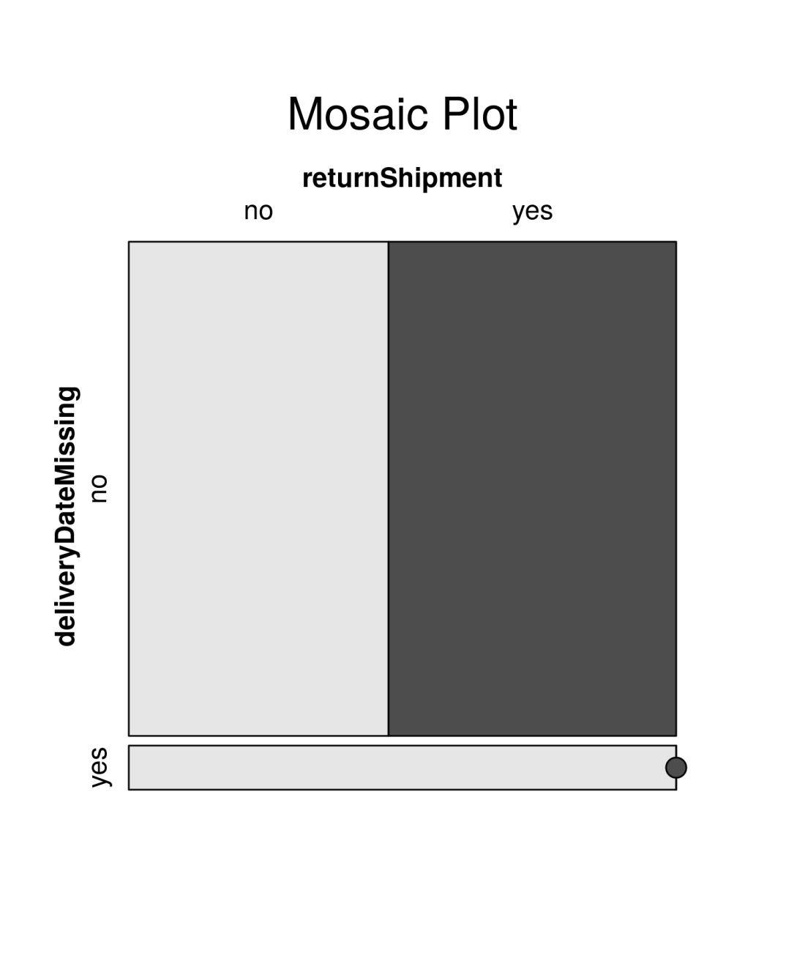
Data Analysis: Missing Delivery Dates
Delivery Date Missing?
Item never delivered
Instances unlabeled
Remove

Slide 4
Model Training: Separate Models for known and unknown customer
Observation: Models use lots of customer related attributes which are not known for new customers yet.
Idea: Train separate models for known and unknown customers.
One Model
Accuracy: 66.91%
Two Models
Accuracy: 68.54%

Slide 5
Feature Engineering
Features:
Laplacian smoothed Return Rates (per Customer, Item, Manufacturer)
Discretized Attributes, i.e. Price: [0, 10), [10, 20), [20, 30)
Clustering of ItemIDs, i.e. Into Summer/Fall/Winter Collections
Customer Attributes, i.e. Favourite Color / Size / Money spent
Feature Selection:
Greedy Selection (leave one out, try, if better, keep out)
Discretized Attributes over Numerical Attributes

Slide 6
Algorithms utilized
Algorithm | Class | Accuracy
C5.0 | Decision Trees | 68.65253%
Stochastic Gradient Boosting | Decision Trees | 68.53615%
Multivariate Adaptive Regression Splines (MARS) | Linear Model++ | 68.18255%
Penalized Discriminant Analysis (PDA) | Linear DA | 67.35556%
Extreme Machine Learning | Neural Network | 67.19302%
All algorithms were tuned.

Slide 7
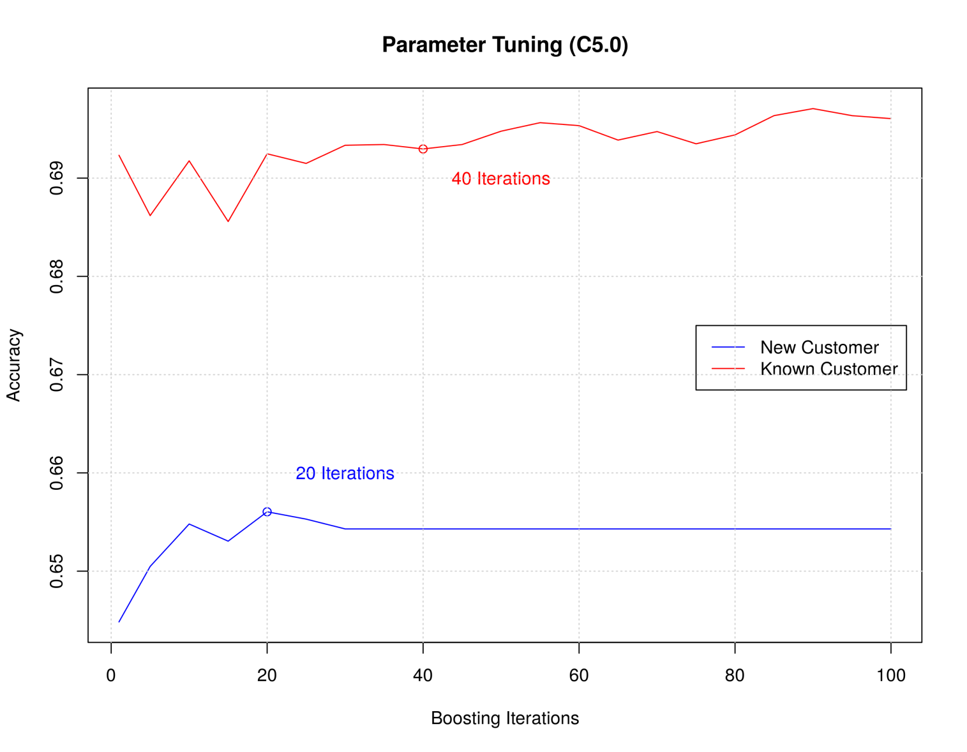
C5.0 Parameter Tuning – Not Enough Time
Better results doable,
but deadline was tight.

Slide 8
The End
Thanks.

