Slide 1

Data Mining Cup 2014
TU_Darmstadt_2 Report
A team effort:
Igor Achieser
Marc-André Bär
Markus Brandt
Johannes Fürnkranz
Fabian Hirschmann
Simon Holthausen
Patryk Hopner
Frederik Janssen
Mirko Köhler
Suiteng Lu
Michael Markert
Eneldo Loza Mencía
Thomas Pignede
Elvir Sabic
Christoph Schatton
Svenja Stark
Michael Stahn
Christian Wirth

Slide 2
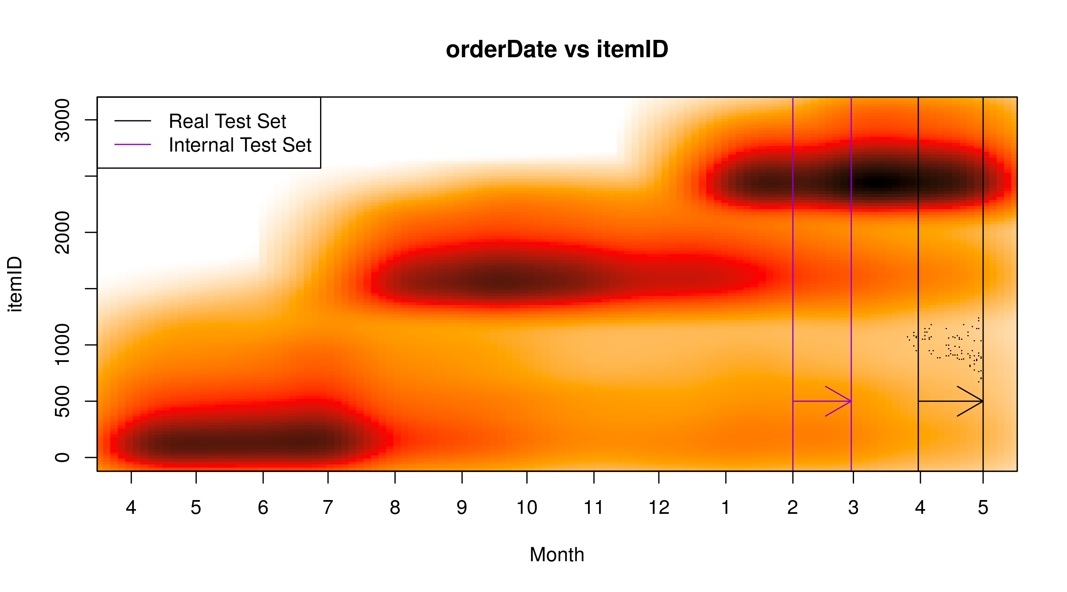

Approach
Binary Predictions:$Accuracy=1 − \frac{DMC Score}{Number of Instances}$
Internal Test Set:

Slide 3
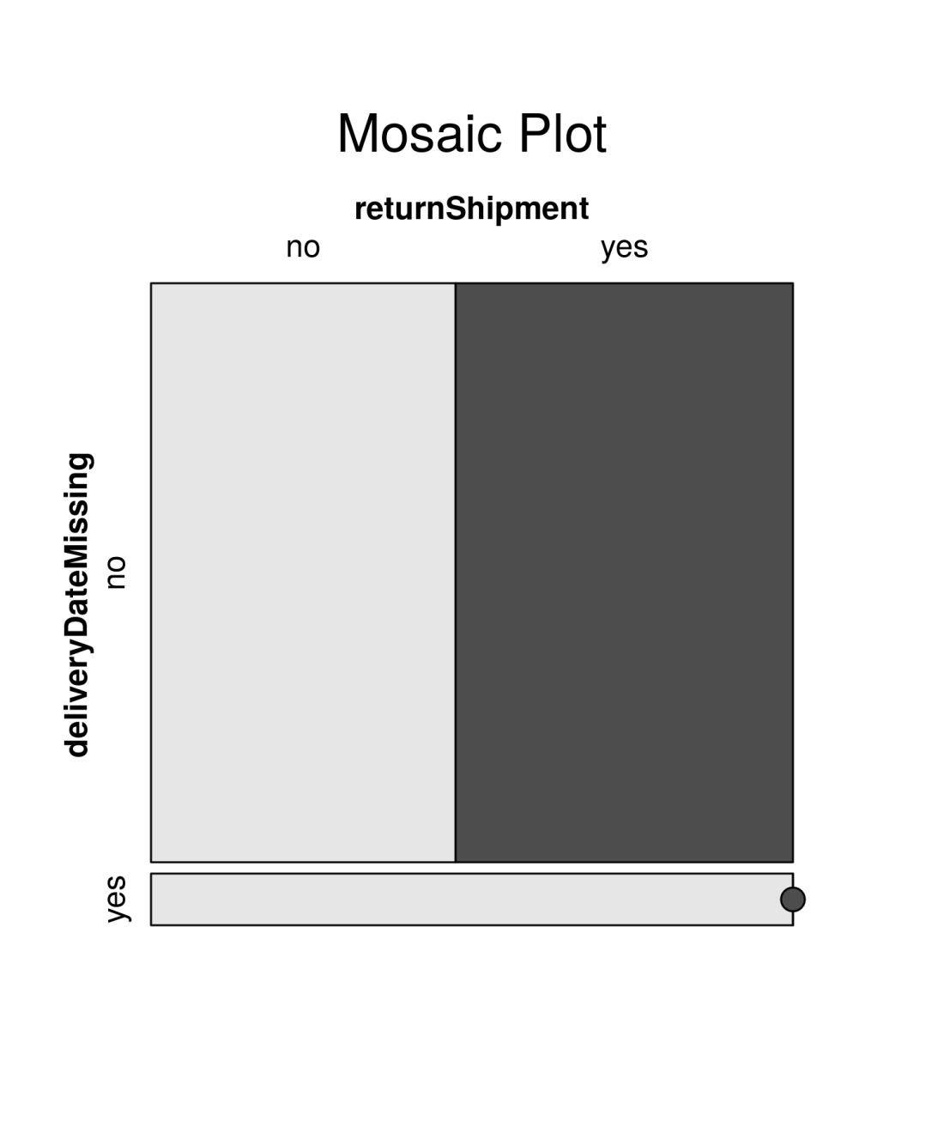
Data Analysis: Missing Delivery Dates
Delivery Date Missing?
Item never delivered
Instances unlabeled
Remove

Slide 4
Model Training: Separate Models for known and unknown customer
Observation: Models use lots of customer related attributes which are not known for new customers yet.
Idea: Train separate models for known and unknown customers.
One Model
Accuracy: 66.91%
Two Models
Accuracy: 68.54%

Slide 5
Feature Engineering
Good Feature Engineering involves
Understanding the Properties of the Task and their interaction with the strengths and limitations with the classifier used
Experimental Work
And led to (inter alia)
Laplacian smoothed Return Rates (per Customer, Item, Manufacturer)
Discretized Price Attributes, i.e. [0, 10), [10, 20), [20, 30)
Clustering of ItemIDs, i.e. Into Summer/Fall/Winter Collections

Slide 6
Algorithms utilized
Algorithm | Class | Accuracy
C5.0 | Decision Trees | 68.65253%
Stochastic Gradient Boosting | Decision Trees | 68.53615%
Multivariate Adaptive Regression Splines (MARS) | Linear Model++ | 68.18255%
Penalized Discriminant Analysis (PDA) | Linear DA | 67.35556%
Extreme Machine Learning | Neural Network | 67.19302%
All algorithms were tuned.

Slide 7
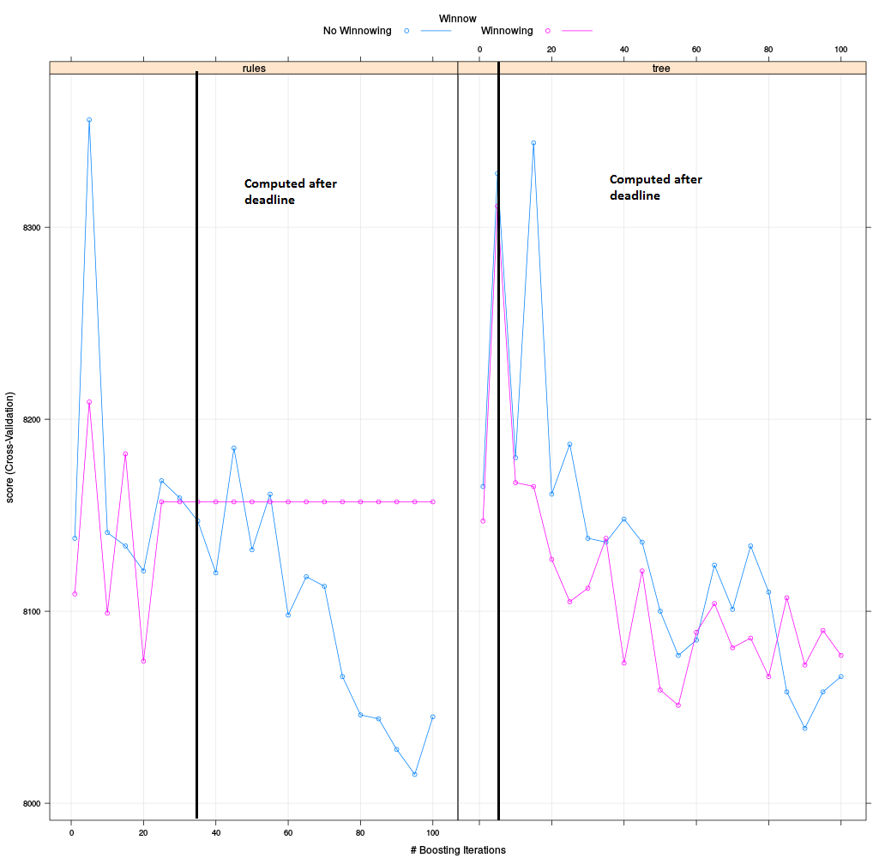
C5.0 Parameter Tuning – Not Enough Time
Final Parameters:
30 Boosting Iterations
No Winnowing
Model=Rules
Better Parameters found,
but time ran out

Slide 8
The End
Thanks.

