Slide 1

Data Mining Cup 2014
TU_Darmstadt_2 Report
Group R:
Fabian Hirschmann
Simon Holthausen
Michael Markert
Christoph Schatton

Slide 2
DMC14: A Team Effort
Igor Achieser
Marc-André Bär
Markus Brandt
Prof. Dr. Johannes Fürnkranz
Fabian Hirschmann
Simon Holthausen
Patryk Hopner
Dr. Frederik Janssen
Mirko Köhler
Suiteng Lu
Michael Markert
Eneldo Loza Mencía
Thomas Pignede
Elvir Sabic
Christoph Schatton
Svenja Stark
Michael Stahn
Christian Wirth

Slide 3
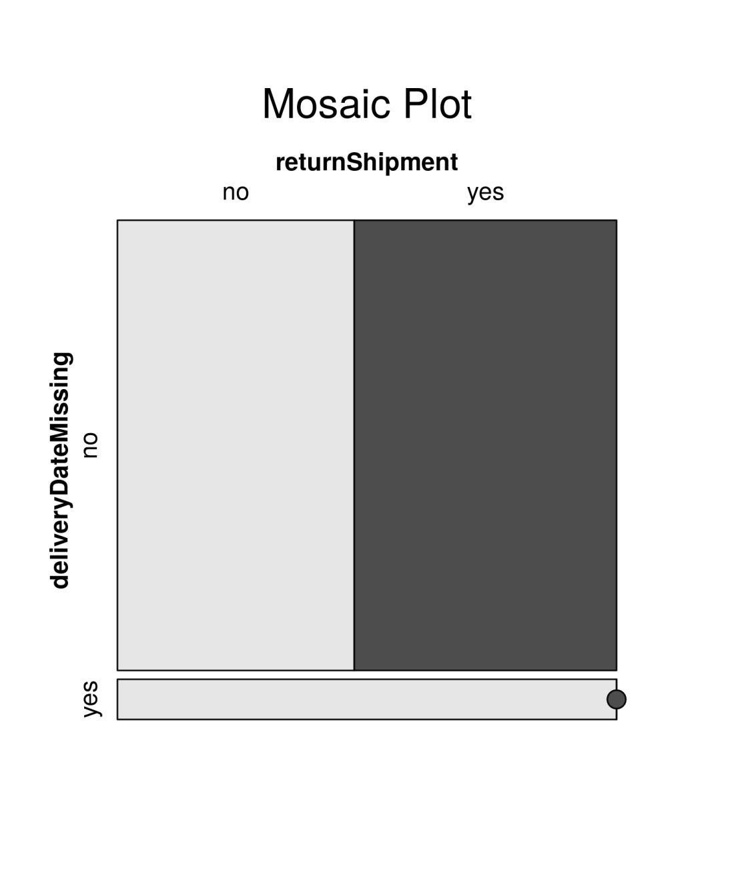
Data Analysis: Missing Delivery Dates
Delivery Date Missing?
Item never delivered
Instances unlabeled
Remove

Slide 4
Feature Engineering
Understanding the properties of the problem and its interactions as well as the algorithms used leads to:
Laplacian smoothed Return Rates (per Customer, Item, Manufacturer)
Discretized Price Attributes, i.e. [0, 10), [10, 20), [20, 30)
Clustering of ItemIDs, i.e. Into Summer/Fall/Winter Collections

Slide 5
Model Training: Train separately for known/unknown customer

