Slide 1
Prediction of Valuable Nodes
Xuesi Jian, Hanlu Feng, Xinzhou Zhou

Slide 2
What we did
Nothing about the ego networks, misunderstanding of the ego networks before.
We would like to predict if the user will be having lots of friends or followers.
Use the information from the profile, which can be gathered after the account has been created.

Slide 3
Is this information useful?
It is useful for the companies of social networks.
Help to keep these valuable users stay.
Improve the service.

Slide 4
What’s new?
Lots of researches working on detecting fake nodes by using many kinds of data.
Our idea is new for the history data free.
We can do the prediction after a new account has been created.

Slide 5
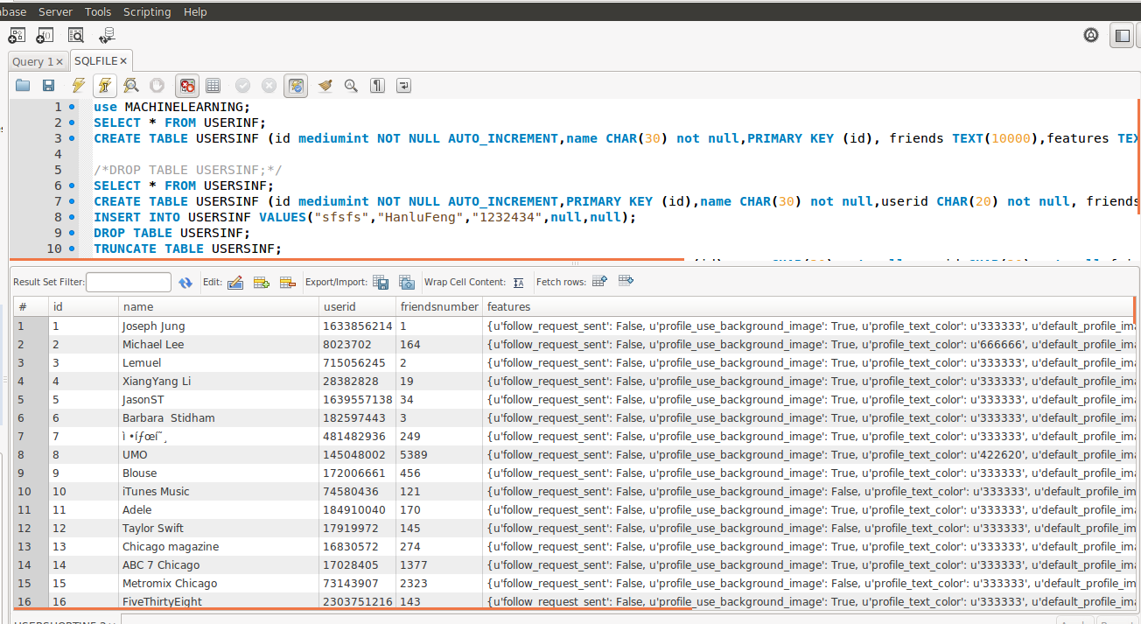
Get Data
https://dev.twitter.com/rest/reference/get/friends/list

Slide 6




Features
Localization
Profile
Gender,Language, TimeZone,Description,etc.

Slide 7
Features in our collecting data
username,userid,u'follow_request_sent',u'profile_use_background_image',u'profile_text_color',u'default_profile_image',u'profile_background_image_url_https',u'verified',u'profile_location',u'muting',u'profile_sidebar_fill_color',u'followers_count',u'profile_sidebar_border_color',u'profile_background_color',u'listed_count',u'is_translation_enabled',u'utc_offset',u'statuses_count',u'description',u'friends_count',u'location',u'profile_link_color',u'following',u'geo_enabled',u'lang',u'profile_background_tile',u'favourites_count',u'screen_name',u'notifications',u'created_at',u'contributors_enabled',u'time_zone',u'protected',u'default_profile',u'is_translator',u'favorited',u'user_mentions',u'hashtags',u'contributors',u'truncated',u'text',u'retweeted',u'in_reply_to_status_id_str',u'coordinates',u'in_reply_to_user_id_str',u'in_reply_to_status_id',u'in_reply_to_screen_name',u'place',u'retweet_count',u'geo',u'favorite_count',u'in_reply_to_user_id',u'possibly_sensitive',u'country',u'place_type',u'full_name',u'attributes',u'w',u'type',u'resize'

Slide 8
Data preprocessing
Useless features: UserID - Delete
History data: Count of tweets - Delete
Grand truth: Count of friends - Take it as grand truth, 2 categories: Lots(top 10%), Few
Default data: Background image - Add a new feature “ Default or not”
Url data: Background image link - Delete
Time data: Created time - Make it into 3 categories in hours: Morning, Noon, Night 2 in days: Weekends, Weekdays

Slide 9
Some new features
How old: 10-, 10 – 20, 20 – 30, 30 – 45, 45 – 60, 60+
Born city: Large city, Small town
Name or Nickname
Source of images: Internet, Local

Slide 10
Dataset
Twitter dataset, 5722 records
Delete those records with over 1000 followers
4246 records left

Slide 11
Clustering
Using Naïve Bayes and NBtree to do the clustering
10-folds-cross-validation
Naïve Bayes get a better result

Slide 12
Results
a b
272 | a = c2
153 | b = c1
Accuracy:23.53%
Really low accuracy, but it is still useful.
Because the low cost of the strategy for the company to use, but high utility.
Some of the current techniques using history information, even some side information to do the de-anonymous, only get 70% accuracy.

Slide 13
Why?
The feature is not enough, some important features we can not get from the API. For example, education, the IP address and so on.
The data is not enough, only 4000+ records maybe too small.

Slide 14
Another dataset
We use dataset from Stanford Large Network Dataset Collection to do the same thing.
65.9942% accuracy with 225 features.
But there exists some features seems like a tag, like “basketball”, we do not sure if it is belongs to the description or the posted tweets.

Slide 15
Future work
We didn’t do the description analysis which seems really useful to improve our accuracy.
We can add a strategy for those coming information. How long will it take to get a good result after the new account created will be also interesting.
Links, maybe the source can be a useful feature.

