Slide 1
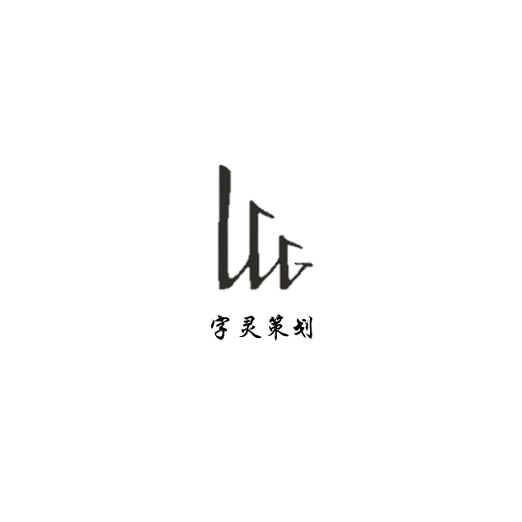
ZILINGCEHUA
day1,product value analysis
没有名字组：龙行超、苏昌盛、秦阳、祁伟、刘志新、李岳聪

Slide 2

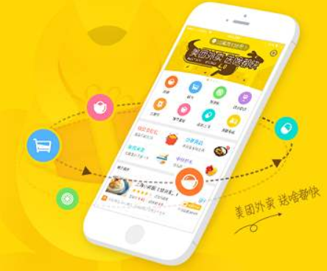
brief introduce to meituan
Meituan app is a mobile application launched by meituan.com, which integrates browsing, payment and consumption services. It can provide you with all kinds of discount and electronic exchange volume for gourmet, movie, hotel, KTV and tourism. All you have to do is to buy the goods you want and participate in the group purchase. As long as you gather enough people, you can buy the goods you want with the discount price and enjoy high-quality service. In addition, you can query the business information and so on. While you are simple and convenient, you can enjoy various safe and convenient group buying services.

Slide 3

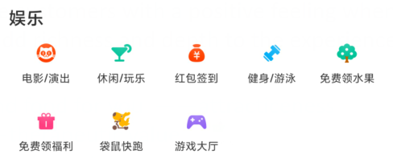
Functional
Functional elements are based on a product attribute thar provides the customer with functional utility
order online, no need to go to the restaurant. Just stay at home. —— simplifies 、 avoids hassles、 saves time
Online group buying website——reduces effort
including Eat, drink, play, have fun——variety，integrates
Emotional
Emotional elements provide customers with a positive feeling when they purchase or use a particular product. they add richness and depth to the experience of owing and using the product
automatically recommend food for you ——attractiveness
buy medicine online——therapeutic value
online mini-games ——Fun/entertainment

Slide 4
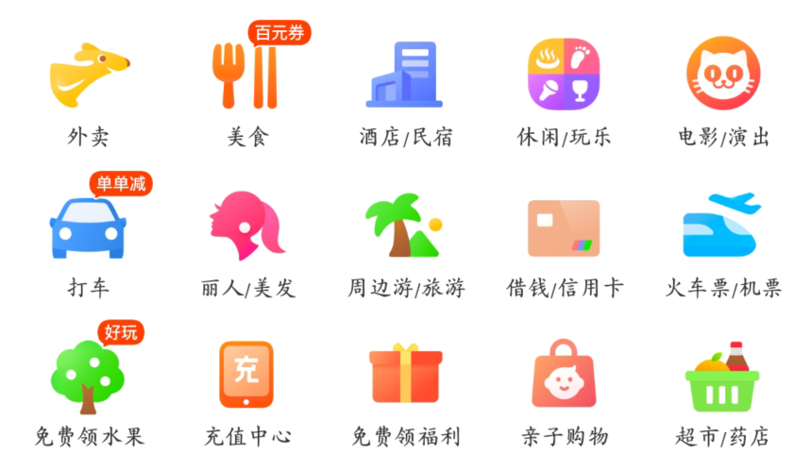
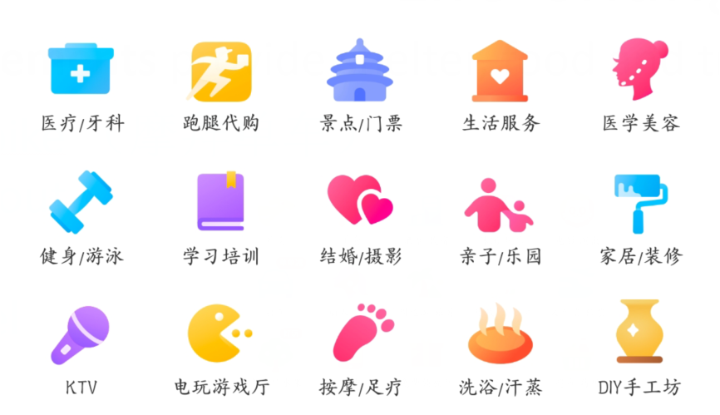
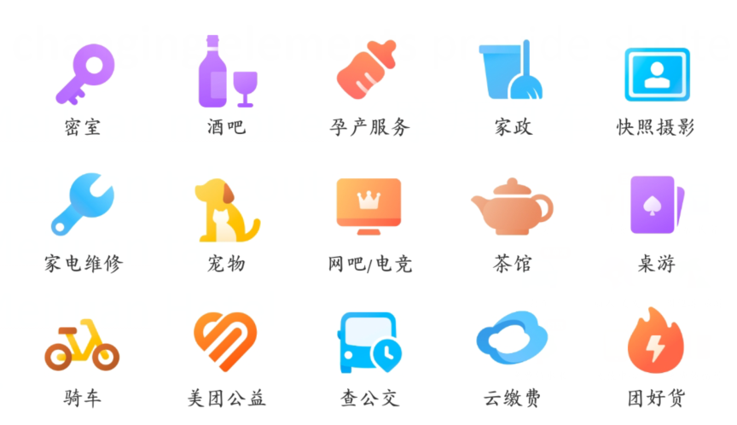
Life Change
Life changing elements provide shelter, food and transportation
MeiTuan mobike （摩拜单车）
Meituan takeout
Meituan taxi
Meituan Hotel
…
Social Impact
Social impact elements convey the sense of doing good for others
Helping other people or society more broadly
During the outbreak of the new coronavirus, meituan had no contact with takeout, and delivered daily necessities free of charge in the disaster areas.

Slide 5
besides the elements of value elements delivered by the selected product.I think the “Quality”is critical but mising. It's not sure that the product is of good quality when we buy it online.
So all merchants on Meituan need to be examined strictly to guarantee quality.
字灵策划简介

