Slide 1
영어논문쓰기 특강: 리뷰어의 입장에서 논문살펴보기
이용직

Slide 2
교수자 소개: 이용직
교수자 소개: 이용직
https://sites.google.com/view/yongjiklee/%ED%99%88

Slide 3
Overview
Recap
Structure of academic English paper
Examples of each section
Academic English writing templates
More examples
Practice with your research topics

Slide 4
논문 작성전에 자가 점검 체크리스트
1. What is my research purpose?
2. Who will be my target audience?
3. What educational problems/issues need to be solved through
your research?
4. What will be the research project's originality and novelty to the field?
** 실험 연구일 경우 -> 연구의 독창성은 더욱 높아짐

Slide 5
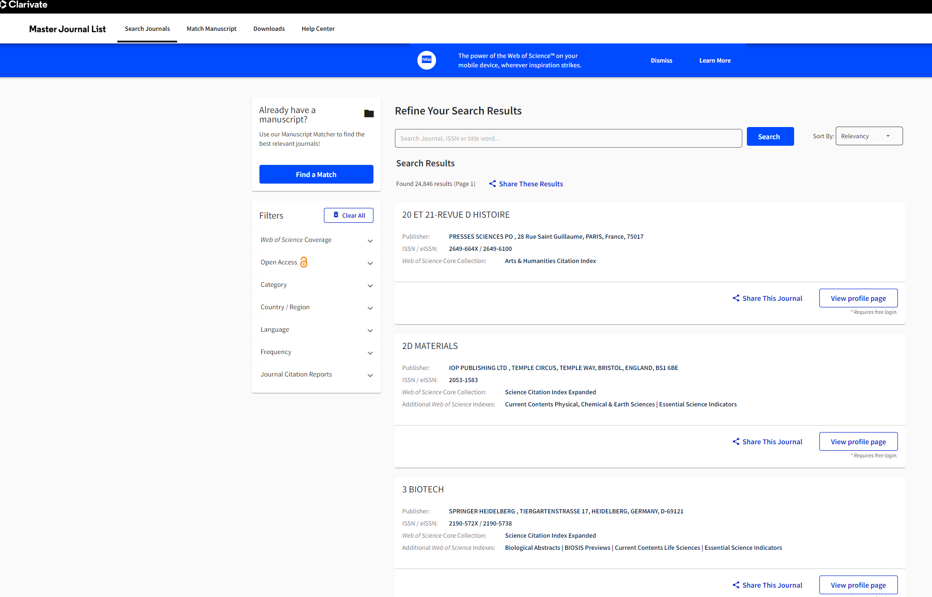
SSCI: Web of Science Journal of Multilingual and Multicultural Development
https://mjl.clarivate.com/search-results

Slide 6
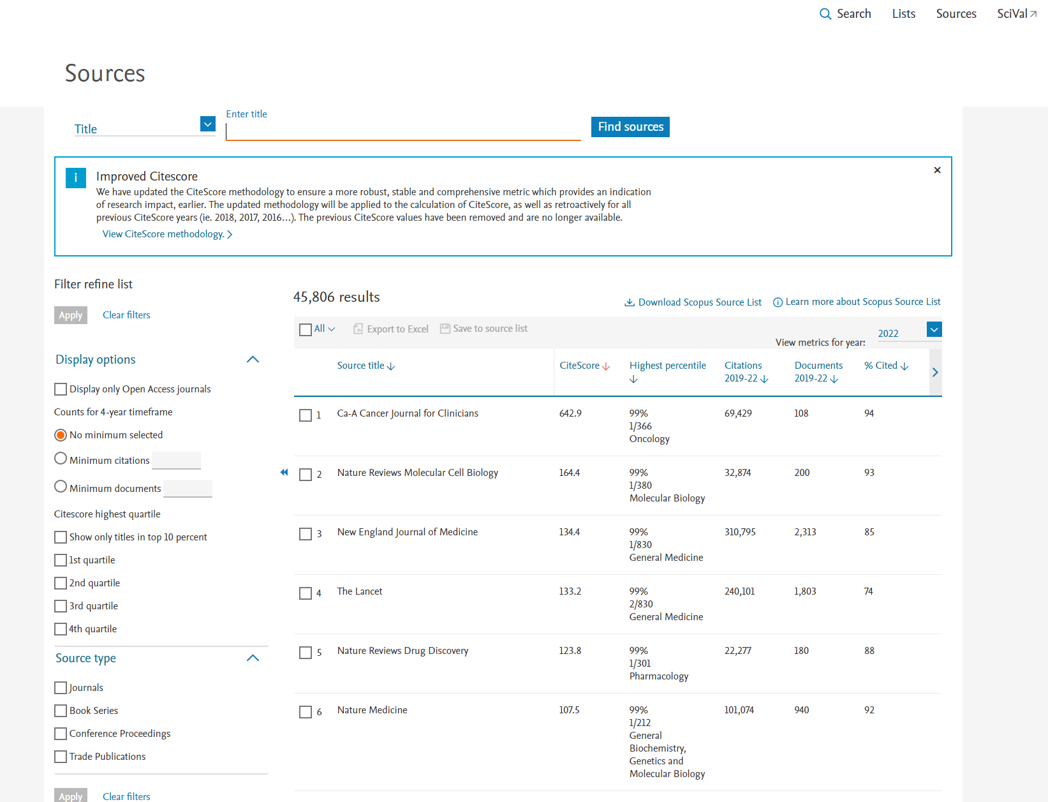
Scopus: Source Online Journal of Communication and Media Technologies https://www.scopus.com/sources.uri?zone=TopNavBar&origin=sourceinfo

Slide 7
리뷰어의 입장에서 논문 평가
1. 초록 – 필요한 요소들이 다 들어갔는가
2. 선행연구 – 선행연구의 gap 이 잘 표현되었는가
3. 연구질문 구성 – 연구목적과 연구질문이 연결되어 구성되었는가?
4. 연구방법 – 연구의 목적에 맞게 연구방법이 설정되었는가?
3번과 4번의 Alignment
5. 논의 – 연구질문에 대답을 잘 하였는가? (가설에 대한 검증이 되었는가?)
6. 결론 – 본 연구의 독창성은 무엇인가? 미래 연구방향 제안점은?
7. 참고문헌 적절성

Slide 8
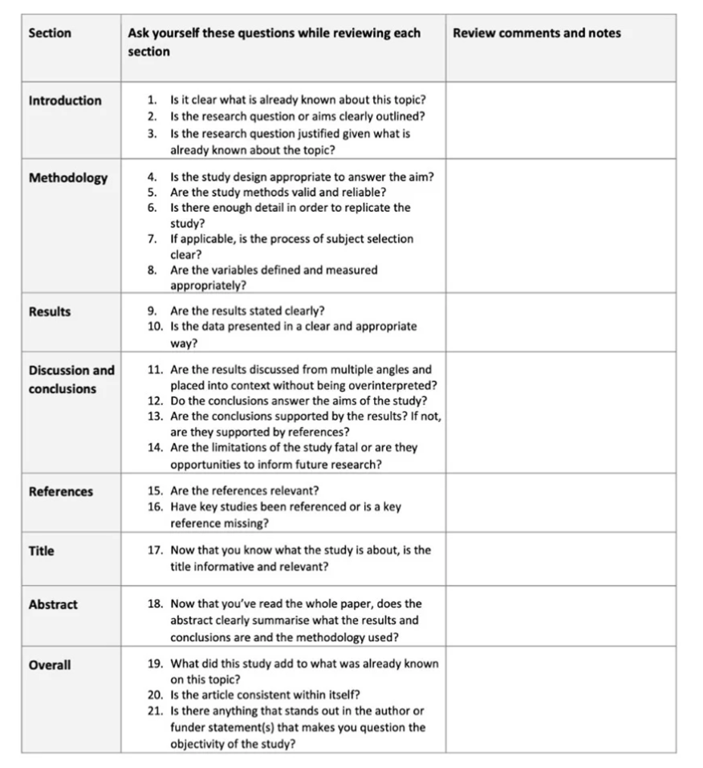
Word 파일참조

Slide 9



ABSTRACT - 썸네일
Invest in the writing of an abstract.
Consider your abstract as a book cover.
The abstract is the cover and face of your thesis. It would help if you crafted an abstract that is unique, attractive, succinct, and interesting.
Typically, the abstract contains a brief summary of the problem and the purpose of the research, an outline of the methodology, a few key findings/results, and the principal conclusion or implication.

Slide 10
Sample Abstract 1
KCI
Preservice teachers’ field experience working with English Language Learners (ELLs) provides an opportunity to engage in various practices to become effective future teachers of ELLs. Previous studies have found that ESL field experiences have an impact on the preservice teachers’ cognitive factors to teach ELLs. Based on the language teacher identity framework, this study explored how ESL field experience influenced preservice teachers’ cognition, including attitudes, perceptions, and knowledge while teaching and working with ELLs in the US. The data sources consisted of collected surveys on preservice teachers and preservice teachers’ reflection papers (n=160) after finishing ESL field experiences. Thematic analysis was implemented to analyze data sources. Study findings showed that ESL field experiences can influence preservice teachers’ positive attitudes/ perceptions towards English language learners (ELLs), increase awareness in terms of content and pedagogical knowledge, and enhance positive beliefs about ELLs’ linguistic and cultural backgrounds. This study provides several suggestions how to effectively incorporate field experience into teacher education programs.
위 초록중에서 빠진 내용은? 추가하고 싶다면?

Slide 11
Sample Abstract 2
SCOPUS
A practice-based approach to teacher education programs is fundamental to preparing preservice teachers (PSTs) for in-service teacher roles. Although many studies have explored the impact of field experience on PSTs' perceptions and attitudes toward diverse students, few have examined PSTs' self-efficacy in hybrid environments that require both F2F (face-to-face) and synchronous online field practicum. This study explored Korean PSTs' self-efficacy changes regarding instructional strategies, classroom management, and student engagement through hybrid field experiences. The data was collected from a teacher education program in Korea in the 2021 spring semester from April to July. This study used the Ohio State teacher efficacy scale (Tschannen-Moran & Hoy, 2001) to measure teacher self-efficacy. As a result, 133 pre-survey and post-survey comparisons were used. After the survey, seven volunteered preservice teachers were interviewed individually. By using a mixed-method design, study results showed that field experience in hybrid environments significantly increases PSTs' instructional strategies (d = 0.58), classroom management (d = 0.47), and student engagement (d = 0.48). This study suggests PSTs' self-efficacy changes through a hybrid field experience in a teacher education program.
위 초록중에서 빠진 내용은? 추가하고 싶다면?

Slide 12
Sample Abstract 3 - SSCI
Educators use various strategies to increase listening comprehension for nonnative English speakers in the classroom and multimedia environments. Research on audio reduction has shown mixed results, whereas a study that enhanced (doubled) virtual human gesturing found increased listening comprehension with procedural information. This research examined the use of virtual human gesture frequency (enhanced, average, no) and video speed (normal, reduced 25%) on participant satisfaction and learning outcomes with procedural information. Analysis based on 234 multinational university students indicated that normal video speed signifcantly increased satisfaction compared to reduced speed; satisfaction was rated signifcantly higher with agents that gestured compared with the no-gesture condition; and enhancing the gesture frequency signifcantly increased learning outcomes compared to the average and no-gesture conditions. These fndings support previous studies that indicated enhanced gestures signifcantly increase the learning of procedural information. Also, agent gesturing increased the satisfaction with the agent, which supports systematic review fndings that gesturing is a principal moderator for agent persona. However, this research provides evidence that a 25% reduction in video speed may be too slow to maintain satisfaction with advanced foreign language users and that less reduced rates such as 15% or 10% should to be considered. Finally, this research puts forth a gesture design framework for designers to create gesturing virtual humans in multimedia environments.
위 초록중에서 빠진 내용은? 추가하고 싶다면?

Slide 13
INTRODUCTION
The introduction logically conveys the research purpose, describes the problem's background, illustrates the problem through multiple perspectives, outlines a summary of prior research and its attempts, provides counterarguments, and states the research direction (purpose, research questions, and hypotheses).

Slide 14
서론 구조화 예시 생성형 AI를 대학 교양영어 수업에 접목
생성형 AI 간단소개
생성형 AI를 교육에 접목한 경우
(narrow down the focus)
더 구체적으로 영어교육에 접목한 경우
대학의 교양영어 수업에 접목한 경우
선행연구의 부족함-gap 설명
(e.g. 4 skills 중에 00부분에서는 선행연구가 부족)
연구의 목적 설명
연구의 질문 제시 (논문에 따라서 다름)
서론에 연구질문 제시 -> 선행연구 정리 뒤에 연구질문 제시가능

Slide 15
Sample Introduction 1
Considering this context, mainstream teachers in the U.S. are expected to accommodate ELLs and differentiate their instruction based on ELLs’ diverse learning needs (Gandara & Rumberger, 2008; Karabenick & Noda, 2004). These teachers have the responsibility of developing ELLs’ academic language proficiency as well as increasing content knowledge during instruction.
However, previous studies demonstrate that most teachers in the U.S. are not effectively prepared to teach and work with ELLs in mainstream classrooms (Gandara & Rumberger, 2008; Karabenick & Noda, 2004). One of the key reasons for the lack of teacher preparation is that preservice teachers receive little ESL training and professional development in teacher education programs (Athanases & de Oliveira, 2011; Walker & Stone; 2011). Similarly, many ESL scholars have highlighted that pre-service teachers should be equipped with necessary ESL knowledge and pedagogy in order to teach ELLs in mainstream classrooms (Durgunoglu & Hughes, 2010).
위 서론은 적절히 구성되었는가?

Slide 16
Sample Introduction 2
Although many studies have explored the impact of field experience on PSTs' perceptions and attitudes, few have examined PSTs' self-efficacy changes in both F2F (face-to-face) and online field practicum. This study examined Korean PSTs' self-efficacy changes regarding instructional strategies, classroom management, and student engagement through hybrid field experiences in a teacher education program.
위 서론은 적절히 구성되었는가?

Slide 17
Sample Introduction 3
However, videos that include virtual humans are designed using various strategies to help foreign language speakers’ listening comprehension. Some of the design elements include the use of animations with the presence or absence of virtual humans (Yung & Paas, 2015), the presence or absence of particular life-like features (Carlotto & Jaques, 2016), the use of gestures (Choi & Clark, 2006; Davis & Antonenko, 2017), and gesture frequency (Davis & Vincent, 2019). However, listening comprehension results, as determined by learning outcomes, have been inconsistent, with only the presence of virtual humans in animations (Yung & Paas, 2015), and gesture frequency (Davis & Vincent, 2019) providing evidence that certain components are benefcial for listening comprehension.
위 서론은 적절히 구성되었는가?

Slide 18
Sample Introduction 3 연결
Therefore, it might be necessary for researchers to explore whether agent design elements such as gestures and frequency are fundamental components which improve listening comprehension, or whether a straightforward strategy such as reducing video speed is more important. The purpose of this research is to examine whether gesture frequency and reduced speech rate through slower video speed afect the satisfaction and learning outcomes of foreign language users when learning procedural knowledge in multimedia environments which feature a virtual human.
위 서론은 적절히 구성되었는가?

Slide 19




LITERATURE REVIEW
How did previous research address the problem, and did it approach the problem similarly or differently?
How did previous studies frame their research, and what did or did not work?
How is your research different, or why is your research important?
Finding the research gap

Slide 20
선행연구를 작성 구조화 예시
기존의 선행연구에서 생성형 AI를 영어교육에 접목한 연구 소개
더 구체적으로 대학의 교양영어 수준에서 접목한 연구 소개
연구를 카테고리를 설정하여 정리 필요
영어 4 skills 구분 하겠다
1) reading, 2) speaking, 3) listening, 4) writing
생성형 AI의 종류에 대해서 설명하겠다
1) ChatGPT, 2) Bard, 3) 00, 4) 00
장점과 단점에 대해서 설명하겠다
1) AI를 대학의 영어 수업에 적용 할 때 영어 학습자에게 미치는 장점 (긍정적),
2) 한계점(부정적 영향)

Slide 21
선행연구를 구조화
생성형 AI를 통해,
1) 영어 실력 측정에서 변화가 있는가?
VS. 2) 정의적 측면에서 변화가 있는가?
1)양적인 방법으로 00을 측정한 경우 (pre-test VS. post-test)
2)질적인 방법으로 00을 조사한 경우 (인터뷰, 학생들 reflection note)
=>카테고리를 통해 정리한 내용을 바탕으로 선행연구의 Gap을 명확히 설명

Slide 22
Sample Lit Review 1
Although previous research has demonstrated that ESL field experience had a positive impact on PSTs’ cognitive factors to teach ELLs, there has been a lack of research that specifically focused on understanding mainstream teachers’ language teacher identity. Thus, this study aims to fill the gap in the literature to better understand the role of being a language teacher on mainstream pre-service teachers, and how pre-service teachers shape and develop their language teacher identity throughout their ESL field experience.
선행연구의 Gap이 제대로 잘 표현되었는가?

Slide 23
Sample Lit Review 2
Bandura (1997) defined self-efficacy as people's beliefs in their capabilities to control their functioning and events that affect their lives. In other words, one's sense of self-efficacy can provide the foundation for motivation, well-being, and personal accomplishment (Bandura, 1997). For instance, an individual's perception of self-efficacy can affect the person's thoughts, feelings, motivation, and actions (Bandura, 1986, 1997). Therefore, Bandura's theory suggests that people with high efficacy will have higher coping behaviors toward their surroundings (Bandura, 1986, 1997).
위 내용은 어떤 경우에 쓰는걸까?
무엇을 설명하려고 하는가?

Slide 24
Sample Lit Review 3
On the other hand, research focused on procedural knowledge, which is information that consists of a series of steps, provides evidence that gestures impact learning outcomes. Yung and Paas (2015) found that seventh grade Taiwanese students learned signifcantly more about the cardiovascular system with a virtual human that performed deictic gestures than an absent agent condition. Likewise, Davis and Vincent (2019) examined the use of gesture type and frequency with foreign language university students learning the procedural information of how lightning works. The research included four conditions: an average gesture condition, an enhanced gesture condition that doubled the average gesture frequency, a conversational gesture condition in which the agent only performed movements that carried no semantic meaning, and a no-gesture condition. The results indicated that the enhanced gesture condition scored signifcantly higher than the no-gesture condition, and approached signifcance against the conversational gesture condition. Since there were no other signifcant conditions, this research showed that increasing the gesture frequency is benefcial to foreign language users’ ability to freely recall procedural information about how lightning forms.
위 내용은 어떤 경우에 쓰는걸까?
무엇을 설명하려고 하는가?

Slide 25
Sample Lit Review 3
Although there have been only a few studies that have measured learning outcomes which can be divided into the knowledge domains of declarative and procedural, the results from those studies signify that procedural information benefits most from designing agents to gesture.
위 내용은 어떤 경우에 쓰는걸까?
무엇을 설명하려고 하는가?

Slide 26
Framing Research Questions:
Informed by the literature, researchers construct their research questions, ensuring they are both relevant and novel.
An example research question could be: "What are the experiences and challenges educators encounter during remote teaching?“
연구질문과 연구목적은 본인이 하고자 하는 연구분야의 대가의 연구
또는 Key paper의 글 구조를 유심히 살펴볼 것.
연구목적-연구질문-연구방법론 3가지의 Alignment 에 반드시 신경 쓸 것

Slide 27
Sample RQ1
The purpose of this study is to explore how ESL field experiences influence pre-service teachers to become effective teachers of ELLs. Using language teacher identity as a theoretical framework, this study explores the following research question: How do ESL field experiences influence preservice teachers’ cognitive factors to teach and work with ELLs?
연구목적과 연구질문이 잘 매칭이 되는가?

Slide 28
Sample RQ2
Q1: How has Korean preservice teachers' self-efficacy changed before and after participating in a hybrid field experience regarding instructional strategies?
Q2: How has Korean preservice teachers' self-efficacy changed before and after participating in a hybrid field experience regarding classroom management?
Q3: How has Korean preservice teachers' self-efficacy changed before and after participating in hybrid field experiences regarding student engagement?
위 내용에서 빠진 부분은 무엇일까?

Slide 29
Sample RQ3 – 아래 내용은 잘 작성이 되었는가?
The purpose of this research is to examine whether virtual human gesture frequency and reduced video speed afect satisfaction, free recall, and transfer when creating multimedia environments to teach procedural information to foreign language users. While the use of gestures has been found to assist with comprehension, the literature on speech rate has only focused on audio recordings and not video and audio together. Although there is evidence that gestures help foreign language users to a signifcant degree in recalling more information, it is unknown whether or to what extent a reduction in video speed could provide equal or greater benefts than designing gestures for a pedagogical virtual human. Thus, this research attempts to answer the following questions.
RQ1: To what extent do gesture frequency (enhanced vs. average vs. no) and video speed (normal vs. reduced) afect learner satisfaction?
RQ2: To what extent do gesture frequency (enhanced vs. average vs. no) and video speed (normal vs. reduced) afect free recall with procedural information?
RQ3: To what extent do gesture frequency (enhanced vs. average vs. no) and video speed (normal vs. reduced) afect transfer with procedural information?

Slide 30
METHODOLOGY/RESEARCH DESIGN
The methodology and research design section includes a detailed explanation of the research design, context, study participants (subjects) or sampling methods, data collection process, and data analysis procedure.
In quantitative research, the reliability and validity processes are explained, while in qualitative research, the trustworthiness is established.

Slide 31
RESEARCH DESIGN & METHODOLOGY
Depending on the research question(s) and research philosophy, a researcher may choose a qualitative, quantitative, or mixed-methods research design.
Selecting research methods: Researchers must select methods that align with their design and questions. Continuing the example above, semi-structured interviews might be selected to garner rich, detailed data regarding educators' experiences.
Sampling strategies: Identifying and selecting participants/sample is pivotal, ensuring the sample is representative and pertinent. Purposive sampling, for instance, might be employed to ensure participating educators have experienced remote teaching, thereby enriching the data's relevance and applicability.

Slide 32
연구방법론 제시 방식
Research Context (Experimental Stage)
Study Participants
Data Collection (Survey Instrument)
Data Analysis

Slide 33
연구 방법론 작성 구조화 예시
연구를 적용하는 연구 문맥 제시 – Research Context, Research Setting
연구의 참여자 (Demographic information of study participants, Study participants’ sampling 방법 등)
실험연구의 단계 정리 (Stages of Experiment)
데이터 수집 (Data collection)
설문지: 도구 설명 (반드시 reliability, validity 보고)
인터뷰: 방법 설명 (1:1인터뷰, 포커스 그룹 인터뷰 등)
데이터 분석 (Data analysis)
양적: SPSS – 무슨 방법을 사용해서 어떻게 분석했는가
질적: 어떤 분석 방법 사용했는가: 주제별 분석

Slide 34
Sample Research Method 1
The current study was conducted in a large, public university located in a southeastern state of the United States (US). Because the State has one of the largest ELL populations in the US, it is mandatory that all teachers have to complete professional development in terms of second language teaching and learning. The professional development consists of five curricular areas: applied linguistics, cross-cultural communication, ESL methods, ESL curriculum and materials development, and ESL assessment.
위는 무엇을 설명한 부분인가?

Slide 35
Sample Research Method 2
In alignment with the teacher professional development for teaching ELLs, the teacher preparation program in the current study implemented two ESL practicums for PSTs to receive an ESL endorsement. The first practicum required PSTs to observe mainstream classrooms, such as math and reading subjects a full day per week in a rural district. By the end of the course, PSTs were required to submit ELL field reports that presented their field experiences. The second practicum asked PSTs to work with ELLs through individual tutoring and small group activities for a minimum of 10 hours during the 16-week semester. PSTs were required to consider targeted questions each week and post a field experience reflection paper on an online discussion forum; and then submit a final reflection essay focusing on their field experience of teaching ELLs at the end of the semester.
위는 무엇을 설명한 부분인가?

Slide 36
Sample Research Method 3
This experiment used a 3×2 factorial design with gesture frequency (enhanced vs. average vs. no) and video speed (1.00=normal vs. .75=reduced). Participants were randomly assigned to one of the six conditions in which they read and were explained informed consent, provided demographic information, watched a video on how lightning forms, completed a satisfaction survey, and answered free recall and transfer questions. A total of 234 students from a foreign language university in Seoul, South Korea, participated in this research. The average age of the participants was 22.67 (SD=3.11), with 145 (62%) identifying their native language as Korean, and 74 (32%) identifying their native language as Russian, Spanish, German, Vietnamese, or Chinese. Fifteen (6%) of the students identifed their native language as English. The data was analyzed to assess whether native English speakers signifcantly altered the fndings. Analysis showed that native speakers were evenly spread across conditions with two or three in each group, and the inclusion of their data did not signifcantly alter any of the outcomes. For these reasons, native English speakers were kept in the study. All students either majored or double majored in a department in which the English language was the area of study, and all participants were registered in classes where English was the language of instruction. All participants would be classifed as advanced English language users.
위는 무엇을 설명한 부분인가?

Slide 37
FINDINGS/RESULTS
The findings or results are presented in an organized manner, tailored to the specific research design and methodology you proposed in the previous section.
In the findings/results section, readability for the readers should be prioritized to ensure the findings are apparent to the readers rather than being overly focused on the author’s perspective.

Slide 38
DATA ANALYSIS & INTERPRETATION
Analyzing data:
Employing suitable analytical strategies enables the data to be meaningfully interpreted.
Interpreting findings: Interpreting the findings involves situating them within the larger research context, considering their implications, relevance, and potential applications.

Slide 39
데이터 분석 결과는 연구의 목적에 맞게 구성하면 제일 좋음
본 연구는 생성형 AI가 대학 교양영어를 수강하는 영어학습자들의 정의적 요인에 미치는 영향을 조사하고자 한다.
정의적 요인(동기부여, 관심, 자신감등)
1) 동기부여 – generative AI on ELLs’ motivation of leaning English
2) 관심 - generative AI on ELLs’ interest in leaning English
3) 자신감 - generative AI on ELLs’ confidence of leaning English

Slide 40
Sample Results/Findings 1
The current study focused on understanding pre-service teachers’ cognitive factors (Borg, 2009; Tsui, 2007) throughout the ESL field placement. Three themes emerged from the data analysis. These consisted of: 1) PSTs’ Attitudes/Perceptions (i.e. ESL field experience has an influence on PSTs’ attitudes and perceptions towards ELLs), 2) PSTs’ Knowledge (i.e. ESL field experience has an influence on PSTs’ pedagogical knowledge of ELL’s language, culture, and ESL pedagogy), and 3) PSTs’ Beliefs (ESL field experience has an influence on PSTs’ self-efficacy and preparedness while working with ELLs).
위 내용은 어떤 연구방법론에 근거해서 설명을 했는가?
위 내용은 가독성이 있는가?

Slide 41
Sample Results/Findings 2
Before assessing self-efficacy for instructional strategies, classroom management, and student engagement from the beginning to the end of the semester, a Shapiro-Wilk test was conducted to determine the normality of the data. The results indicated that instructional strategies (W(132) = 0.981, p = 0.058), classroom management (W(132) = 0.981, p = 0.062), and student engagement (W(132) = 0.981, p = 0.058) did not violate normality; thus, inferential statistics could be used to compare pre-test and post-test data.
Pair-sample t-tests were conducted on pre-survey and post-survey data to assess if changes could be detected with self-efficacy in instructional strategies, classroom management, and student engagement. The results indicated that the hybrid practicum design of F2F and synchronous online significantly increased preservice teachers' instructional strategies (t(132) = -6.658, p < 0.001, d = 0.58), classroom management (t(132) = -5.366, p < 0.001, d = 0.47), and student engagement (t(132) = -5.532, p < 0.001, d = 0.48). Means and standard deviations for all self-efficacy measures can be viewed in Table 3.
위 내용은 어떤 연구방법론에 근거해서 설명을 했는가?
위 내용은 가독성이 있는가?

Slide 42
DISCUSSION/CONCLUSION
The discussion section is a crucial part in your thesis or research writing that distinguishes your research from the existing literature.
Specifically, the discussion section is where you explain how your research findings or results align or differ from and confirm or extend previous research.
Highlight the importance of your research:
The discussion section is also a place for you to reiterate the relevance and importance of your research and findings.
Circle back to the purpose/hypotheses/research questions as you highlight the critical contributions of your research findings/results.
As you conclude, ensure that you are offering future directions and implications for research and/or practice.

Slide 43
Discussion/Conclusion 함께 제시할 경우
연구의 목적을 다시 리마인드
연구질문1:
A. 본 연구에서 도출된 결과물 요약 제시
B. 선행연구와의 결과 일치/불일치-> 왜 그런지 설명
C. 본 연구만의 독창적 결과 부분 제시
D. 앞으로의 미래 연구 방향성 제시
연구질문2:
위와 같은 방법으로
연구질문3:
위와 같은 방법으로

Slide 44
Conclusion 결론을 따로 빼낼 경우
연구의 초록 부분을 paraphrasing
본 연구의 결과물을 통해서 미래에 00 부분을 더 추가적으로 연구할 수 있다
제안할 수 있는 부분
Suggestions
교사교육 프로그램의 방향성 및 제안점 도출
첫째
둘째
셋째,
Limitations
연구의 제한점 제시

Slide 45
Sample Discussions and Conclusions 1
The data analysis showed that the preservice teachers learned valuable lessons and gained knowledge, including understanding of ELL’s second language acquisition and development. In addition, during the ESL field practica, the PSTs’ self-confidence in teaching ELLs increased and they felt more prepared to work with ELLs. Furthermore, the PSTs perceived ELLs as intelligent and motivated students; thus, the ESL field experience had a positive impact on the PSTs’ attitudes and perceptions towards ELLs. This study confirms the importance of ESL field experiences to support mainstream teacher preparation and cognition (Borg, 2009; Tsui, 2007). Practica that include direct interactions with ELLs and are carefully scaffolded for PSTs to reflect on their experiences can raise awareness of the role of language and culture in the classroom and build essential teaching skills (Borg, 2009; Tsui, 2007).
적절히 작성되었는가? 보강하고 싶은 부분이 있는가?

Slide 46
Sample Discussions and Conclusions 2
The findings from this study showed that hybrid field experience could positively influence preservice teacher self-efficacy in instructional strategies, classroom management, and student engagement. However, in terms of the online field practicum perspective, PSTs showed limitations in improving their field experience. Thus, it is suggested that future research should collect data on the different experiences to understand if self-efficacy is impacted more by the environment of experience (F2F vs. synchronous Zoom setting). In addition, larger scale studies with a longitudinal research design can provide additional data and insights related to this field experience research. When future researchers include questions about PSTs' level of academic achievement and personal efforts during teacher education courses, studies could show additional findings and suggestions associated with PSTs' sense of preparedness and self-confidence in future teaching.
적절히 작성되었는가? 보강하고 싶은 부분이 있는가?

Slide 47
Sample Discussions and Conclusions 3
This study investigated whether gesture frequency was afected by reducing video speed when foreign language users learn procedural information in a multimedia presentation. The experiment consisted of three gesture frequencies (enhanced vs. average vs. no) and two video speeds (normal vs. reduced) in measuring the outcomes of satisfaction, free recall, and transfer. Prior research indicates that agents designed with enhanced gesturing capabilities signifcantly increase free recall when measured against no-gesture conditions (d=.59, Davis & Vincent, 2019). While speech rate reduction has been tested with audio, and time compression has been conducted with video, no research has been found which measured satisfaction or learning outcomes of foreign language users while viewing video at reduced speeds. This research examined whether the benefts of gesture design can be replicated from a previous study (Davis & Vincent, 2019) and to what extent, if any, reduced video speed might counterbalance the need for gestures in agent design.
적절히 작성되었는가? 보강하고 싶은 부분이 있는가?

Slide 48
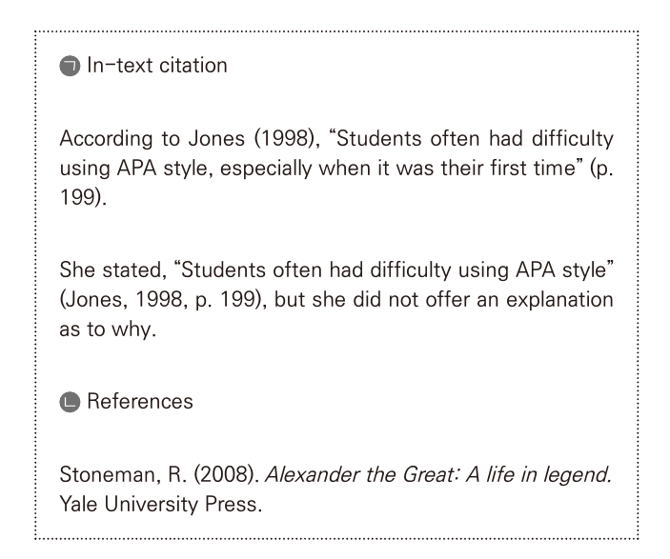
APA 인용스타일 https://essayreview.co.kr/apa-citation-generator

Slide 49
APA with DOI
Anderson, R., & Puckett, J. (2005). The usefulness of an online platform capturing literacy field experiences: Four lessons learned. Literacy Reading Research and Instruction, 44, 22–46. https://doi.org/10.1080/19388070509558430
Almazroa, H. (2020). Insights from Saudi Student Teachers: Successes and Challenges. International Journal of Instruction, 13(3), 445-460. https://doi.org/10.29333/iji.2020.13331a

Slide 50
Academic Writing Templates
ESTABLISHING A RESEARCH TERRITORY
IDENTIFYING THE RESEARCH/KNOWLEDGE GAP
STATING YOUR RESEARCH PURPOSE
DEFINING CONCEPTS/TERMS/OBJECTS
PROVIDING EXAMPLES
REFERENCING SOURCES/REPORTING OTHERS’ WORK

Slide 51
ESTABLISHING A RESEARCH TERRITORY
Studies have shown that English language learners(ELLs) in elementary and secondary schools are frustrated because the school system is failing to support them in achieving their goals of acquiring English and obtaining postsecondary education (Menken, 2008; Olsen, 1997; Suarez-Orozco, Suarez-Orozco, & Todorova, 2008; Valdés, 2001).
Much recent literature on teacher education highlights the importance of identity in teacher development.

Slide 52
IDENTIFYING THE RESEARCH/KNOWLEDGE GAP
Attention is paid to core practices across subjects and grade levels, including, for example, leading a discussion or eliciting student thinking (Ball & Forzani, 2009). However, developing TE pedagogies for core practices in work with linguistically diverse learners has been less fully realized.
Although extensive research has been carried out on the teacher knowledge base in general (Guerrero, 2005) and ESL teacher cognition (Franco-Fuenmayor, Padrón, & Waxman, 2015), there has been no detailed investigations of what mainstream teachers already know and what they need to learn to support ELLs in their classrooms.

Slide 53
STATING YOUR RESEARCH PURPOSE
This article presents a teacher preparation model—a language-based approach to content instruction (LACI)— developed over the past 10 years of research in content area classrooms with English language learners (ELLs) and based on recent scholarship on the language demands of schooling.
The purpose of this paper is to provide an overview of the issues related to teacher identity stemming from recent literature and to suggest the implications for effective teacher education embedded in the discussion of these issues.

Slide 54
STATING YOUR RESEARCH PURPOSE
In the present study, we focus on a core practice of reviewing and carefully assessing student work, with attention to viewing that work as language and meaning in process.
We aim to add to this body of literature concerning the education and experiences of prospective Latino/a teachers and to see how their concerns, strengths, hopes, and struggles are negotiated in their program of teacher education, whom they see themselves teaching, and how they imagine working with children and youth.

Slide 55
DEFINING CONCEPTS/TERMS/OBJECTS
Identity can be conceptualized as “stories to live by” (Clandinin, Downey, & Huber, 2009, p. 141) or as “those narratives about individuals that are reifying, endorsable and significant” (Sfard & Prusak, 2005, p.16).
English language learners (ELLs)—that is, students who speak a first language other than English—now account for nearly 10% of the U.S. public school student population (Kena et al., 2016).
Cochran-Smith and Lytle (1993) define teacher research as "systematic, intentional inquiry by teachers" (p. 5).

Slide 56
PROVIDING EXAMPLES
Grammar accuracy is the primary criterion by which they assessed a person’s command of language. As an example, Emily’s comment was that whatever “roughness” is present in an international pal’s writing is labeled as nonstandard grammar.
This disjunction between research and practice stems from practical factors (e.g., too few bilingual teachers), ideological factors (e.g., opposition to languages other than English in schools), and federal policy. For instance, the No Child Left Behind Act of 2001 (NCLB, 2003 ) required schools to monitor the academic performance of ELLs through state standardized tests.

Slide 57
REFERENCING SOURCES/REPORTING OTHERS’ WORK
Studies have found that translanguaging is a social practice that goes beyond classroom interactions and that it includes all metadiscursive regimes that are performed by all multilingual speakers in their everyday way of making sense of the world around them (García, 2009; Wei, 2011). To explain this phenomenon, García (2009) uses a metaphor of an all-terrain car that has wheels that extend, contract, flex, and stretch while making movements that are irregular on ‘an uneven ground’ (García, 2009, p.45).

Slide 58
REFERENCING SOURCES/REPORTING OTHERS’ WORK
In education, King (2004) draws on Wynter’s scholarship to propose a “deciphering” form of culture-centered knowledge that moves beyond relations of domination, masked by calls for unity, toward conditions of autonomy where “differences are not suppressed or ranked” (p. 357). She defines culture-centered knowledge as the “thought, perception, and belief structures” that contribute to generating “the coherence of a referent social framework” required “to secure the loyalty, motivated participation, and relevant consciousness of its subjects (adherents).

Slide 59
그래머리 활용법
https://app.grammarly.com/
무료버전 사용
자주 쓰면 유료버전 추천

Slide 60
구글 드라이브의 샘플논문 분석
SSCI
SCOPUS
KCI
Google Link
https://drive.google.com/drive/folders/19Q1NJNwuvTdNeng9Yhkm_8NEUpjQnjJN?usp=sharing

Slide 61

질의응답
Q & A
Q & A

