Slide 1
StegoCrypt Scheme using LSB-AES base64

Slide 2
Introduction
Internet & Security
Cryptography
Steganography
Notes:
1. Berawal dari diceritakannya seperti yang di abstract sampai kenapa menggunakan algoritma tersebut

Slide 3
Method that was proposed
Cryptography
AES
Base64
Steganography
Least Bit Significant (LSB)

Slide 4

Base64
Least Bit Significant (LSB)
Advanced Encryption Standard (AES)
Radix-64
Modern algorithm
Hide messages in the image
Method that was proposed
Notes:
1. Point point menggunakan kripto base64 dan aes
2. Diberikan penjelasan untuk alur alur metodenya
3. Dengan metode ini sepert bla bla blaaa
4. Poin poin mengguakan stegano LSB

Slide 5
Proposed scheme
Message (Plaintext)
Base64
AES
Convert to Biner
Key
Message (Ciphertext)
Stego Image
LSB Embedding
Cover Image
Embedding Encrypt

Slide 6
Proposed scheme
Key
LSB Extracting
Message (Ciphertext)
AES
Stego Image
Convert to String
Base64
Message (Plaintext)
Extracting Decrypt

Slide 7
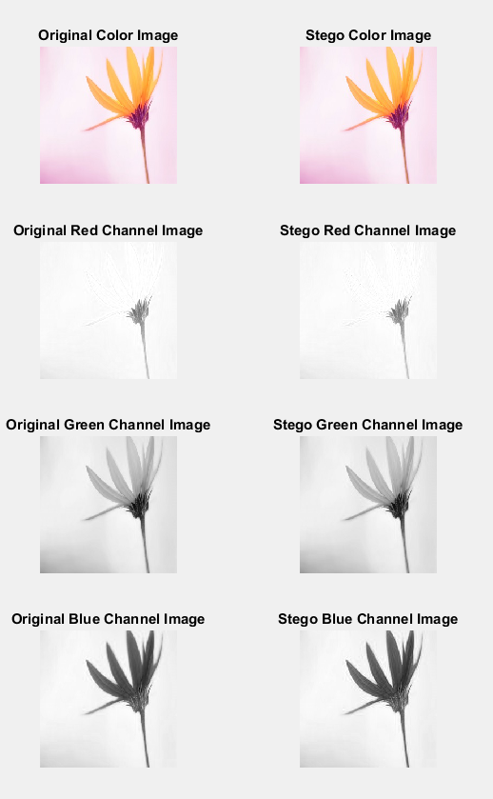
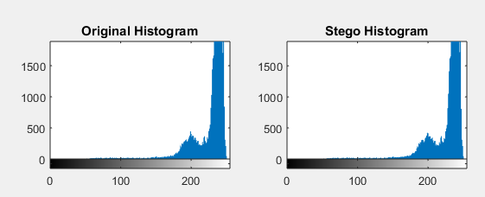
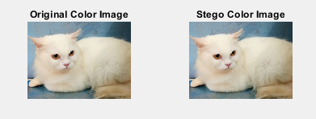
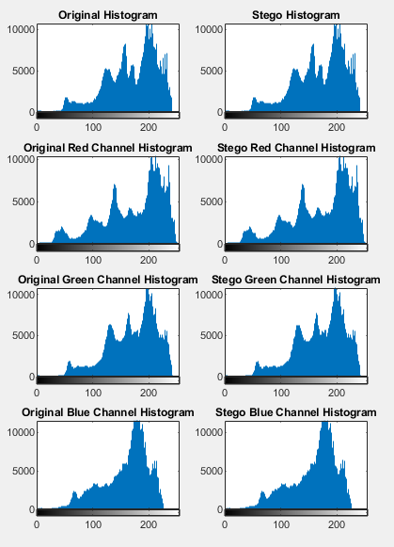
Table of result

Slide 8


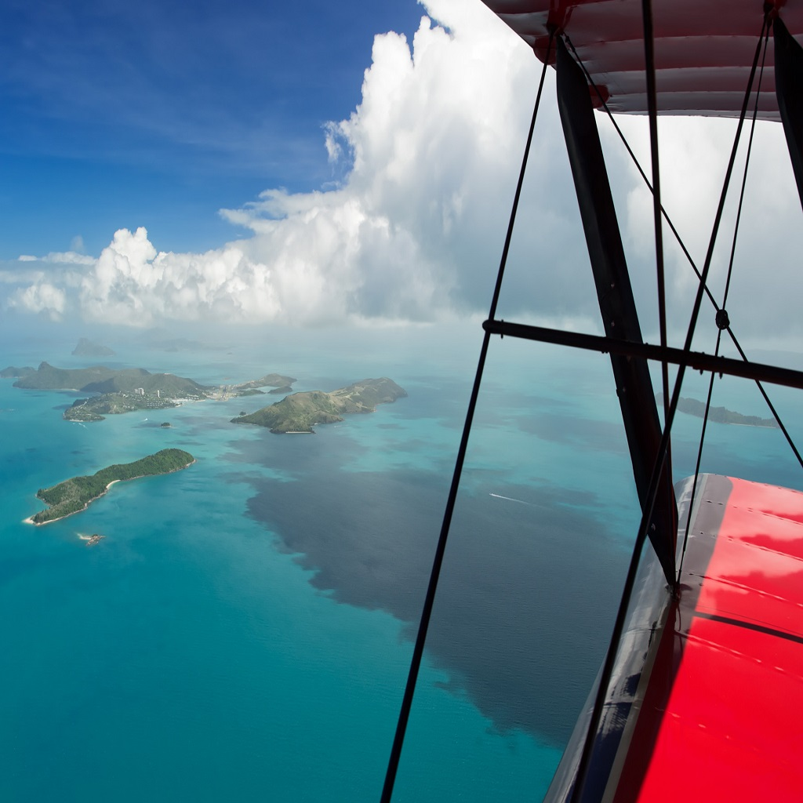
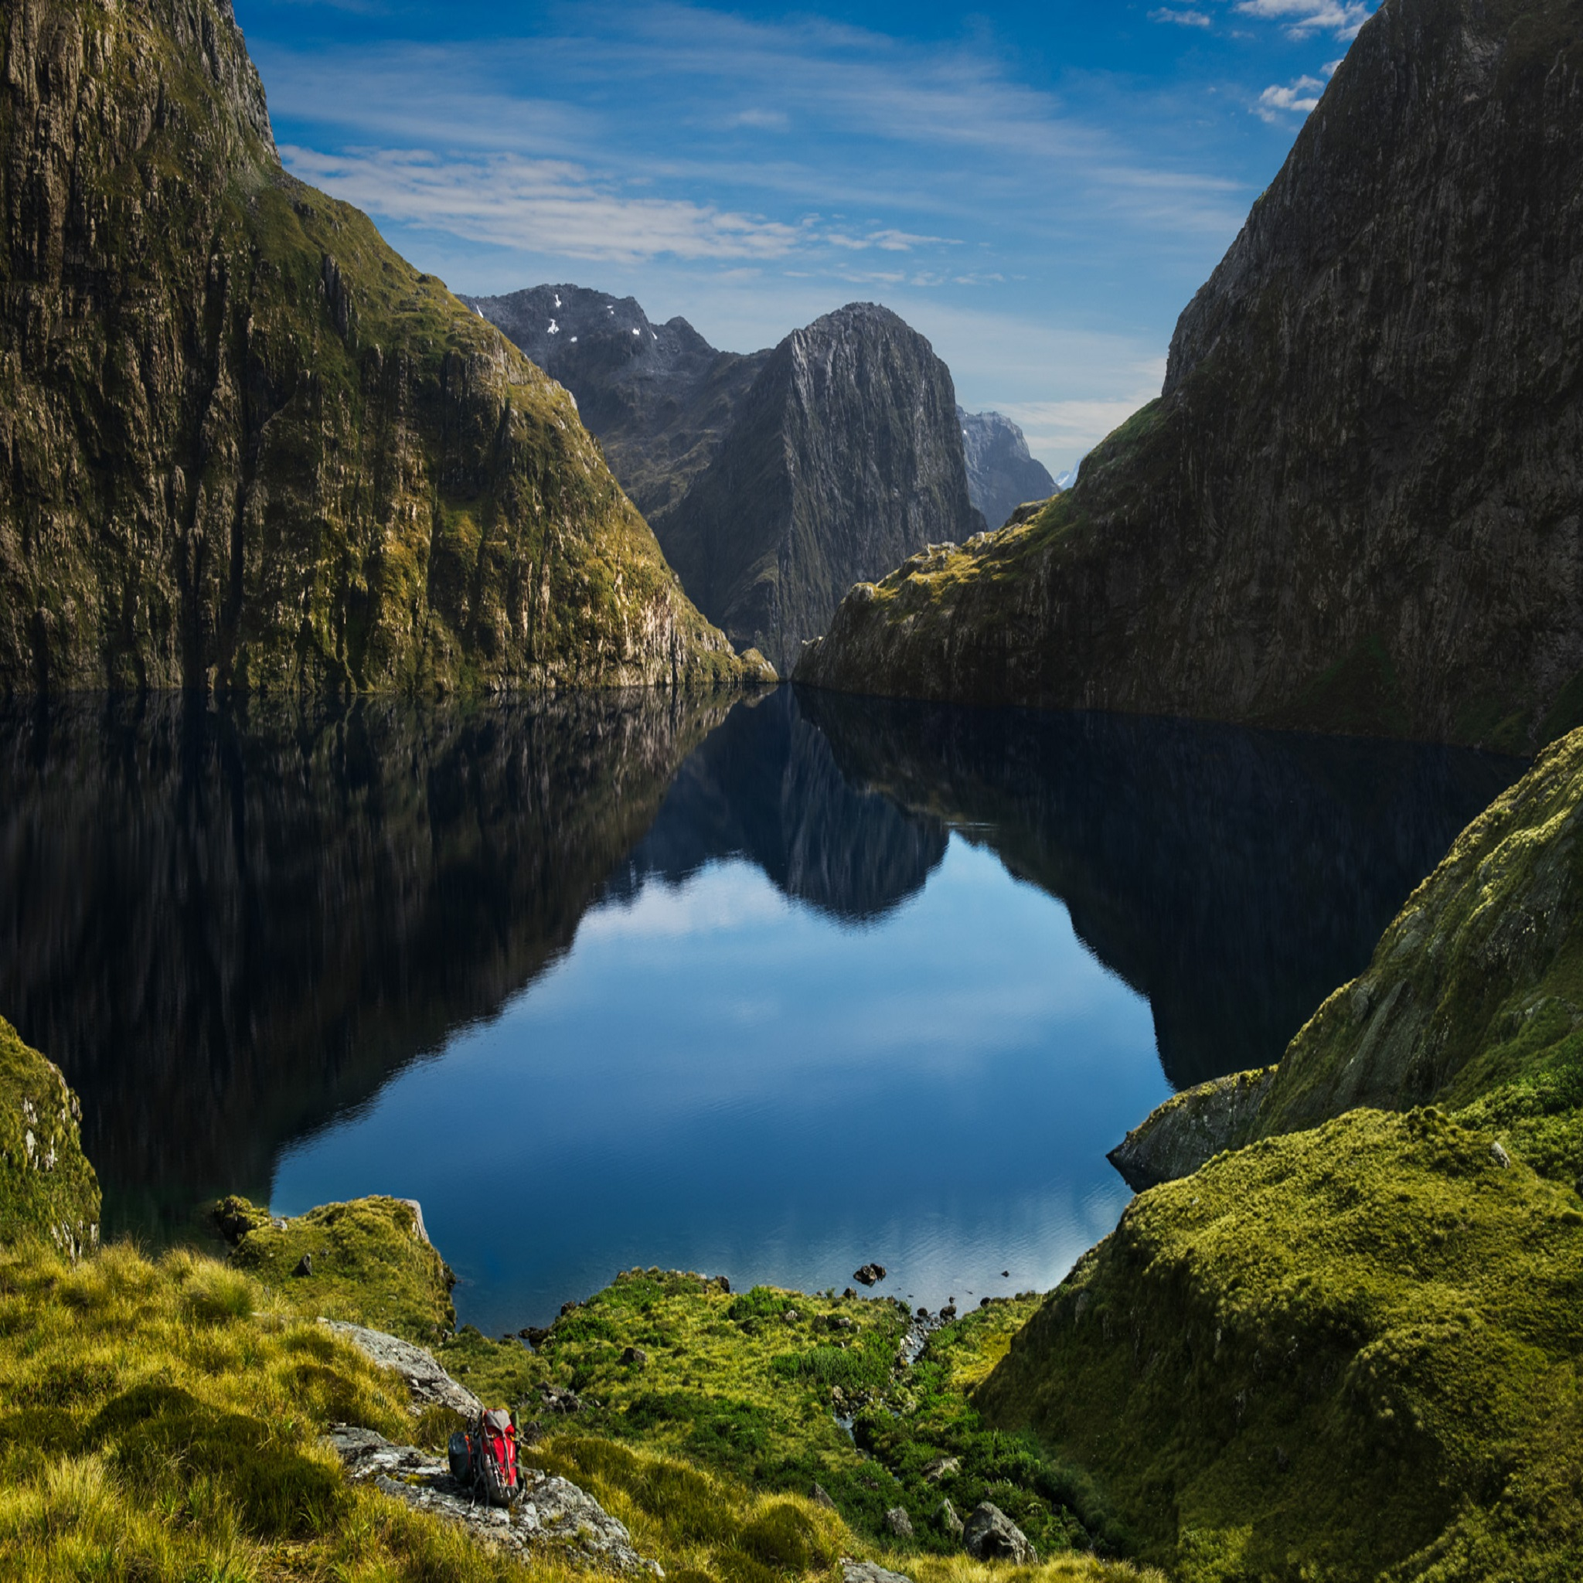
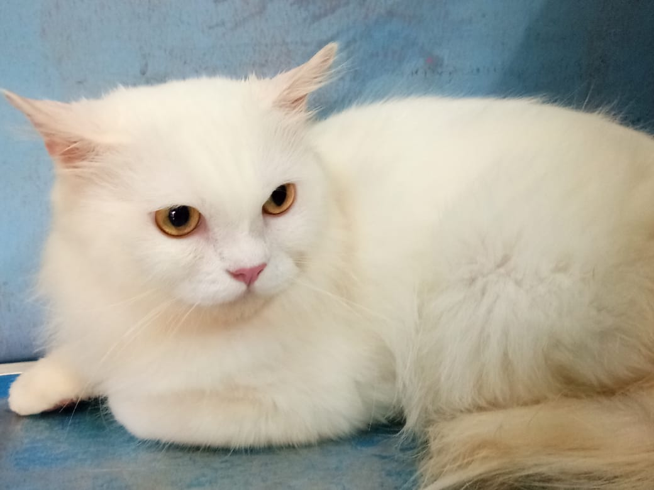
Image and Dimension | Message types and Sizes | PSNR | MSE
256x256 Pixels | .xls (23 kb) | 48,9573 dB | 1,3828
 | .txt (2 kb) | 48,9681 dB | 1,3826
 | .ppt (280 kb) | 48,9579 dB | 1,3827
 | .pdf (37 kb) | 48,9581 db | 1,3826
 | .doc (19 kb) | - | -
512x512 Pixels | .xls (23 kb) | 52,5469 dB | 0,4198
 | .txt (2 kb) | 52,5494 dB | 0,4197
 | .ppt (280 kb) | 52,5493 dB | 0,4197
 | .pdf (37 kb) | 52,5495 dB | 0,4197
 | .doc (13 kb) | 52,5489 dB | 0,4198
1024x1024 Pixels | .xls (23 kb) | 54,2741 dB | 0,2768
 | .txt (2 kb) | 54,2747 dB | 0,2768
 | .ppt (280 kb) | 54,2746 dB | 0,2768
 | .pdf (37 kb) | 54,2747 dB | 0,2768
 | .doc (13 kb) | 54,2745 dB | 0,2768
2048x2048 Pixels | .xls (23 kb) | 52,1949 dB | 0,7103
 | .txt (2 kb) | 52,1967 dB | 0,7102
 | .ppt (280 kb) | 52,1967 dB | 0,7102
 | .pdf (37 kb) | 52,1967 dB | 0,7102
 | .doc (13 kb) | 52,1967 dB | 0,7102
780x1040 Pixels | .xls (23 kb) | 60,4790 dB | 0,0657
 | .txt (2 kb) | 60,4795 dB | 0,0657
 | .ppt (280 kb) | 60,4792 dB | 0,0657
 | .pdf (37 kb) | 60,4796 dB | 0,0657
 | .doc (13 kb) | 60,4788 dB | 0,0657

Slide 9
conclusions
The highest average PSNR value of around 60 dB use private image with original dimensions of 780x1040
The lowest average PSNR value of around 48 dB in image with a dimensions 256x256 and has a file size of 23 kb

Slide 10
Reference
W. D. Somchai and W. Dong, "Research on Base64 Encoding Algorithm and PHP Implementation," in The National Natural Science Foundation of China, Kunming, 2017.
P. U. Deshmukh and T. M. Pattewar, "A Novel Approach for Edge Adaptive Steganography on LSBInsertion Technique," in International Conference on Information Communication and Embedded Systems (ICICES), Chennai, 2014.
E. H. Rachmawanto, C. A. Sari, Y. P. Astuti and L. Umaroh, "A Robust Image Watermarking Using Hybrid DCT and SLT," in International Seminar on Application for Technology of Information and Communication (ISemantic), Semarang, 2016.
J. R. T. and E. T. Sivadasan, "Secure Transmission of Data by Splitting Image," in International Conference on Computing and Network Communications (CoCoNet), Trivandrum, 2015.
E. H. Rachmawanto, R. S. Amin, D. R. I. M. Setiadi and C. A. Sari, "A Performance Analysis StegoCrypt Algorithm based on LSB-AES 128 bit in Various Image Size," in International Seminar on Application for Technology of Information and Communication (ISemantic), Semarang, 2017.
S. L. Chikouche and N. Chikouche, "An Improved Approach for LSB-Based Image Steganography using AES Algorithm," in International Conference on Electrical Engineering - Boumerdes (ICEE-B), Algeria, 2017.
J. Amal, A. B. K.X, P. S and F. K. A, "Text to Image Encryption Technique using RGB Substitution and AES," kerala, 2017.
A. Jain and V. Jain, "PNG Image Copyright Protection and Authentication Using SVD Hash and AES," in International Conference on Advances in Engineering & Technology Research (ICAETR), Unnao, 2014.
T. Mantoro, D. D. Permadi and A. Abubakar, "Stego-Image as a Digital Signature to Improve Security Authentication System in Mobile Computing," in International Conference on Informatics and Computing (ICIC), Mataram, 2016.
G. Singh and S. , "Modified Vigenere Encryption Algorithm and its Hybrid Implementation with Base64 and AES," in Second International Conference on Advanced Computing, Networking and Security, Punjab, 2013.
M. K. and A. H., "Trust Managemen Approach for Secure and Privacy Data Access in Cloud Computing," in International Conference on Green Computing, Communication and Conservation of Energy (ICGCE, Coimbatore, 2013.
R. Sulaiman, B. Isnanto, H. and C. Kirana, "Cryptography in (LSB) Method Using RC4 algorithm and AES algorithm in Digital Image to Improve Message Security," in International Conference on Computing, Engineering, and Design (ICCED), 2018.
A. Singh and H. Singh, "An Improved LSB based Image Steganography Technique for RGB Images," in IEEE International Conference on Electrical, Computer and Communication technologies (ICECCT), 2015, 2015.

Slide 11
Thank you for attention

