Slide 1
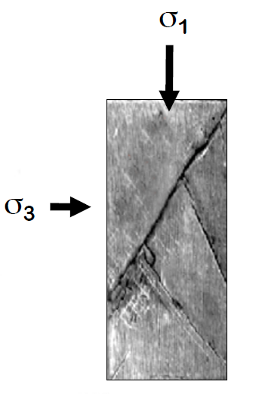
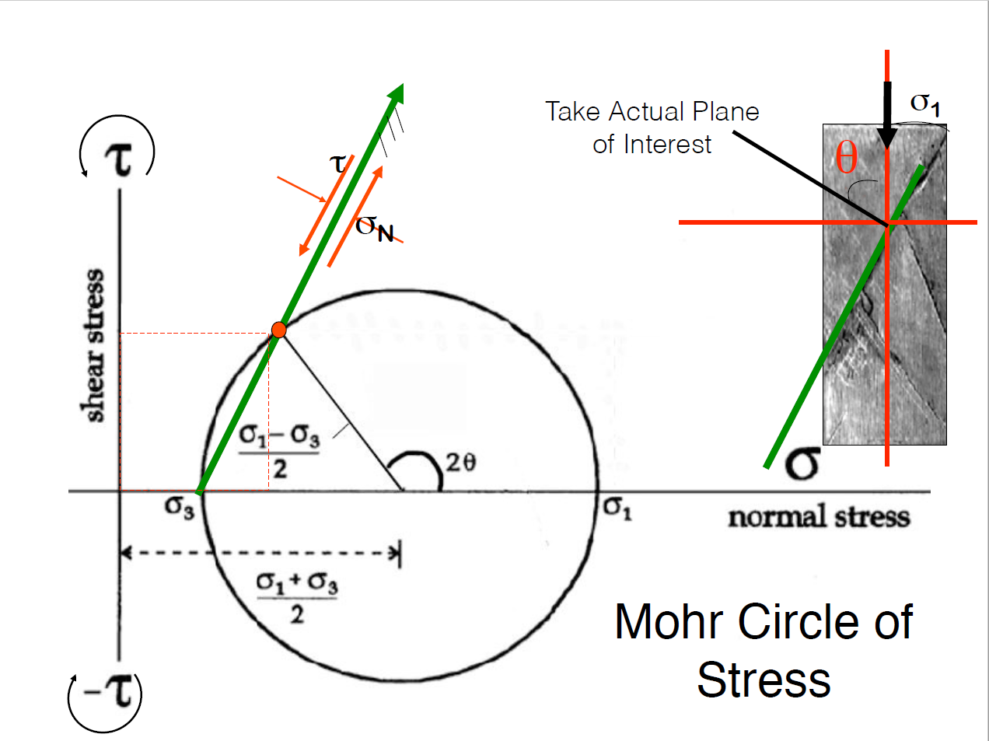
σ₁ and σ₃ are major and minor stresses of the 2D stress ellipse. They define overall stress state and the position and diameter of Mohr’s circle via equations in the diagram. Centre of the circle is mean stress and circle radius is deviatoric stress.
Note, by convention σ₁ is the larger than σ₃.
Every point on the circle represents the stress acting on the plane of specific orientation
Shear stress τ and normal stress σ are sometimes called σ_{S} and σ_{N} respectively.

Slide 2
A portion of rock with stresses labelled
Mohr’s circle representation with shear and normal stresses at a chosen location (i.e. on the fault plane or crack).
Shear stress τ and normal stress σ are also referred to as σ_{S} and σ_{N} .

