Slide 1

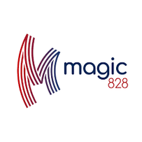



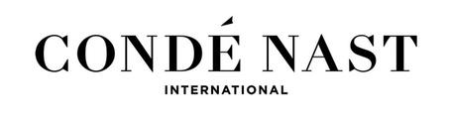


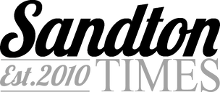
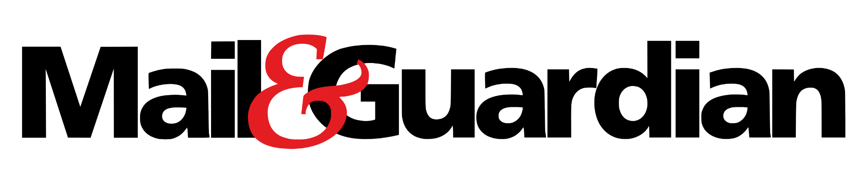
BUSINESS
PROPOSAL
{{Client Name}}

Slide 2








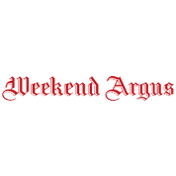

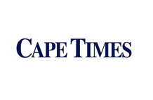











INTRODUCTION
Empower Your Brand with Volt.Africa
Premium Partnerships
At Volt.Africa, we redefine advertising with a 360° approach—seamlessly integrating print, digital, social, and paid media for maximum brand impact.
As specialists in multi-channel advertising across buy and sell sites, we deliver advanced strategies—premium inventory buying, dynamic social campaigns, and tailored solutions—to meet your unique objectives.
Why Volt.Africa?
Because we go beyond traditional advertising, creating results-driven campaigns that amplify your brand’s voice and reach the right audience at the right time.
Volt Africa has forged powerful connections with one of South Africa's premier news platforms, IOL (Independent Online), as well as Condé Nast, home to South Africa's leading fashion, beauty and entertainment titles. Our exclusive partnerships elevate your campaign with prioritised placements, strategically targeted messaging across multiple verticals and platforms.
WWWW.VOLT.AFRICA | POWER YOUR DIGITAL AMBITION

Slide 3


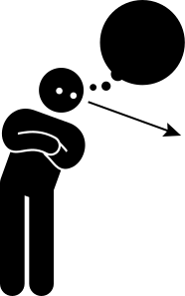
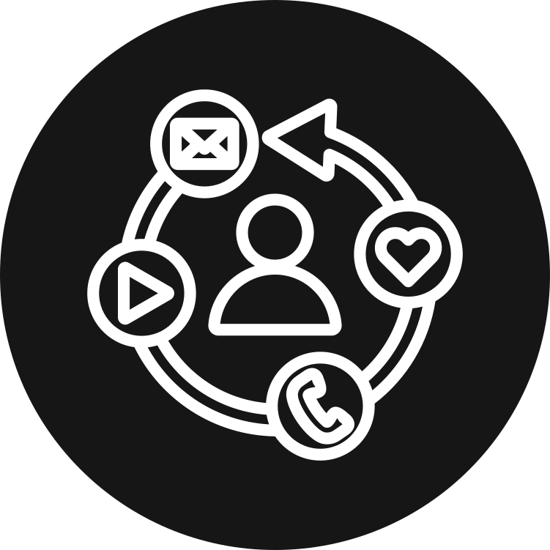











OUR NUMBERS
Audience based targeting
Audience-based advertising allows brands to segment and target their audiences beyond age and gender, while providing more granular measurement than traditional buying. It leads naturally to more effective ad buys with less waste by reaching consumers in whatever corner of digital media they might visit.
Average USERS p/m
16.5 million
Average PAGE VIEWS p/m
53 million
Average IMPRESSIONS p/m
205.5 million
Social Media followers
8.7 million
COUNTRY
South Africa 77%
International 23%
TOP CATEGORIES
News / Sport
Business
Entertainment
Lifestyle
TOP REGIONS
Gauteng 51%
Western Cape 26%
KZN 22%
MALE
52%
FEMALE
48%
AGE
18- 34 ( 28%)
35- 44 (25%)
45 - 54 (24%)
55+ (22%)
RACE (Sample Date)
Indian 6%
Black 69%
Coloured 11%
White 10%
SEM Sample Date
1-2 (5%)
3-5 (15%)
6-7 (24%)
8-10 (48%)
FACEBOOK
5.3 m
TIKTOK
1 m
INSTAGRAM
445K
X
1.8 m
WWWW.VOLT.AFRICA | POWER YOUR DIGITAL AMBITION

Slide 4
CAMPAIGN OUTLINE
Campaign Period: {{Slide 4 Campaign Period}}
Campaign Objective:
{{Slide 4 Campaign Objective}}
WWWW.VOLT.AFRICA | POWER YOUR DIGITAL AMBITION

Slide 5
TARGETING OVERVIEW
Age | {{Slide 5 Target Age Group}}
Gender | {{Slide 5 Target Gender}}
Interests | {{Slide 5 Interests}}
Income Level / LSM | {{Slide 5 Income Level}}
Geographics | {{Slide 5 Target Regions}}
Pain Points | {{Slide 5 Pain Points}}
WWWW.VOLT.AFRICA | POWER YOUR DIGITAL AMBITION

Slide 6
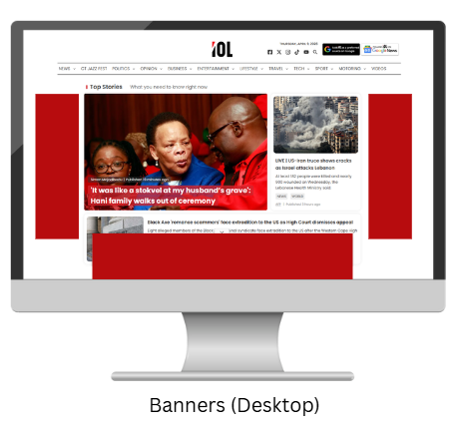
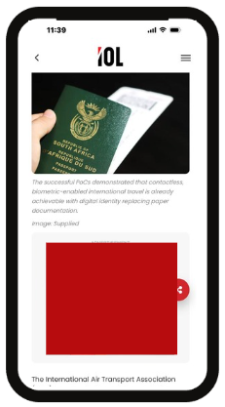
DISPLAY ADVERTISING
Best for: Boost brand visibility / recognition / Awareness
Drives measurable results
Supports in depth targeting
Display ads put your brand front and center with high-impact visuals that grab attention. Designed for reach and visibility, they drive traffic, build awareness, and deliver measurable results. Flexible formats and precise targeting ensure your message is seen, remembered, and acted on.
Placement: {{Slide 6 Display Site Placement}}
Format: {{Slide 6 Targeting Format}}
Goal: To drive high-visibility brand awareness and consideration by reinforcing key campaign messaging, while directing audiences to engage with featured content and learn more.
Marketing Funnel Objective: Awareness
Metrics: Reach, Impressions
WWWW.VOLT.AFRICA | POWER YOUR DIGITAL AMBITION

Slide 7
CONTENT MARKETING
Brands that publish quality content on trusted news platforms see up to 67% more leads than those who don’t.
Content connects with audiences naturally, blending your brand message into trusted editorial environments. By providing value through storytelling, education, or inspiration, they build credibility, drive awareness, and encourage action. Aligning with high-quality journalism captures attention, earns trust, and boosts engagement, recall, and conversions.
Placement: {{Slide 7 Content Placement}}
Format: {{Slide 7 Content Format}}
Goal: To build awareness, drive audience engagement, and position the brand as a credible and authoritative voice within its industry, ultimately moving audiences from awareness to consideration.
Marketing Funnel Objective: Awareness → Consideration
Metric: Users, Pageviews
Native articles on publisher sites drive 53% higher engagement compared to brand-owned channels.
Partnered content on established media platforms builds 3× more brand trust than traditional display ads.
WWWW.VOLT.AFRICA | POWER YOUR DIGITAL AMBITION

Slide 8
SOCIAL MEDIA
Instant access to an engaged, trusting audience
Sharing your brand via our social channels gives instant access to an engaged, trusting community. Positioned as organic content rather than a competing ad, your message drives authentic engagement, stronger brand association, and higher credibility. Leverage our reach to connect with an active, receptive audience for maximum visibility and influence.
Placement: {{Slide 8 Social Media Placement}}
Format: Static Images, Carousels, GIFs, 10–30 second video clips
Goal: To amplify partnered content and brand storytelling by reaching wider, targeted audiences beyond organic reach. Social media boosting will drive measurable visibility, engagement, and brand affinity, positioning the brand as credible, relevant, and impactful within its market.
Marketing Funnel Objective: Awareness
Metrics: Reach, Impressions,
Organic placement drives authentic engagement and credibility
Maximized visibility with stronger brand association and influence
WWWW.VOLT.AFRICA | POWER YOUR DIGITAL AMBITION

Slide 9
PAID MEDIA
Paid Media advertising delivers precision-targeted reach at scale. Programmatic ads reach the right audience across premium sites and apps, while boosted social posts extend visibility beyond organic reach. Together, they drive measurable performance—maximizing engagement, conversions, and ROI.
Key Placements: DV360, Google Ads, YouTube, CTV, Display, Facebook, Instagram, Messenger, etc.
Amplifies reach
Placement: {{Slide 9 Paid Media Placement}}
Format: Static Images, Carousels, GIFs, 10–30 second video clips - dependent on placement
Goal: The paid media campaign will amplify the brand’s presence by promoting key products, services, or messaging across multiple platforms. Using precision targeting, it will extend reach beyond owned and publisher audiences through programmatic display networks and video platforms, while social media channels will engage both broad and niche audience segments.
Marketing Funnel Objective: Awareness, Consideration
Optimized performance
Precision targeting at scale
WWWW.VOLT.AFRICA | POWER YOUR DIGITAL AMBITION

Slide 10
PRINT ADVERTISING
Print delivers trusted, lasting impact in a tangible format that drives deeper engagement than digital alone. Readers spend quality time with content in a clutter-free environment, giving your brand visibility alongside credible journalism. With strong visuals, premium placement, and extended shelf life in homes and offices, print builds recognition well beyond publication day.
Ad Placement
{{Slide 10 Print Ad Sizes}}
Placement: {{Slide 10 Print Ads Titles}}
Goal: To leverage the credibility and wide reach of print media to showcase brand initiatives, impact, and storytelling in a trusted environment. Print acts as a strong foundation within a broader multi-channel campaign, reinforcing messaging across digital and social platforms.
This integrated approach ensures consistent storytelling, maximises audience reach, and strengthens overall brand perception, highlighting the importance of multiple touchpoints in building awareness and trust.
Marketing Funnel Objective: Awareness
WWWW.VOLT.AFRICA | POWER YOUR DIGITAL AMBITION

Slide 11
INVESTMENT
PRODUCT | PLACEMENT | QUANTITY | RATE
Display | {{Slide 6 Display Site Placement}} | {{Slide 11 Display Site Placement Quantity}} | {{Slide 11 Display Rate}}
Content Marketing | {{Slide 7 Content Placement}} | {{Slide 11 Content Quantity}} | {{Slide 11 Content Rate}}
Social Media | Organic Placement on {{Slide 8 Social Media Placement}} | {{Slide 11 Social Media Organic Posts Quantity}} | {{Slide 11 Social Media Rate}}
 | Boosting |  | {{Slide 11 Social Boosting Amount}}
 | 30% Management Fee of Boosting amount |  | {{Slide 11 Social Media Management Fee}}
Paid Media | {{Slide 9 Paid Media Placement}} | Per month | {{Slide 11 Paid Media Amount}}
 | Setup Costs (Once off) | {{Slide 11 Paid Media Accounts Quantity}} | {{Slide 11 Paid Media Setup Cost}}
 | 30% Management Fee | per month | {{Slide 11 Paid Media Management Fee}}
Print | {{Slide 10 Print Ads Titles}} | {{Slide 11 Print Ads Quantity}} | {{ Slide 11 Print Ads Rate}}
TOTAL | excluding VAT |  | {{ Slide 11 Print Total quote amount}}
WWWW.VOLT.AFRICA | POWER YOUR DIGITAL AMBITION

Slide 12
THANK YOU
{{Rep Name}}
Note: This proposal is based on the brief we received, and should the brief evolve, the quotation and recommendations will adapt accordingly. All strategic ideas and frameworks shared remain the property of Volt and are intended exclusively for this collaboration.
WWWW.VOLT.AFRICA | POWER YOUR DIGITAL AMBITION

