Slide 1


Building a BlockChain
Md. Farhad Hussain
Intern Engineer

Slide 2
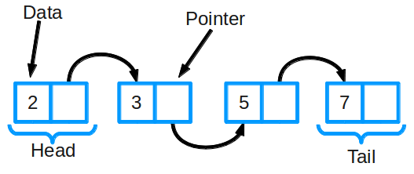
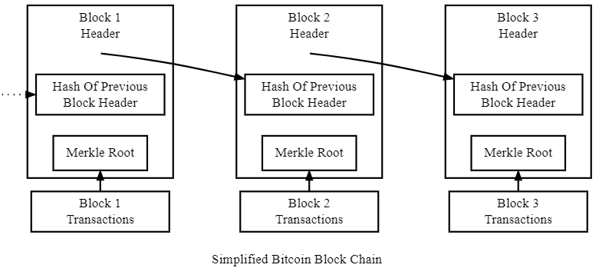

Slide 3
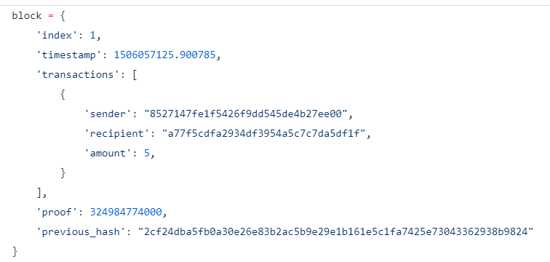

Slide 4
Step 1: Building a Blockchain
Representing a Blockchain
Adding Transactions to a Block
Creating new Blocks
Implementing basic Proof of Work

Slide 5
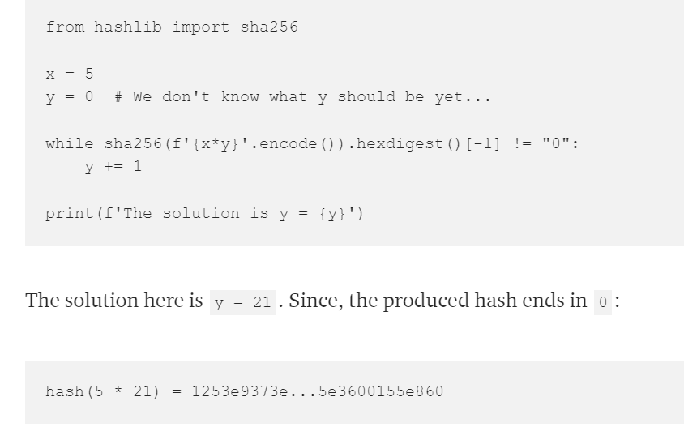

Slide 6
Step 2: Our Blockchain as an API
Setting up Flask
The Transactions Endpoint
The Mining Endpoint

Slide 7
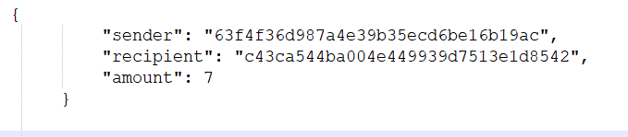
Step 3: Interacting with our Blockchain
Fire up the server
Let’s try mining a block
Let’s create a new transaction
Let’s inspect the full chain
http://localhost:5000/mine
http://localhost:5000/transactions/new
http://localhost:5000/chain

Slide 8

Step 4: Consensus
Registering new Nodes
Implementing the Consensus Algorithm
http://localhost:5000/nodes/register
http://localhost:5000/nodes/resolve

Slide 9
blockchain.py
https://github.com/dvf/blockchain
Requires Python 3.6+
PIP
Flask
PostMan

Slide 10
Refference
Daniel van Flymen
https://hackernoon.com/learn-blockchains-by-building-one-117428612f46
https://github.com/dvf/blockchain

