Slide 1
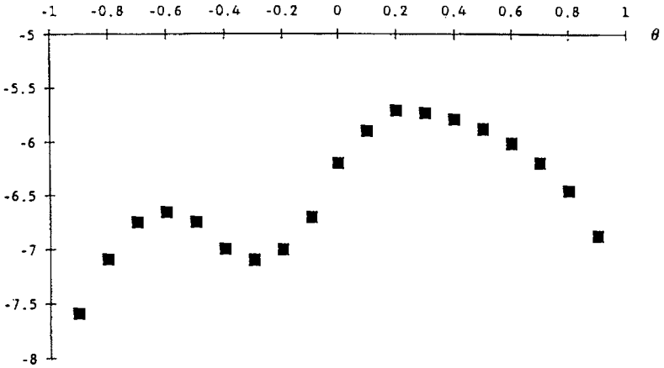









$$θ^{∗∗}$$
$$θ_{B}^{2}$$
$$θ_{A}^{1}$$
$$θ^{∗}$$
$$θ_{B}^{1}$$
$$θ_{A}^{0}$$
$$θ_{C}^{1}$$
$$θ_{B}^{0}$$
$$θ_{C}^{0}$$

