Slide 1
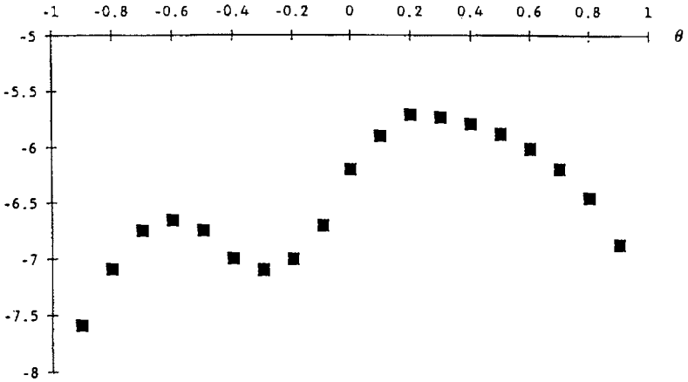










$$θ$$
$$θ^{∗∗}$$
$$θ_{B}^{2}$$
$$θ_{A}^{1}$$
$$θ^{∗}$$
$$θ_{B}^{1}$$
$$θ_{A}^{0}$$
$$θ_{C}^{1}$$
$$θ_{B}^{0}$$
$$θ_{C}^{0}$$

Slide 2
$$θ$$

Slide 3


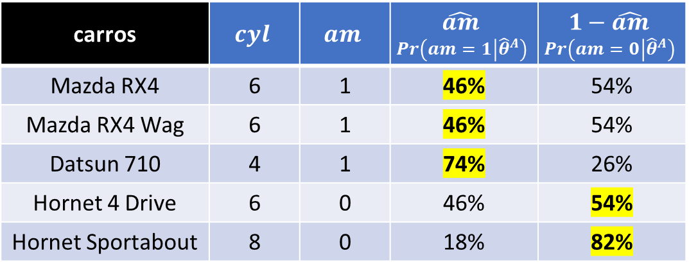


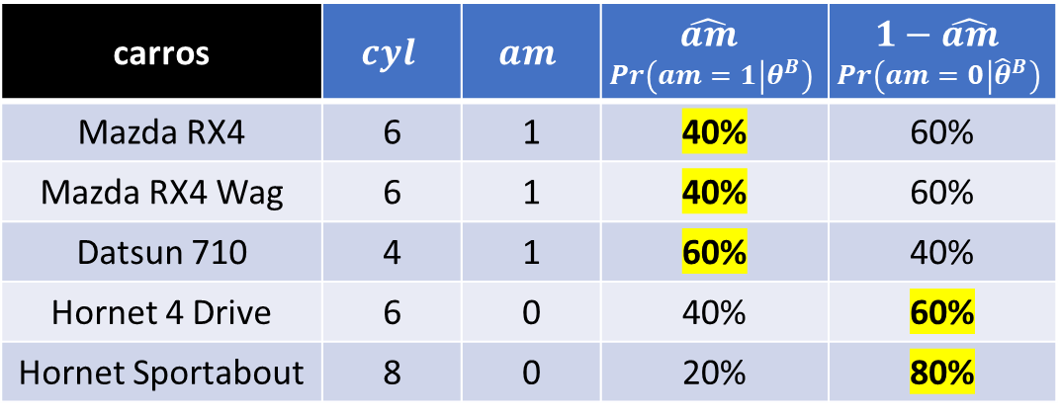
$${\hat{θ}}^{A}=\left\{{\hat{β}}_{0}^{A}=1,3;{\hat{β}}_{1}^{A}=−0,14\right\}$$
carros | $$cyl$$ | $$am$$ | $$\hat{am}$$ $$Pr\left(am=1 | {\hat{θ}}^{A}\right)$$ | $$1−\hat{am}$$ $$Pr\left(am=0 | {\hat{θ}}^{A}\right)$$
Mazda RX4 | 6 | 1 | 46% | 54%
Mazda RX4 Wag | 6 | 1 | 46% | 54%
Datsun 710 | 4 | 1 | 74% | 26%
Hornet 4 Drive | 6 | 0 | 46% | 54%
Hornet Sportabout | 8 | 0 | 18% | 82%
Likelihood $= 6,933\%$
$${\hat{θ}}^{B}=\left\{{\hat{β}}_{0}^{B}=1,0; {\hat{β}}_{1}^{B}=−0,10\right\}$$
carros | $$cyl$$ | $$am$$ | $$\hat{am}$$ $$Pr\left(am=1 | θ^{B}\right)$$ | $$1−\hat{am}$$ $$Pr\left(am=0 | {\hat{θ}}^{B}\right)$$
Mazda RX4 | 6 | 1 | 40% | 60%
Mazda RX4 Wag | 6 | 1 | 40% | 60%
Datsun 710 | 4 | 1 | 60% | 40%
Hornet 4 Drive | 6 | 0 | 40% | 60%
Hornet Sportabout | 8 | 0 | 20% | 80%
Likelihood $= 4,608\%$

Slide 4
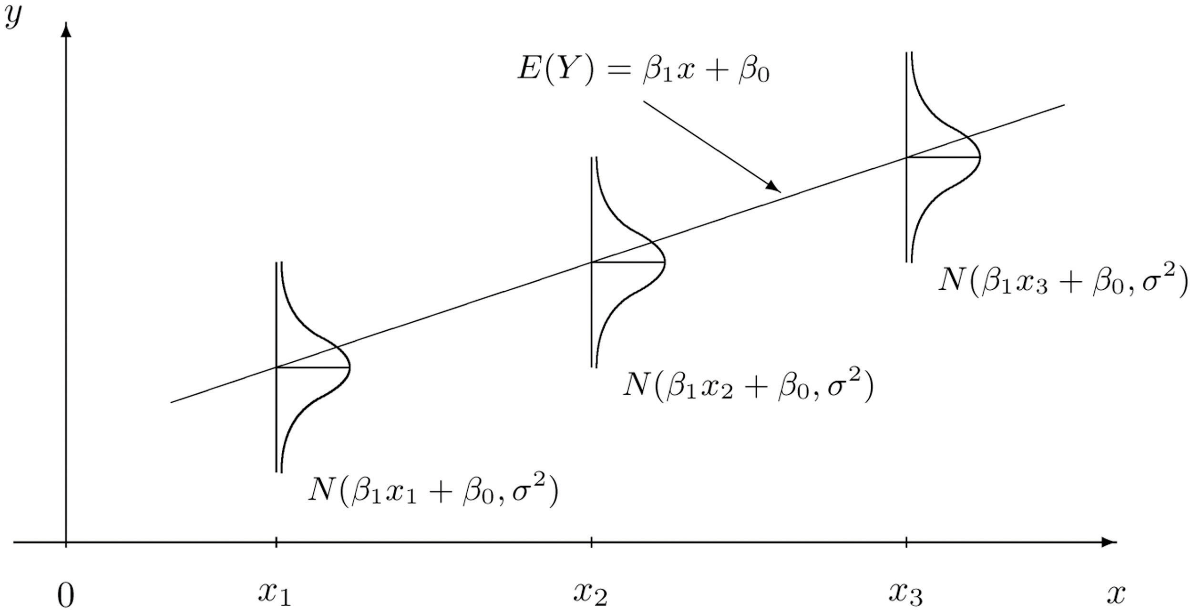




$$\hat{y}={\hat{β}}_{0}+{\hat{β}}_{1}x$$
$N\left({\hat{β}}_{0}+{\hat{β}}_{1}x_{3},{\hat{σ}}^{2}\right)$
$N\left({\hat{β}}_{0}+{\hat{β}}_{1}x_{3},{\hat{σ}}^{2}\right)$
$N\left({\hat{β}}_{0}+{\hat{β}}_{1}x_{1},{\hat{σ}}^{2}\right)$

