Slide 1
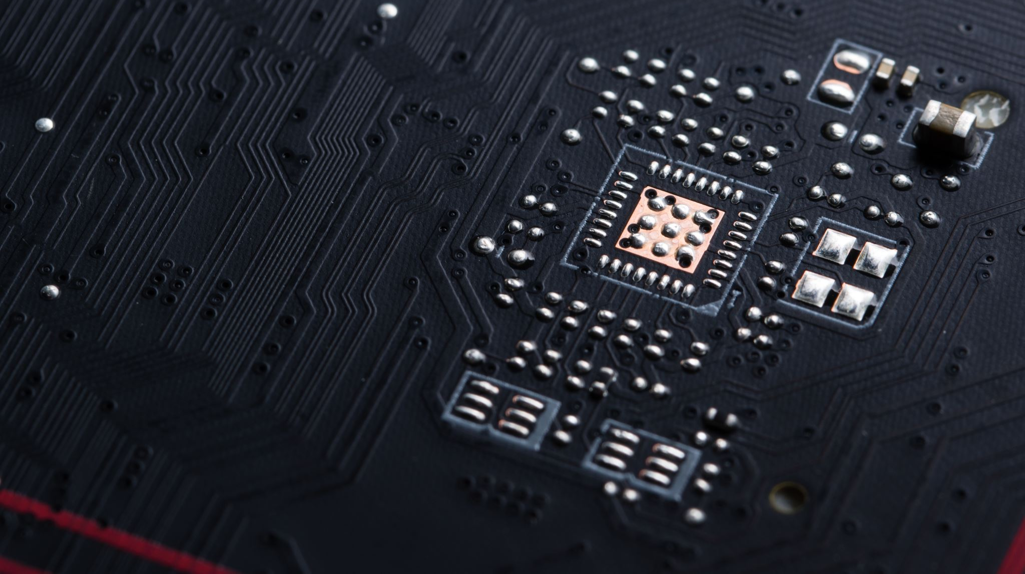
HPC MC1
Shwetav Behera

Slide 2


Problem Statement

Slide 3
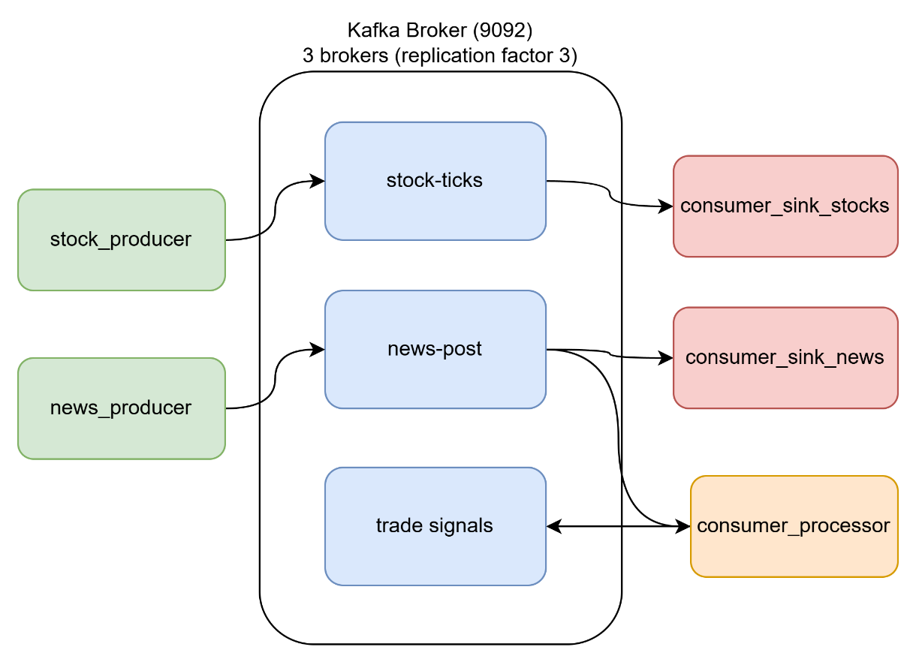
Application: Stock news trend tracker
Msgpack as serializer
CSV sink calles flush() after every row
Offset Earliest (not too much data in stream, so in this case ok to read full topic)
Dockerized services

Slide 4
Part 2: Consumer Group
Fan out (2 Consumer in diff. groups consume from 1 partition)
Load balancing failure
Demonstrated how 2 cons. From same group can’t consume from same partition

Slide 5
Part 2: Partition & Replication factors
Fan out (2 Consumer in diff. groups consume from 1 partition)
Attempted Partition Parallelism
Demonstrated how 3 cons. From same group can’t consume from same partition
Real Partition Parallelism
3 cons. Consume messages from 3 partition in 1 topic
Broker failure & replication
Demonstrated replication logic by shutting of 1 partition
Leader change

Slide 6
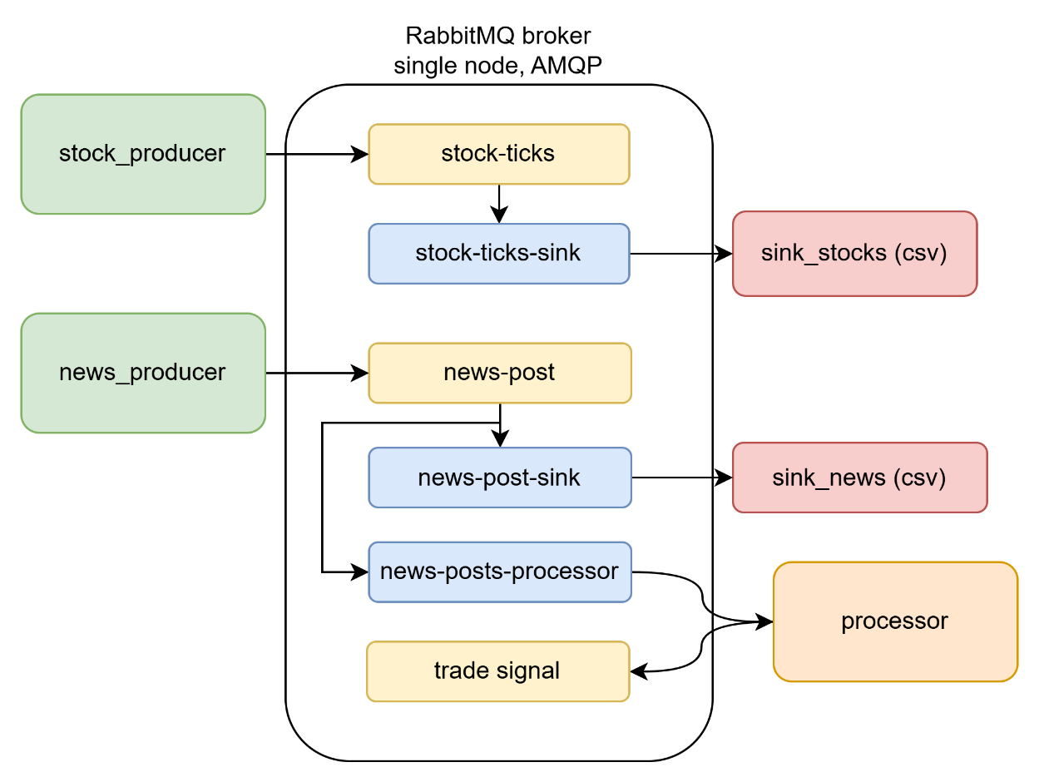
Part 3: RabbitMQ
Msgpack as serializer
CSV sink calles flush() after every row
Fanout (all exchanges)
Basic_ack

Slide 7
RabbitMQ vs Kafka - Similarities
Similar
Both pub/sub
Business logic is same

Slide 8
RabbitMQ vs Kafka - Differences
Kafka | RabbitMQ
Fan Out by design | Traditional MQ system
High throughput | Moderate data volumes
Logging | Queue
Heavy lifting by cons. | Heavy lifting by broker

Slide 9
RabbitMQ vs Kafka - Scalability
Kafka | RabbitMQ
Add brokers | Add brockers
Add partitions | Add consumers (same queue)

Slide 10
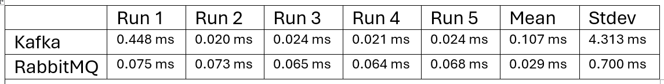
Part 4: Wall time per iteration (producer)
Setup:
5 runs x 500 producer messages
Measure walltime
Kafka warm up is high, then low
RabbitMQ consistent but high

Slide 11
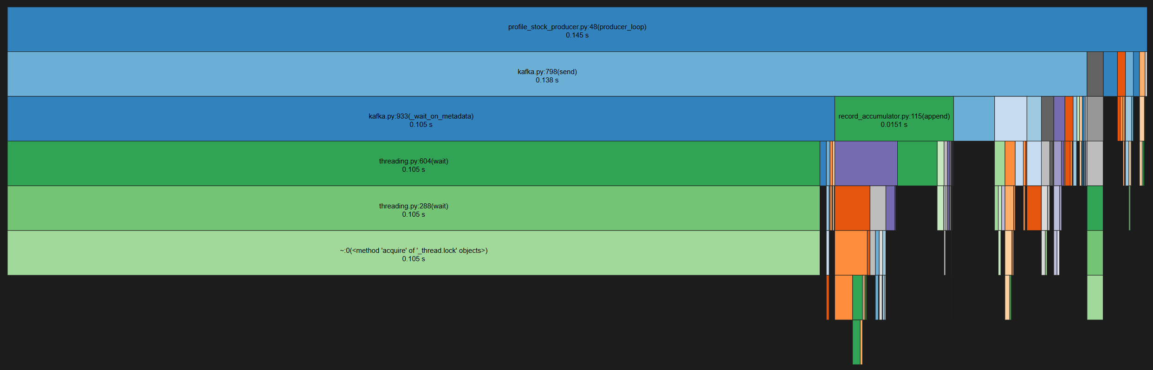
Part 4: Kafka cProfile
75% inside metadata fetching from broker (first send)

Slide 12
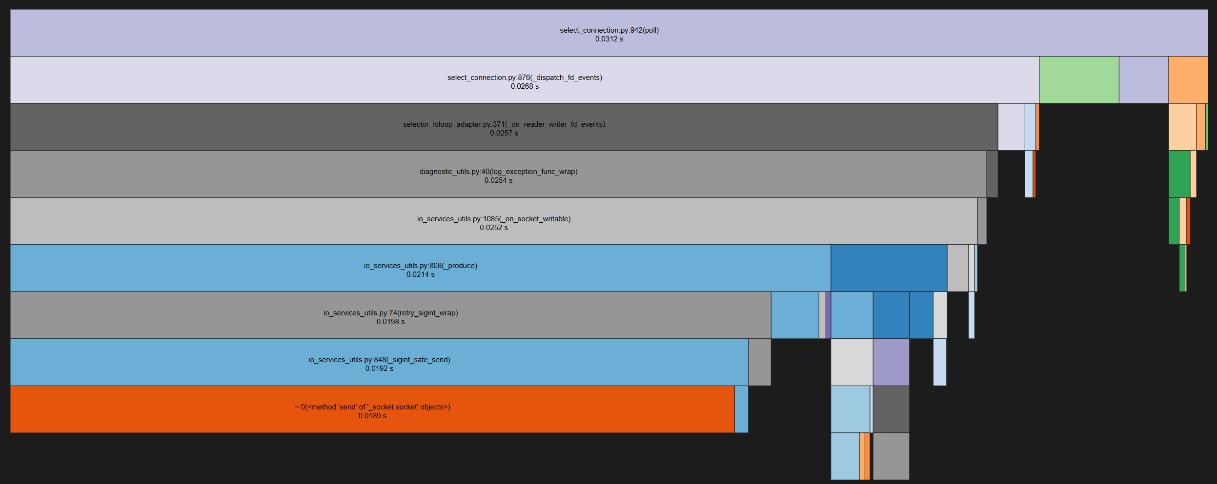
Part 4: RabbitMQ cProfile
Publishing by the producer to the buffer takes longer

Slide 13
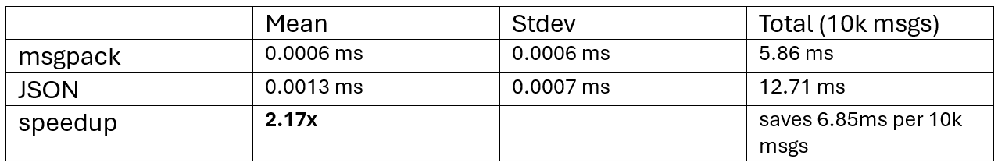
Part 4: Deserialization only
Msgpack is 2.17x faster than JSON

Slide 14
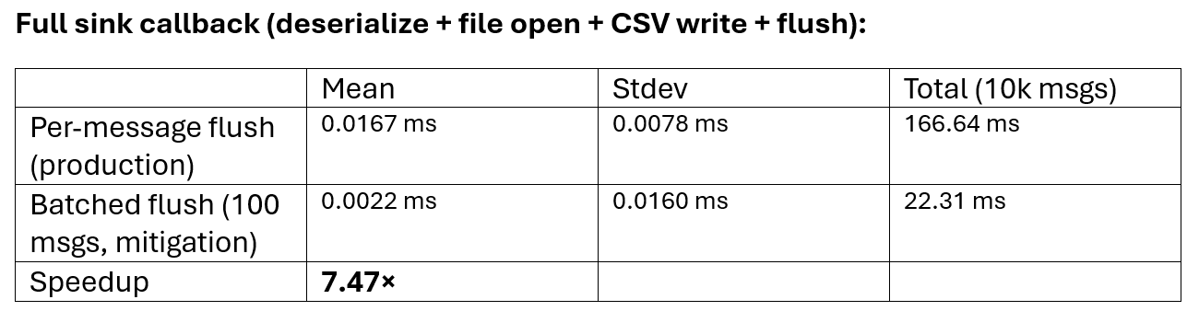
Part 4: Consumer latency
Main Bottleneck in current consumer design

Slide 15
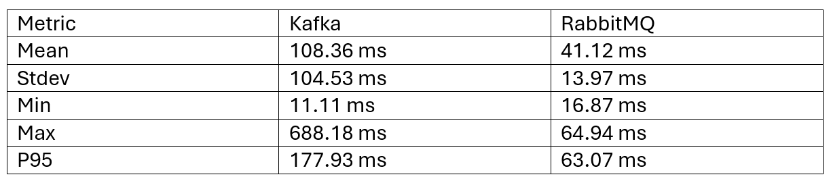
Part 5 - End-to-End Latency
- Producer send to receiving by consumer
200 messages
RabbitMQ synchronous, Kafka asynchronous

Slide 16
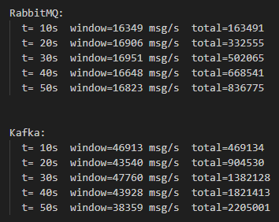
Part 5 - End-to-End Latency
RabbitMQ stable
Synchronous
Kafka instable
Asynchronous

