Slide 1
The Merlin6 cluster
Introduction to Slurm
Basic Concepts, Components, Job Submission Guide
Marc Caubet Serrabou
Paul Scherrer Institut, September 2025

Slide 2
Agenda
Introduction to Merlin6 and Slurm
  Hand-on: Merlin6 access and topology
Slurm: Job Scheduling and Priorities
Using Slurm on Merlin6
  Partitions (Hands-on)
  Job submission and monitoring (Hands-on)
  Scheduler & Priorities (Hands-on)
  Resource selection & Task Placement (Hands-on)
Goals
Learn how to submit and monitor jobs in Slurm.
Learn how the Slurm scheduler and job priorities work.
Understand how the hardware topology may affect your jobs.

Slide 3
1. Introduction to Merlin6 and Slurm

Slide 4
About Merlin6
Merlin6 is the High-Performance Computing (HPC) cluster at the Paul Scherrer Institut (PSI).
Enables PSI researchers and collaborators to run compute-intensive workloads.
Provides an environment for developing, testing, and running scalable applications.
Designed to support scientific simulations, data analysis, and experiments requiring large-scale computing resources.
Currently in the process of being phased out, with projects and users being migrated to Merlin7 (ALPS supercomputer), ensuring service continuity.
Highlights
Architecture: Multi-node Linux cluster with high-speed interconnects (Infiniband).
Workload Manager: Uses Slurm for job scheduling and resource management.
Storage: Integrated with a large-scale storage, the GPFS parallel filesystem.
User Access: Provided via login nodes (e.g., merlin-l-001.psi.ch).
Applications: Physics, materials science, chemistry, biology, engineering simulations, etc.

Slide 5

The Slurm Workload Manager
Slurm (Simple Linux Utility for Resource Management) is a free, open-source, fault‑tolerant, and highly scalable workload manager and job scheduler for Linux clusters.
Allocate exclusive/non-exclusive access to compute resources.
Provide a framework for starting, executing, and monitoring jobs.
Manage queues and arbitrate resource contention.
Accounting support
Slurm integrates with accounting through slurmdbd, which record job usage information in a database.
Users and admins can query this information with sacct and sacctmgr.
Batch system alternatives examples:
PBS (Portable Batch System), IBM LSF (Load Sharing Facility), HTCondor

Slide 6
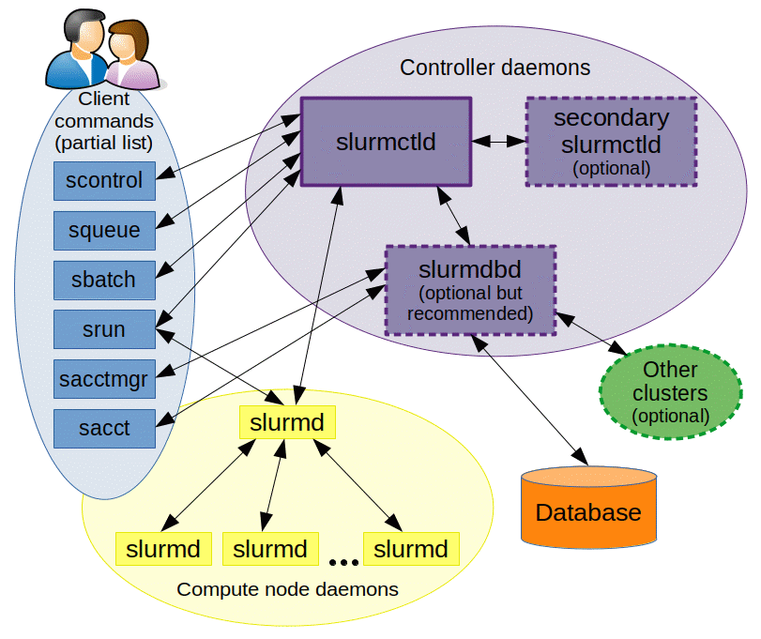
Slurm components
Control Daemon (slurmctld): Acts as the central orchestrator. (schedules jobs, tracks cluster state, and allocates resources)
Compute Node Daemon (slurmd): Runs on each compute node; executes jobs and reports status back to slurmctld.
Slurm client: Agentless, contains a local copy of slurm.conf with configuration details.
Database Daemon (slurmdbd) (optional): Handles job accounting
and logging in a database for long-term usage tracking and reporting.
Other components
Auth & Credential Kiosk Daemon (sackd): Used primarily on login or submission nodes that do not run slurmd.
Source: SchedMD
REST API Daemon (slurmrestd): Provides a RESTful interface to Slurm, allowing clients to interact via HTTP rather than the traditional CLI or C API. Stateless. Authentication via JSON Web Tokens (JWT) or local Unix
authentication.
Client commands
srun, sbatch, squeue, sinfo, scontrol, scancel, sacct, sacctmgr

Slide 7
Slurm client commands
Command | Purpose | Example
sbatch | Submit a batch job script | sbatch job.slurm
srun | Run interactively or launch tasks inside a job | srun --partition=hourly –-time=00:30:00 --pty bash
salloc | Allocate resources interactively (creates a job allocation) | salloc --nodes=2 –ntasks=8 --hint=nomultithread --time=2:00:00 salloc -–ntasks=1 –-cpus-per-task=6
squeue | Show running & pending jobs | squeue -u $USER
sinfo | Show partitions and node states | sinfo -s
sprio | Show user priority for pending jobs | sprio -l
scancel | Cancel jobs | scancel <jobid>
sacct | Show job history/accounting info. | sacct -j <jobid>
scontrol* | Advanced tool to query, manage, and modify jobs, nodes, and partitions in real time. * Many commands may require admin rights | scontrol show job <jobid> scontrol hold <jobid> scontrol release <jobid> scontrol show node <nodename> scontrol update JobId=<jobid> TimeLimit=02:00:00
sacctmgr* | Inspect your accounts, associations, QoS, and limits. Check fairshare and usage limits tied to your project/s. * Many commands may require admin rights Visibility is also restricted to the user | sacctmgr show qos format=Name%12,Priority,MaxCpusPU,MaxTresPU%20 sacctmgr show assoc user=$USER \ format=Cluster,Account,MaxSubmit,MaxTRES%20
Extended summary with common parameters: https://slurm.schedmd.com/pdfs/summary.pdf

Slide 8
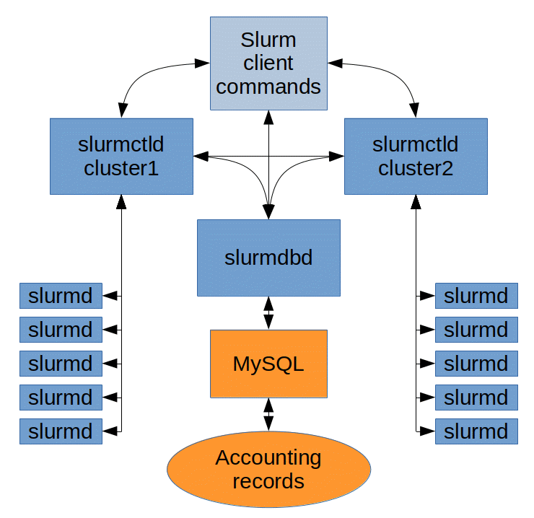
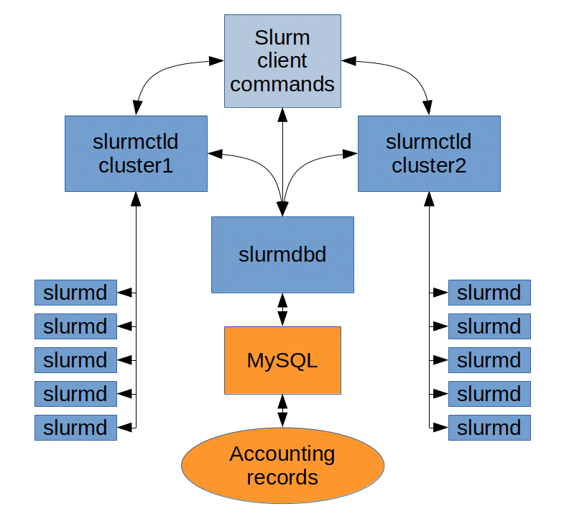
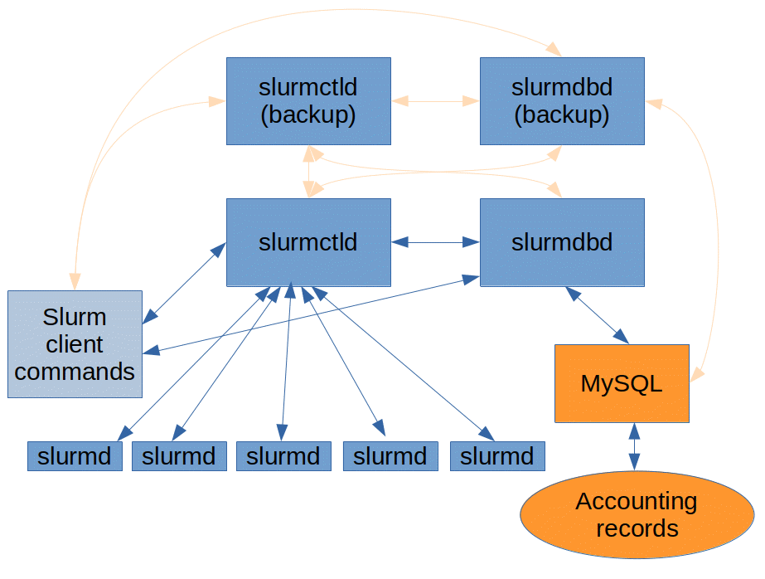
Common Slurm topologies: H.A.
Fallback slurmctld and slurmdbd
Multi-Cluster configuration
Federation configuration
Image source: SchedMD

Slide 9
Common Slurm topologies: Multi-cluster
Fallback slurmctld and slurmdbd
Multi-Cluster configuration
Federation configuration
Image source: SchedMD

Slide 10
Common Slurm topologies: Federation
Fallback slurmctld and slurmdbd
Multi-Cluster configuration
Federation configuration
Image source: SchedMD

Slide 11
Merlin6 cluster topology
Fallback slurmctld and slurmdbd
Multi-Cluster configuration
Federation configuration
Image source: SchedMD

Slide 12
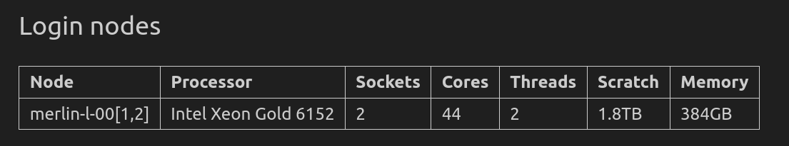
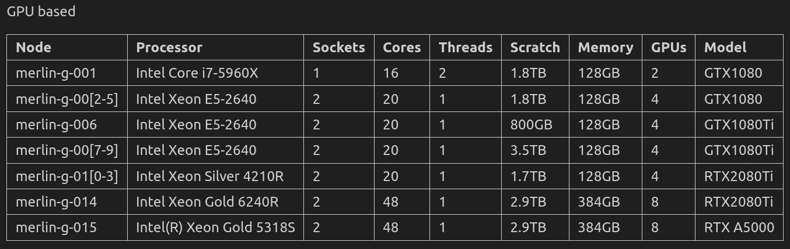
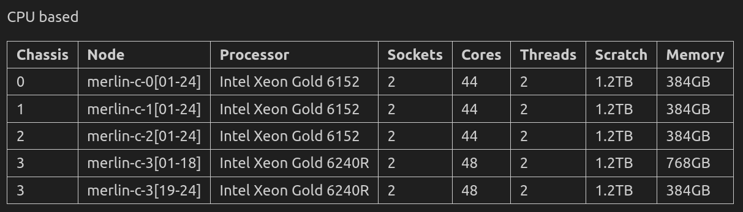
Merlin6 cluster topology
merlin6
slurmctld
gmerlin6
slurmctld
Slurm client commands
MariaDB
slurmd
slurmd
slurmd
slurmd
Original image source: SchedMD
Federation configuration
merlin6: CPU cluster, 2 x slurmctld H.A., 96 nodes
gmerlin6: GPU cluster, 1 x slurmctld (small cluster), 16 nodes
2 x slurmdbd H.A.

Slide 13
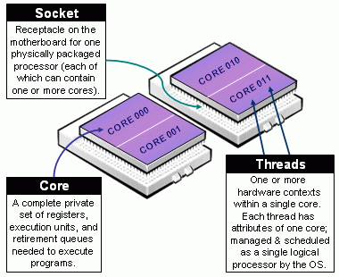
Slurm Terms
Ldom, locality domain or NUMA (Non-Uniform Memory Access, each processor has faster access to its own local memory than to memory attached other processors).
Socket, in general a physical CPU processor chipset. Also known as CPU socket.
Cpu, a CPU hardware thread. If hyperthreading is not used, this corresponds to a CPU core.
  1 CPU core may contain multiple CPU hardware threads (typically 2).
  1 CPU socket may contain multiple CPU cores.
Gpu, graphics accelerator chipset / processor unit.
Task, OS process, MPI rank.
Affinity, the state of being bound to a specific logical processor.
Partition basically a queue for compute jobs with access to certain resources.
Node, compute node, which may contain one or more Sockets.
Cluster, collection of compute nodes.
Source: SchedMD

Slide 14
Merlin6 cluster topology
Hands-on
03_Cluster/ClusterSoftware/BatchSystem.ipynb
1. Merlin6 access and topology
merlin6
slurmctld
gmerlin6
slurmctld
Slurm client commands
MariaDB
slurmd
slurmd
slurmd
slurmd
Original image source: SchedMD
Federation configuration
merlin6: CPU cluster, 2 x slurmctld H.A., 96 nodes
gmerlin6: GPU cluster, 1 x slurmctld (small cluster), 16 nodes
2 x slurmdbd H.A.

Slide 15
2. Slurm: Job scheduling & priorities

Slide 16
Slurmctld
Acts as the central controller in Slurm’s architecture.
Manages job queue, tracks overall cluster state, and orchestrates resource allocation, communication with slurmd, and scheduling decisions.
Main scheduler
Periodically (and upon job submission or completion), slurmctld locks job/partition structures and processes pending jobs in priority order, starting with the highest priority ones, then continuing with others in different partitions.

Slide 17
Slurmctld
Job Priorities and Backfill Scheduling (1/4)
Job Prioritization
Slurm supports different priority models:
  Basic (FIFO): Jobs are queued and executed in submission order.
  Multifactor (default): Incorporates factors like job age, requested size, fair-share usage, account, and QOS settings to compute a composite priority.s
These priority policies are configurable using parameters like PriorityType (e.g., basic or multifactor) and various weights in slurm.conf
PriorityDecayHalfLife=7-00:00:00
PriorityCalcPeriod=00:05:00
PriorityFavorSmall=No
PriorityMaxAge=7-00:00:00
PriorityUsageResetPeriod=NONE
PriorityType=priority/multifactor
PriorityWeightAge=2000
PriorityWeightAssoc=0
PriorityWeightFairShare=10000
PriorityWeightJobSize=1000
PriorityWeightPartition=1000
PriorityWeightQOS=10

Slide 18
Slurmctld
Job Priorities and Backfill Scheduling (2/4)
Backfilling Strategy (sched/backfill):
When enabled via SchedulerType=sched/backfill, Slurm allows lower-priority jobs to fill gaps in the schedule, as long as doing so does not delay the start time of any higher-priority job
The backfill scheduler:
  Locks job/partition structures.
  Evaluates pending jobs by priority.
  Determines if a job can launch immediately or schedules it for a future start time that doesn’t interfere with higher-priority job start times.
  Continues this process, accumulating a schedule of jobs (with estimated StartTime and SchedNodeList) that can run without conflict
This mechanism enhances overall utilization by avoiding resource idle time.

Slide 19
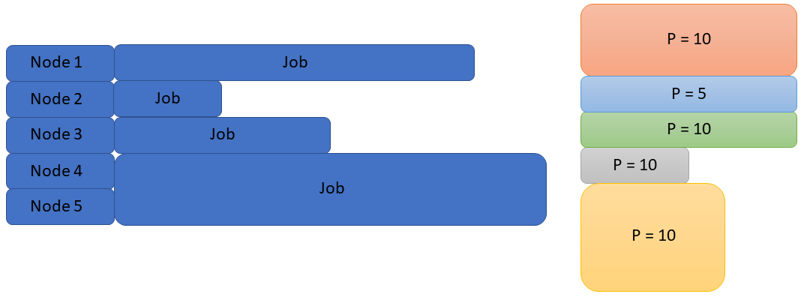
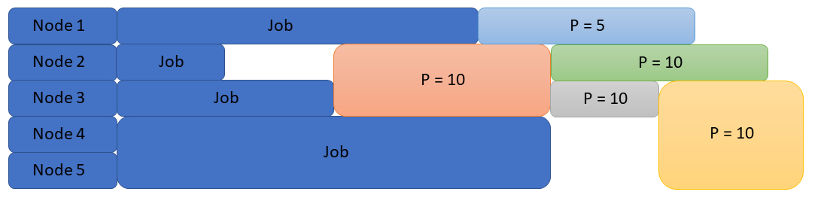
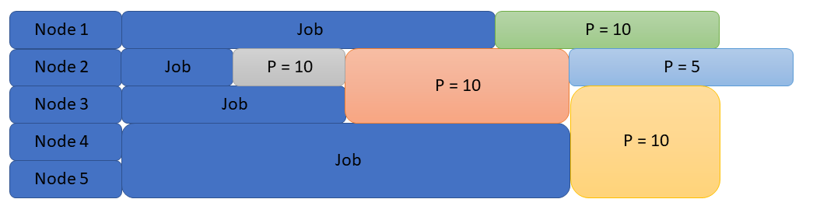
Slurmctld
Job Priorities and Backfill Scheduling (3/4)
+ Priority -
Source: marquette.edu
FIFO
Ineficient, simple, higher chances of leading to idle nodes
Source: marquette.edu
Multifactor with backfilling jobs
Efficient, higher complexity, smart use of resources (thanks to backfilling)
Priority Multifactor Plugin Link
Source: marquette.edu

Slide 20
Best Practices for Submitting Jobs
Good job submission practices help Slurm schedule more efficiently and leads to shorter waiting times and better cluster utilization. How?
Know your partition: Understand the purpose and limits of each partition (e.g., short vs. long jobs, GPU vs. CPU) and always submit to the partition that matches your workload.
Request the right runtime (--time=D-HH:MM:SS) to help the scheduler make better decisions and to enable backfilling.
Match resources to your workload: Request only the CPUs, GPUs, and memory you actually need. Over-allocating slows scheduling for everyone.
Test small, then scale up: Start with small test jobs before launching large-scale runs. Reduces wasted resources if something goes wrong.

Slide 21
3. Using Slurm on Merlin6

Slide 22
Merlin6: Partitions
Public partitions, all with PriorityTier=1
  general (default): ≤7 days, broad CPU pool, PriotityJobFactor=1 Hard job restriction (QoS).
  Daily: ≤1 day, higher PriorityJobFactor=500, QoS daytime, faster starts for short jobs.
    QoS updated at nights and weekends to allow more parallel jobs.
  hourly: ≤1 hour, highest PriorityJobFactor=1000, QoS unlimited, ideal for backfill/quick tests.
  Extra private nodes assigned from stakeholders owning nodes.
Private partitions: Project-specific queues (e.g., asa-*, mu3e), hidden to regular users.
PriorityTier > 1
→ Idea: duration-tiered queues accelerate short jobs and increase backfill opportunities without blocking long jobs. Private partitions will always process pending jobs first (thanks to PriorityTier)
Hands-on
03_Cluster/ClusterSoftware/BatchSystem.ipynb
2. Merlin6 Partitions

Slide 23
Merlin6: Job submission and monitoring (1/2)
sbatch is used for batch job submission
  Submits a job script to the scheduler (non-interactive).
  Scheduler queues and runs when resources are available.
  Best for longer jobs or production runs.
salloc is used for interactive allocations
  Requests compute node resources and gives an interactive shell.
  Useful for testing, debugging, compiling.
srun is used to launch parallel tasks
  Runs a command within an allocation.
  Often used inside sbatch scripts.
  Can also be used directly (with implicit allocation).
#!/bin/bash
#SBATCH --job-name=test_job
#SBATCH --partition=hourly
#SBATCH --time=00:30:00
#SBATCH --ntasks=1
#SBATCH --cpus-per-task=4
#SBATCH --mem=8G
#SBATCH –-output=job_%j.out
module load gcc
./my_program input.dat
sbatch --nodes=1 job.slurm
salloc –nodes=1 –ntasks=1 --cous-per-task=8
srun –nodes=2 –nasks=2 hostname

Slide 24
Merlin6: Job submission and monitoring (2/2)
squeue is used to view job and job step information for jobs managed by Slurm.
sacct displays accounting data for all jobs and job steps in the Slurm job accounting log or Slurm database
sprio is used to view the components of a job's scheduling priority when the multi-factor priority plugin is installed. It extracts information from the multi-factor priority plugin.
sinfo is used to view partition and node information for a system running Slurm.
Hands-on
03_Cluster/ClusterSoftware/BatchSystem.ipynb
3. Job submission and monitoring

Slide 25
Merlin6: Scheduler & Priorities
Scheduler: SchedulerType=sched/backfill
→ Idea: classic main+backfill design to keep nodes busy without delaying higher-priority starts.
Priority model: PriorityType=priority/multifactor with weights: Age=2000, Fairshare=10000, JobSize=1000, Partition=1000, QOS=10.
→ Idea: strong emphasis on fairshare so heavy users’ priority tapers, while job age ensures older jobs rise. Partition/QoS provide smaller nudges; job size gets moderate weight.
Hands-on
03_Cluster/ClusterSoftware/BatchSystem.ipynb
4. Scheduler & Priorities

Slide 26
Merlin6: Resource Selection & Task Placement
Selector: SelectType=select/cons_tres with SelectTypeParameters=CR_ONE_TASK_PER_CORE,CR_Core_Memory.
→ Idea: modern cons_tres packs by TRES (CPUs, memory, GRES) and enforces one task per core so MPI/OpenMP ranks don’t share cores unintentionally; Core_Memory accounts memory at core granularity to avoid overcommit on fat nodes.
Task plugins: TaskPlugin=task/affinity,task/cgroup with TaskPluginParam=autobind=cores
→ Idea: Slurm automatically pins tasks to specific CPU cores and places them inside cgroups. This enforces CPU binding and memory usage limits, therefore enforcing CPU/MEM isolation
Hands-on
03_Cluster/ClusterSoftware/BatchSystem.ipynb
5. Resource Selection & Task Placement

Slide 27
Summary

Slide 28
Summary
Slurm provides flexible resource management and scheduling
Partitions, QoS, and job priorities guide scheduling decisions
Backfill and Fairshare improve utilization and fairness
Users can influence scheduling with time limits, job size, and nice values
Best practices reduce contention and improve throughput
Hands-on examples showed
  How to submit and monitor your jobs.
  Priority factors and backfilling.
  Understanding the hardware topology matters.

Slide 29
Questions?

