Slide 1
Build Monitor
iot project

Slide 2
Use Case
Build Failure Notification
Build Success Notification
Commit Fixing

Slide 3
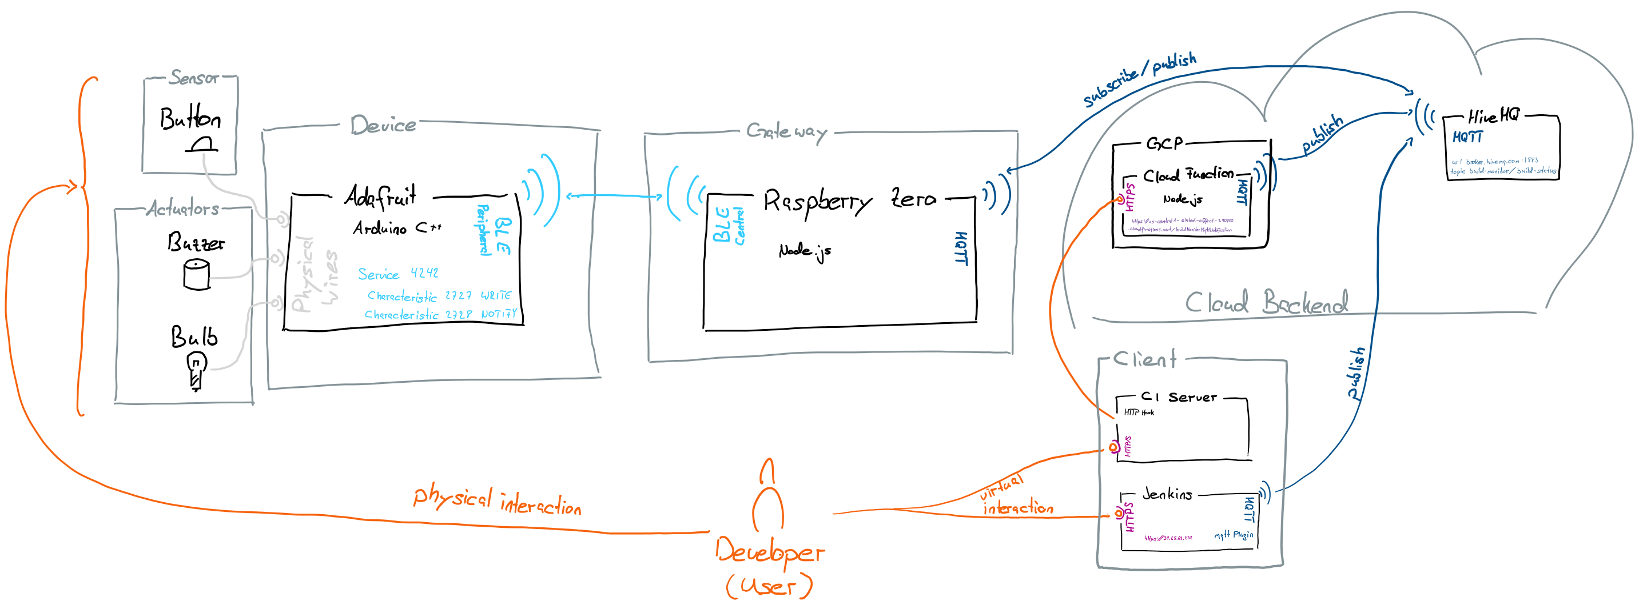
Reference Model

Slide 4
Interface Documentation
Todo: document interfaces according to https://github.com/fhnw-iot-4ia/iot-project-build-monitor/tree/master/Arduino & https://github.com/fhnw-iot-4ia/iot-project-build-monitor/tree/master/Nodejs & https://github.com/fhnw-iot-4ia/iot-project-build-monitor/tree/master/GCP

Slide 5
Issues

Slide 6
Live Demo
Jenkins CI
MQTT Client

