Slide 1
The Build Monitor
IoT project

Slide 2

Live Demo

Slide 3
Use Case
Build Failure Notification
Commit Fixing
Build Success Notification
Jenkins CI
MQTT Client (Raspberry-Jenkins-CloudFunction)

Slide 4
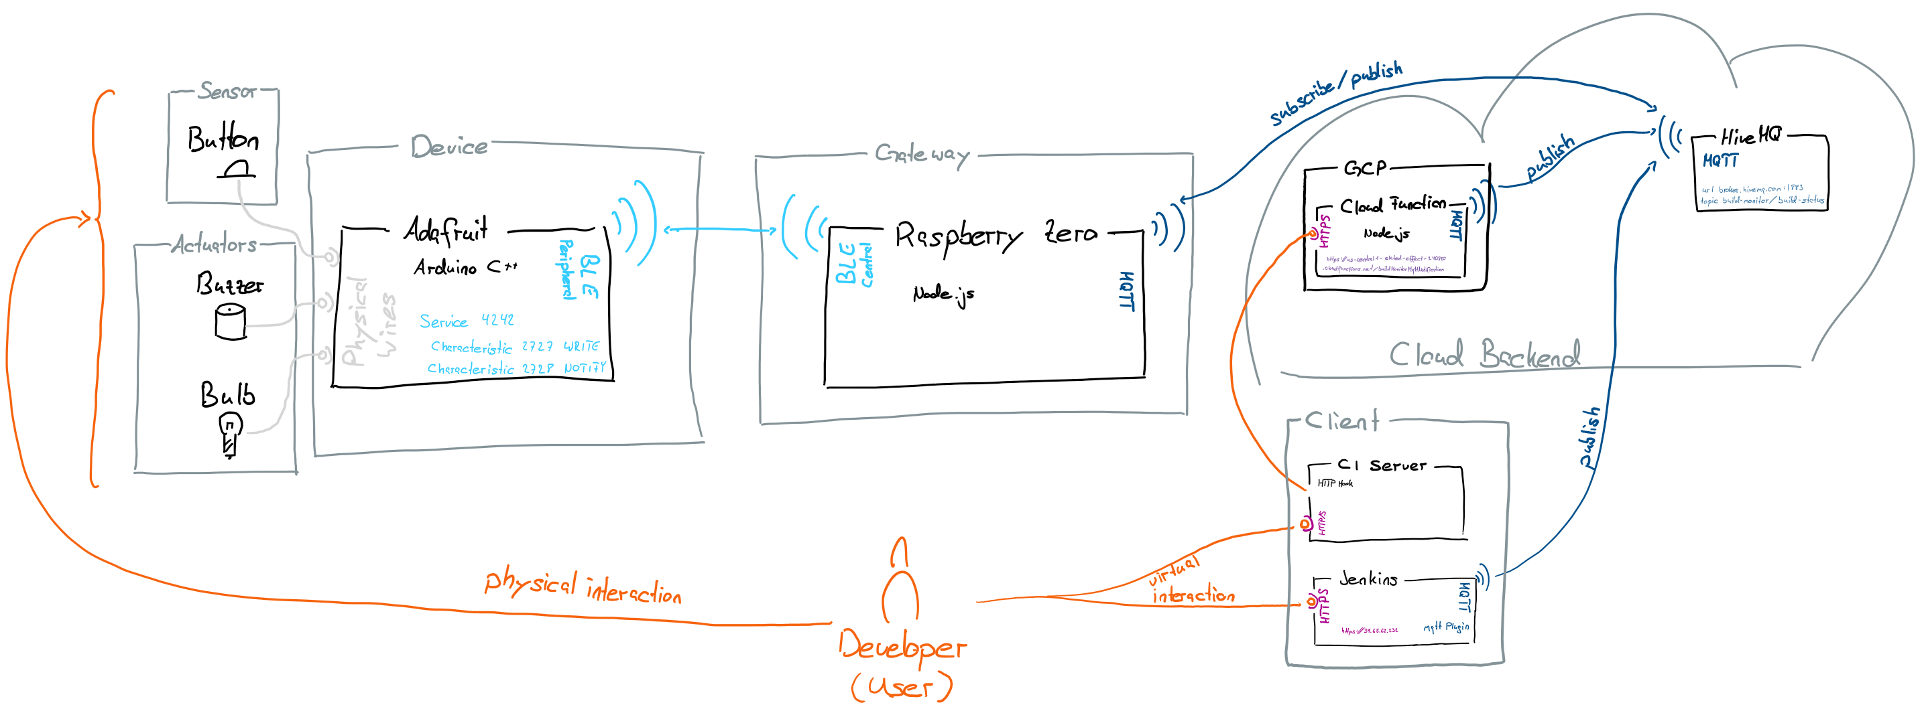
Reference Model

Slide 5
Interface Documentation
Todo: document interfaces according to https://github.com/fhnw-iot-4ia/iot-project-build-monitor/tree/master/Arduino & https://github.com/fhnw-iot-4ia/iot-project-build-monitor/tree/master/Nodejs & https://github.com/fhnw-iot-4ia/iot-project-build-monitor/tree/master/GCP

Slide 6
Issues

