Slide 1
The Build Monitor
IoT project

Slide 2

Live Demo

Slide 3
Use Case
Build Failure Notification
Commit Fixing
Build Success Notification
Jenkins CI
MQTT Client (Raspberry-Jenkins-CloudFunction)

Slide 4
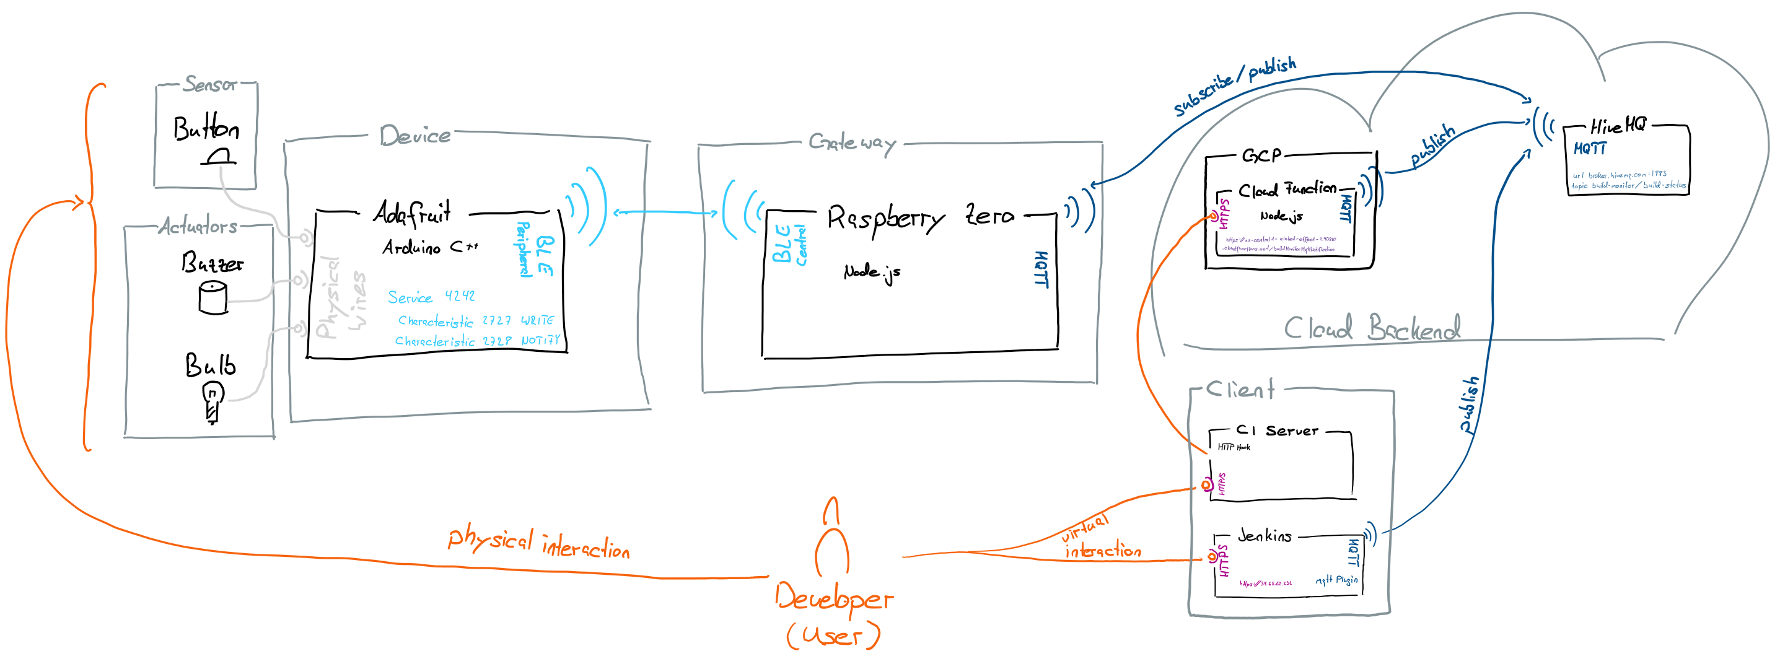
Reference Model

Slide 5
Interface Documentation
BLE Service #4242
#2727 | WRITE | 00: build success 01: build failure 02: fix in progress
#2728 | NOTIFY | 00: no user action 01: build fixing committment
Google Cloud Function
success (POST Request) | Publish build success
failed (POST Request) | Publish build failure
MQTT topic /build-monitor/build-status
00 | Build success
01 | Build failed
02 | Build fix awaiting

Slide 6
Issues
ESP with Glove Shield
Interfaces
1 BLE Service with Characteristics vs. 2 BLE Services
Get Chainable LED working

