Slide 1
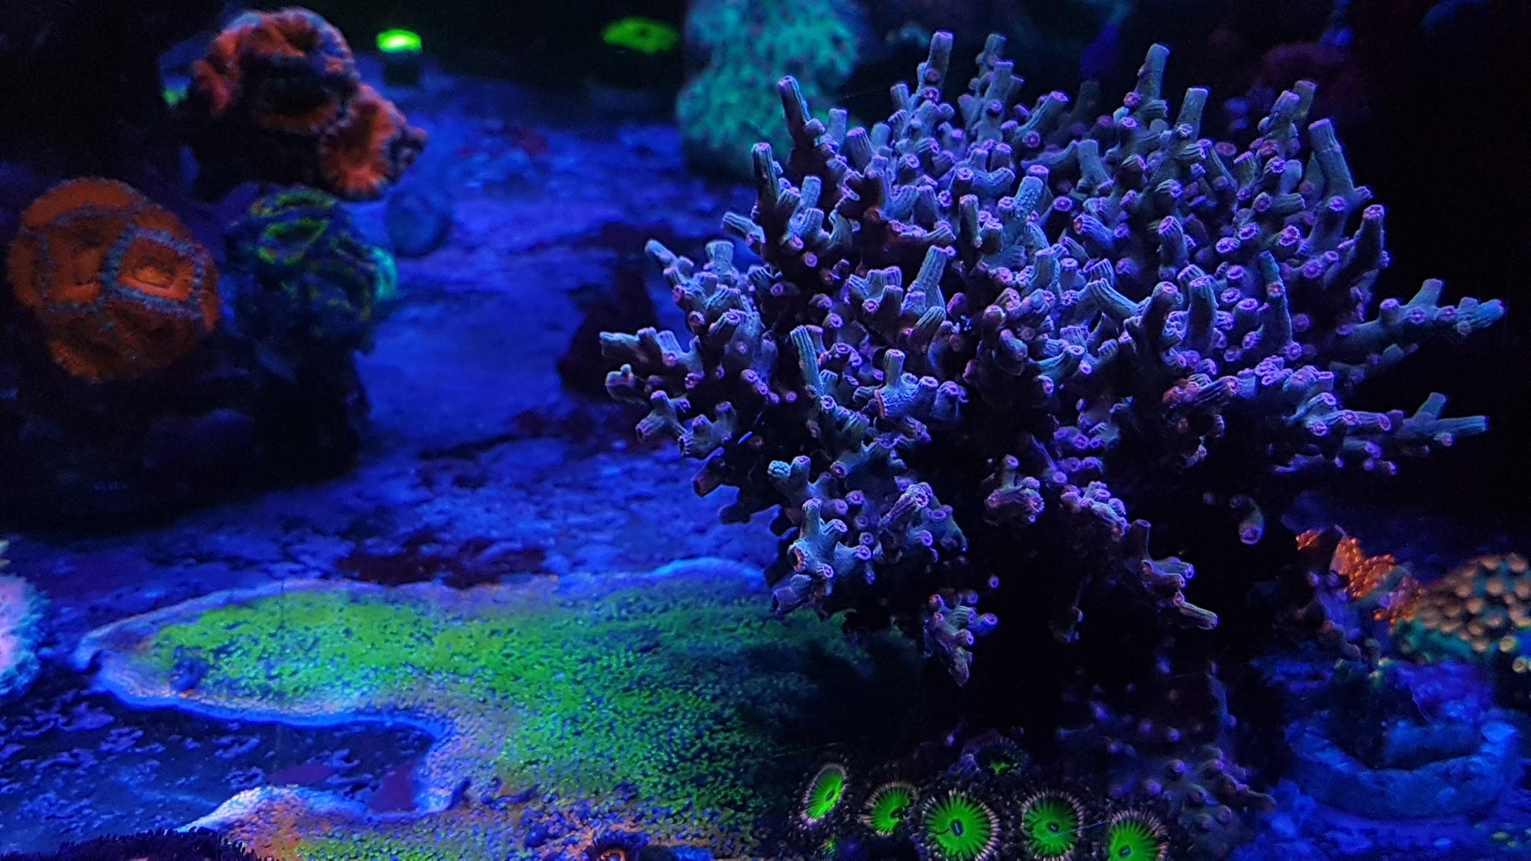
RaspberryReef
FHNW-IoT Project by Jonathan Bättig

Slide 2






Reference model
Twitter Backend
HTTP
HTTP
Device
Wi-Fi Gateway
Wi-Fi
HTTP
TS Backend
HTTP
T1
T2
R1
R2
W1
W2
W3
R3
T -> Temperature Sensor
W -> Water Level Sensor R -> Relay Actuator

Slide 3
Use cases
Measure water temperature
Switch on / off reef aquarium led
Refill evaporated water with RODI water
Send Twitter DM to reef owner
Display sensor and actuator data on ThingSpeak

Slide 4
Interface documentation
HTTP API to write ThingSpeak
$ curl -vX POST https://api.thingspeak.com/update.json --data 'api_key==WRITE_API_KEY&field1=TEMP_GROUND&field2=TEMP_SURFACE&field3=WATER_REEF_MIN&field4=WATER_REEF_MAX&field5=WATER_REFILL_MIN&field6=LAMP_LEFT_STATE&field7=LAMP_RIGHT_STATE&field8=REFILL_PUMP_STATE’

Slide 5
Interface documentation
HTTP API to write Twitter DM
curl --request POST --url https://api.twitter.com/1.1/direct_messages/events/new.json - header 'authorization: OAuth oauth_consumer_key="CONSUMER_KEY", oauth_nonce="AUTO_GENERATED_NONCE", oauth_signature="AUTO_GENERATED_SIGNATURE", oauth_signature_method="HMAC-SHA1", oauth_timestamp="AUTO_GENERATED_TIMESTAMP", oauth_token="USERS_ACCESS_TOKEN", oauth_version="1.0"' --header 'content-type: application/json' --data '{"event": {"type": "message_create", "message_create": {"target": {"recipient_id": "RECIPIENT_USER_ID"}, "message_data": {"text": MESSAGE_TEXT}}}}'

Slide 6
Issues
ThingSpeak write restriction
Pull-up and pull-down resistors and the correct resistor size
Soldering
Attaching the water level sensors to my reef aquarium
Random Twitter DM caused by a magnetic field
Twitter Oauth 1.0 authentificaiton

