Slide 1
UTSC Computational Physics Workshops, Fall 2017
Session 1: Introduction and the Linux Terminal
Fergus Horrobin
fergus.horrobin@mail.utoronto.ca | fergus.horrobin.com

Slide 2
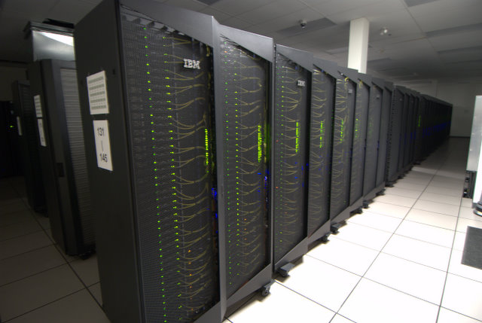
Why learn scientific computing (as a physics student)
Essential for data analysis
Research opportunities
Many experiments use computer software to control devices
Good general skills for potential jobs outside of physics
Data sciences, software design etc.

Slide 3
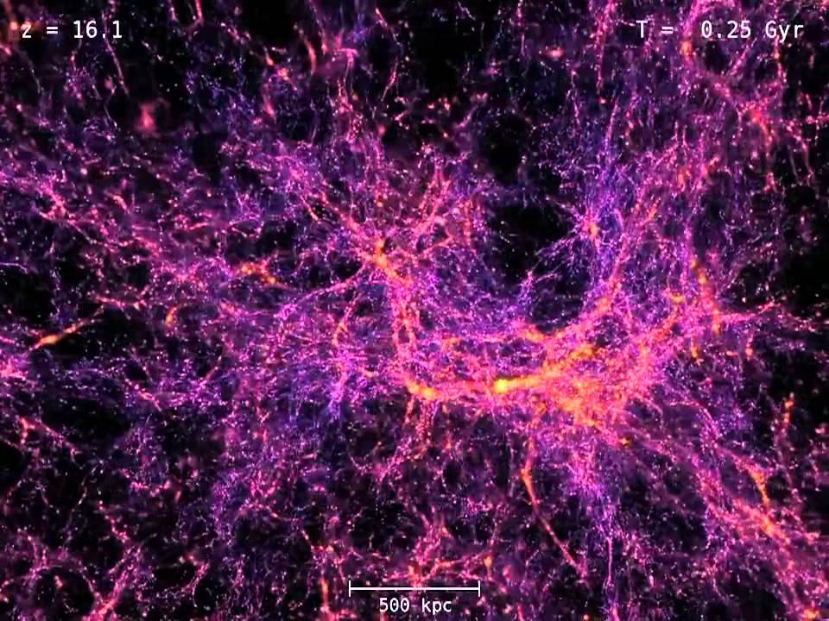
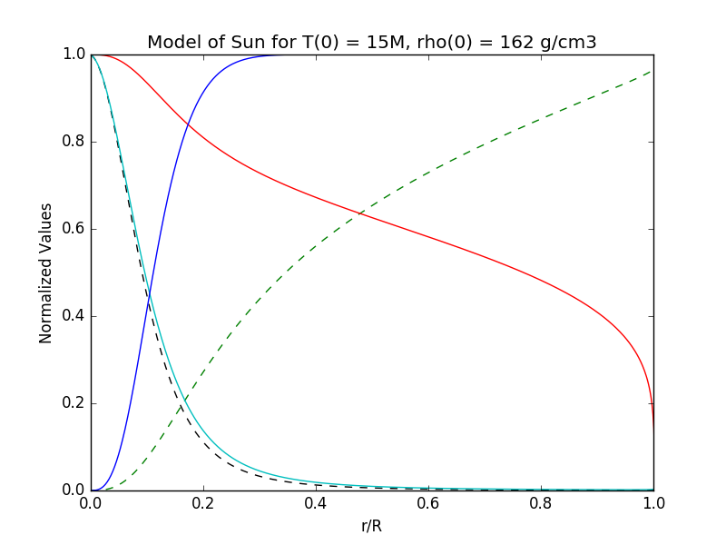
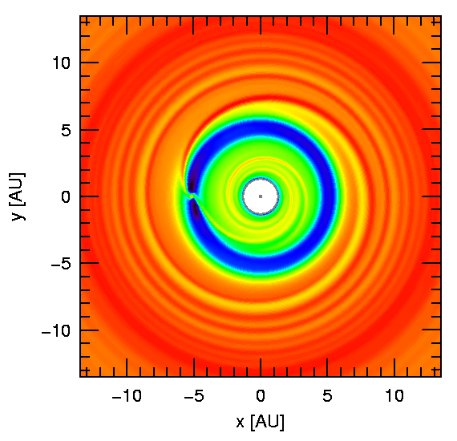
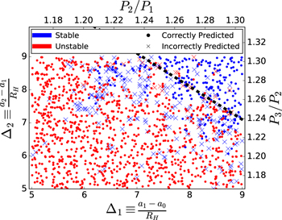
Examples of scientific computing

Slide 4
Usual languages used in scientific computing
Scripting/Multipurpose
High Performance
Python
Matlab
IDL
R
Mathematica
…
Fortran
C/C++
CUDA C/Fortran (GPU)
MPI/OpenMP/OpenCL
…

Slide 5
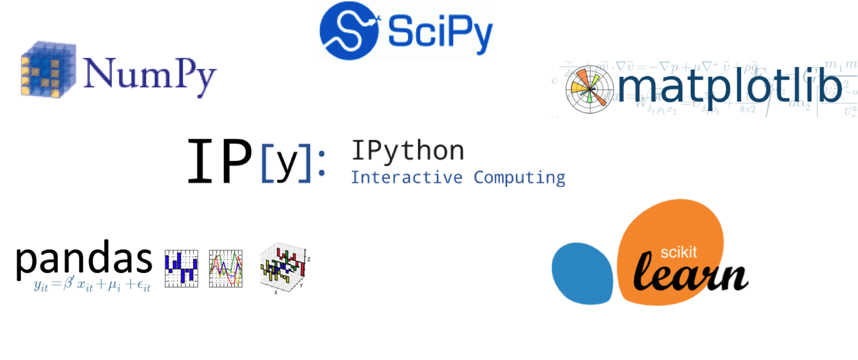
So why are we choosing python?
Easy to write – very natural transition from language to code
Many available packages – You don’t have to solve every problem from scratch
Large user base – Easy to find support
Free! Everything we use is Open Source so it wont cost you anything

Slide 6
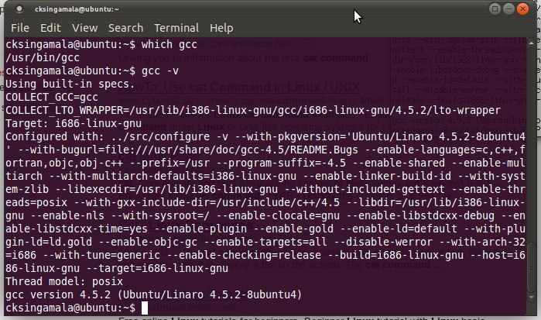
Software we will use
We will work in Linux for these sessions (Ubuntu 16)
Compatible with all scientific packages
Powerful terminal environment
Easy to setup for scientific programming
Python 3.x
Jupyter Notebook
Numpy, Scipy
Matplotlib

Slide 7
What will you learn in this course
Basic procedural programming in Python
Problem solving skills for solving physics and math problems with a computer
Using Linux to install scientific software and create programs for it
Data analysis, plotting and basic statistics with a computer
Other fun things (time dependent) such as: Electronics labs, Machine Learning, Image Analysis

Slide 8
For the rest of today
See some basic commands in the Linux terminal
Look at how to install software
Get familiar with using the terminal to find files, make files, run programs more.
Let’s do something more interactive now. I’ll post notes on the rest of what we do on my website:
fergus.horrobin.com/teaching.html

