Slide 1
Feature extraction (signal properties)
Matching
(comparison of properties)
s
decision
Sensor
ID claim
Biometric database (stored identities)
accept
reject
verification

Slide 2
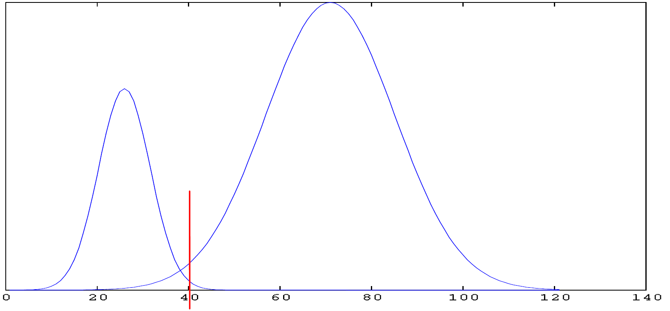
Histogram
ShDist
Histogram
OhDist

Slide 3
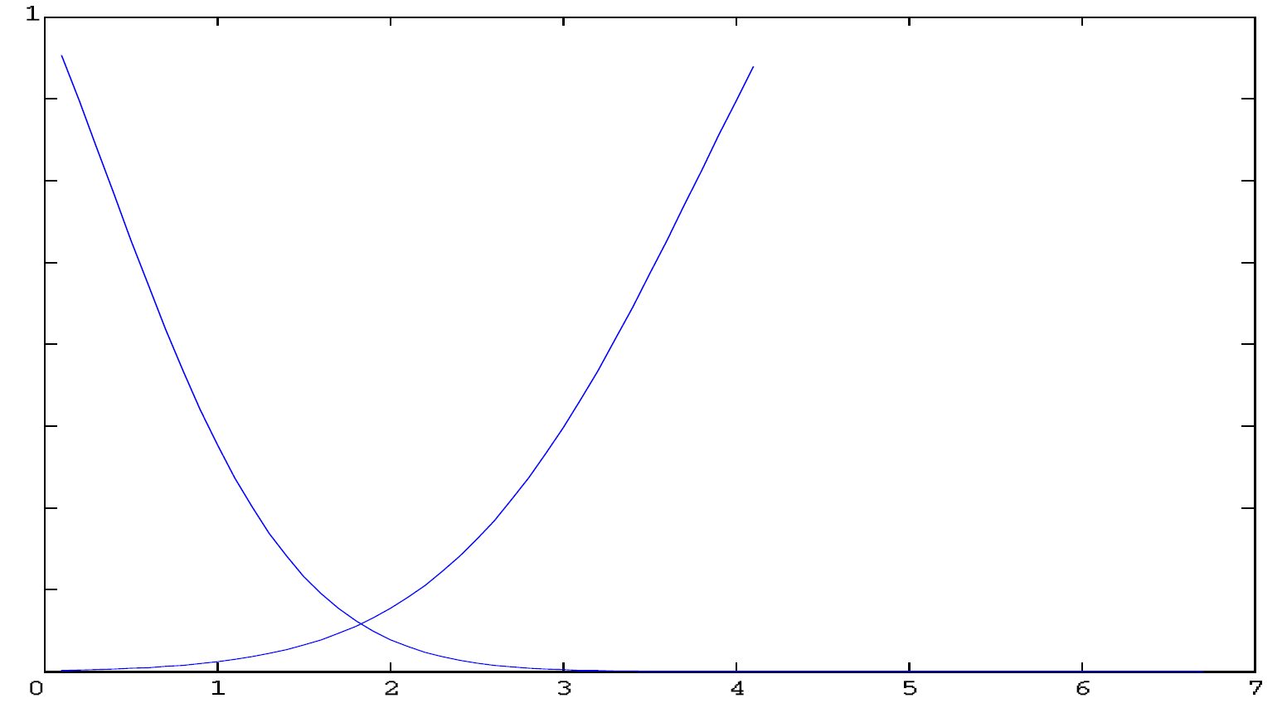
FRR
FAR
Probability (Slh)
Threshold (Th)

